Slide 1
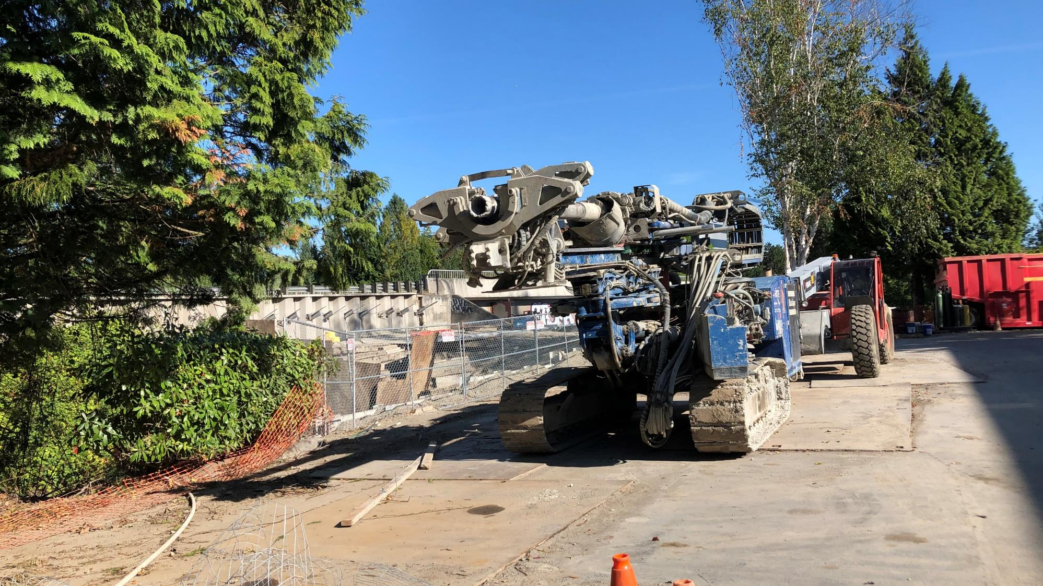
16-1215 Bear Creek Reach 6 – Ph II Construction
Adopt-A-Stream Foundation
Friendly Village Mobile Home Park
King County Housing Authority
August 27, 2020
Elizabeth Butler & Walt Rung

Slide 2
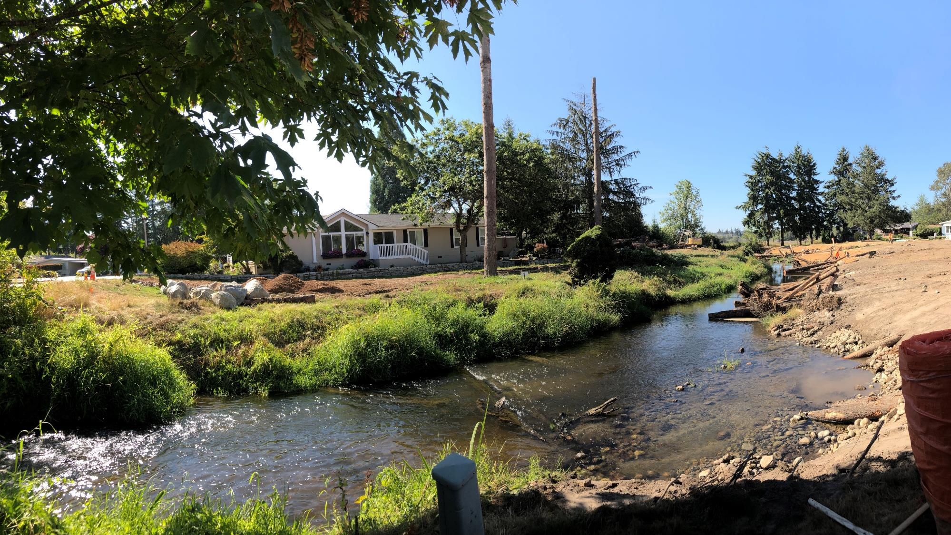
Notes:
Construction underway. Right bank laid back and wood placement begins.

Slide 3
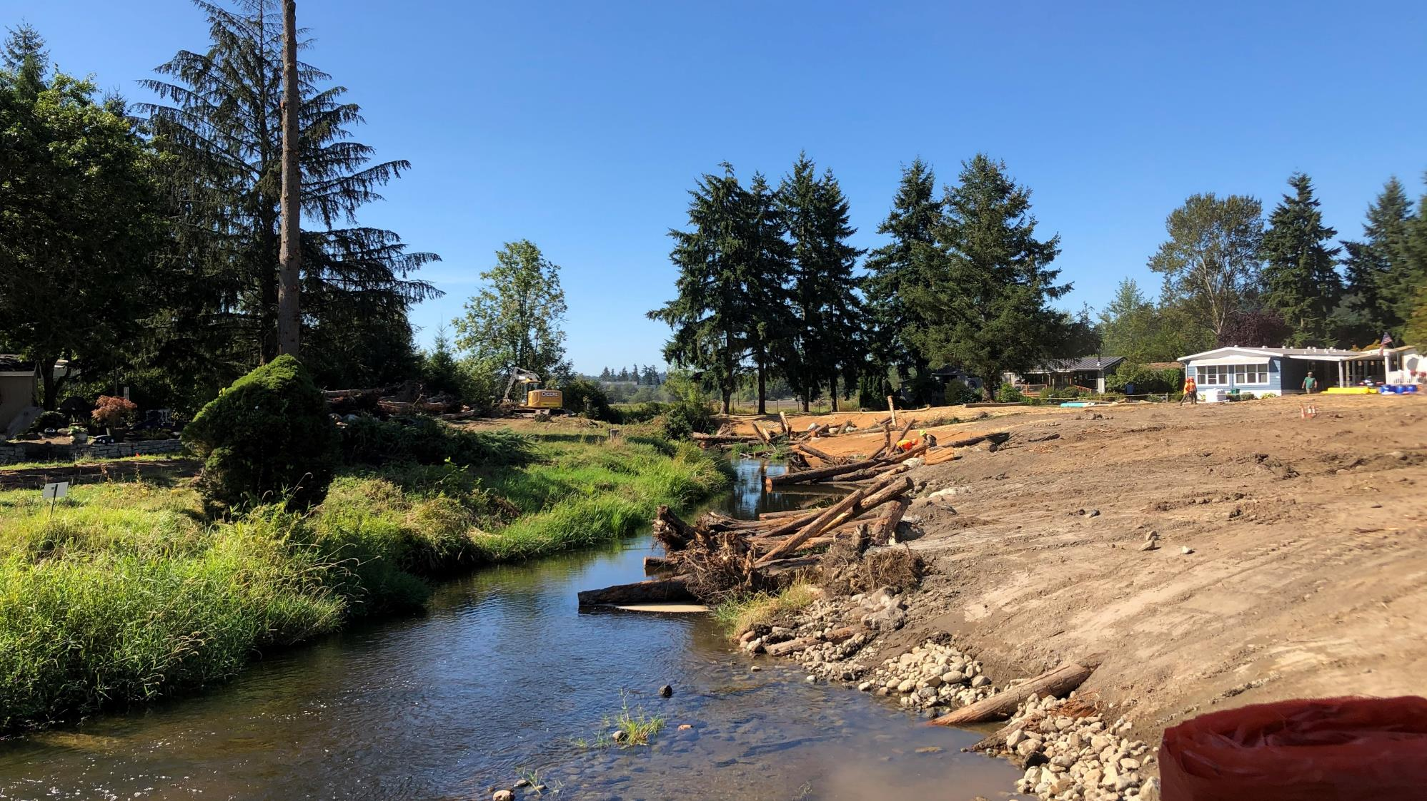

Slide 4
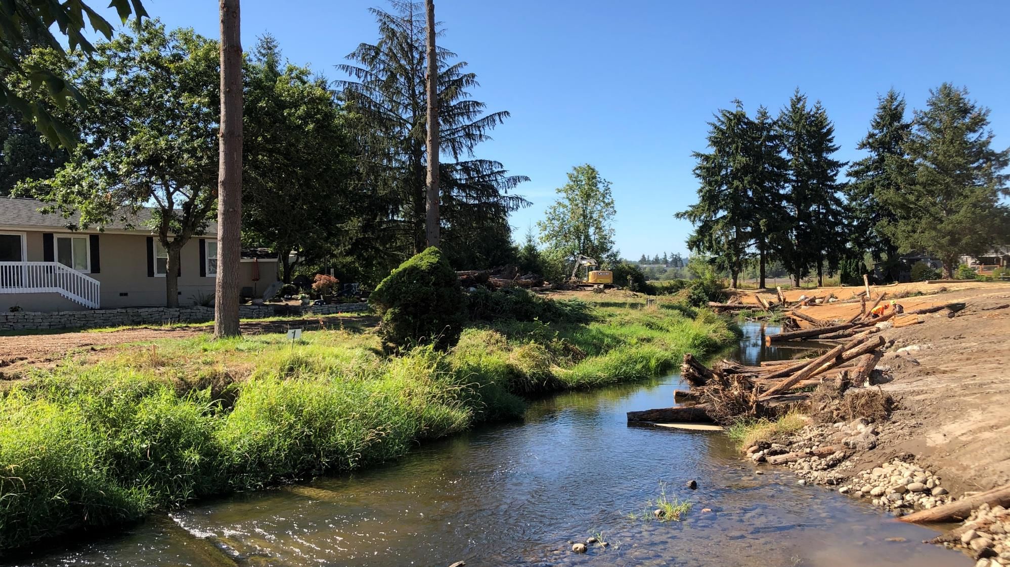

Slide 5
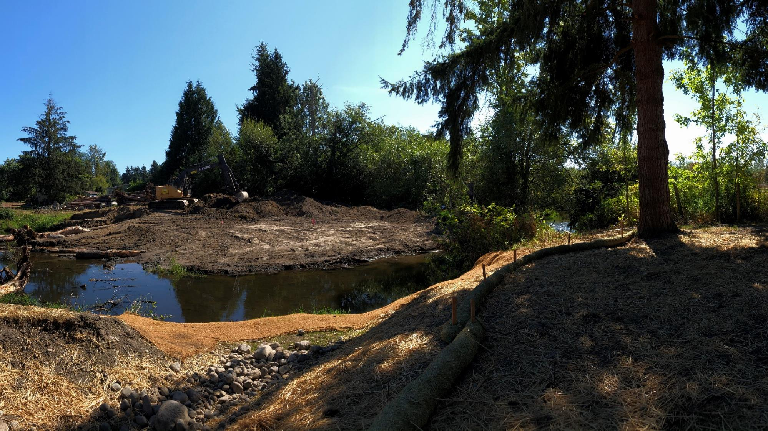

Slide 7
