Slide 1
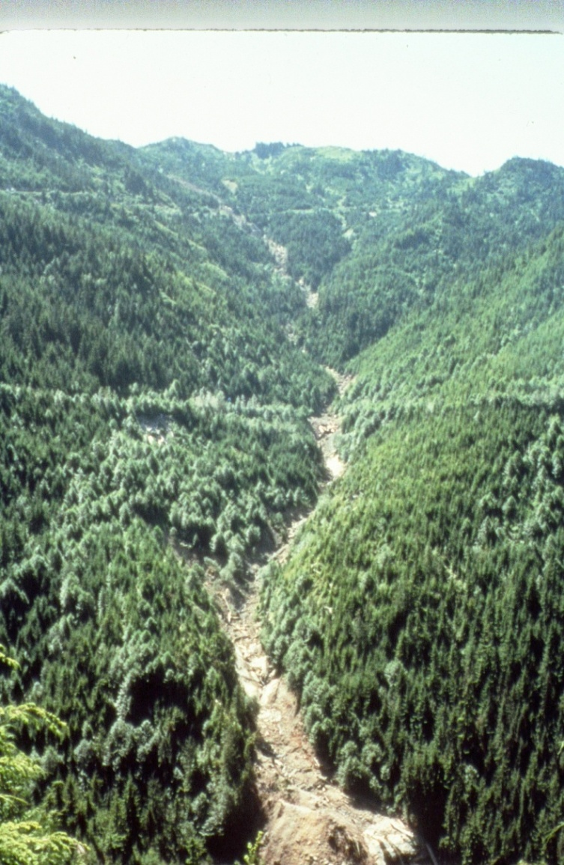
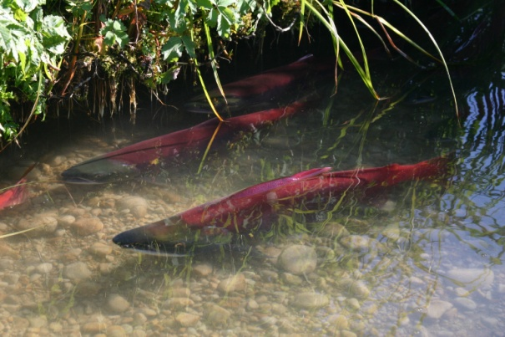
Roads to Success for Sediment Reduction Roger Nichols, U.S. Forest Service

Slide 2
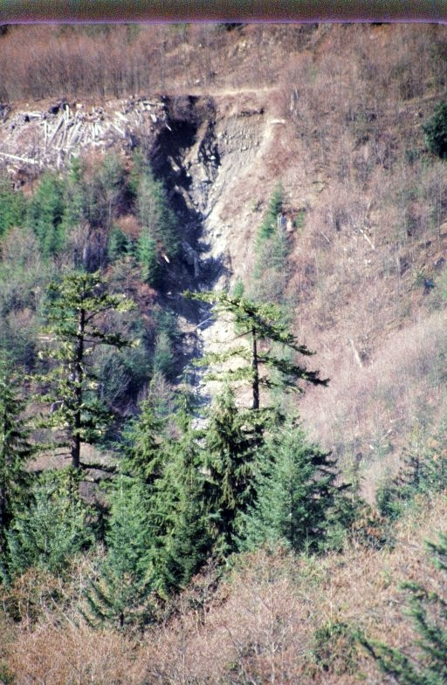
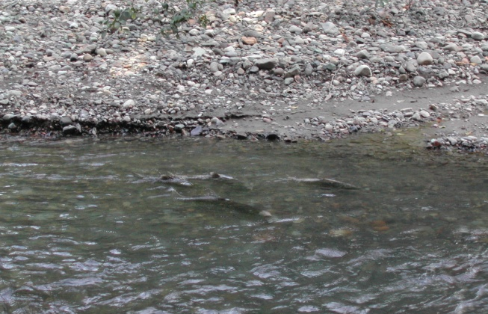
Why Reduce Sediment Delivery?
Chokes Salmon Redds
Reduces Egg-to-Fry Survival
Fills Stream Channels/Pools
Widens Active Channel
Increases Water Temperatures

Slide 3
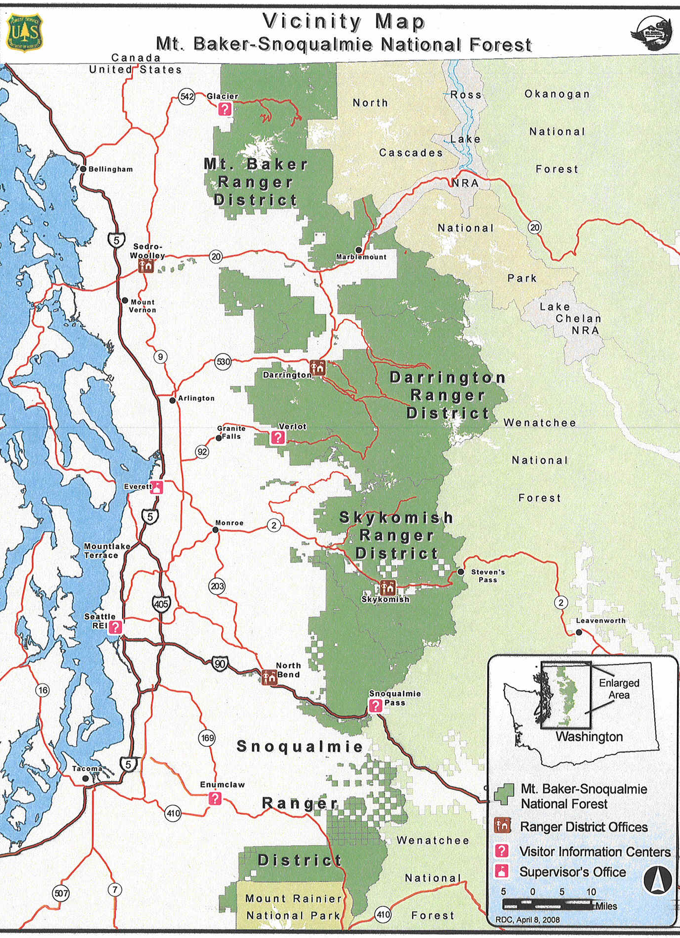
Mt. Baker-Snoqualmie National Forest
North Puget Sound Watersheds Critical to Chinook Recovery in Puget Sound
Nooksack
Skagit
Stillaguamish

Slide 4
Focus on Three Priority Puget Sound Watersheds
1999- 2009
Watershed | # of Projects | SRFB $ | Match $ | Total | Road Miles Treated
Nooksack | 4 | 408,199 | 93,520 | 501,719 | 37.40
Skagit | 9 | 2,822,994 | 697,621 | 3,520,615 | 168.54
Stillaguamish | 5 | 923,768 | 211,136 | 1,134,904 | 59.34
Total | 18 | $4,154,961 | $1,002,277 | $5,157,238 | 265.28

Slide 5
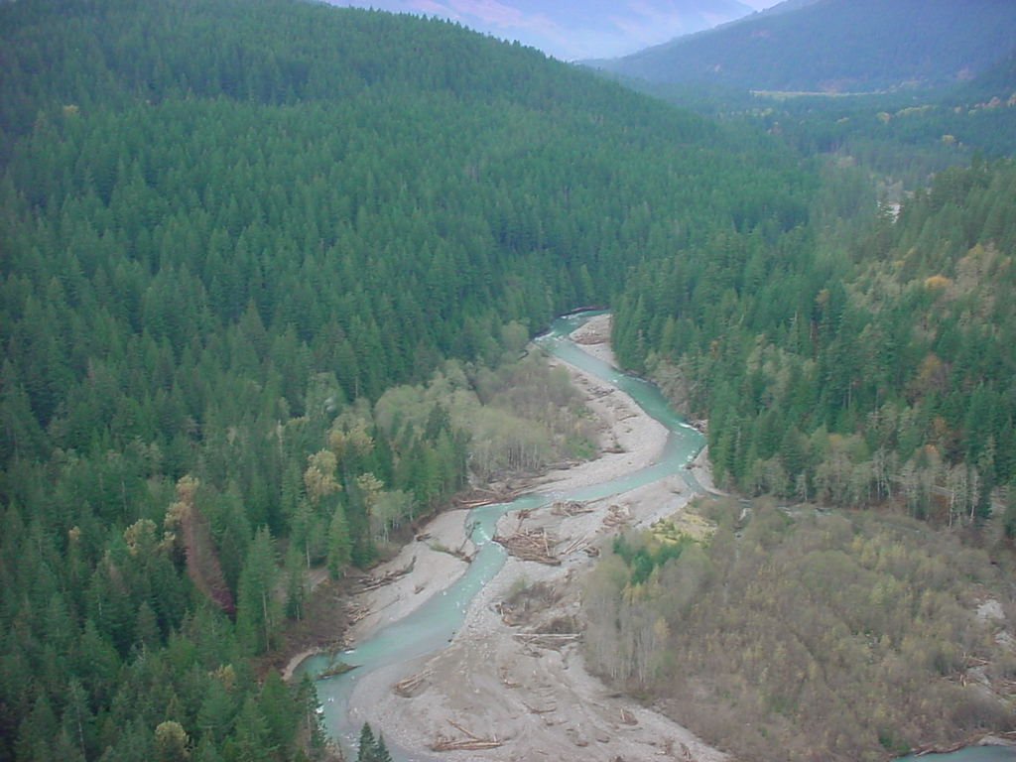
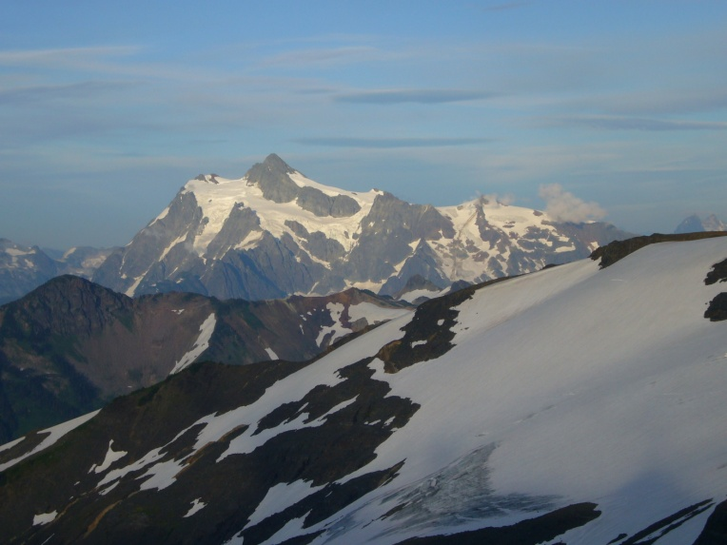
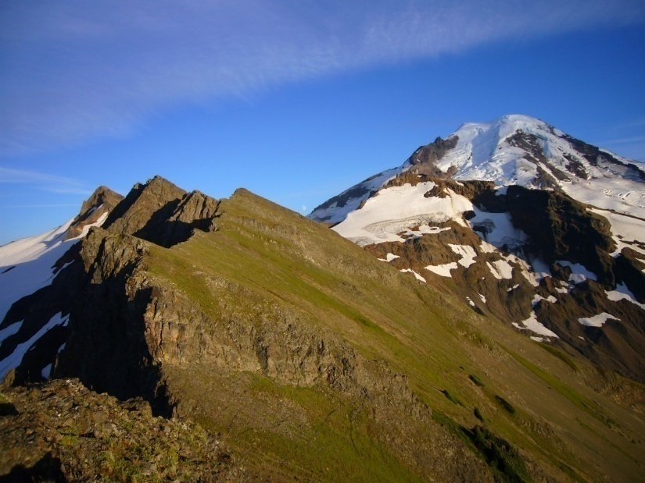
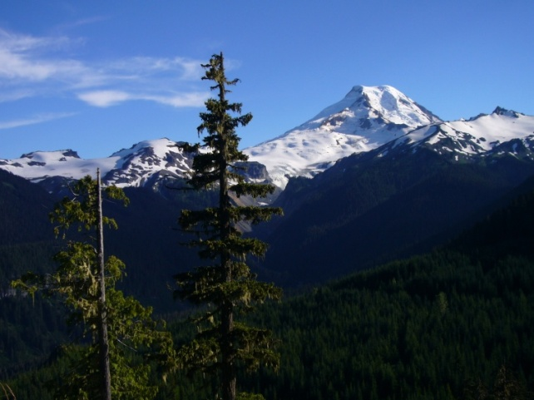
Nooksack River WRIA 1 Salmon Recovery Board
Nooksack Chinook Recovery Plan
WRIA 1 Limiting Factors Analysis
Hazardous Slope Inventories

Slide 6
Nooksack River Nooksack Salmon Enhancement Association (NSEA)
1999- 2001
Project # | Sponsor | Title | SRFB $ | Match | Total | Road Miles Treated
01-1295R | NSEA | Nooksack Roads | 174,199 | 31,000 | 205,199 | 10.80
00-1792R | NSEA | Wells Creek | 90,000 | 25,000 | 115,000 | 13.00
00-1138R | NSEA | Grouse Butte | 90,000 | 30,050 | 120,050 | 7.30
99-1342R | NSEA | West Church | 54,000 | 7,470 | 61,470 | 6.30
 |  |  | $408,199 | $93,520 | $501,719 | 37.40

Slide 7
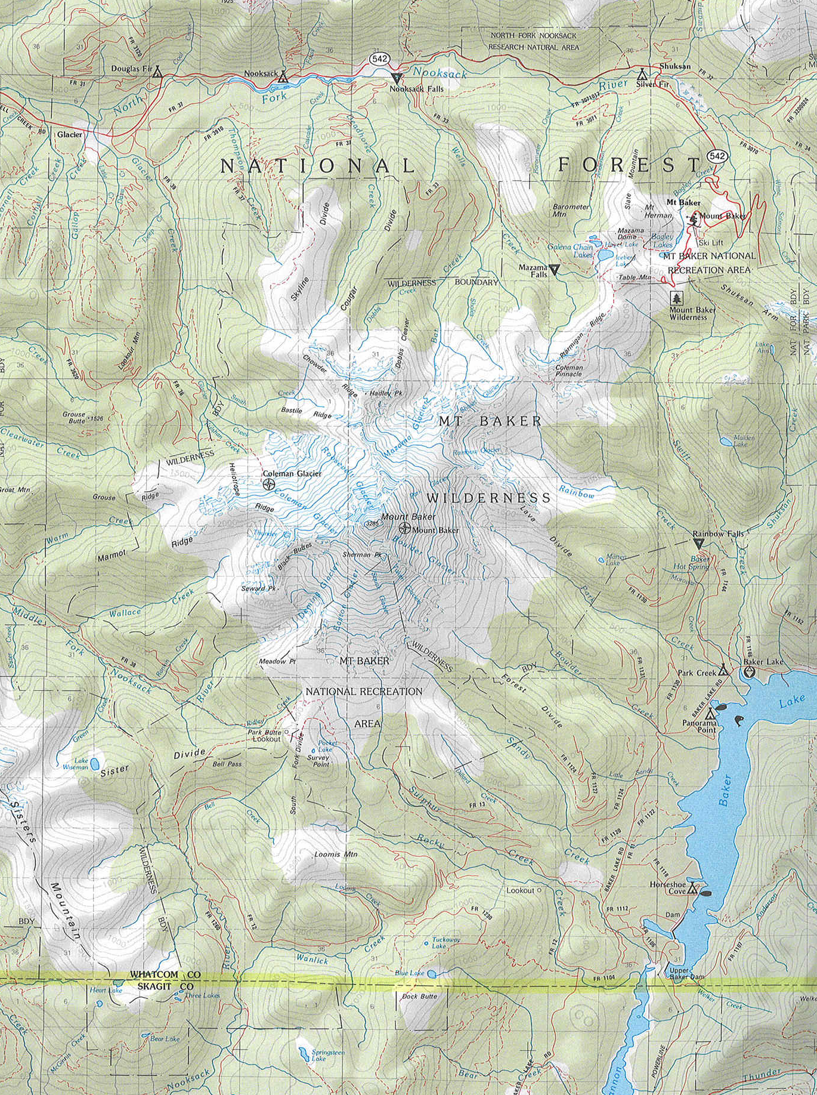
Comprehensive Nooksack Focus
West Church
Nooksack Roads
Wells Creek
Grouse Butte
Grouse Butte
Nooksack Roads
Wells Creek

Slide 8
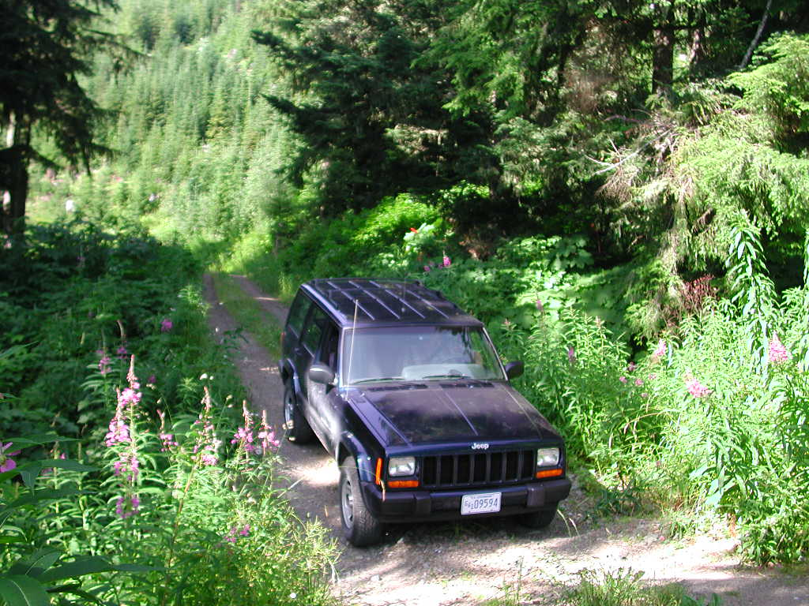
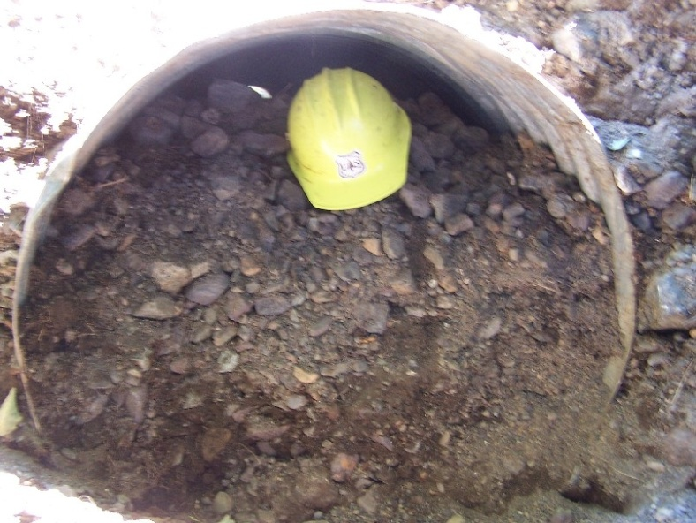
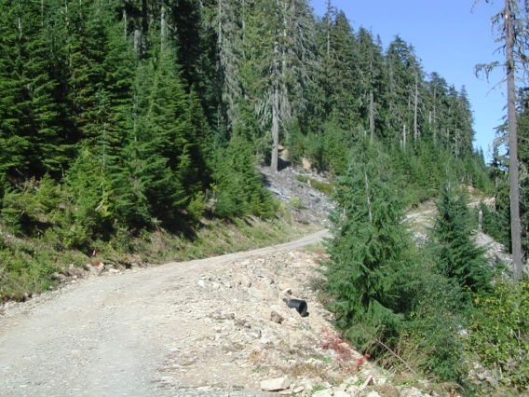
West Church

Slide 9
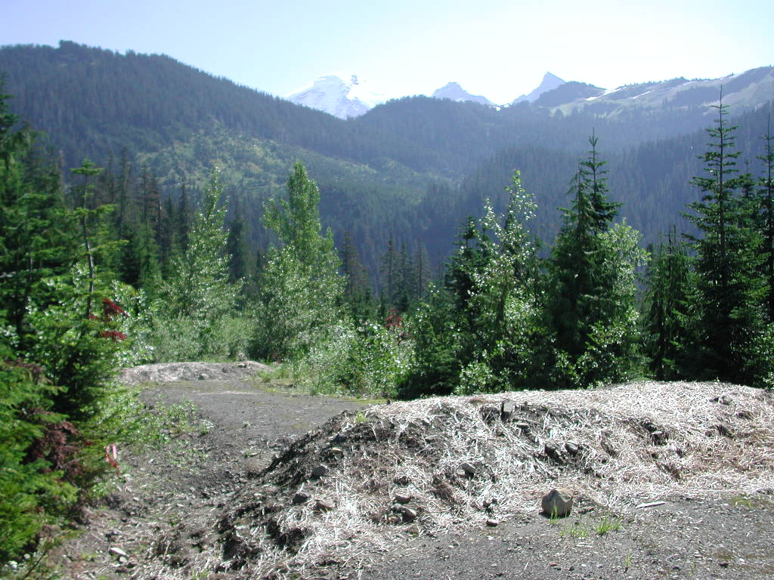
Grouse Butte
More Efficient to Treat Entire Road
System in an Area

Slide 10
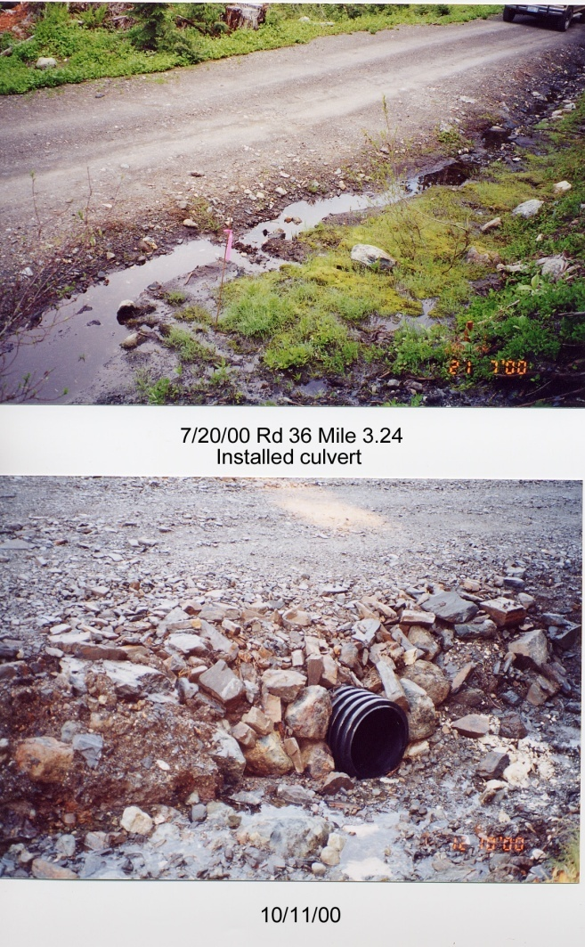
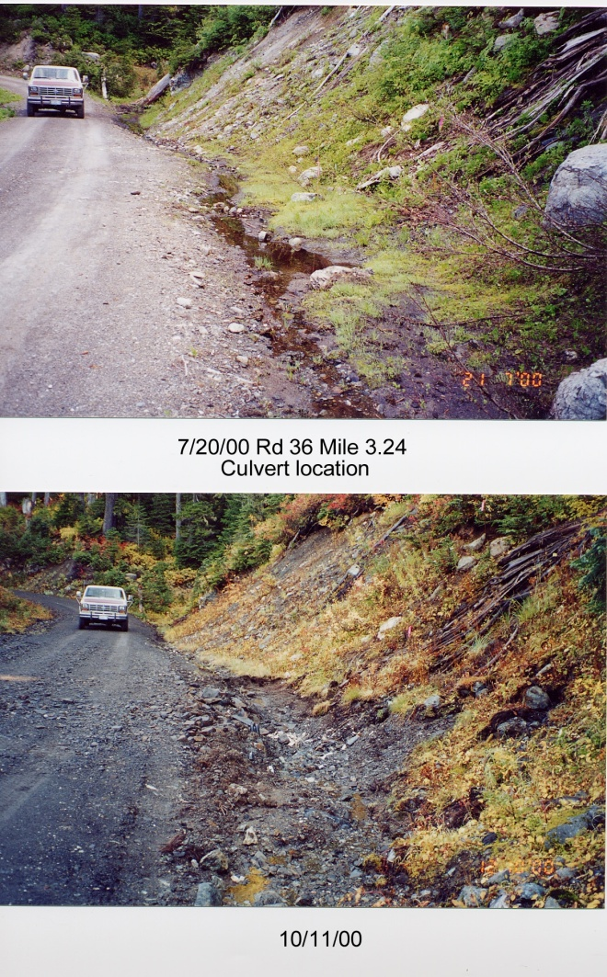
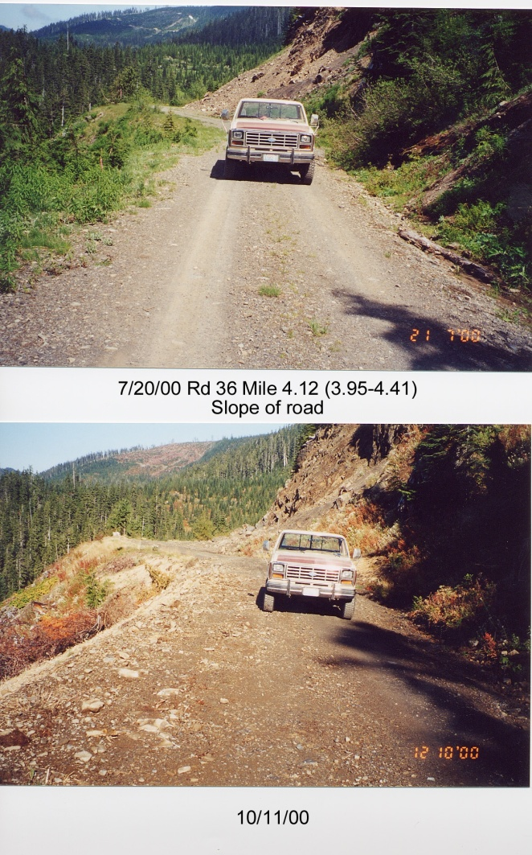
Grouse Butte

Slide 11
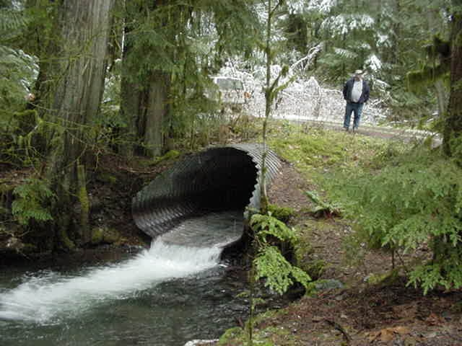
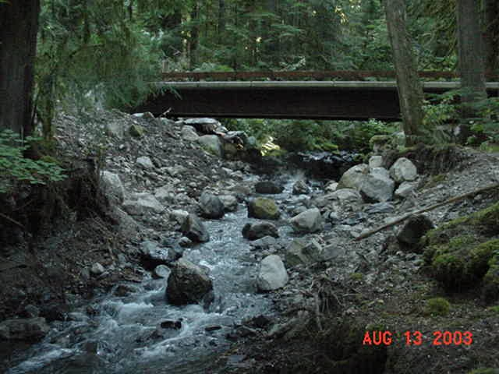
Nooksack Roads

Slide 12
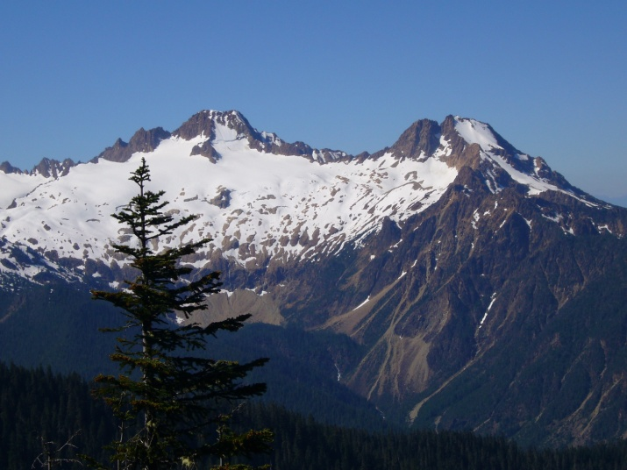
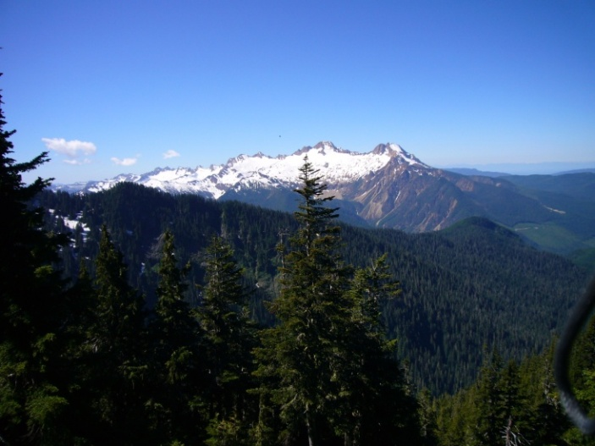
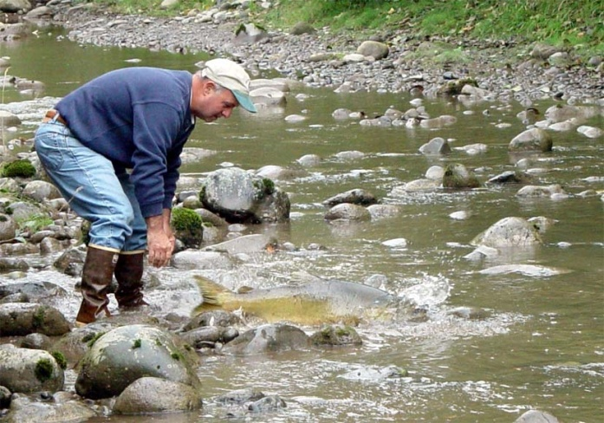

Slide 13
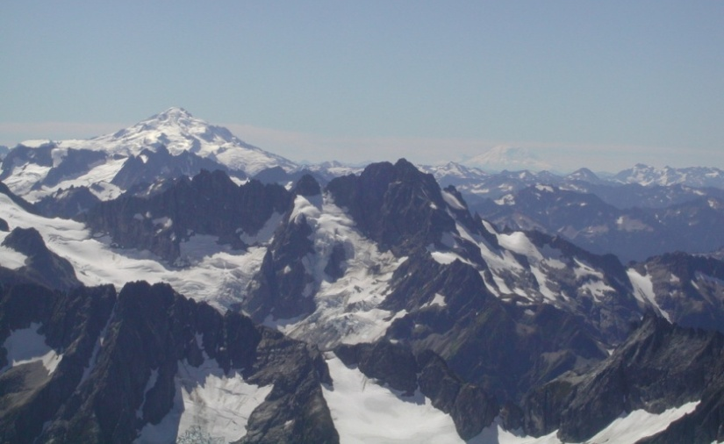
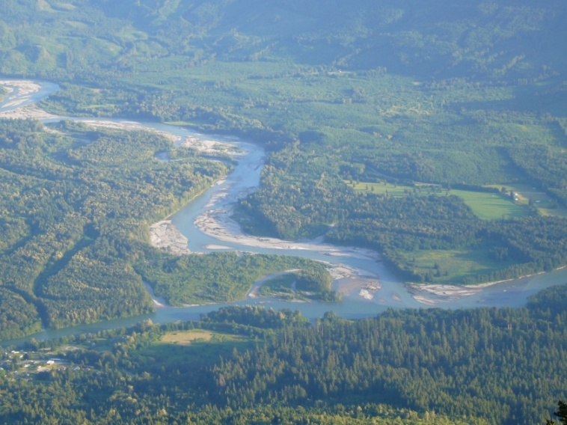
Skagit River Skagit Watershed Council
Skagit Chinook Recovery Plan
WRIA 3 & 4 Limiting Factors Analysis
Hazardous Slope Inventories

Slide 14
Skagit River Skagit Conservation District & Skagit River System Cooperative
2000- 2009
Project # | Sponsor | Title | SRFB $ | Match $ | Total | Road Miles Treated
08-1750R | Skagit CD | Diobsud Creek | 335,000 | 60,000 | 395,000 | 11.00
07-1791R | Skagit CD | Bacon Creek | 395,000 | 70,000 | 465,000 | 17.50
06-2213R | Skagit CD | Finney Phase III | 274,000 | 49,915 | 323,915 | 10.80
06-2212R | Skagit CD | Cascade Roads | 355,000 | 65,000 | 420,000 | 9.90
01-1358R | Skagit CD | Finney Phase II | 367,016 | 64,750 | 431,766 | 26.84
01-1232R | Skagit CD | Goodman Road | 71,584 | 12,726 | 84,310 | 4.50
00-1723R | Skagit CD | Finney Phase I | 341,399 | 254,300 | 595,699 | 44.00
07-1789R | SRSC | Suiattle Phase I | 302,600 | 53,625 | 356,225 | 19.00
01-1357R | SRSC | Sauk Sediment | 381,395 | 67,305 | 448,700 | 25.00
 |  |  | $2,822,994 | $697,621 | $3,520,615 | 168.54

Slide 15
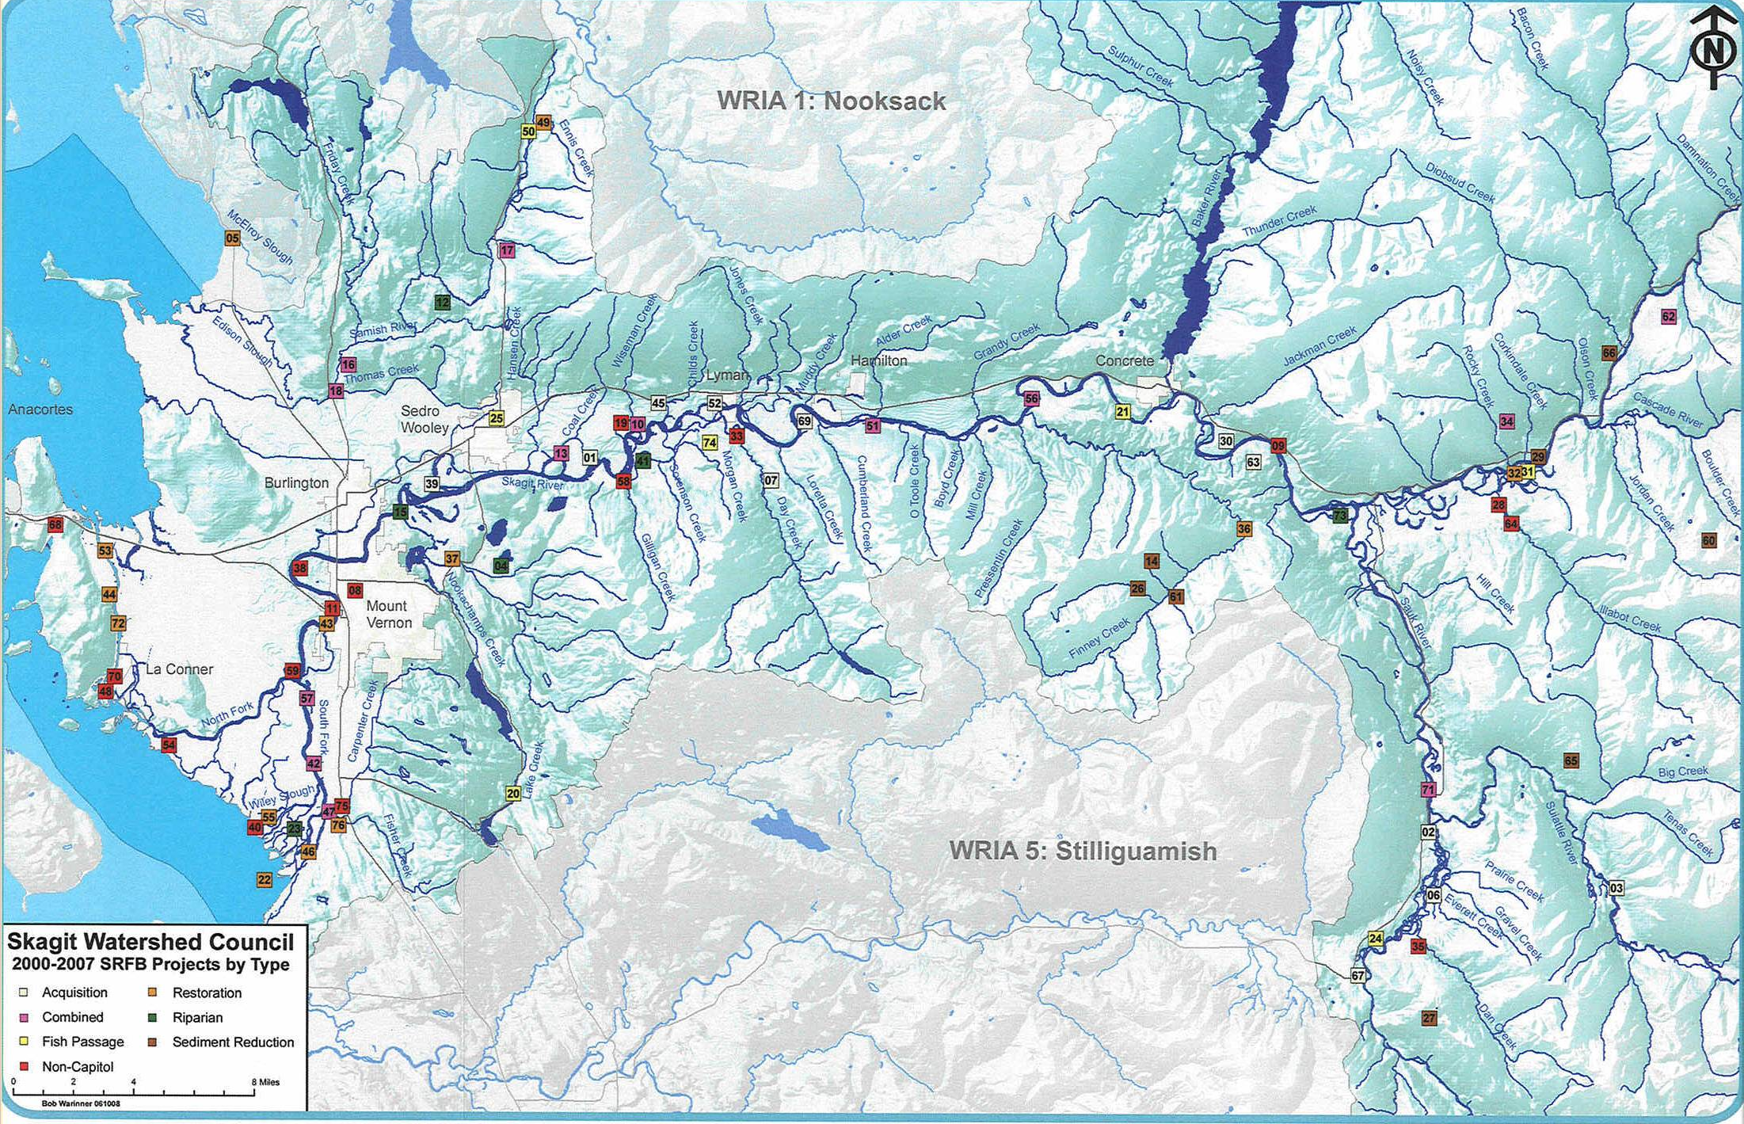
Comprehensive Skagit Focus
Bacon
Diobsud
Cascade
Suiattle
Finney I, II & III
Sauk
Goodman

Slide 16
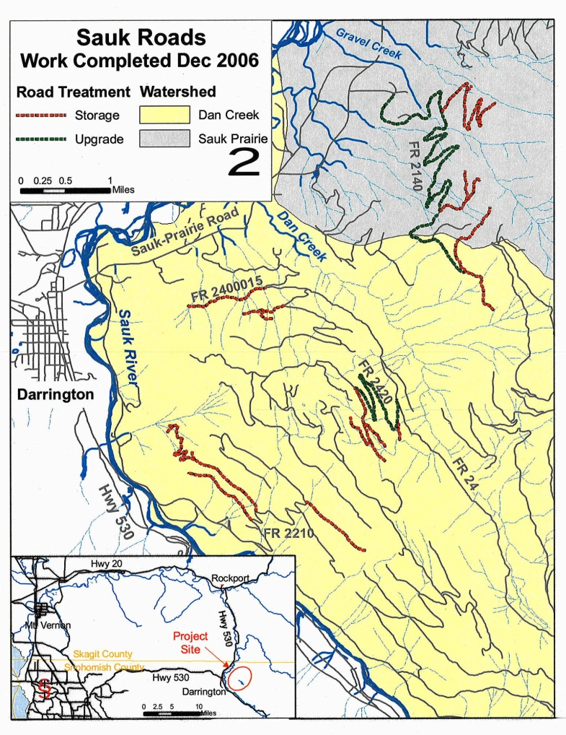
Sauk – Suiattle Roads

Slide 17
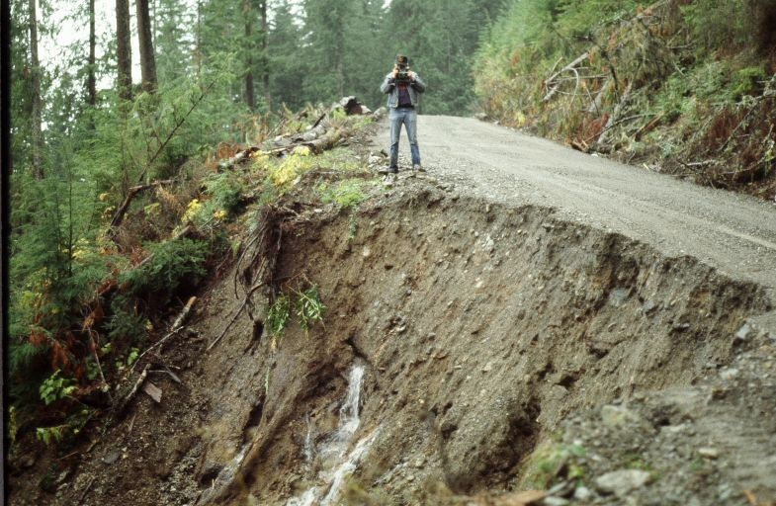
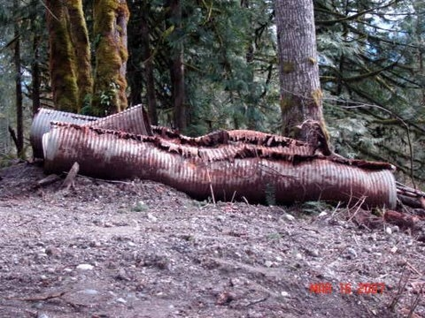
Finney Creek

Slide 18
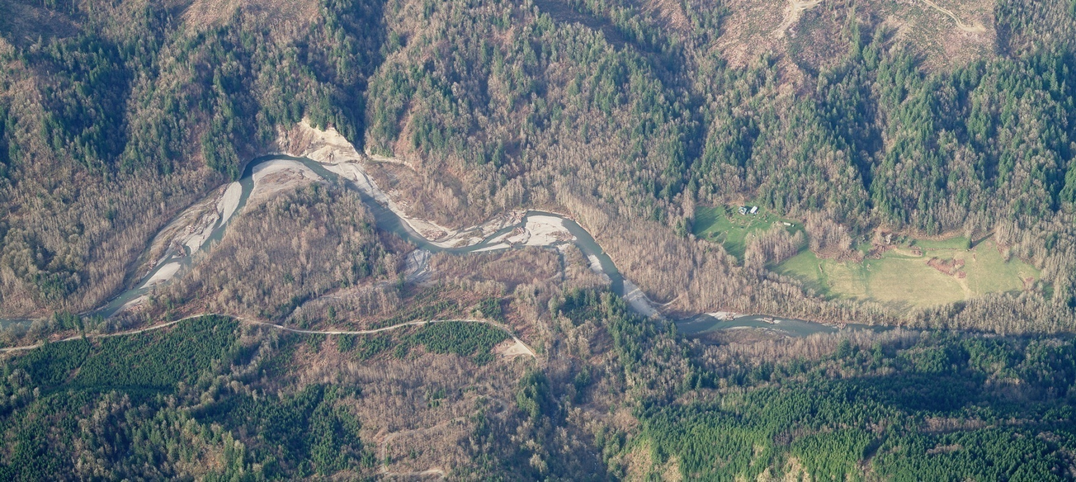
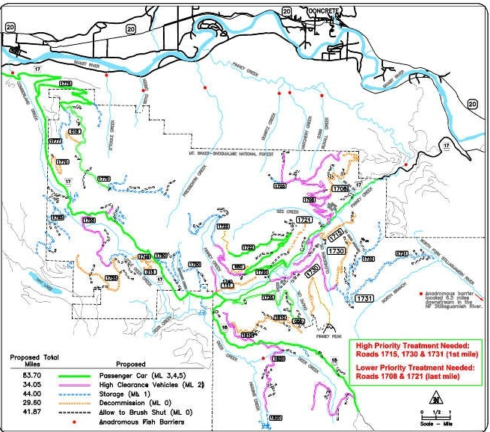
Headwater Road Treatments
Reduce Sediment
in Lower Reach
Anadromous Barrier

Slide 19
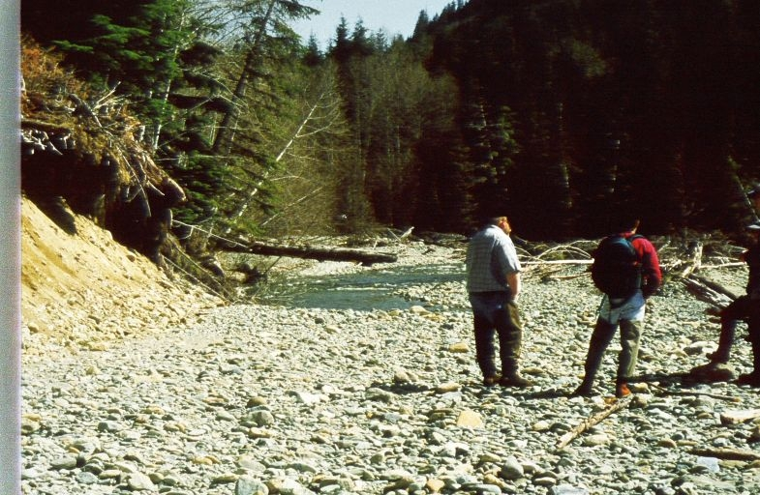
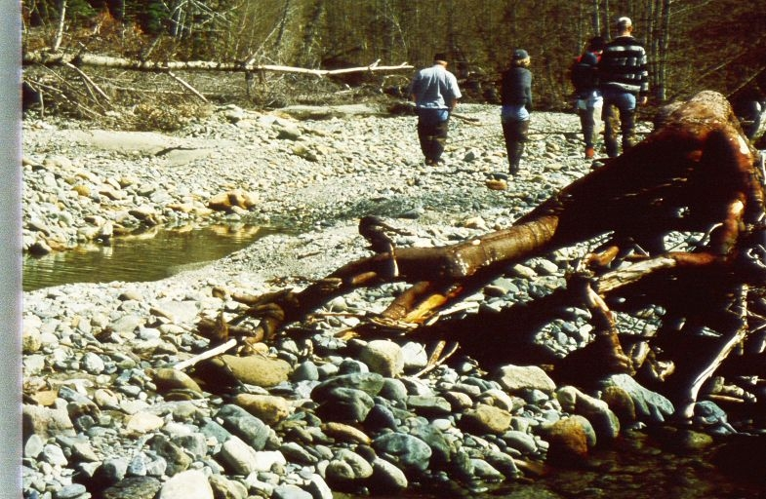
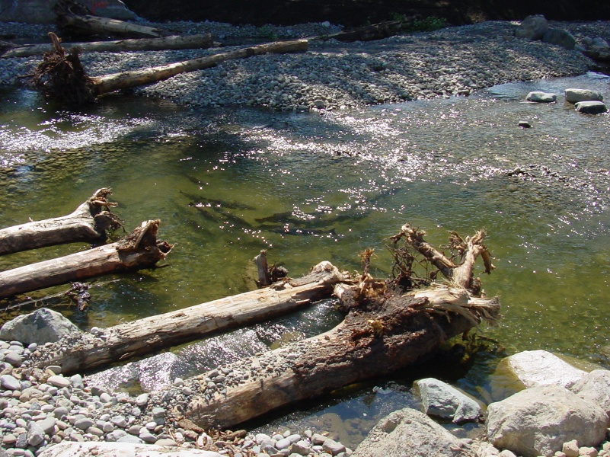

Slide 20
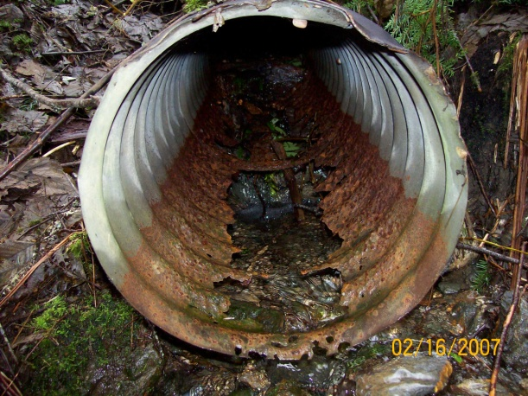
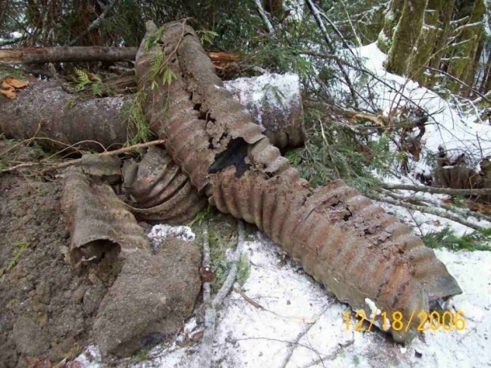
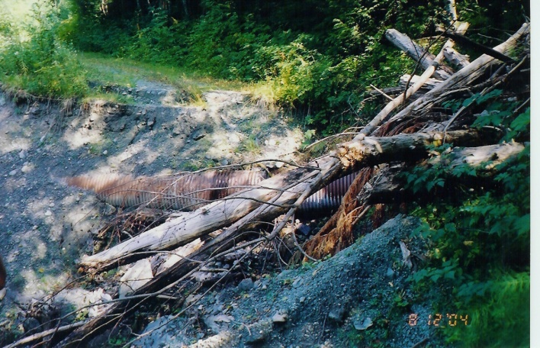
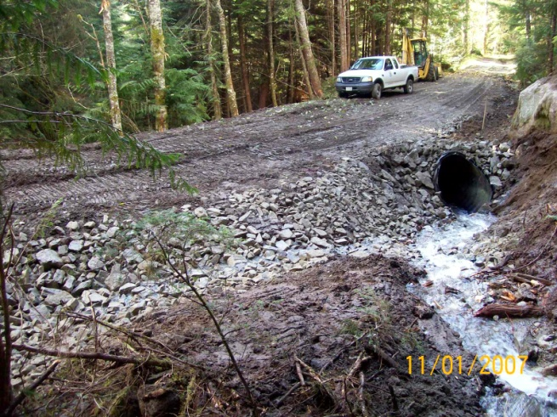
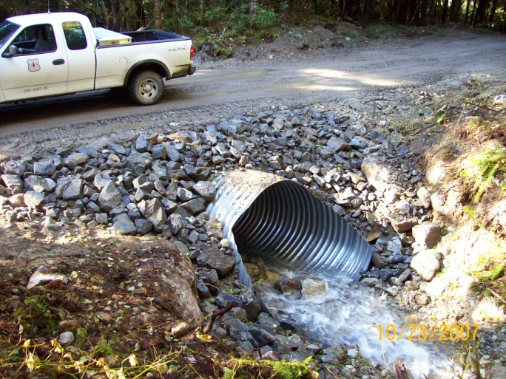
Cascade Roads
Obsolete Culverts
Failed Culverts

Slide 21
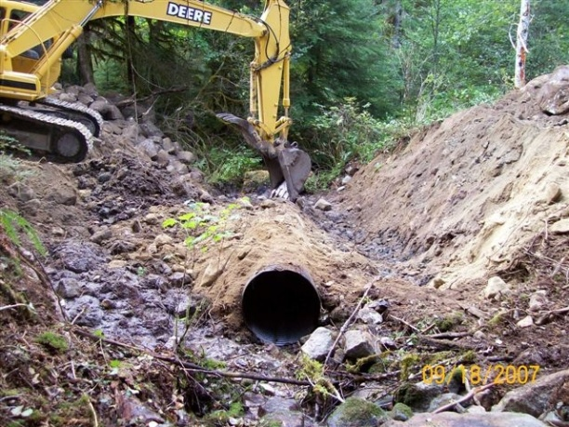
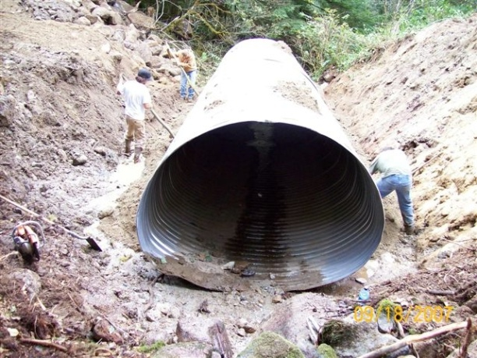
Undersized Culvert

Slide 22
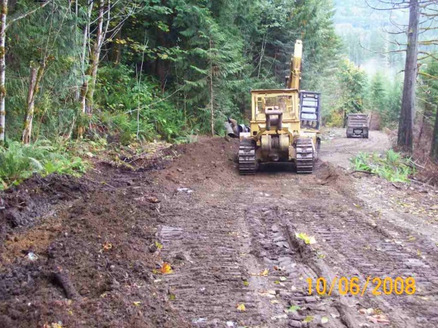
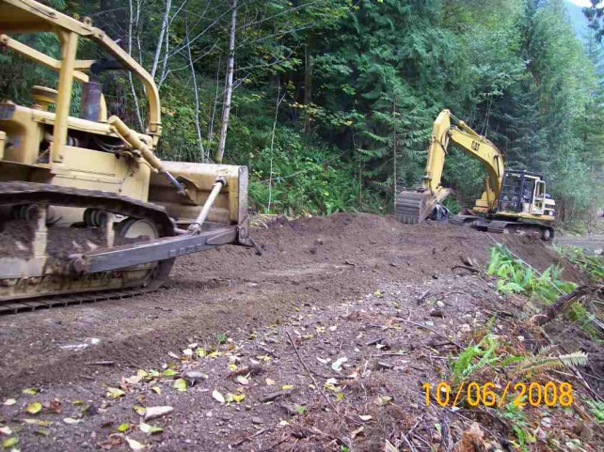
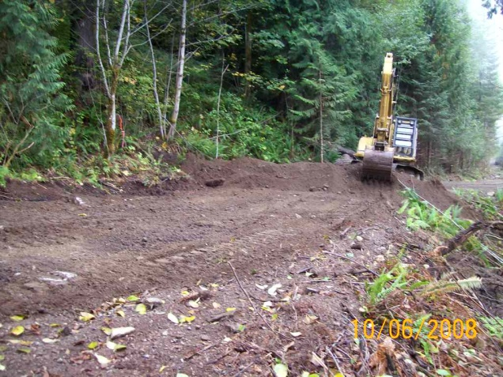
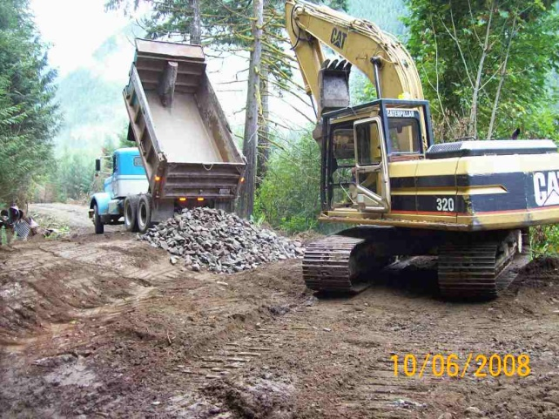
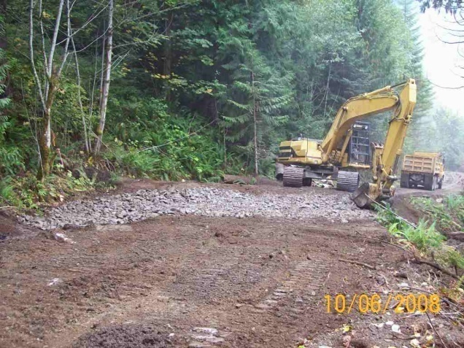
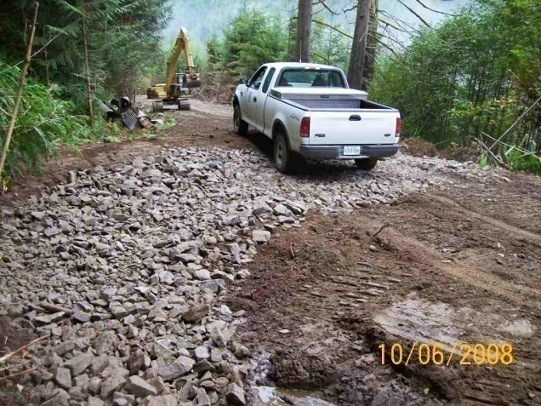
Rock-Lined Rolling Dip
1
2
3
4
5
6

Slide 23
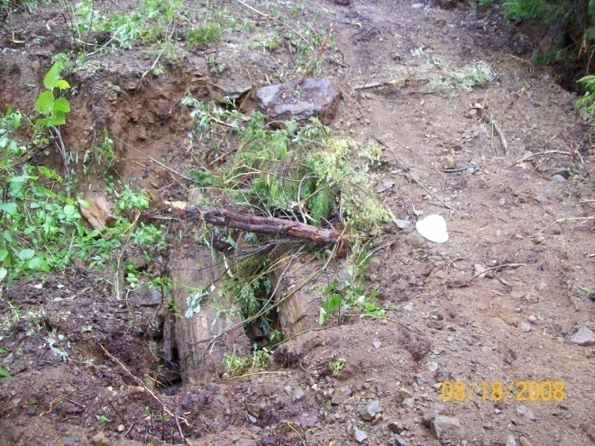
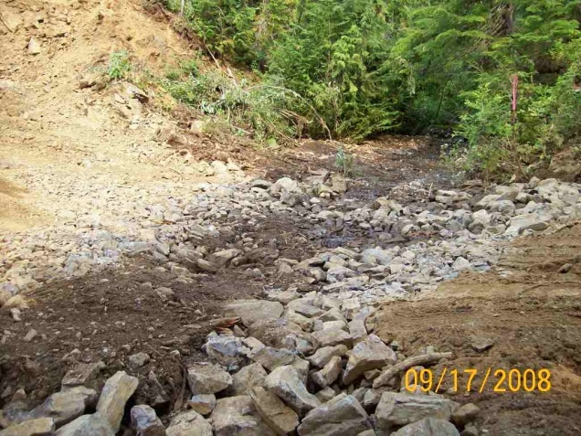
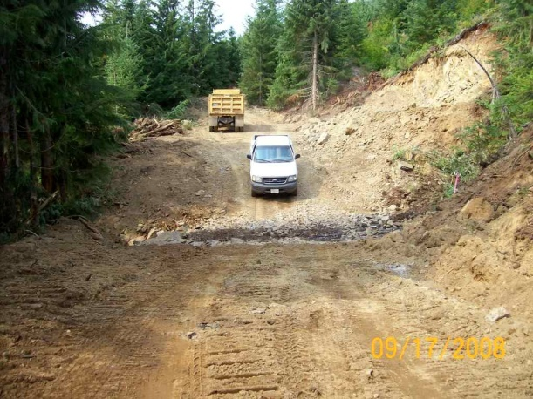
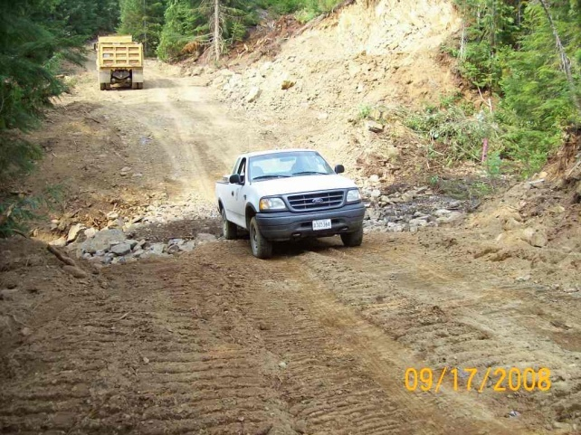
Bacon Creek

Slide 26
Stillaguamish River Stillaguamish Tribe & Snohomish County
Stillaguamish Chinook Recovery Plan
WRIA 5 Limiting Factors Analysis
Hazardous Slope Inventories

Slide 27
Stillaguamish River Snohomish Conservation District & Stillaguamish Indian Tribe
2000- 2008
Project # | Sponsor | Title | SRFB $ | Match | Total | Miles Treated
06-2266R | Snohomish CD | Deer Creek | 178,248 | 36,274 | 214,522 | 8.50
05-1588R | Snohomish CD | Segelsen Road | 302,568 | 67,525 | 370,093 | 12.30
02-1596R | Snohomish CD | Little Deer | 253,110 | 47,000 | 300,110 | 19.64
00-1779R | Snohomish CD | Westside Higgins | 89,644 | 30,685 | 120,329 | 5.90
00-1775R | Stilly Tribe | NF Stilly Decommission | 100,198 | 29,652 | 129,850 | 13.00
 |  |  | $923,768 | $211,136 | $1,134,904 | 59.34

Slide 28
North Fork Stillaguamish Focus
Little
Deer
Deer
Segelsen
Westside
Higgins
NF Stilly

Slide 29
NF Road Decommissioning

Slide 30
Westside Higgins Road

Slide 31
Deer - Segelsen

Slide 33
Little Deer Creek

Slide 34
Little Deer Creek

Slide 36
Sure glad everyone is doing habitat restoration!

Slide 37
Thank you!
Hopefully Tomorrow We’ll Respect Our Rivers Instead of
Taking Them for Granted as We Do Today!

