Slide 1
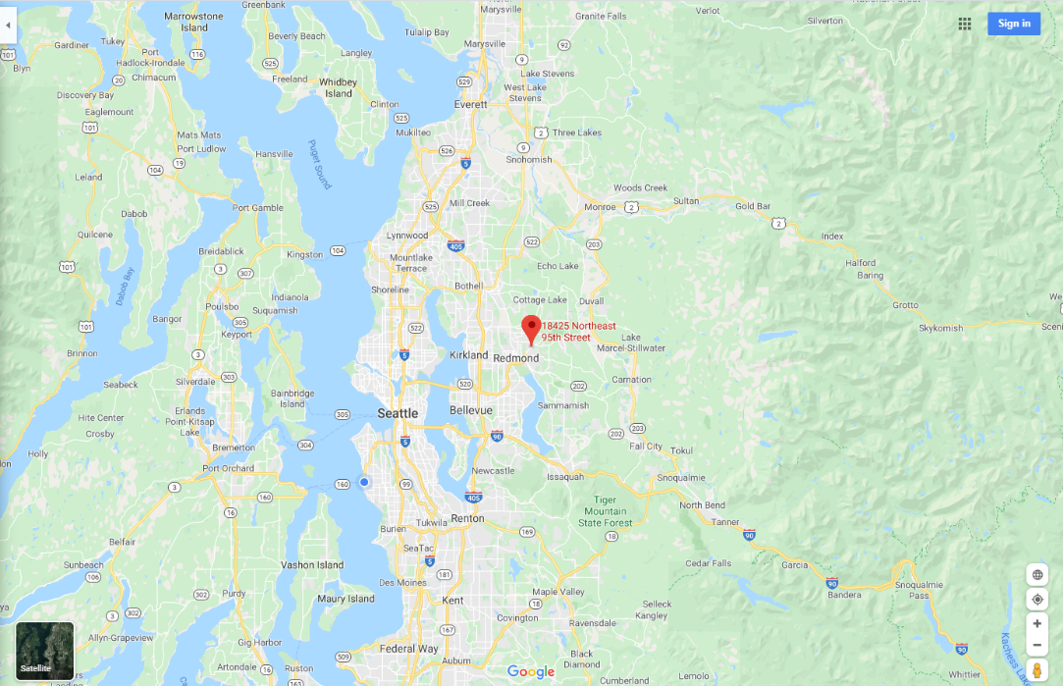
Cedar Sammamish Watershed (WRIA 8) Cost Increase Request
Adopt A Stream Foundation: Bear Creek Reach 6 Restoration
 | Current | Cost Increase | Total
PSAR | $169,967 | $147,332 | $317,299
Match | $30,000 | $26,000 | $56,000
Total | $199,967 | $173,332 | $373,299

Slide 2
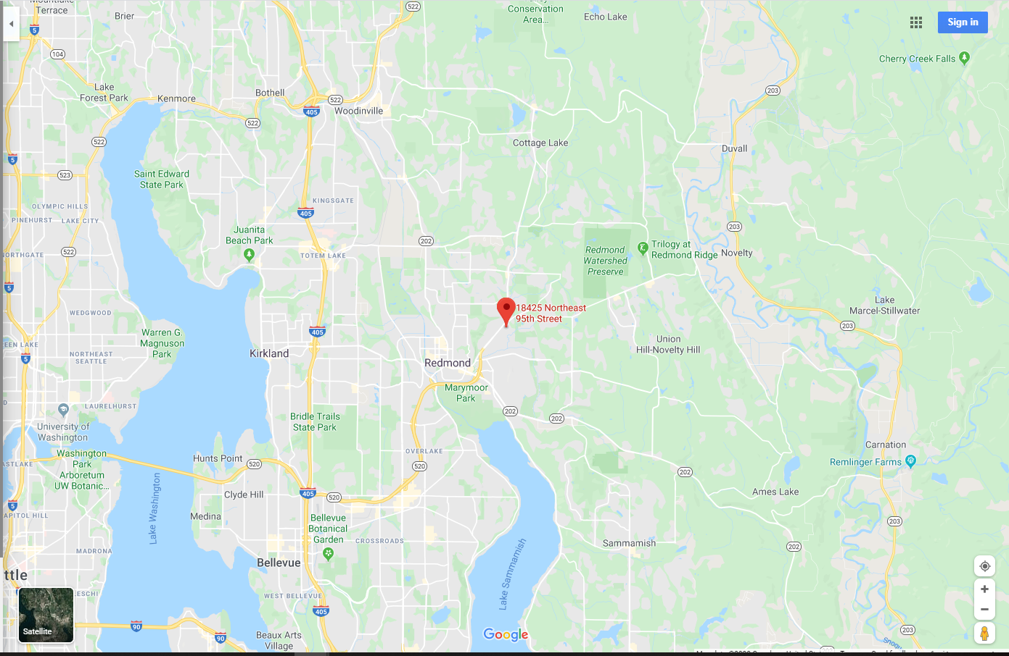
Friendly Village Manufactured Home Community
Project delay due to landownership change:
Early 2019, King County Housing Authority purchased property

Slide 3
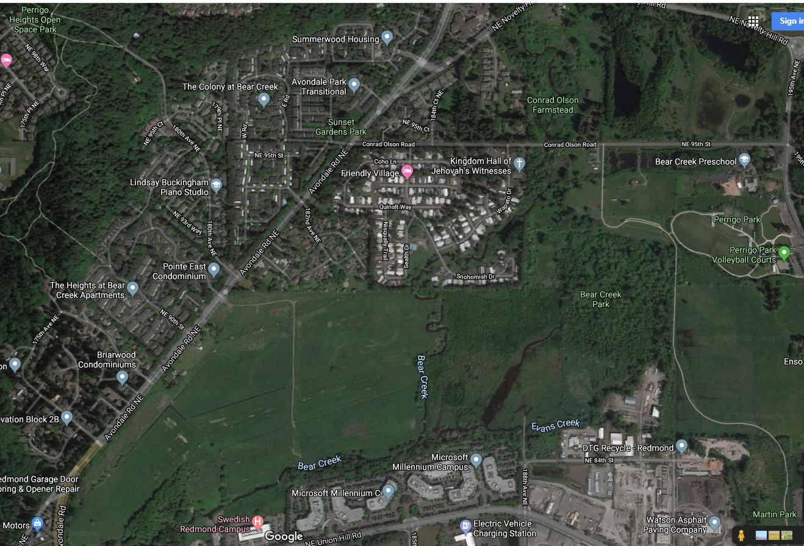
City of Redmond Mitigation
Keller Farm Mitigation Bank
Just upstream and downstream of the restoration site, Bear Creek is benefiting from mitigation related restoration projects.

Slide 4
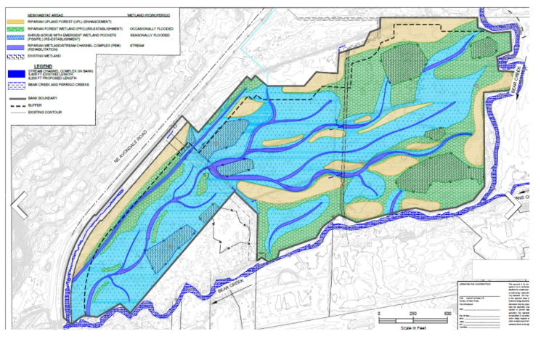
City of Redmond Mitigation
Keller Farm Mitigation Bank
Keller Farm Wetland Mitigation Bank received final mitigation bank certification at the end of 2019. Without major infrastructure downstream, permitting agencies and tribes encouraged design team to allow for natural processes.

Slide 5
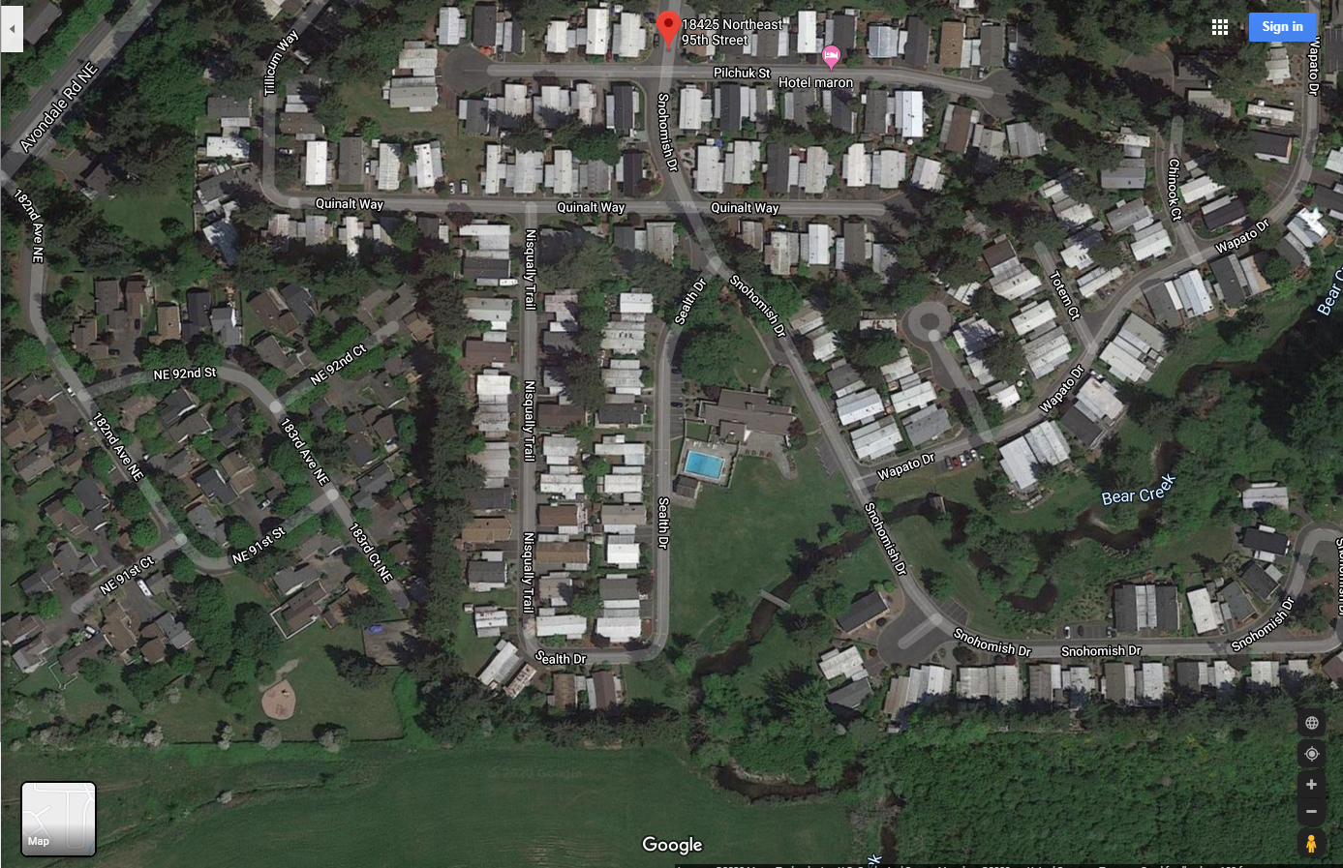
Friendly Village
(12-1282) Phase I
(16-1215) Phase II
Friendly village is a 55+ community with 224 mobile home sites, a pool, club house, landscaped and natural open space. Bear Creek flows through the southeast corner of the 40 acre site. In 2016, Adopt-A-Stream Foundation completed a restoration project just upstream where they added wood, constructed habitat benches and planted native trees and shrubs to improve instream and riparian habitat for Chinook and coho salmon, and steelhead, cutthroat and bull trout.

Slide 6
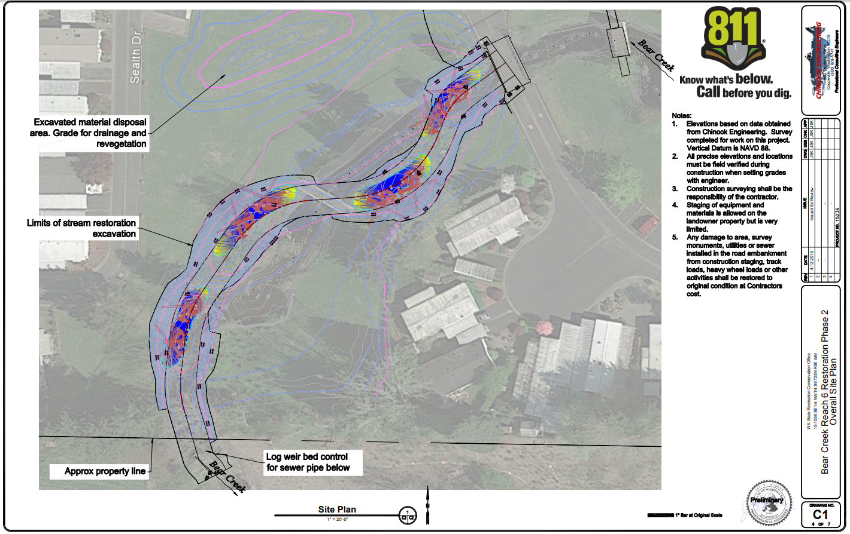
Preliminary Designs included four large channel spanning jams, re-meandering the channel, adding floodplain benches, and planting a ~100 ft. wide riparian buffer on each bank (where buildings don’t constrain).

Slide 7
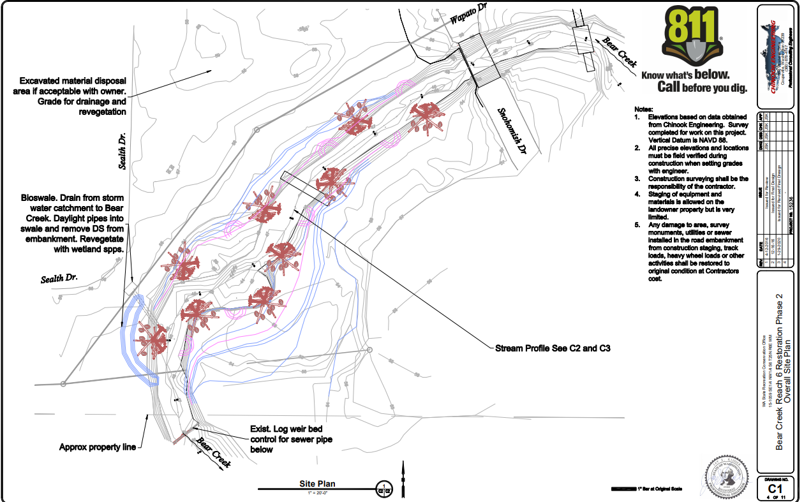
7 Scallops (off-
channel refugia)
9 Log jams improve instream habitat, create pools
Floodplain Terraces improve edge habitat during higher flows.
Final Designs respond to Muckleshoot Tribe’s request to reduce excavation to avoid potential impact to cultural resources. Nine smaller log jams will be constructed along the banks but extending in to the channel. Instead of re-meandering, seven scallops will be carved out of the bank to provide off channel refuge. Landowner reduced the riparian buffer to 60 ft. width.
Design allows for natural habitat forming processes: Bear Creek is expected to create pools at the jams, and transport smaller wood material downstream.

Slide 8
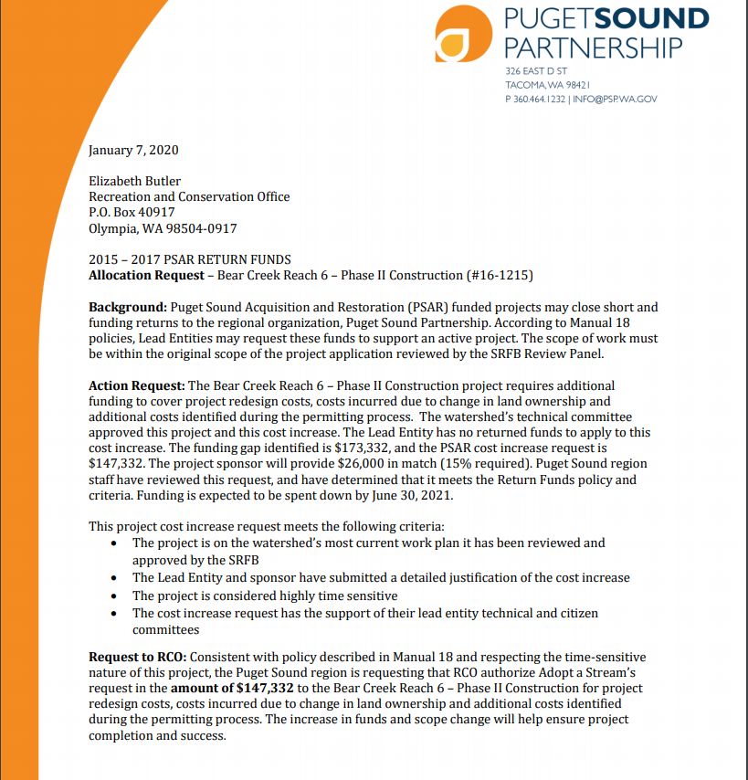
Landownership change mid-project caused delays. Cost estimate to construct in 2020 is $173,332 short due to higher costs for wood, boulders, excavation/spoils placement. Cultural Resources monitoring is also required and not accounted for in the original scope. Adopt-A-Stream Foundation is contributing an additional $26,000 of match. Partnership approved $147,332 of PSAR (2015-17) return funds .

Slide 9
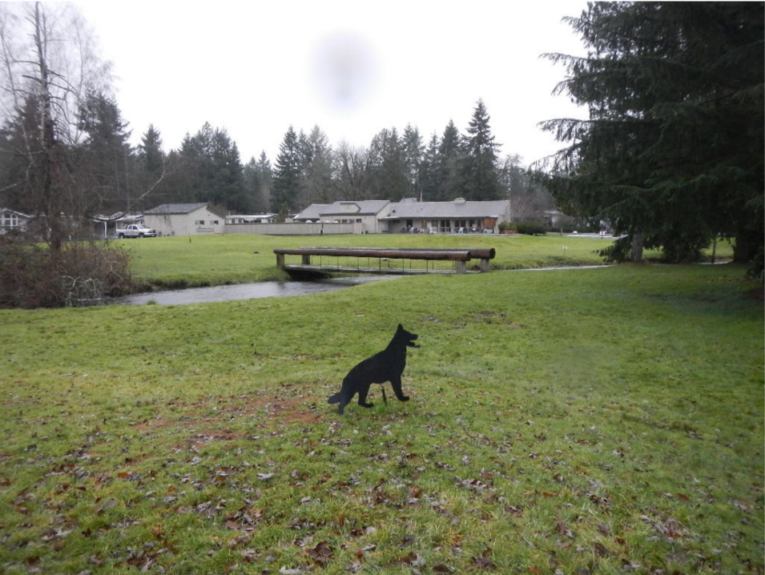
Cedar Sammamish Watershed (WRIA 8) Cost Increase Request
Adopt A Stream Foundation: Bear Creek Reach 6 Restoration
 | Current | Cost Increase | Total
PSAR | $169,967 | $147,332 | $317,299
Match | $30,000 | $26,000 | $56,000
Total | $199,967 | $173,332 | $373,299

