Slide 1
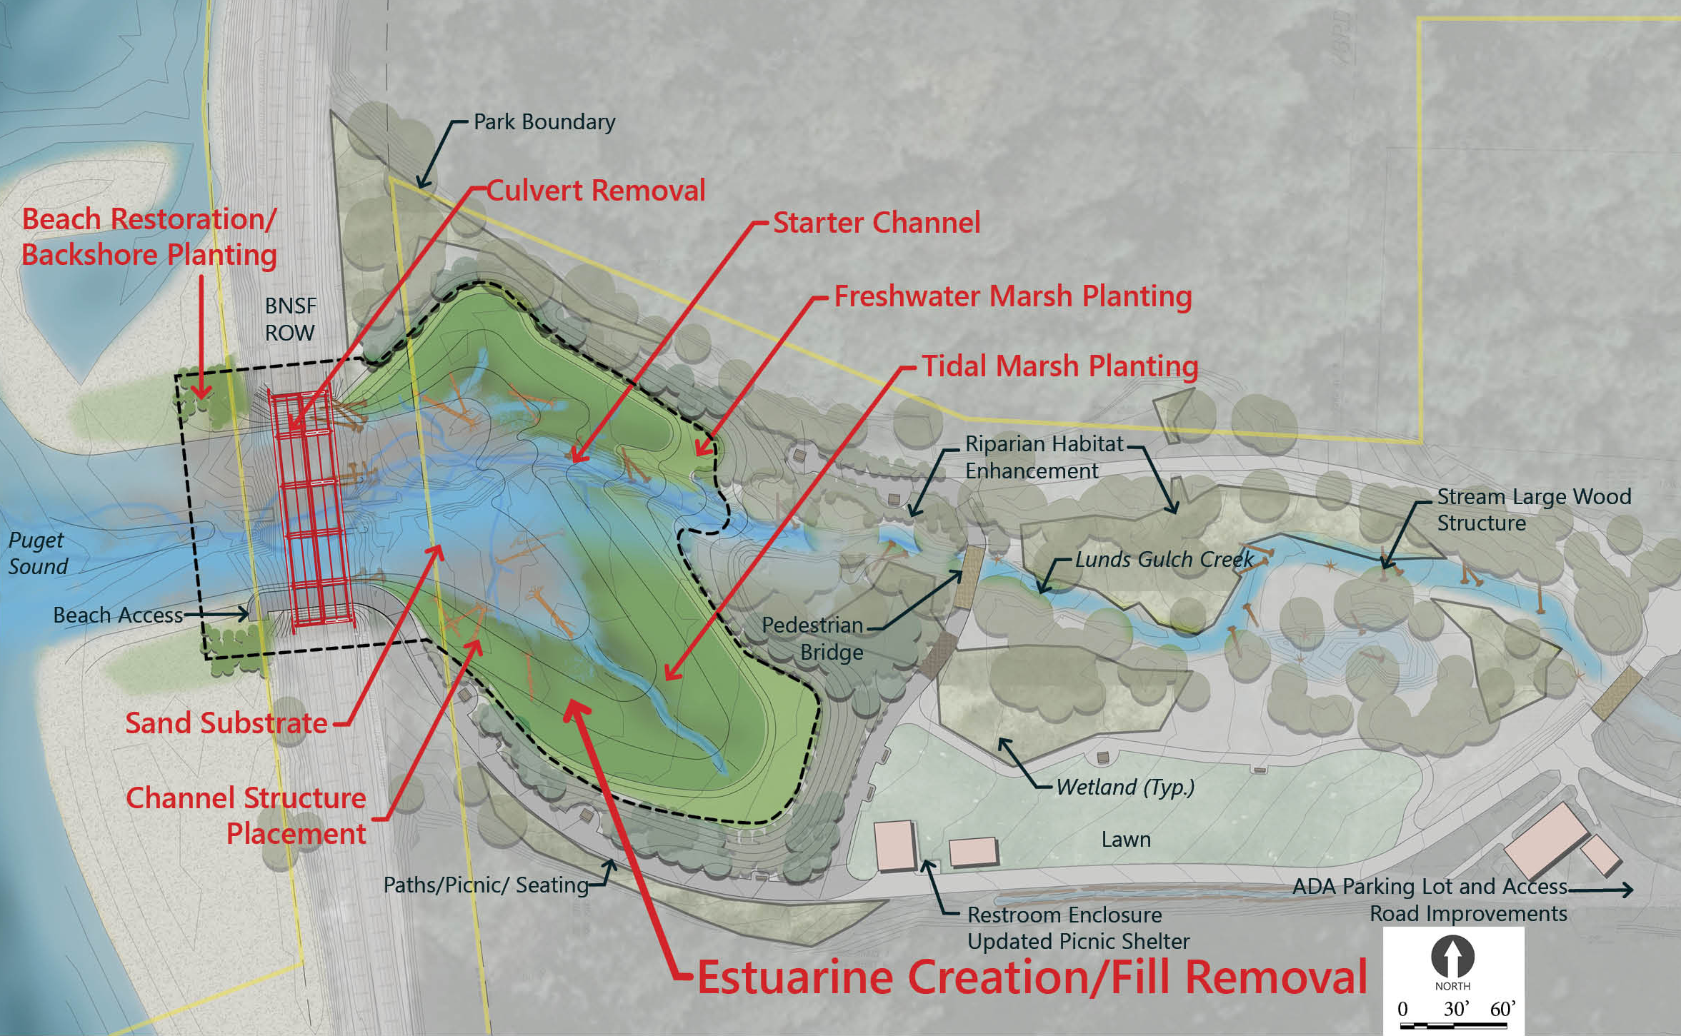
Meadowdale – Larger Project Overview
Grant | Construction Funding Request
ALEA | $500,000
ESRP | $1,000,000
Fed Rail | $3,500,000
LWCF | $500,000
SRFB | $800,000
UTC | $20,000
Water Access | $1,000,000
Total Grants | $7,320,000
SNOCO | $8,380,000
TOTAL(1) | $15,700,000
1. Incl. est. $2M for BNSF Mitigation – not incl in any RCO grant request match except allowed under FRA grant
SRFB #18-1259 RST
Slide 1 of 3

Slide 2
Costs
RAILROAD BRIDGE (RESTORATION/SAFETY/ACCESS) CONSTRUCTION FUNDING BREAKDOWN
SOURCE | AMOUNT | PERCENT OF TOTAL
ESRP | $417,700 | 5.4%
Fed Rail Admin (CRISI) | $3,500,000 | 45.8%
SRFB | $261,178 | 3.4%
UTC | $20,000 | 0.3%
Water Access | $699,722 | 9.2%
Total Grants | $4,898,600 | 64.1%
Snohomish County | $2,743,948 | 35.9%
TOTAL | $7,642,548 | 100%
SRFB #18-1259 RST
Slide 2 of 3

Slide 3
Costs
HABITAT RESTORATION CONSTRUCTION FUNDING BREAKDOWN
SOURCE | AMOUNT | PERCENT OF TOTAL
ESRP | $ 405,700 | 14.6%
SRFB | $ 406,600 | 14.6%
ALEA | $ 272,800 | 9.8%
LWCF | $ 215,300 | 7.7%
Water Access | $ 57,100 | 2.1%
Total Grants | $1,357,500 | 48.8%
Snohomish County | $1,423,600 | 51.2%
TOTAL | $2,781,100 | 100%
SRFT #18-1259 RST
Slide 3 of 3

