Slide 1
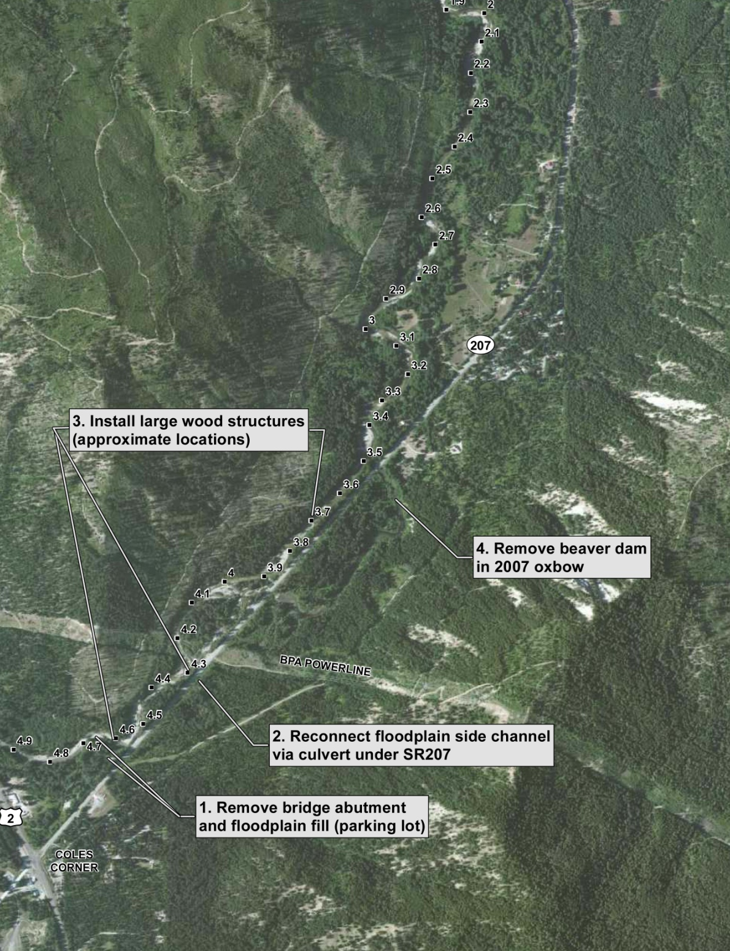
Nason Creek RM 3.5 – 4.7
Remove 0.64 acres of floodplain fill
Reconnect floodplain
Install large wood structures
Enhance flow velocity through the existing oxbow
Notes:
Overview of four proposed actions

Slide 2
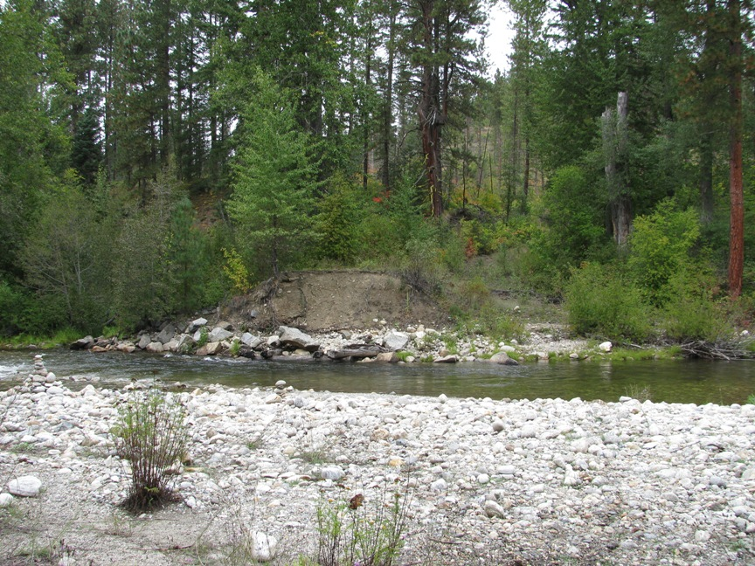
Floodplain Fill Removal 0.64 acres

Slide 3
Large Wood Structures

Slide 4
LIDAR Depicting channel scars in N1 Floodplain

Slide 5
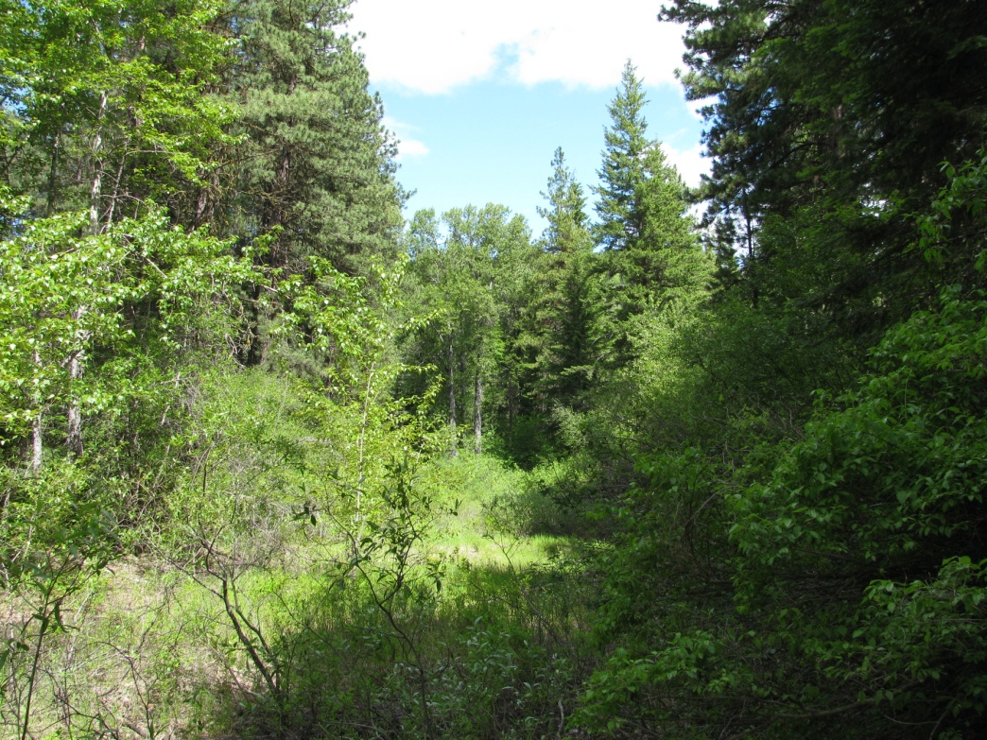
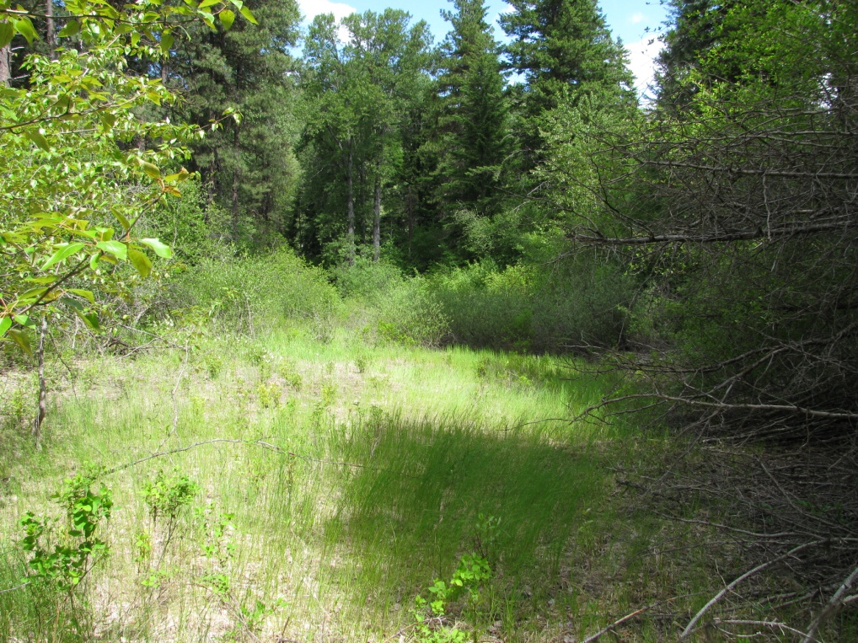
Downstream Floodplain Conditions

Slide 6
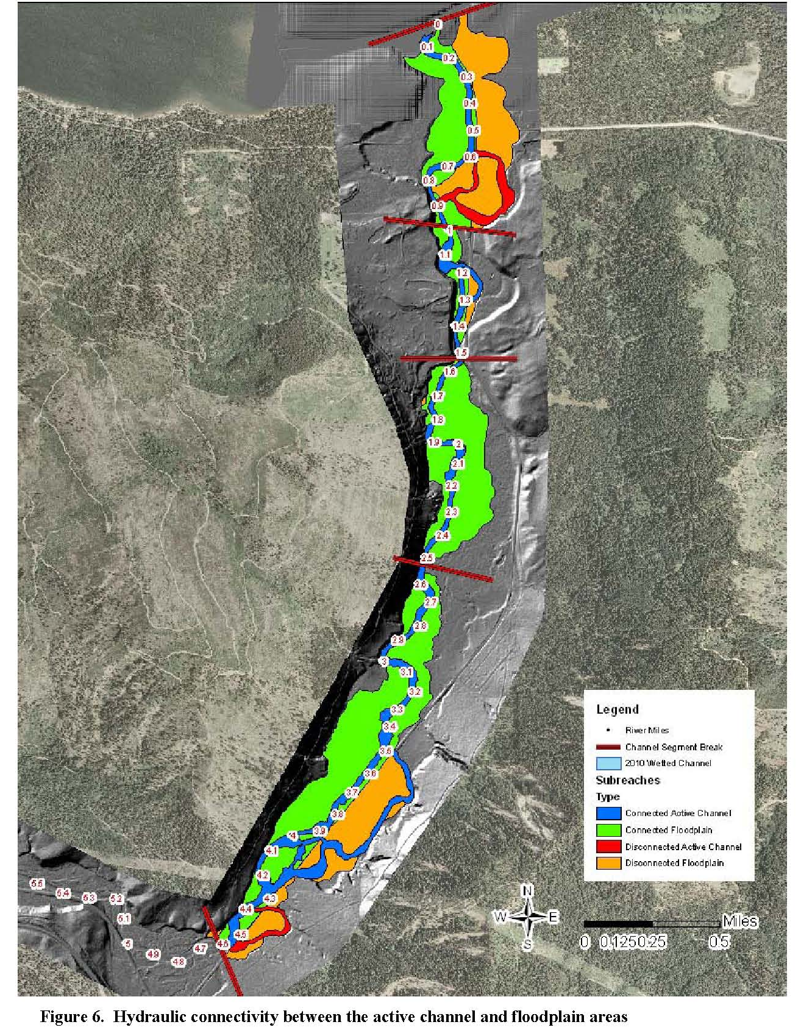
Lower Nason Assessment of Geomorphic and Ecologic Indicators
USBR April 2011
132.7 acres disconnected floodplain
Reconnect 12.9 acres, 9.7%
Notes:
This is Figure 6 from the USBR Lower Nason Assessment of Geologic and Ecologic Indicators 2011. It depicts the 132.7 acres of disconnected floodplain in the lower 4 miles of Nason Creek. This project area is 12.9 acres of disconnected floodplain or 9.7% of the total disconnected floodplain in Lower Nason Creek. But it may represent the last remaining opportunity for reconnection

Slide 7
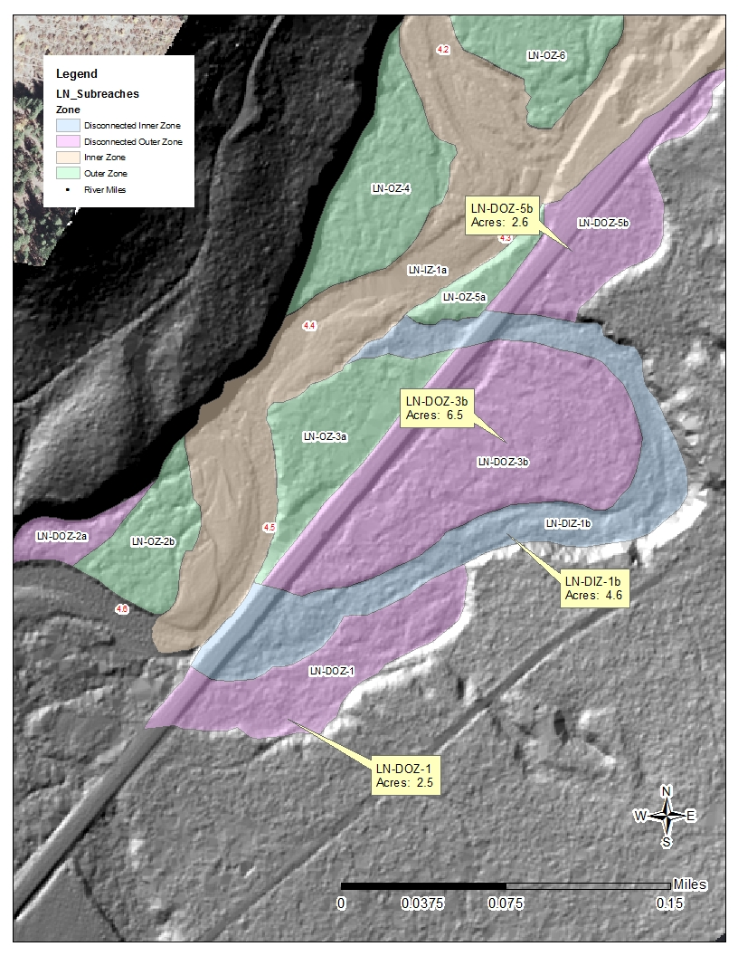
LN-DIZ-1b
4.6 acres of historic active channel path
LN-DOZ-1 and LN-DOZ-3b
9 acres adjacent floodplain
Total
~ 13 acres disconnected floodplain
Note: Acres of floodplain connection will change depending upon the flow event and depth of inundation

Slide 8
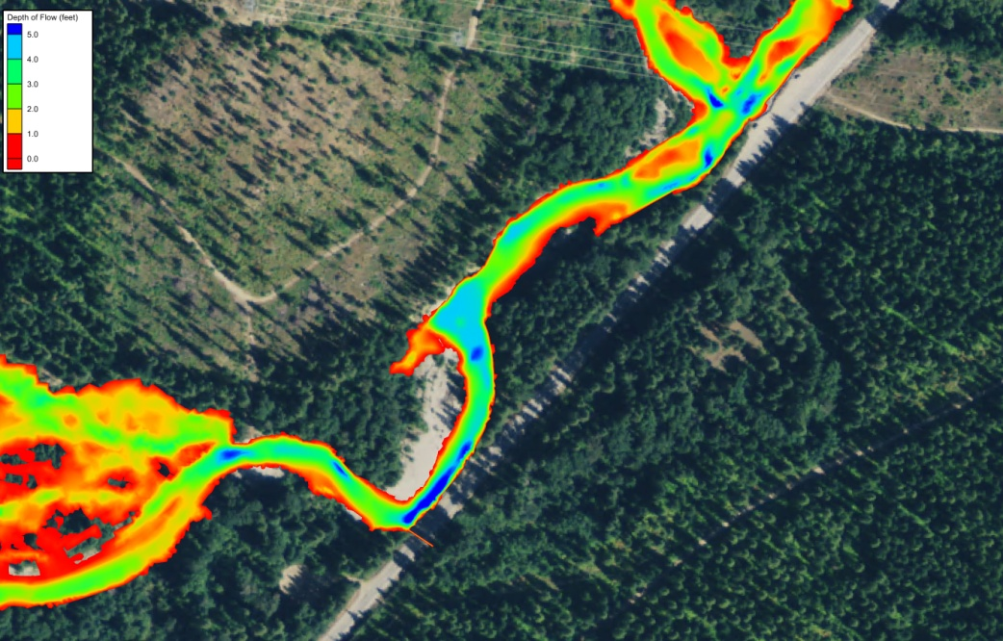
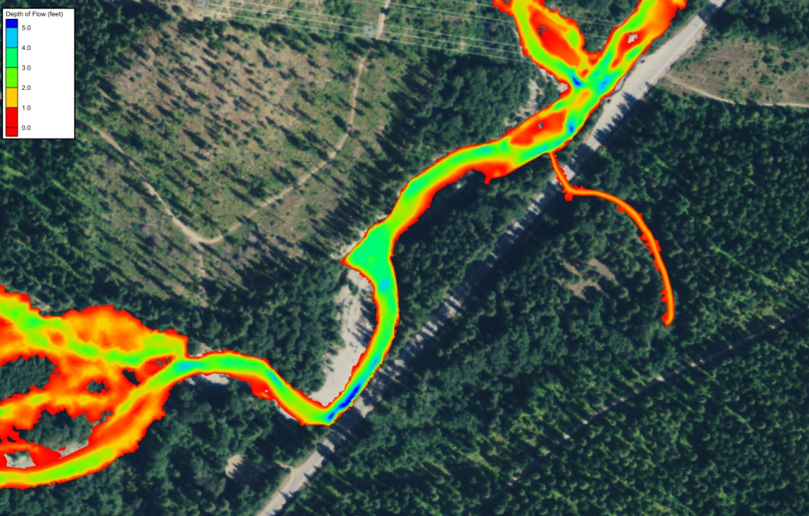
Floodplain Inundation Typical Spring Conditions (600 cfs)
With two culverts under SR 207
.26 acres inundated > 1 foot of water
Existing Conditions
For reference, flows were approximately 1,200 cfs during the tour which is ~1 year event where the water stays high for a week or so at a time

Slide 9
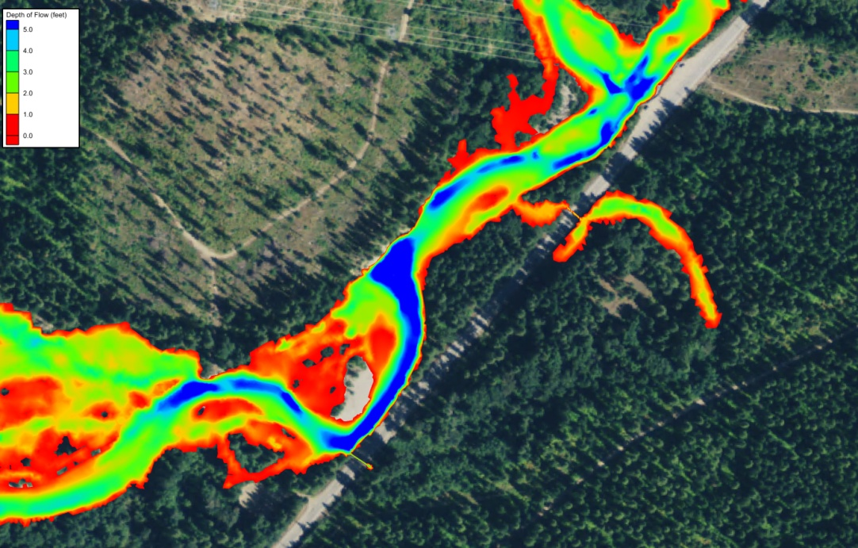
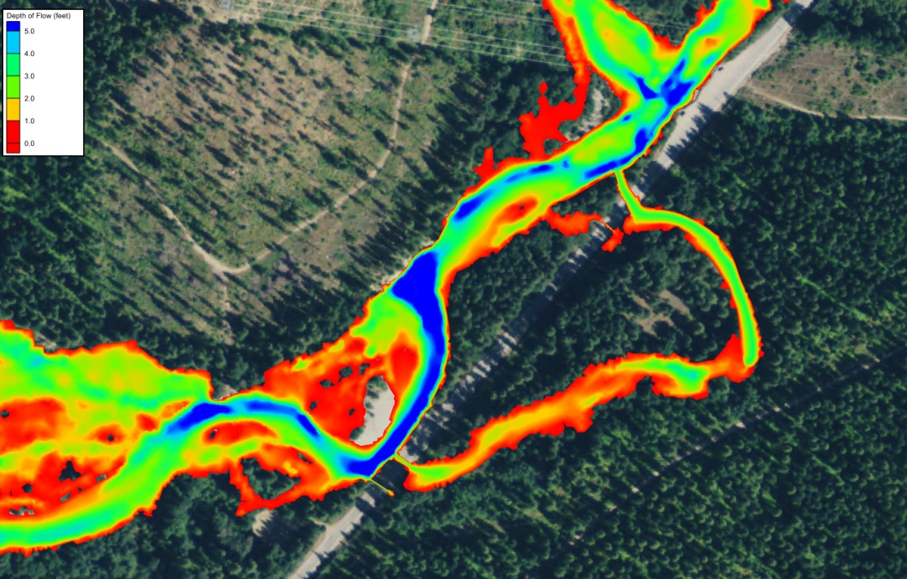
Floodplain Inundation 2 Year Flow Conditions (2200 cfs)
Existing Conditions
0.34 acres inundated > 1 foot of water No flow through the floodplain
With two culverts under SR 207
1.2 acres inundated > 1 foot of water
100 cfs flow through the floodplain

Slide 10
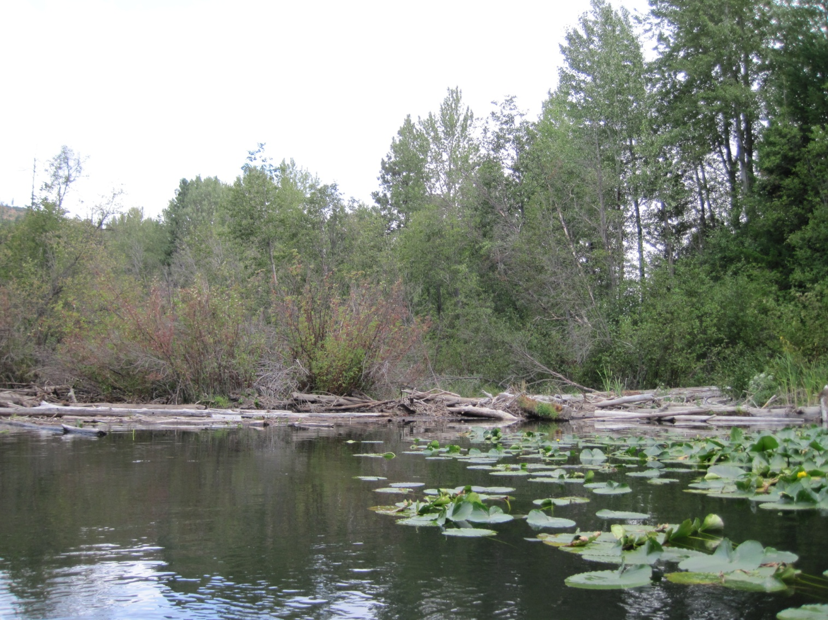
2007 Oxbow Conditions above the Beaver Dam ~ 1000 linear feet of ponded area

Slide 11
Chinook/Steelhead Fry Habitat Suitability
Low velocities
Temps between 10-15 C
Shallow water <1 meter
Snorkeling surveys in deep pools between beaver dams found reduced juvenile use
Lower beaver dam was created under limited flow conditions

Slide 12
