Slide 1
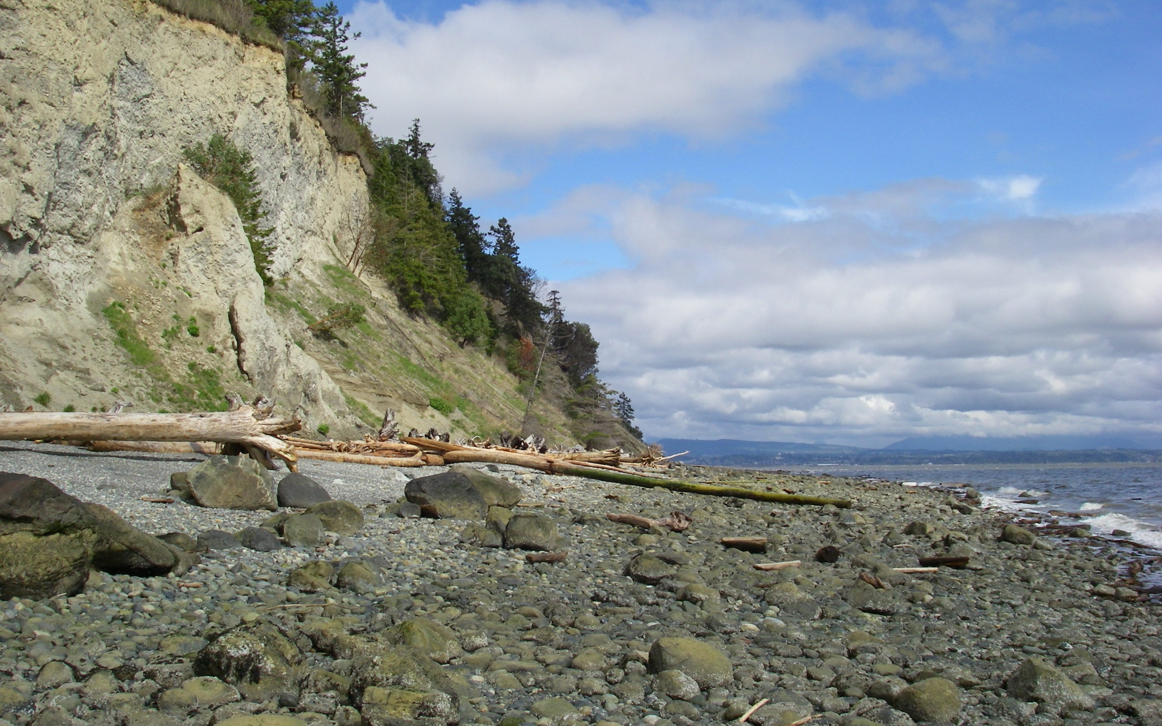
Barnum Point Acquisition – Phase I
ALEA Project Review Presentation – RCO Project #10-1438

Slide 2
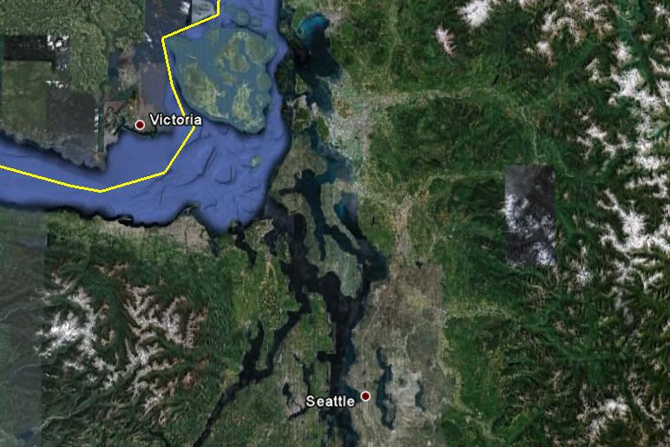
Regional Location
Barnum Point
Barnum Point

Slide 3
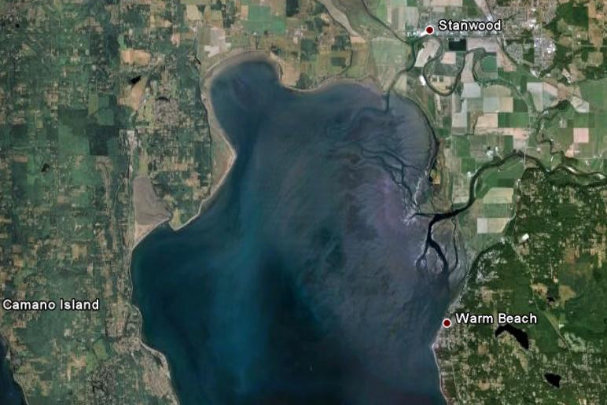
Site Location
Livingston Bay
Stillaguamish River
(Hatt Slough)
Iverson Spit
Triangle Cove
Barnum Point
Port Susan Bay

Slide 4
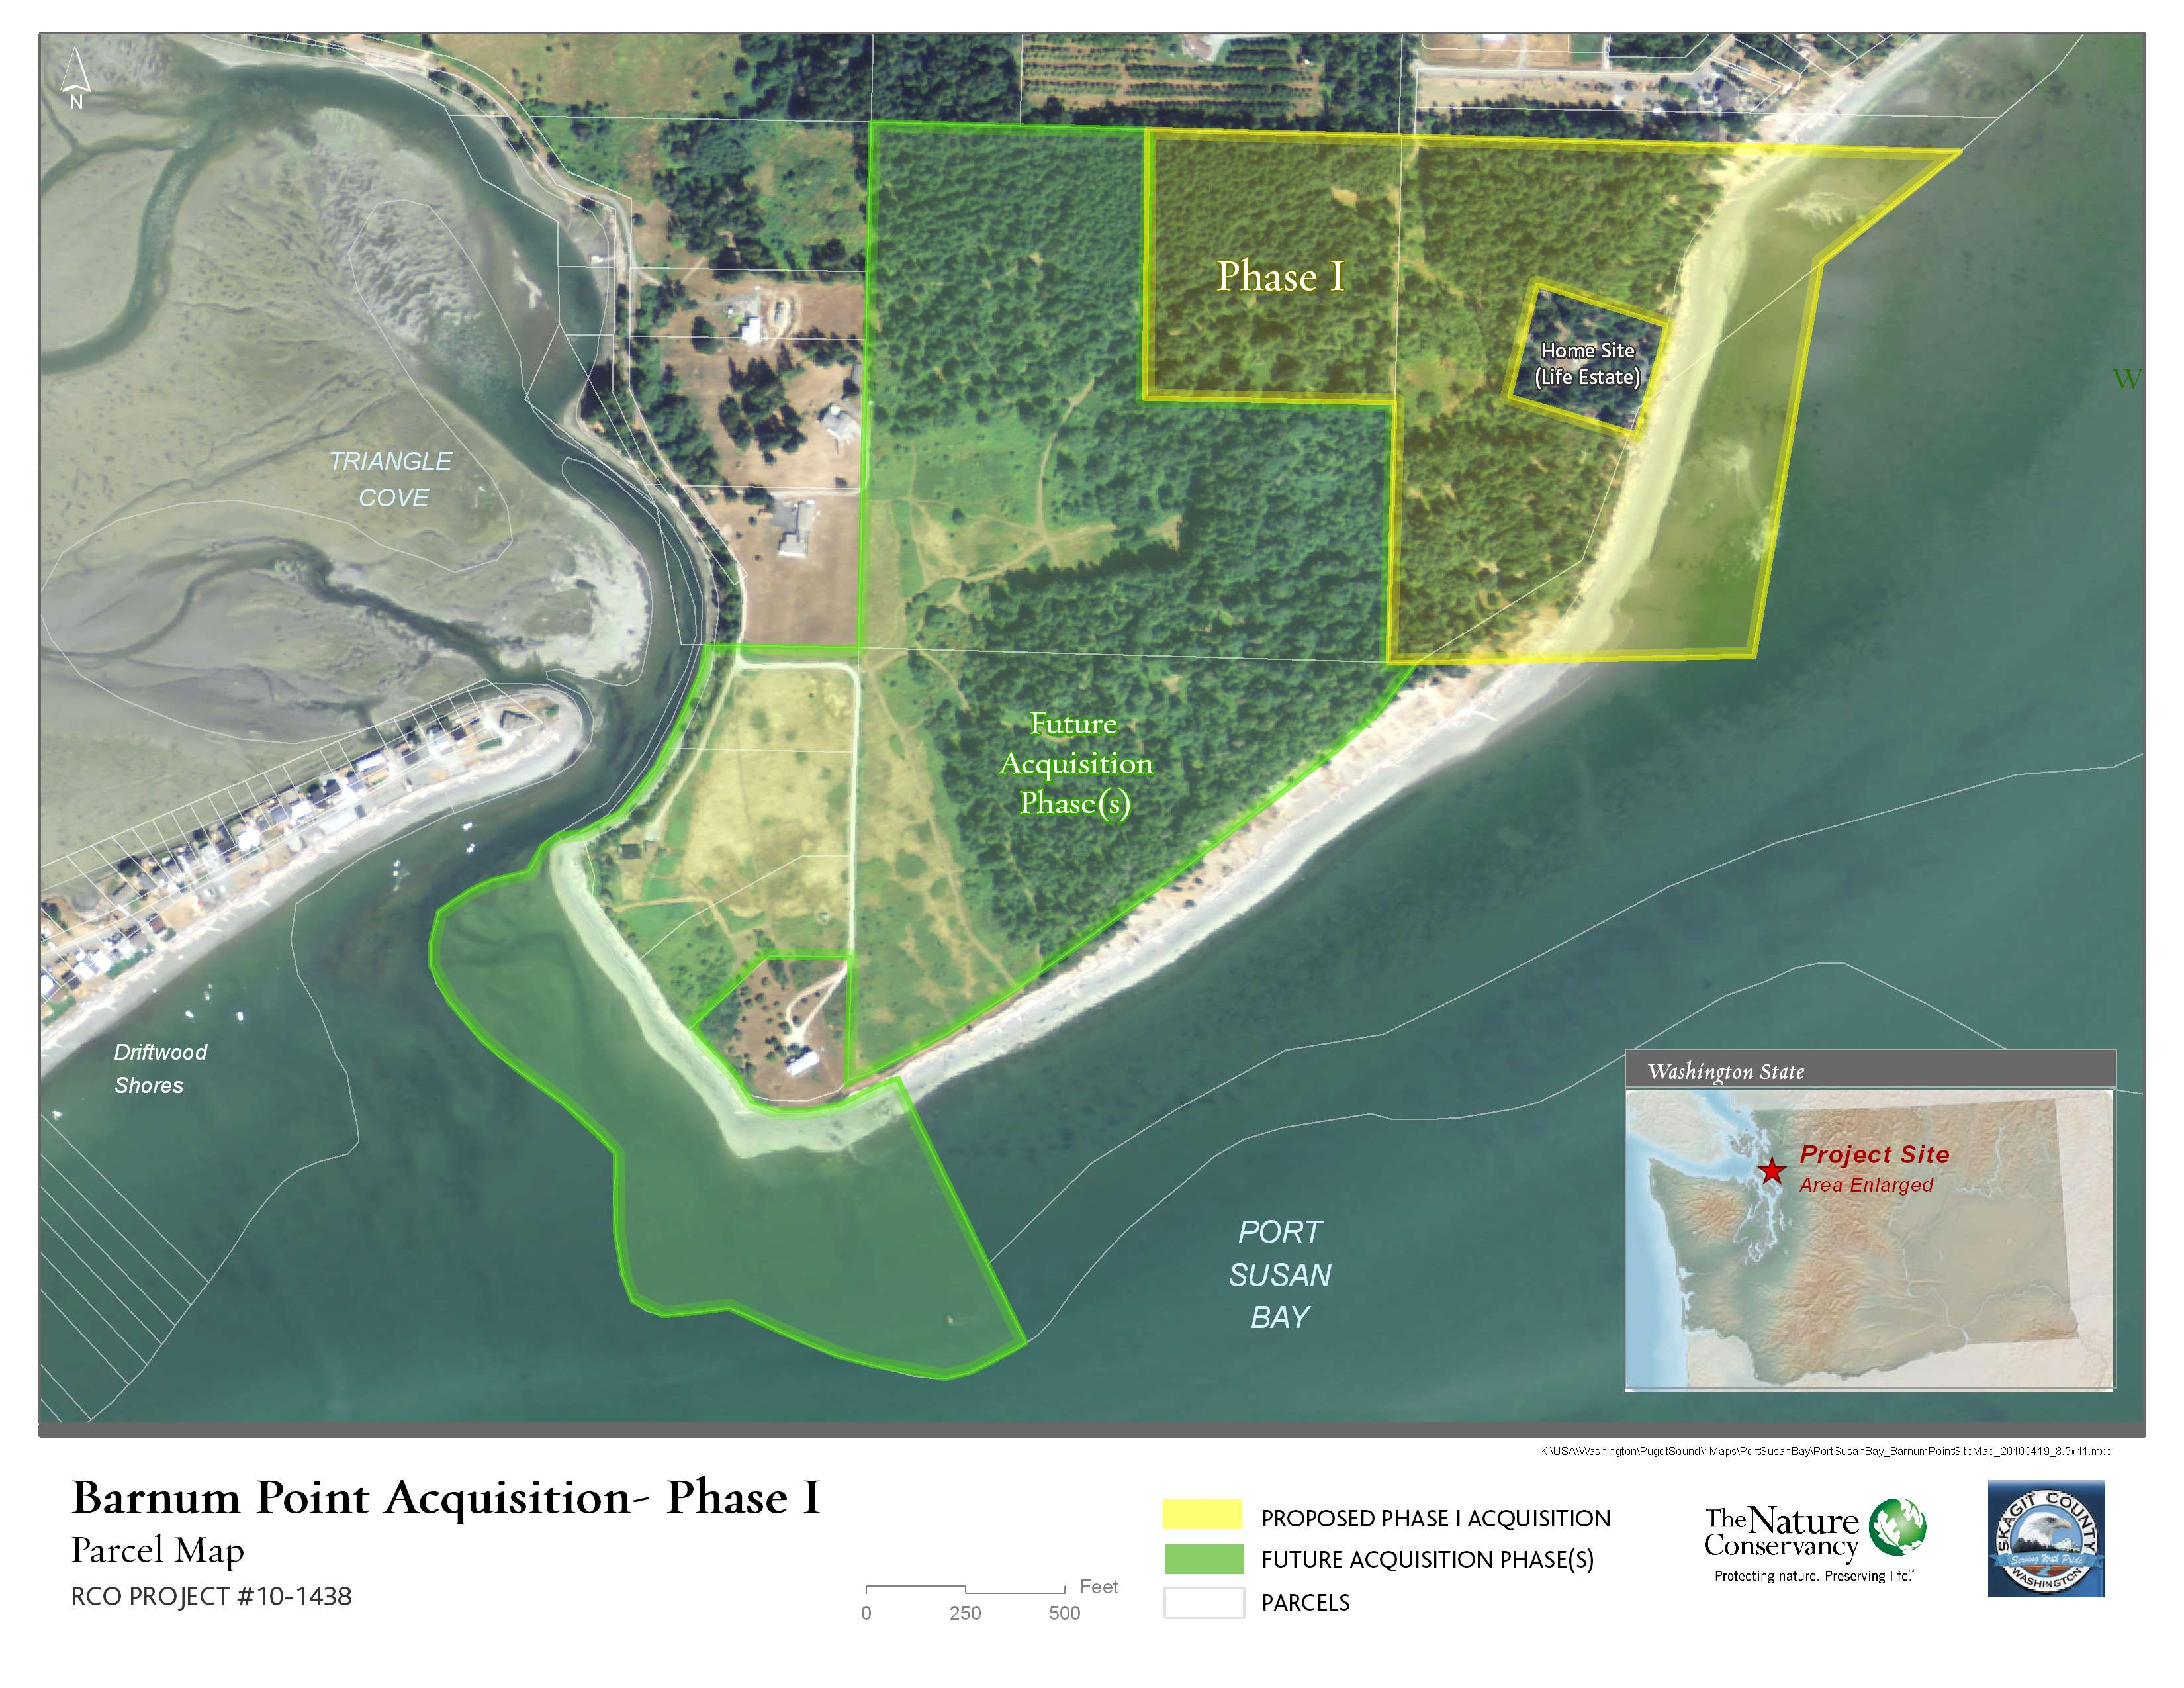
Project Parcels – Phase I and Future Phases
Proposed Phase I Acquisition
Future Acquisition Phase(s)

Slide 5
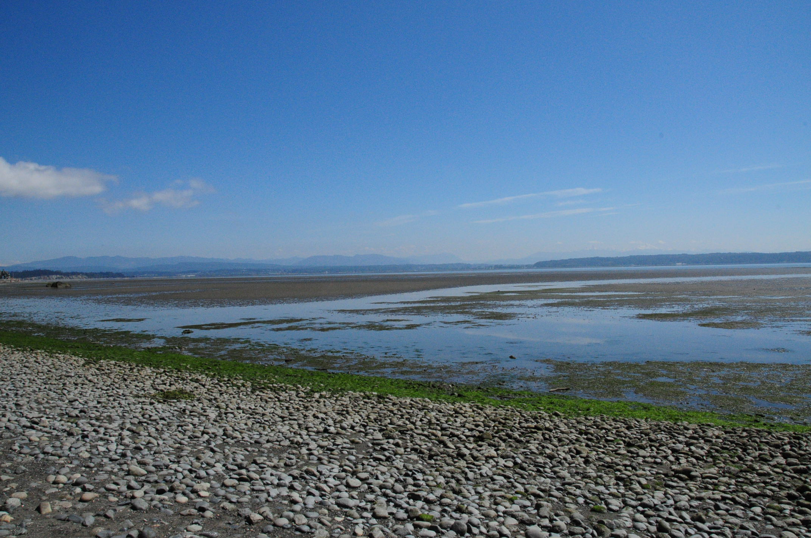
1. Fit with ALEA Program Goals
Significance of Stillaguamish estuary
Ecological processes
On-site habitats
Shoreline and bluffs
Tidelands
Marine riparian forest

Slide 6
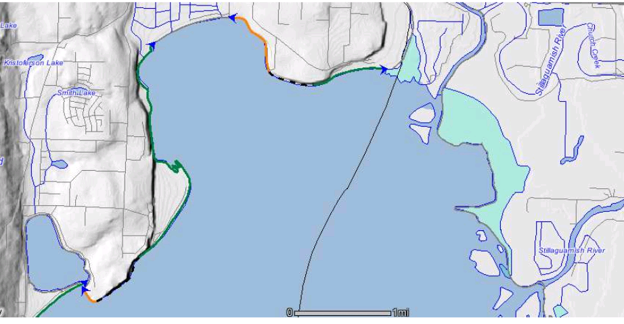
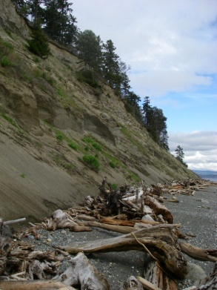
1. Fit with ALEA Program Goals
Primary sediment source in 3-mile drift cell
Livingston Bay
Livingston Bay pocket estuary
Iverson pocket estuary
Triangle Cove pocket estuary
Drift cell: left to right
Drift cell: right to left
Divergence zone (sediment source)
Barnum Point
Map source: WA DOE

Slide 7
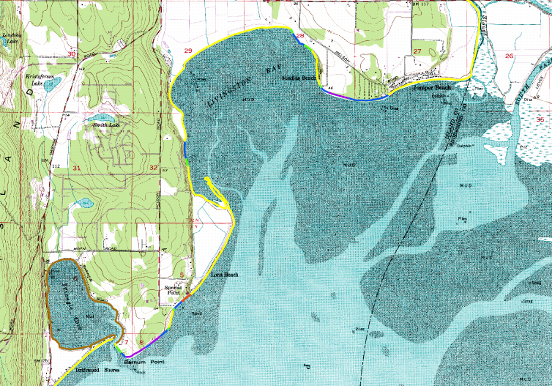
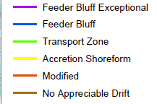
1. Fit with ALEA Program Goals
Barnum Point – Feeder Bluff Exceptional
From: Johannessen and Chase 2005

Slide 8
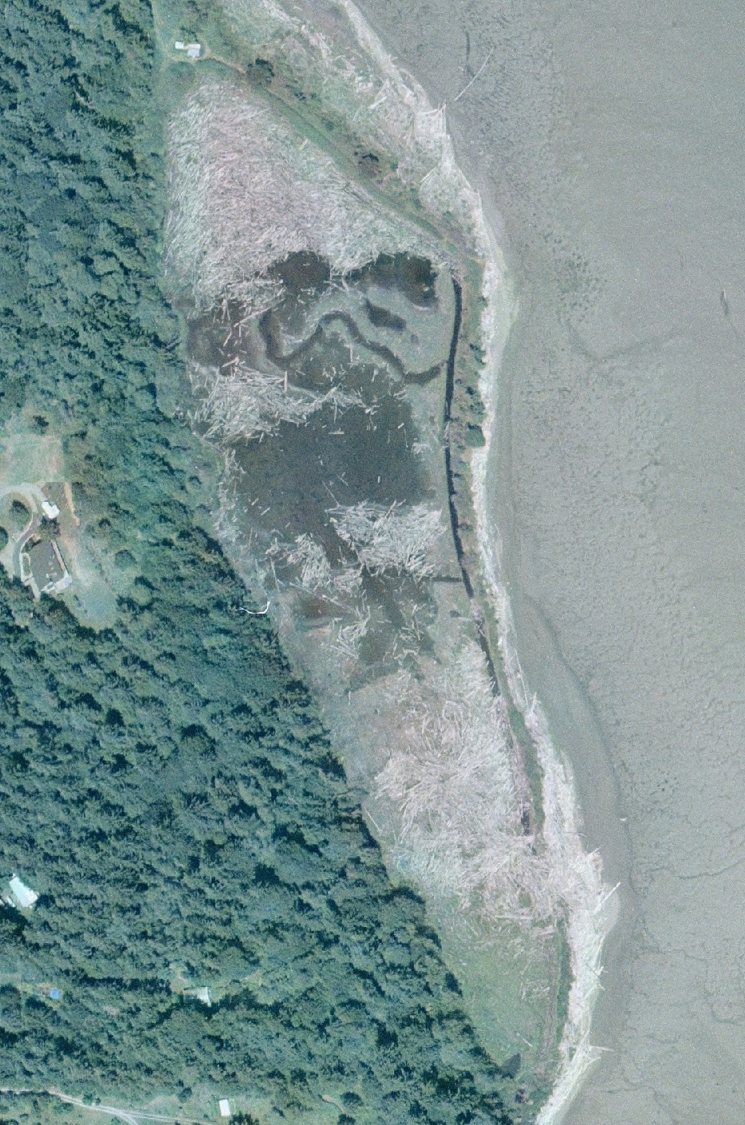
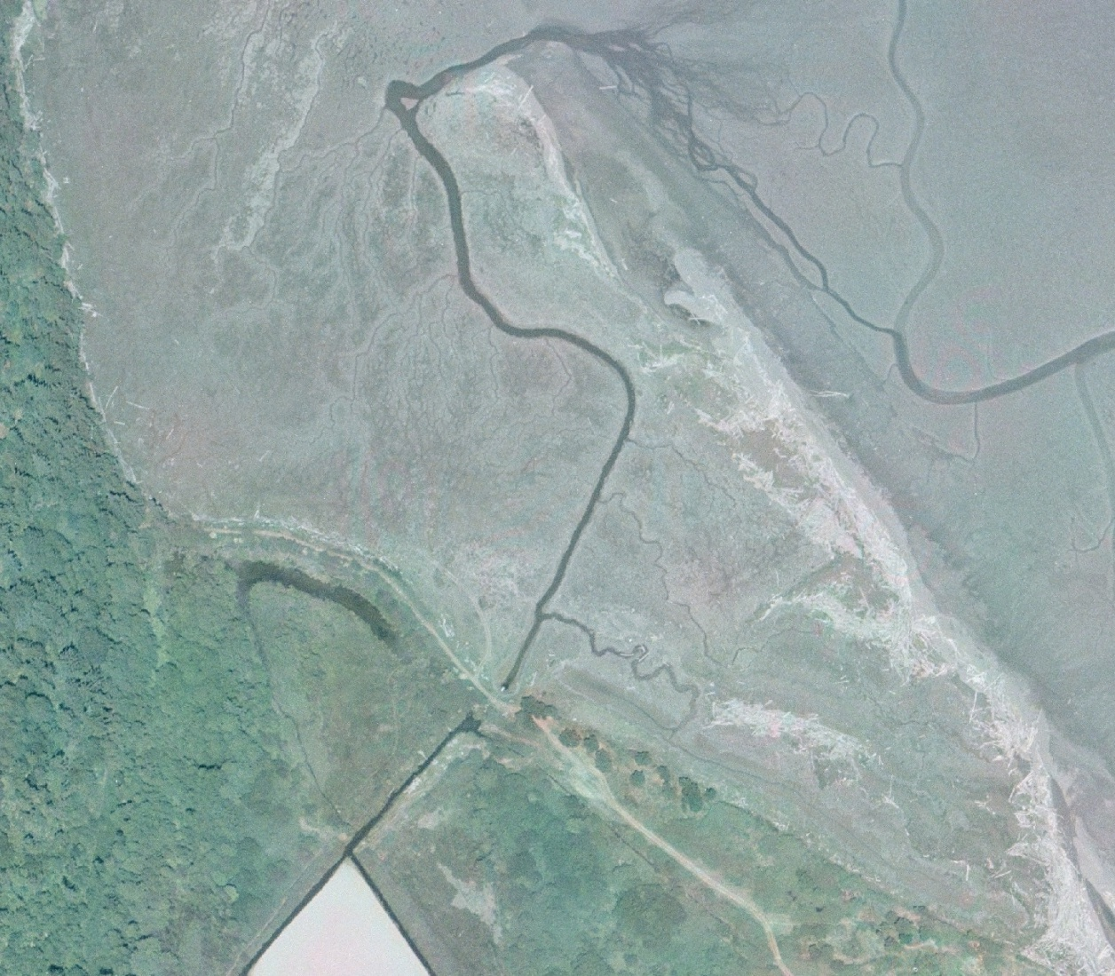
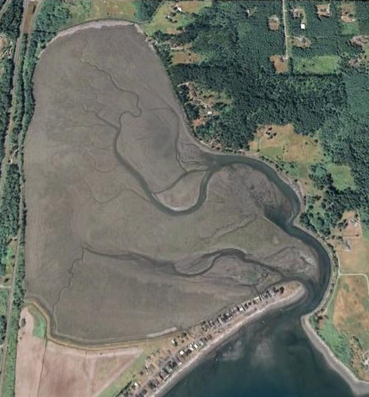
1. Fit with ALEA Program Goals
Livingston Bay pocket estuary
Iverson Spit
Triangle Cove
Notes:
Examples of pocket estuaries and accretion shoreforms maintained by sediment from Barnum Point.

Slide 9
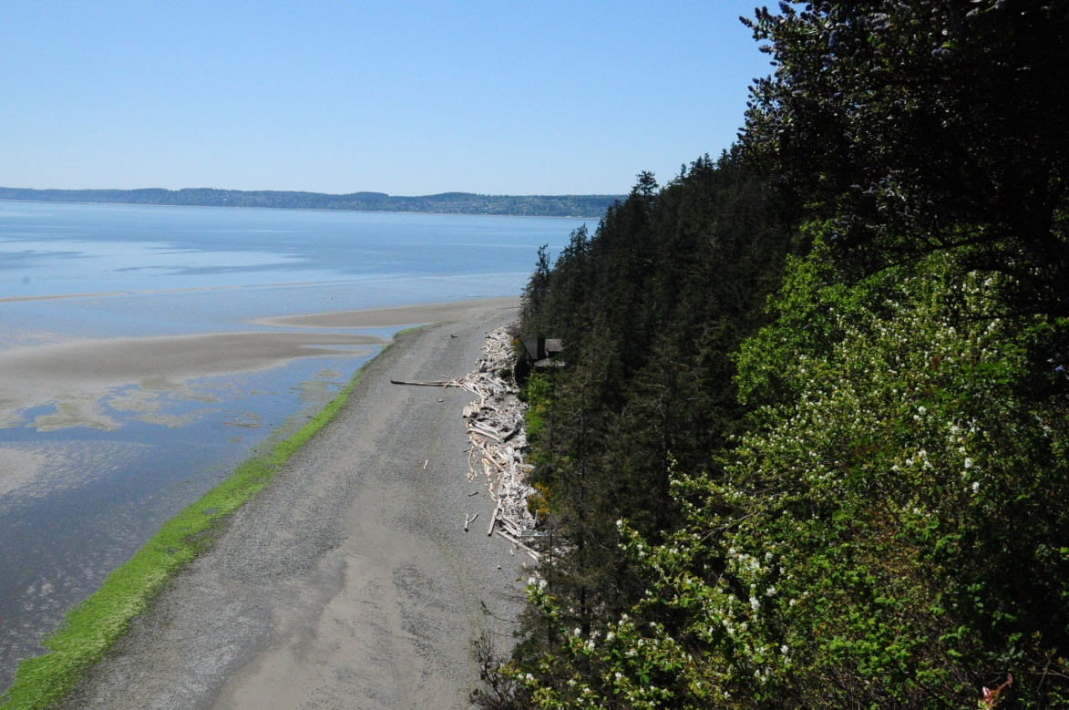
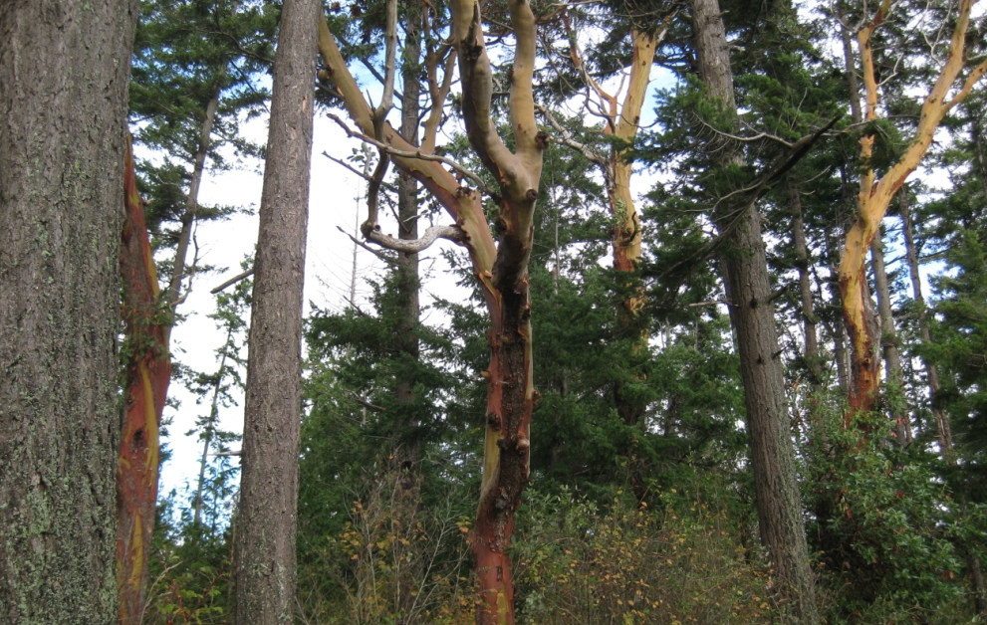
1. Fit with ALEA Program Goals – On-site Habitats
Feeder bluffs
Tidelands
Steep forested bluffs
Marine riparian forest

Slide 10
2. Project Need – Approved Plans
Multi-species Salmon Recovery Plan for WRIA 6
Regional Nearshore & Marine Aspects of Salmon Recovery in Puget Sound
Island County Critical Areas Plan
Greater Skagit Delta Biodiversity Assessment & Conservation Plan (Draft)
WDFW Priority Species and Habitat Management Plans
WA’s Comprehensive Wildlife Conservation Strategy
Washington Biodiversity Conservation Strategy
Washington Shoreline Management Act
North American Waterfowl Management Plan
Bull Trout Recovery Plan (Draft )
Recovery Plan for Southern Resident Killer Whales
USFWS Pacific Region Partners for Fish and Wildlife and Coastal Program Strategic Plan
Pacific Coast Joint Venture Strategic Plan
Northern Pacific Coast Regional Shorebird Conservation Plan
U.S. Shorebird Conservation Plan
North American Waterbird Conservation Plan
Conservation Strategy for Landbirds in Lowlands & Valleys of Western Oregon & Washington

Slide 11
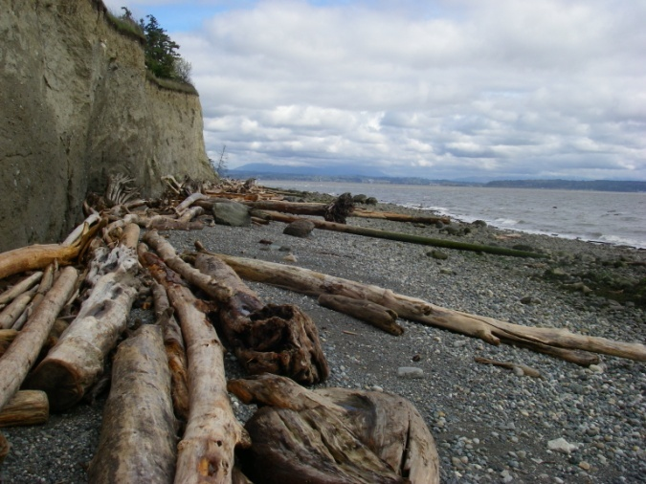
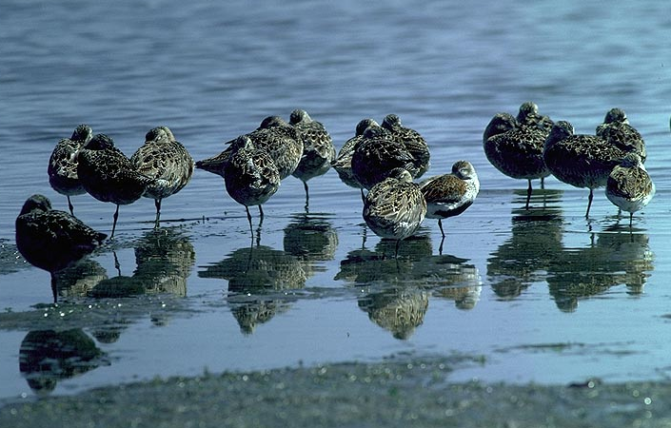
2. Project Need – Studies & Assessments
Biodiversity
The Nature Conservancy’s Willamette Valley-Puget Trough-Georgia Basin Ecoregional Assessment
Ecological Processes
Island County Feeder Bluff and Accretion Shoreform Mapping: Final Report
Forage Fish Spawning
Island County forage fish spawning and habitat suitability
Juvenile Salmon
Stillaguamish estuary use by juvenile Chinook: Final Report
Habitat and fish use of pocket estuaries in the Whidbey Basin and North Skagit County Bays, 2004 and 2005
Birds
National Audubon Society Important Bird Area
Marine Riparian Forest
Marine Riparian: An assessment of riparian functions in marine ecosystems
© Keith Lazelle

Slide 12
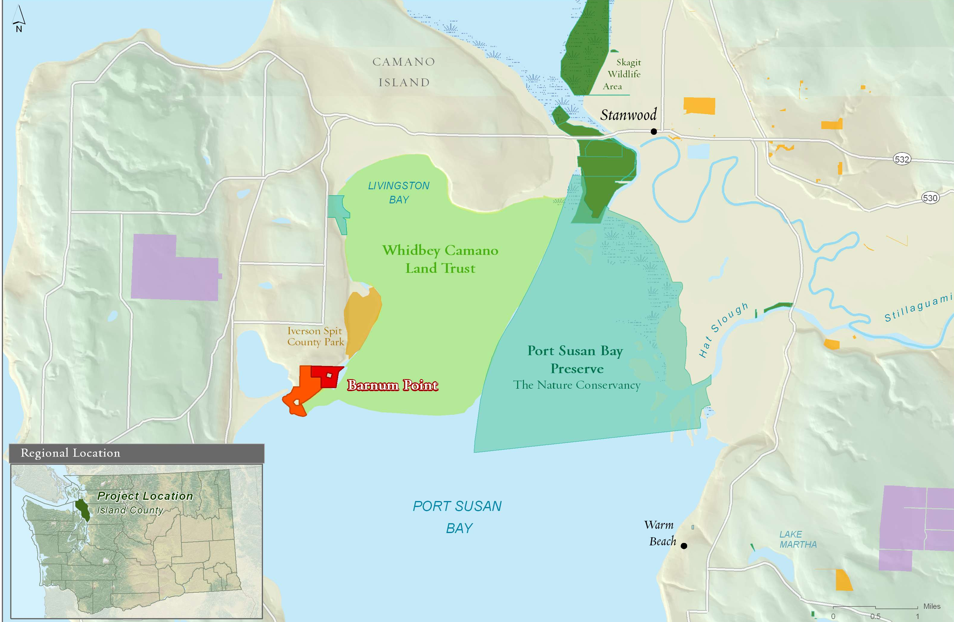
2. Project Need – Nearby Protection/Enhancement
Proposed Phase I Acquisition
Future Acquisition Phase(s)
The Nature Conservancy
Whidbey Camano Land Trust
WA Dept. of Natural Resources
WA Dept. of Fish and Wildlife
County Land
Notes:
Project Need: Nearby protection and enhancement efforts.

Slide 13
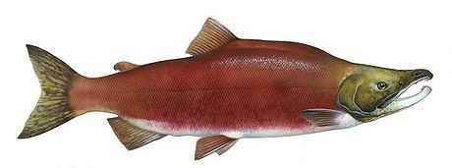
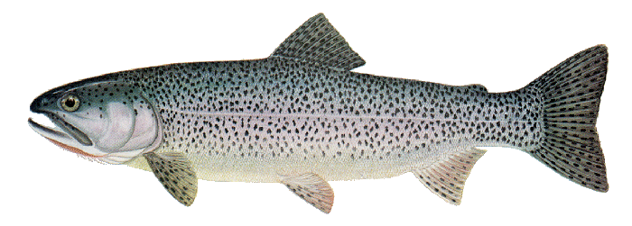
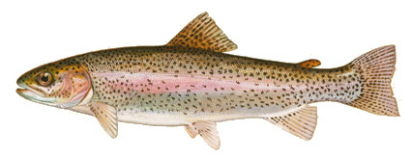
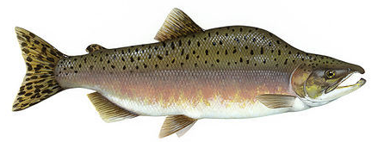
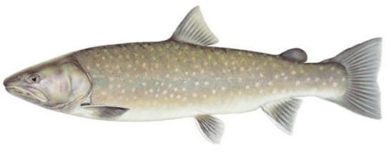
2. Project Need – Species Benefits
Benefits all 8 salmonids that spawn in the Skagit and Stillaguamish Rivers
sockeye
Chinook
chum
steelhead
coho
coastal cutthroat trout
bull trout
pink

Slide 14
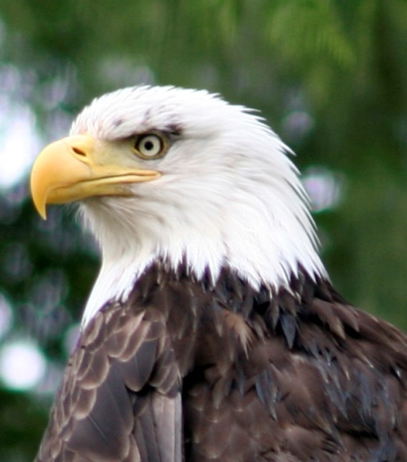
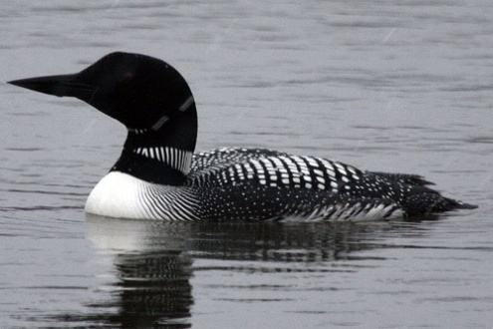
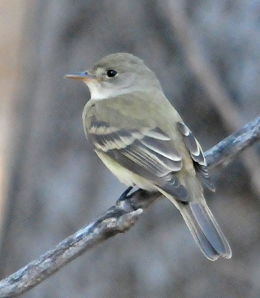
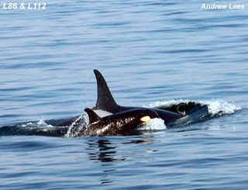
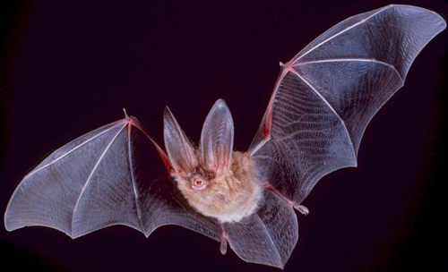
2. Project Need – Species Benefits
Federal and State listed species
common loon
peregrine falcon
bald eagle
pileated woodpecker
western grebe
Southern Resident killer whale
Townsend’s big-eared bat
willow flycatcher
marbled murrelet
Not pictured: Pacific herring, merlin, Yuma myotis, Vaux’s swift

Slide 15
2. Project Need – Action Agenda
Priority A: Protect intact ecosystem processes, structures and functions
Near-term Action A.2.1. Protect high-value habitat and land at immediate risk of conversion as identified through existing processes such as the salmon recovery plans and others.
Whidbey Action Area

Slide 16
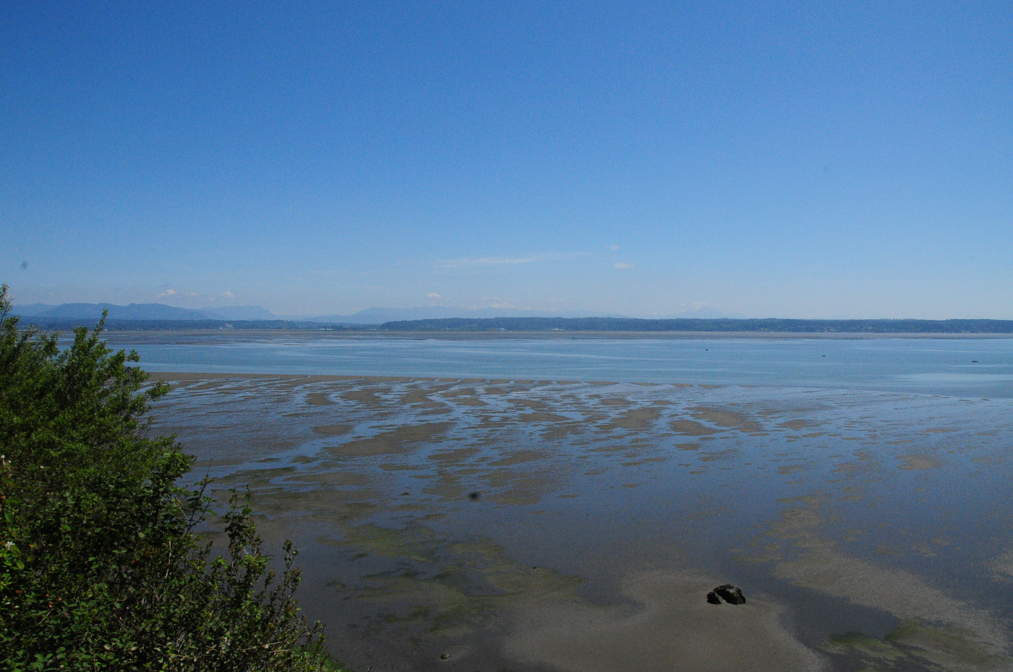
3. Site Suitability
Highly suitable for protection/enhancement
Intact shoreline
Adjacent to 7,100 acres of protected land
Ecological processes – feeder bluffs
Terrestrial—nearshore connection
On-site habitats
Tidelands
Marine riparian forest
Future phases: Suitable for public access

Slide 17
3. Site Suitability
Long-term vision:
Passive-use County park

Slide 18
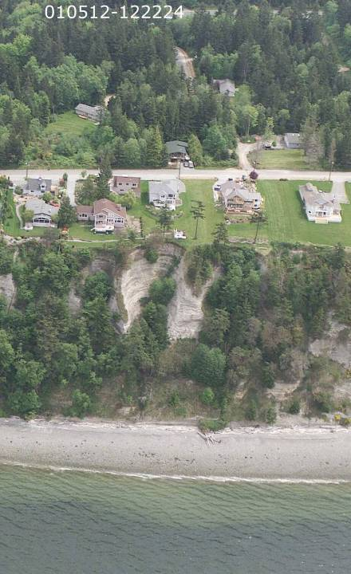
4. Urgency and Viability
Threats
Development
High value view property in rapidly growing county
Landowner willing to sell for development
Growth – Island County
Projected 23,000 new residents (+32%) between 2000-2020
Ecological Processes
Loss of feeder bluff function
Western shore of Camano Island
Photo: Washington Department of Ecology

Slide 19
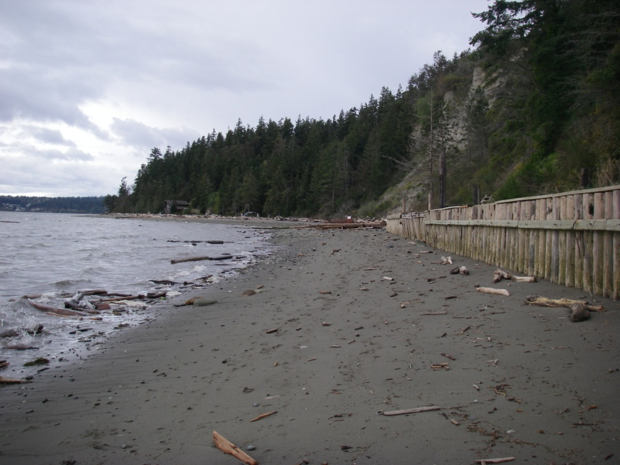
4. Urgency and Viability
Bulkhead north of Barnum Point
Driftwood Shores

Slide 20
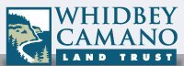
5. Community Involvement and Support
Project partners and supporters
Stillaguamish and Tulalip tribes
Friends of Camano Island Parks
WSU Extension – Island Co. Beach Watchers
CARE (Camano Action for a Rural Environment)

Slide 21
5. Community Involvement and Support
Presented to Island County Commissioners
Commissioners unanimously approved pursuing project
“[Barnum Point will] represent an exciting opportunity for Island County”
John Dean , Island County Commissioner
County examines potential of acquiring Barnum Point waterfront
February 9, 2010

Slide 22
Project Financing Plan
Funding Sources:
ALEA $1,000,000 (45% of total)
WWRP – Riparian* $1,000,000 (45% of total)
Private Funds $ 220,000 (10% of total)
TOTAL $2,220,000
*Additional grants will be pursued as back-up (Estuary and Salmon Restoration Program, USFWS National Coastal Wetlands, Coastal & Estuarine Land Conservation Program)
Use of Funds:
Land Acquisition $2,166,500
Incidentals $ 41,950
Administration $ 11,550
TOTAL $2,220,000

Slide 23
Questions

