Slide 1
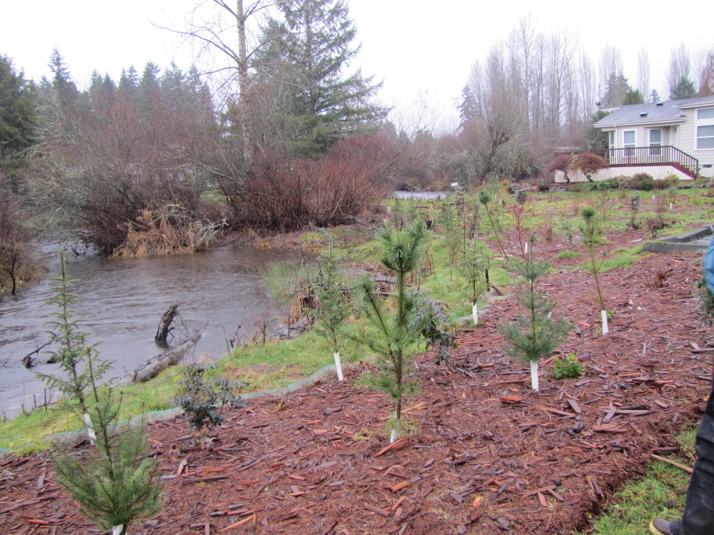
Bear Creek Reach 6
12-1282
Final Inspection
December 21, 2015
Josh Lambert &
Elizabeth Butler
Notes:
An extra year of riparian stewardship – knotweed is knocked back and conifers look good.

Slide 2
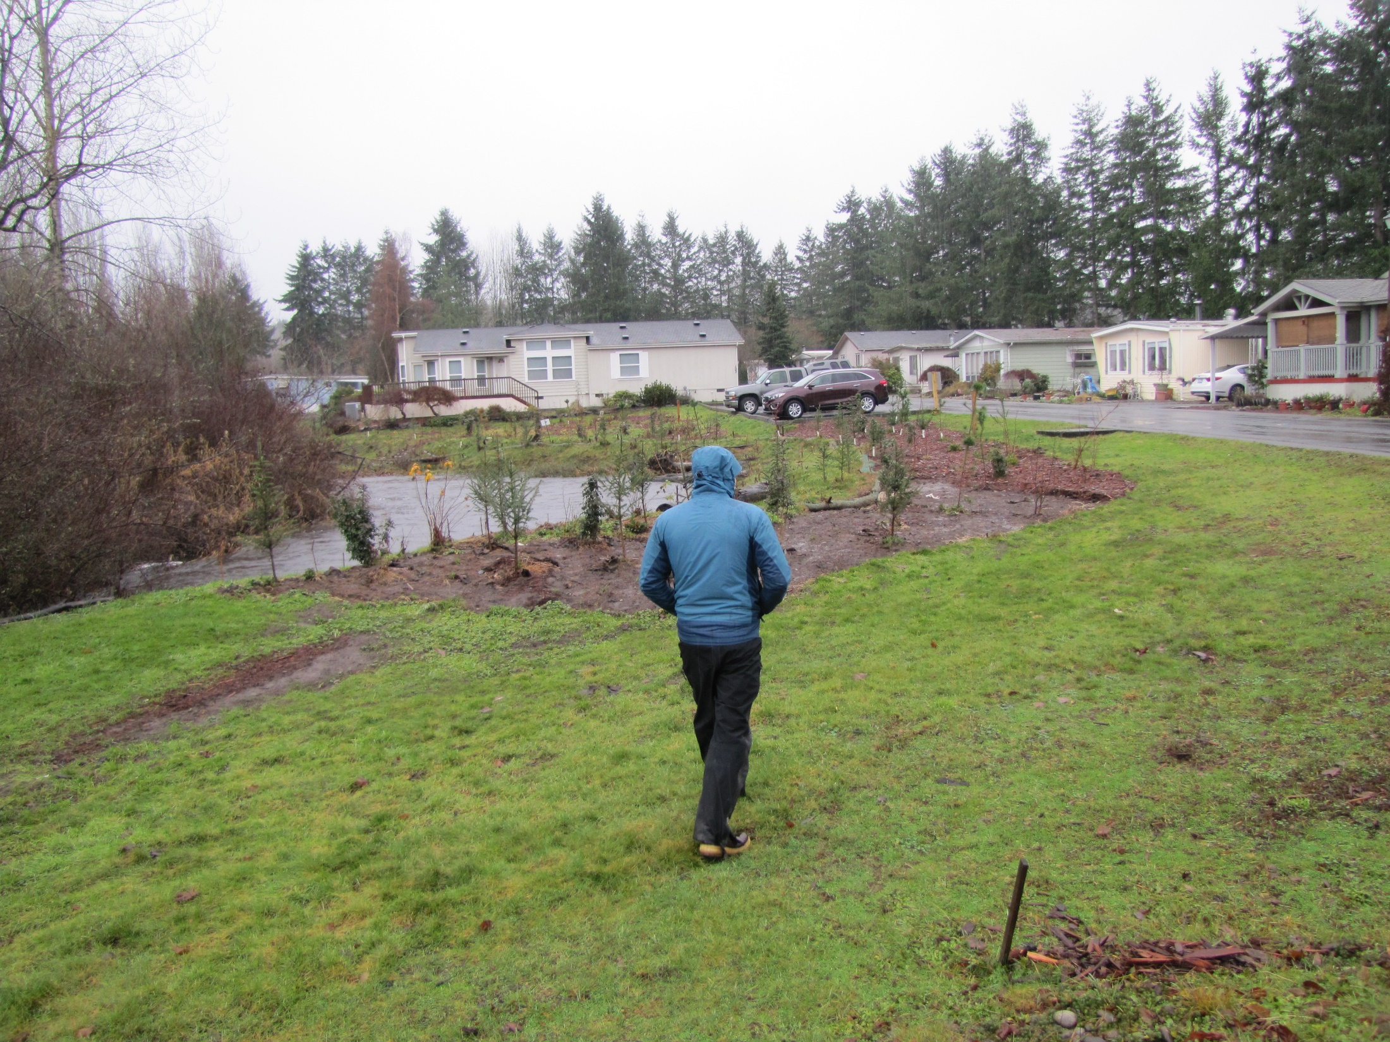
Notes:
Flood water washed away some of the mulch.

Slide 3
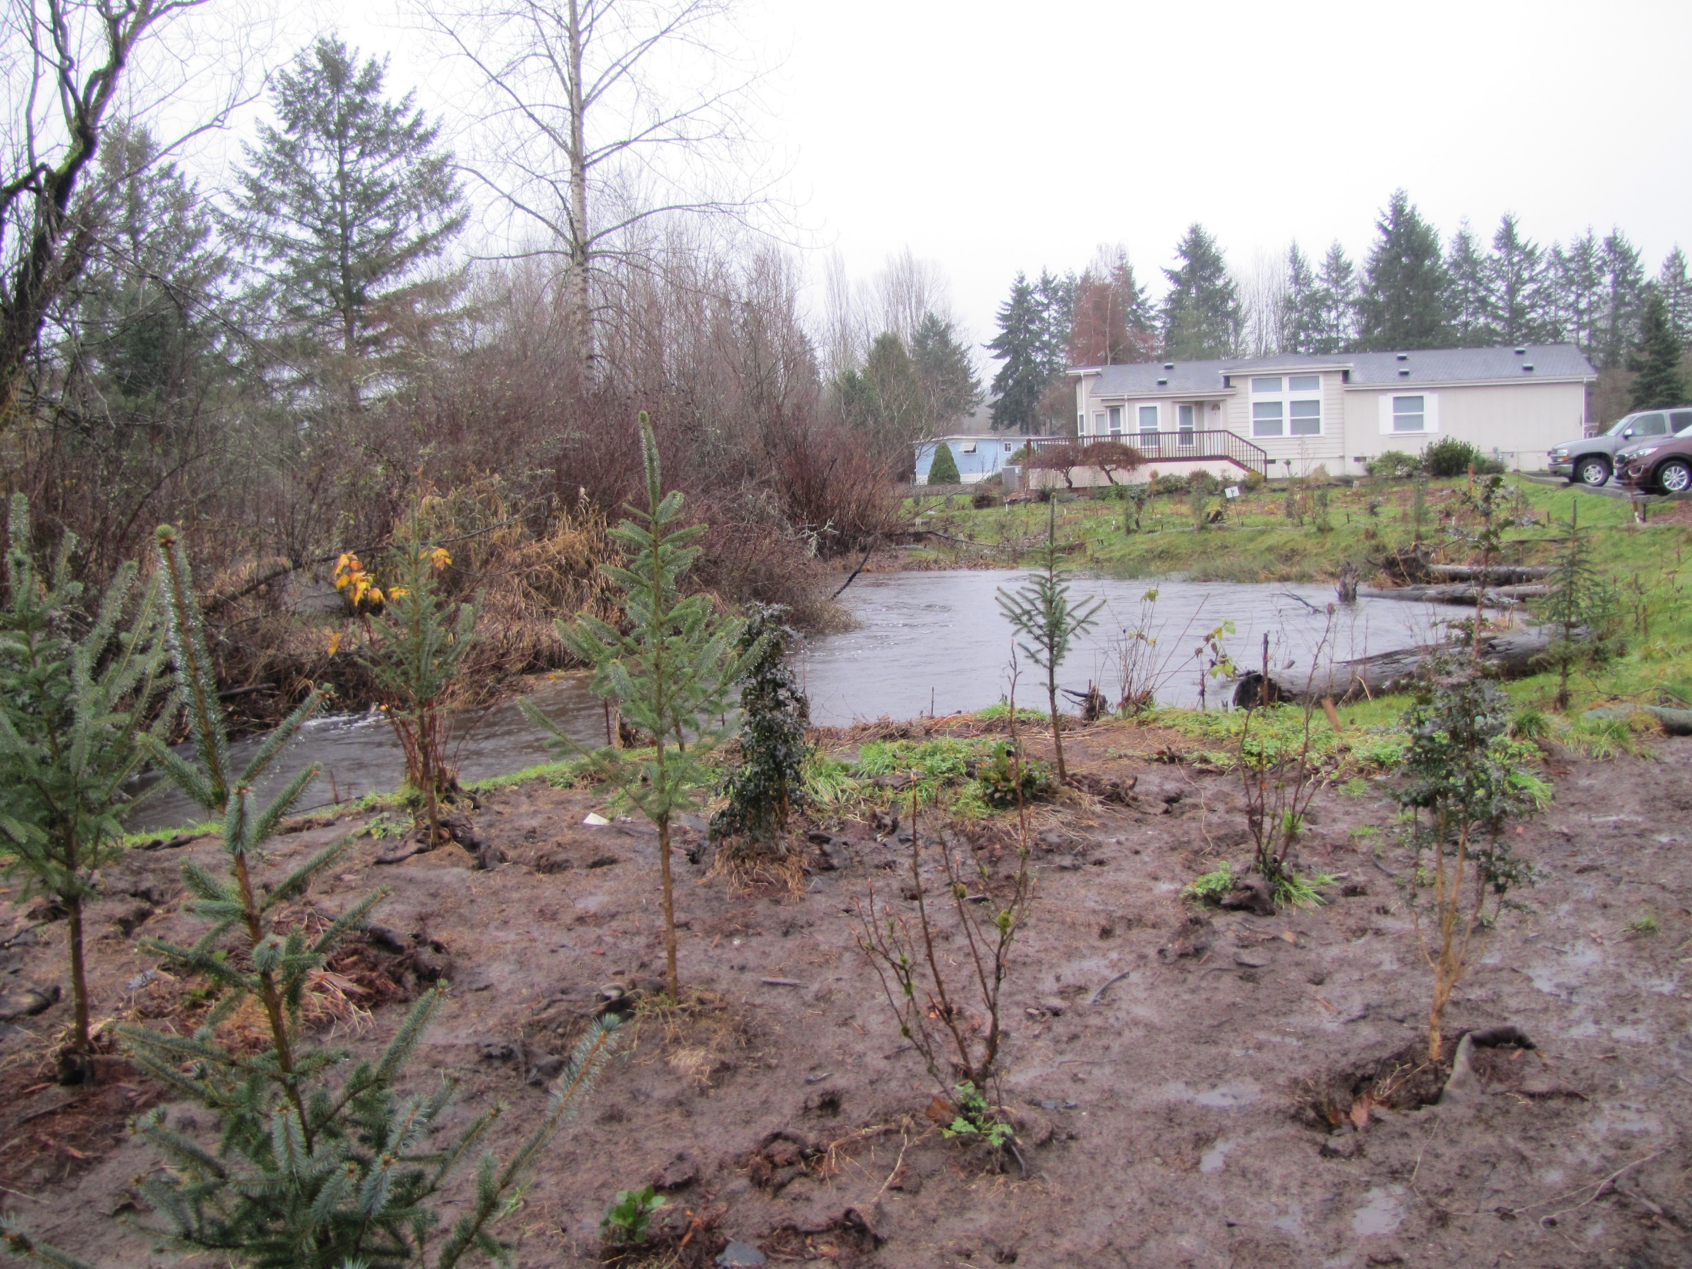

Slide 4
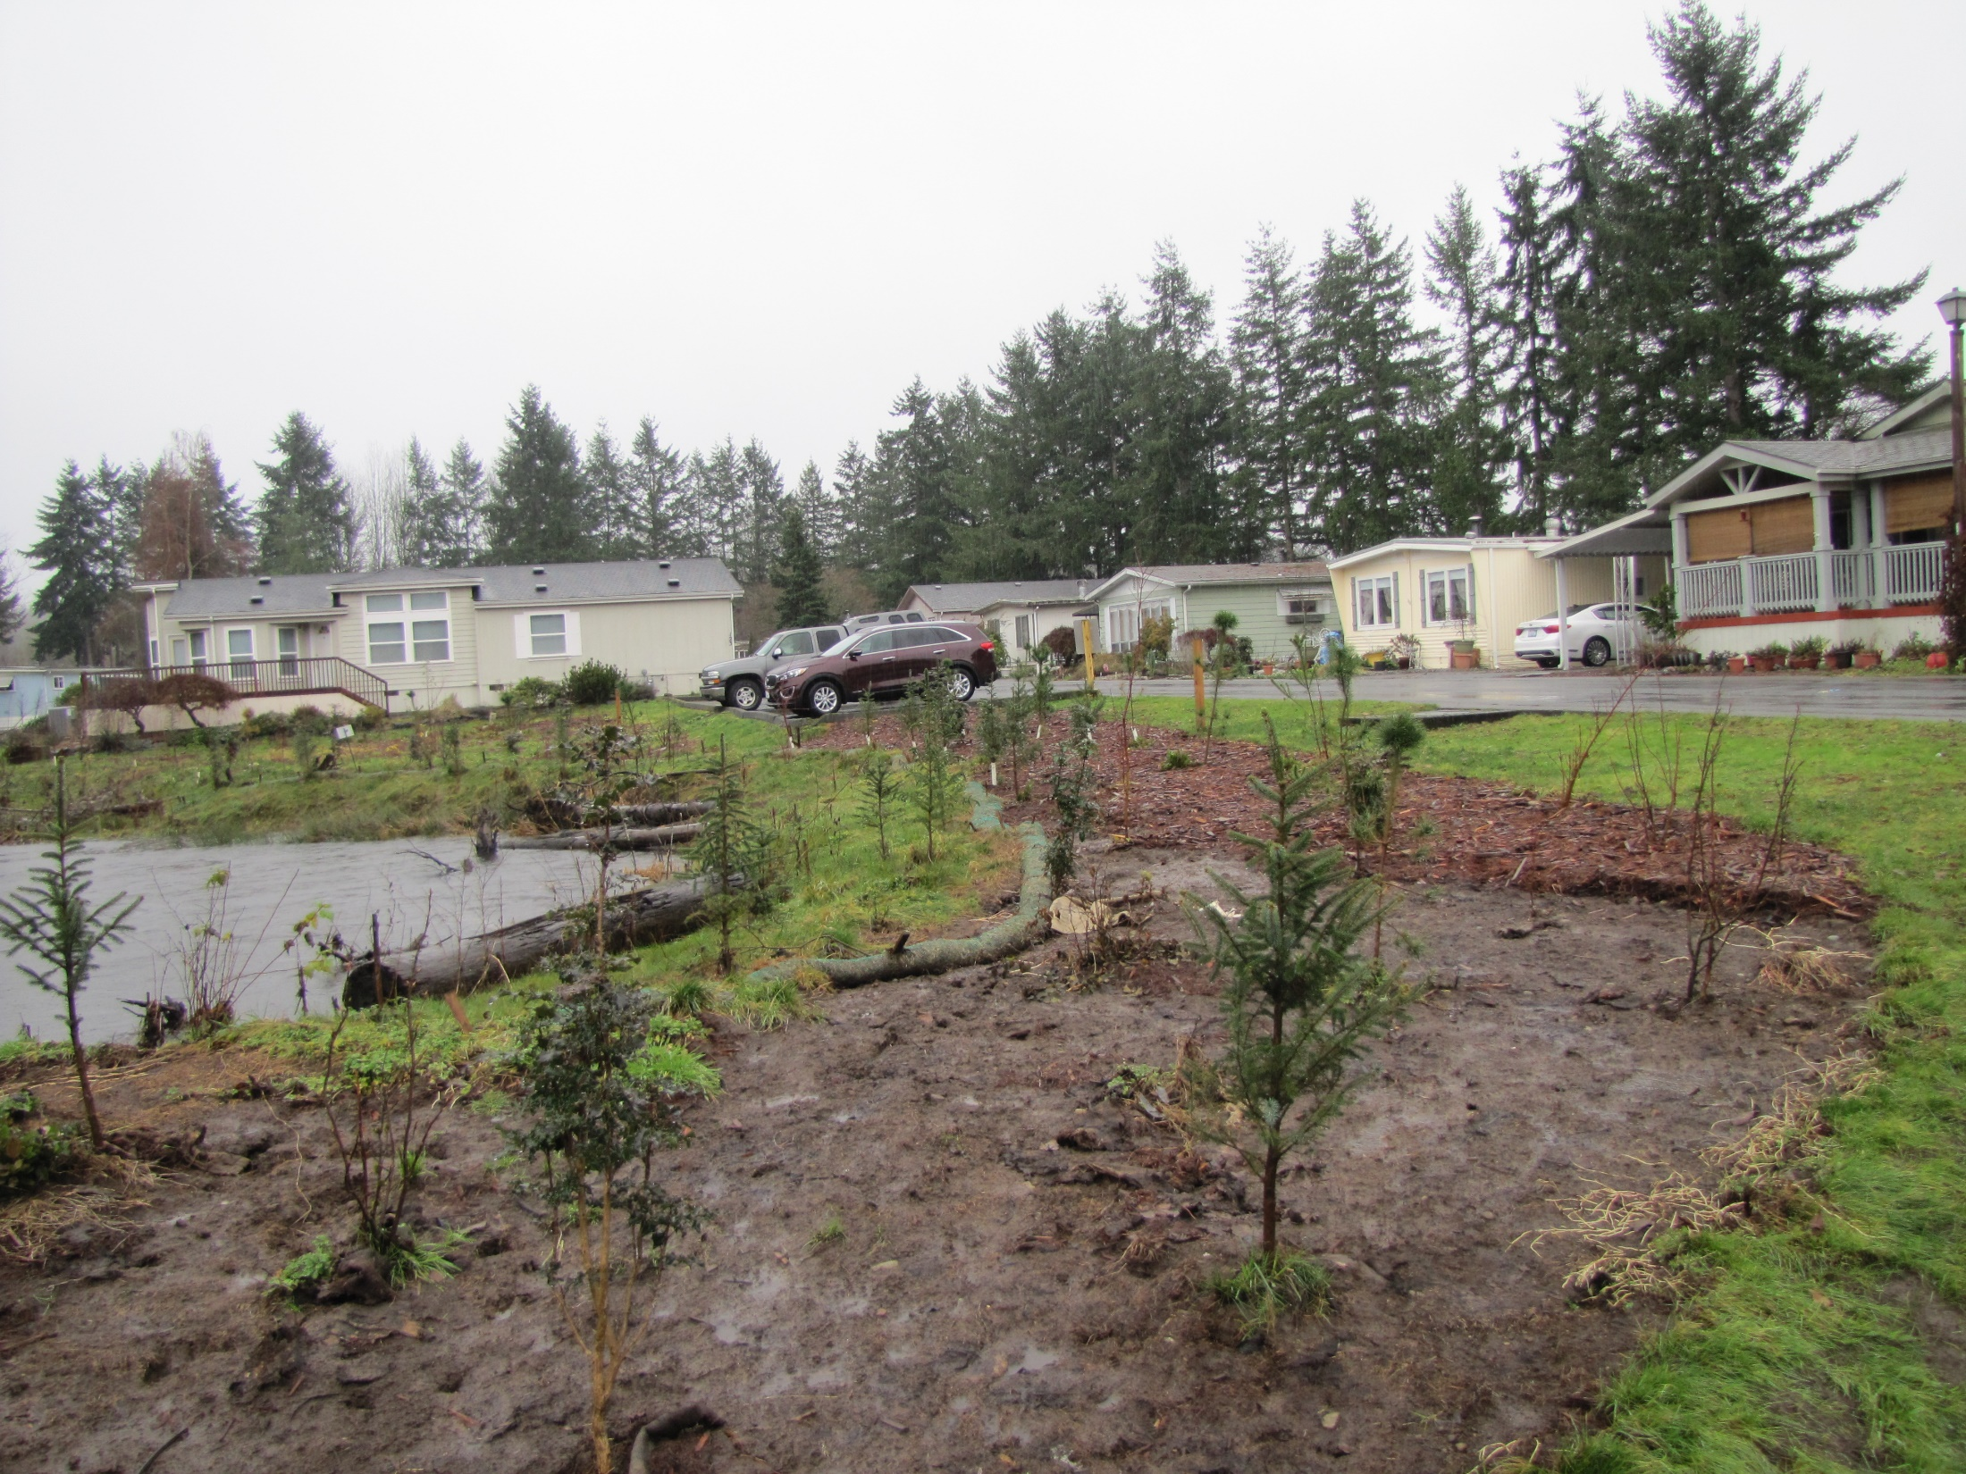

Slide 5
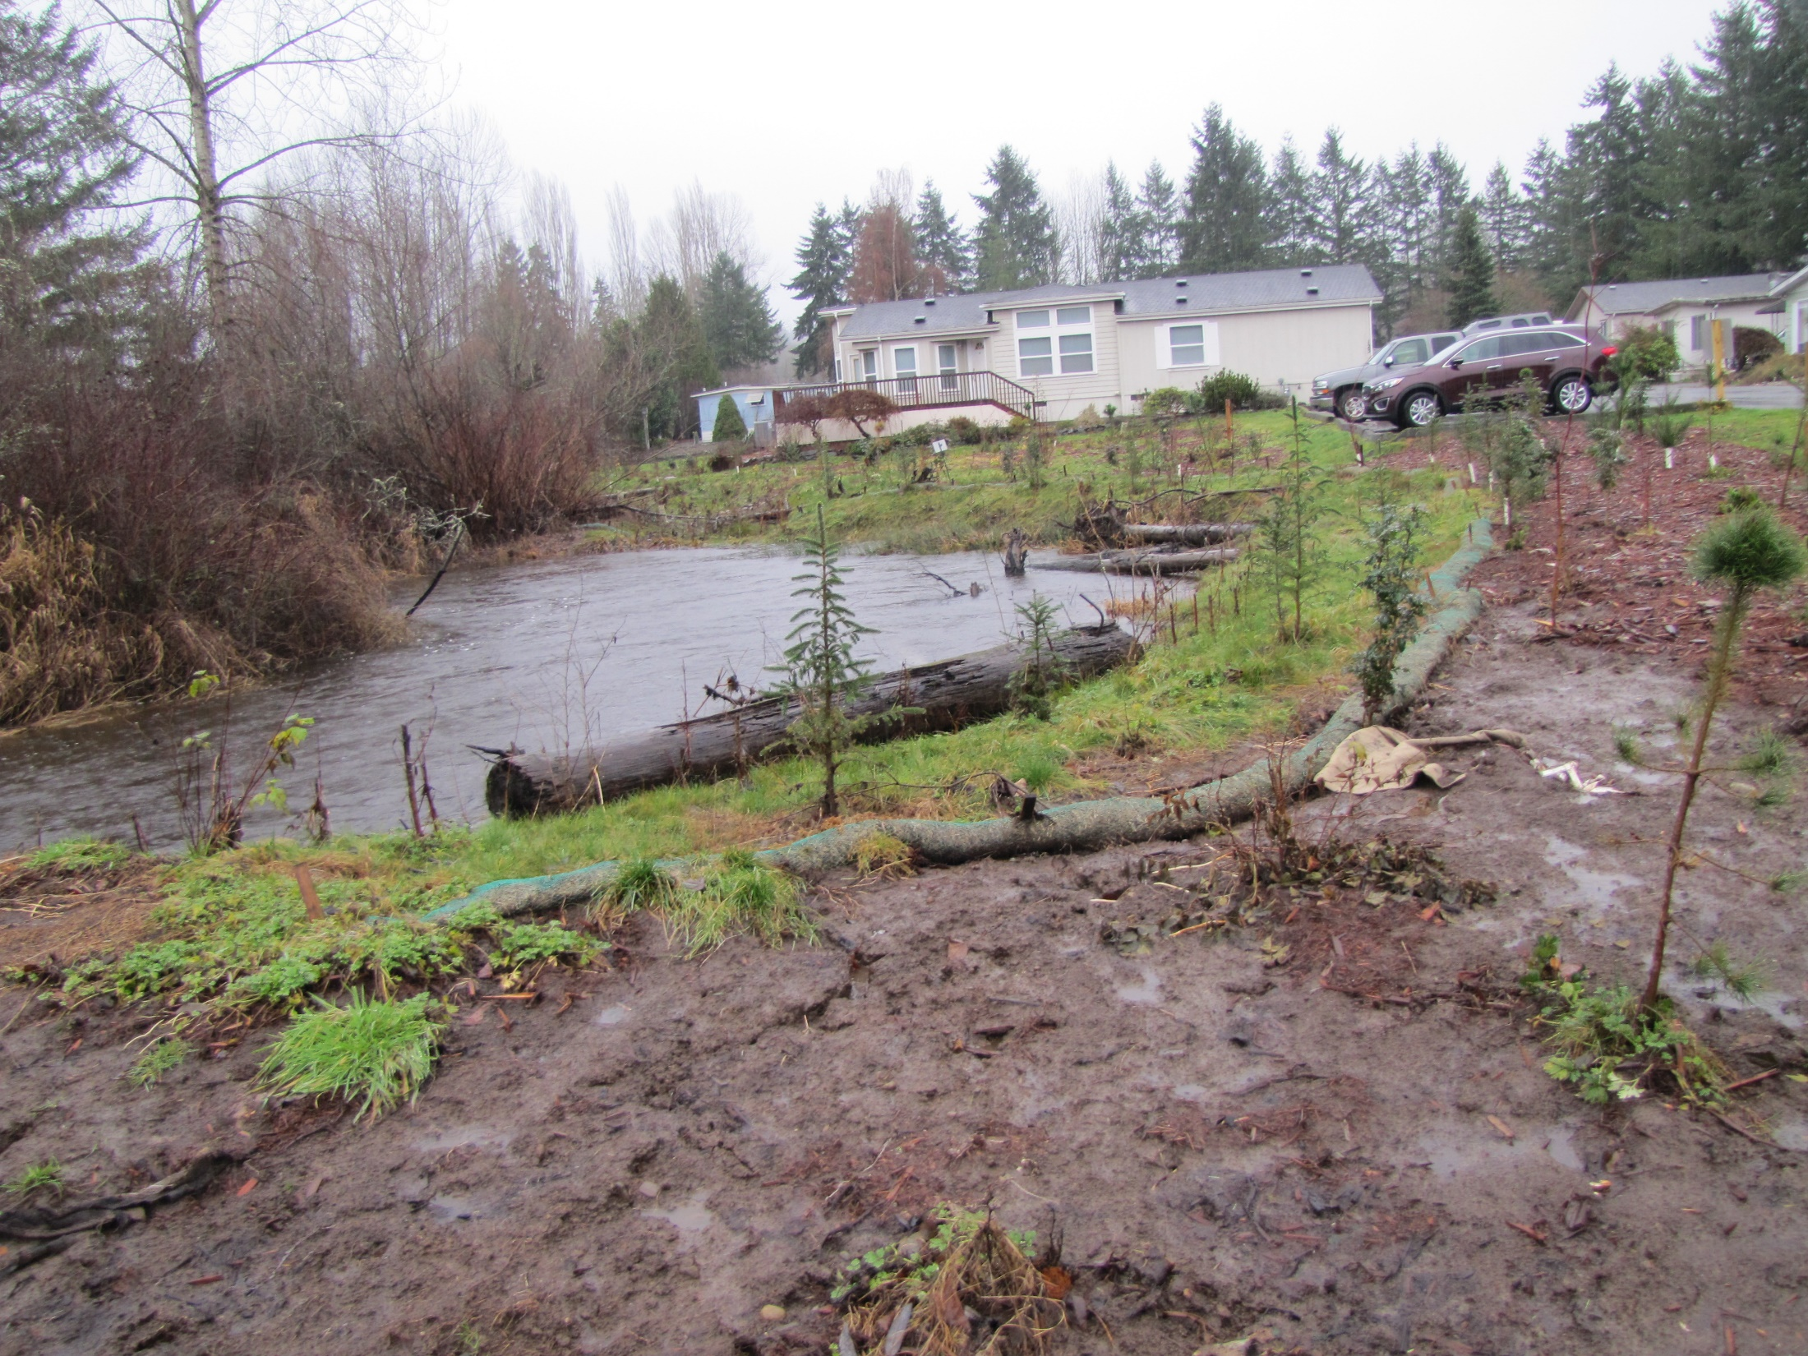

Slide 6
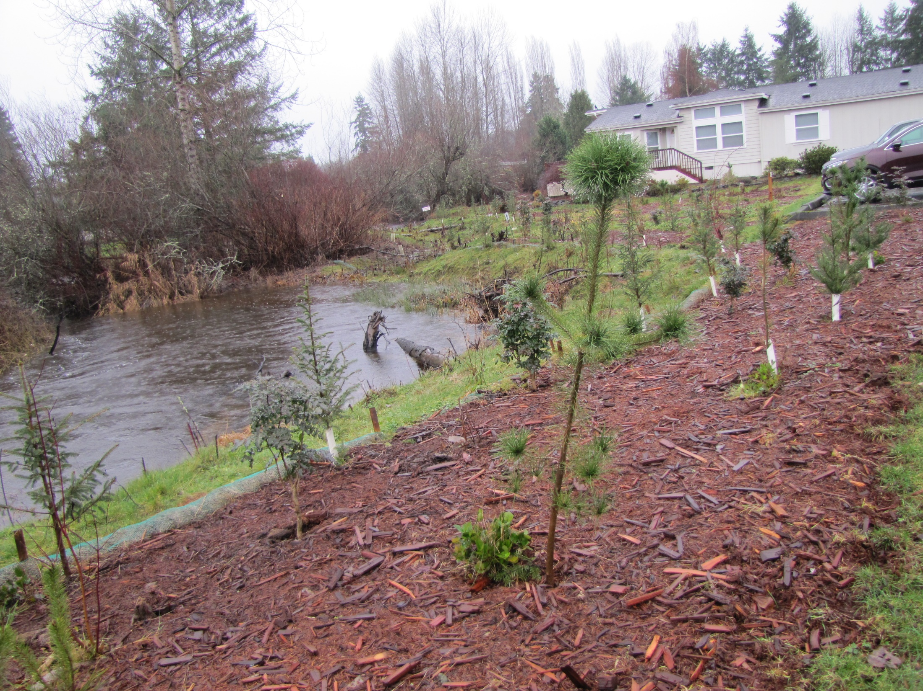
Notes:
Cedars didn’t survive as well --

Slide 7
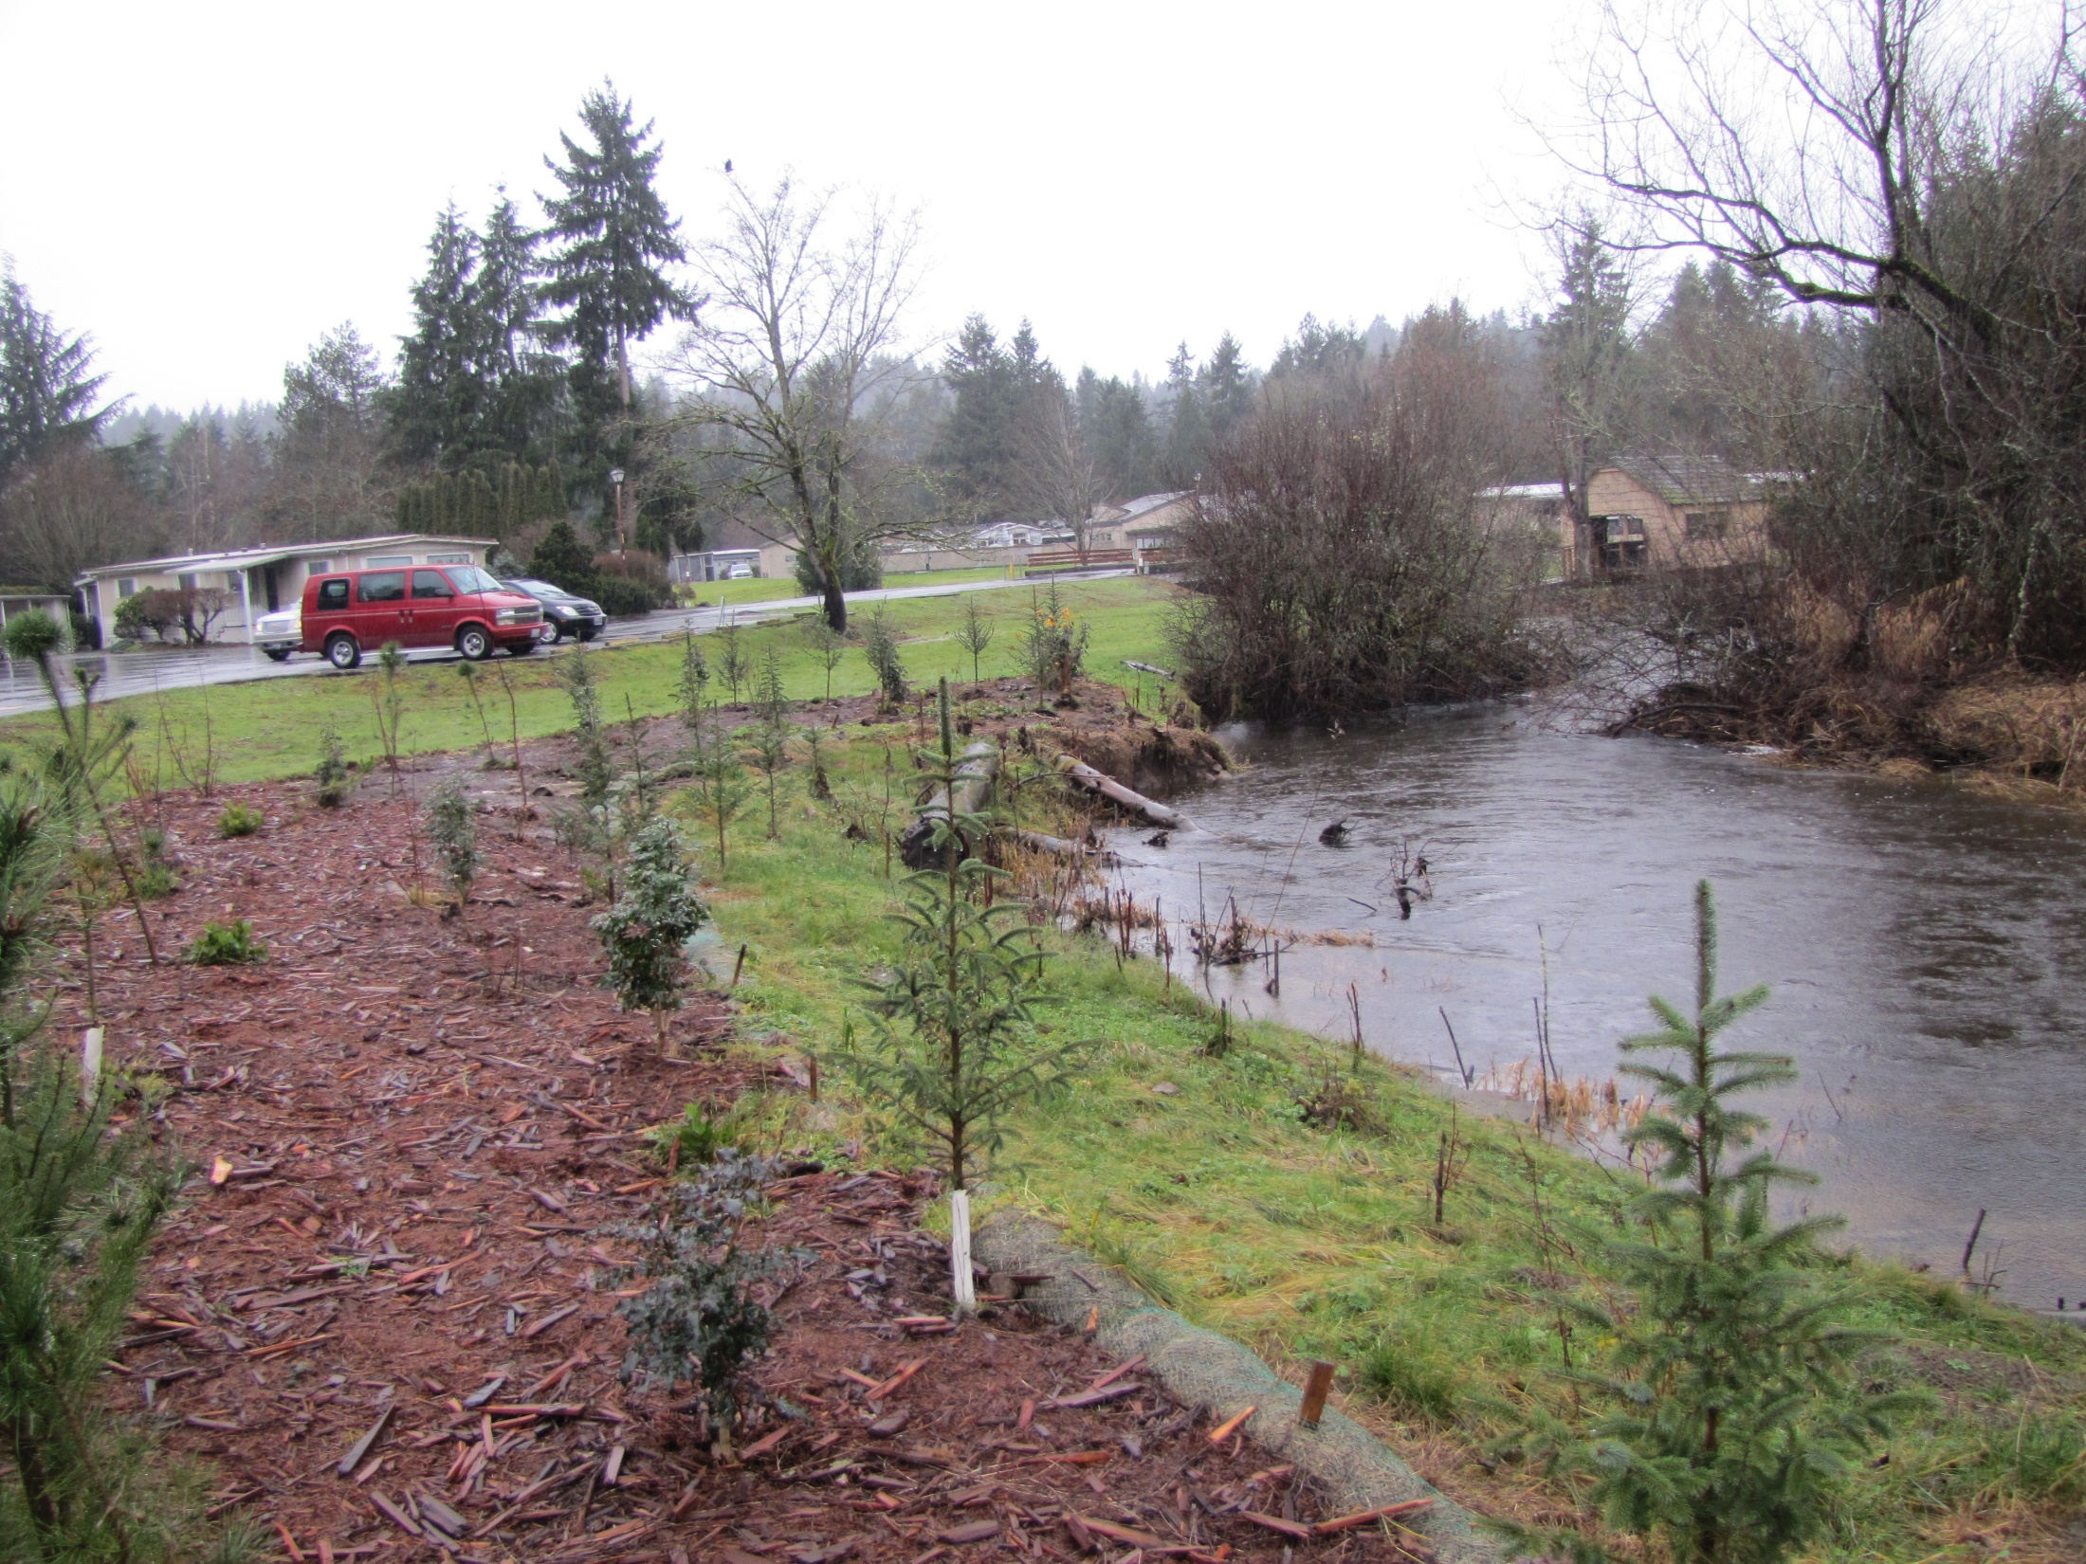
Notes:
Bank setback is performing well.

Slide 8
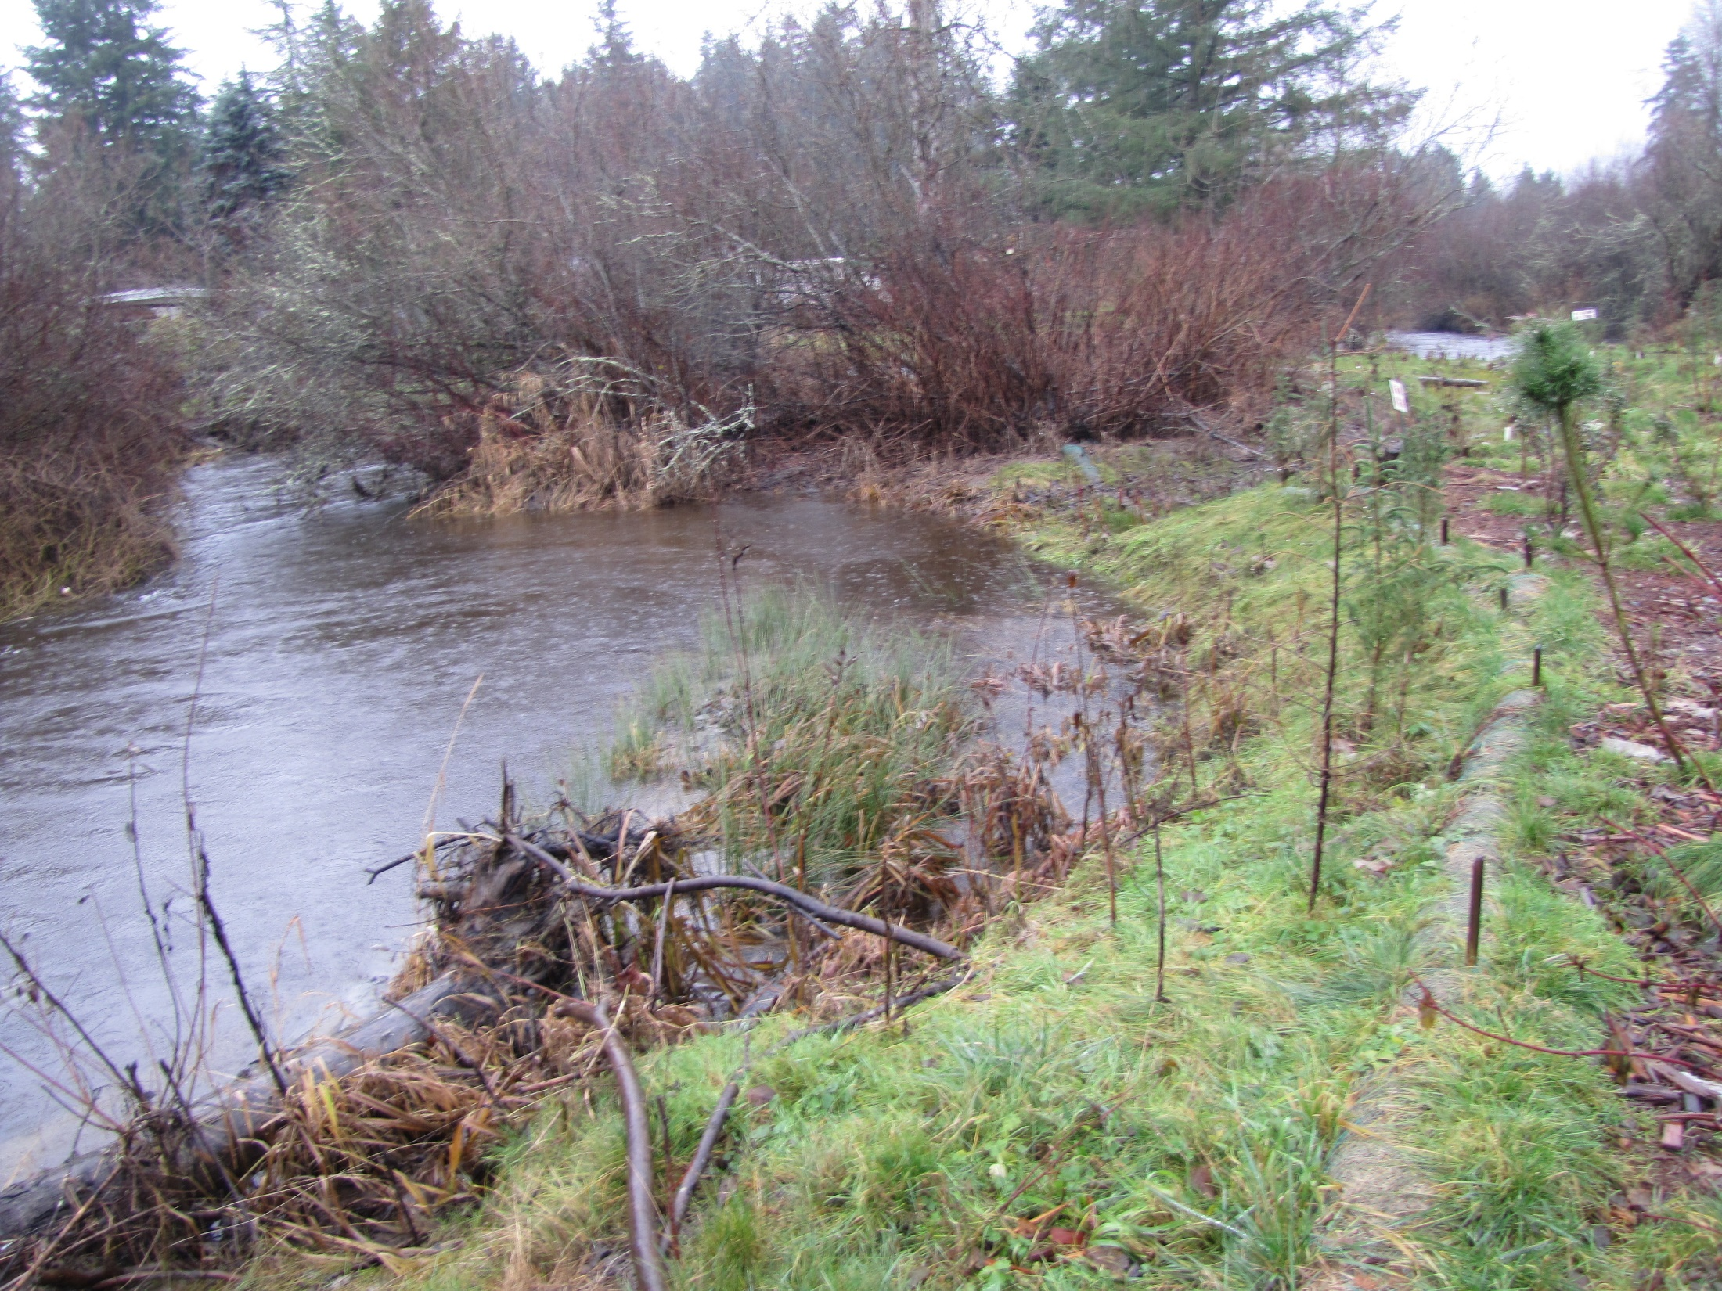

Slide 9
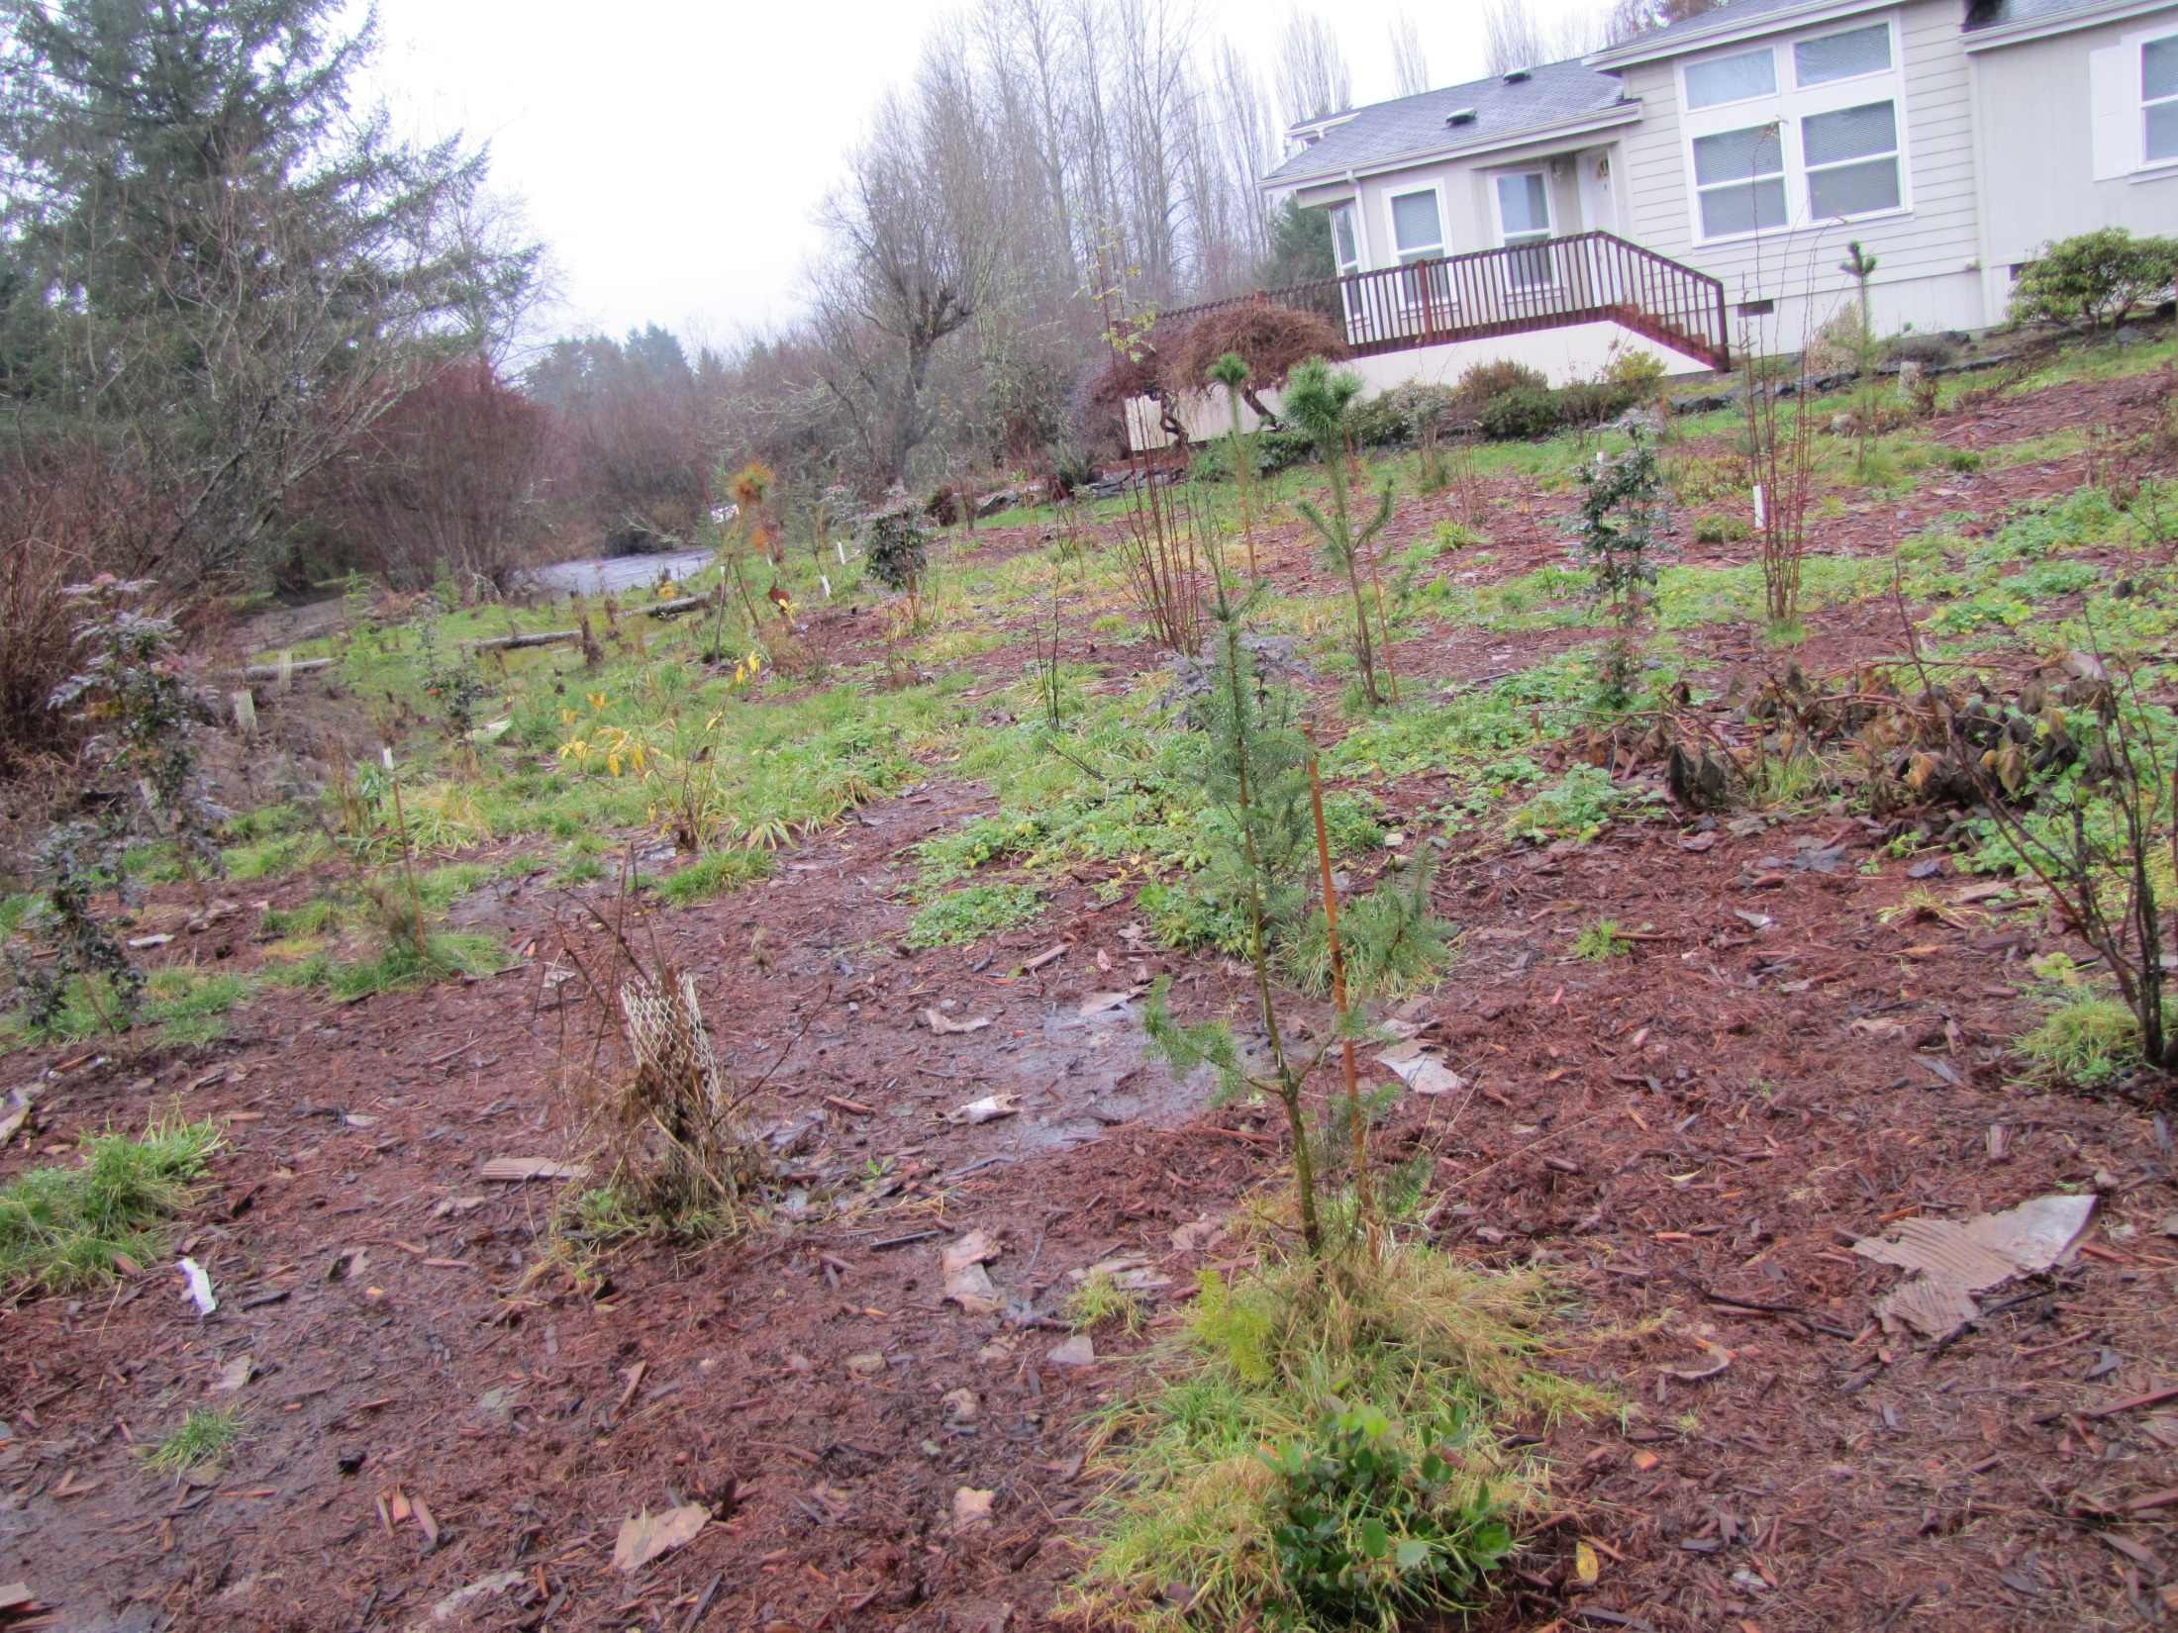

Slide 10
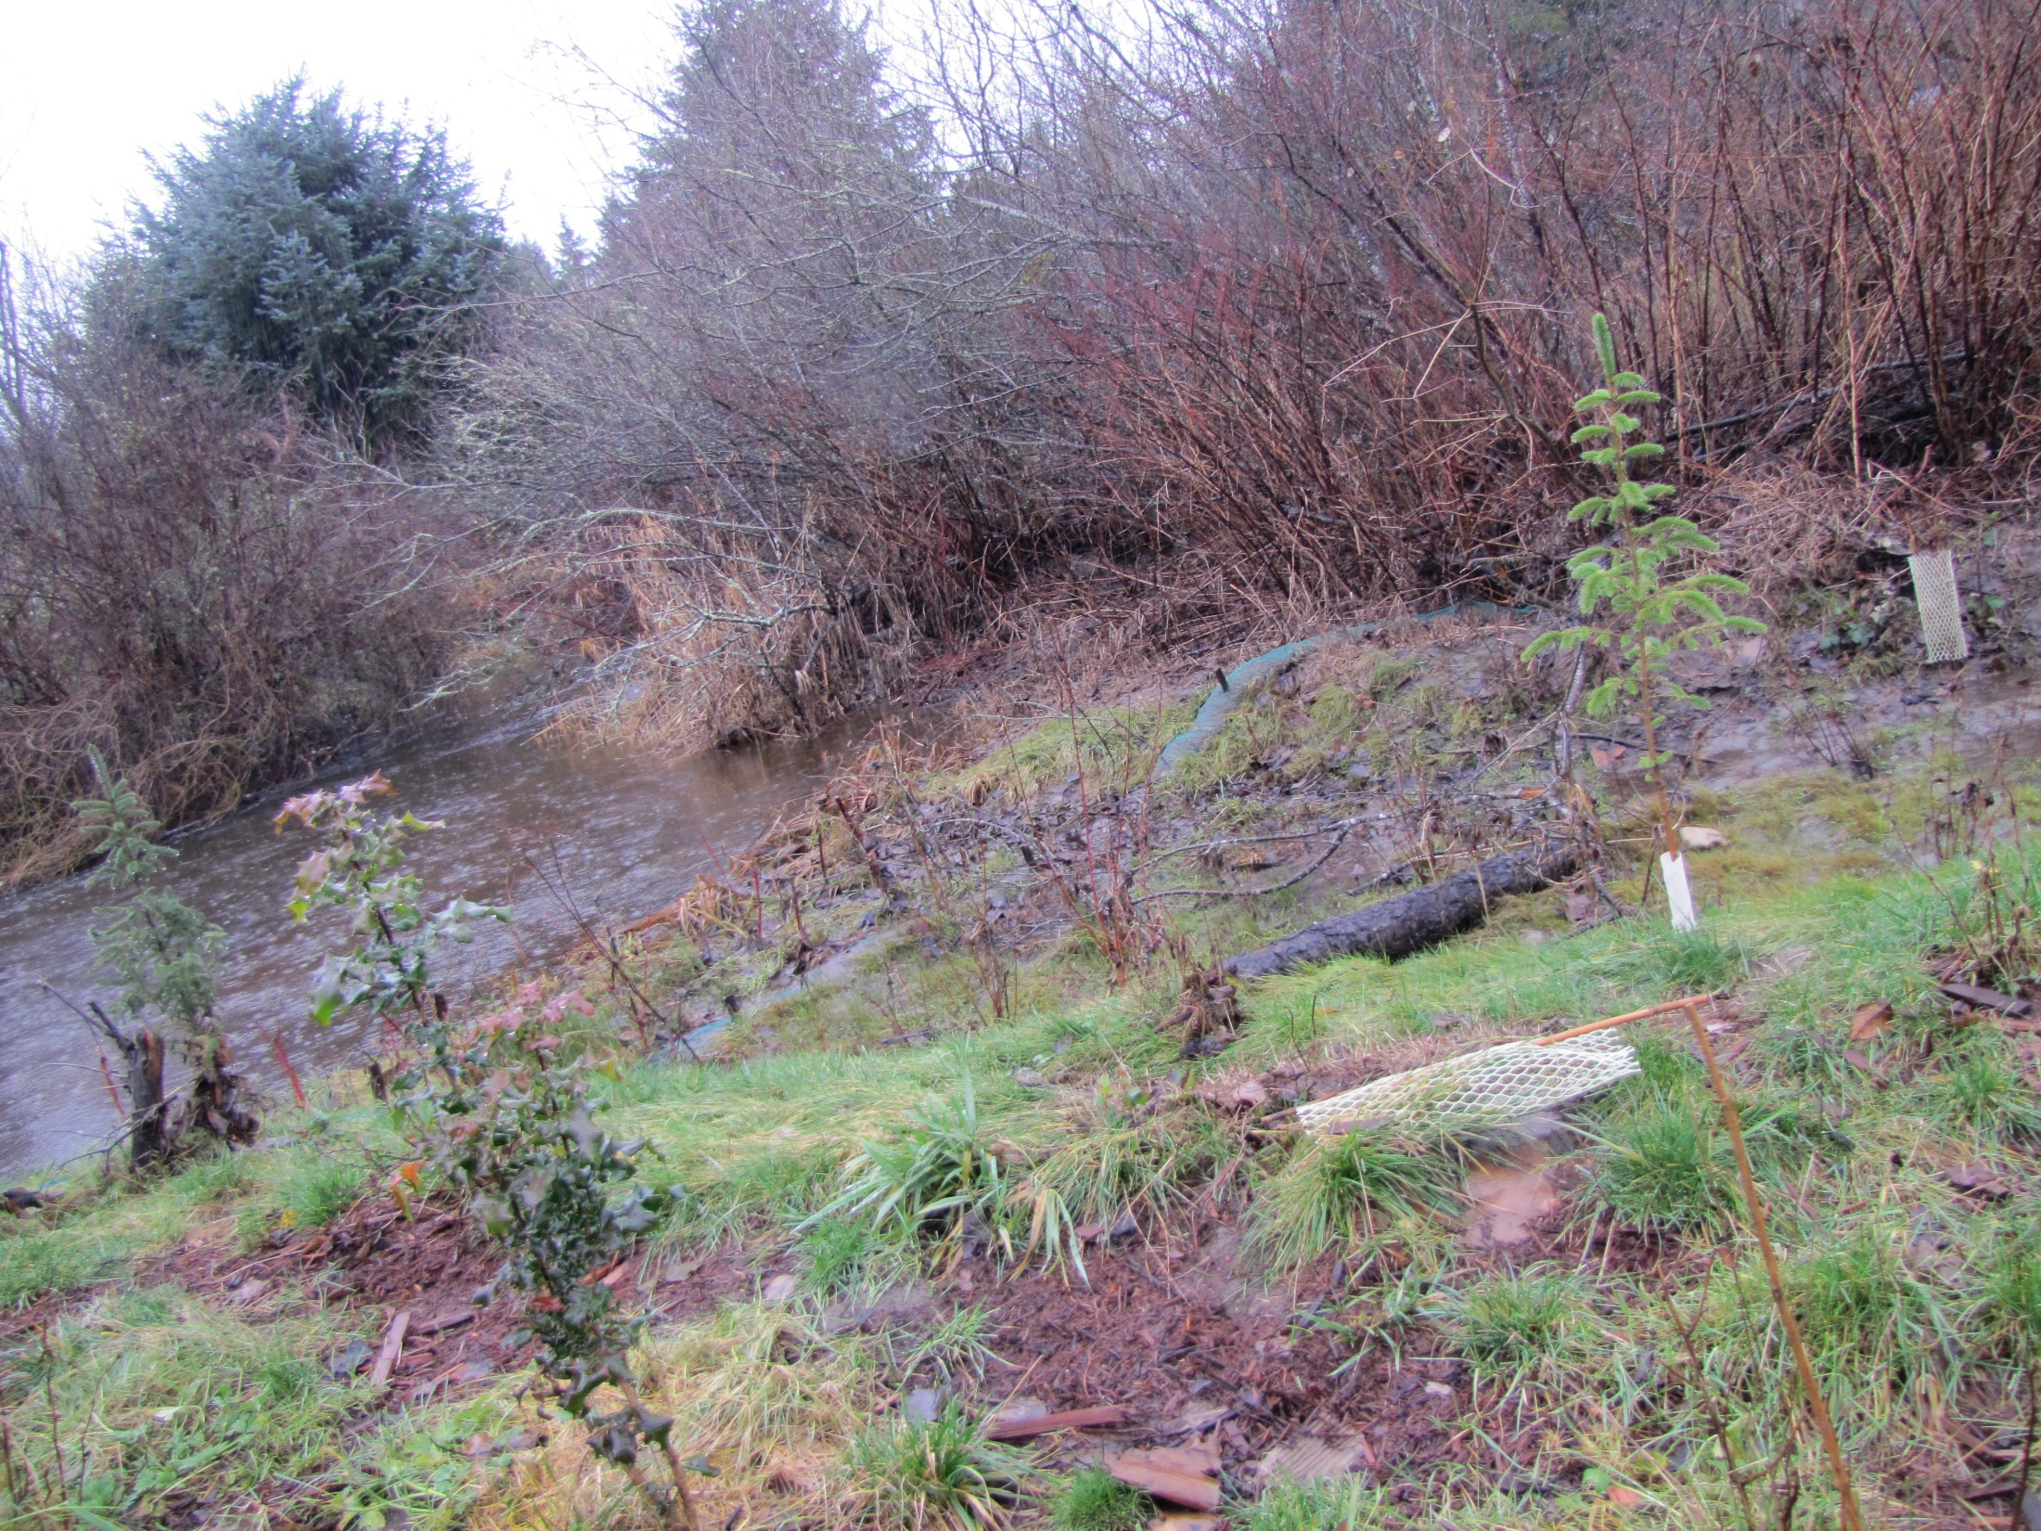

Slide 11
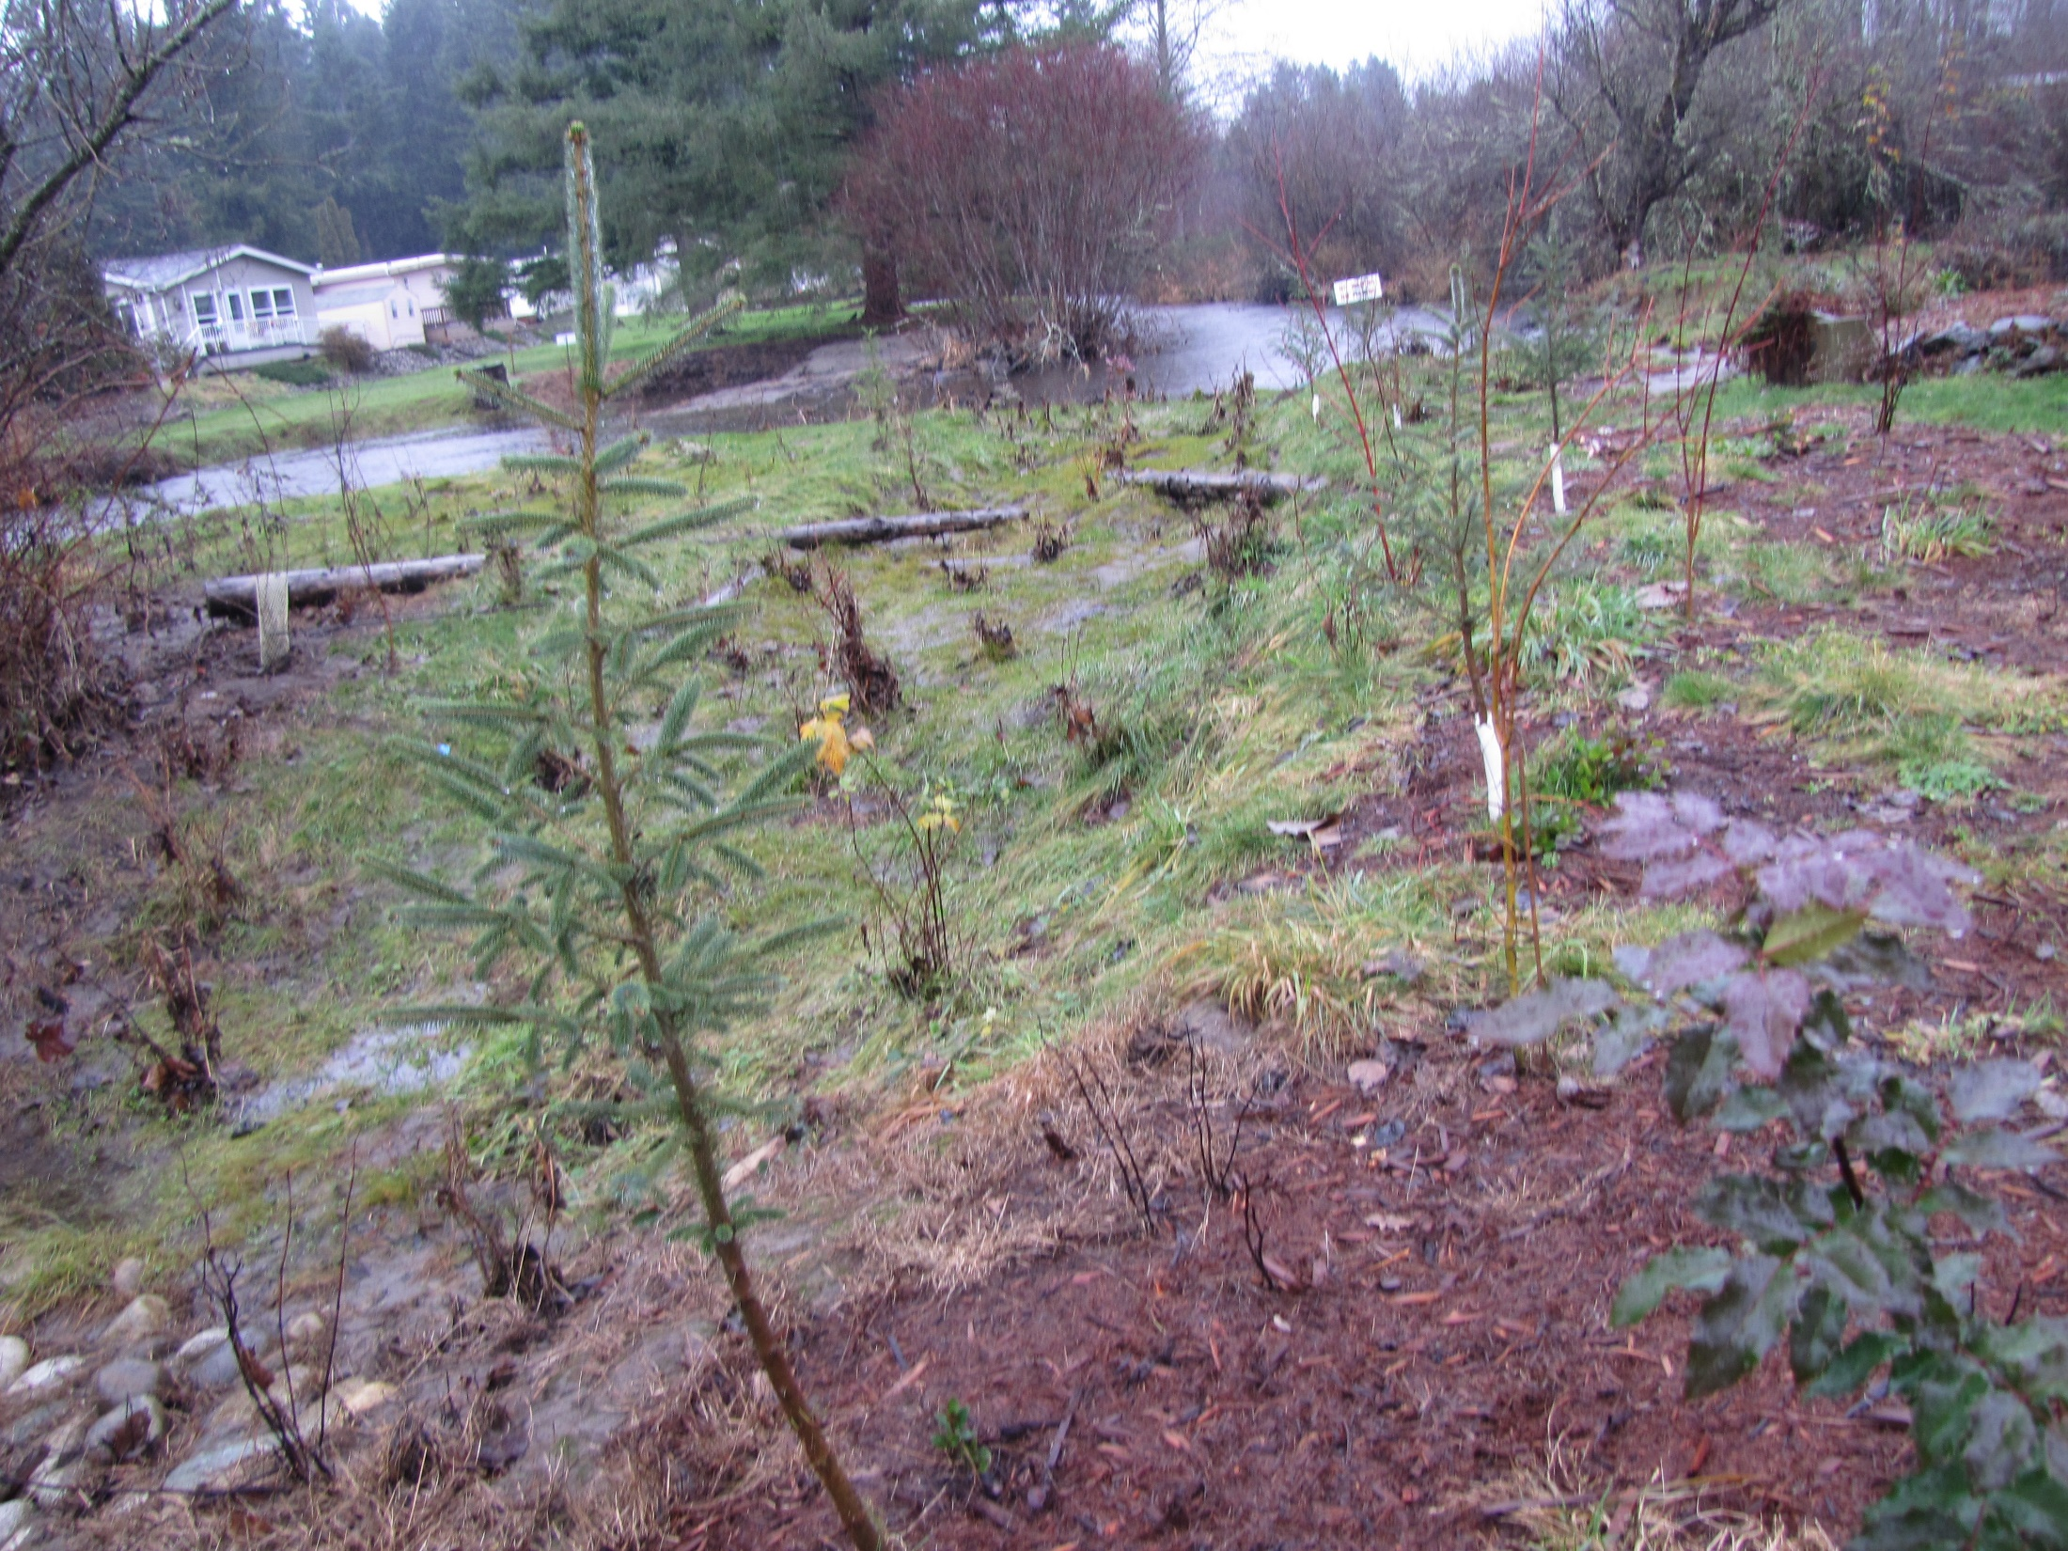

Slide 12
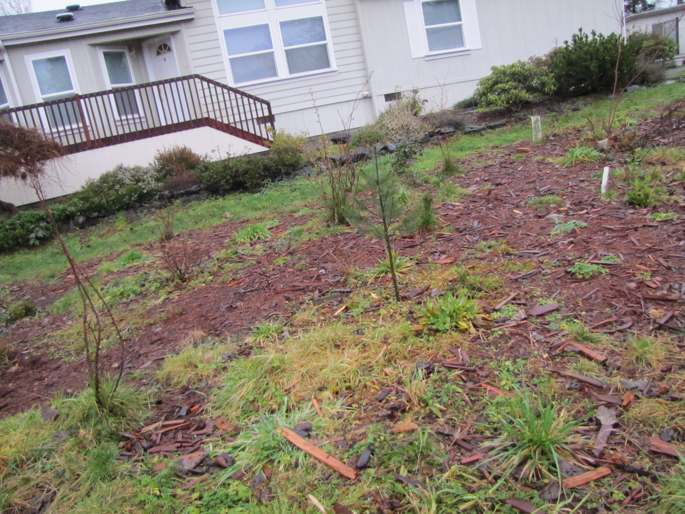

Slide 13
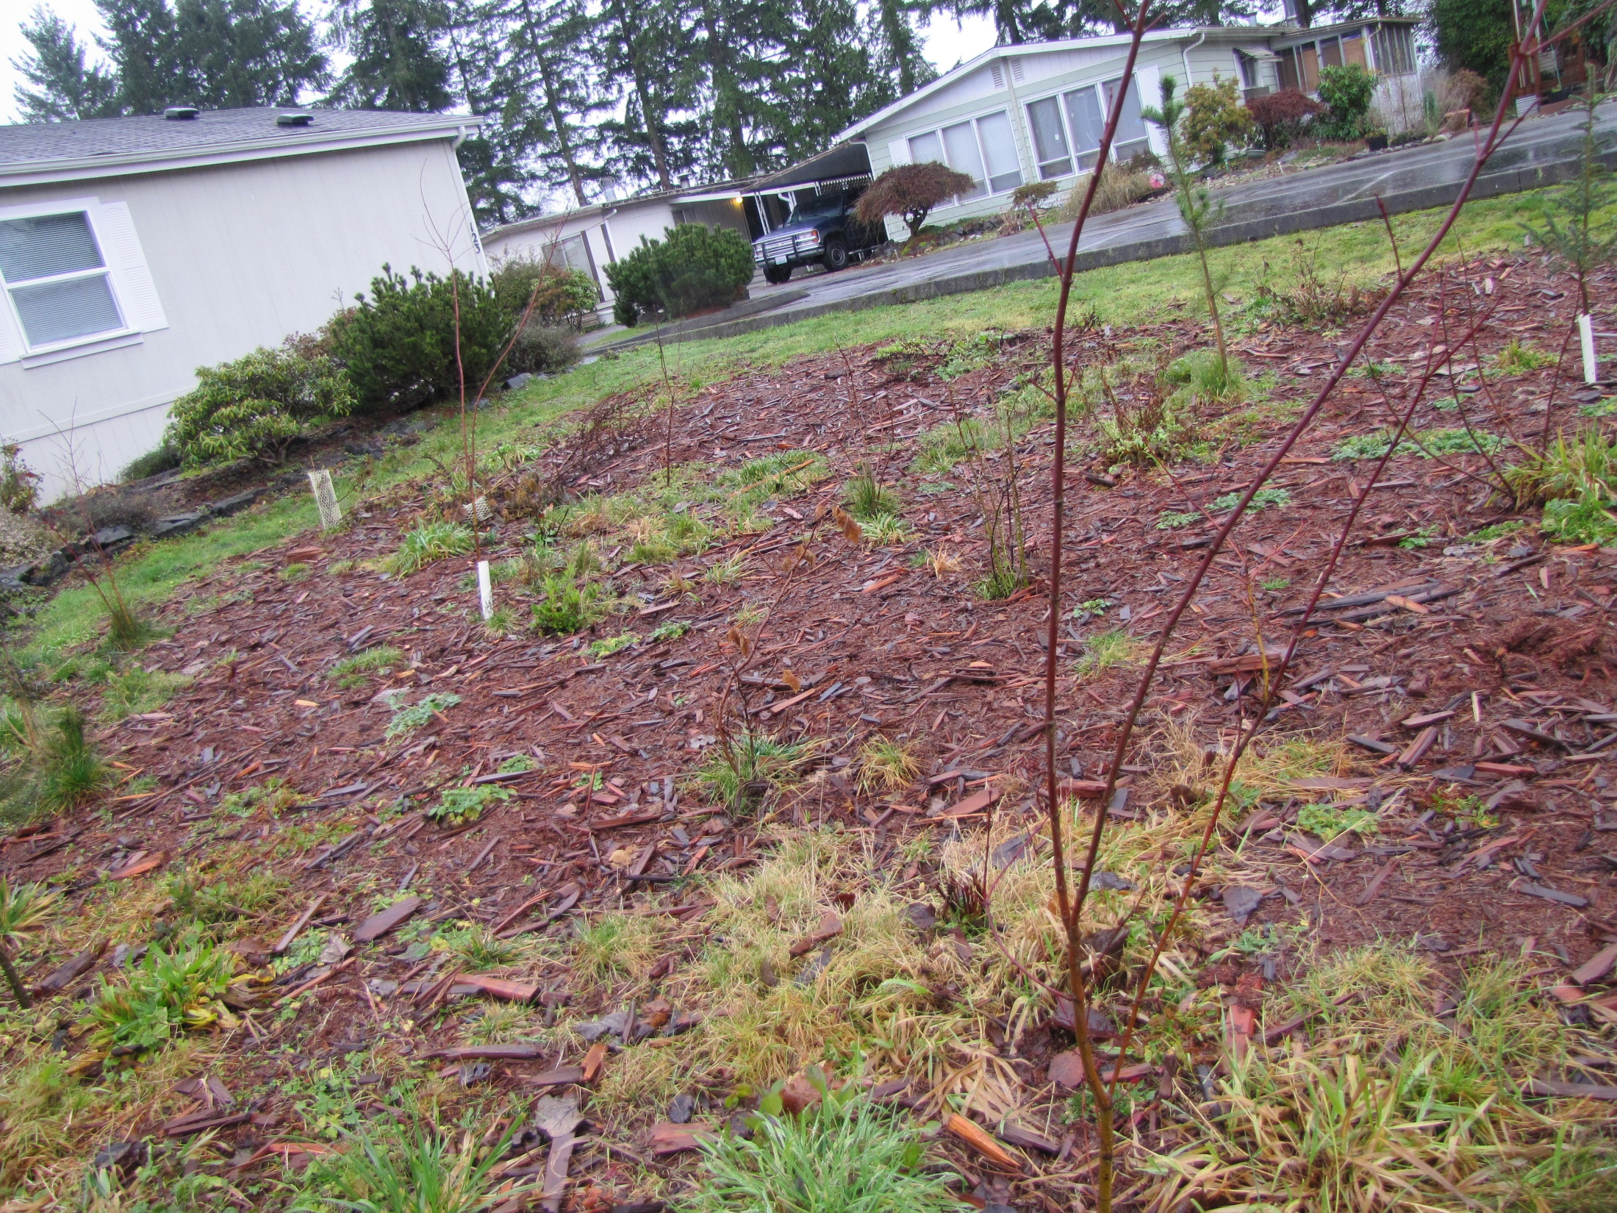

Slide 14
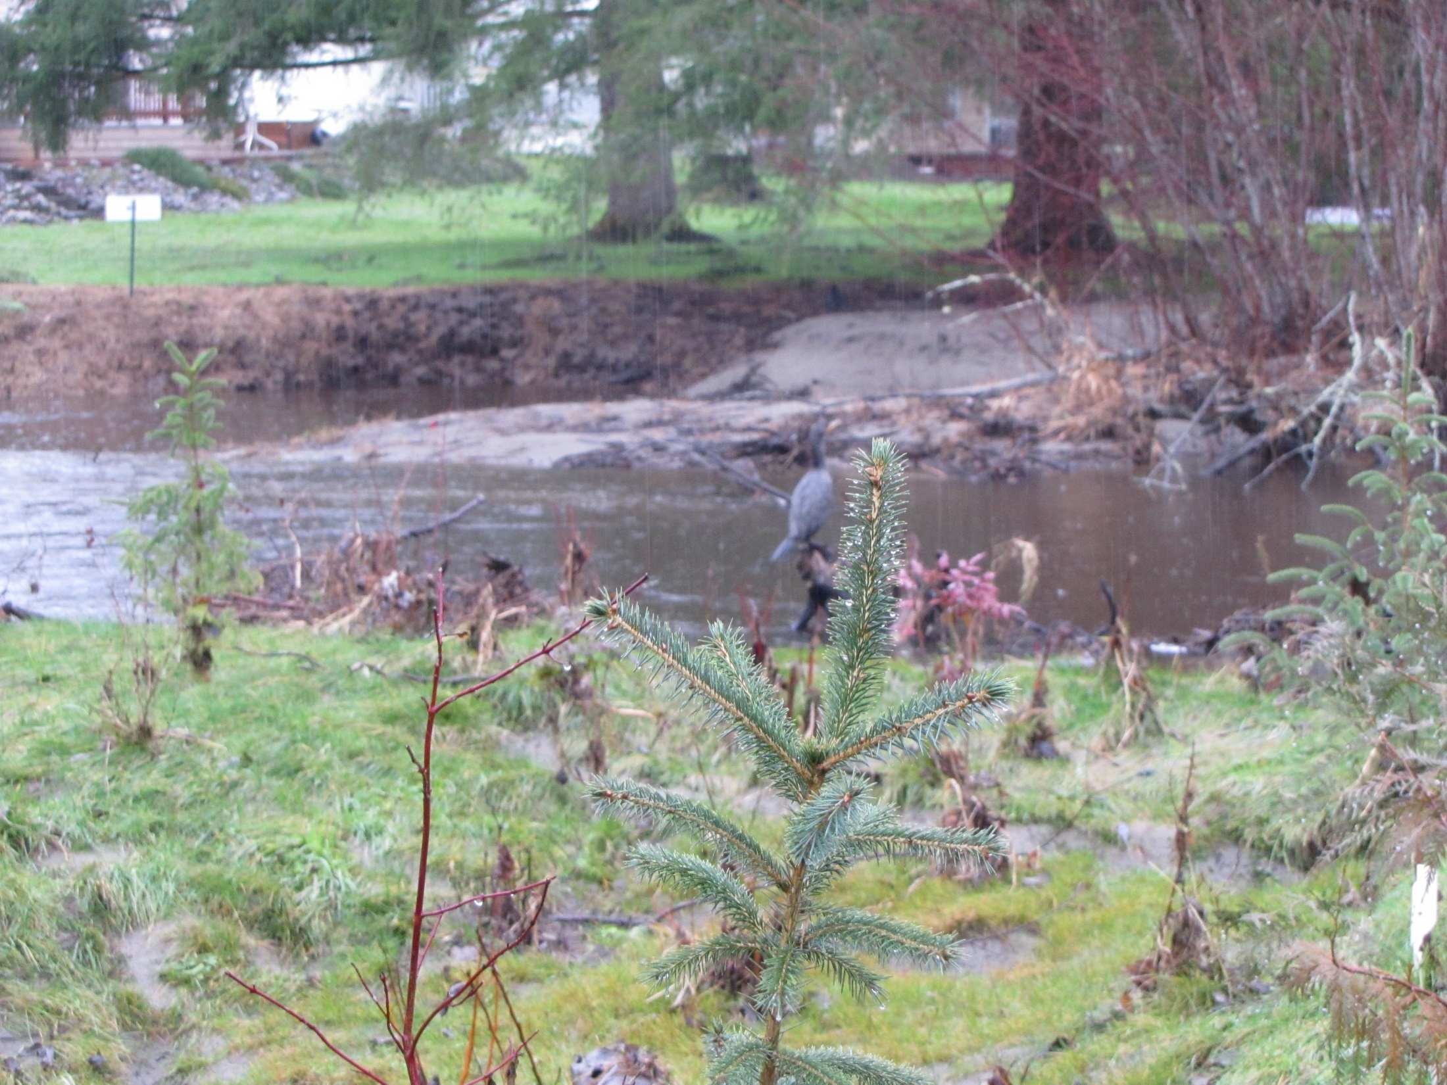
Notes:
Cormorant in the distance.

Slide 15
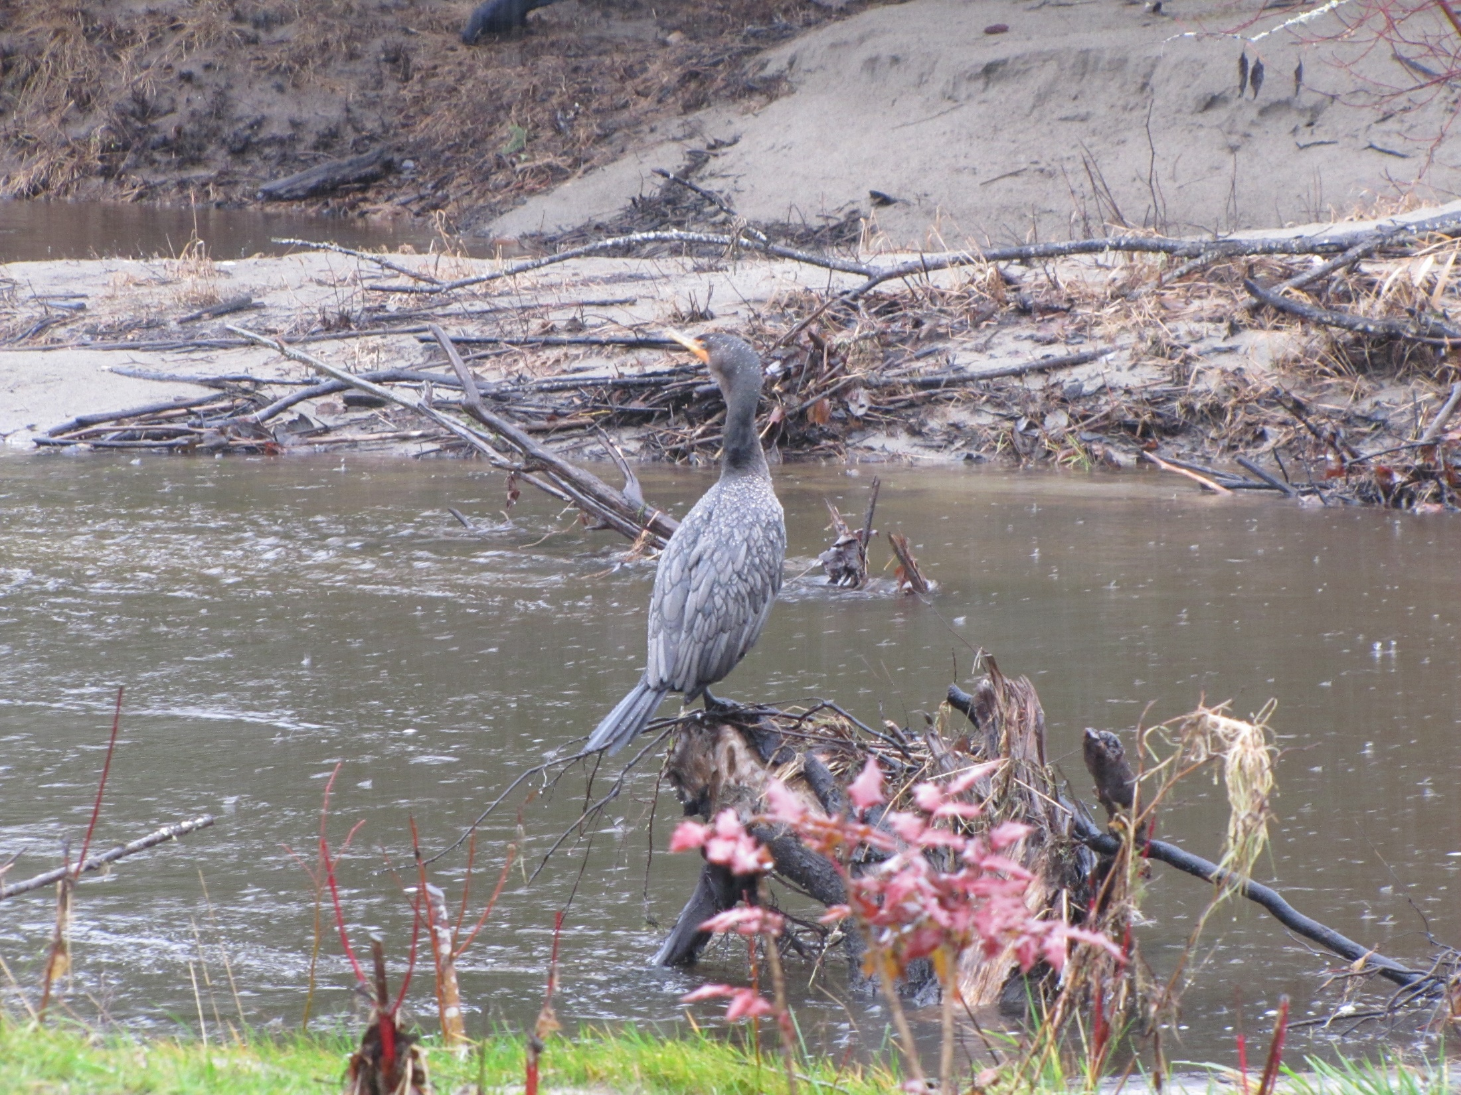

Slide 16
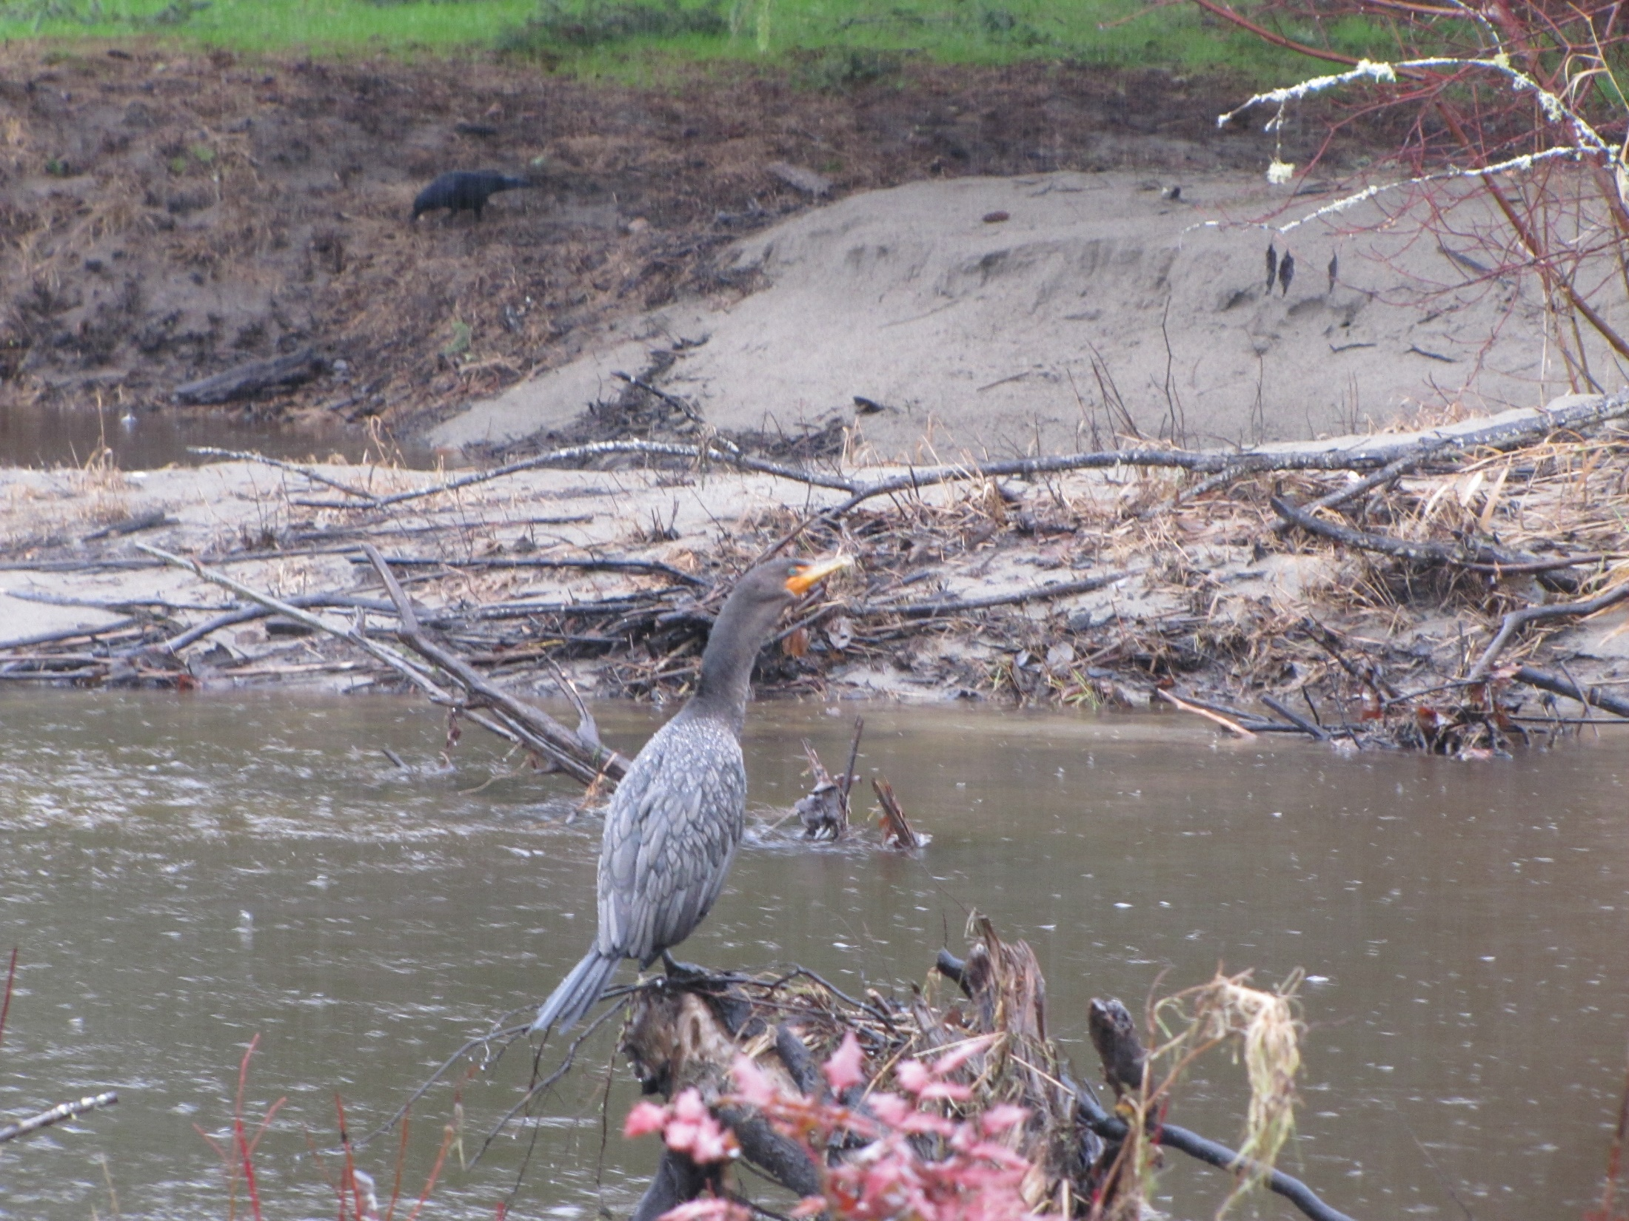

Slide 17
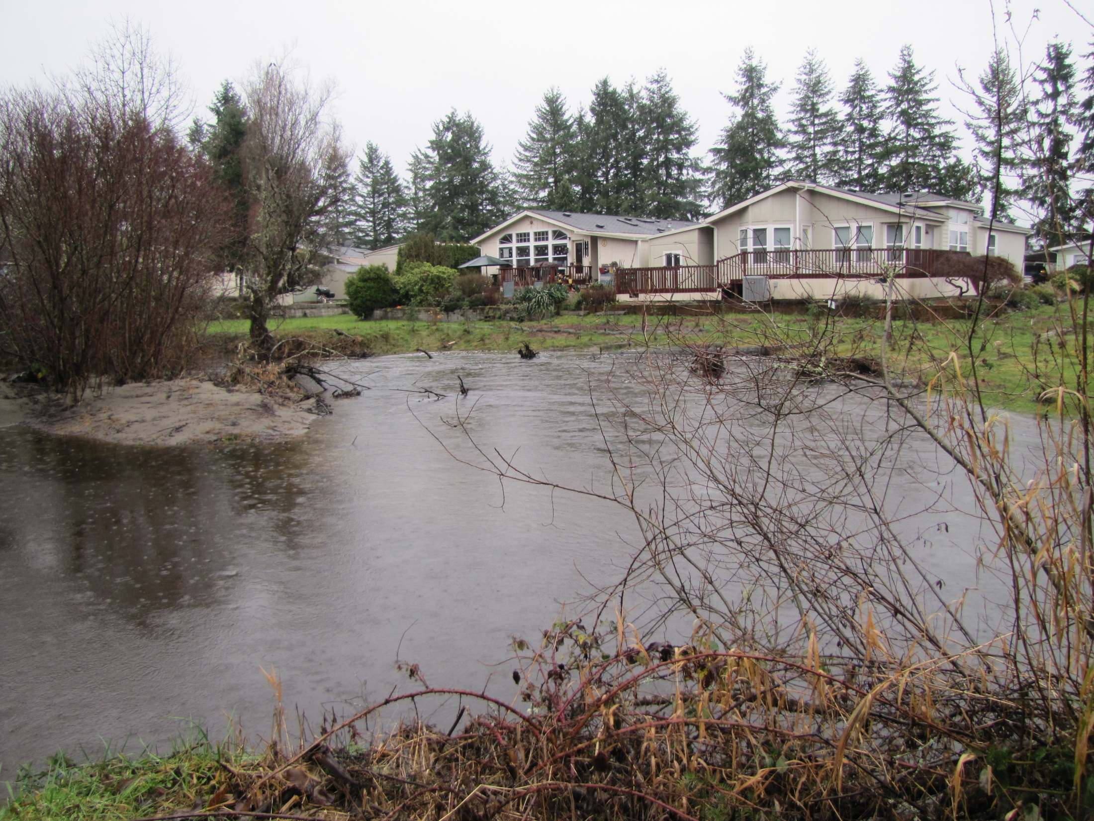

Slide 18
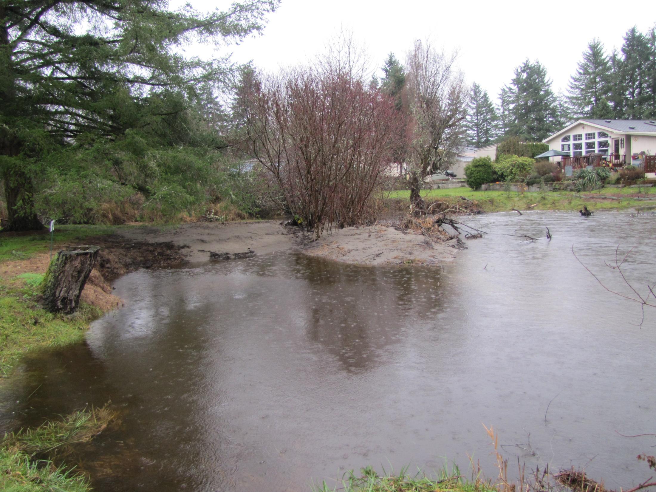

Slide 19
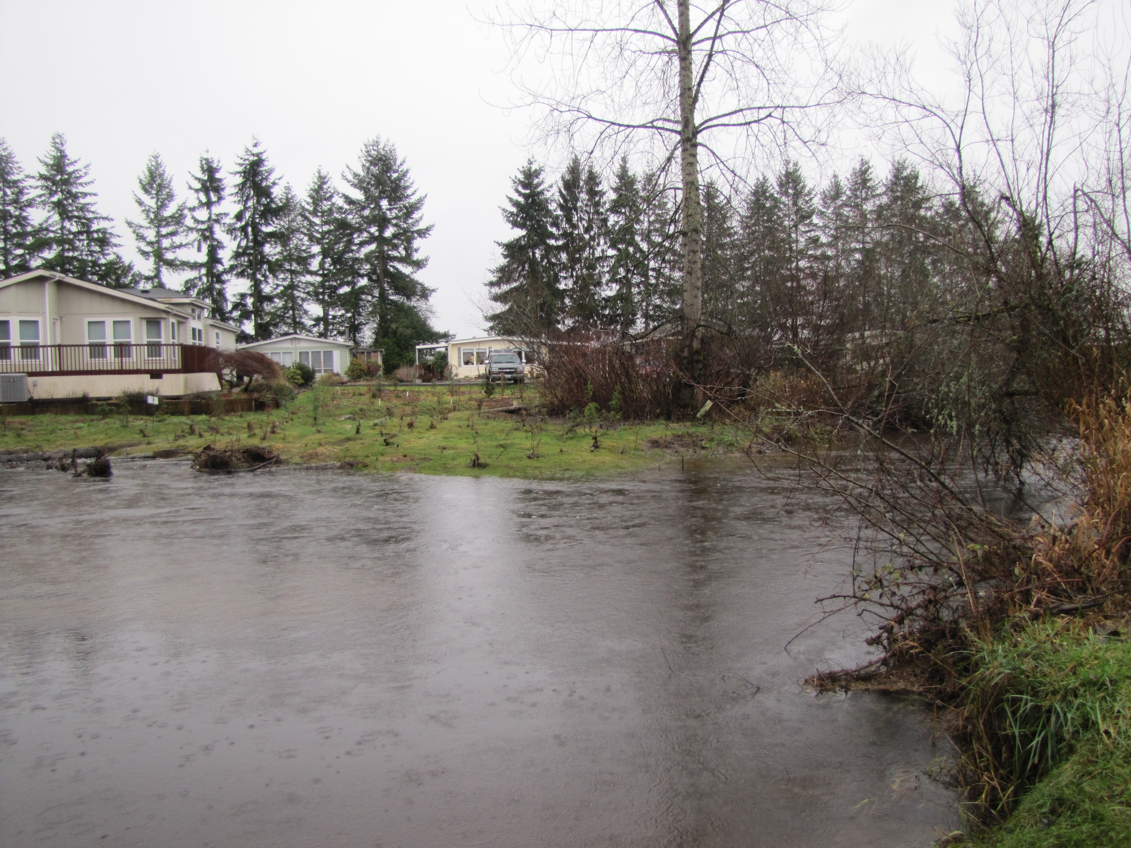
Notes:
View from across the channel.

Slide 20
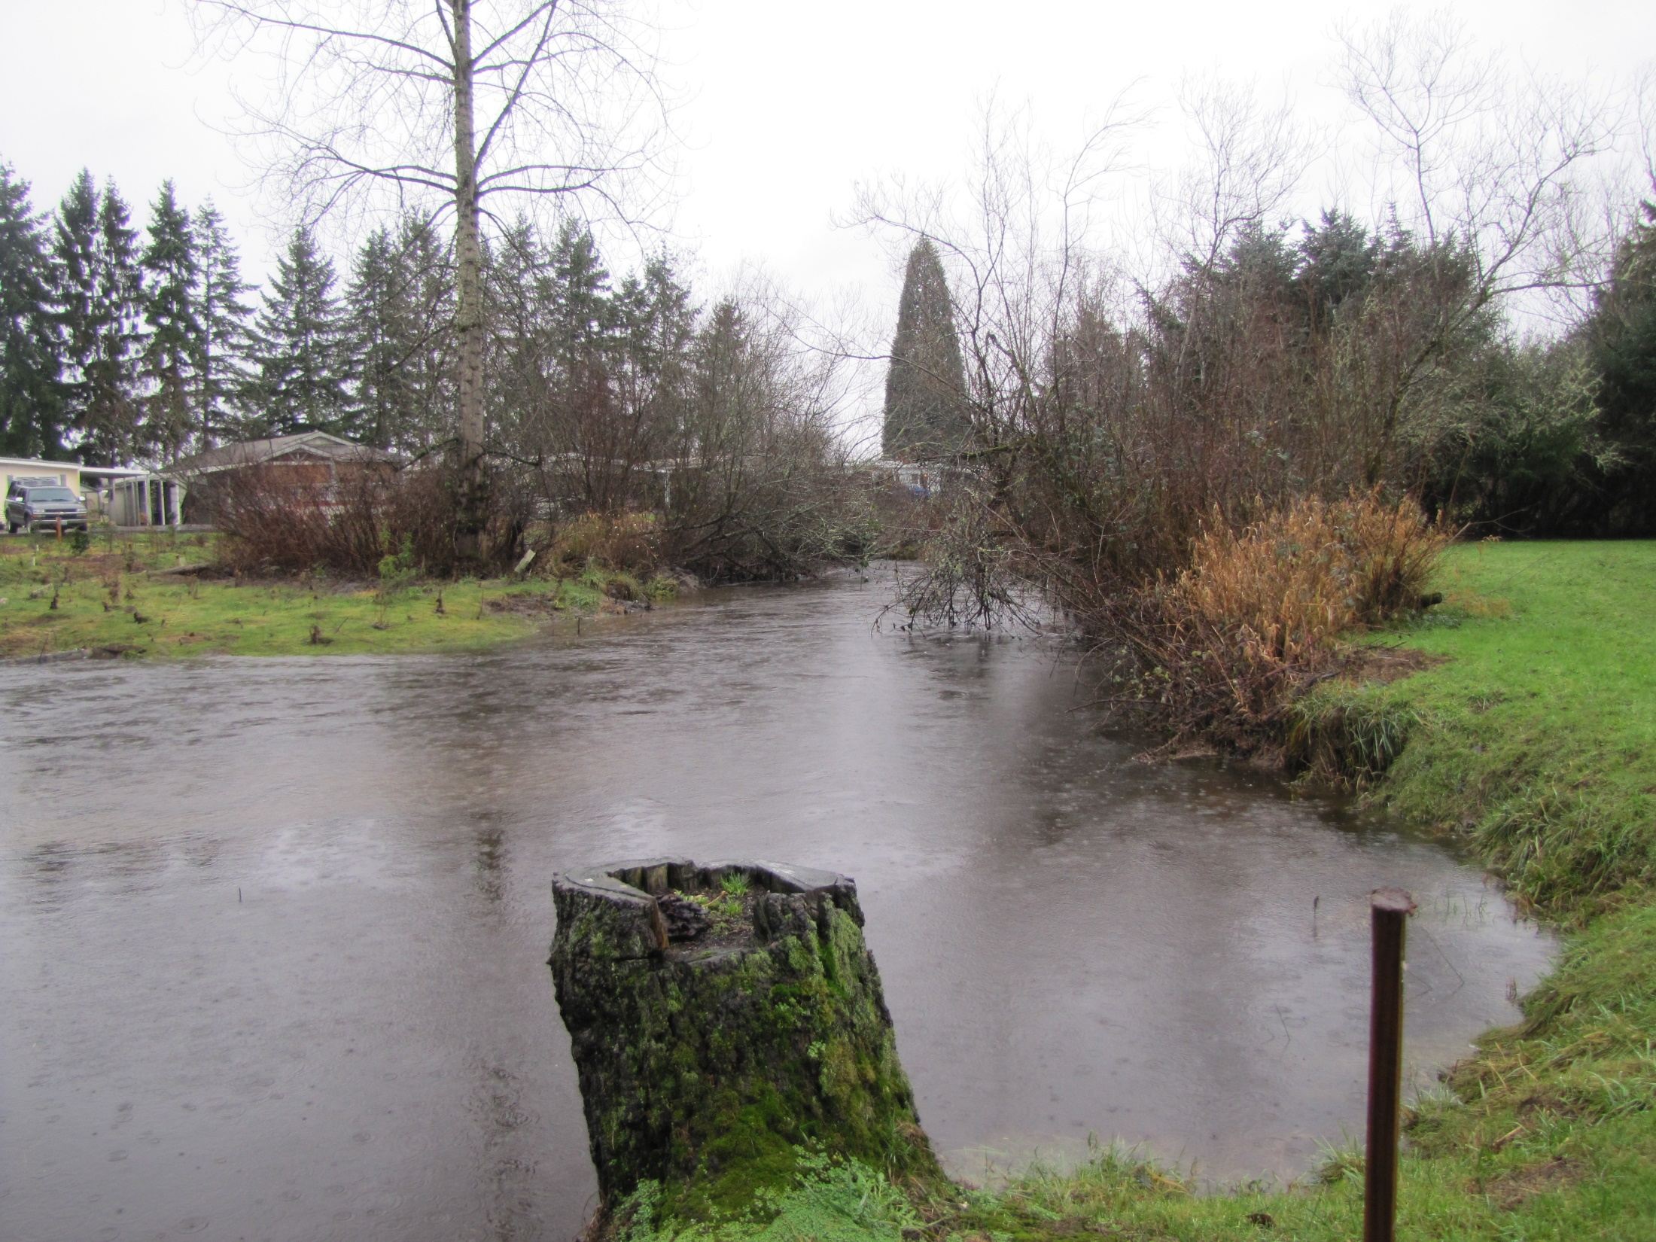

Slide 21
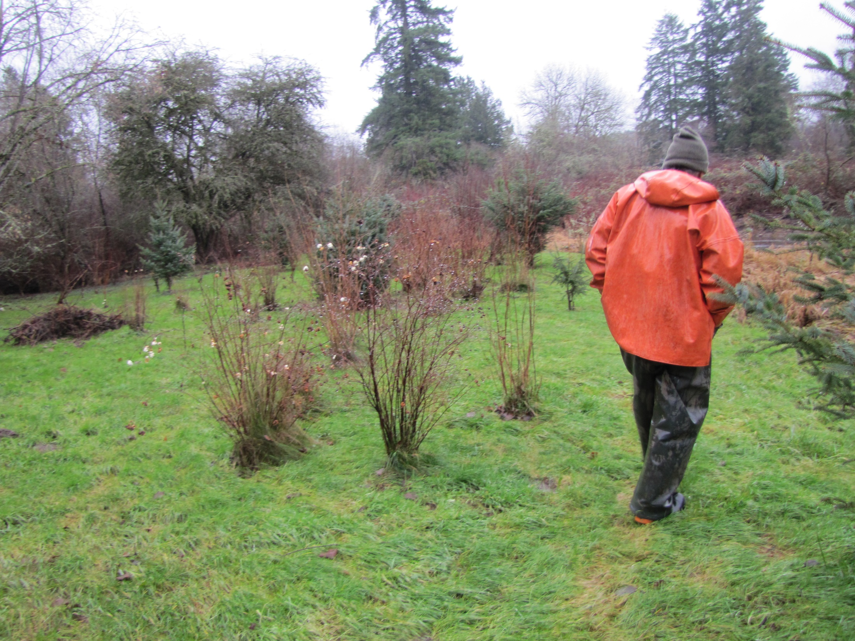
Notes:
The first riparian planting – is doing well. The Friendly Village maintenance crew is maintaining the plantinsgs ,removing the bindweed and blackberry.

Slide 22
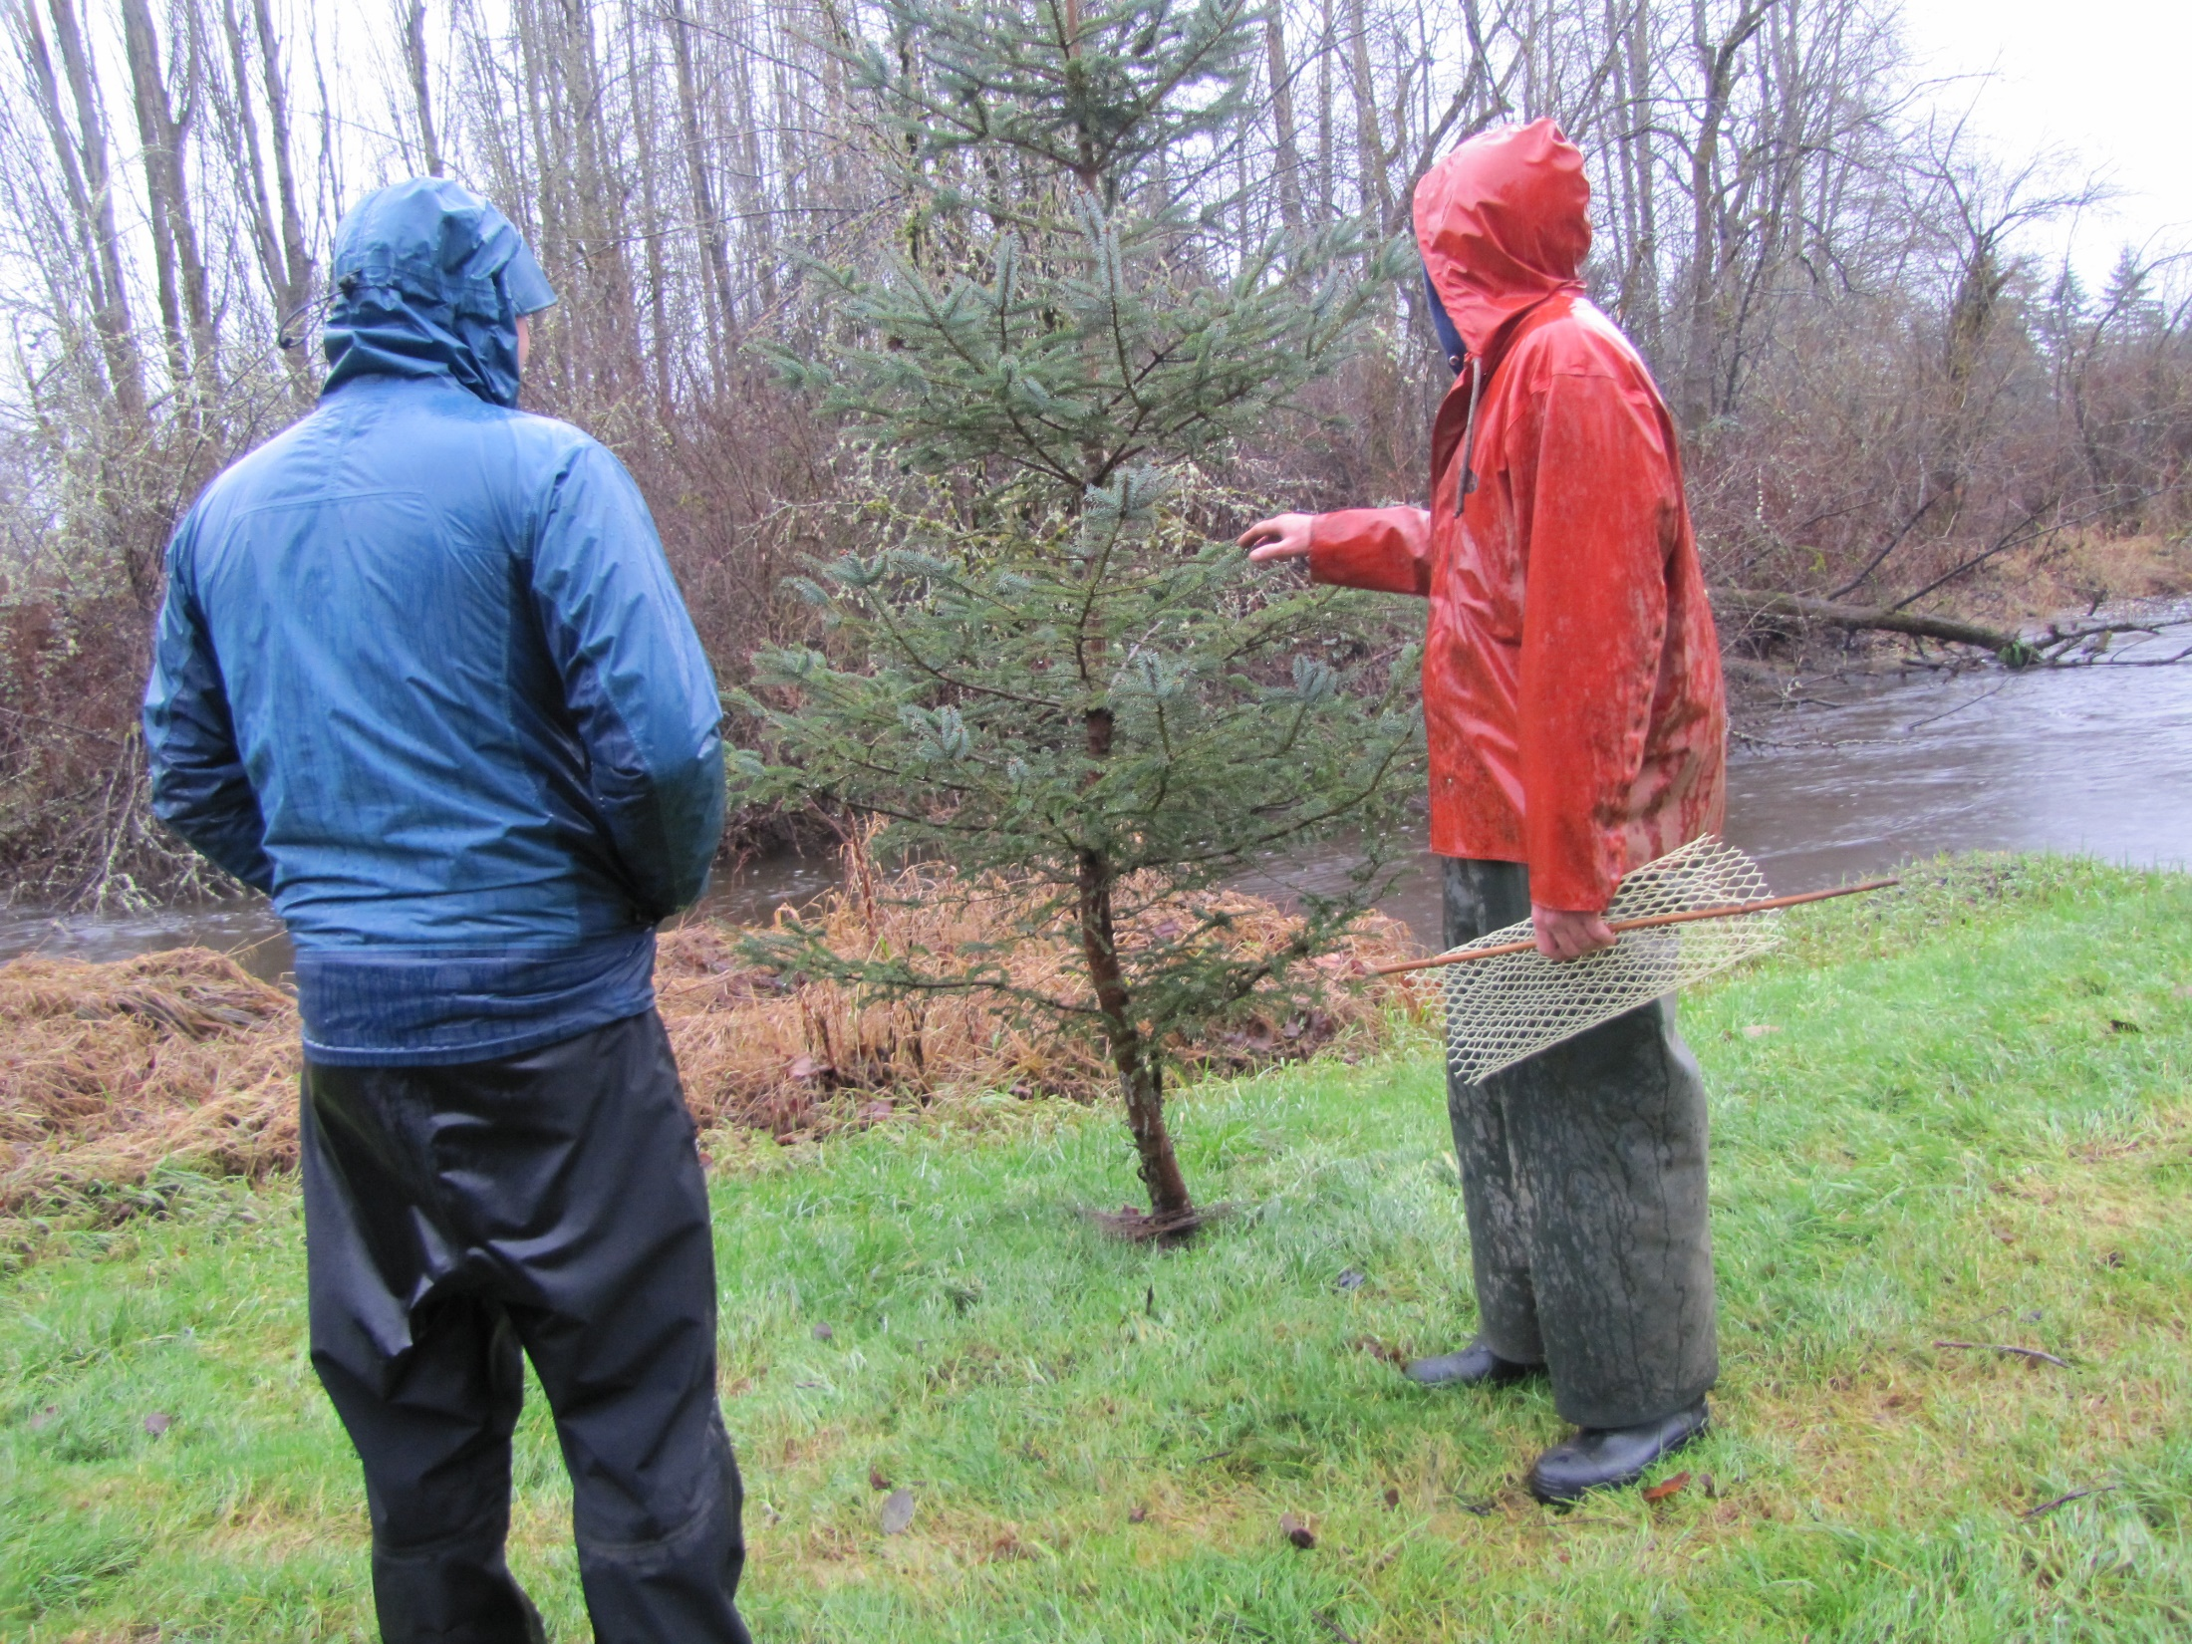

Slide 23
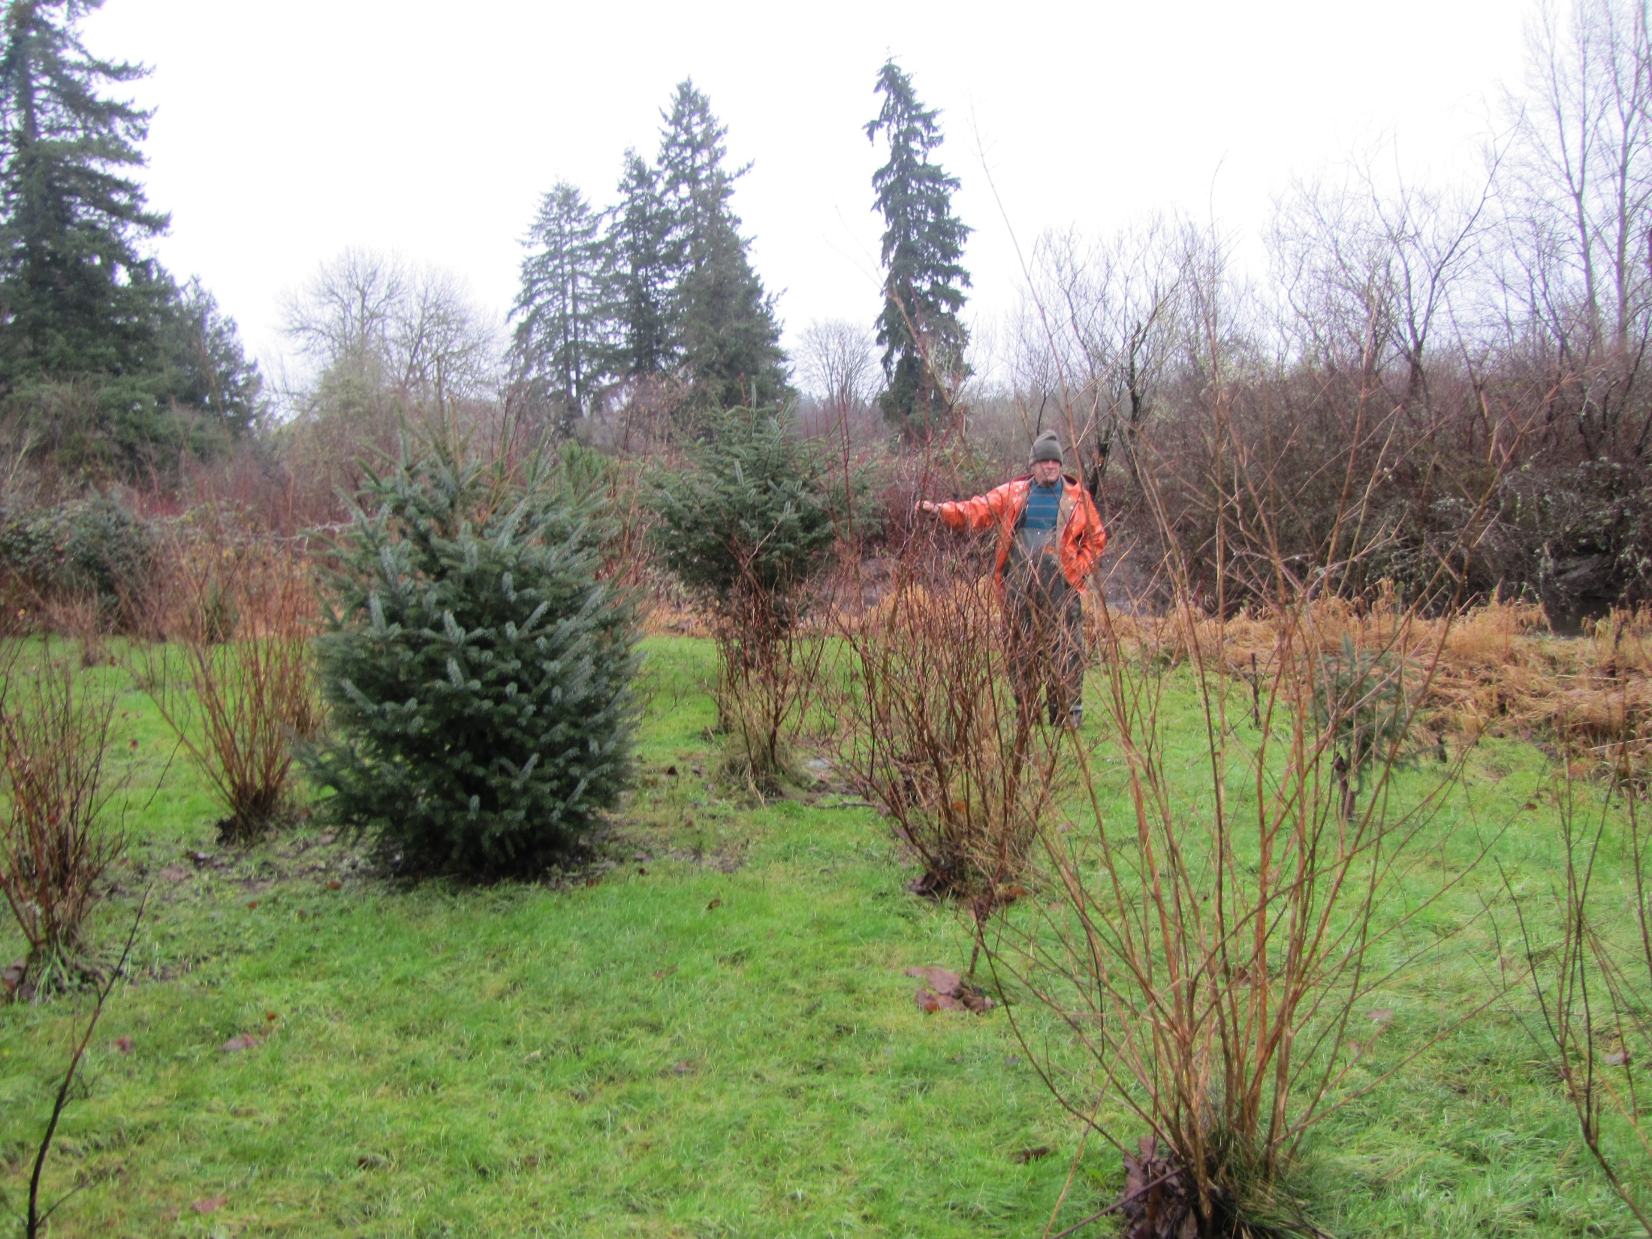

Slide 24
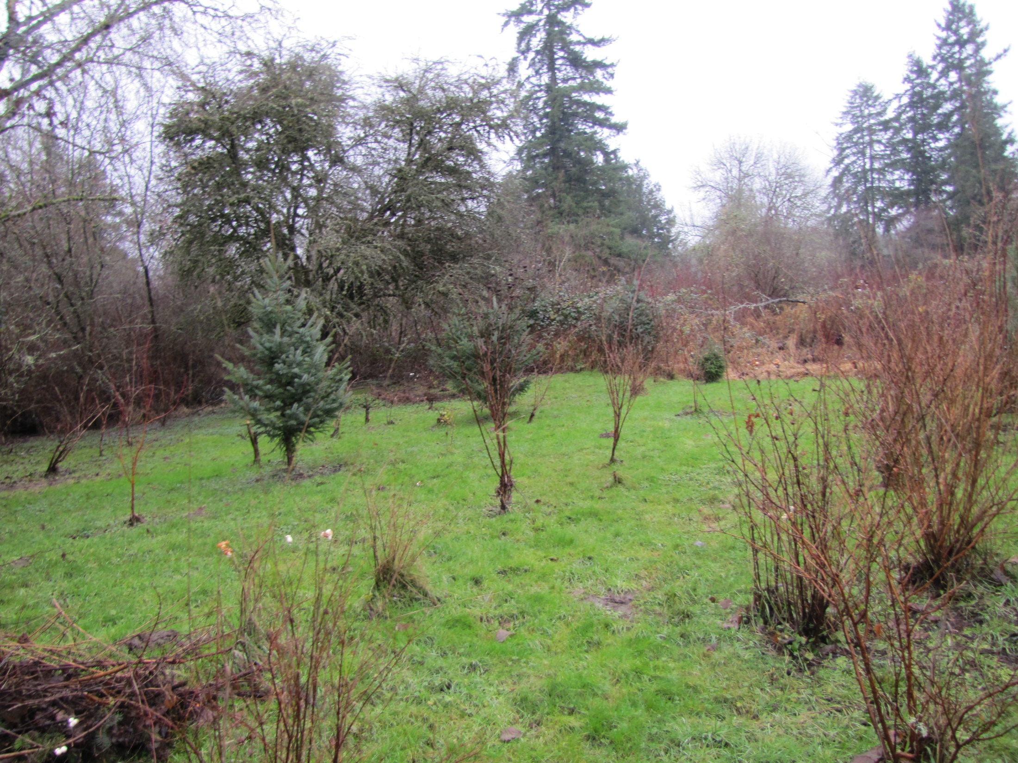

Slide 25
