Slide 1
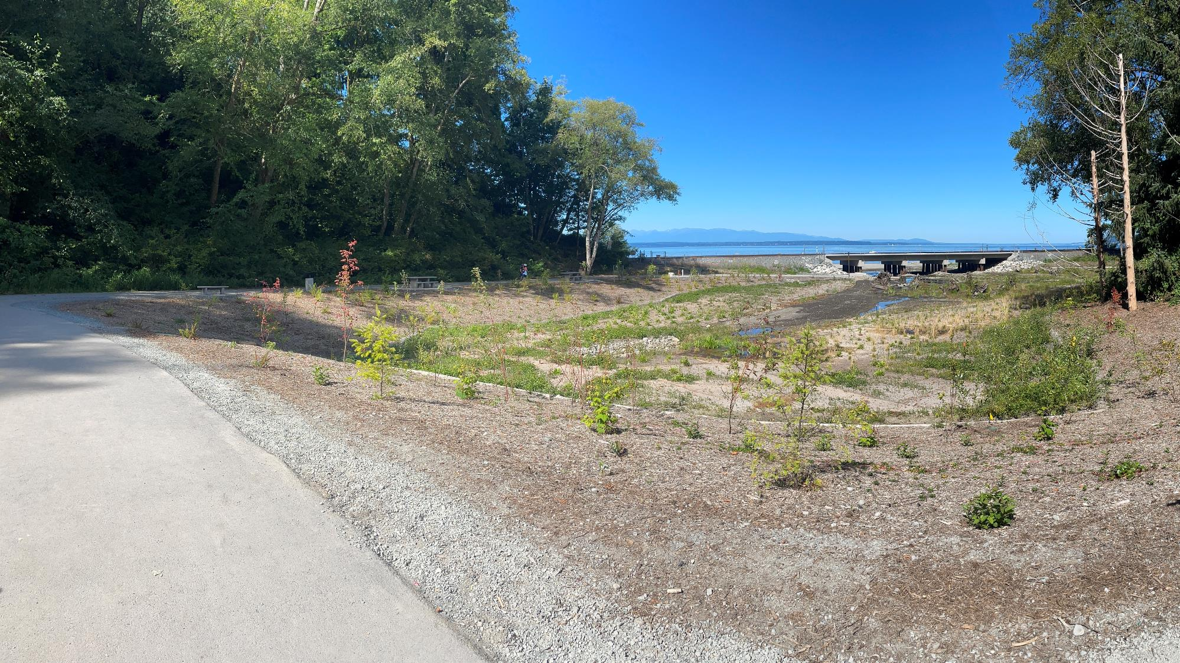
Meadowdale Beach Park & Estuary Restoration (18-1259)
Site Visit August 4, 2023
(with additional photos from Sept/Oct 2023 added by SnoCo staff when construction was complete)
Butler, Elizabeth (RCO)
Rachel Dotson & Rob Marchand (Snohomish County Parks)
Notes:
As-Builts of the estuary are uploaded to Prism. A full draft of the as-builts will be ready by mid-October.
0.17 mile of stream treated
1.4 acre pocket estuary restored (17,000 CY fill removed)
1 culvert removed
5 span railroad bridge constructed
6.3 acres opened to fish passage
0.8 acre estuary planted
Pathways approx. 9’ wide (narrows to 6’ under bridge): 75 ft of concrete path, 995 feet asphalt path, 45 ft boardwalk, 890 ft crushed rock = total 2,030 ft ADA 1 electric light
5 benches
5 new and 4 existing picnic benches = 9 total
1 portable restroom enclosure + landslide barrier wall
1 picnic shelter
6 signs (four environmental education, 1 funder acknowledgment, 1 Ribbon Cutting commemoration)
240 ft shoreline riparian planting
0.17 stream habitat enhancements
53 channel structure placement
0.2 mi riparian planting
1.2 acres riparian planting
ADA Roadway/Driveway was strengthened with spiral nails before construction started (Fed Railway Agency funded that work)

Slide 2
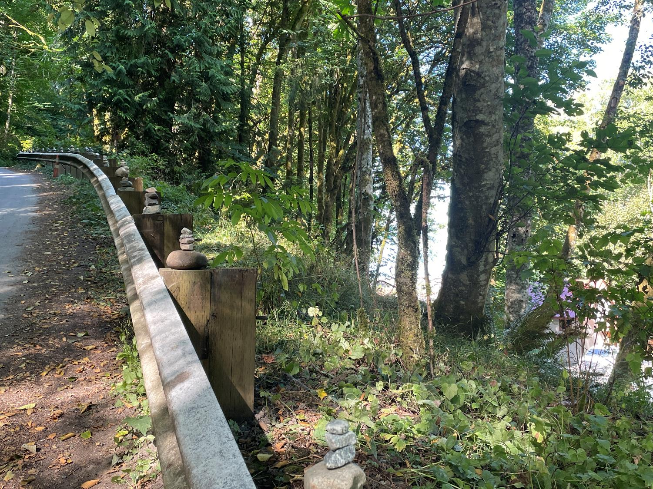
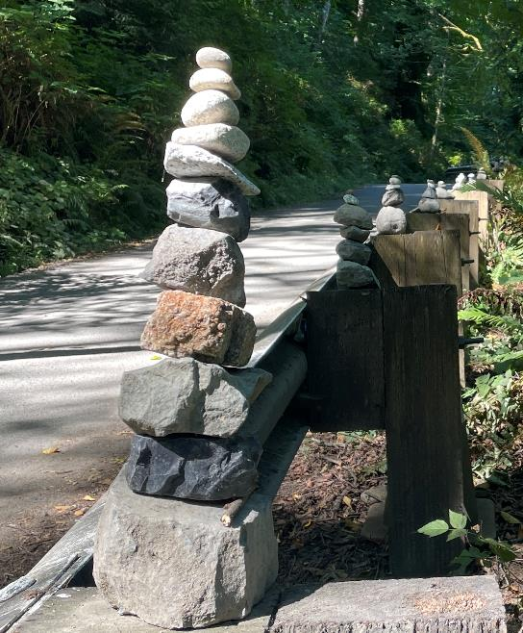
The road off of 75th Pl W is available to those needing ADA access to the lower park as an alternative to hiking the trail (the phone number to call for the passcode is posted at the gate).
Inspired community members created a series of cairns atop each of the guardrail posts.

Slide 3
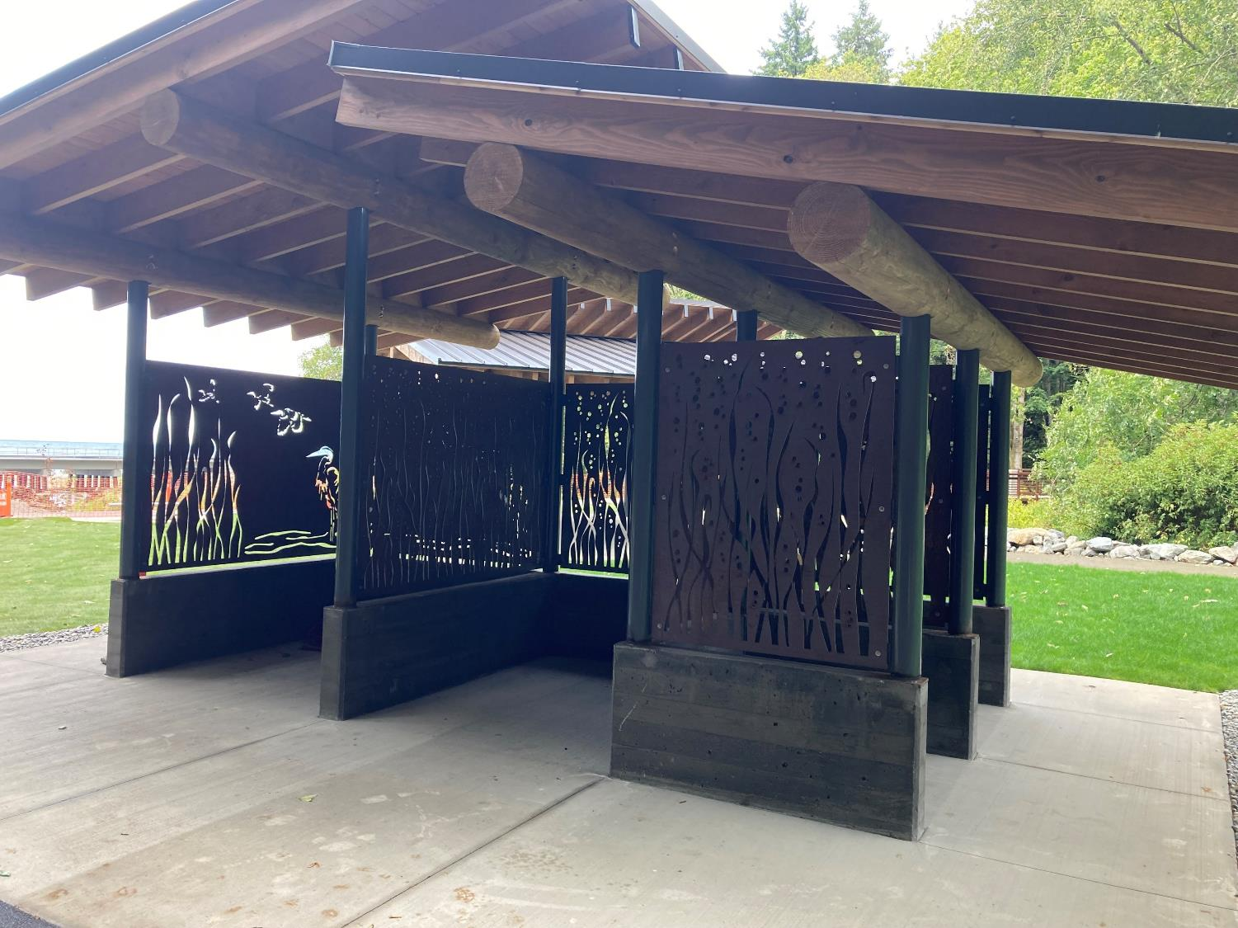
Sanicans will sit within the three walled screening structure comprised of decorative metal plates. Staff at Snohomish County Parks designed the cutouts.

Slide 4
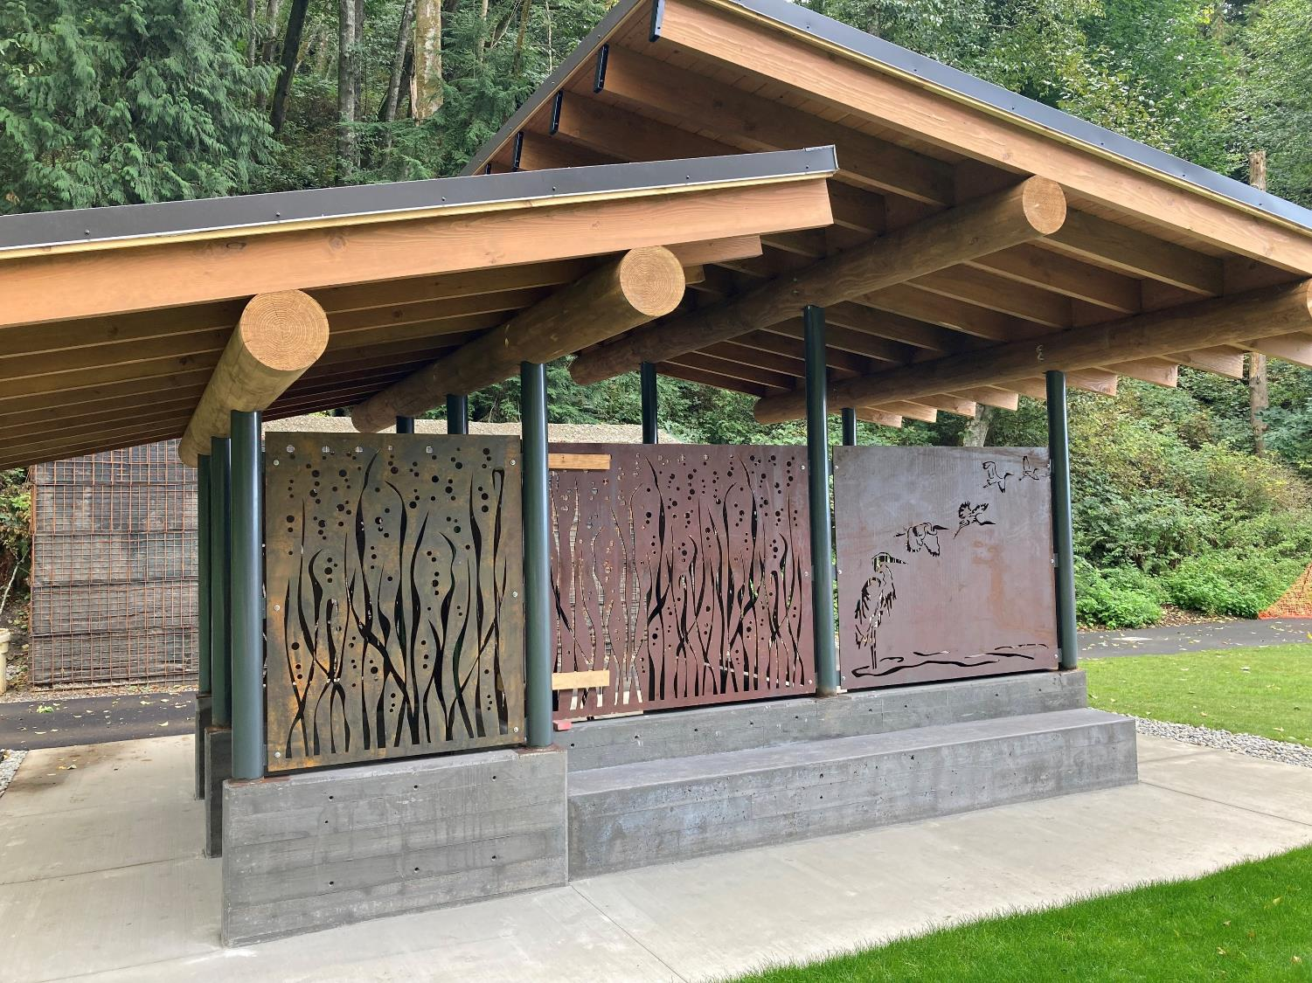
Adaptive management:
Some of the cutout pieces are long and could potentially be bent to deform the screens. The vulnerable pieces will be welded to a crossbar on the inside of the panel.

Slide 5
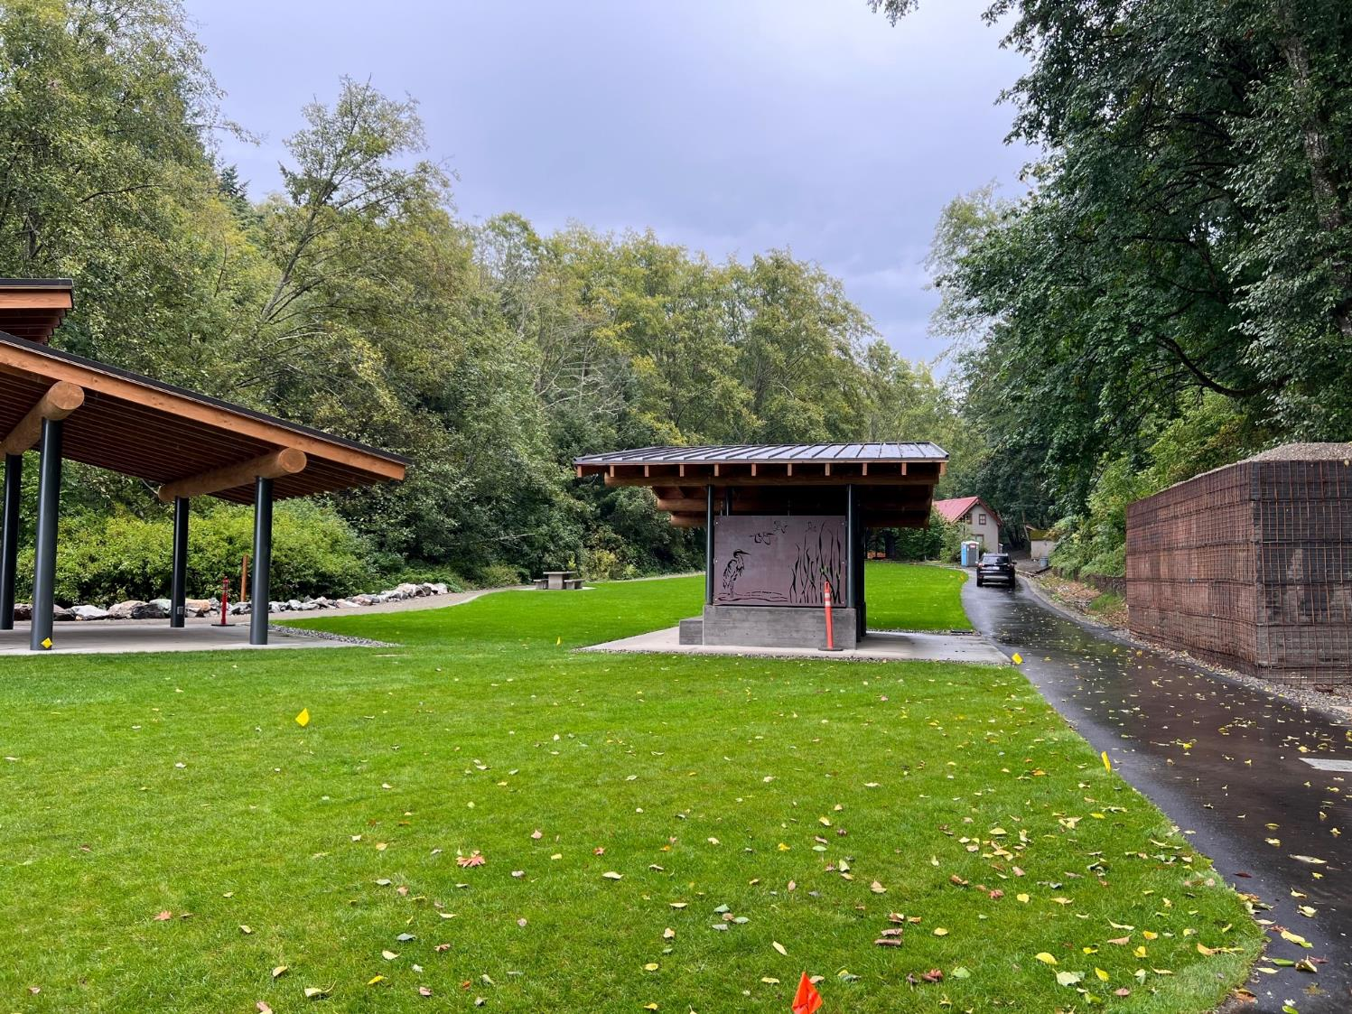

Slide 6
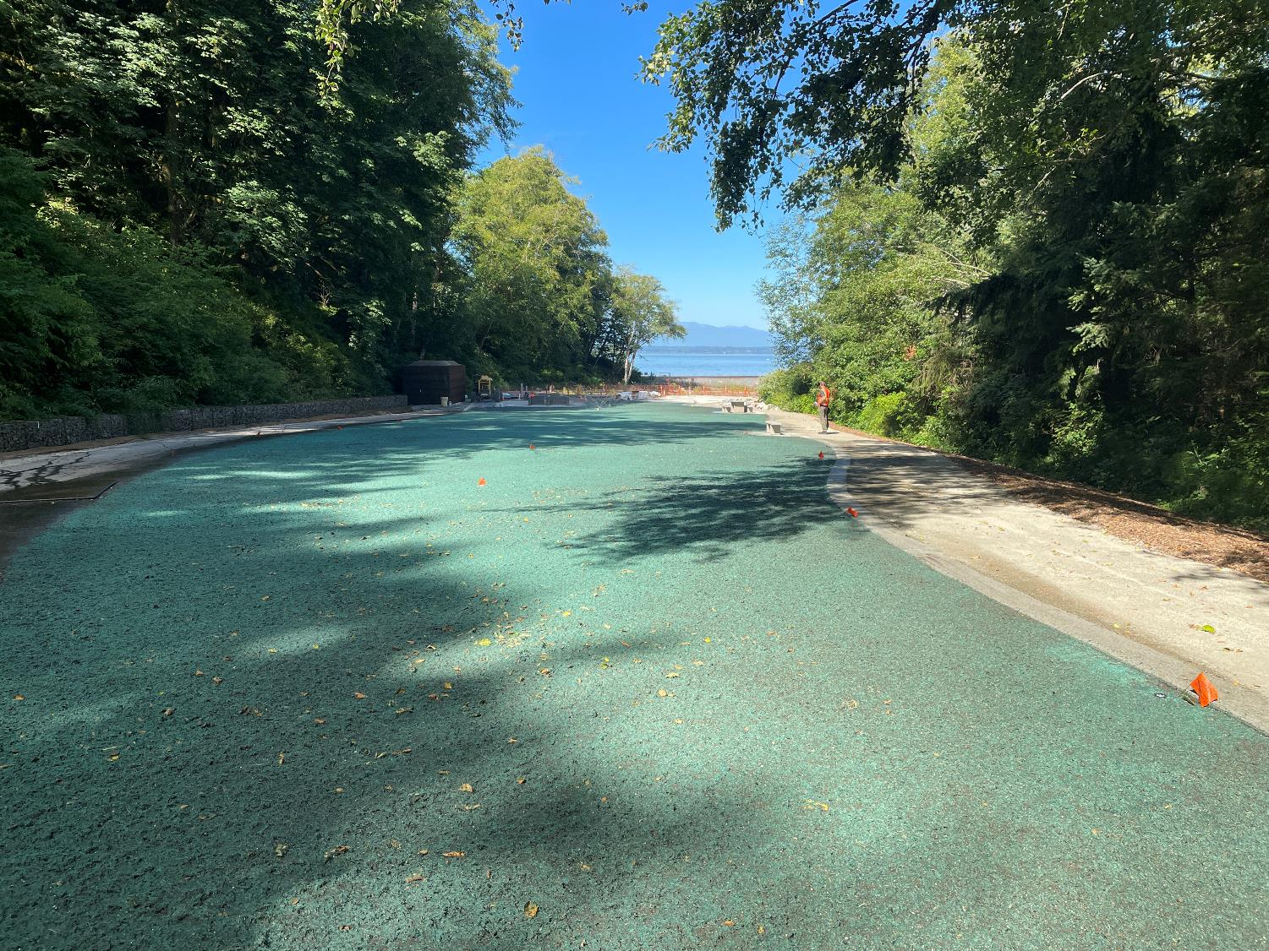
The lawn is hydroseeded. Once established, will provide a place to picnic, gather, and play, up away from the beach.

Slide 7
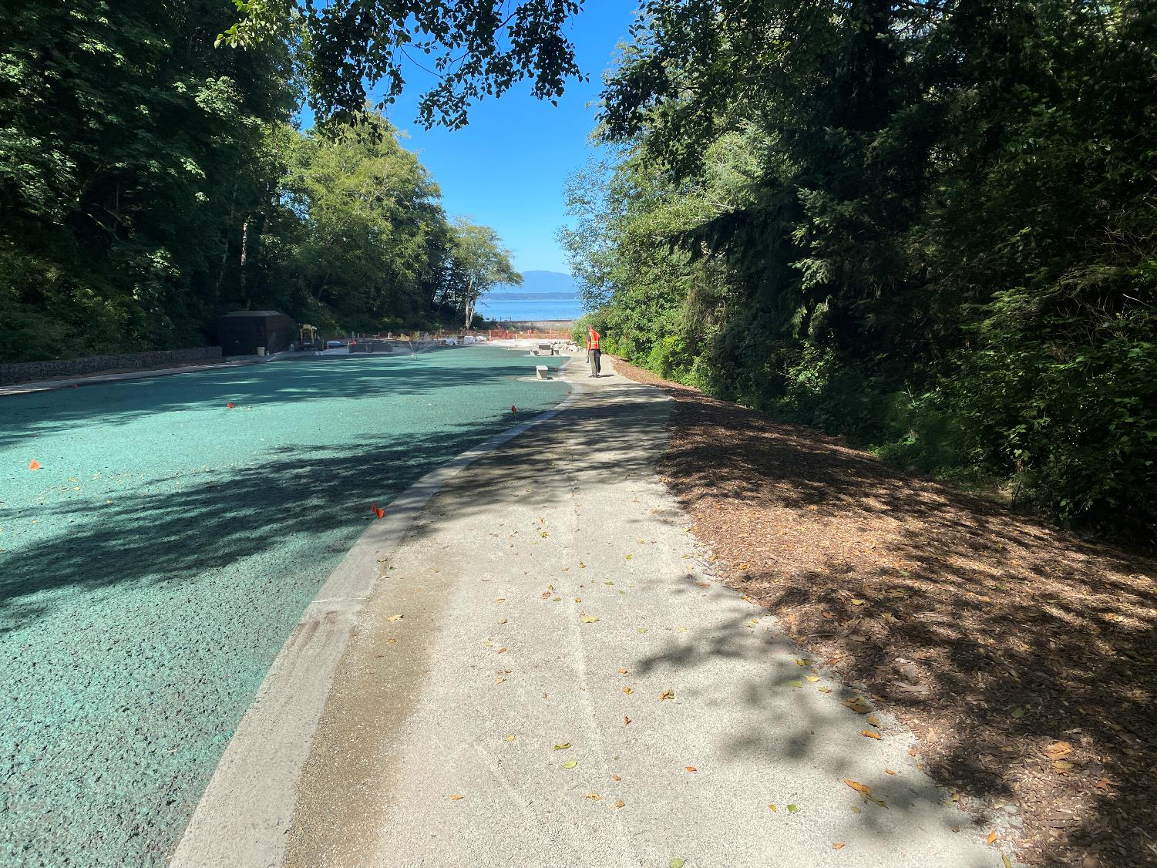
The crushed gravel path is compacted to allow for ADA compliance.

Slide 8
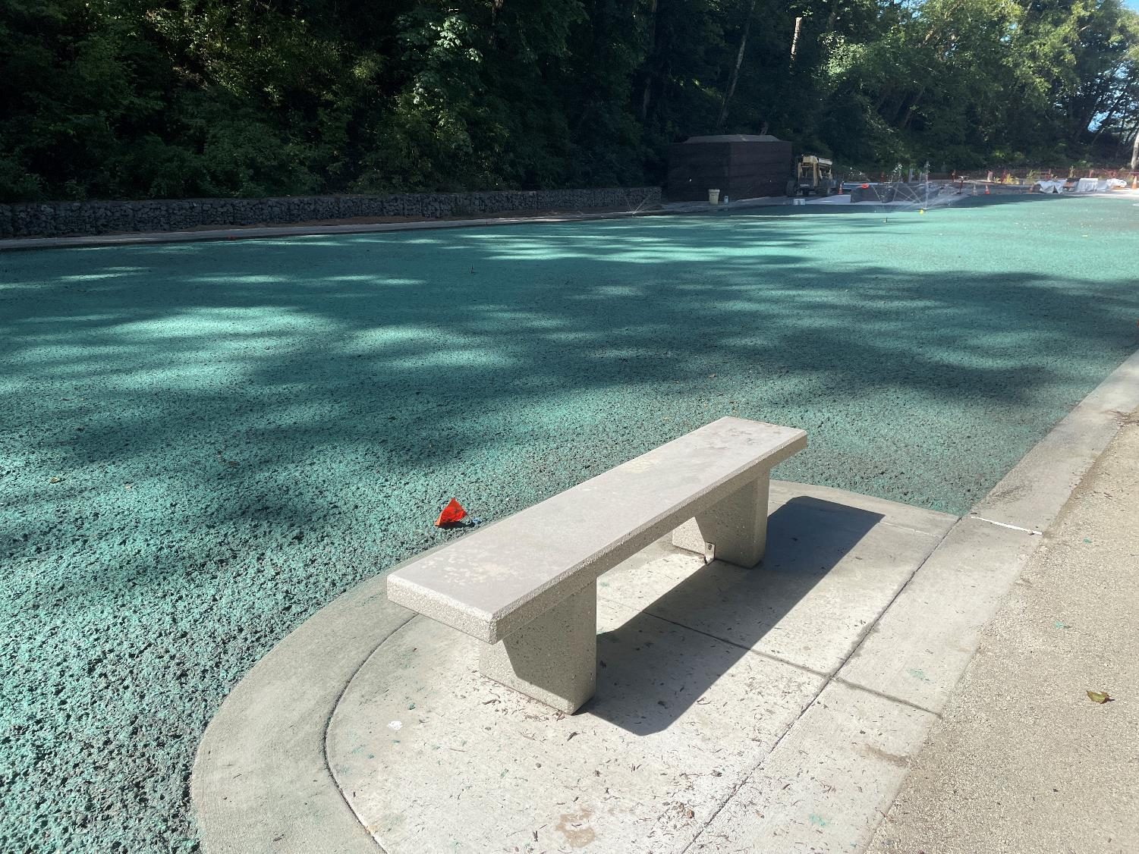
Concrete benches installed around the lawn provide seating. There are a total of 6 new benches in the park.
Notes:
How many benches total?

Slide 9
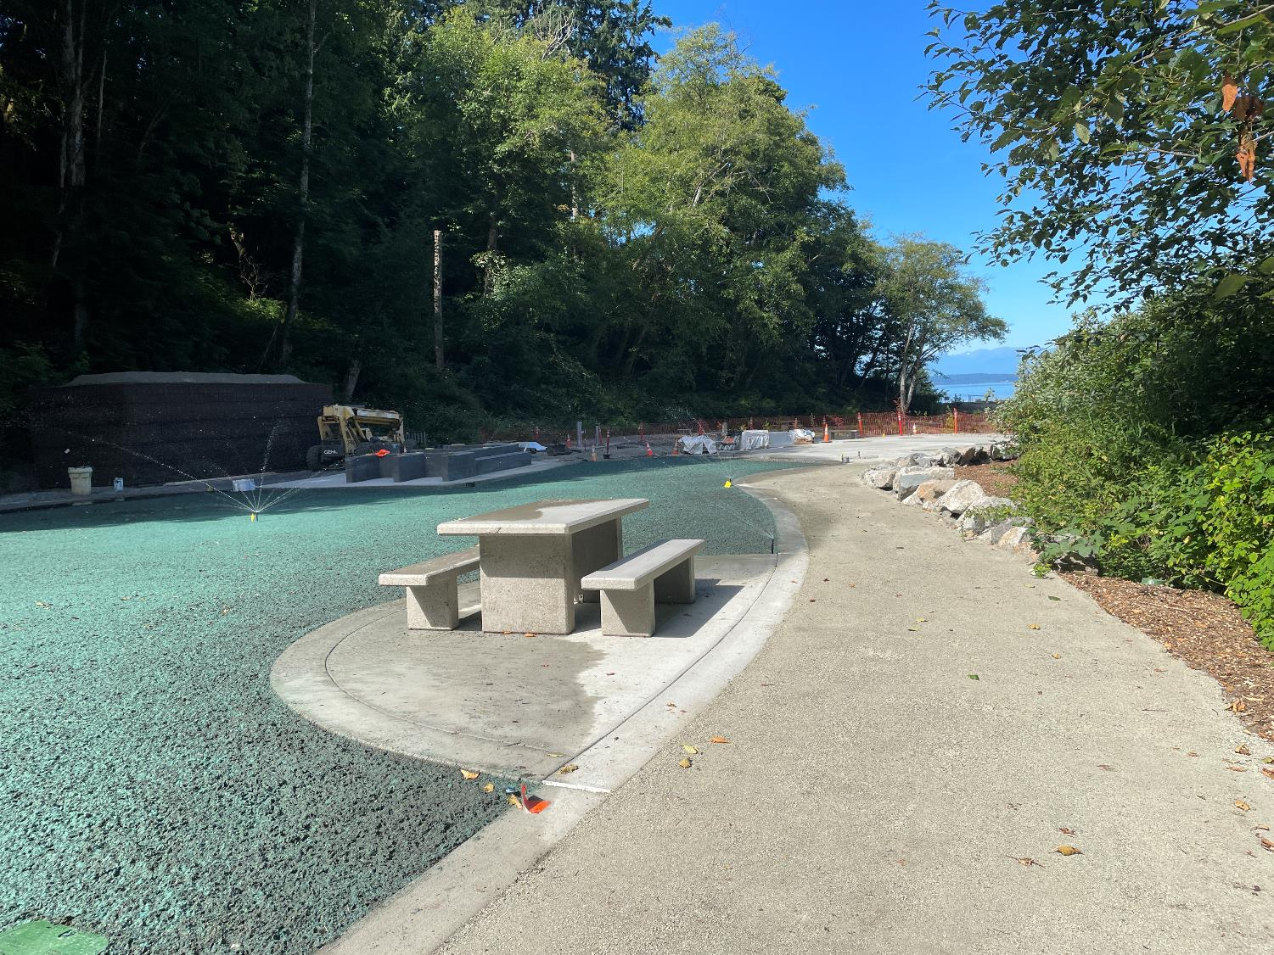
Concrete picnic tables installed around the lawn. There are a total of 5 new picnic tables at the park (not counting 4 that will be replaced in the picnic shelter).
Notes:
How many picnic benches total?

Slide 10
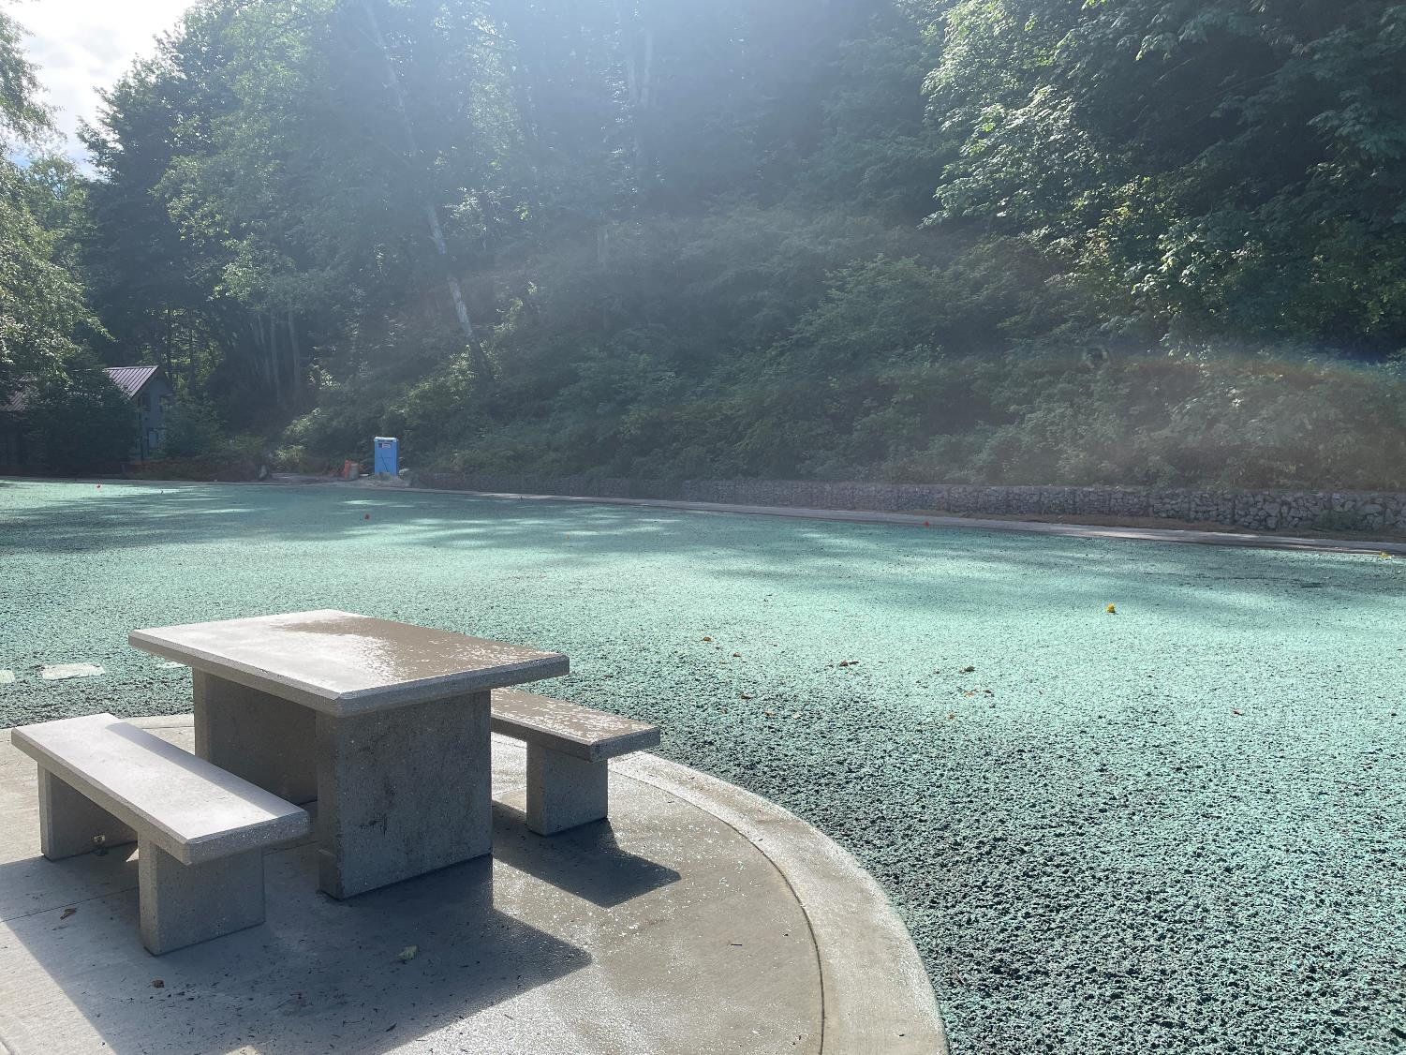
Concrete picnic tables installed around the lawn.

Slide 11
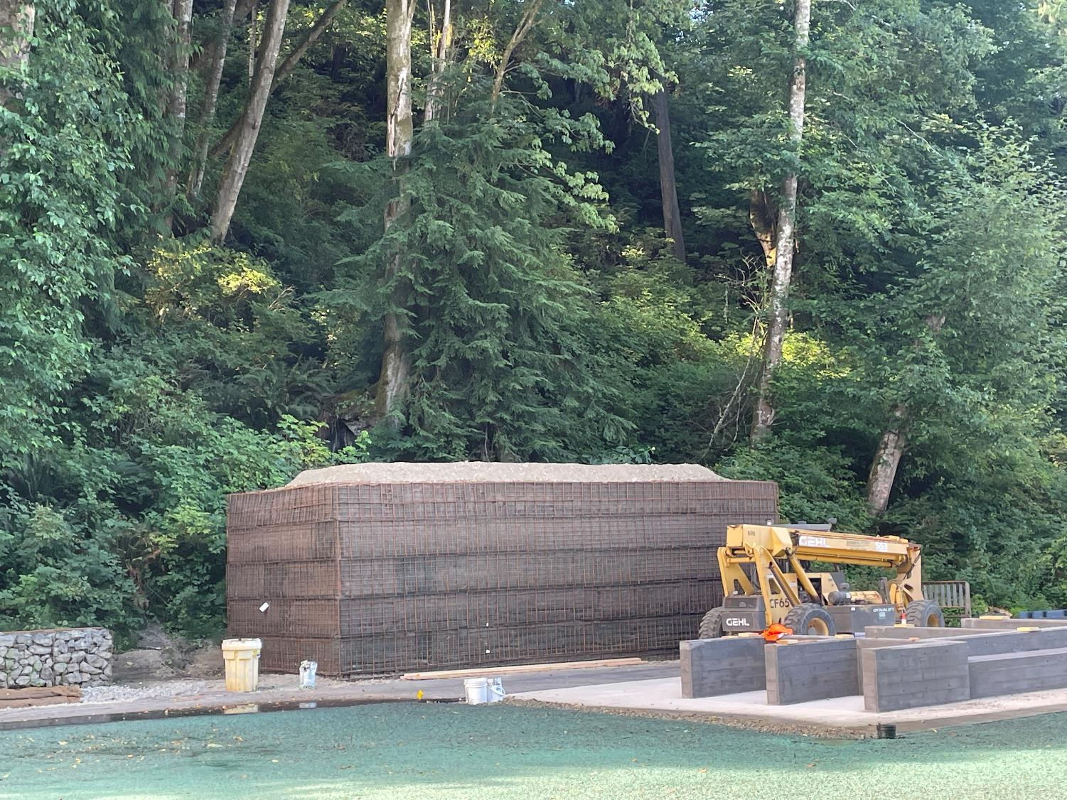
Landslide Hazard Barrier Wall to keep new infrastructure safe during a landslide.

Slide 12
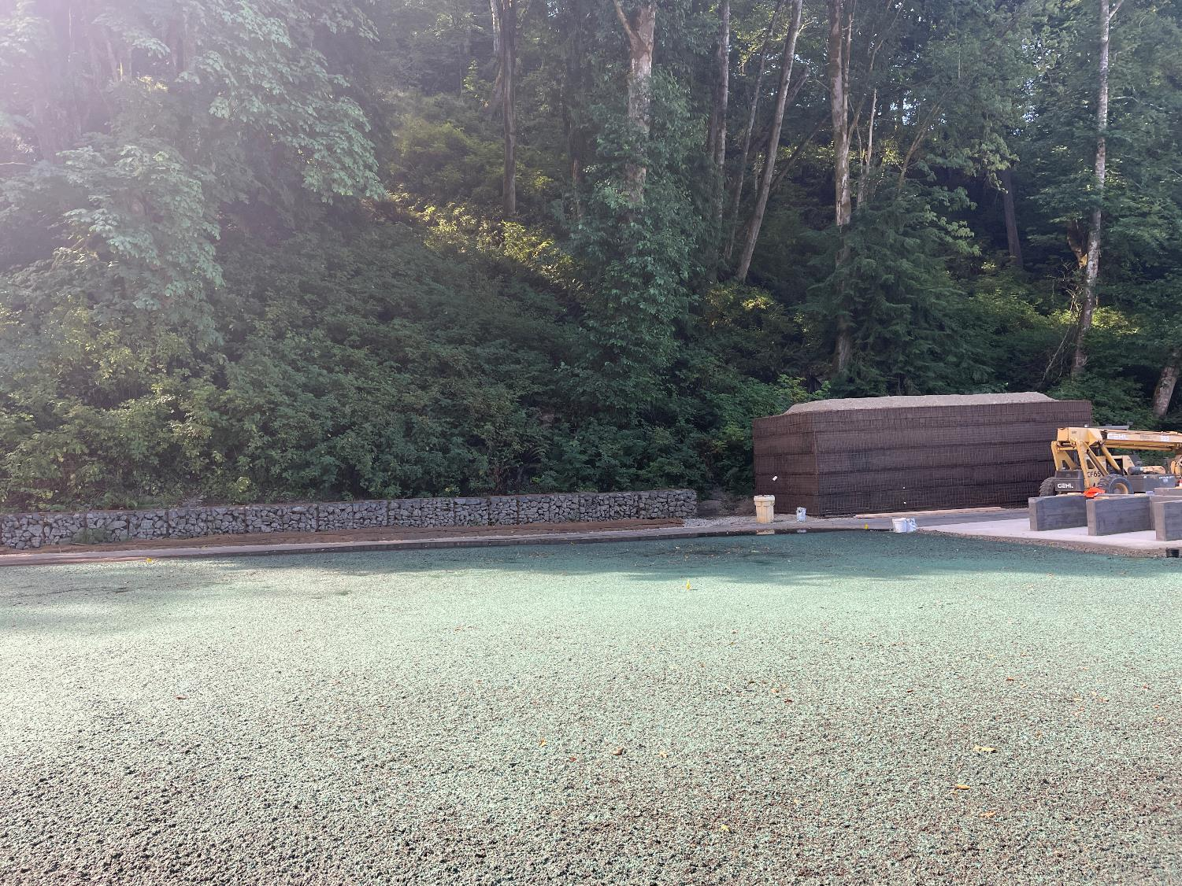
Landslide Hazard Barrier Wall to keep new infrastructure safe during a landslide.

Slide 13
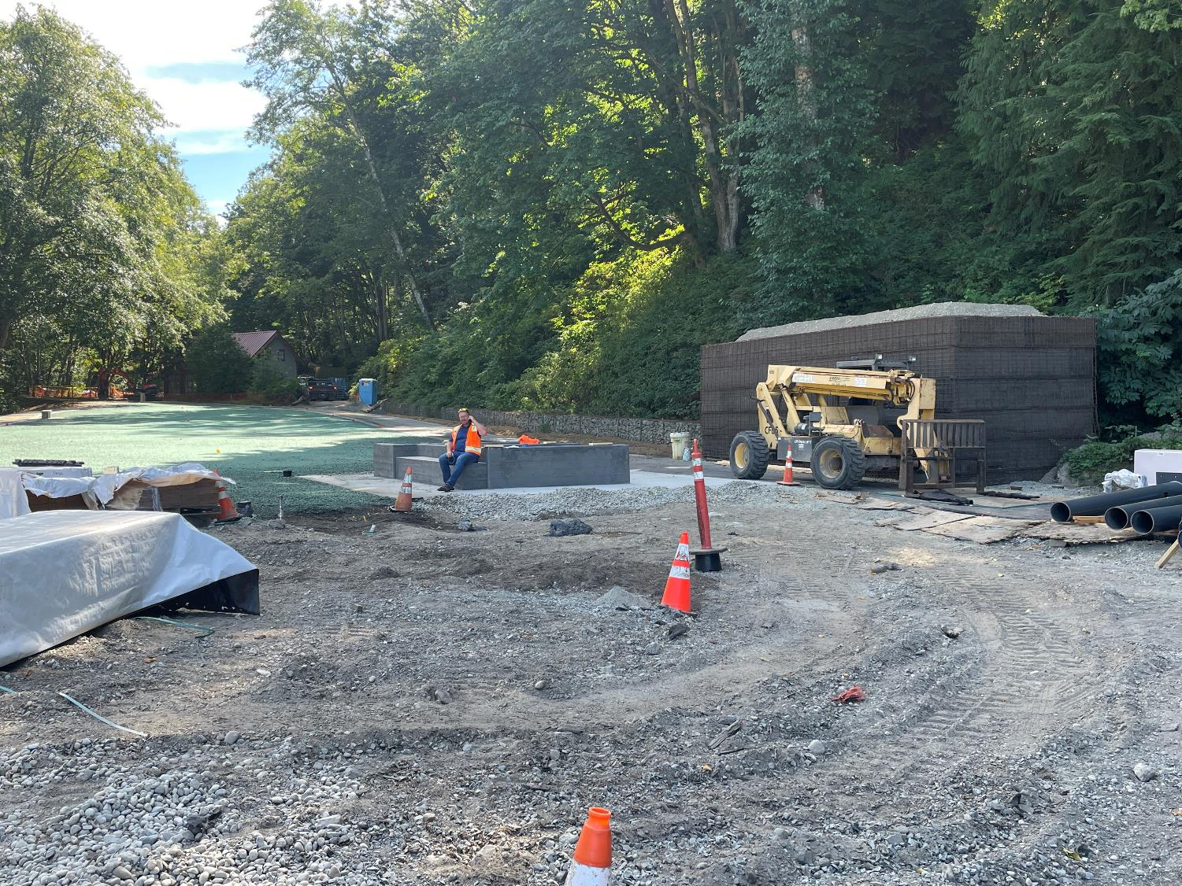
Bench seating incorporated into the retaining wall surrounding the Restroom Enclosure.

Slide 14
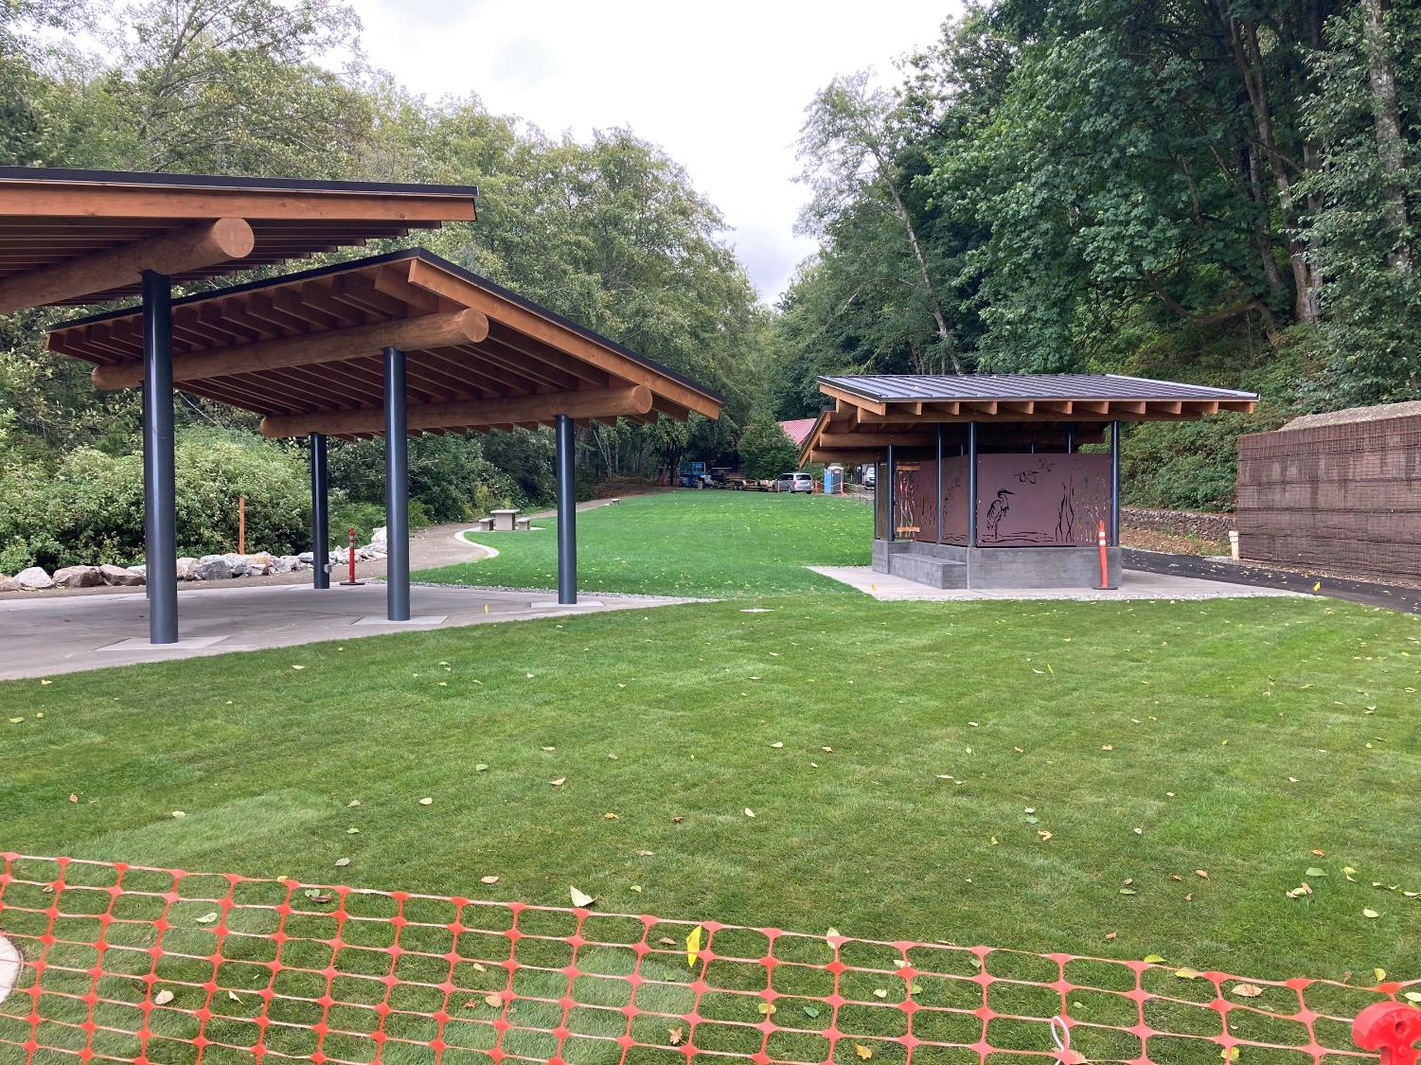
The new lawn area is establishing well.

Slide 15
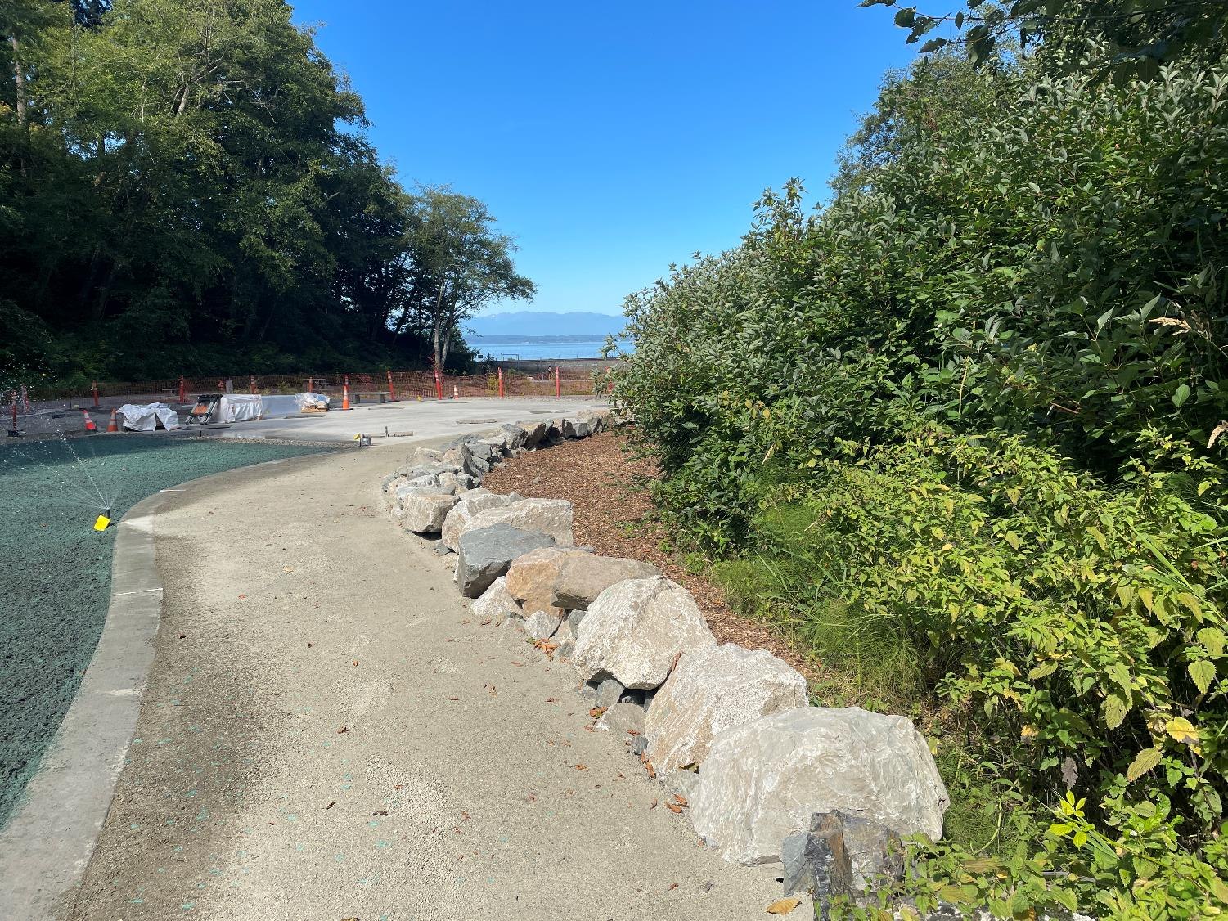
This crushed gravel path winds along the lower park and new lawn area and is ADA accessible.

Slide 16
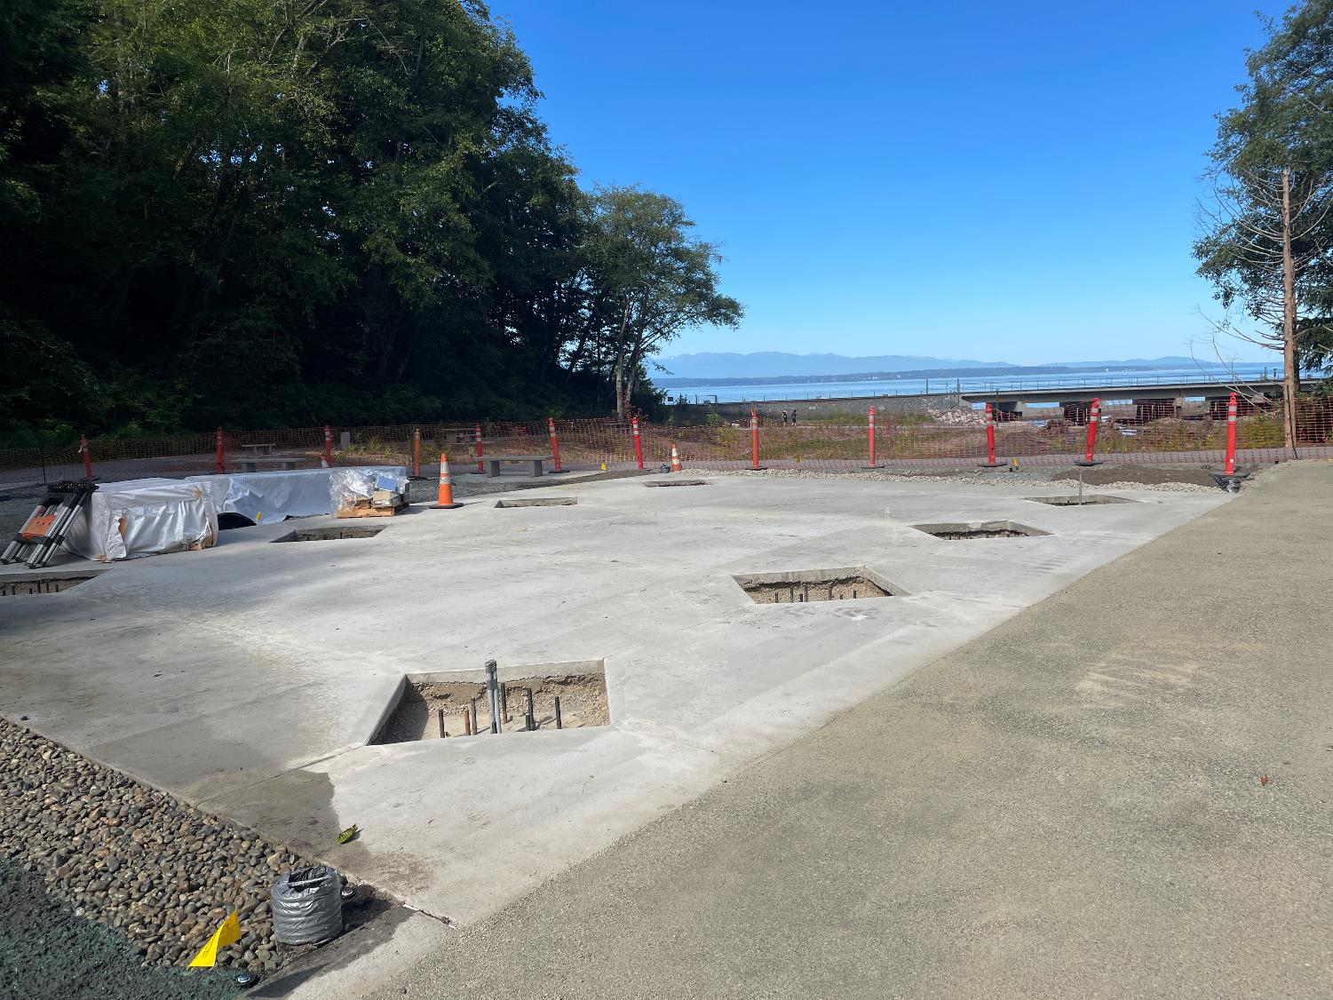
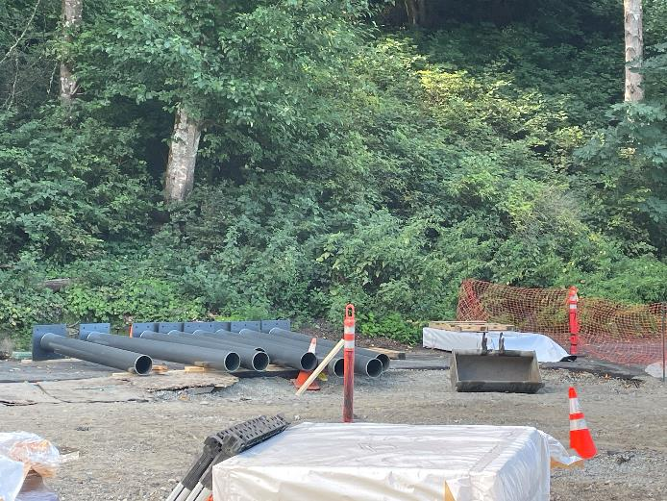
Construction progress on the picnic shelter.

Slide 17
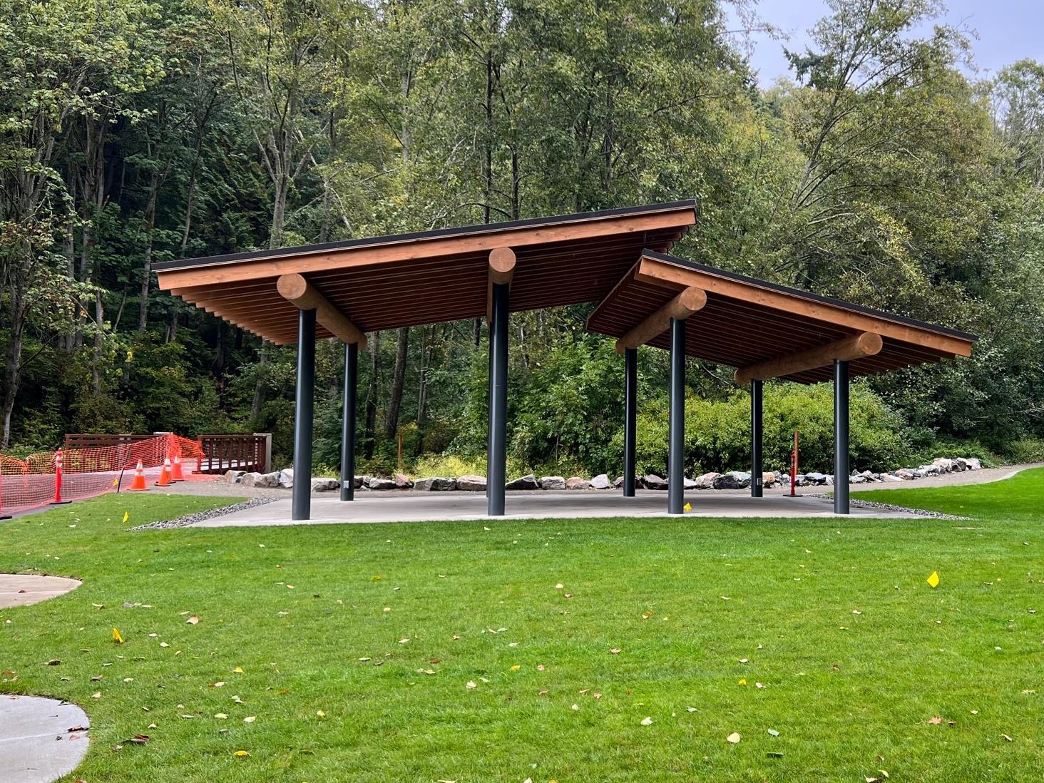
The new picnic shelter was designed to compliment the architectural style of the restroom enclosure and the existing house in the lower park.
Picnic tables will be added by Parks staff prior to the Ribbon Cutting event.

Slide 18
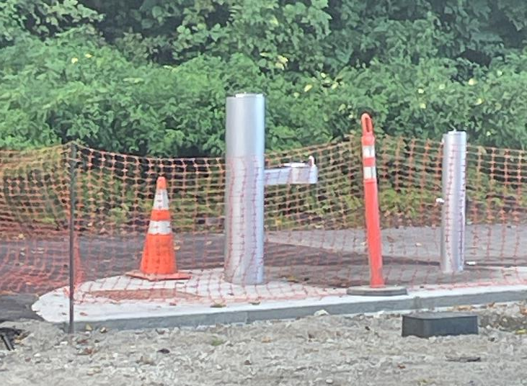
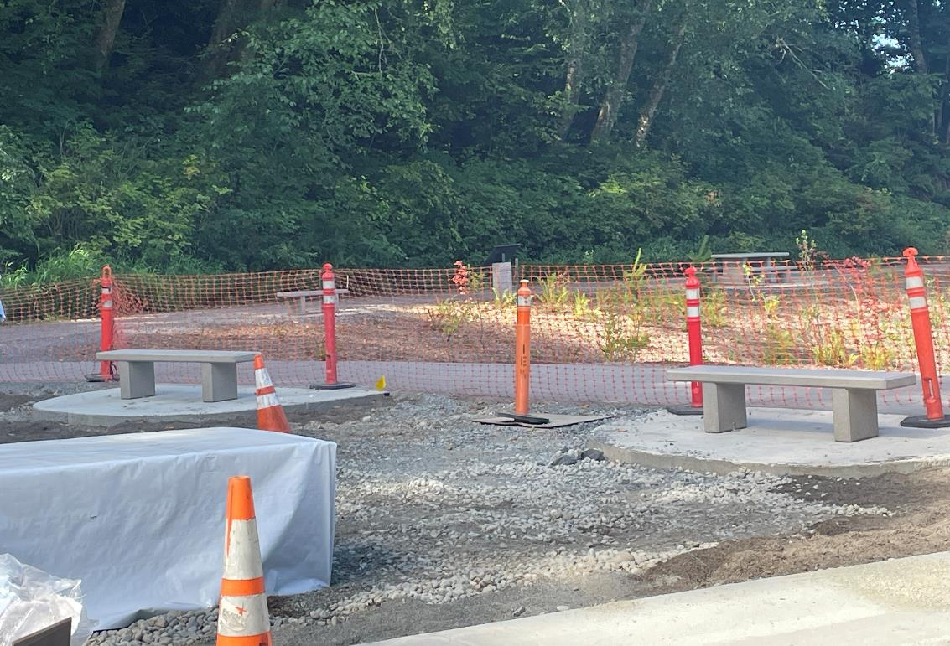
More benches on the edge of the lawn, and a water fountain and footwash station on the way to the beach.

Slide 19
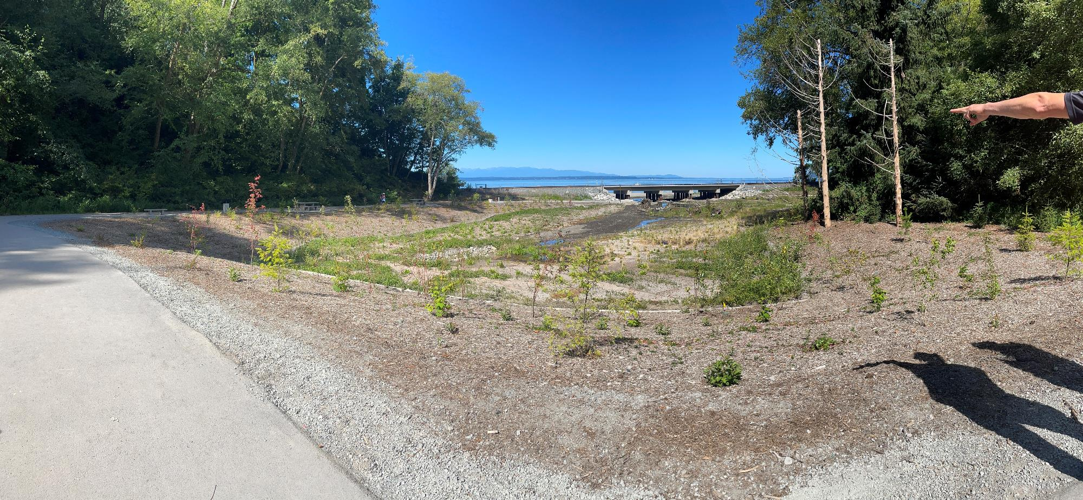
And here we have the pocket estuary inside the path to the BNSF bridge and ADA beach access.

Slide 20
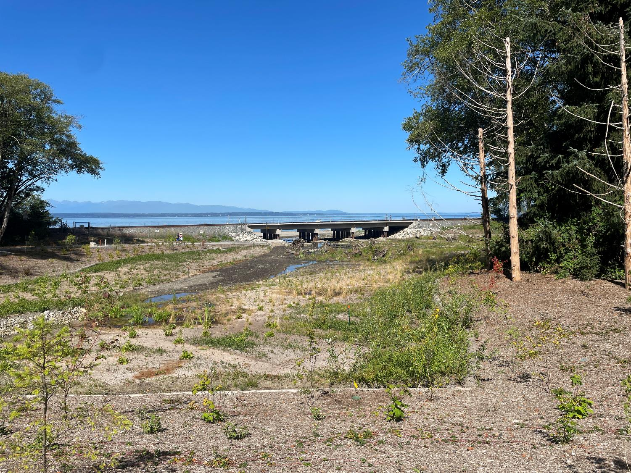
The riparian plantings are staying hydrated with sprinklers until established.
Before we head down to the beach, we’ll turn right towards the Lund’s Gulch Creek.

Slide 21
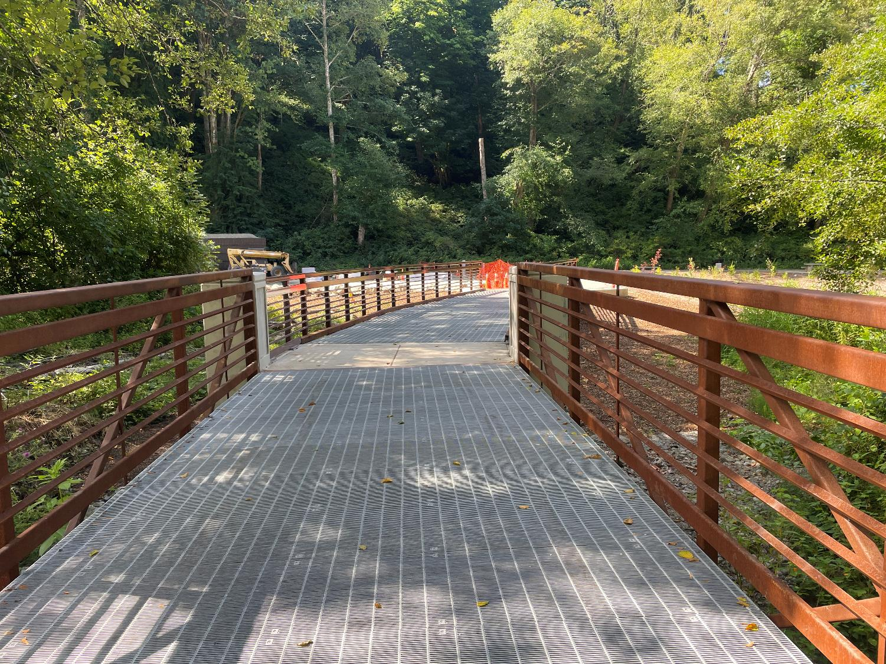
Looking back towards the lawn, future picnic shelter, and path to the beach -- over the bridge that crosses the creek.

Slide 22
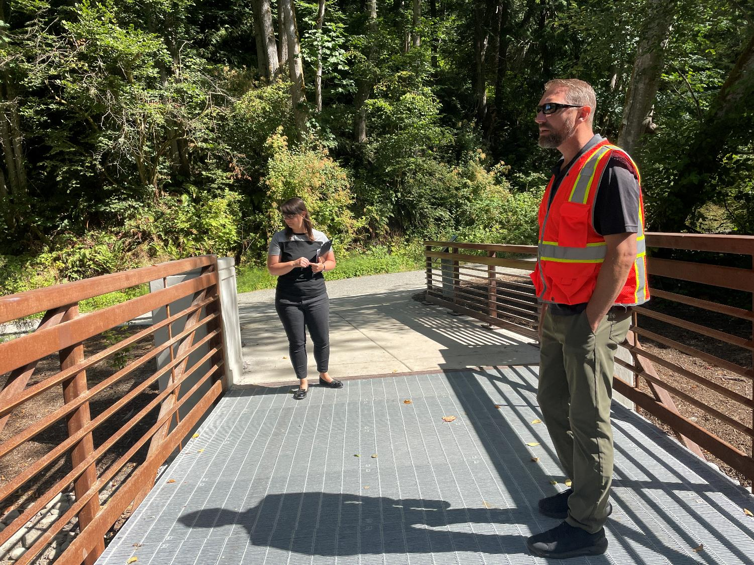
Looking towards trail that runs along the north side of the park on the other side of the creek.

Slide 23
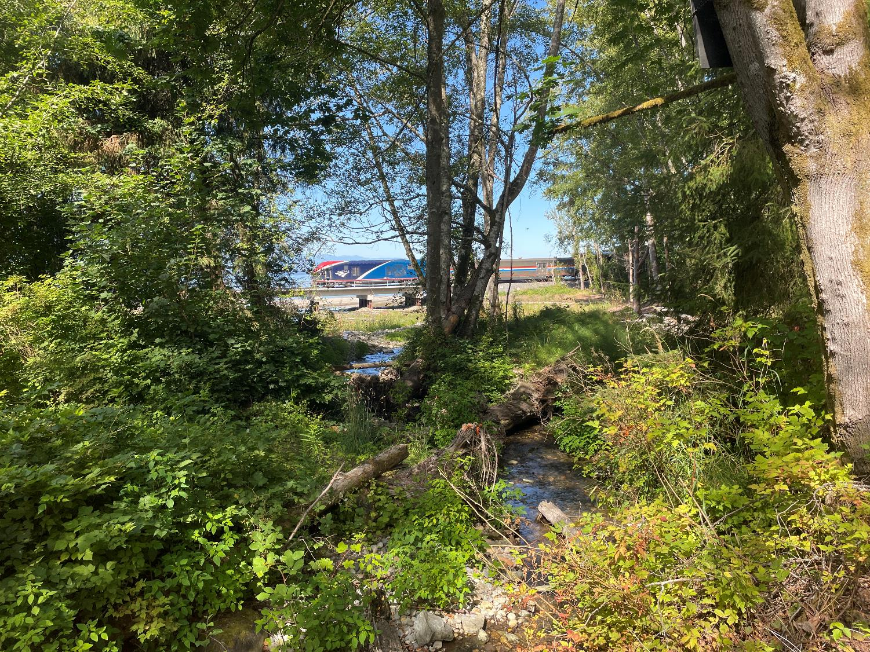
View looking west from the bridge – note the train crossing the bridge.

Slide 24
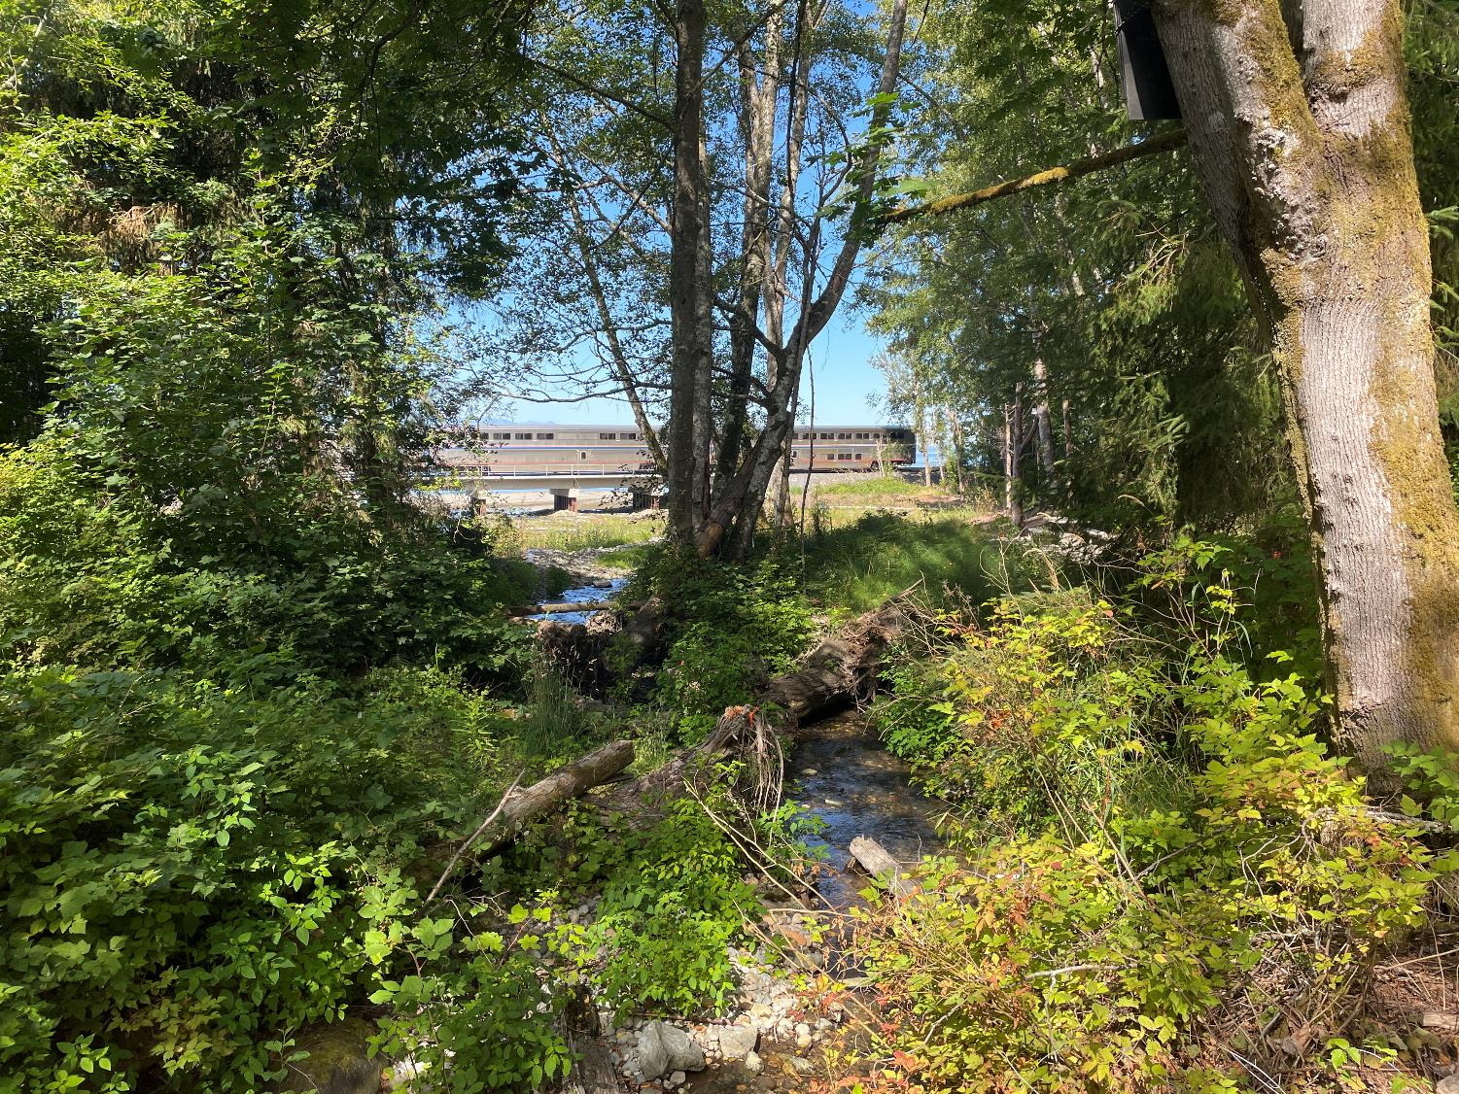
View looking west from the bridge – note the train crossing the bridge.

Slide 25
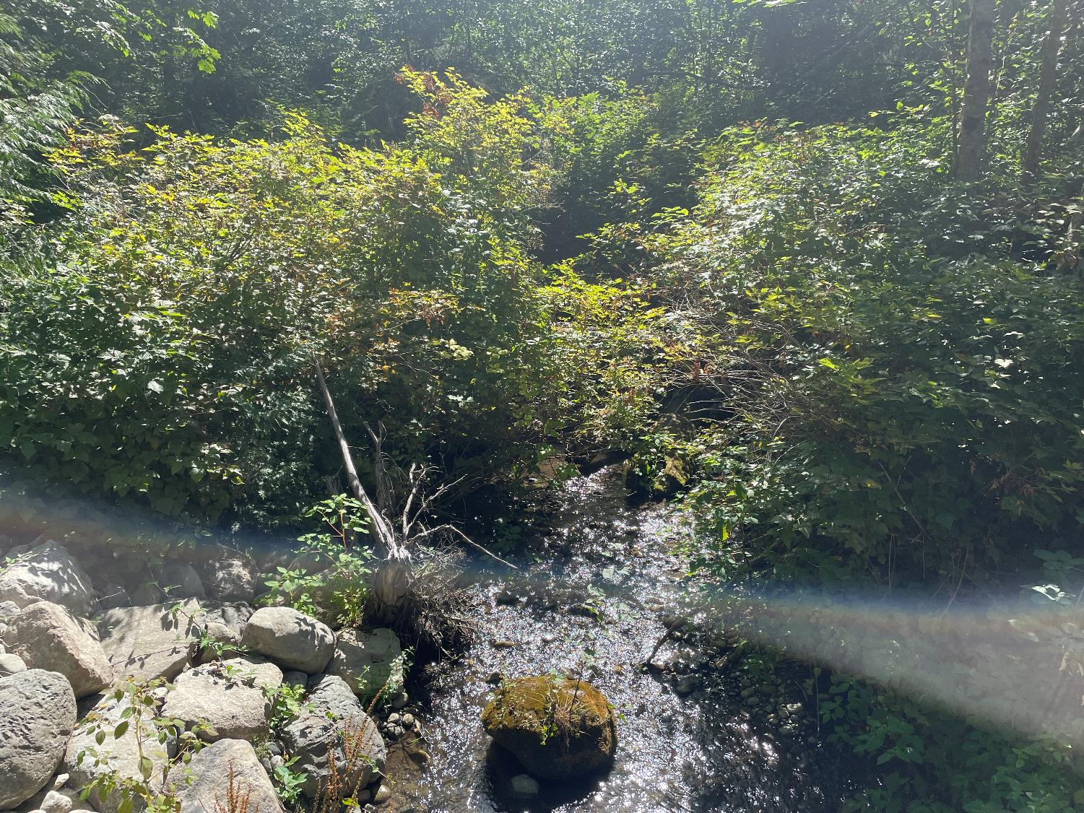
View looking east and upstream from the bridge. (Rocks on left protect the bridge footings.)

Slide 26
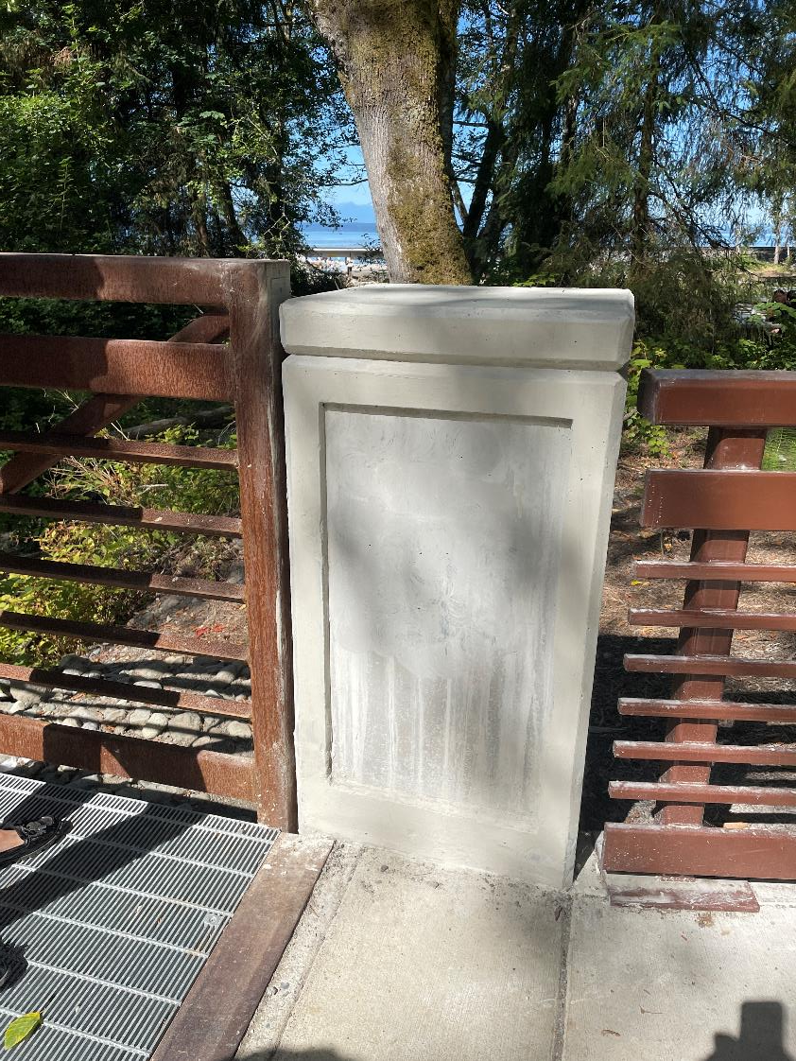
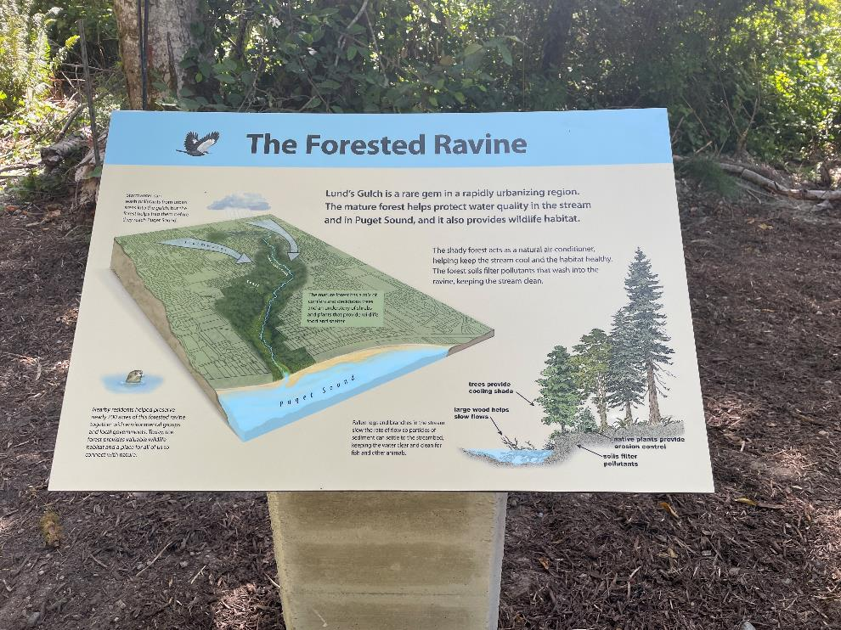
Ecosystem Signage.
The sign with project funders will be installed in the bridge post, shown on the right.
Notes:
Photos of the funding sign is coming soon.

Slide 27
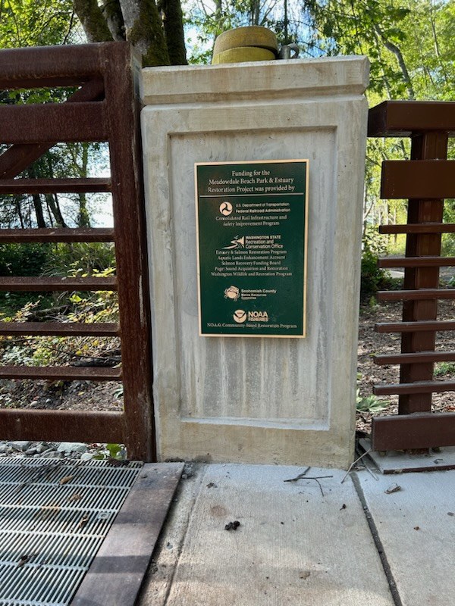
The funding acknowledgement sign is mounted to the pillar of the pedestrian bridge. It was purposefully placed here so visitors will see it as they enter the new lower park area.

Slide 28
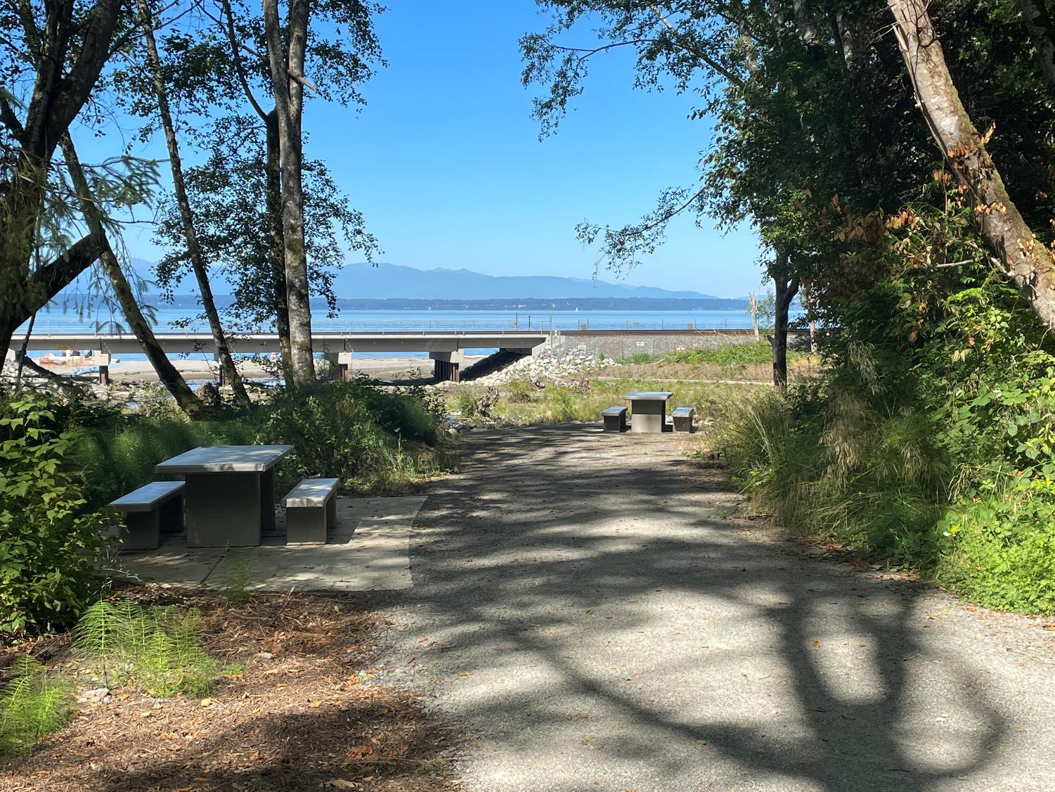
Follow the northern trail to its end for a view over the creek mouth, pocket estuary, bridge, beach, and Puget Sound along with 2 picnic tables.

Slide 29
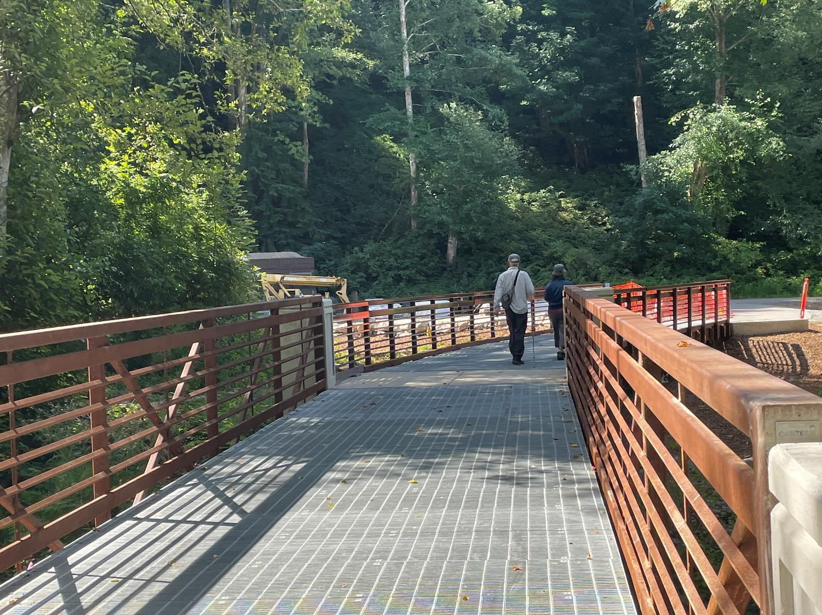
View looking south over the pedestrian bridge – towards the lawn and picnic shelter.

Slide 30
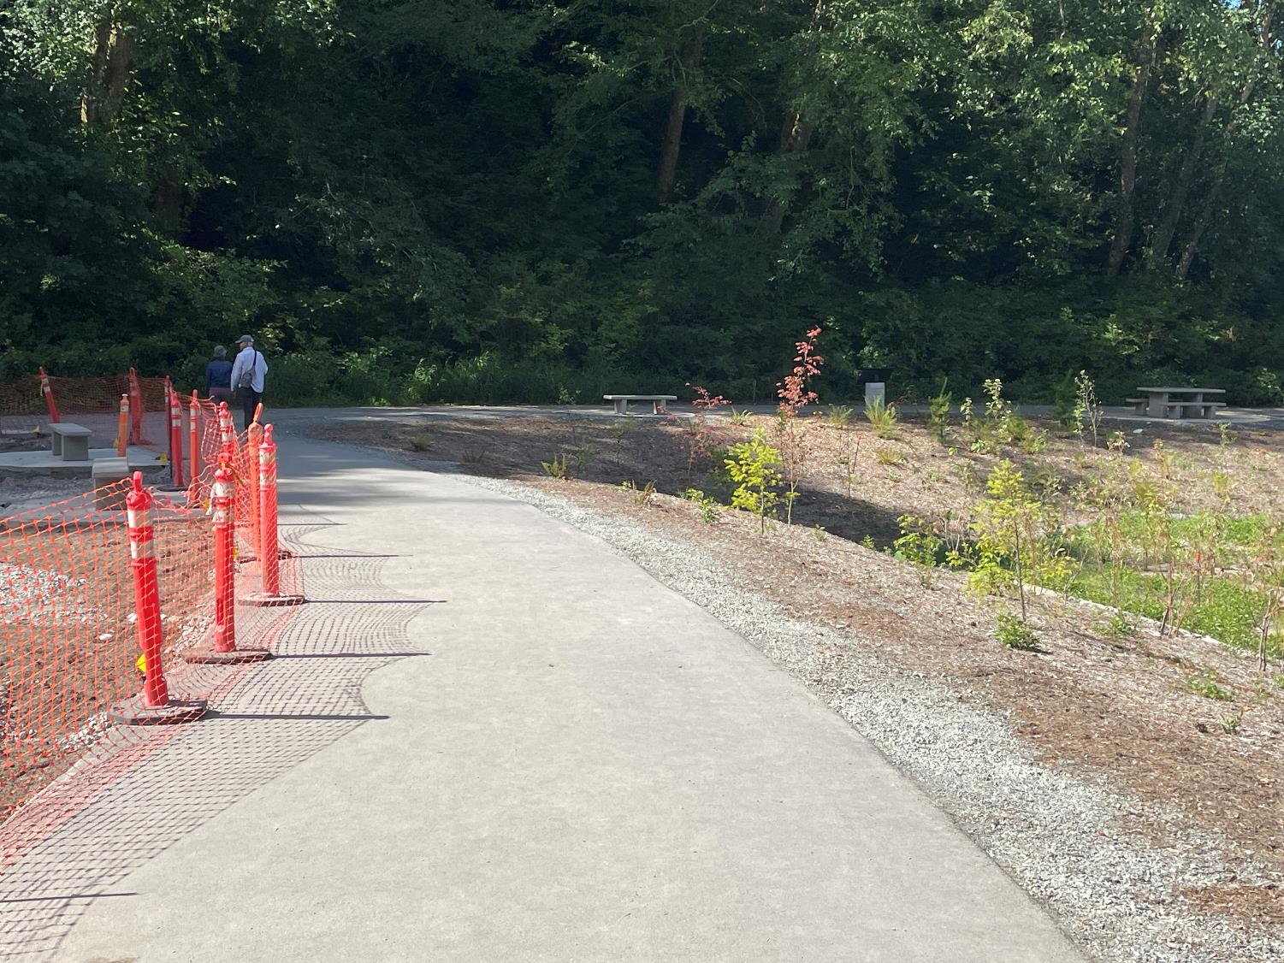
Now we’ll walk down around the pocket estuary to the beach.

Slide 31
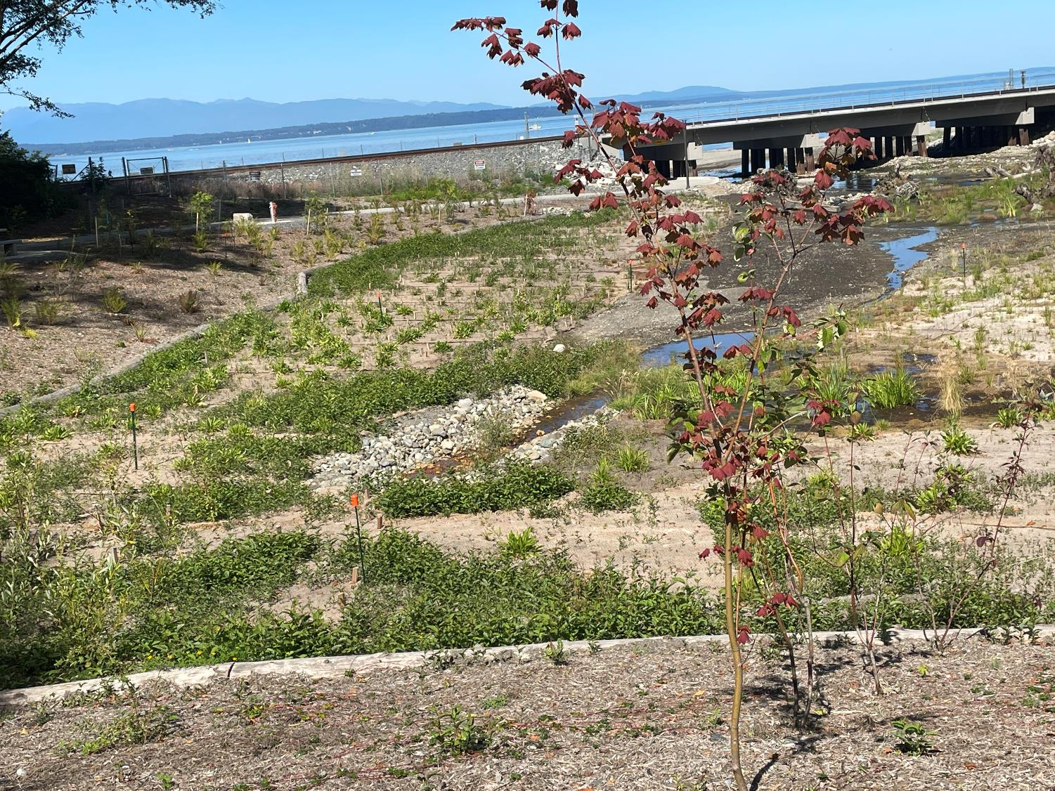
Stormwater outfall from upper park area.

Slide 32
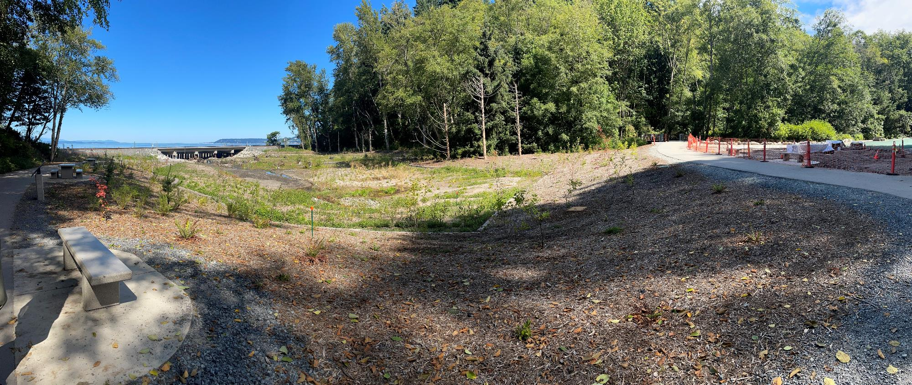
Two more picnic tables, an educational sign, and a bench on the path to the beach with views out onto the pocket estuary.

Slide 33
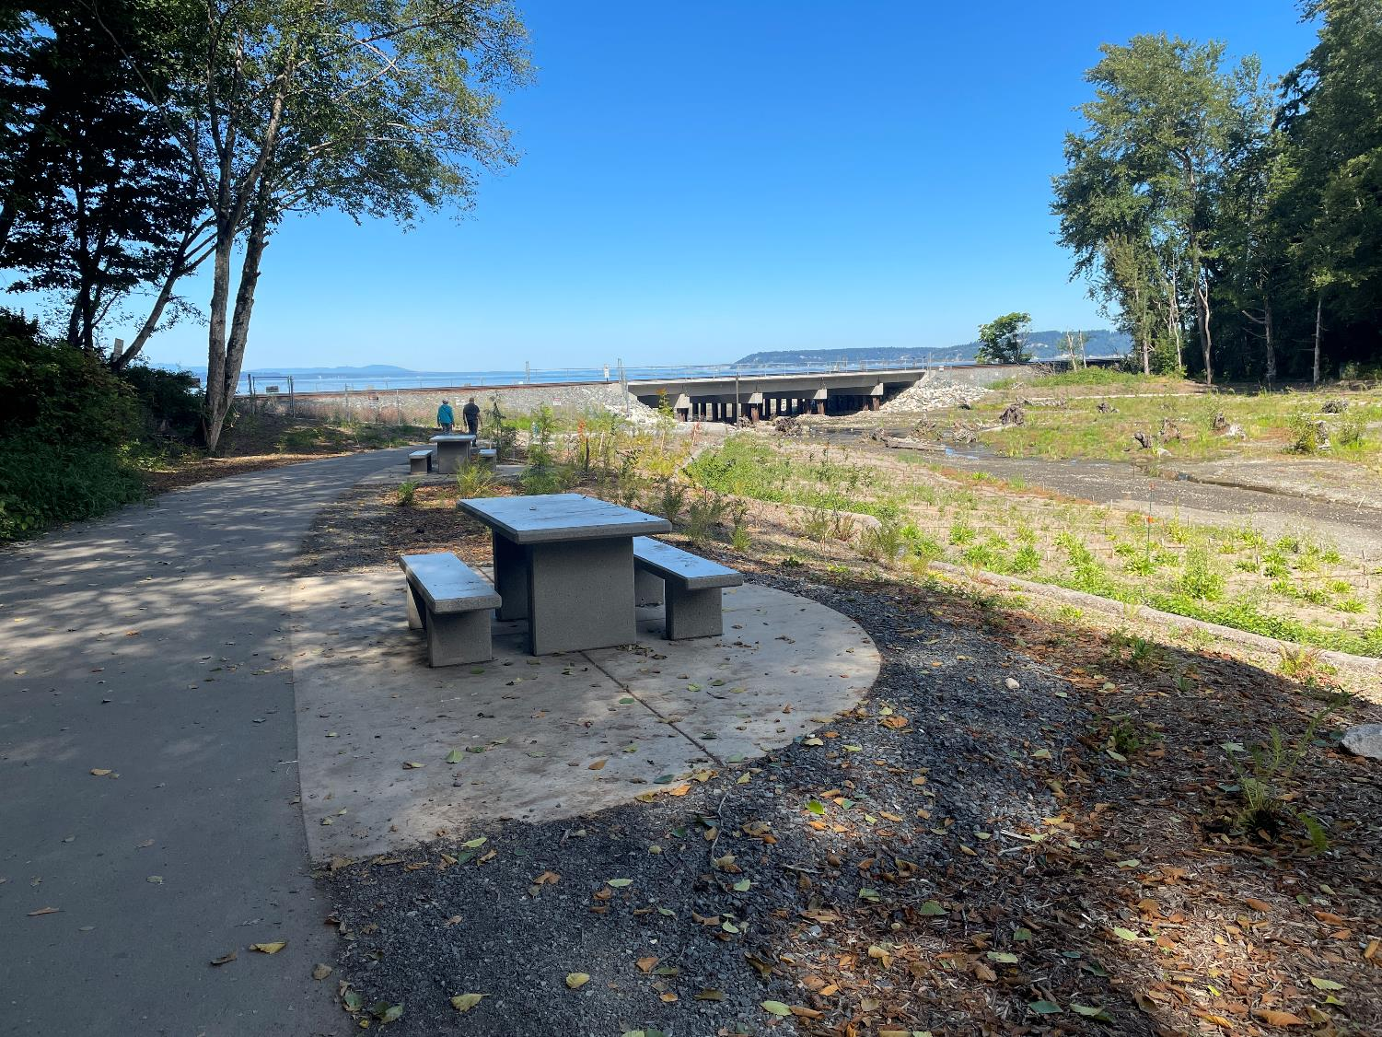
Picnic tables on the path to the beach with views out onto the pocket estuary.

Slide 34
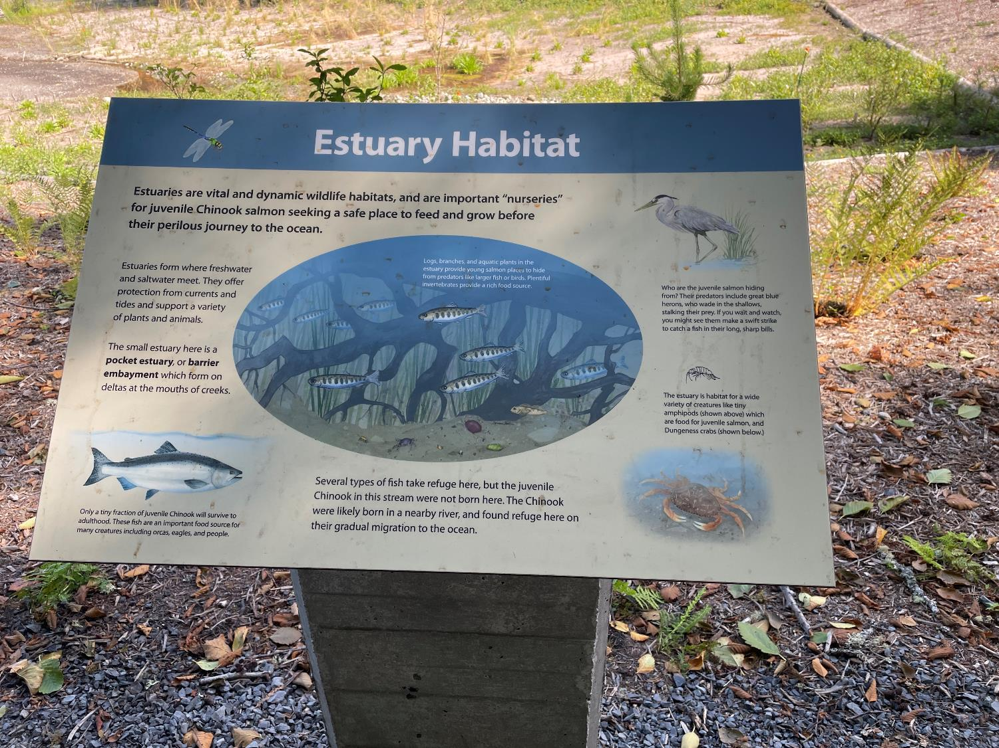
Educational ecosystem sign.

Slide 35
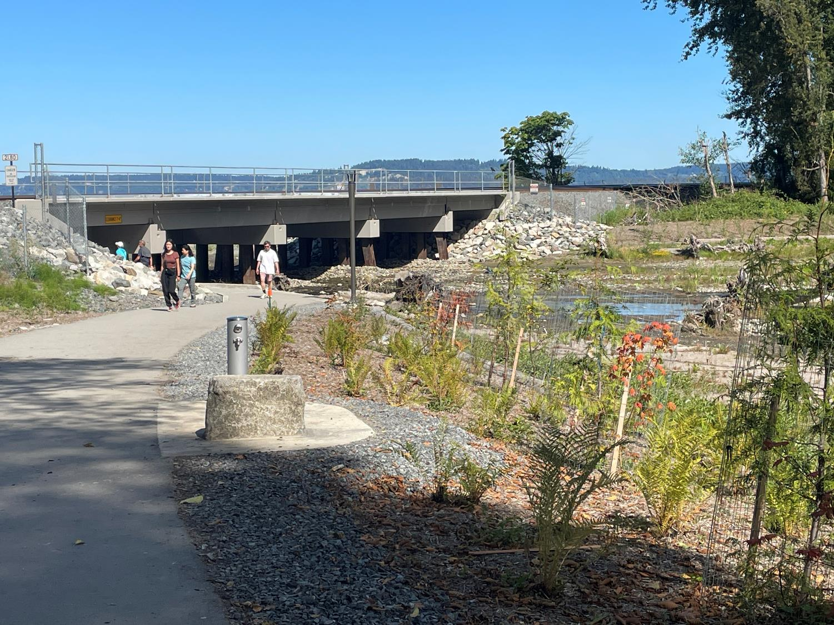
A foot wash station with a stone for seating.
Riparian plantings seem to be doing well in the August heat.

Slide 36
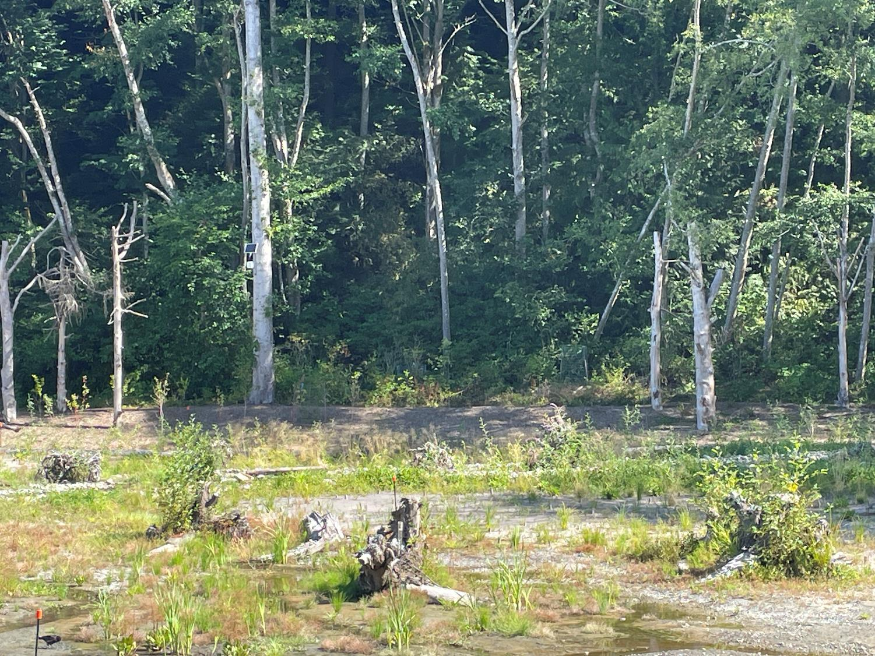
Rootwads placed in estuary to create habitat.
Estuarine emergent plants are helping establish the marsh.

Slide 37
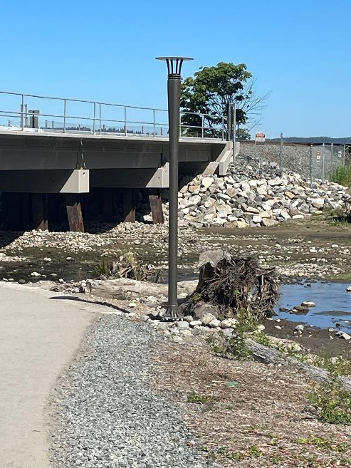
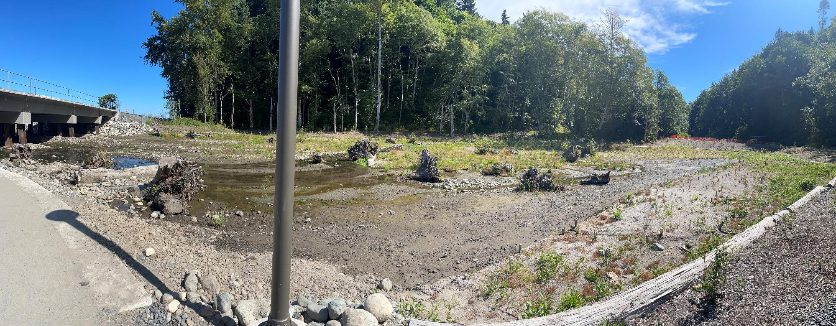
High tides and stream flows have begun to further shape the habitat.
The sole electric light.
Notes:
PROPOSAL INDICATED THERE WOULD BE 53 STRUCTURES… some individual logs, anchored and unanchored, and logjams anchored and unanchored. Looks to be less? PLEASE CLARIFY and ADD PHOTOS IF WE ARE MISSING THESE ENHANCEMENTS IN THIS PPT.

Slide 38
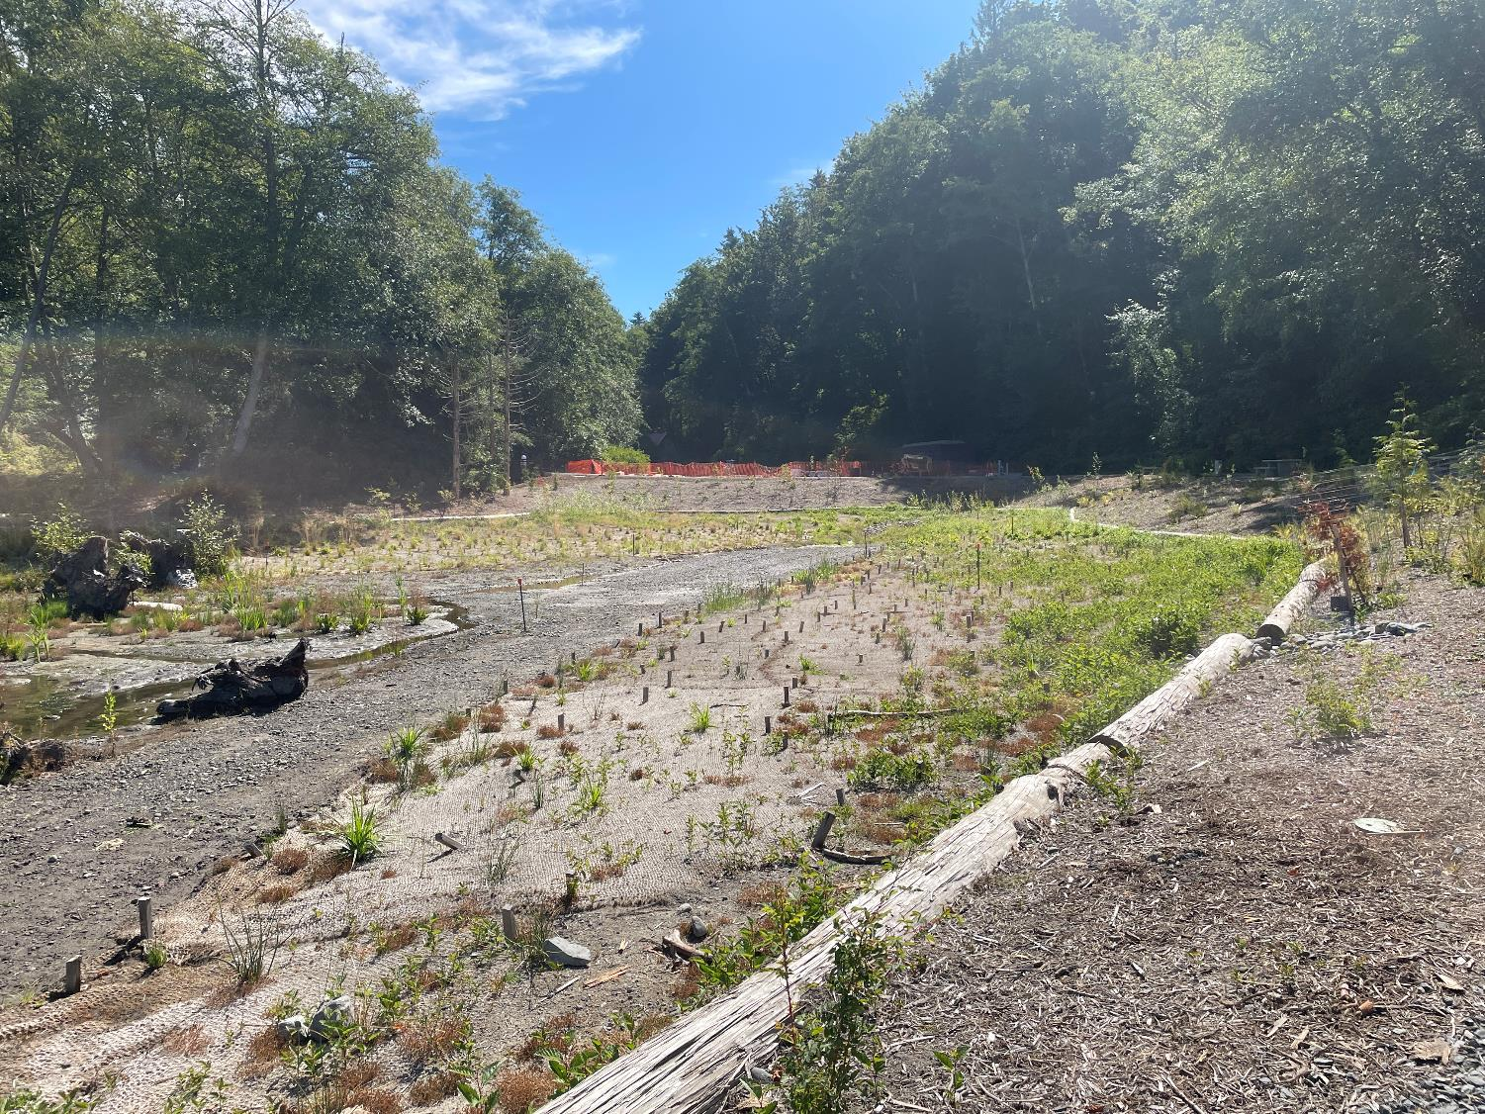
Looking east towards the lawn and picnic shelter, across the pocket estuary.

Slide 39
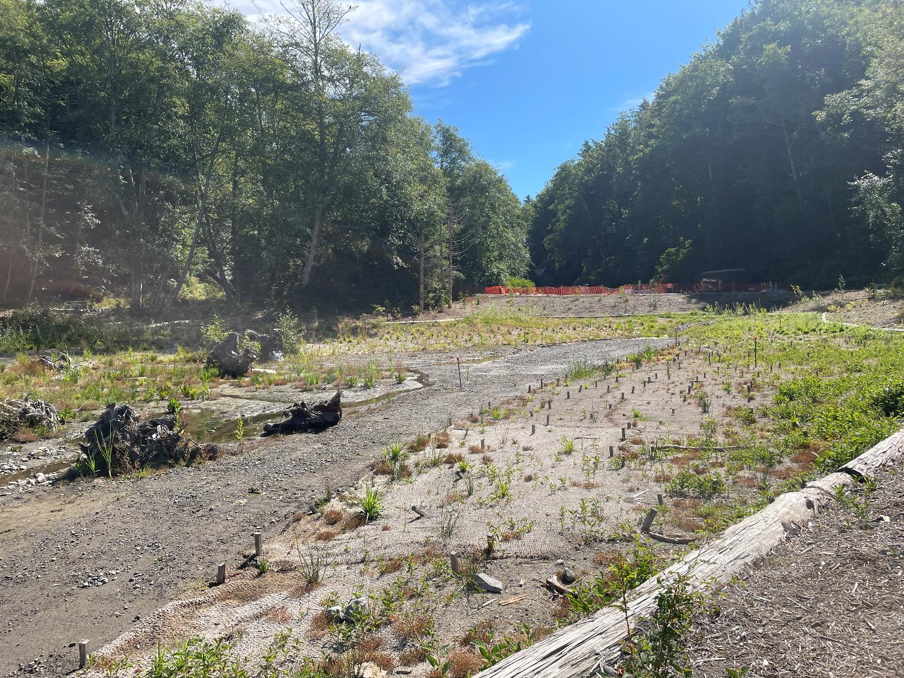
Looking east towards the lawn and picnic shelter, across the pocket estuary.

Slide 40
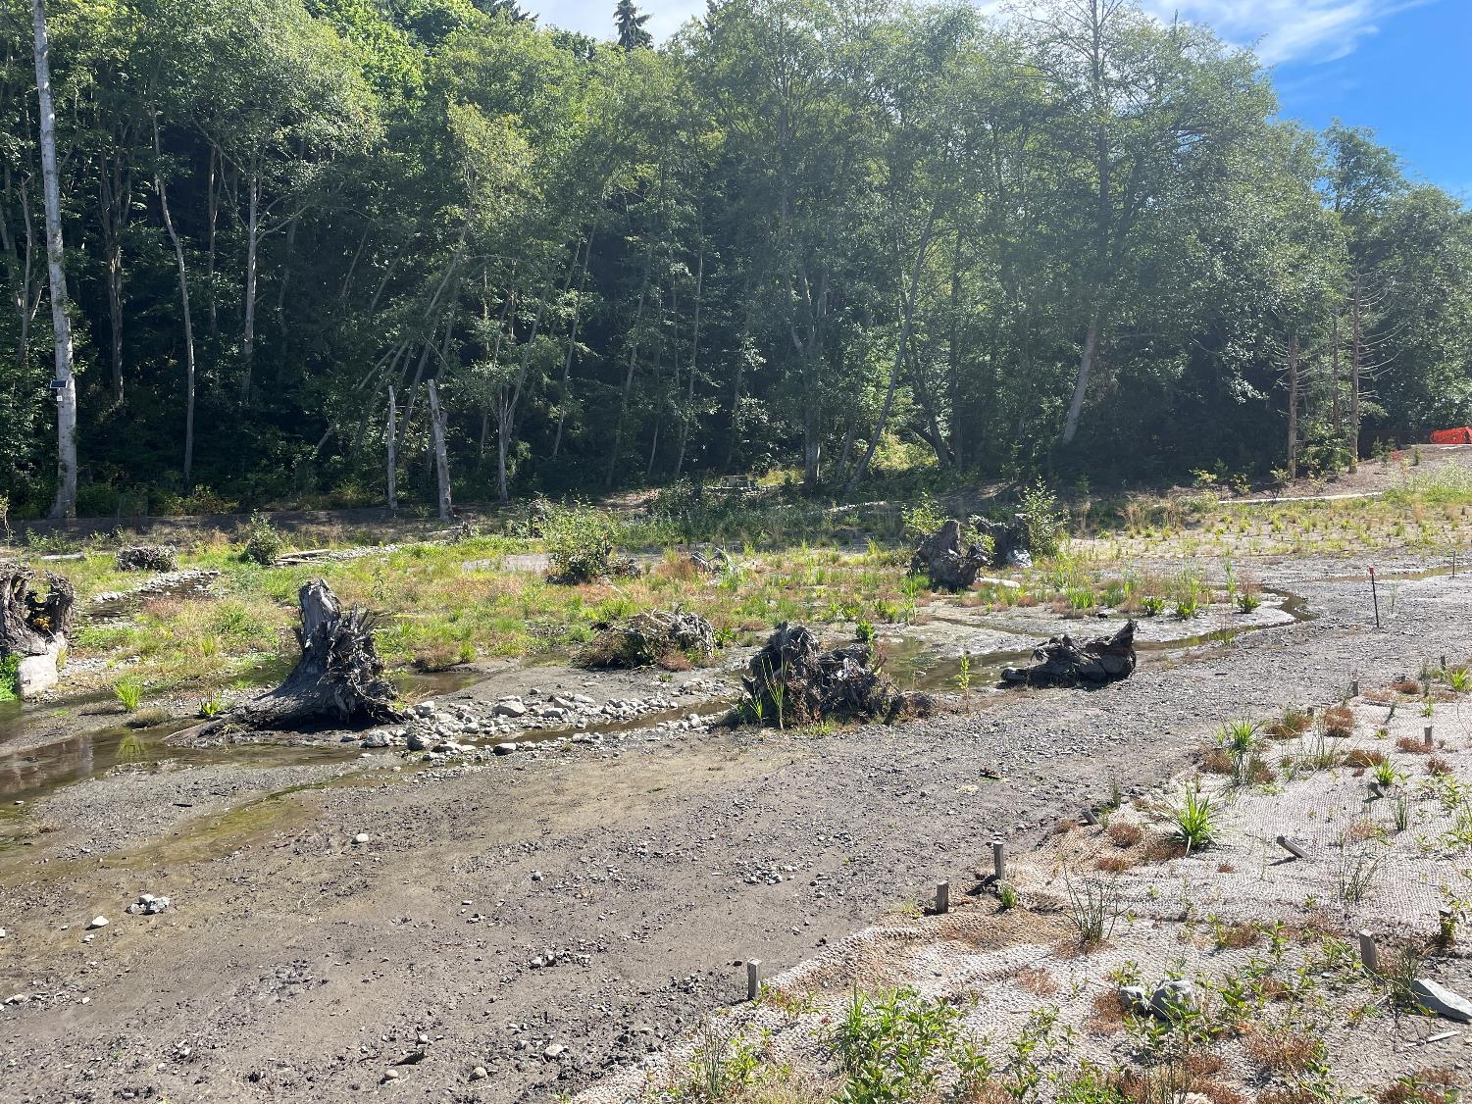
Looking north towards the creek mouth, across the pocket estuary.

Slide 41
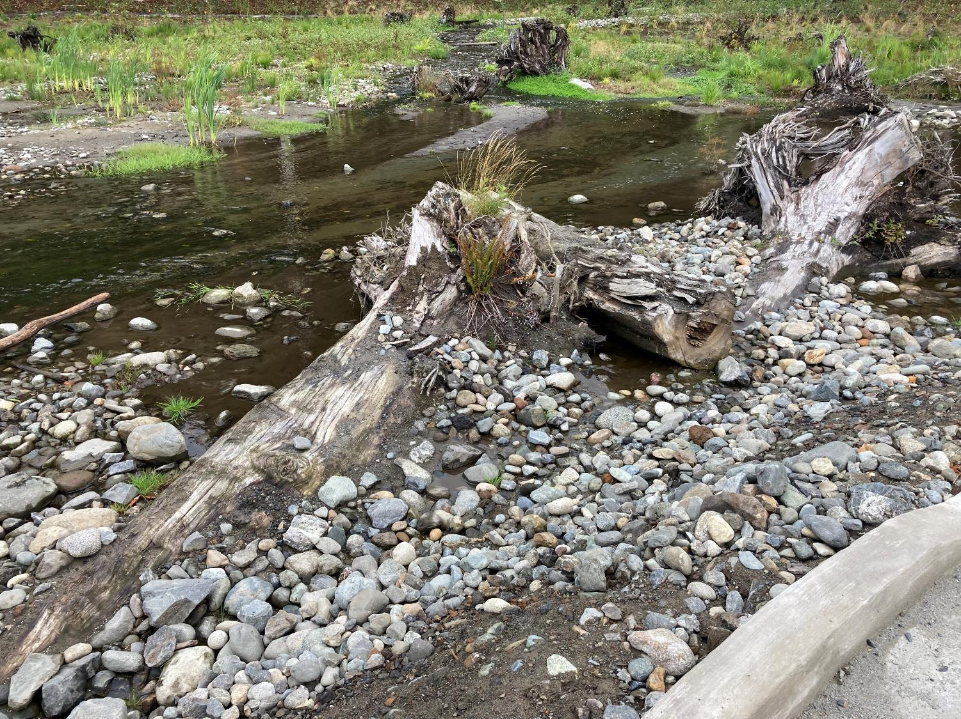
Large Woody Debris.

Slide 42
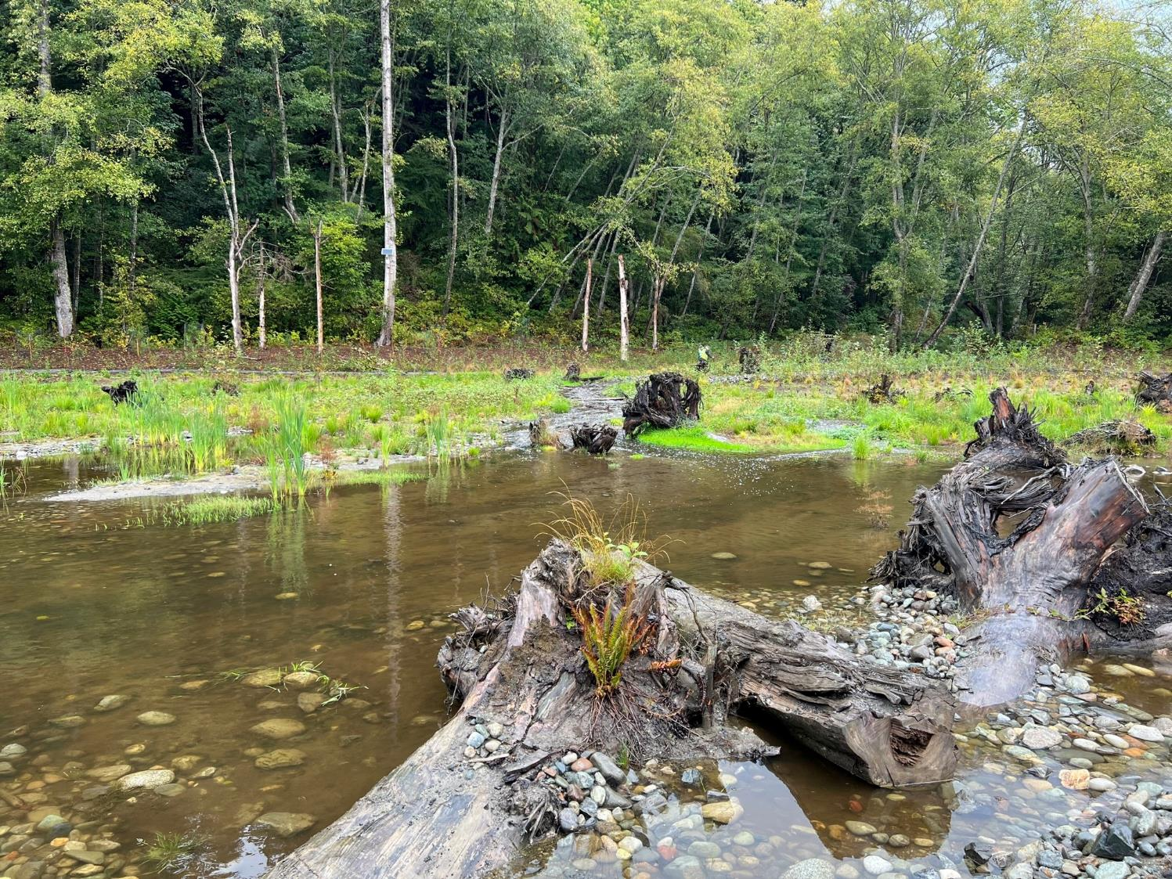
A similar image taken at near high-tide.

Slide 43
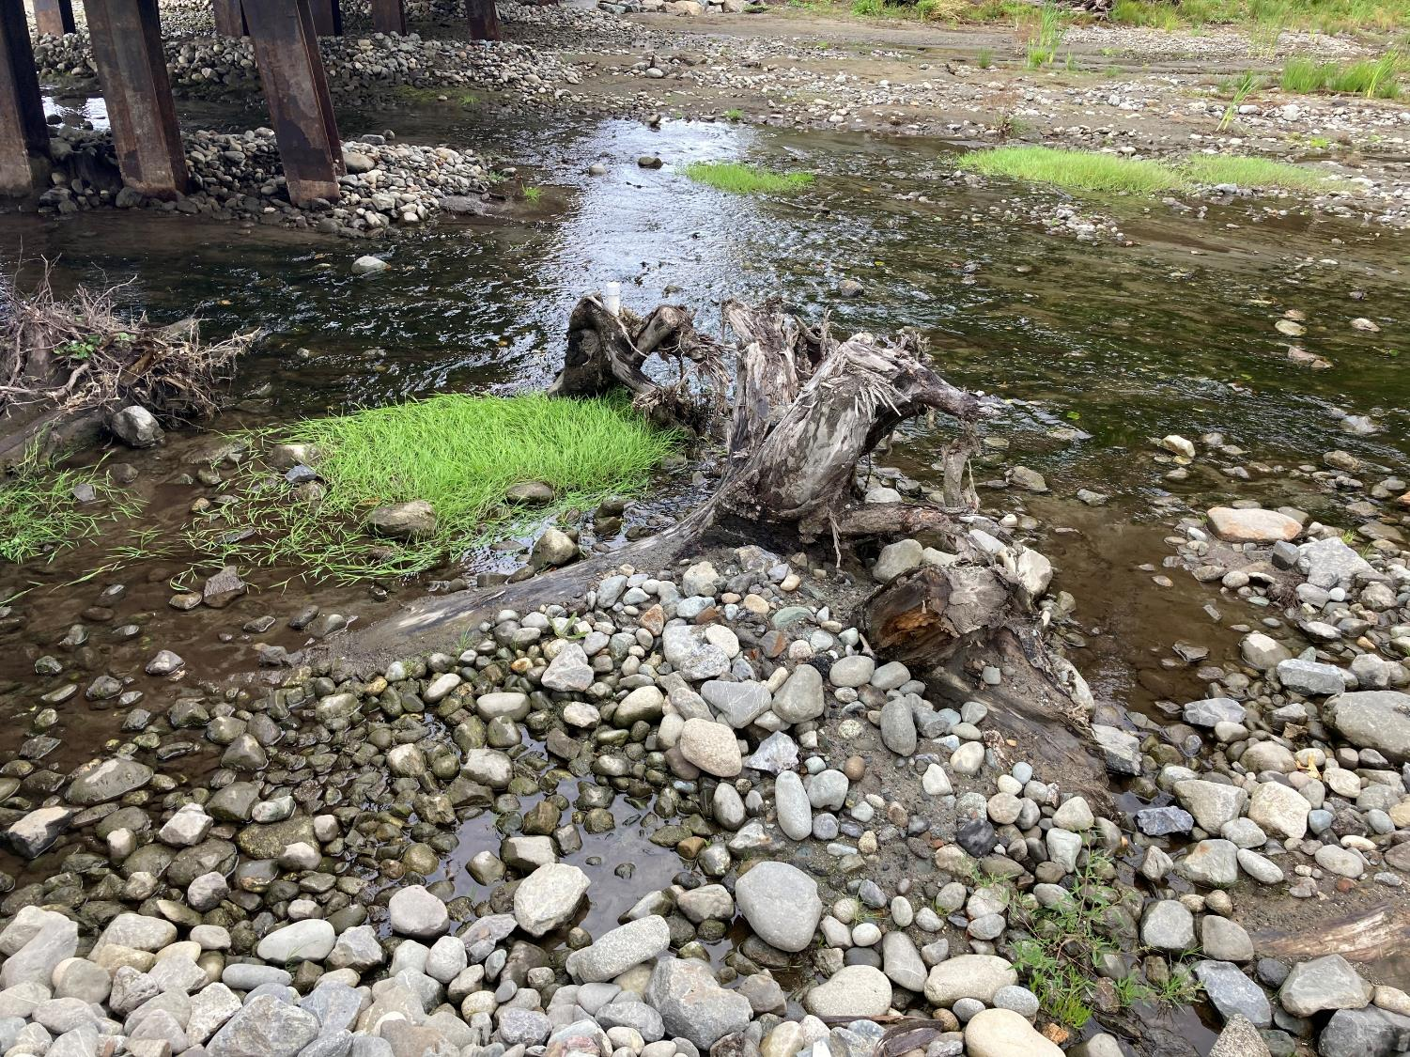
Large Woody Debris.

Slide 44
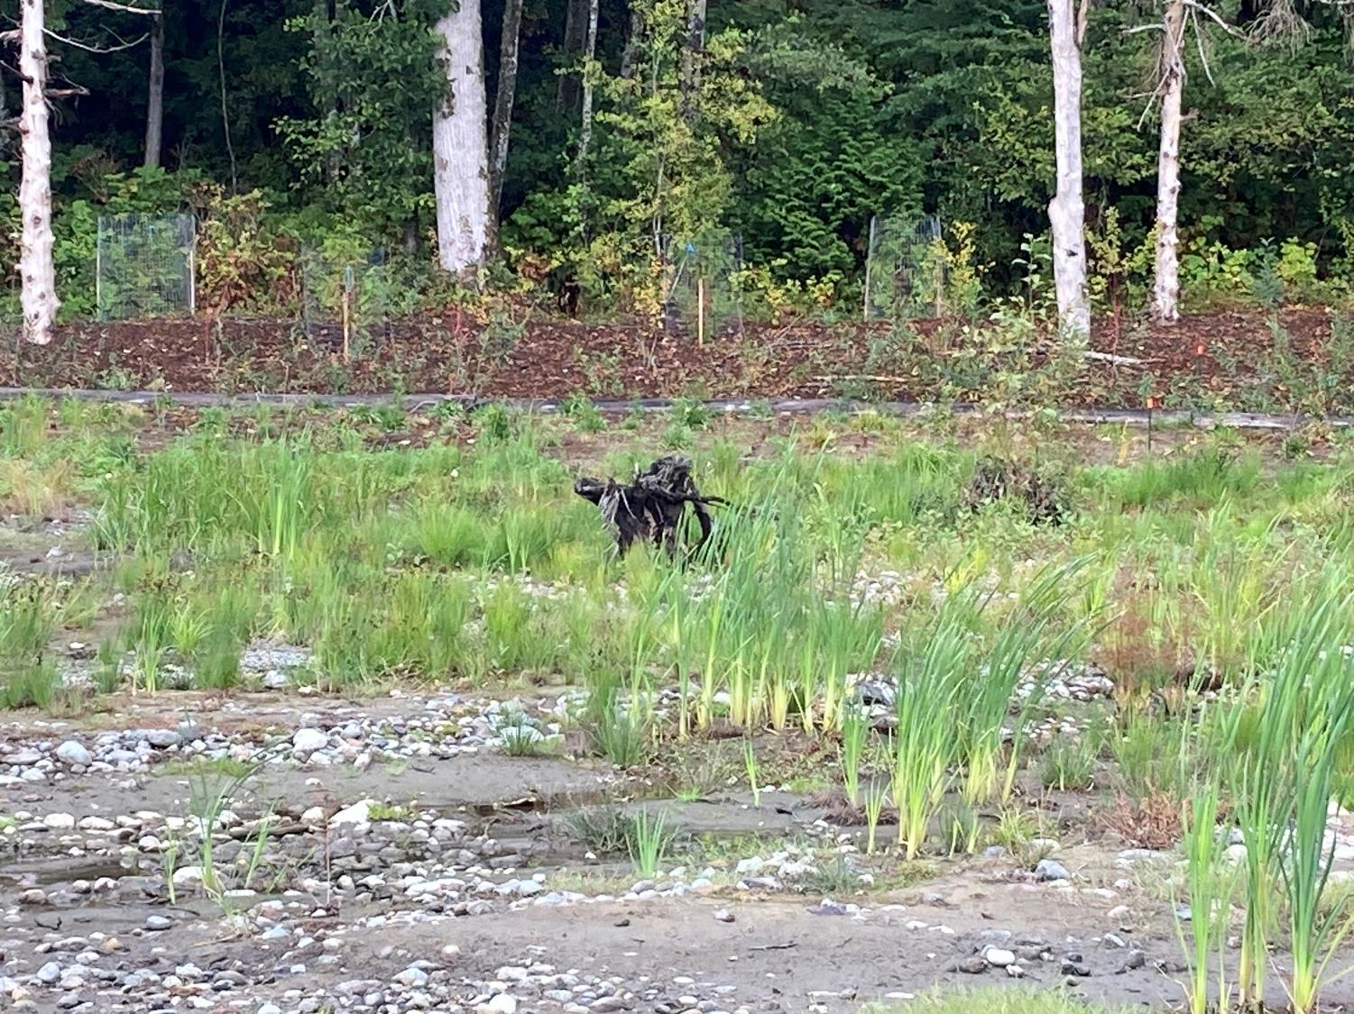
Large Woody Debris.

Slide 45
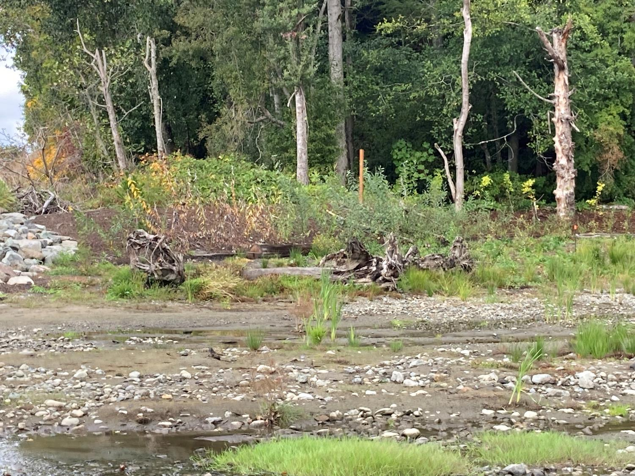
Large Woody Debris.

Slide 46
Large Woody Debris.

Slide 47
Large Woody Debris.

Slide 48
Large Woody Debris.

Slide 49
Large Woody Debris.

Slide 50
The BNSF Railroad Bridge – 5 span – was funded with a Federal Railroad Administration grant. RCO funding was not needed for this element.
SRFB and ESRP funding focused on the estuary fill removal, habitat enhancements, and riparian planting.
ALEA and WWRP funds focused on the park amenities including the pathways, benches, picnic shelter, and restroom infrastructure.

Slide 51
The trail needed to narrow a bit under the bridge to provide room for the bridge footings and rock revetment, but it is still wide enough for a wheelchair and pedestrian to pass.
Notes:
The revised width (7’) exceeds ADA minimum requirements for path width.

Slide 53
On the other side, a bench and environmental education sign for visitors.

Slide 54
The ADA beach mat makes it easier for wheelchairs to gain access further onto the beach.
The county pulls the mat out and stores it after September 30th per WDFW requirements.
Notes:
Elizabeth, I edited this note and want to clarify here that this access mat is not intended to be a water access mat. When the tide is very high, the mat may be covered with water but the mat is intended to give access further out to the beach and not the water.

Slide 58
Looking northeast towards the pocket estuary under the bridge.

Slide 59
Recreational dams are forming at the estuary mouth. Snohomish County will need to consider ways to reduce impacts from such activities. Perhaps additional signage – or volunteer crews to deconstruct. And flood flows will likely disperse most of these.
Monitoring will be needed to determine whether fish passage is impacted.

Slide 60
Looking south along the beach to see the riparian planting, protected by the fencing.

Slide 61
Picnic table (former park infrastructure) with a view. Driftwood fort construction underway.

Slide 62
Lund’s Gulch Creek reach through the beach.
The berms were constructed to establish meanders that they hope the beach grass will colonize.

Slide 65
Creek connected to Puget Sound.

Slide 66
Kayaking campers floating by.

Slide 68
More recreational dams to be on the lookout for. Not a good feature for juvenile and adult fish passage.

Slide 69
Returning to pass under the bridge.

Slide 70
Before there was an undersized culvert, now we have easy access, pocket estuary connection, and safe bridge for BNRR

Slide 74
Once passed the estuary we crossed the creek again and took the norther trail east towards the caretaker home and the ADA parking area.

Slide 75
Rock retaining structure appears new – county will check to see if it is part of this project.

Slide 76
Caretaker housing.

Slide 77
Eastern-most extent of the creek enhancements. Bridge to parking area existed before this project was constructed.

