Slide 1
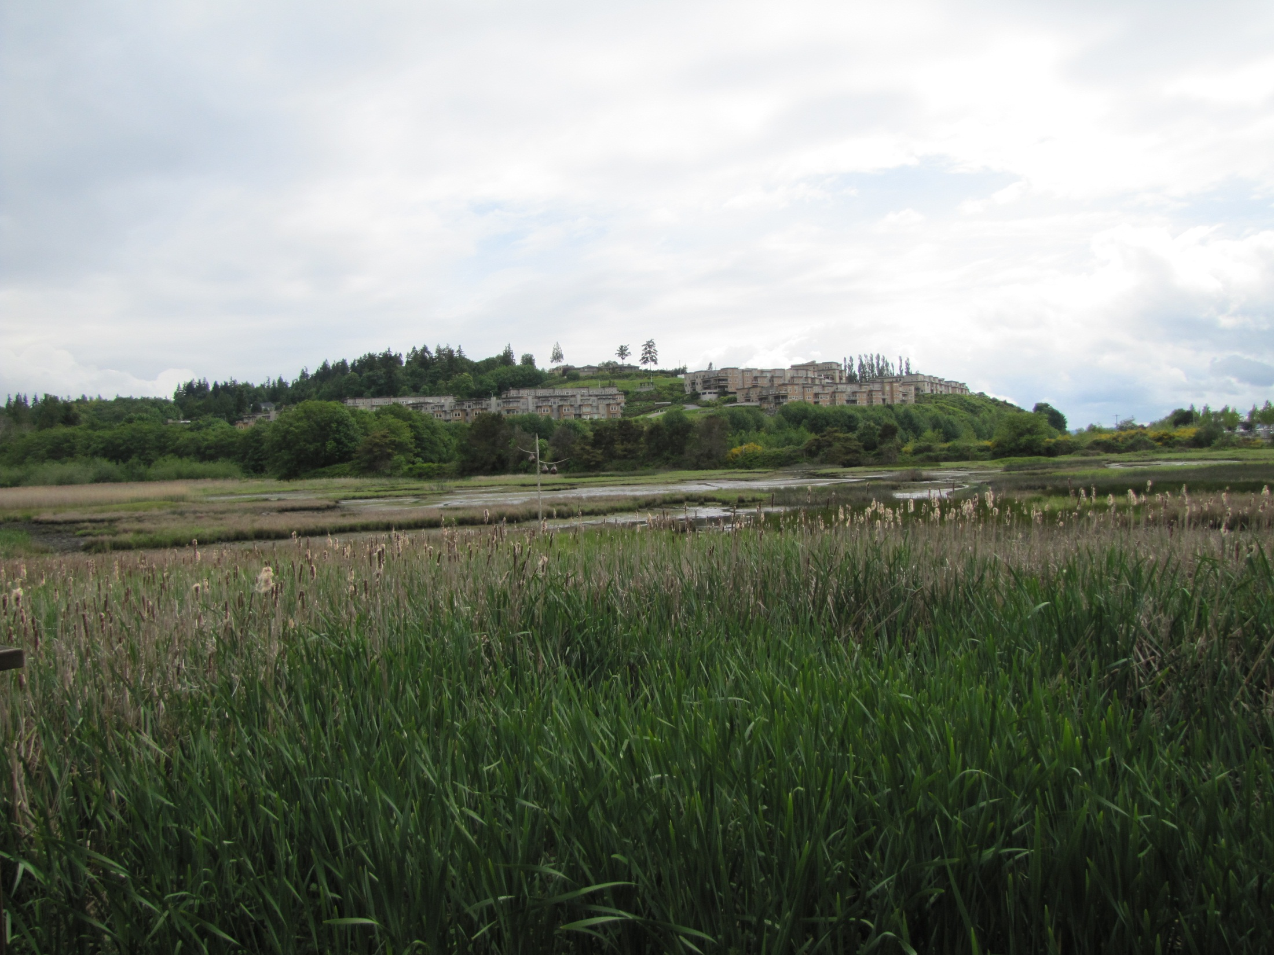
City of Edmonds Willow Creek Daylighting Final Feasibility Study (Edmonds Marsh) 13-1107 Site Visit May 22, 2013

Slide 3
