Slide 1
09-1623R, Trout Unlimited, Lower Wenatchee Flow Enhancement
by Marc Duboiski
Final Inspection of Diversion Dam Removal 09-10-13

Slide 2
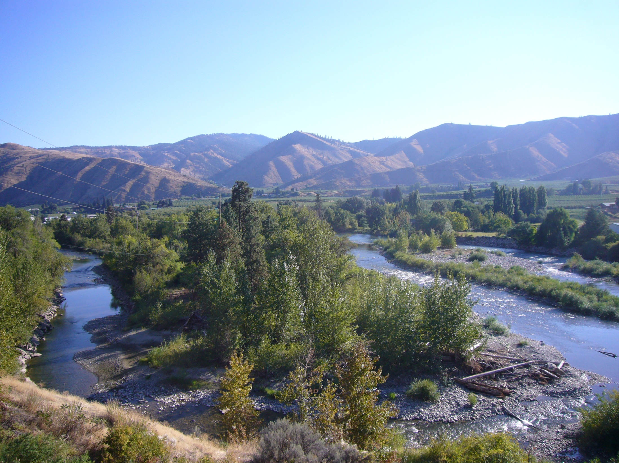

Slide 3
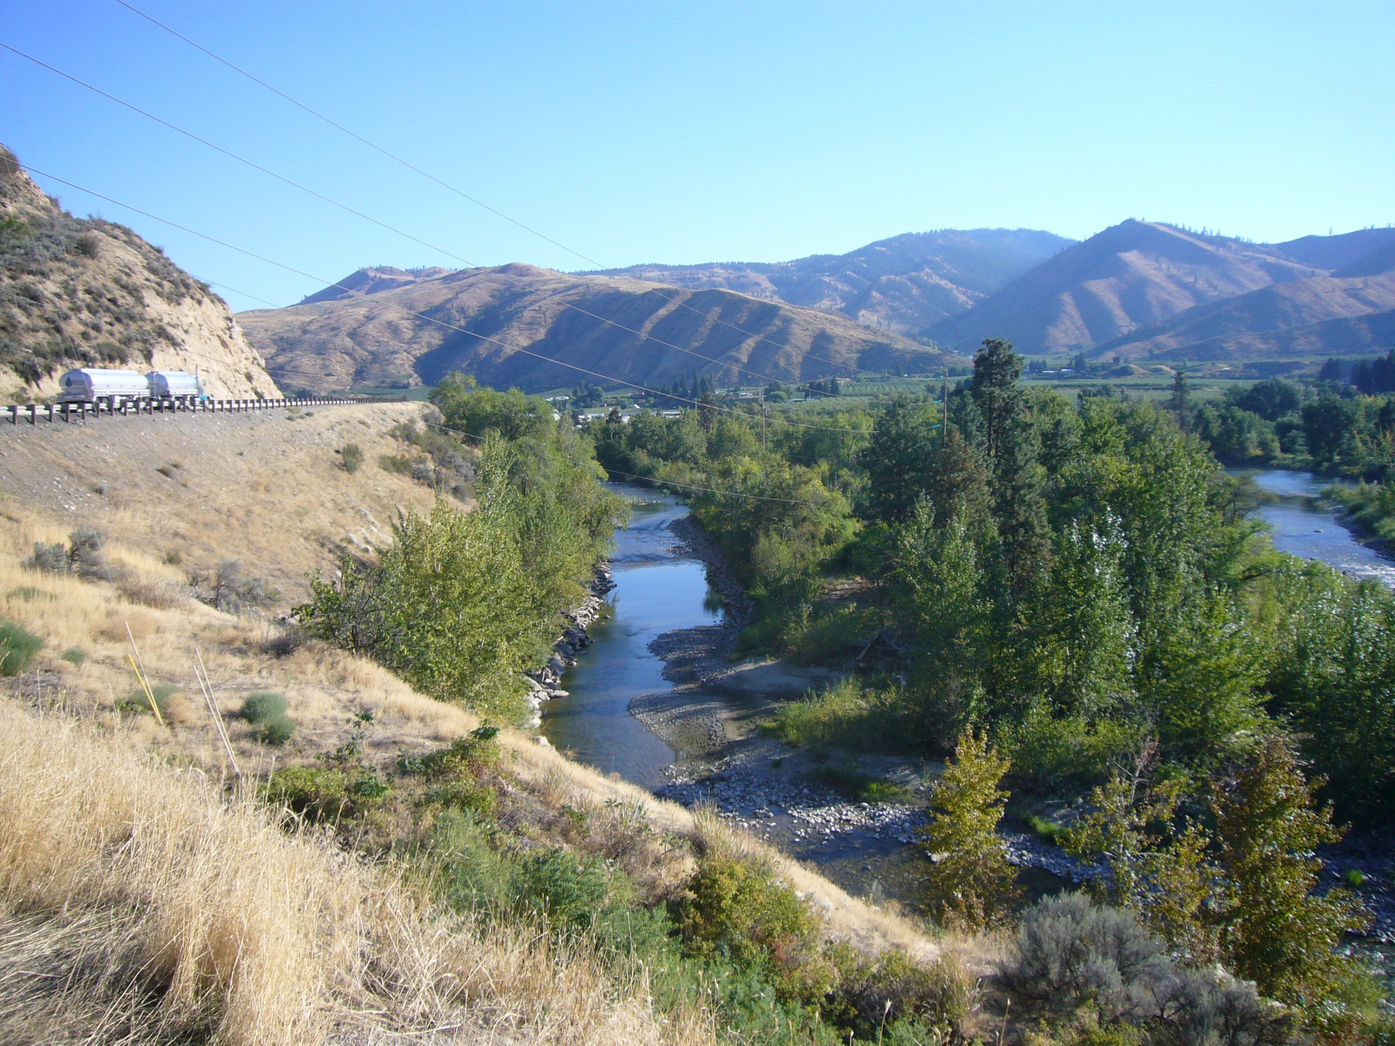

Slide 4
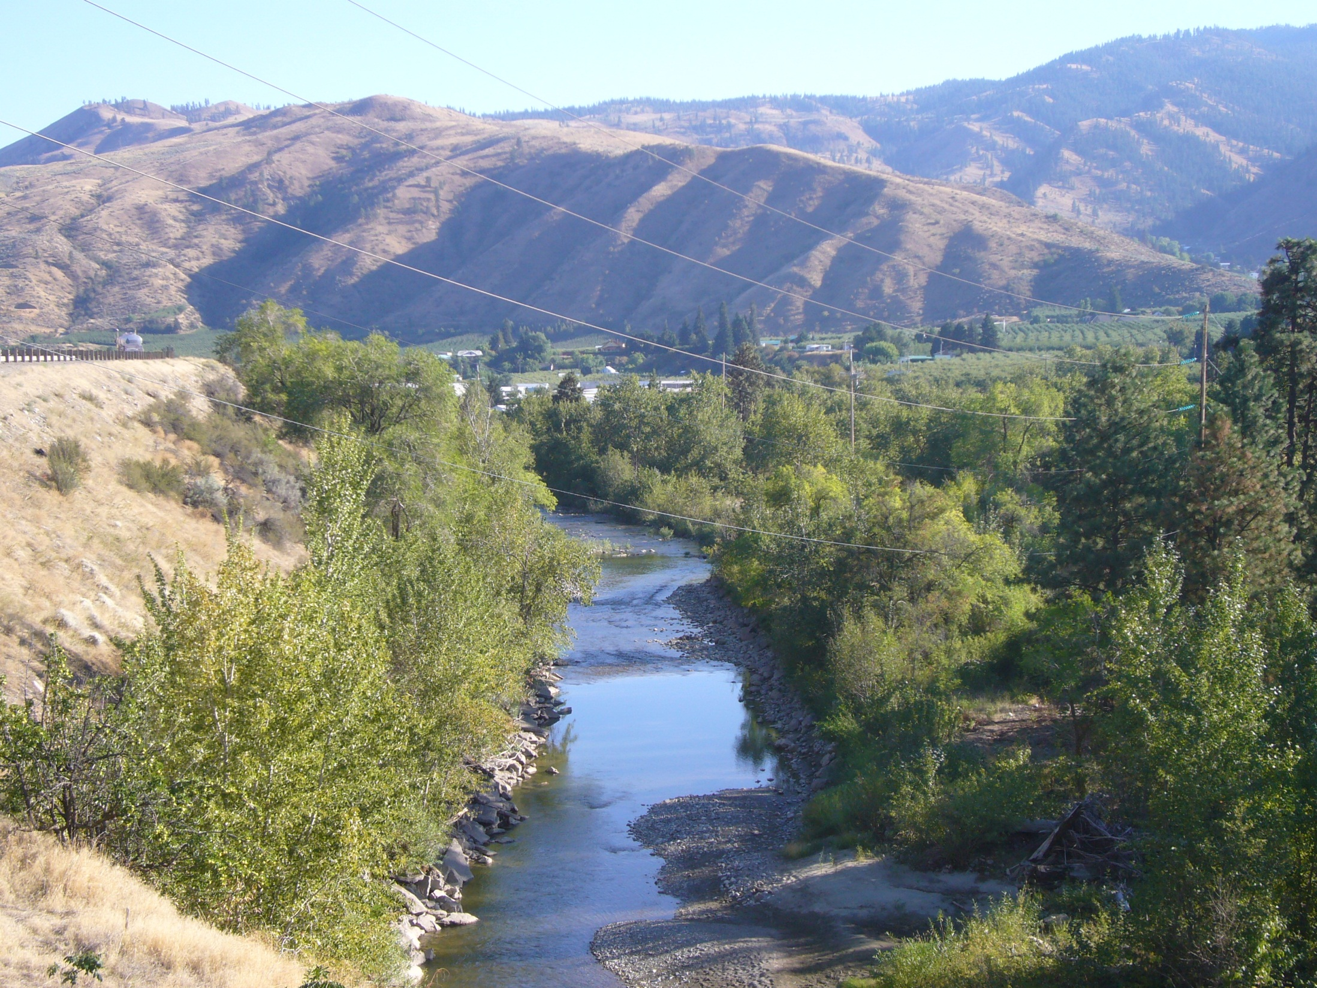

Slide 5
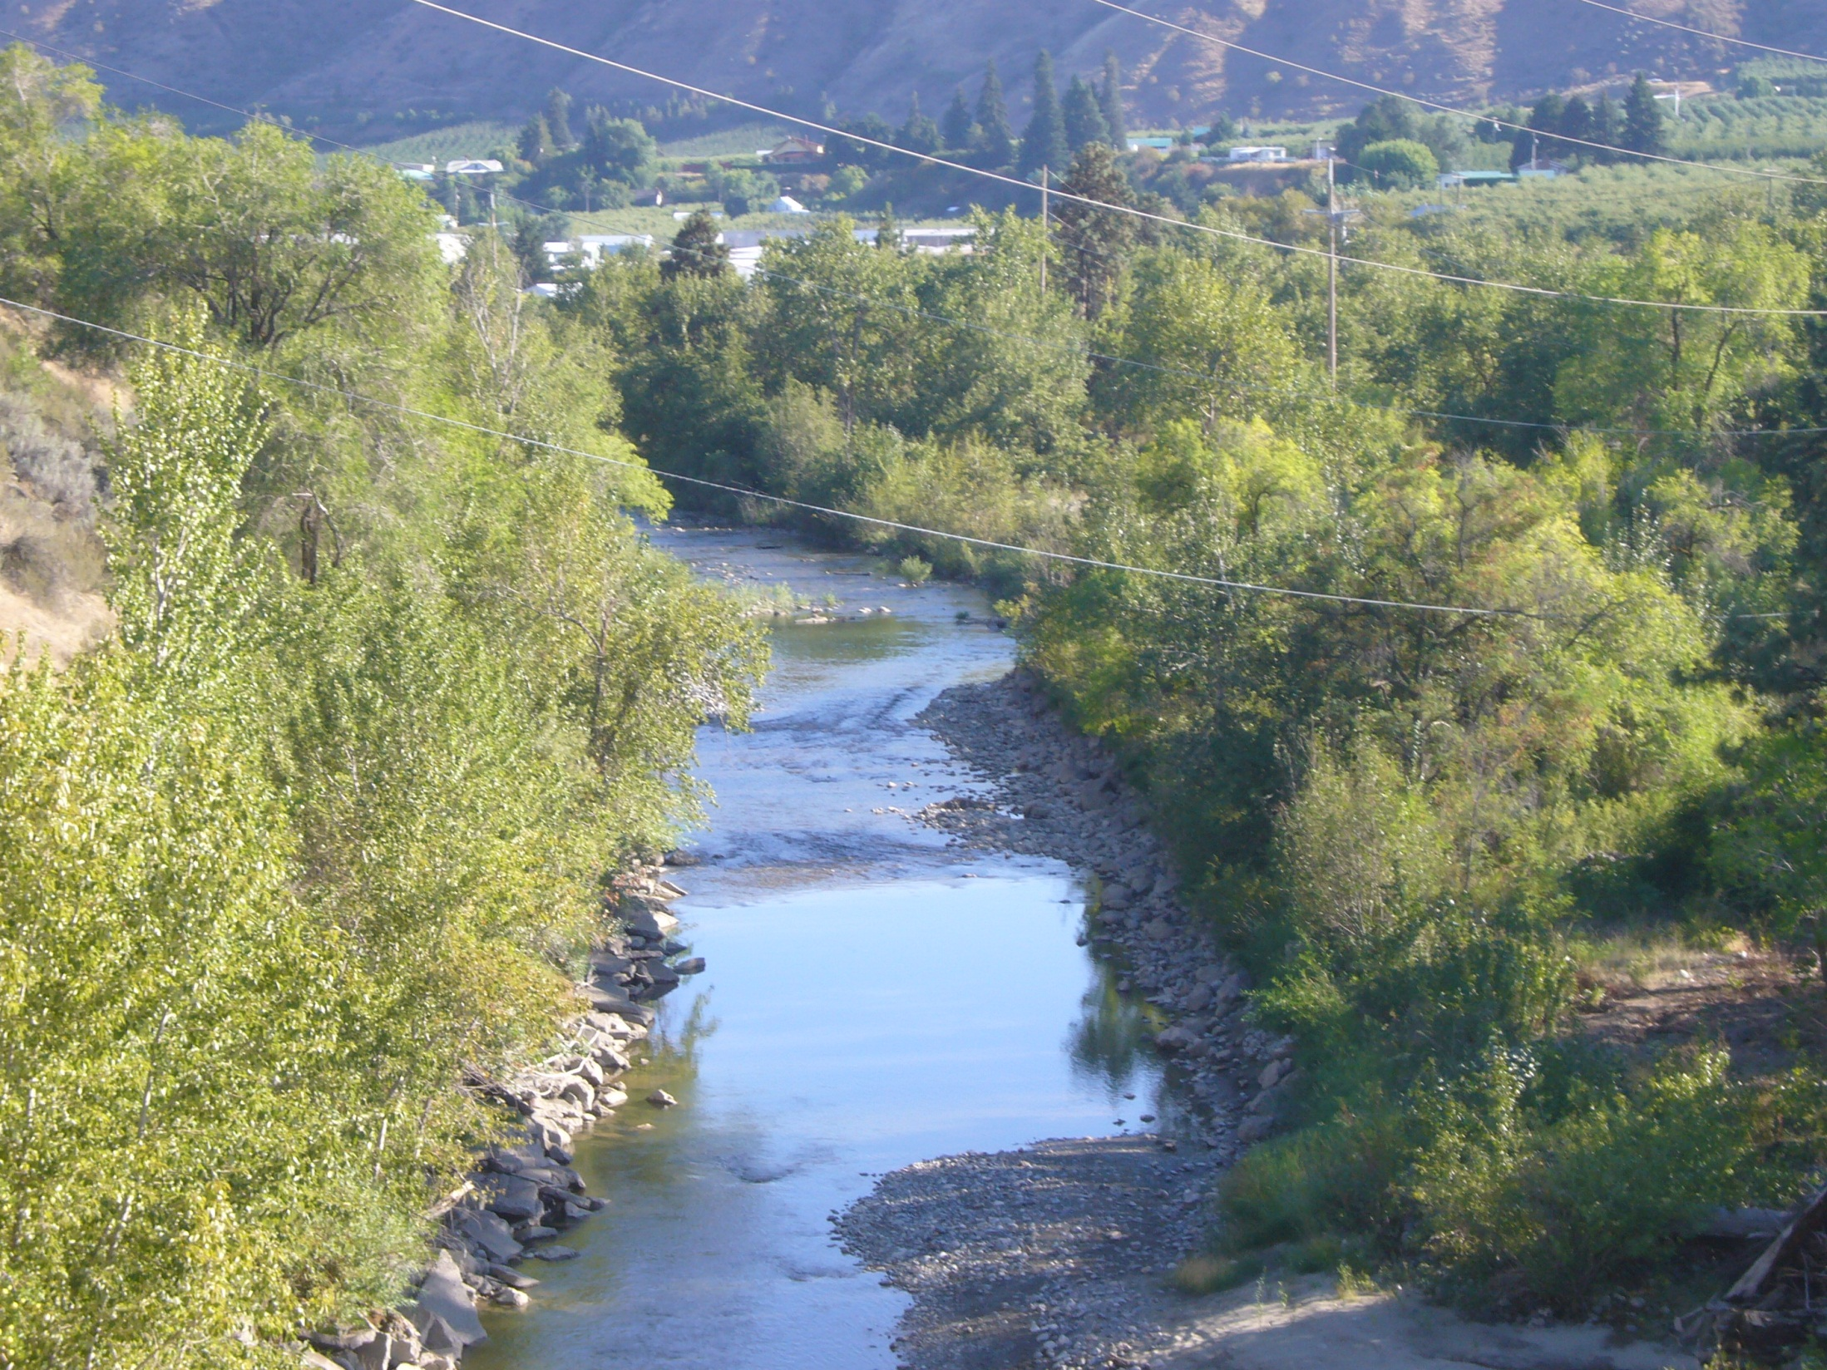

Slide 6
