Slide 1
Chumstick Creek Culverts RM 0.52 and RM 1.48 19-1584 Post-Project Site Visit August 2023
With Chelan County – Scott Bailey, Brian Maloney, Marc Duboiski, and John Foltz

Slide 2
RM 0.52

Slide 3
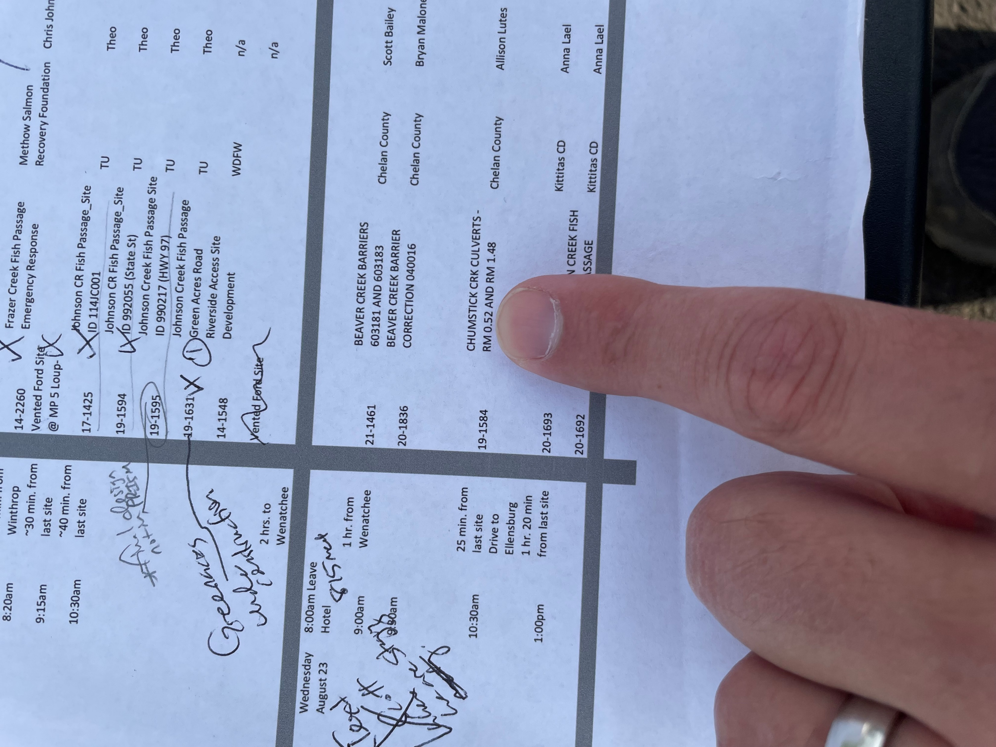

Slide 4
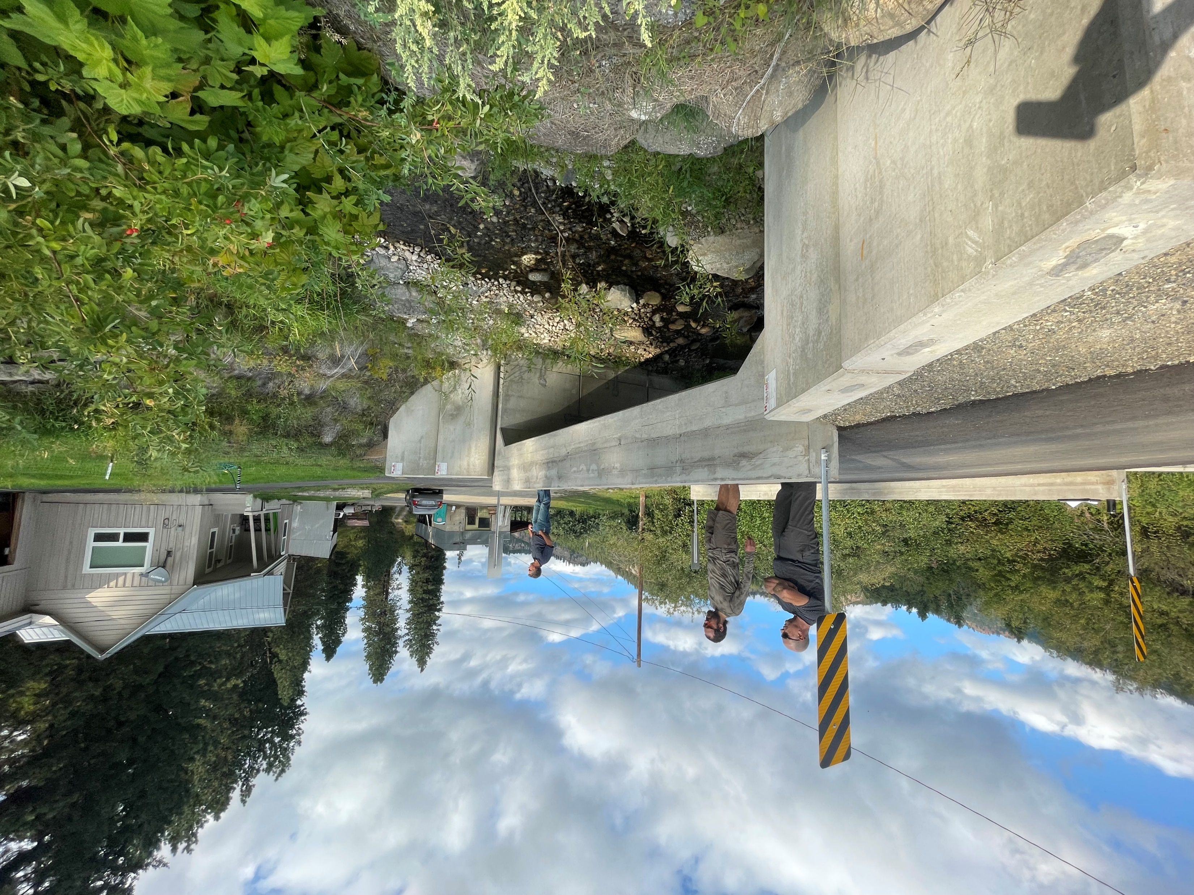

Slide 5
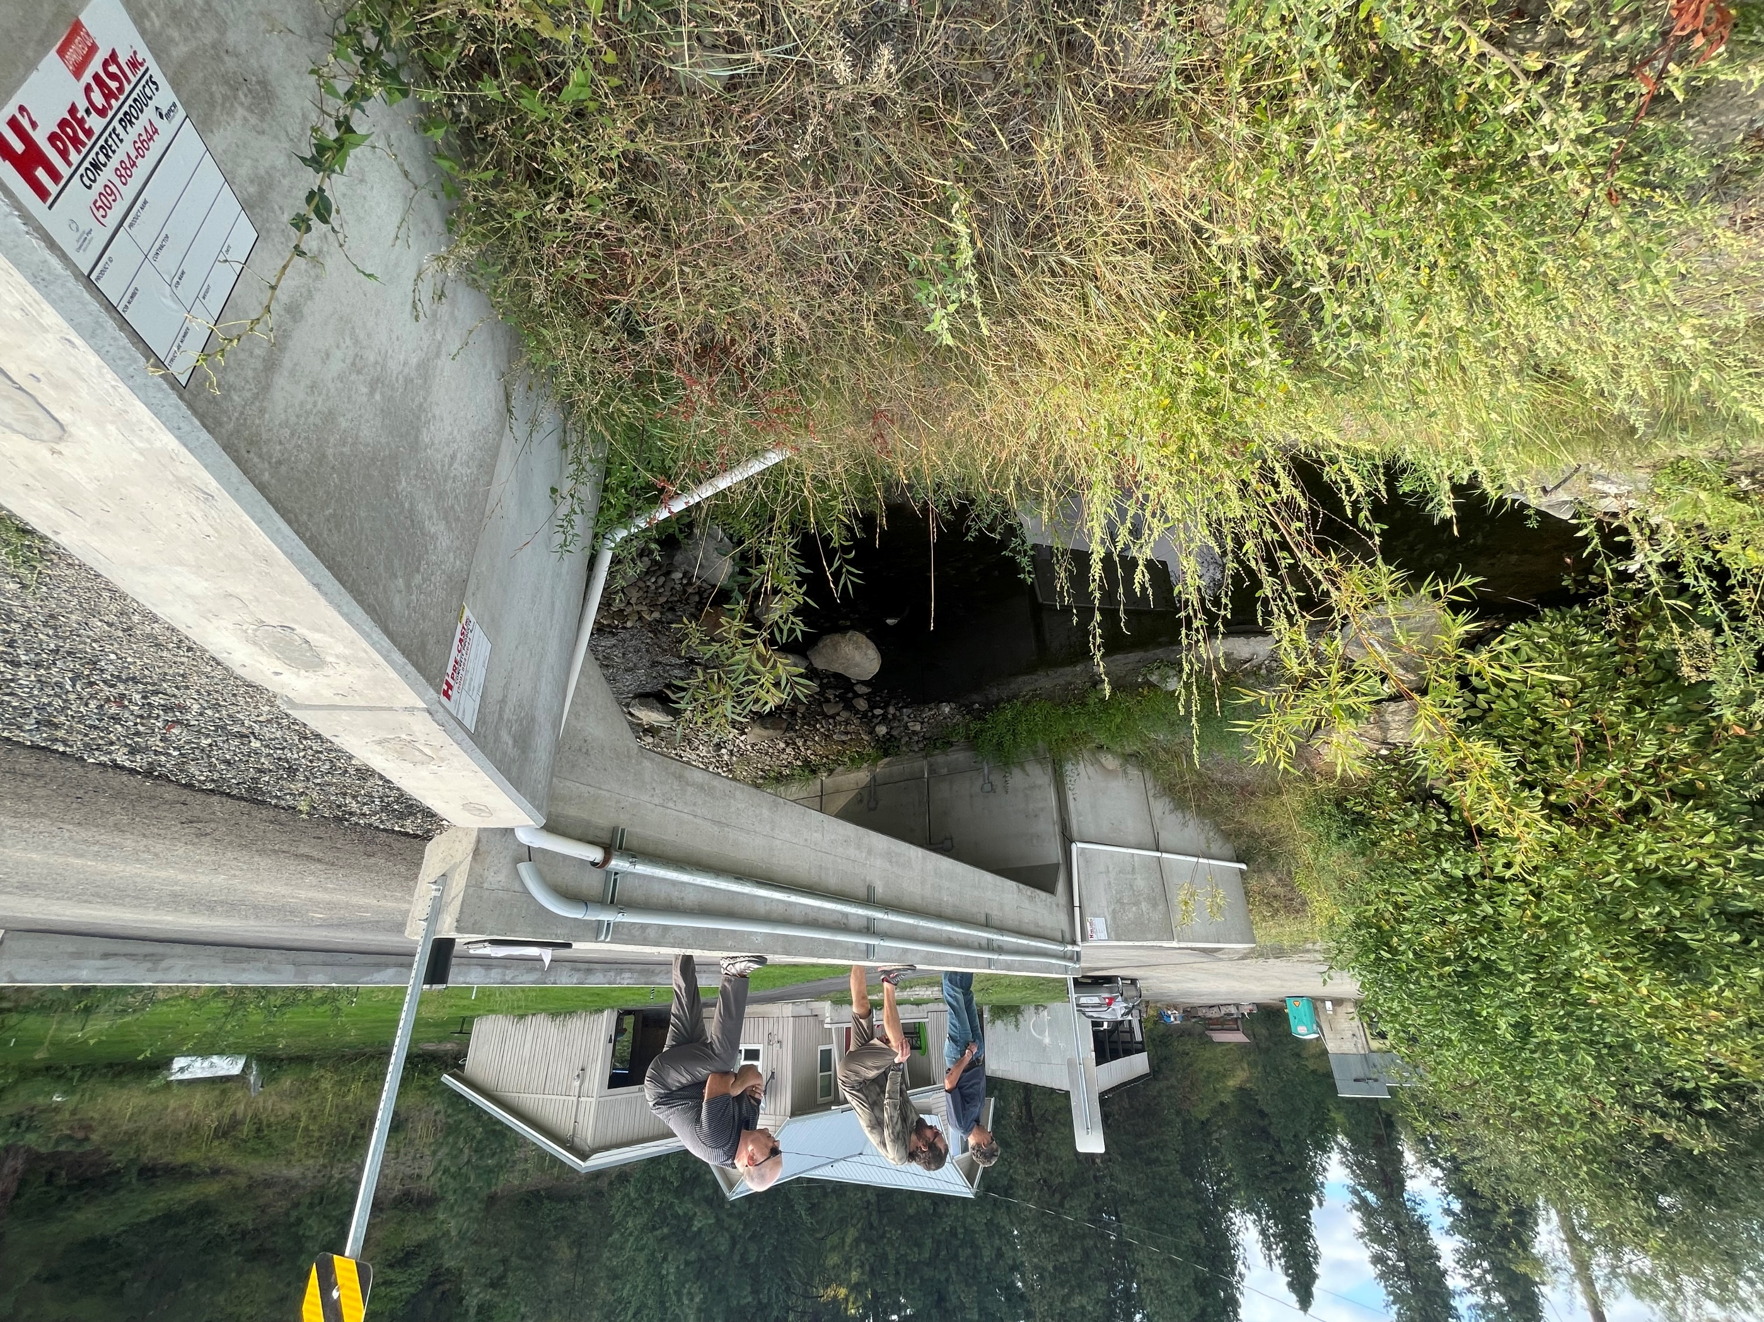

Slide 6
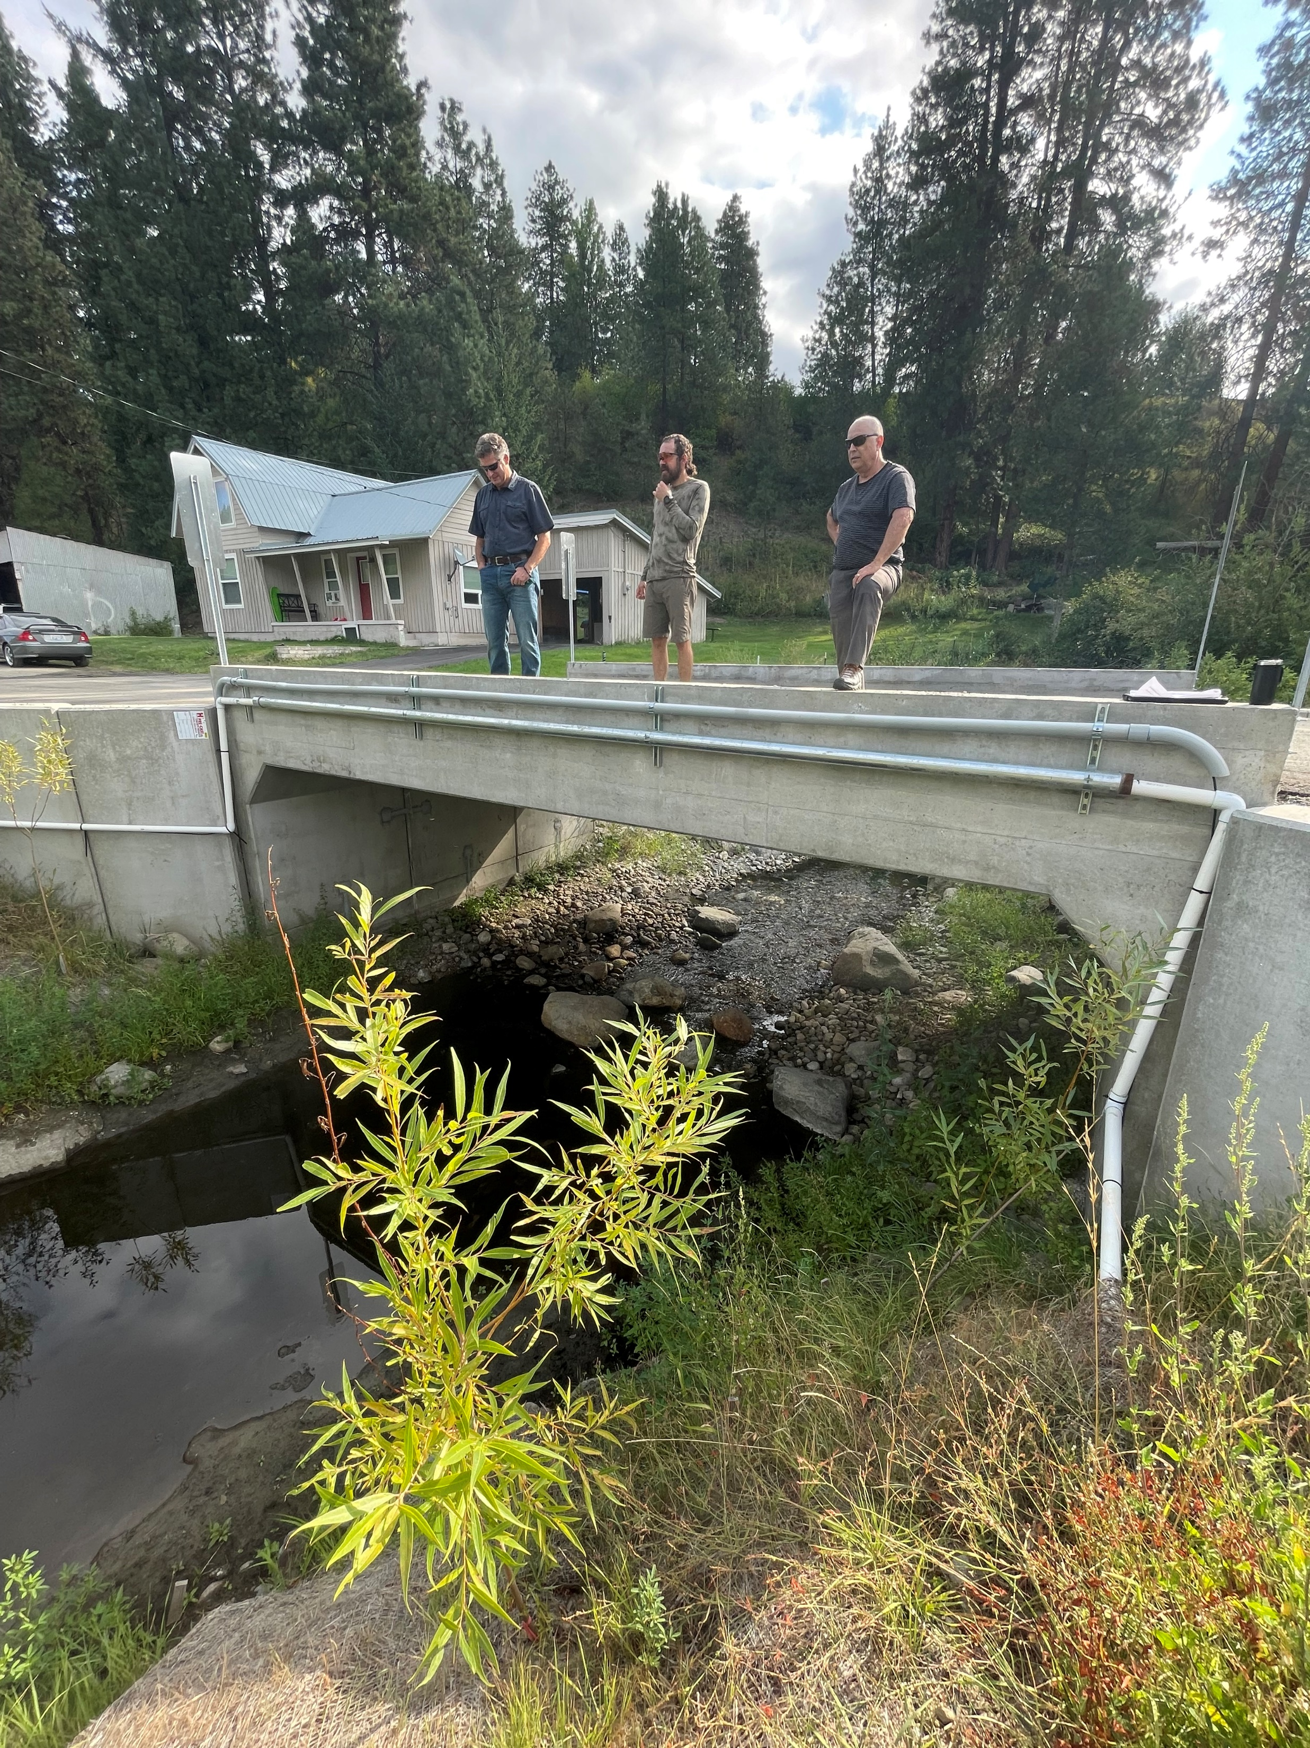

Slide 7
RM 1.48

Slide 8
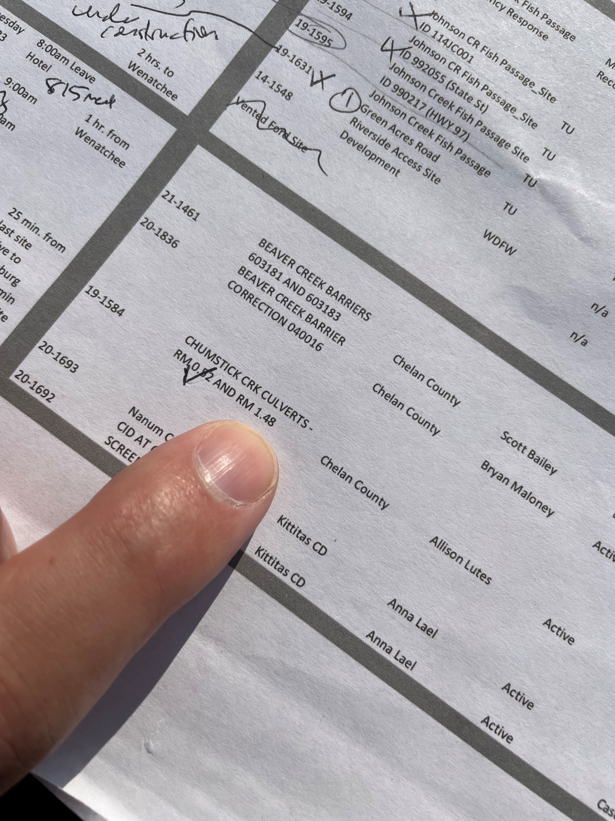

Slide 9
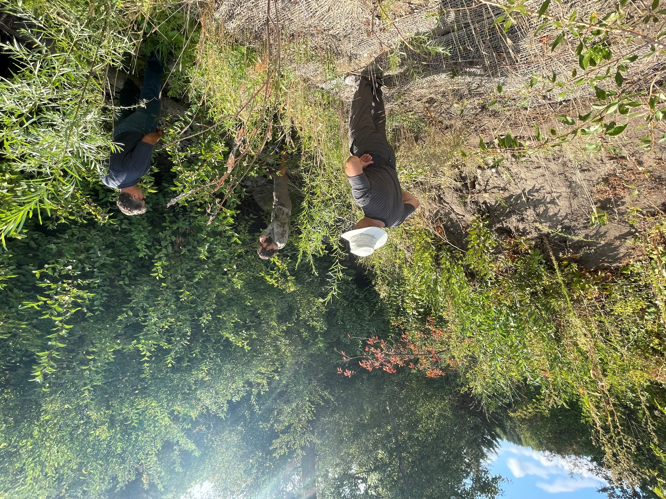

Slide 10
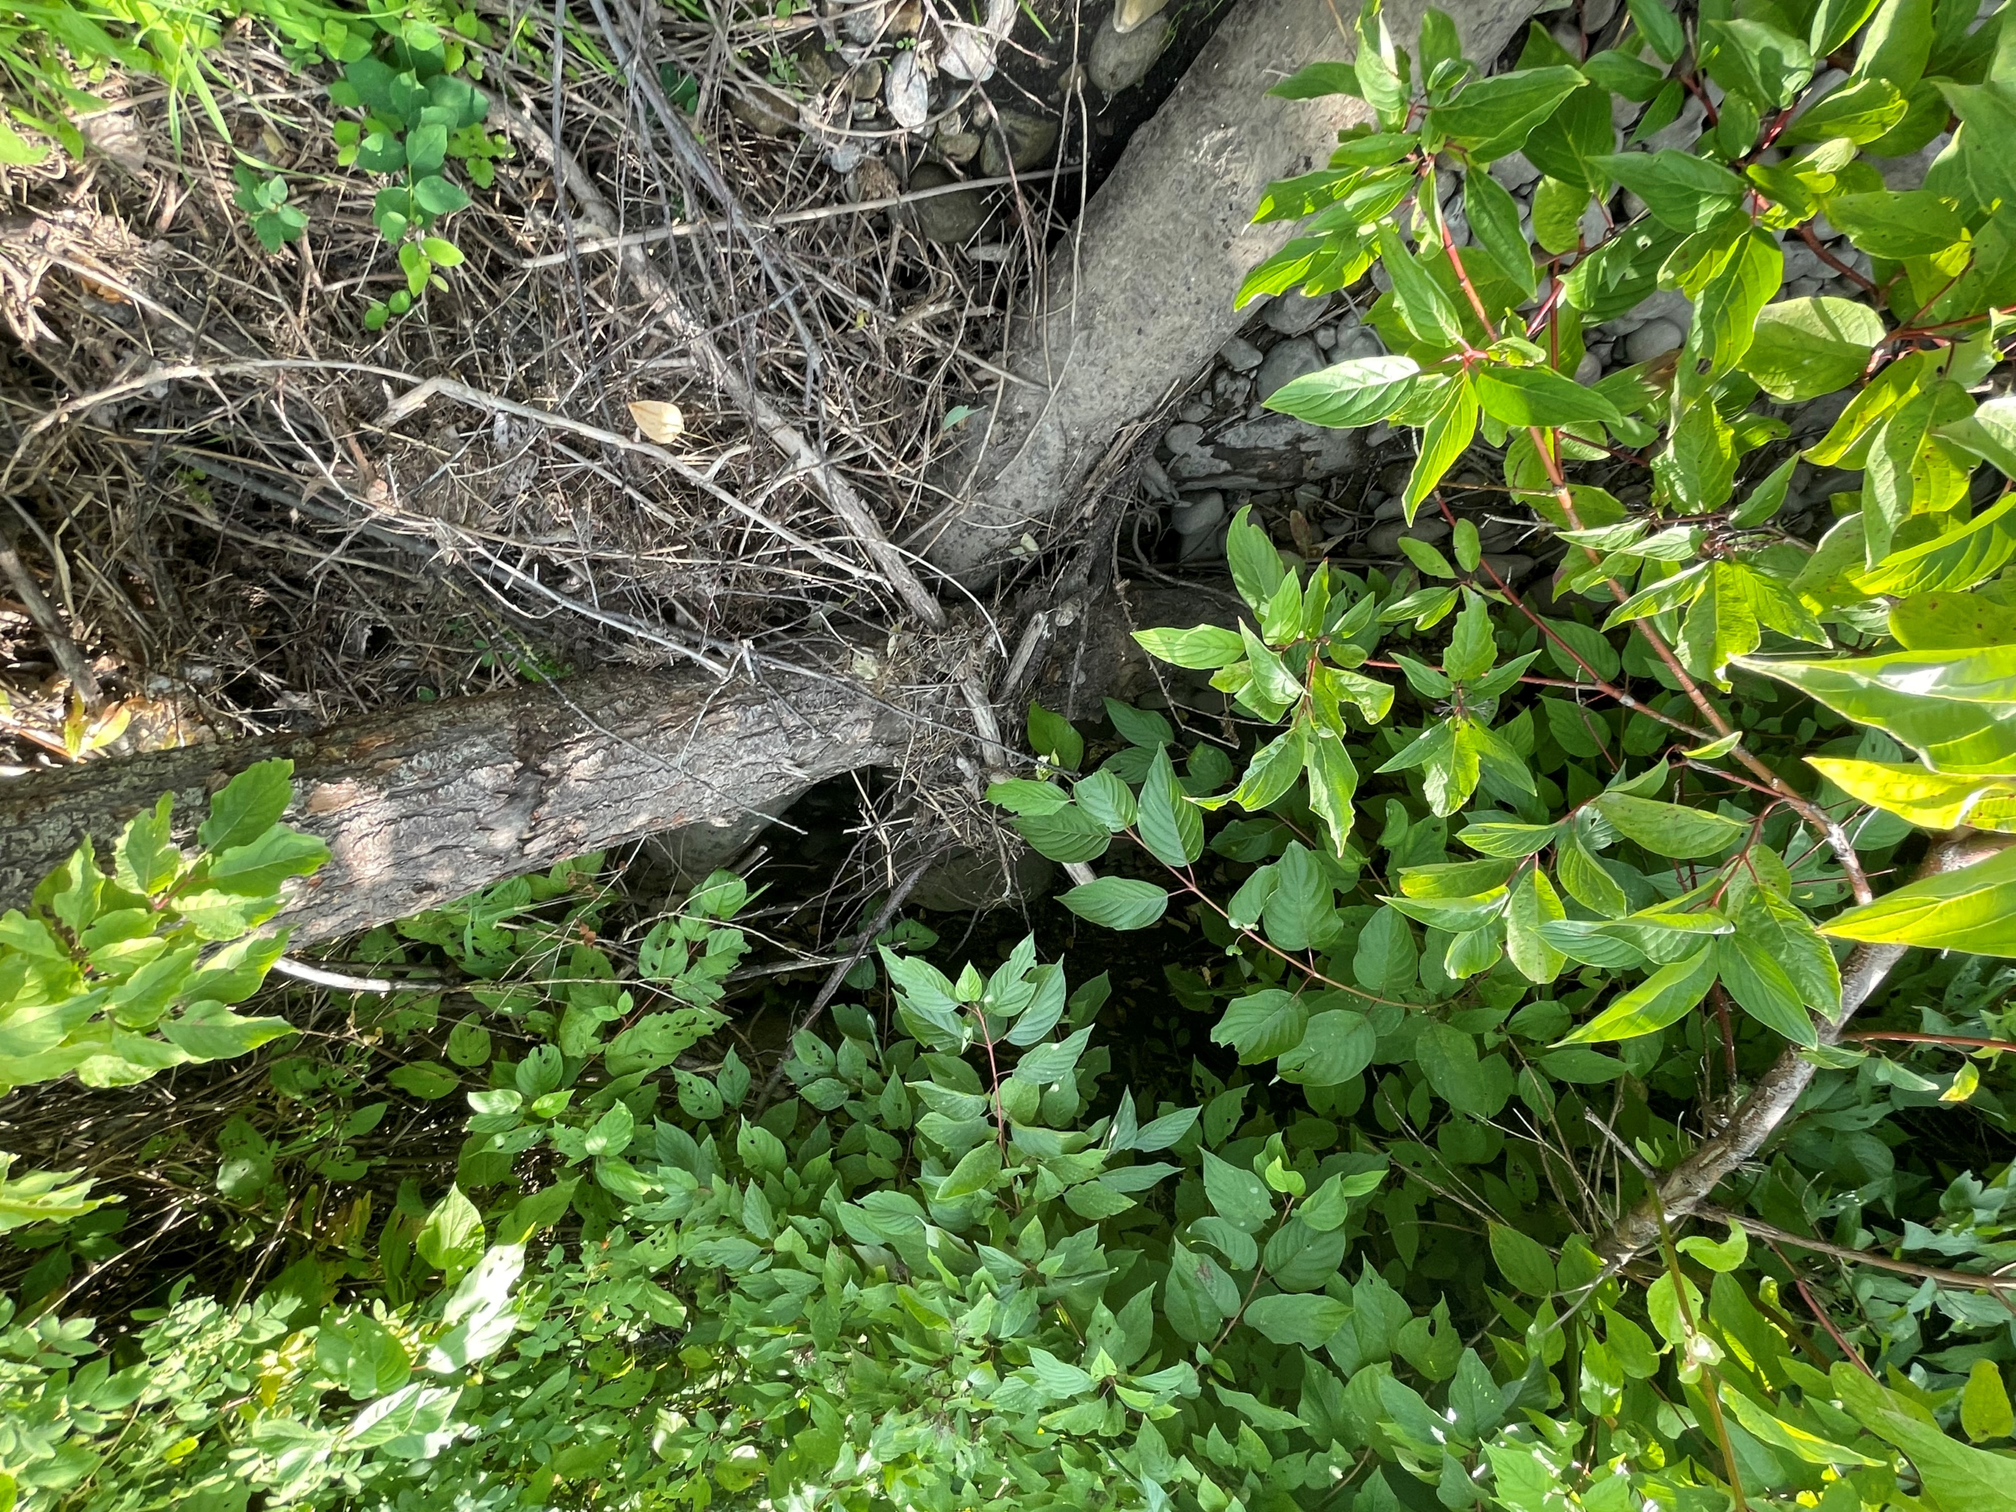

Slide 11
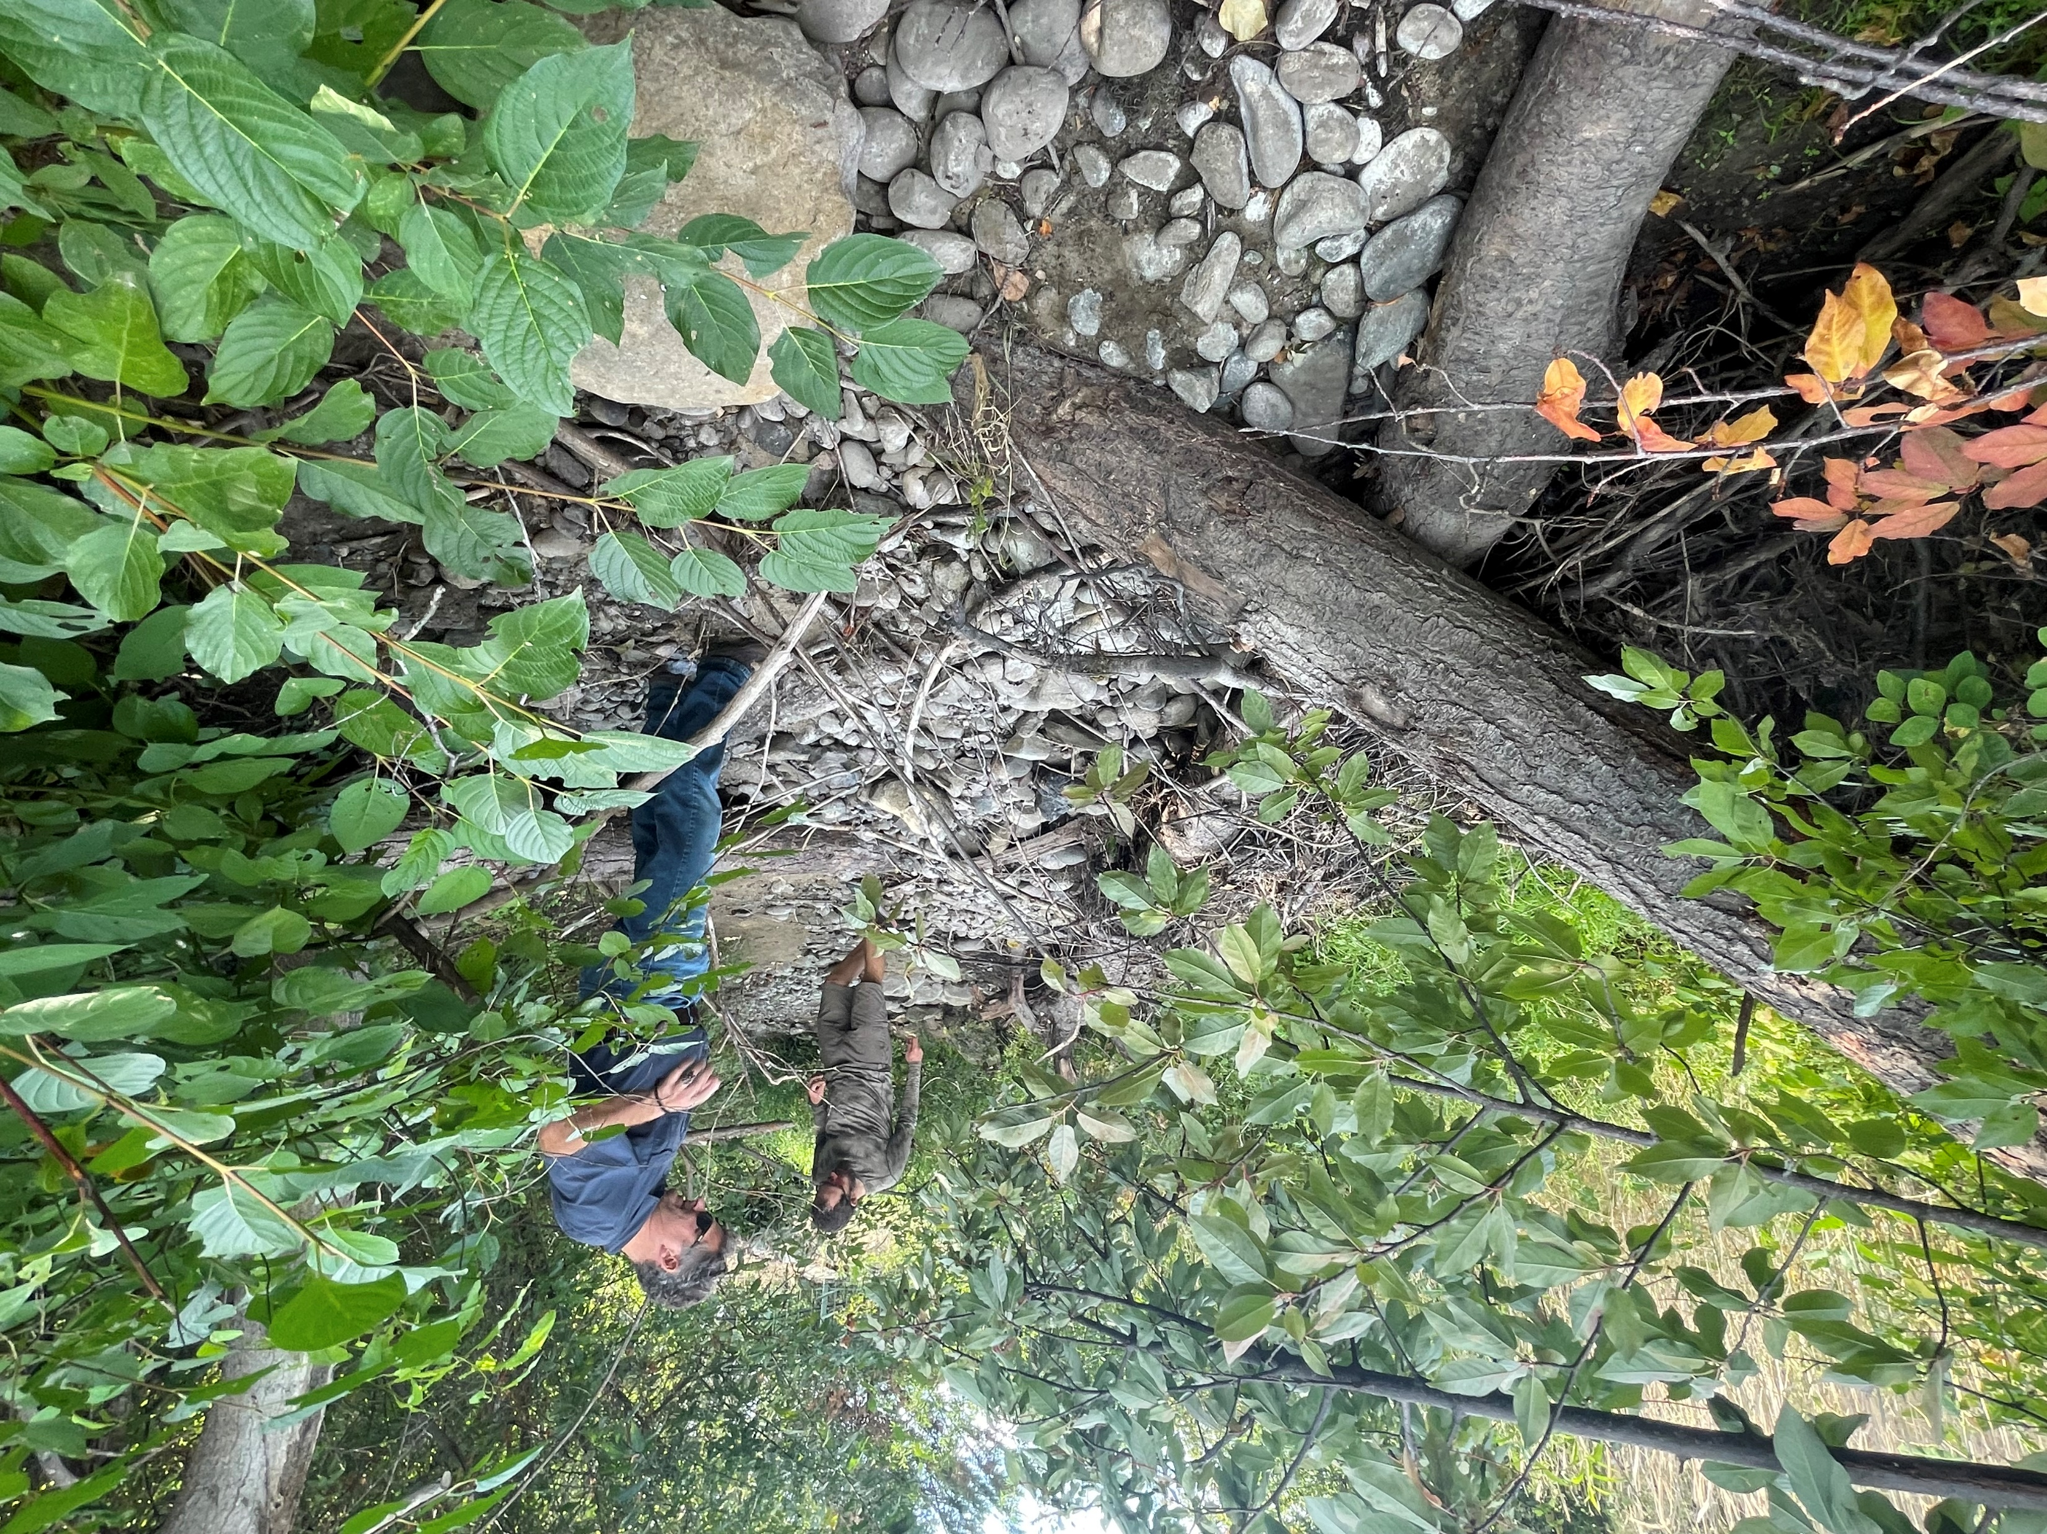

Slide 12
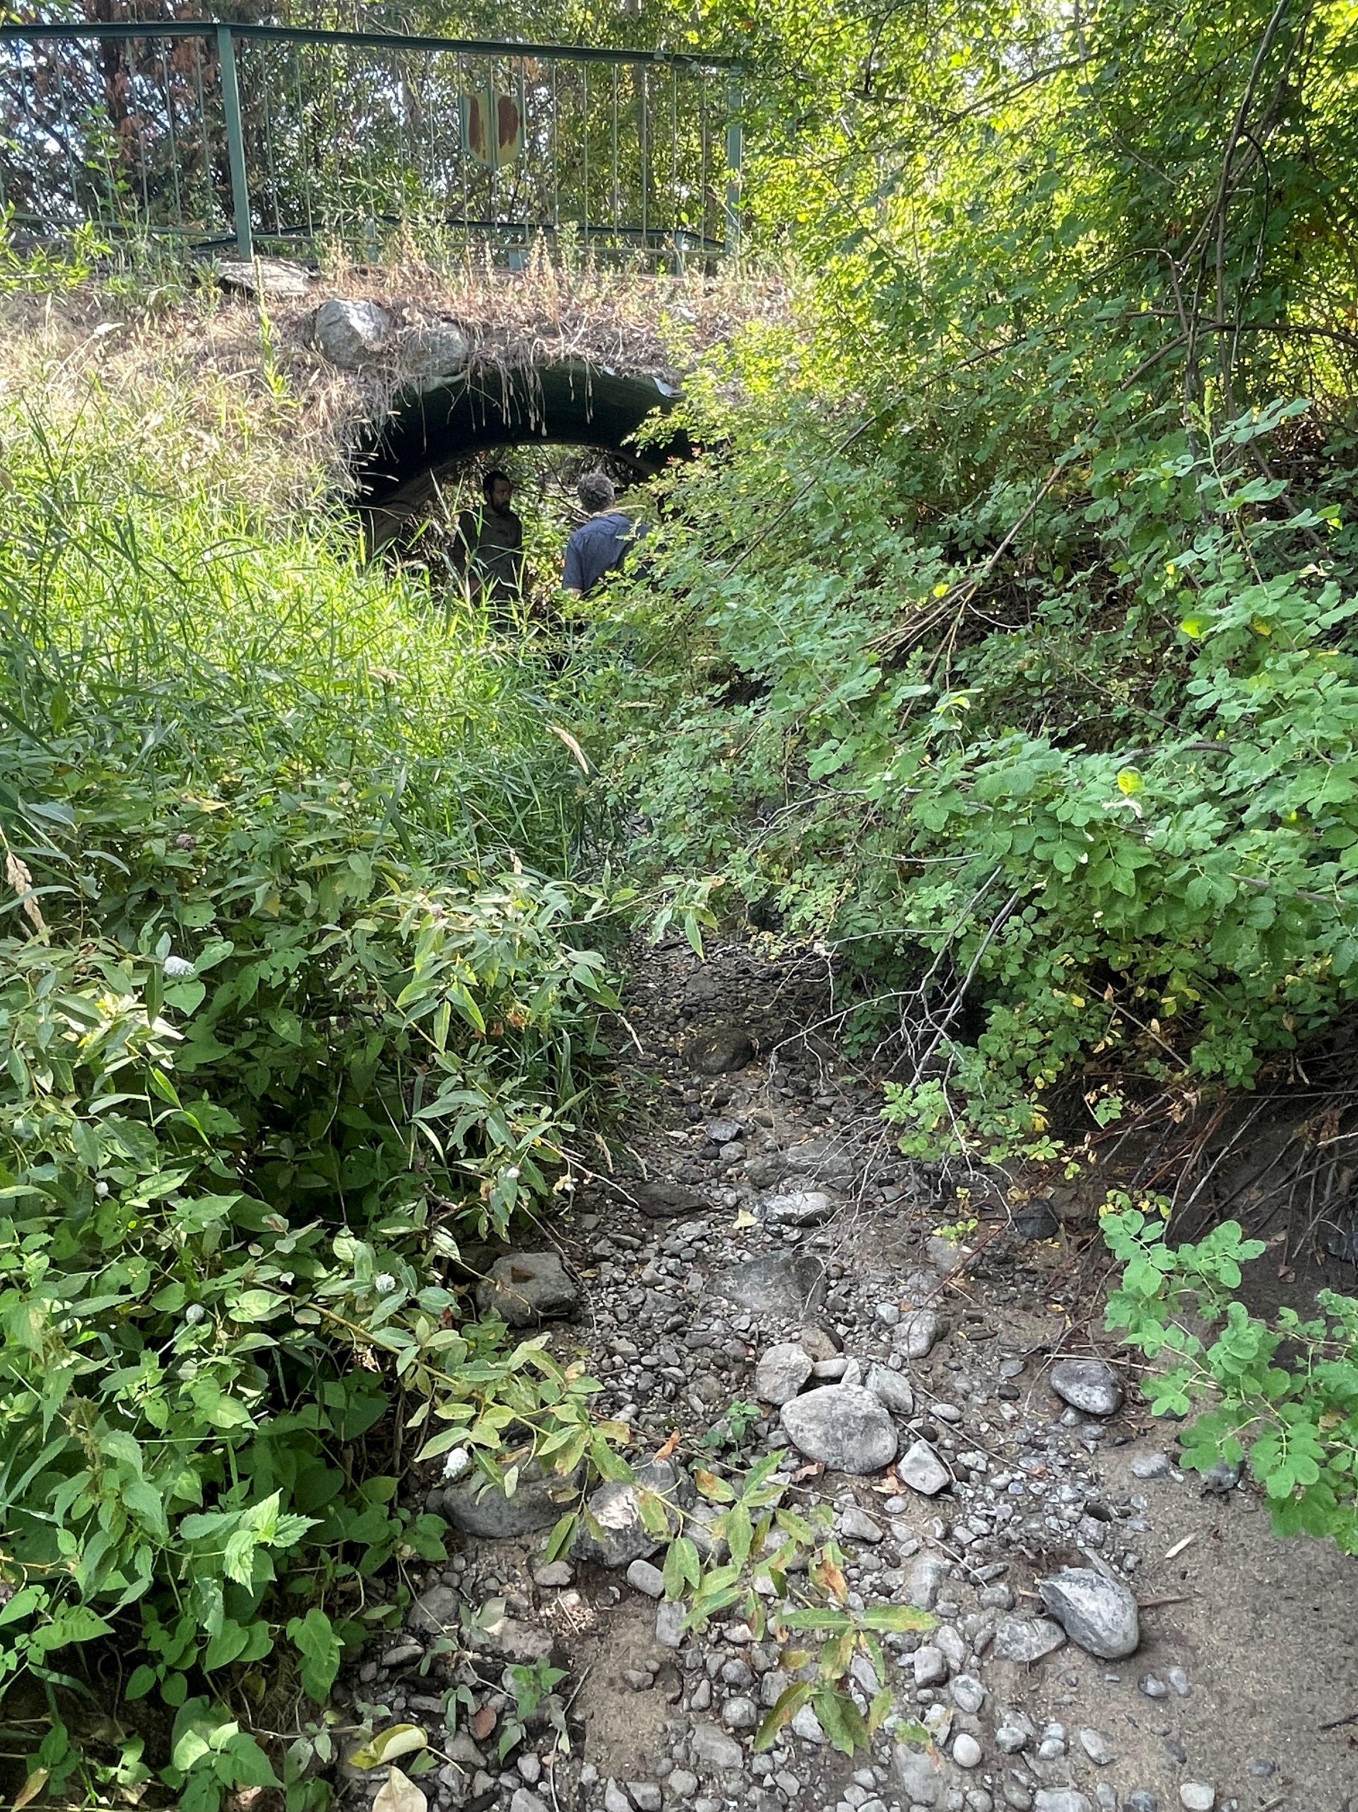

Slide 13
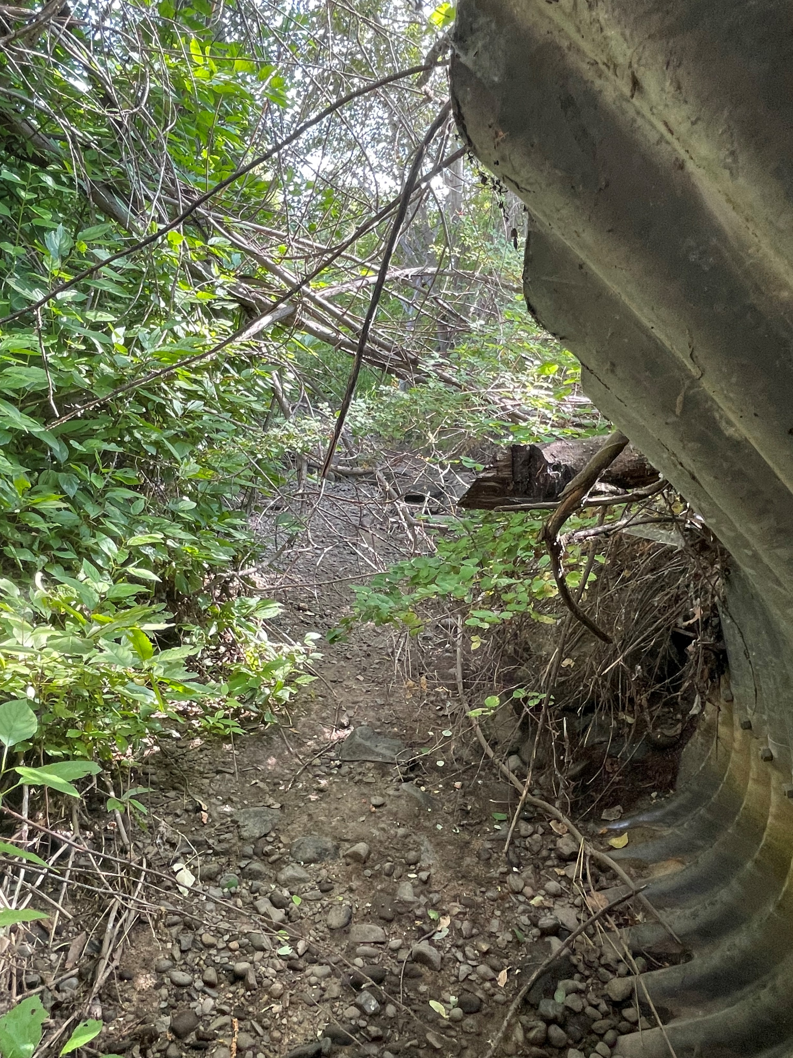

Slide 14
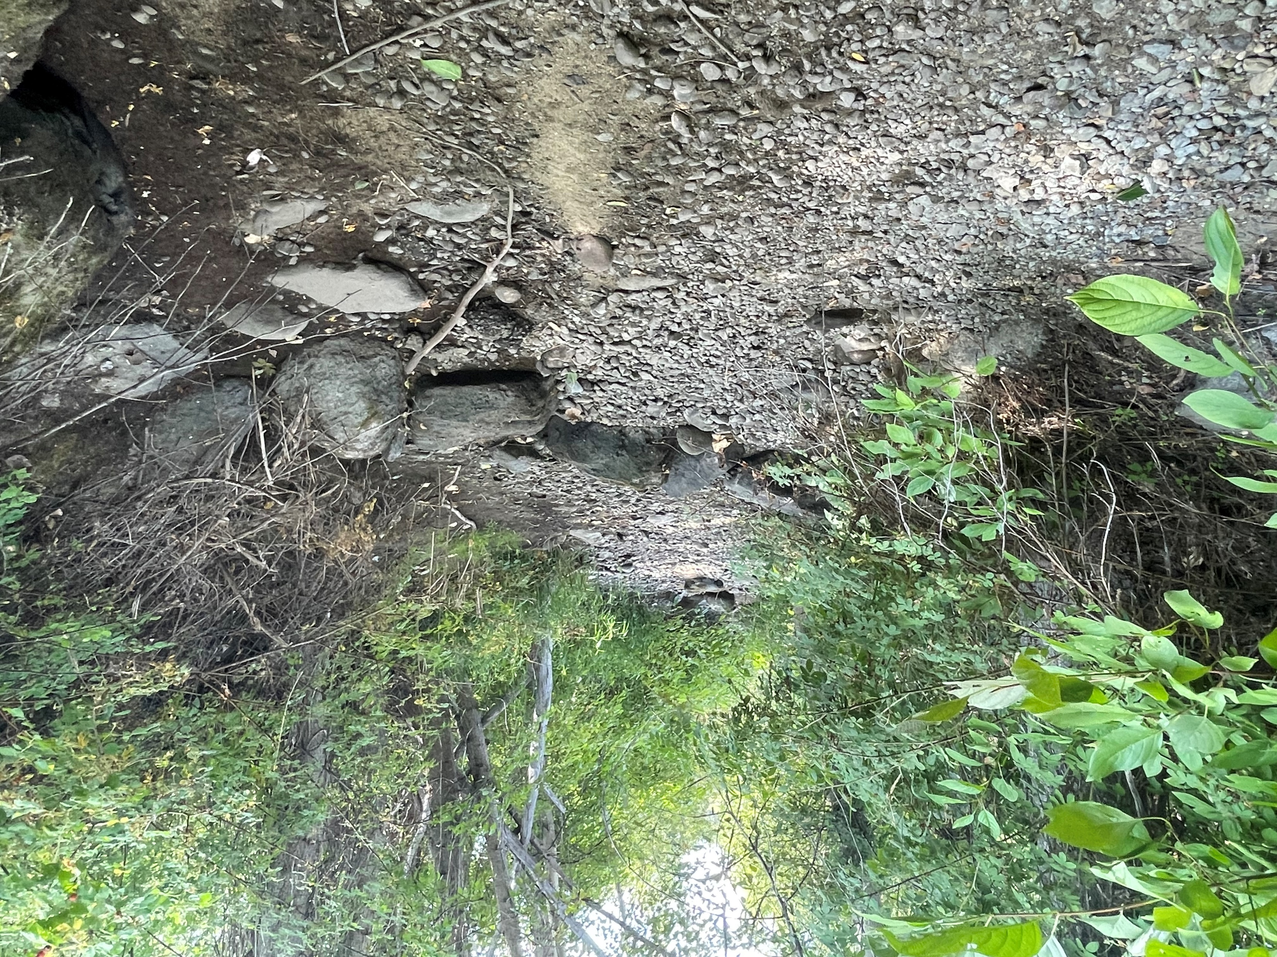

Slide 15
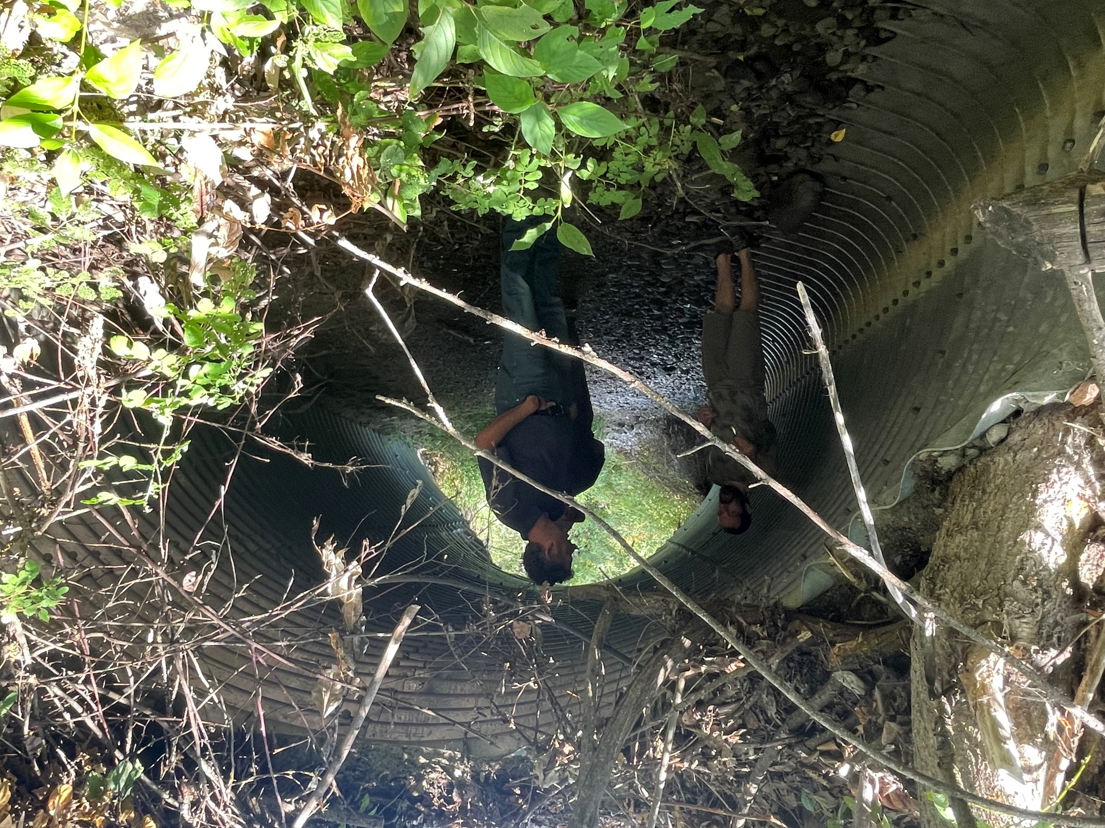

Slide 16
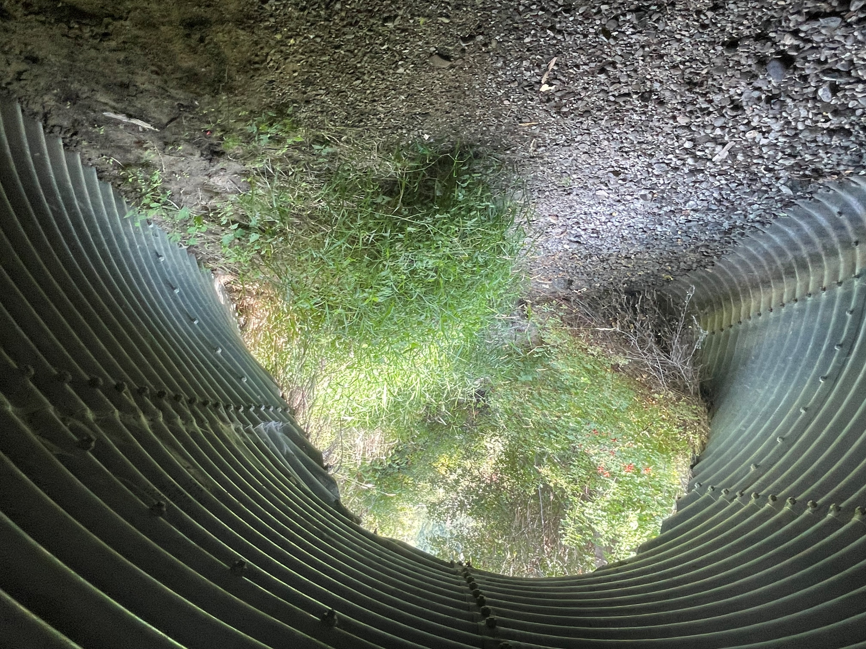

Slide 17
