Slide 1
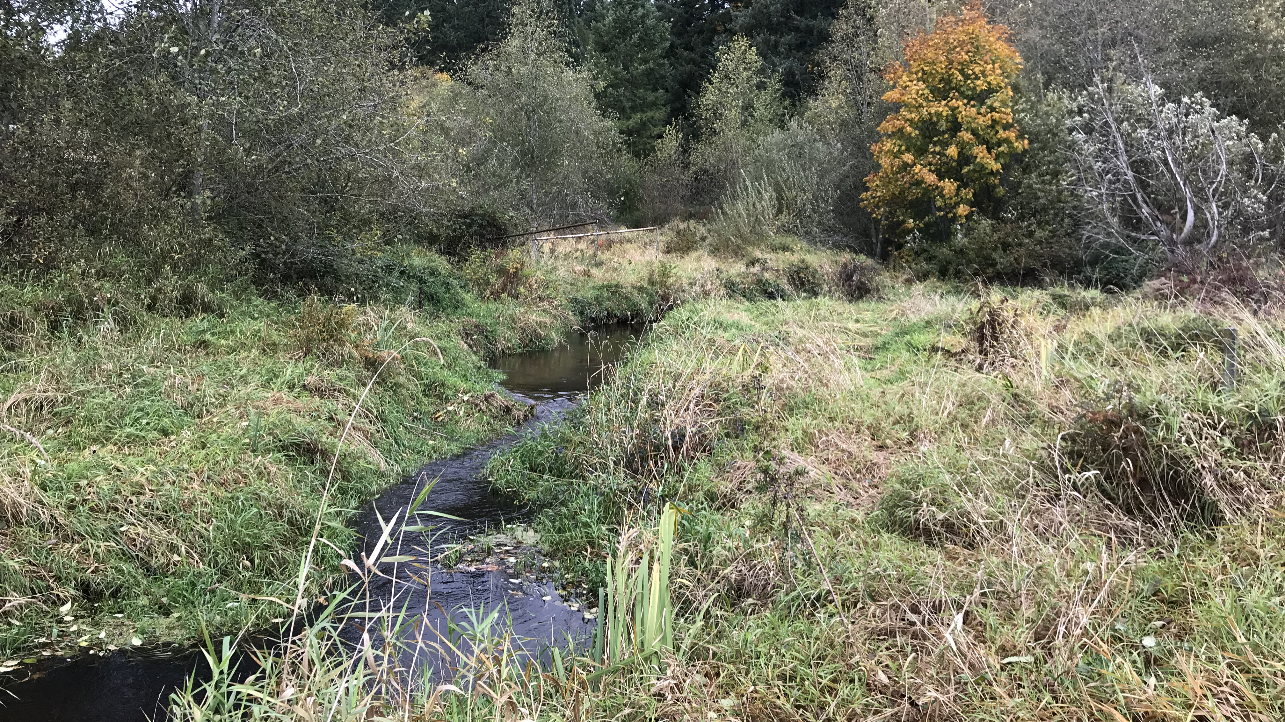
Seawest Granston (Middle Bear) Restoration Project RCO Project number 22-1190
Denise Di Santo, Basin Steward (WRLD)
Laird O’Rollins, Project Manager (ERES)
King County Water and Land Resources Division
Notes:
Thank you for the opportunity to present the Seawest Granston Restoration project to you. The project is presented today by Denise Di Santo, Bear Creek Basin Steward, and Laird O’Rollins, the project manager for this project.

Slide 2
Project Location
Middle Bear Creek Natural Area, WRIA 8
River Mile 8 – 8.5
Notes:
The project location is in unincorporated King County, and includes the area of Middle Bear Creek Natural Area that lies southeast of Woodinville and northeast of Redmond. River mile 8.

Slide 3
Project Site Reach 9 Approx. 3,000 feet of channel About 50 acres of riparian area Low-gradient (~0.5%) Inventoried Class 1 Wetland (lower half of reach)
Notes:
The project site includes portions of the Middle Bear Creek Natural Area, and will also utilize secured conservation easements to access and restore the site. The location known as Reach 9 in the salmon conservation plan, was originally cleared and used for agricultural purposes, and now the area is mainly in large lot residential use with a golf course to the east.

Slide 4
Topography
Residences are well above the floodplain
Floodplain is void of infrastructure (except for bridges)

Slide 5
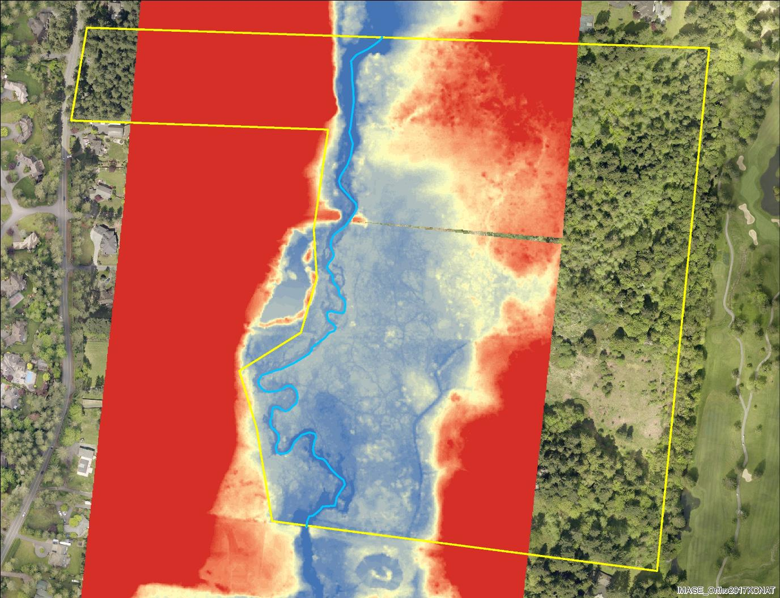
Detrended LiDAR
Notes:
Laird
Current channel in bright blue and historic channels and topography…plan form and low areas that can be activated by raising water levels.

Slide 6
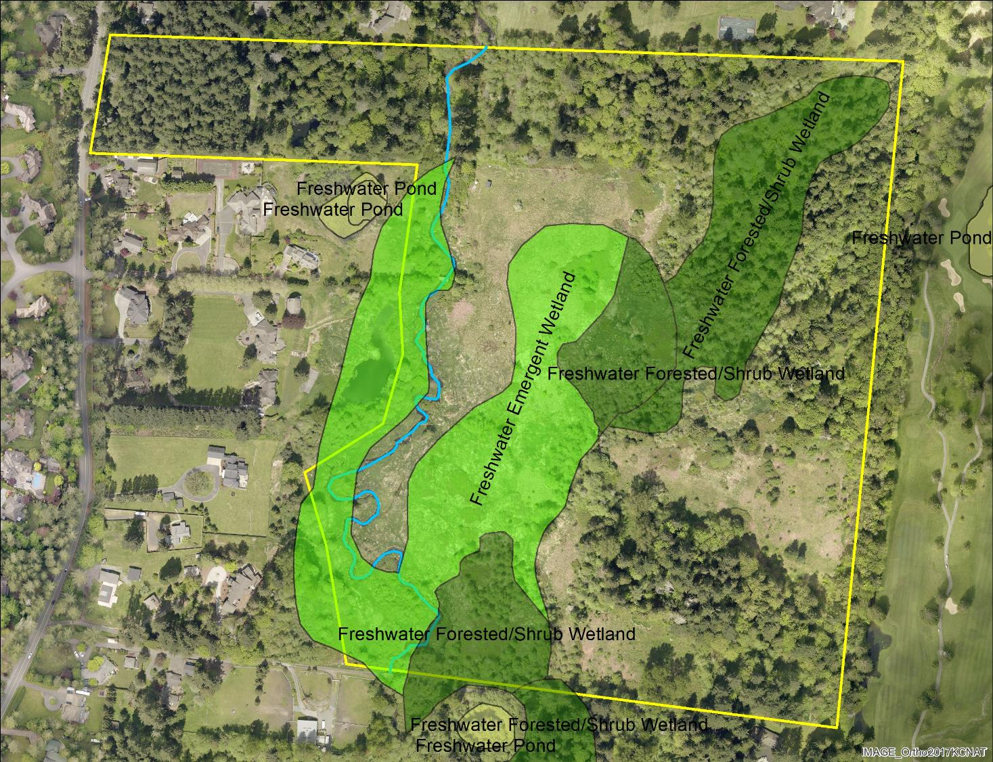
Notes:
Laird
Current conditions show County inventoried wetland types with restoration opportunity. Diverse wetland communities will be restored under this project.

Slide 9
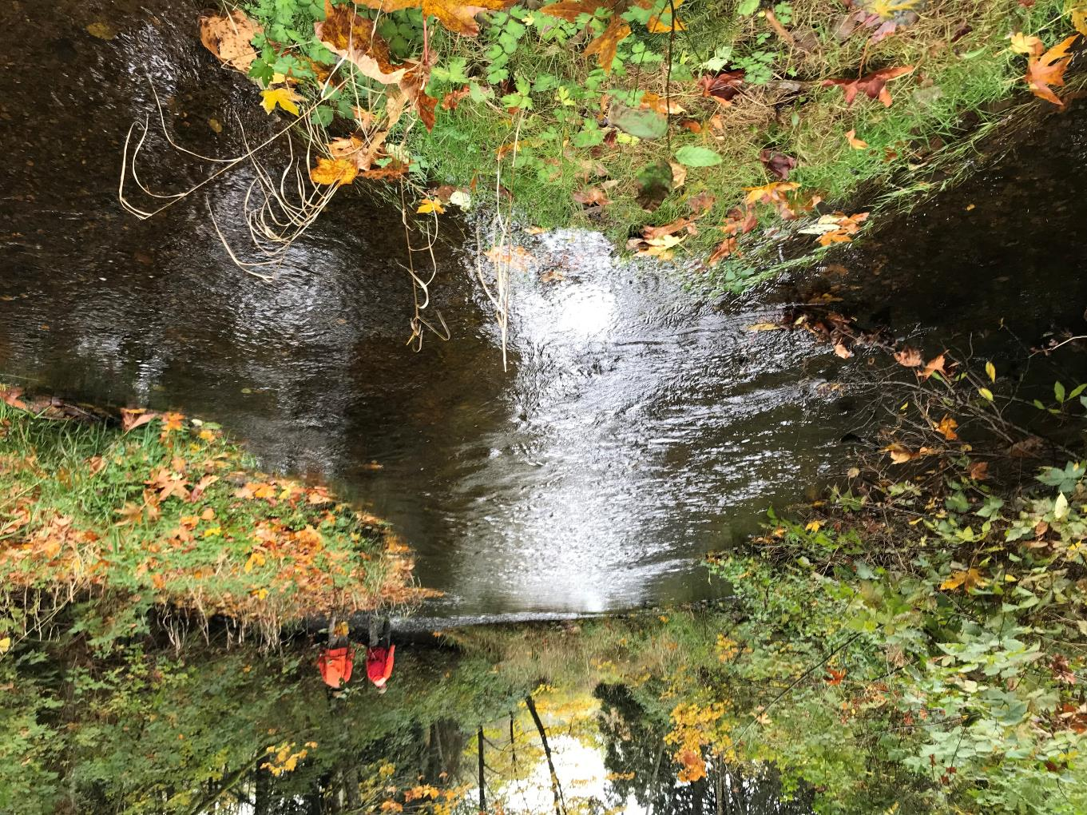
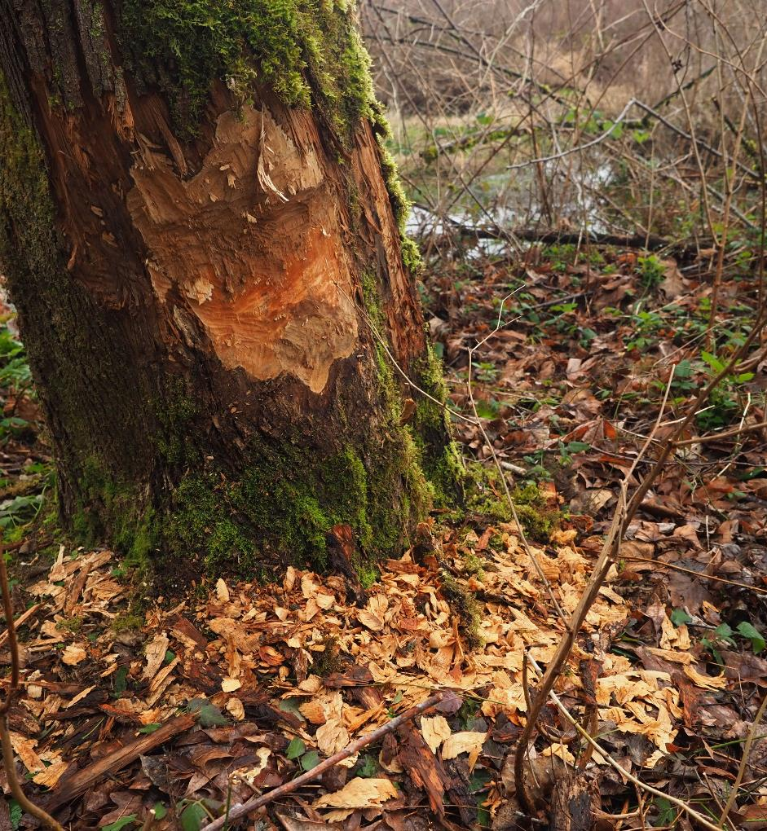
Notes:
Laird
The following slides show current conditions at the project site. Here we see the upstream-most reach on the left and uplands east of the creek on the right…

Slide 10
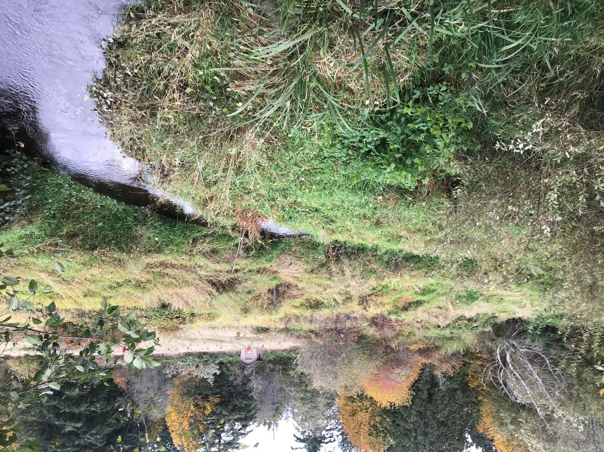
Notes:
A bridge (with no roads leading to or from) that will be useful during construction. On the right we can see the low gradient stream channel with sparse cover.

Slide 11
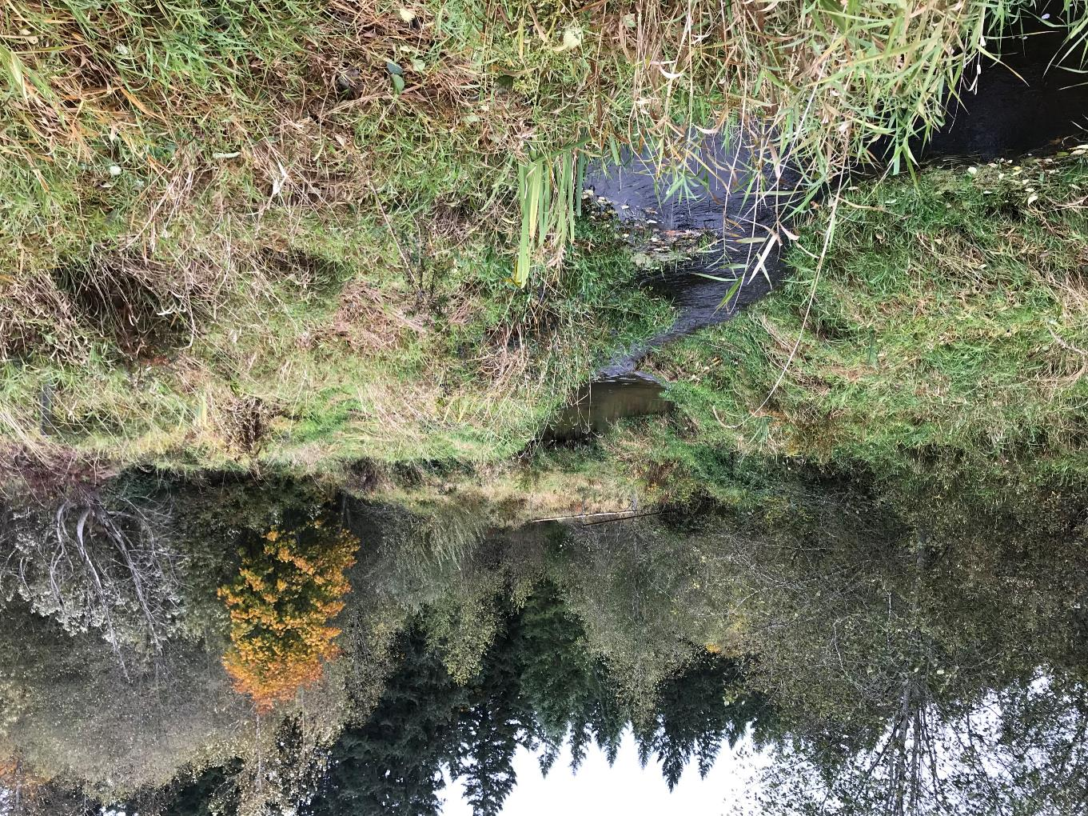
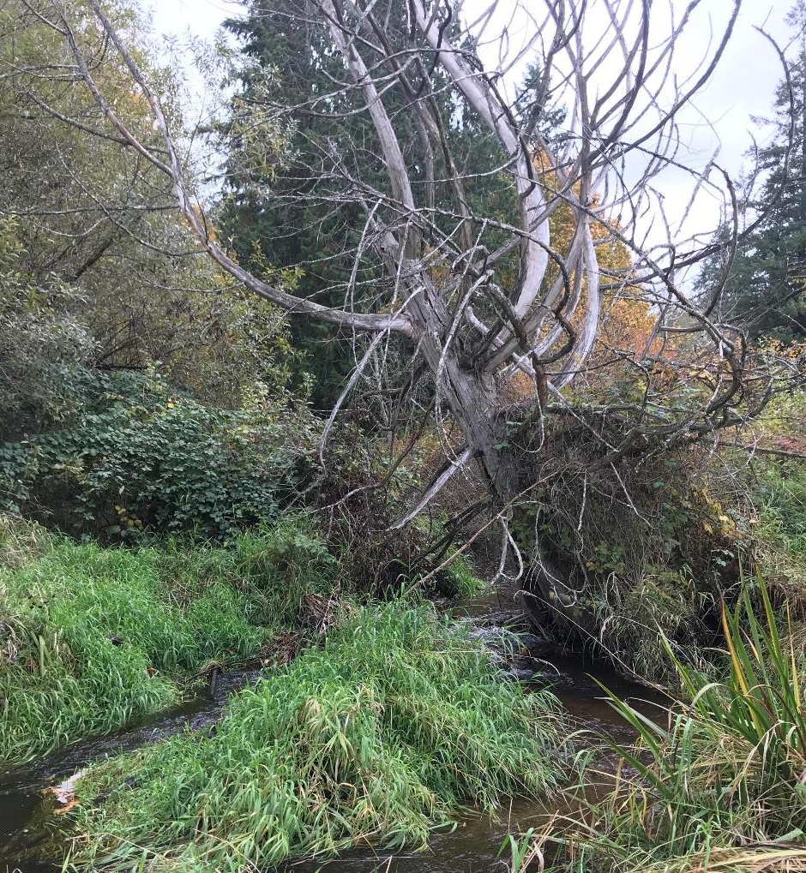
Notes:
Lack of cover and shading, currently with reed canary grass, but complex channel plan forms still persist (right) with vegetated islands and the like in other sections of this reach.

Slide 12
Water temperatures hit 20 degrees C each summer
Notes:
L
This graph shows discharge and temperature. Temperatures regularly approach 20 degrees C each summer. Bear Creek is a 303(d) listed stream for temperature impairment. This project will help improve stream temperature.

Slide 13
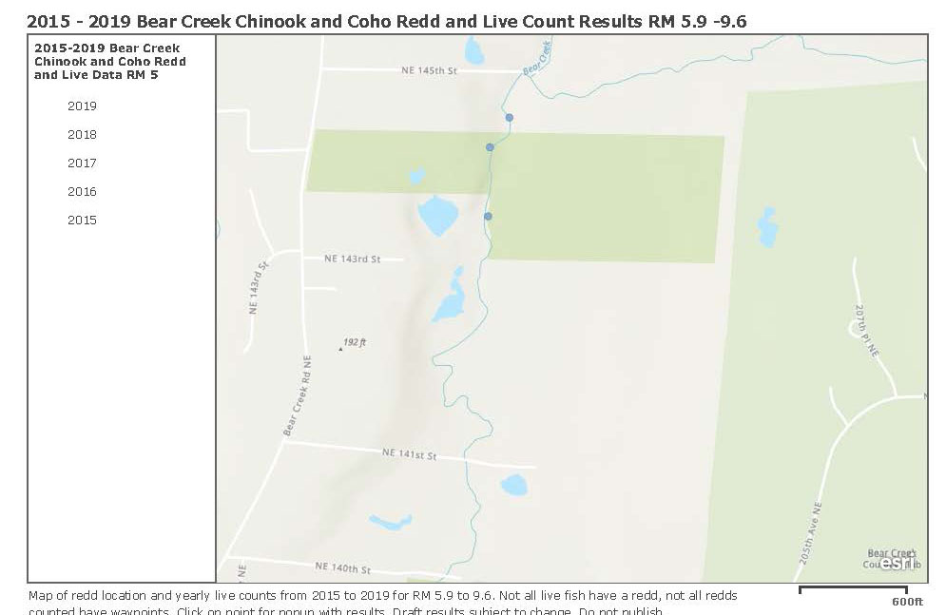
Notes:
Laird
There is documented spawning of Chinook and Coho in this reach. This is from WDFW’s data set.

Slide 14
Ecological need
More instream structure;
Lower water temperatures
More shade and riparian cover/structure;
Greater connection to floodplain and more frequent activation of relict channel features;
Better sorting of substrate to enhance spawning opportunities;
Enhanced wetland plant communities;
Enhanced upland plant communities.
Notes:
Laird
WE can see from this site that this reach is in need of ecological lift for salmon recovery.

Slide 15
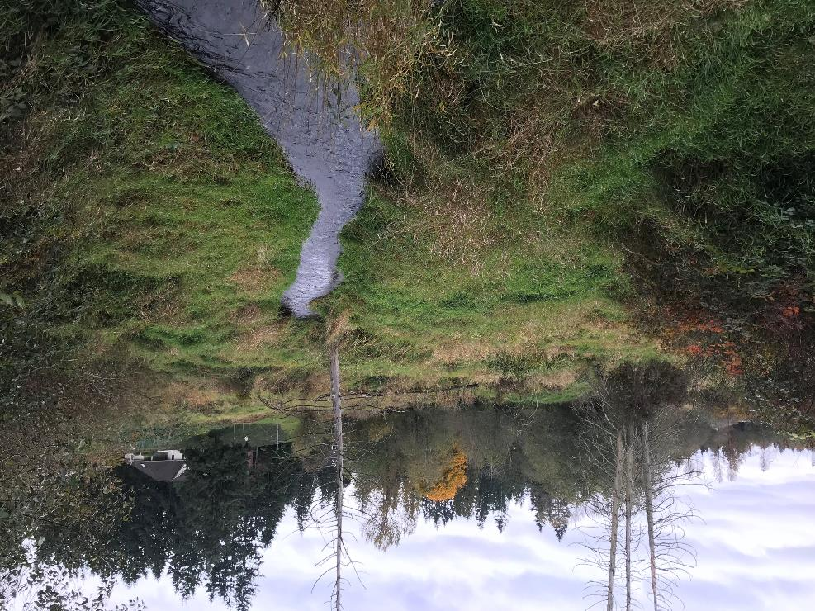
Beaver Effect

Slide 16
Channel Evolution Model
Stage Zero Concept
From Cluer and Thorne, 2014

Slide 17
Goals and objectives
Long term and short-term goals of the Salmon Conservation Plan
Restore Reach 9
Increase wood volume in Bear Creek (short term)
Provide functional riparian areas (long term goal)
Restore and provide complex stream channels
Create off channel habitat
Objectives
Raise water levels by ~12” by adding channel roughness/structure
Add >200 pieces of woody debris
Achieve a beaver dam, or similar in-channel structure, density of at least 5 dams per 1,000 feet by the end of 2026.
Plant >18 acres of riparian area to increase shade and lower summer stream temperatures
Provide a long-term source of riparian native large wood supply by 2050.
Notes:
Laird
The project goals and objectives and your approach to the project. Importance to salmon recovery…

Slide 19
Estimated TOTAL Project costs
Planting >18 acres: ~$410K
Design/Permitting: $250K
~200 pieces of LWD installed: ~$300K
Beaver Dam Analogs: ~$25K
TOTAL Project Cost: $985,000
Notes:
Denise
Here are the total estimated costs of the project.

Slide 20
Connecting recovery strategies
WRIA 8 Strategies - Appendix E
Protect and restore floodplain connectivity
Protect and restore functional riparian vegetation
Protect and restore channel complexity
Provide adequate streamflow
Notes:
Allow the new stream channels to more extensively occupy floodplain; riparian area plantings will improve ecosystem health and biodiversity, shading and water quality improvements; creation of new channels and large woody debris to allow for gravel and bedload sorting and pools and riffle formation; provide increased conveyance and streamflow with improved hydraulic connection

Slide 21
PSAR GRANT REQUEST
Total project cost $985,000
Early Action Planting $410,000
PSAR funding request $200,000
For Design and Implementation of Early Action Planting
Notes:
The total project cost is $1.4 million. We are requesting $200,000 under this Cooperative Watershed Management grant request. This amount will cover all phases of design and permitting costs for the proposed habitat improvements.

Slide 22
Outcomes
Design for 18.47-acre planting
Creation of Beaver Management Plan
Implementation of 18.47-acre planting in January 2023
Raised low-flow water elevations by1-foot
Maintain or decrease water temperatures through the reach
Increase beaver dam density by the end of 2026 to 5 dams per 1,000 linear feet of channel
Notes:
Project outputs and outcomes include

Slide 23
Questions Laird o’rollins, PROJECT MANAGER Laird.Orollins@kingcounty.gov Denise Di Santo, Project Sponsor DDISANTO@kingcounty.gov
Notes:
Thank you for your time and attention.

Slide 24
Reference SLIDes

Slide 25
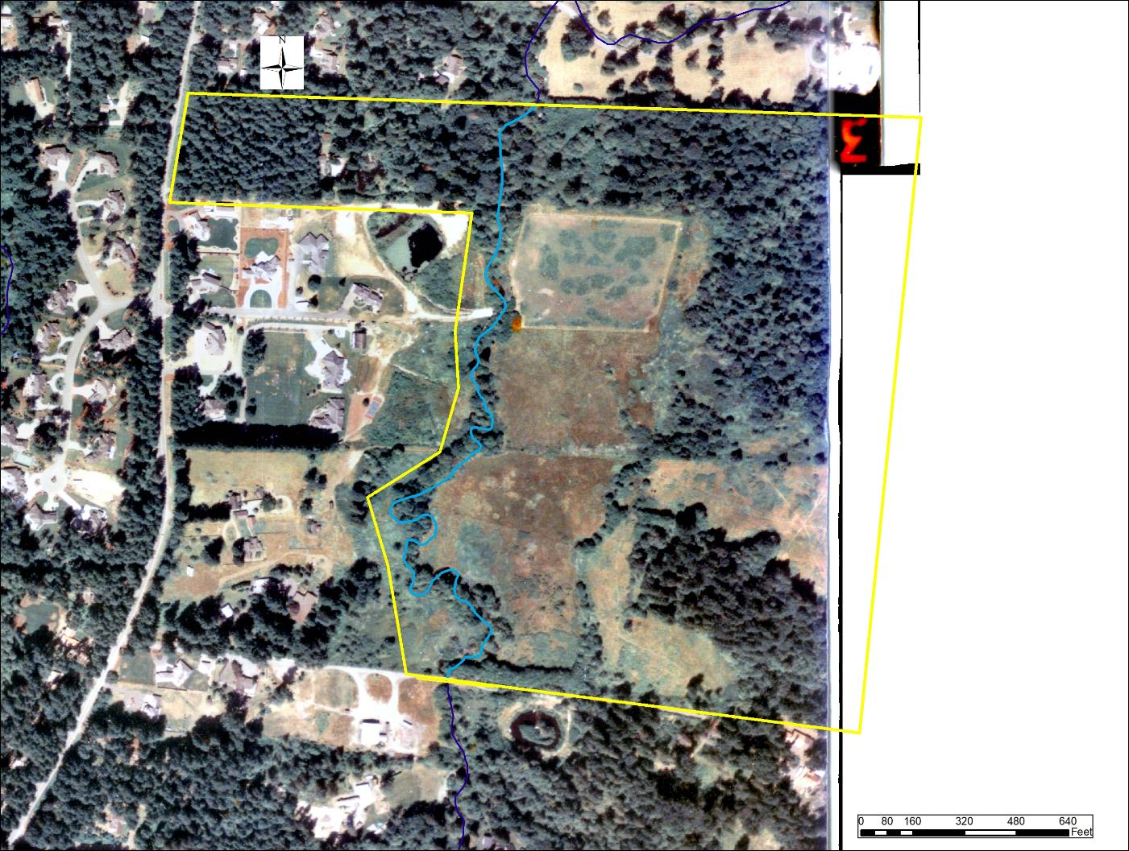
1990
Notes:
Build out over the past several decades has decreased functional habitat and degraded water quality in Bear Creek basin. Those impacts are evident in this reach as well.

Slide 26
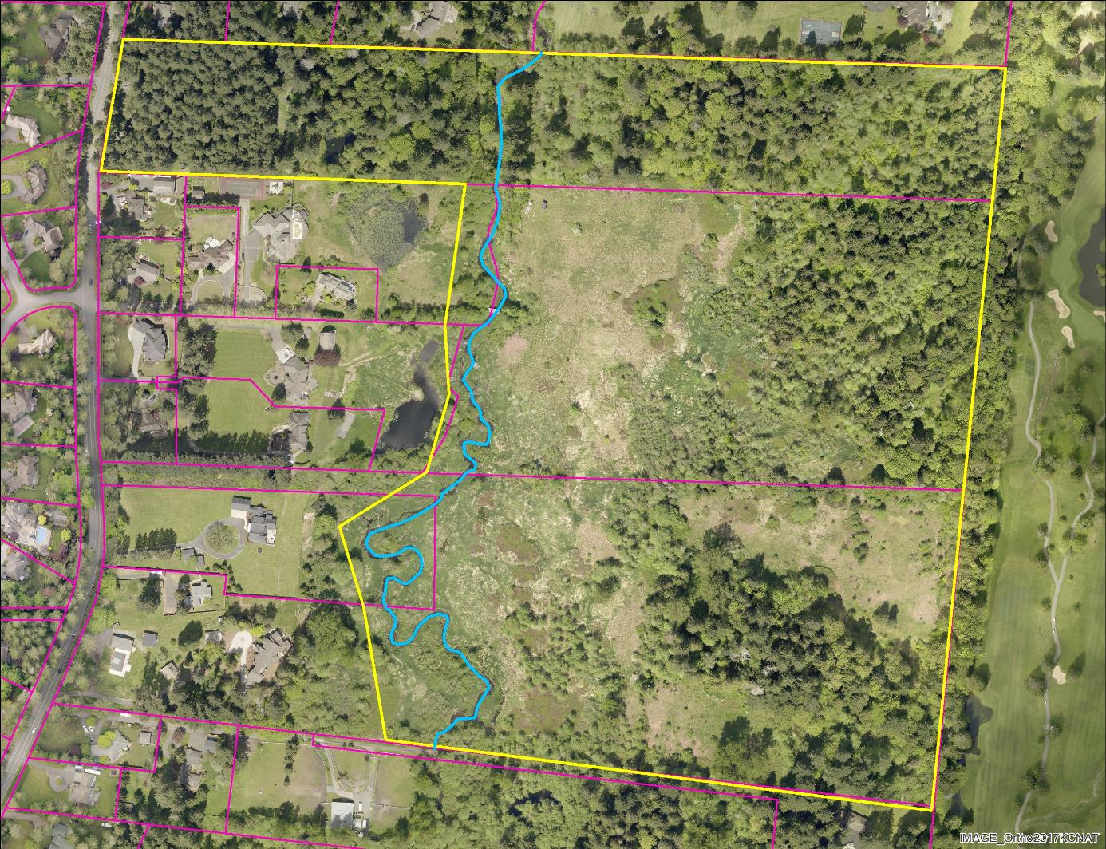
2017
Notes:
This more current aerial photo shows current conditions with sparse cover in the riparian and upland areas adjacent to the reach.

