Slide 1
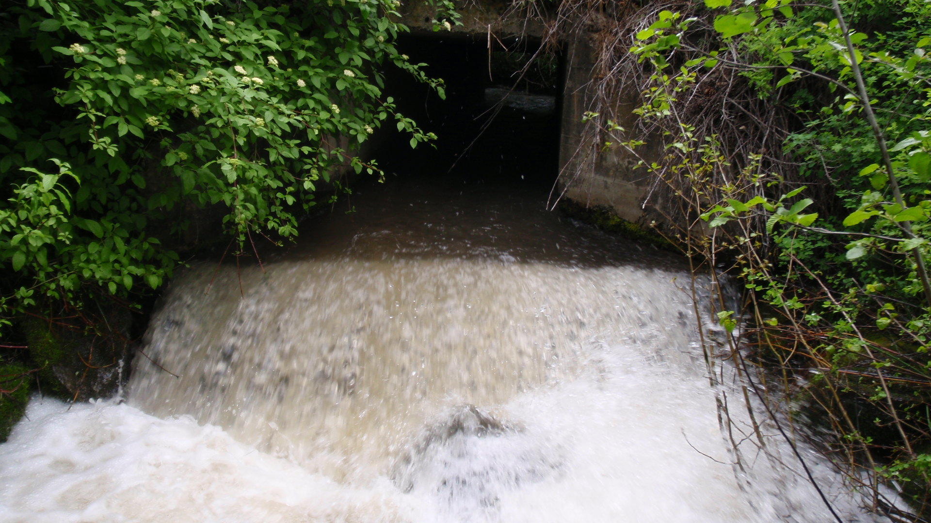
Mill Creek Fish Passage June 13, 2012 RTT Presentation
Low Flow Conditions
High Flow Conditions

Slide 2
Mill Creek Flow Data
Date | Annual low flow reading
9-24-11 | 11.1 cfs
8-26-10 | 17.7 cfs
9-1-09 | 11.6 cfs
10-1-08 | 6.5 cfs
Sept. 2007 | < 10 cfs
High flow data - April 2012 insert cfs
Peshastin Flows at Green Bridge Road 2007 – 2011 DOE data
Mill Creek contributes 5-10% of low flows in Peshastin Creek

Slide 3
Mill Creek Temperature Data
Site | 7 day average | Highest recording
Peshastin Mouth | 24.5 C | 25.5 C
Peshastin RM 0.3 | 22.2 C | 23.4 C
Peshastin below Ingalls | 16.7 C | 17.3 C
Peshastin above Ingalls | 17.9 C | 18.4 C
Ingalls at road crossing | 15.6 C | 16.1 C
Mill Creek | 16.6 C | 18.4 C
Ruby Creek | 13.8 C | 14.1 C
DOE 2005 Wenatchee River TMDL study

Slide 4
DOE Thermal Infared Surveys
Mill Creek enters Peshastin Creek where the mainstem temperature is ~ 17-19 C

Slide 5
Fish Data
Steelhead juvenile rearing and spawning
Possibly Chinook juvenile rearing
WDFW Spawning data from 2003-2009
Majority of steelhead spawning occurs in the mainstem (ave. reds 43/year)
Redd surveys in Mill, Ingalls, Ruby, Tronson Scottty, Shaser, and Schafer Creeks (about 3% of the watershed total in 7 years)
Steelhead redds were found in Mill Creek 2/5 years surveyed

Slide 6
Fish Barrier Inventory
3.8 km of habitat above barrier
~ 0.25 km < 4% gradient
Moderate ranking for small stream priority matrix
High ranking culverts (Chumstick and Icicle)
Reduced to low priority
Logging/roads, unknown base flow, amount of habitat with <4% gradient

Slide 7
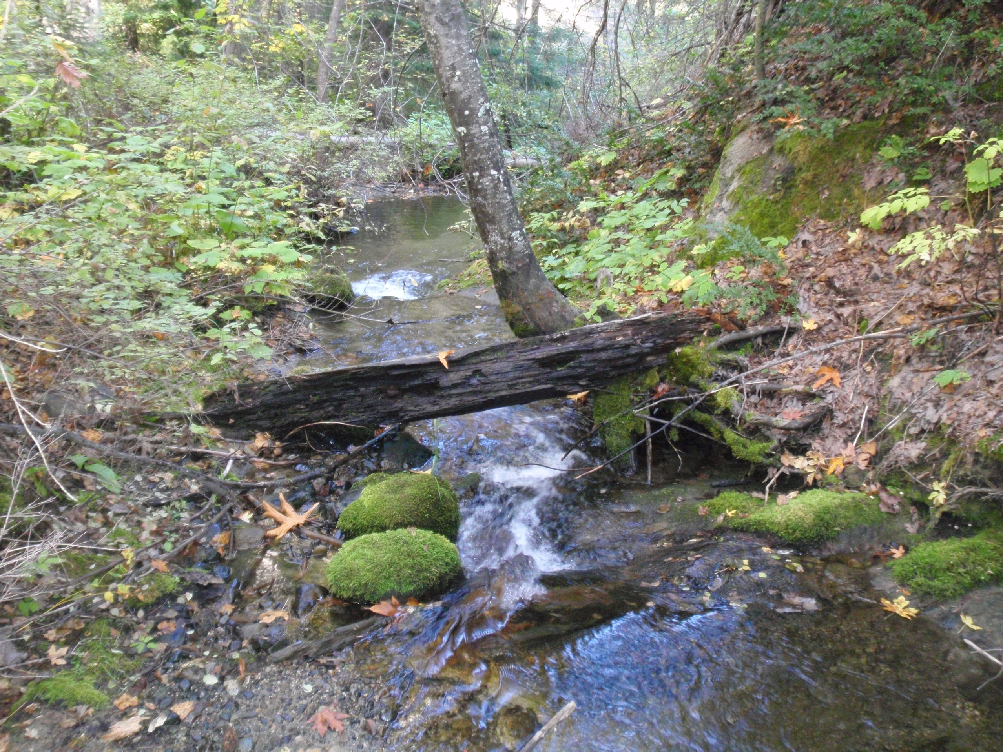
Mill Creek Typical Habitat Upstream of the Culvert

Slide 8
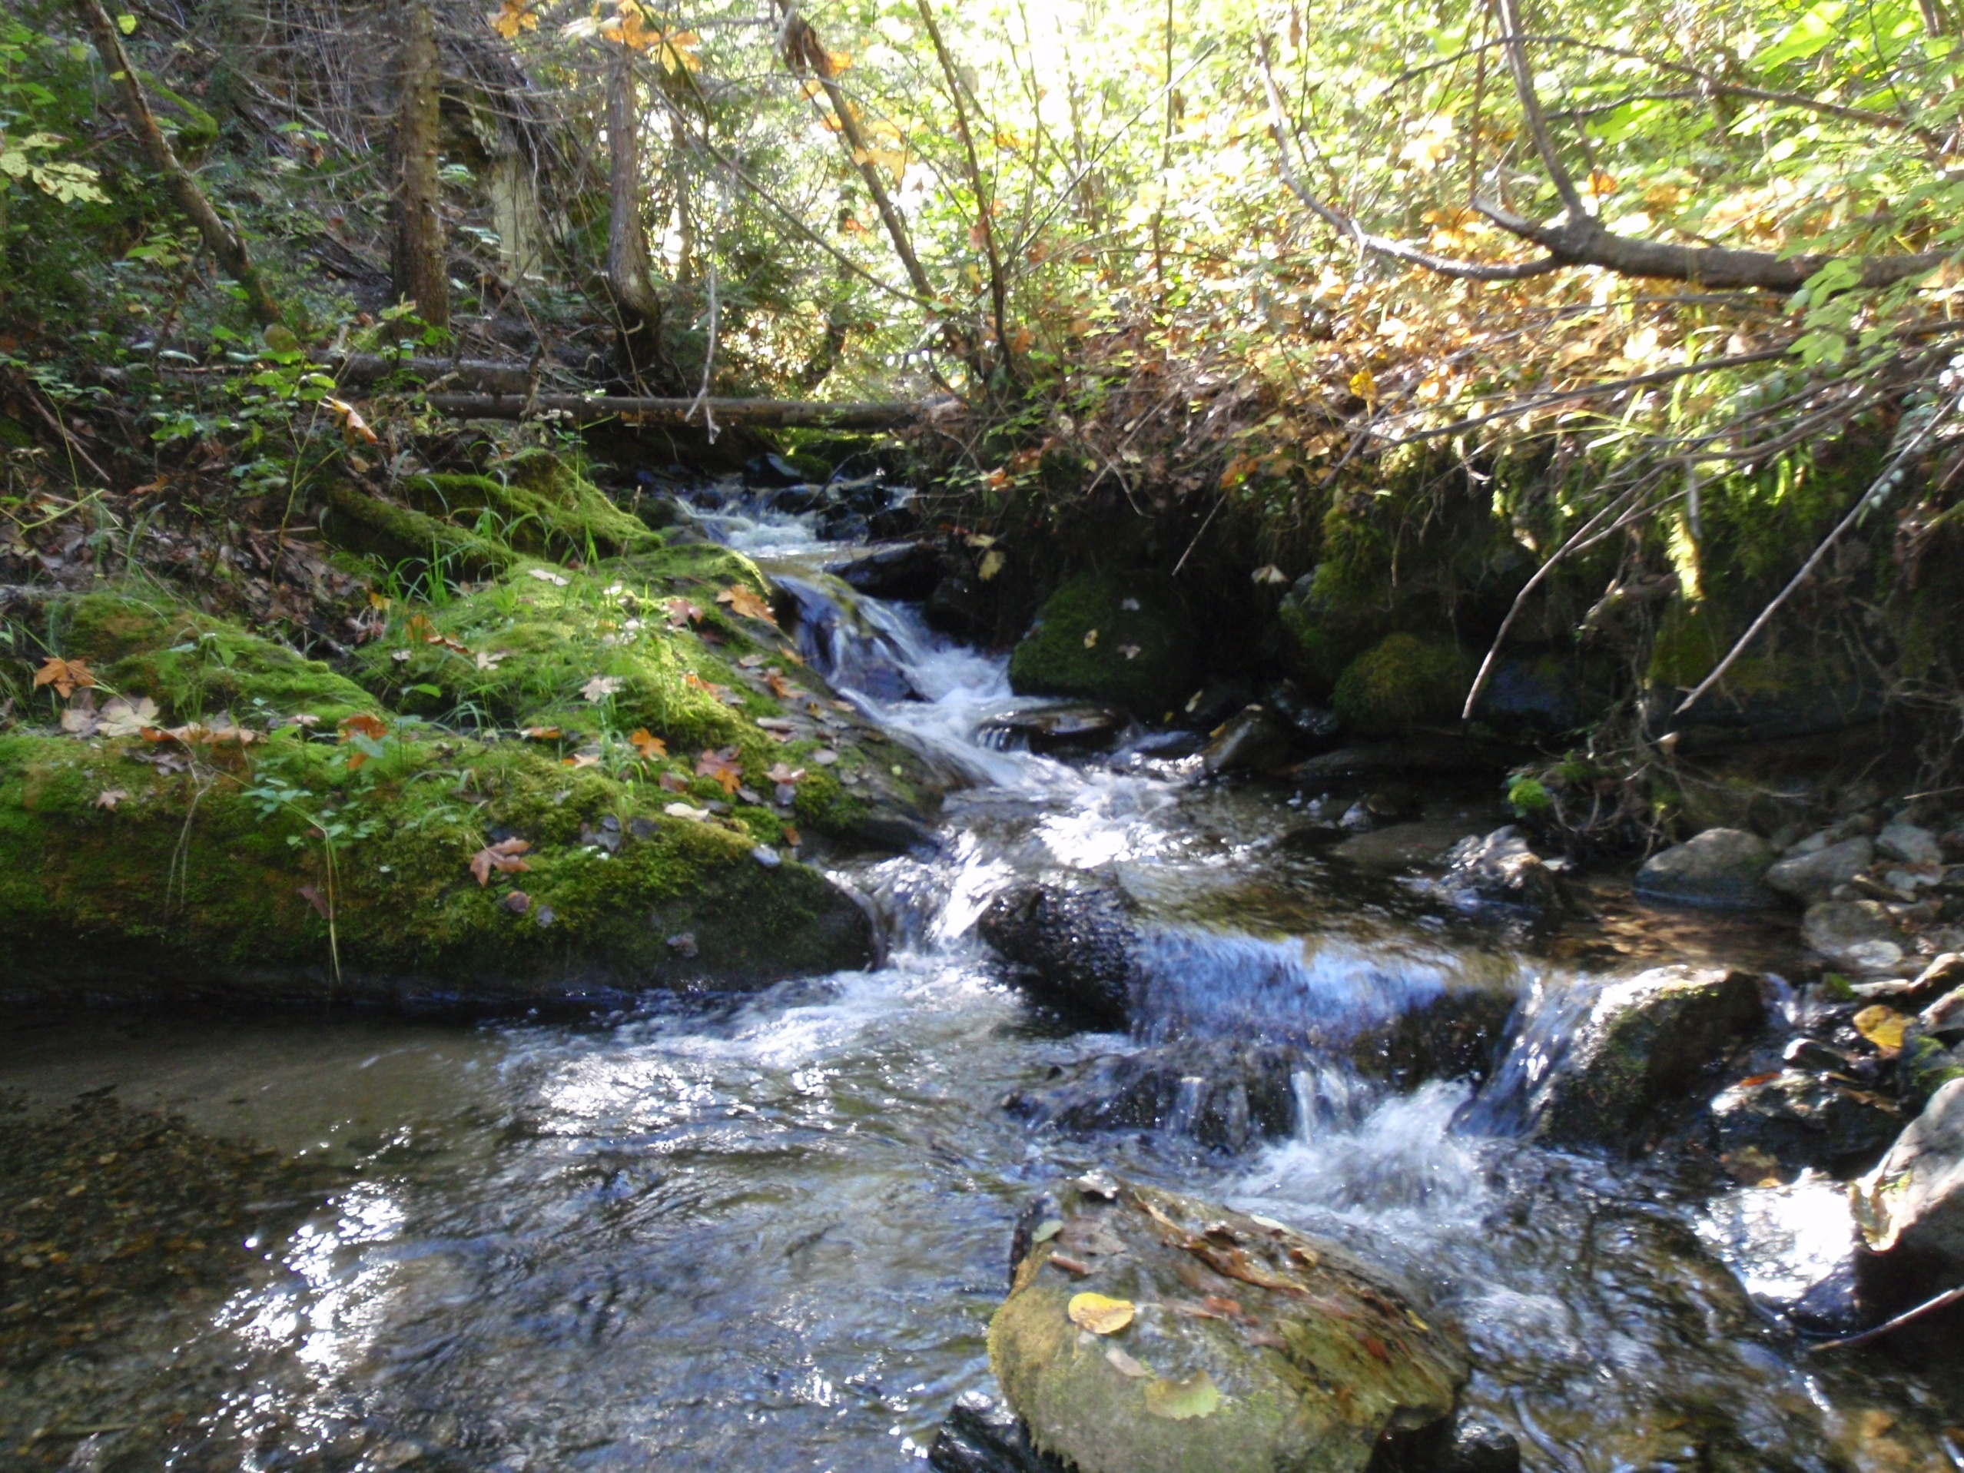

Slide 9
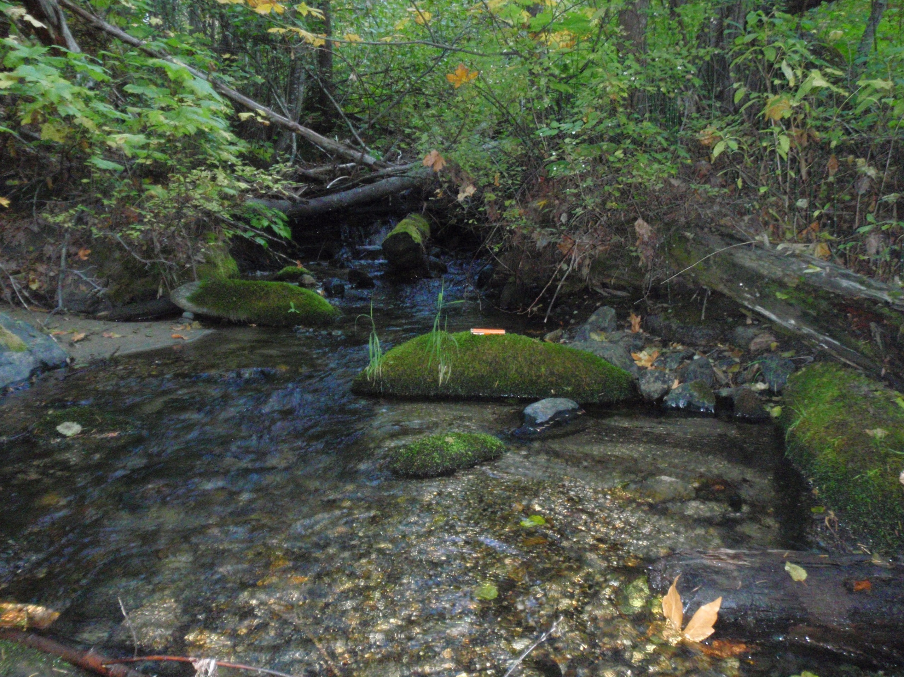

Slide 10
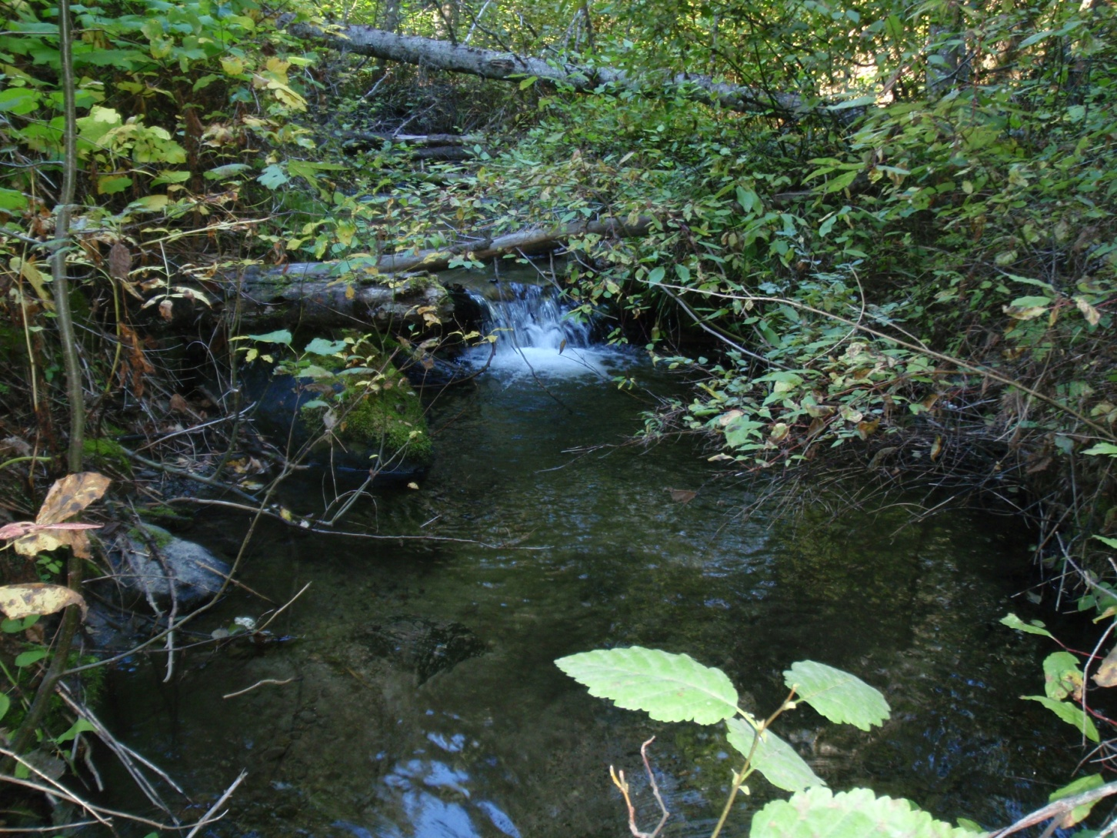
Upstream structures

