Slide 1
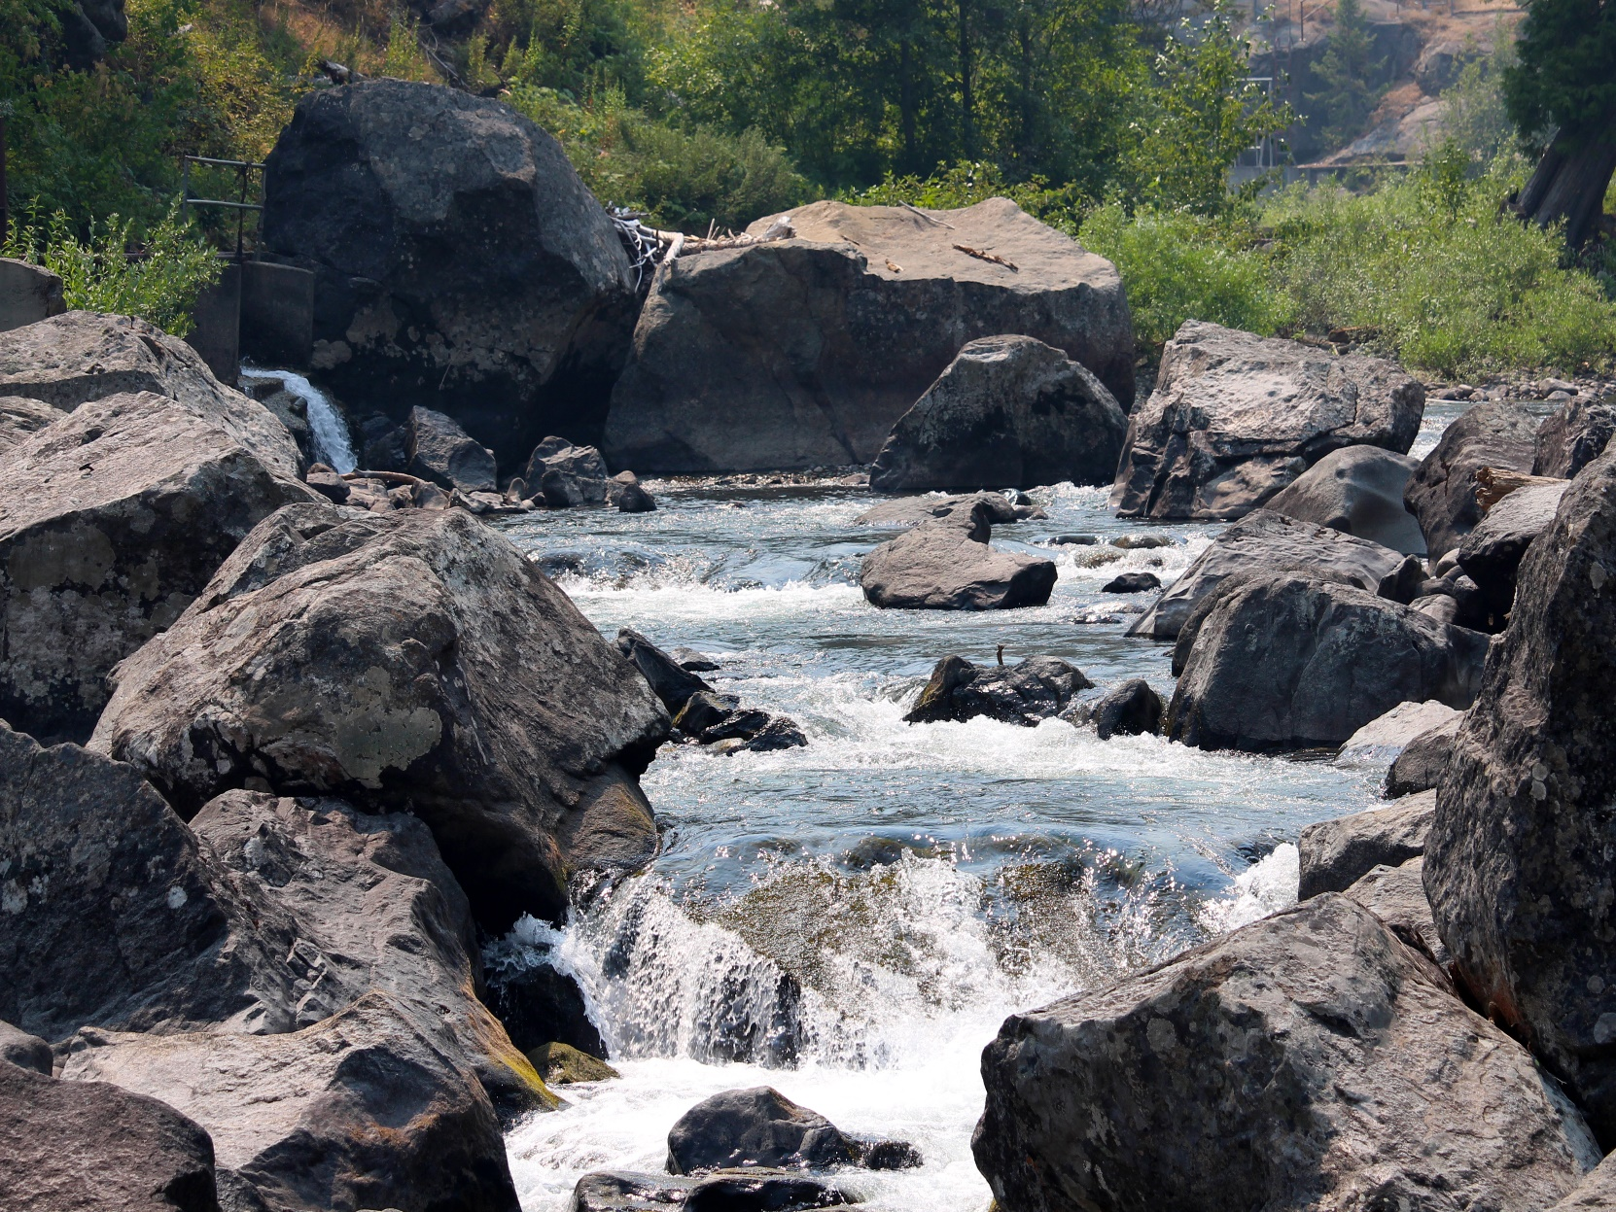
Icicle Creek Integrated Water Resource Management Strategy

Slide 2
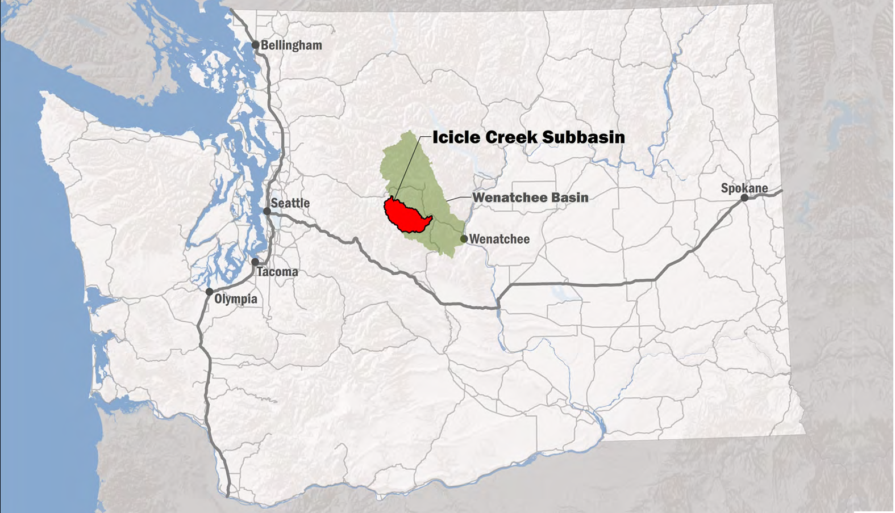
Icicle Creek is a tributary to the Wenatchee River (WRIA 45) located in Chelan County, WA
Notes:
MD

Slide 3
Background
Co-Conveners: Ecology’s Office of Columbia River and Chelan County
Process: Assembled Icicle Workgroup (IWG) Stakeholders
Goals: Meet instream and out-of-stream objectives in Icicle Creek Basin, provide an alternate pathway for conflict resolution other than litigation

Slide 4
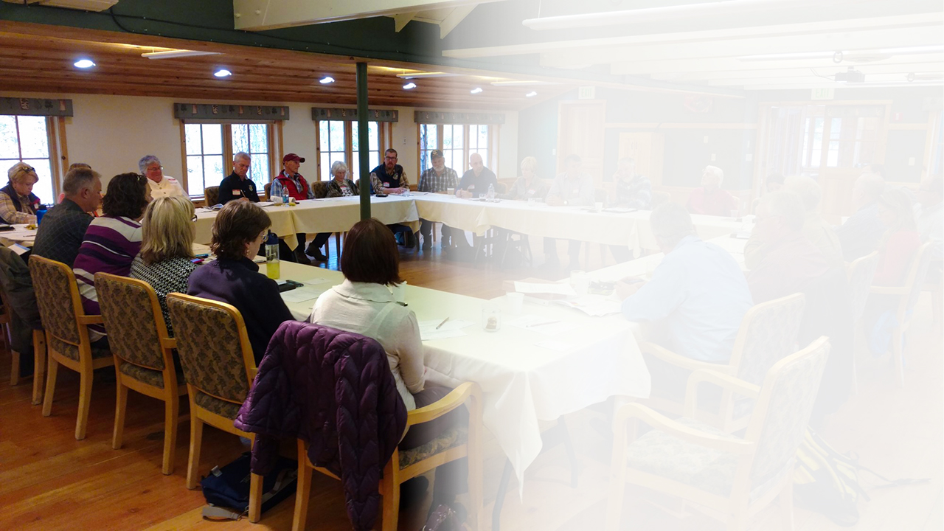
IWG Members
Ecology Office of Columbia River
Chelan Co Board of Commissioners
Yakama Nation
WA State Dept of Fish & Wildlife
Conf Tribes of the Colville Reservation
Icicle & Peshastin Irrigation District
USFWS – Leavenworth Fish Hatchery
City of Leavenworth
NOAA Fisheries
WA Water Trust
US Forest Service
Trout Unlimited
Agricultural Representatives
City of Cashmere
US Bureau of Reclamation
Cascadia Conservation District
Cascade Orchard Irrigation Co
Icicle Creek Watershed Council

Slide 5
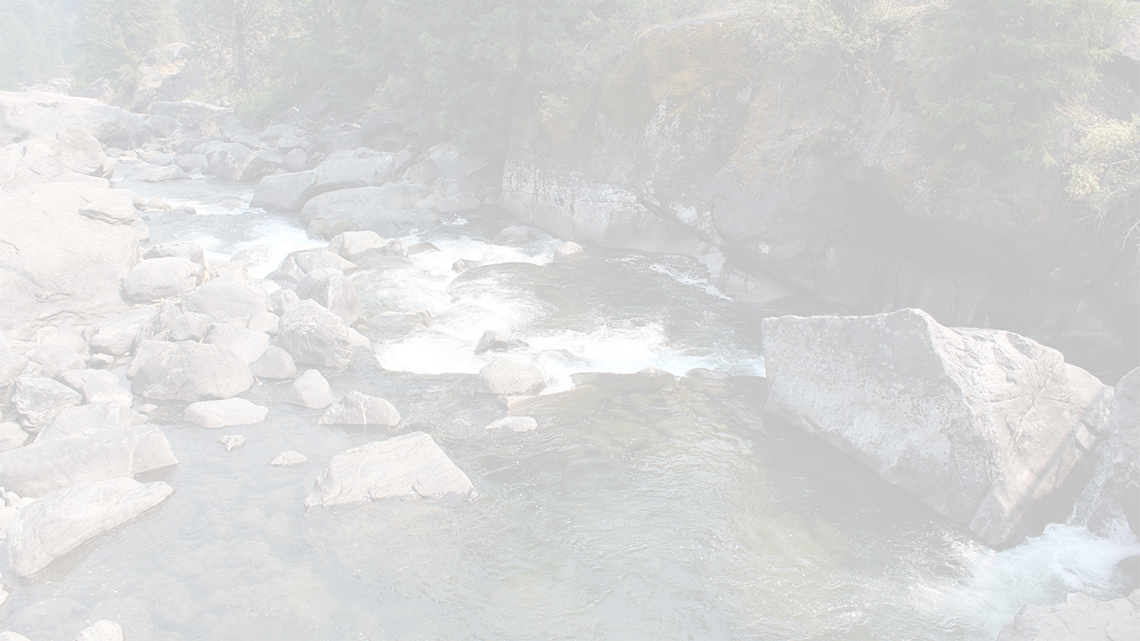
Timeline of Icicle Strategy
Litigation amongst numerous Icicle stakeholders
Icicle Workgroup Guiding Principles
Alternatives Programmatic EIS
Project SEPA NEPA Feasibility Design
Funding
Implementation
Adaptive Management
Monitoring
Decision-Support Tool Long-Term Icicle Strategy Goals
Pre-2012
2012 - 2019
2019 - 2029
2029 +

Slide 6
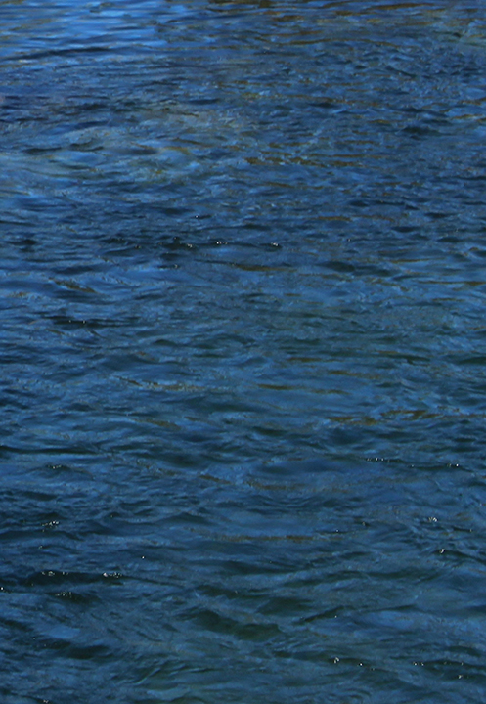
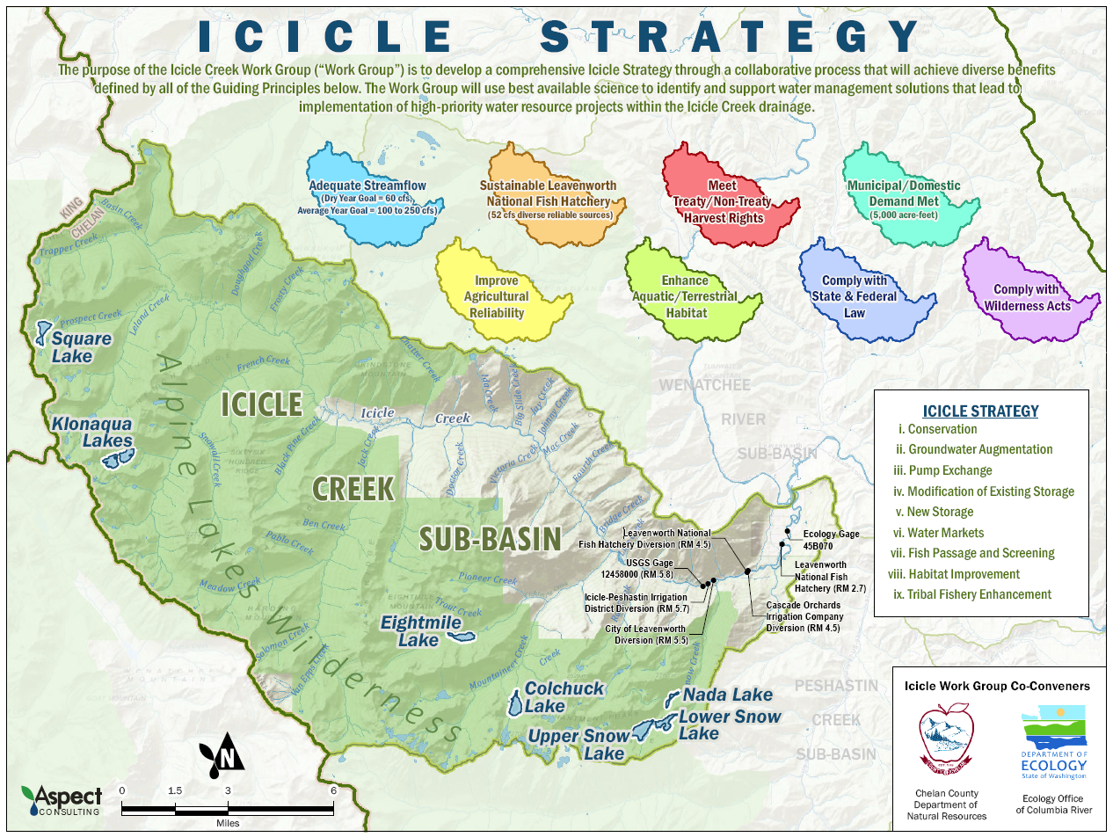
Icicle Strategy Overview
Guiding
Principles for
the Icicle
Strategy

Slide 7
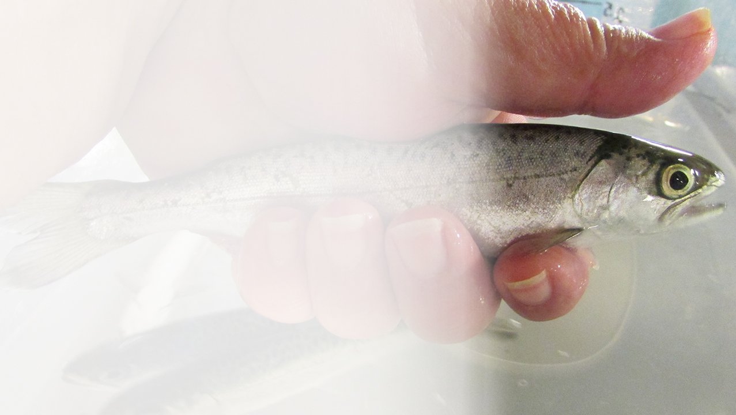
Guiding Principles
Improve Streamflow
Dry Year Goal = 60 cfs (current conditions <20 cfs)
Average Year Goal = 100 to 250 cfs (current is 60 cfs)
Improve Sustainability of the Leavenworth National Fish Hatchery
Meet fish production requirements
Fulfill federally protected Tribal fishing rights
Protect and conserve water rights
Maximize fish health
Minimize fish barriers
Photo credit: Marcia Porter

Slide 8
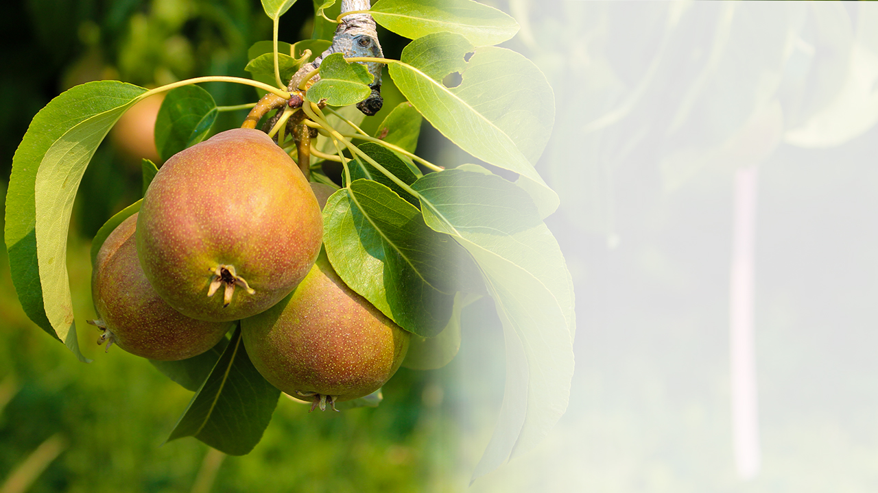
Guiding Principles
Protect Tribal Treaty and Federally-Protected fishing/ harvest rights
Meet Domestic Water Demand
Increase year-round supply by 3-6 cfs (peak) (thru 2050)
Improve Agricultural Reliability
Improve management of existing lake storage
Current interruptible water use (2-4 cfs) made firm

Slide 9
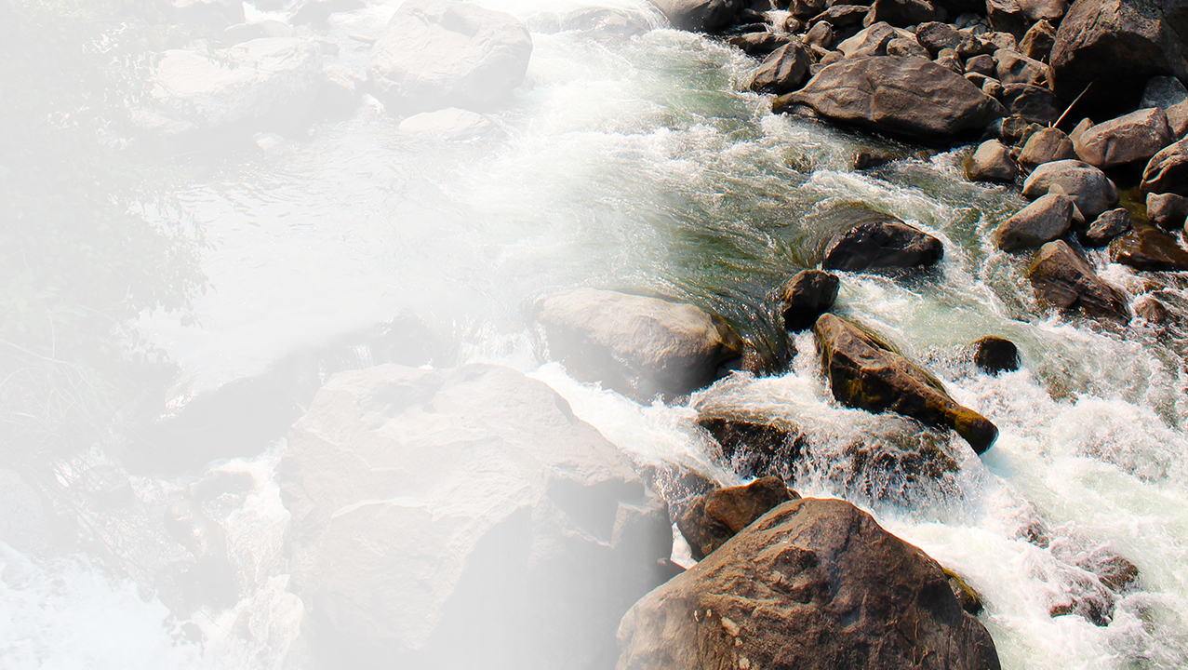
Guiding Principles
Improve and Protect Icicle Creek Habitat
Stream habitat enhancement and protection
Improve fish passage
Fish screen upgrades
Protect Non-Treaty Harvest
Comply with State and Federal Laws and Wilderness Acts

Slide 10
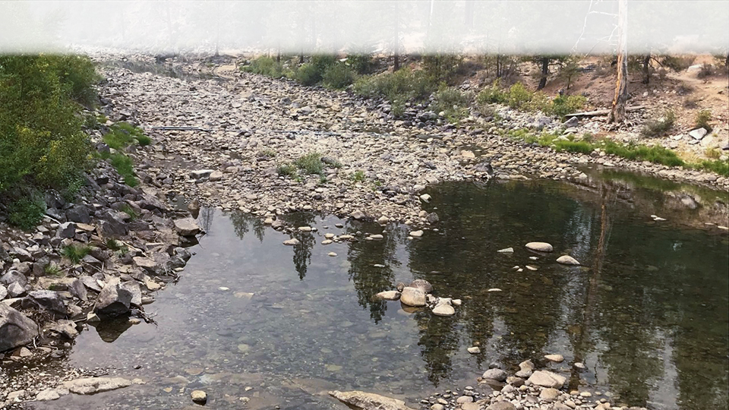
What Does Flow In Icicle Creek Look Like?
September 13, 2020

Slide 11
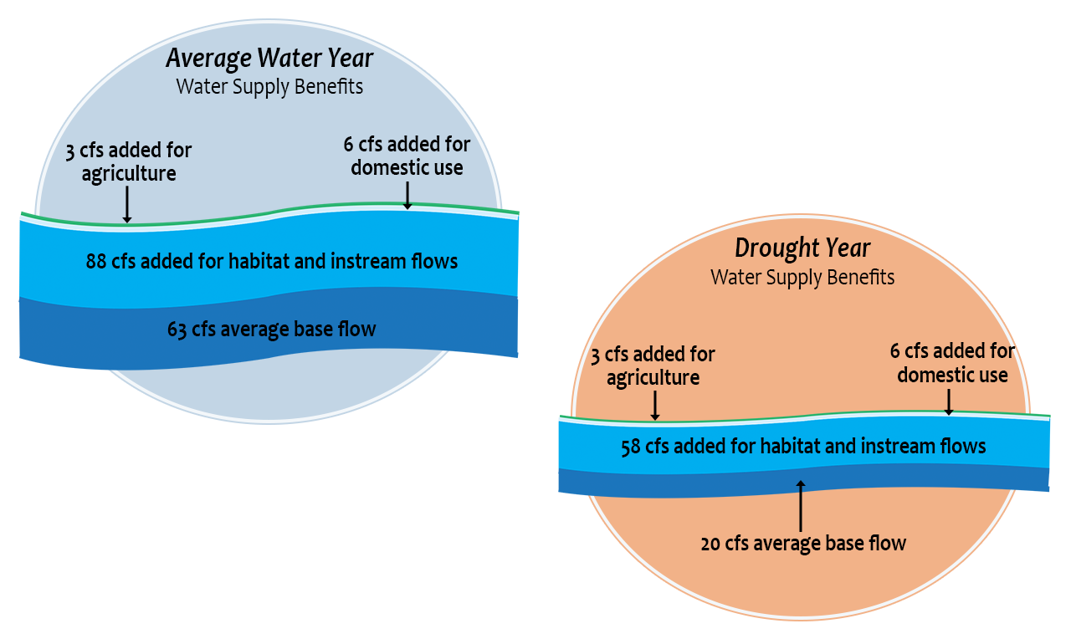
Water Supply Benefits

Slide 12
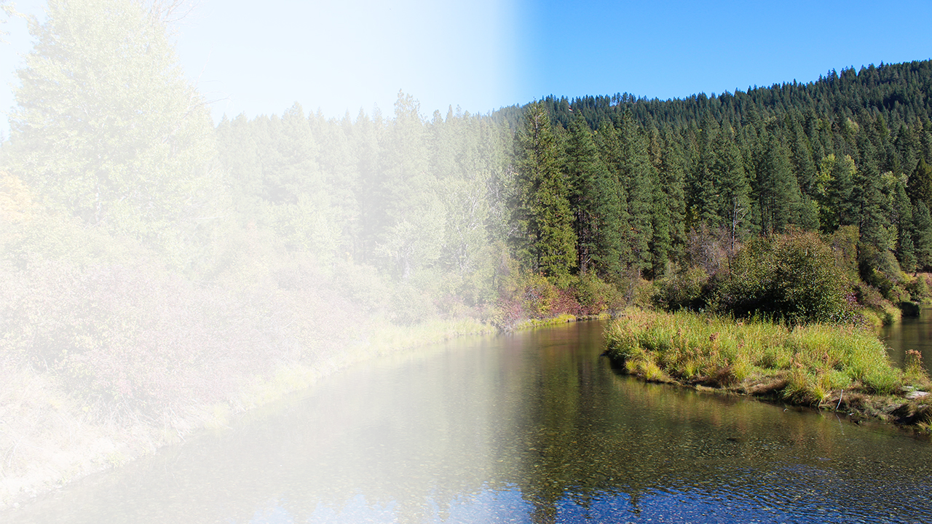
Projects – collectively meet all guiding principles
Water Conservation and Efficiencies
Fish Passage and Fish Screens
Irrigation Pump Exchanges
Modification of Existing Storage
Stream Habitat Enhancement
Tribal Fishery Adaptive Management Plan
Groundwater Augmentation
Legal and Administrative Tools

Slide 13
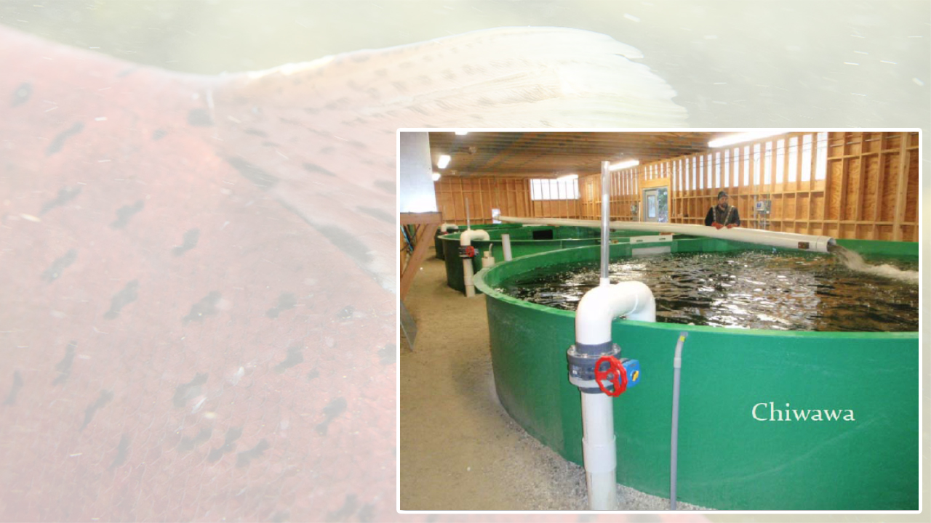
Water Conservation and Efficiencies
Leavenworth National Fish Hatchery Water Reuse
Pilot Circular Tanks: Construction of 4 pilot tanks is underway, will be completed in summer 2021.
3 years of monitoring will inform plans and potential next steps for full buildout
Goal: Up to 20 cfs anticipated

Slide 14
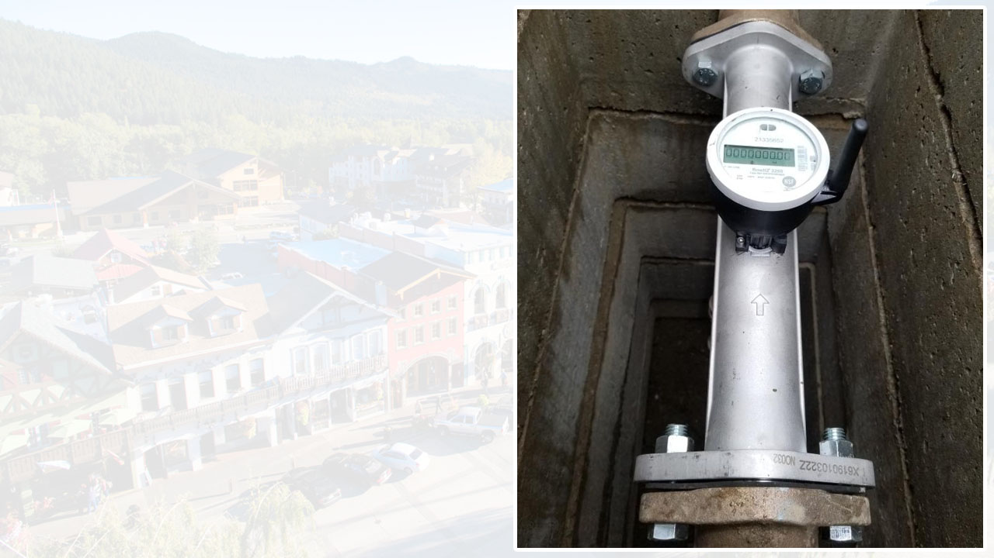
Water Conservation and Efficiencies
Municipal and Domestic
Status: City of Leavenworth Advanced Metering Infrastructure (AMI) Implementation Fall 2020-Spring 2021
Upcoming
Leak detection and pipe replacement
City and Rural Voluntary Lawn Reduction and water use efficiencies

Slide 15
Water Conservation and Efficiencies
Icicle Peshastin Irrigation District
15 miles of pipe installation plus lining projects completed
Wooden Flume replacements completed
Additional piping and lining being planned and implemented annually
Status: estimated 7 cfs savings to date
Goal: 10 cfs water savings

Slide 16
Fish Passage and Fish Screens
Boulder Field Project
Status: Completed Fall 2020
Step pools constructed in channel to improve fish passage through large boulder field

Slide 17
Fish Passage and Fish Screens
City of Leavenworth Fish Screen Replacement
Construction will be completed in Spring 2021
Icicle Peshastin Irrigation District Fish Screen Replacement
Access bridge replaced in March 2021 to enable screen construction
Screen construction planned for Fall 2021

Slide 18
Fish Passage and Fish Screens
LNFH Surface Water Intake, Fish Screen and Passage Project
Phase 1 begins spring 2022: new intake headworks and fish screen plus roughened channel and fishway.
Phase 2 begins spring 2023: replace and line conveyance pipeline
Both Phases will be complete by 2025 or sooner

Slide 19
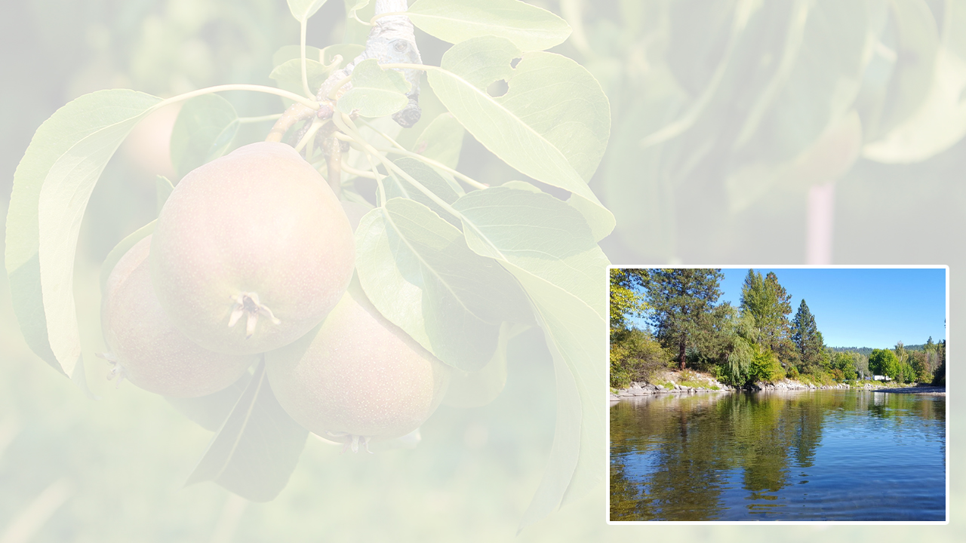
Pump Exchanges – Cascade Orchard Irrigation Co.
Cascade Orchard Irrigation Company (COIC) Irrigation Efficiency and Instream Flow Enhancement
Construction planned for 2021-2022
Move diversion from RM 4.5 to RM 1.9 with new pump station and fish screen.
Convert open ditch to closed pipe.
Instream Flow: 11.9 cfs for 2.6 miles; 3.5 cfs below new diversion during September low-flow period

Slide 20
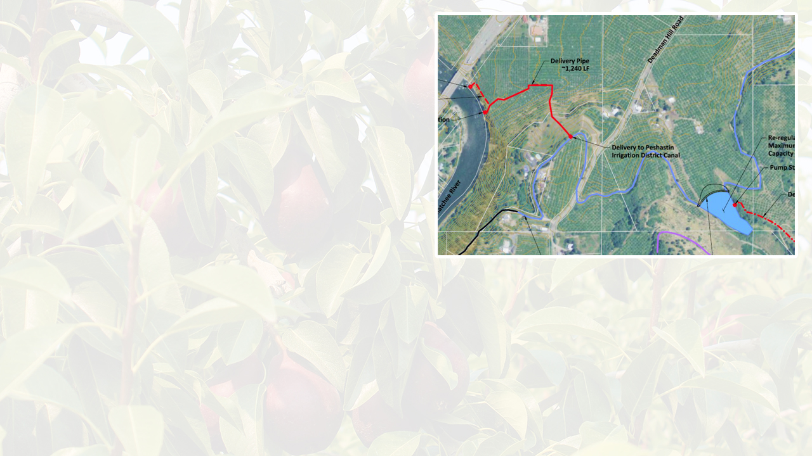
Pump Exchanges -- IPID
Icicle Peshastin Irrigation District
Pump Exchange Project
Status: Alternatives Analysis and Conceptual Deign (2021)
Construction of two full season pump stations on the Wenatchee River
Eliminate Peshastin Creek Diversion
Decrease Icicle Creek diversion up to 20-25 cfs at times.
Evaluating options to offset long-term pumping power costs (i.e. power generation)

Slide 21
Modification of Existing Storage
Eightmile Lake Dam Rebuild and Restoration
IPID and Ecology Dam Safety Office developed options to meet safety standards
Office of Columbia River is preparing an EIS under SEPA to examine alternatives
Alpine Lakes Automation and Optimization
Automate Lake releases based on need and conditions
30+ cfs instream flow benefit
Status: 30% design
Collecting data on streamflow and temperature

Slide 22
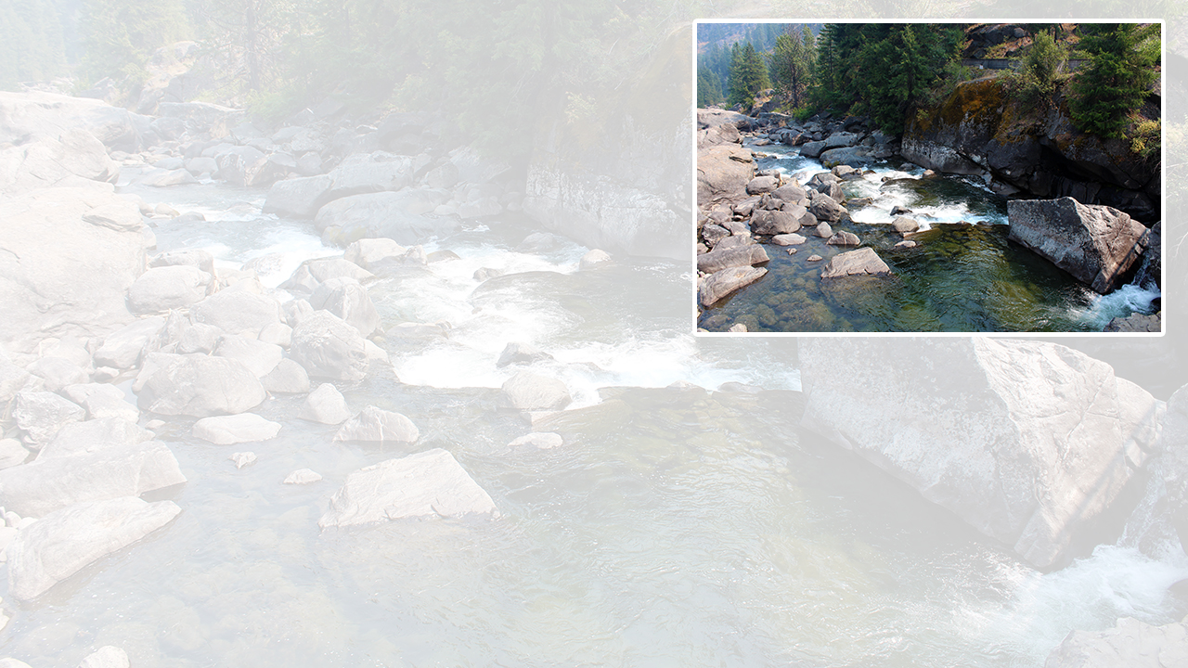
Stream Habitat Enhancements
Several Riparian Improvement and Sediment Reduction Projects being designed.
Construction planned at river mile 1.0 in 2022
Upcoming Projects may include riparian planting, side channel restoration, engineered log jams

Slide 23
Tribal Fishery Adaptive Management
Projects being identified by Tribal fishers and coordinated with Leavenworth National Fish Hatchery
Assessing flow and channel morphology
Tribal fishery effectiveness monitoring

Slide 24
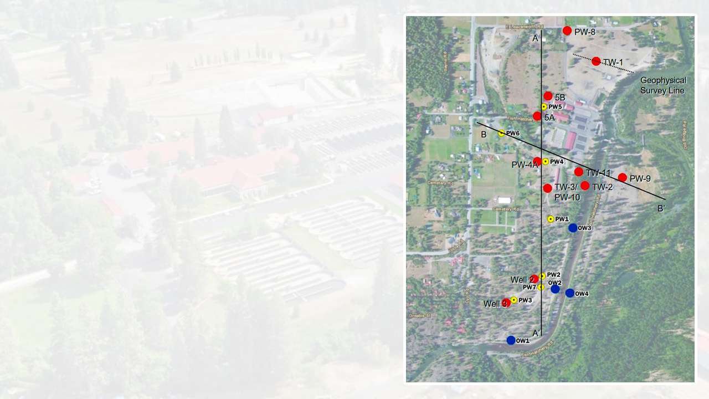
Groundwater Augmentation
Restore groundwater supplies at Leavenworth Hatchery
7+ cfs
Production level shallow groundwater collectors planned
Colder water coordinated with water reuse project

Slide 25
Legal and Administrative Tools
Water Markets
Create a voluntary Icicle Creek Water Market
Improve agricultural reliability for market participants
Instream Flow Rule Amendment
Amend Icicle portion of Wenatchee Instream Flow Rule to increase reserve
Provides water for domestic use
Rule requires instream flow improvement

Slide 26
Questions?

Slide 27
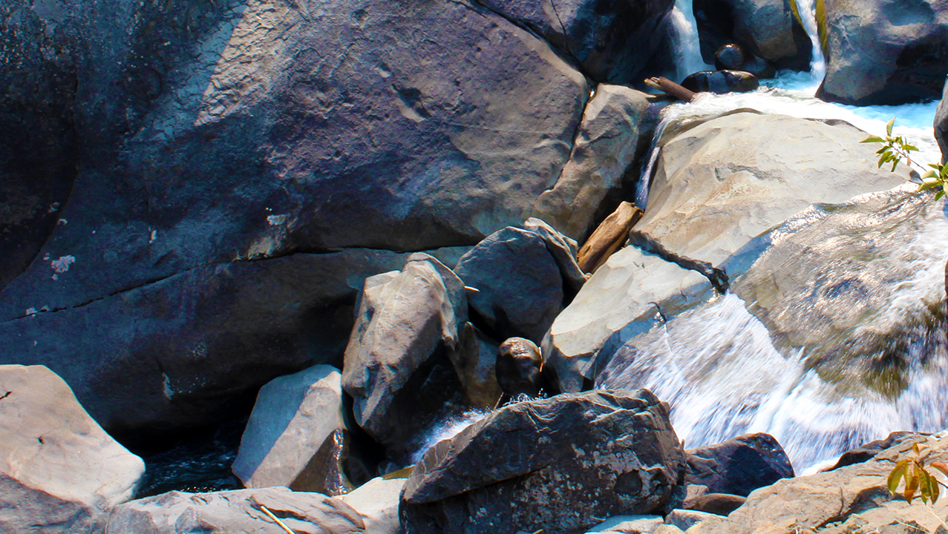
Video template

