Slide 1
16-1306 Stairs, and Rock wall on each side of stairs 1/23/2023

Slide 2
Same picture as page 1, but from higher up the hill.

Slide 3
Stairs and rock wall from the beach

Slide 4
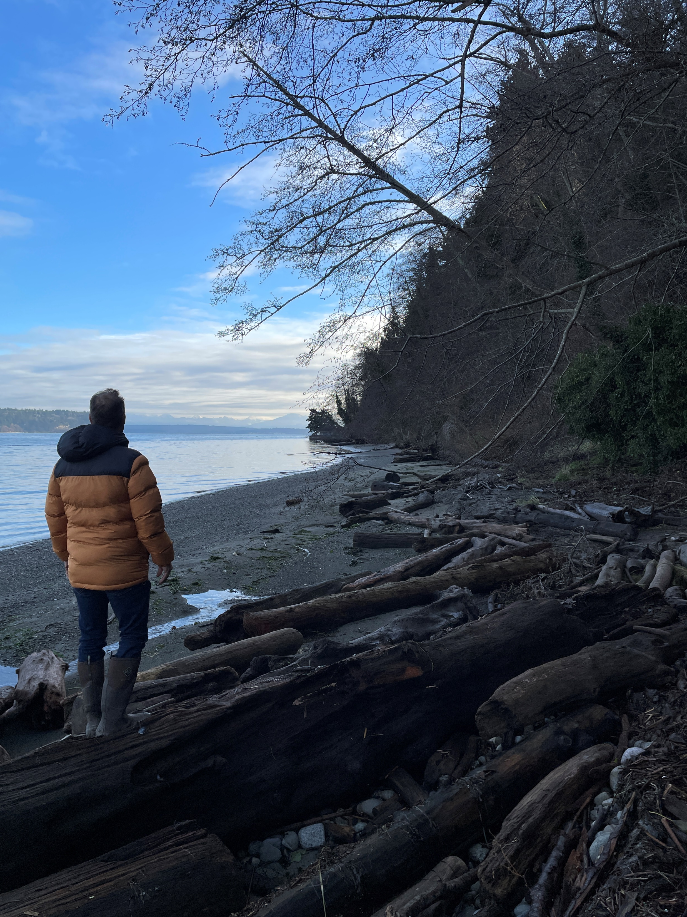
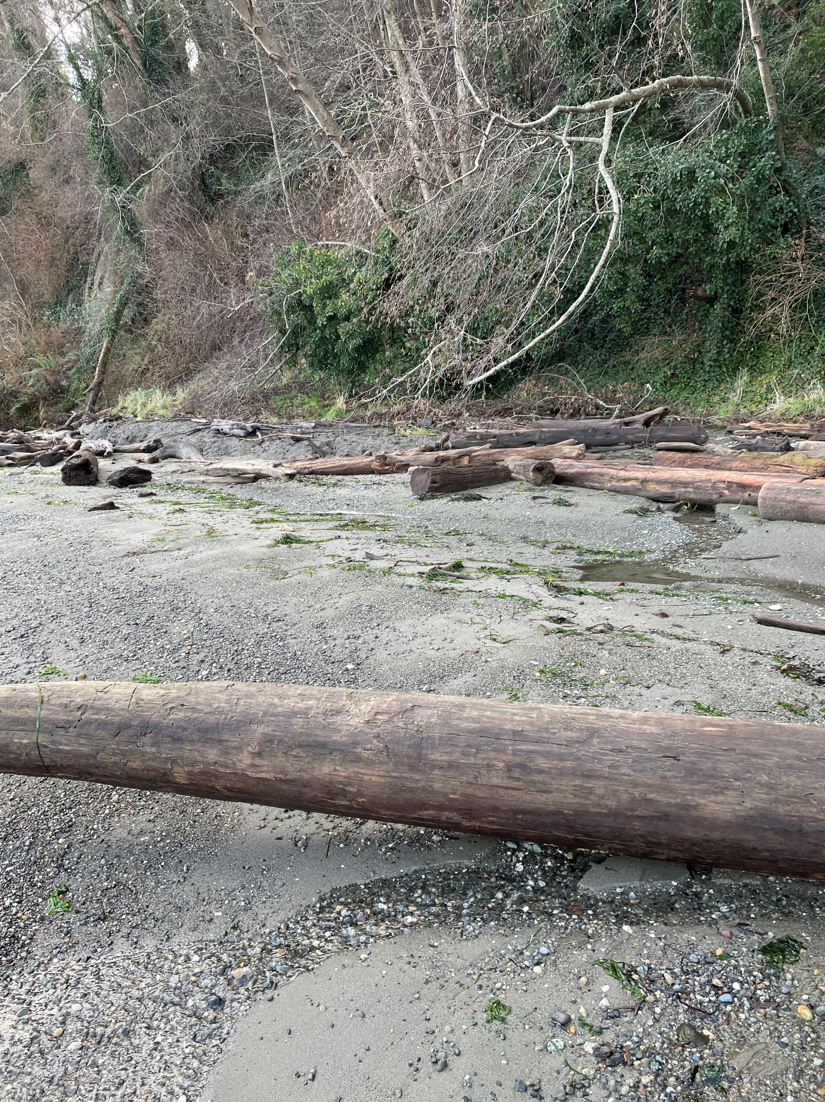
Looking to the right of the stairs, as facing the water

Slide 5
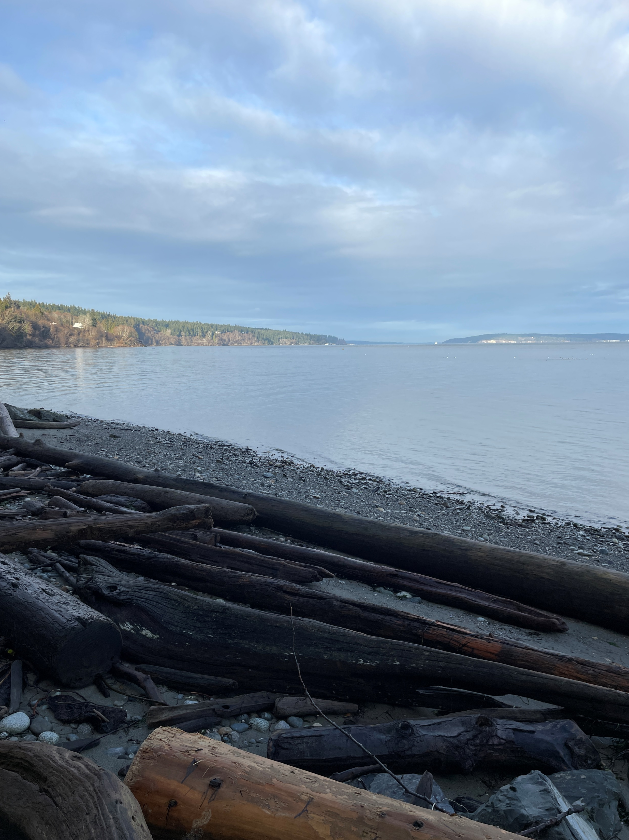
Looking to the left of stairs, as facing the water

