Slide 1
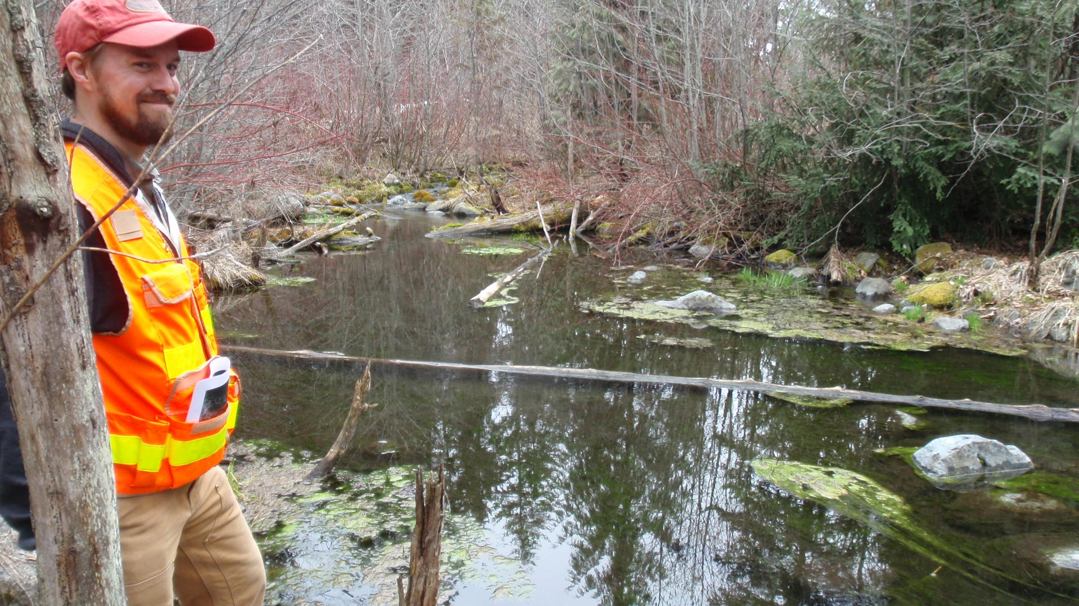
Peshastin Creek-BRG Side Channel Reconnection Design

Slide 2
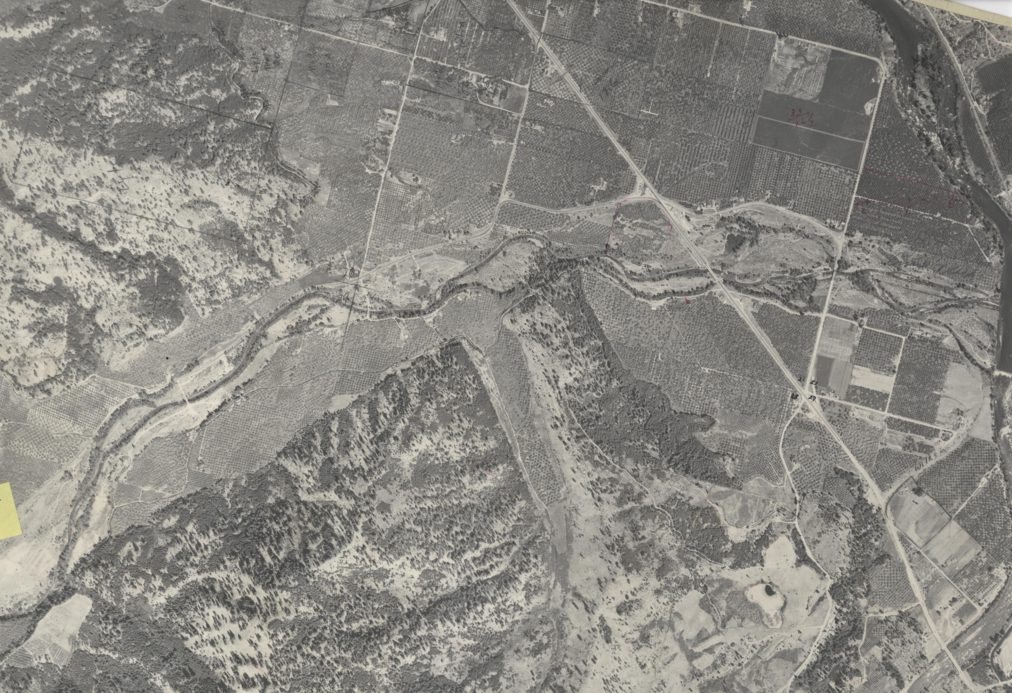
SR 97 Highway Construction 1956
Reduced length of stream by 0.8 miles
Disconnected 194 acres of flood plain
Increased channel confinement
Impaired riparian condition

Slide 3
How BRG fits with UC Recovery Plan:
Reconnect side channel habitats and floodplains (35 acres floodplain, 6 acres channel)
Biological Strategy Tier 1 action
Top priority for addressing limiting habitat factors
Directly benefits spring Chinook, steelhead and bull trout

Slide 4
Project Design
Selection of a Preferred Alternative
Completion of Preliminary Design
Topo and Boundary Survey
Geotech
Analyze site hydraulics
Plan view and cross-sections (permitting)
Calculate quantities and cost
Completion of Preliminary Design Report

Slide 5
Project Design cont.
Project Permitting
Wetlands delineation and report
Cultural Resources survey and report
Impacts analysis to wetlands and waters of US
Biological Assessment
JARPA submittal
Design review by stakeholders, permit agencies, HSC, etc.
Complete Final design and technical specs.

Slide 6
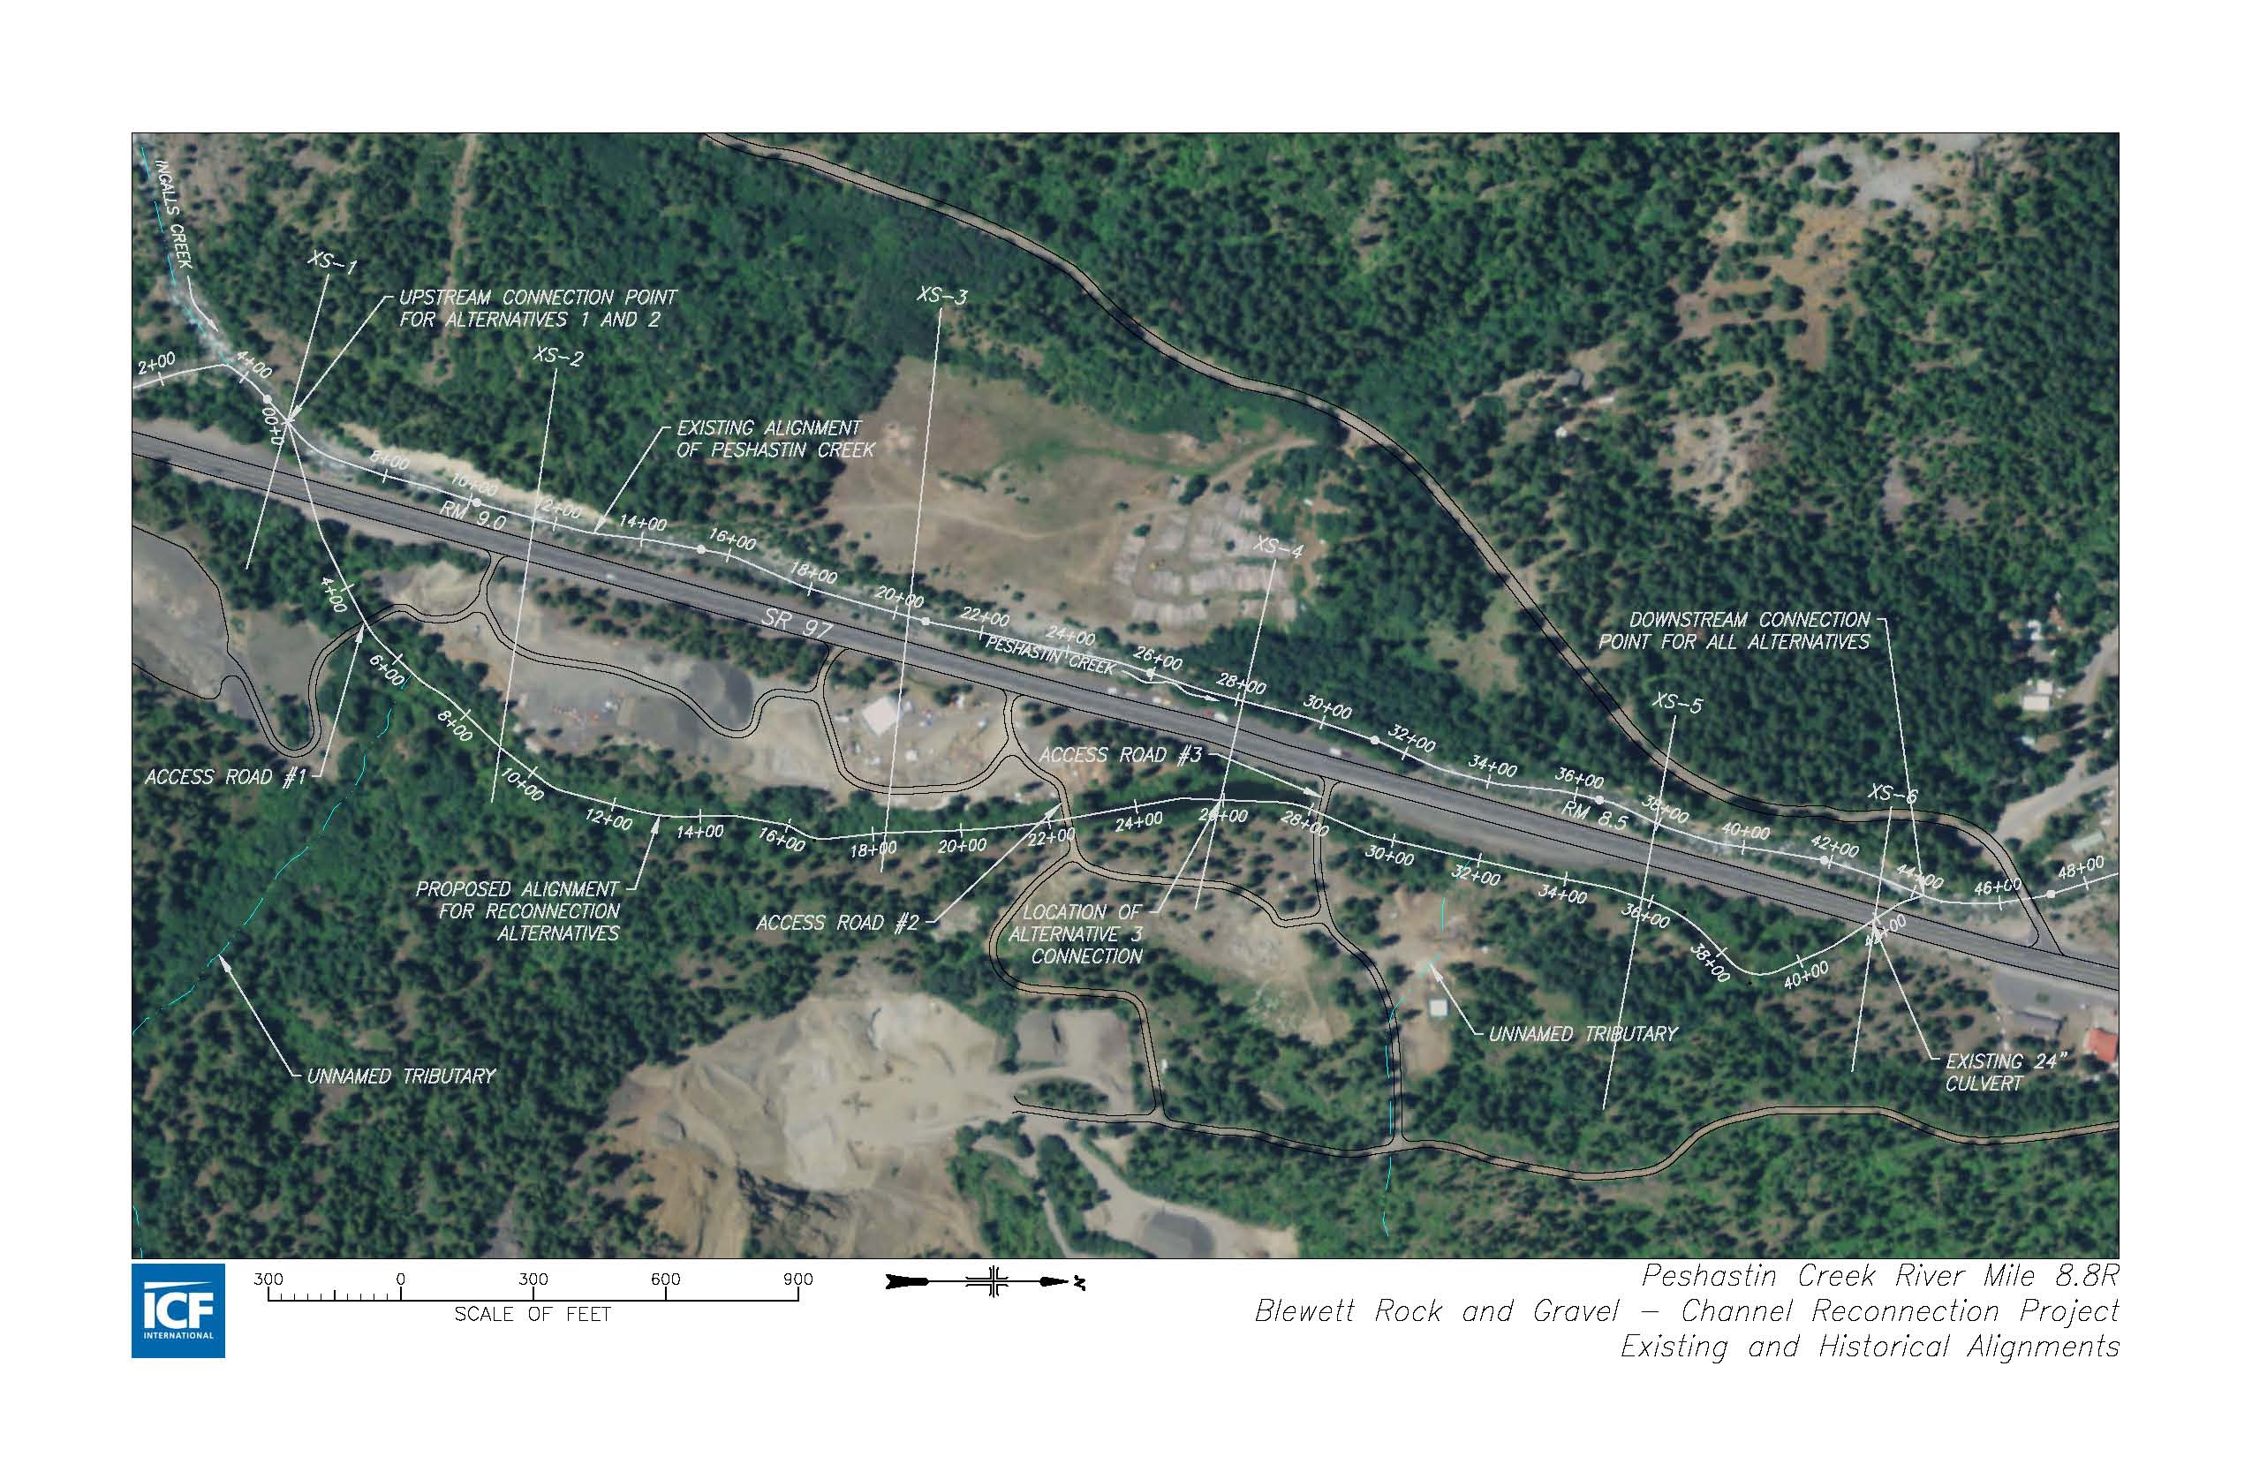

Slide 7
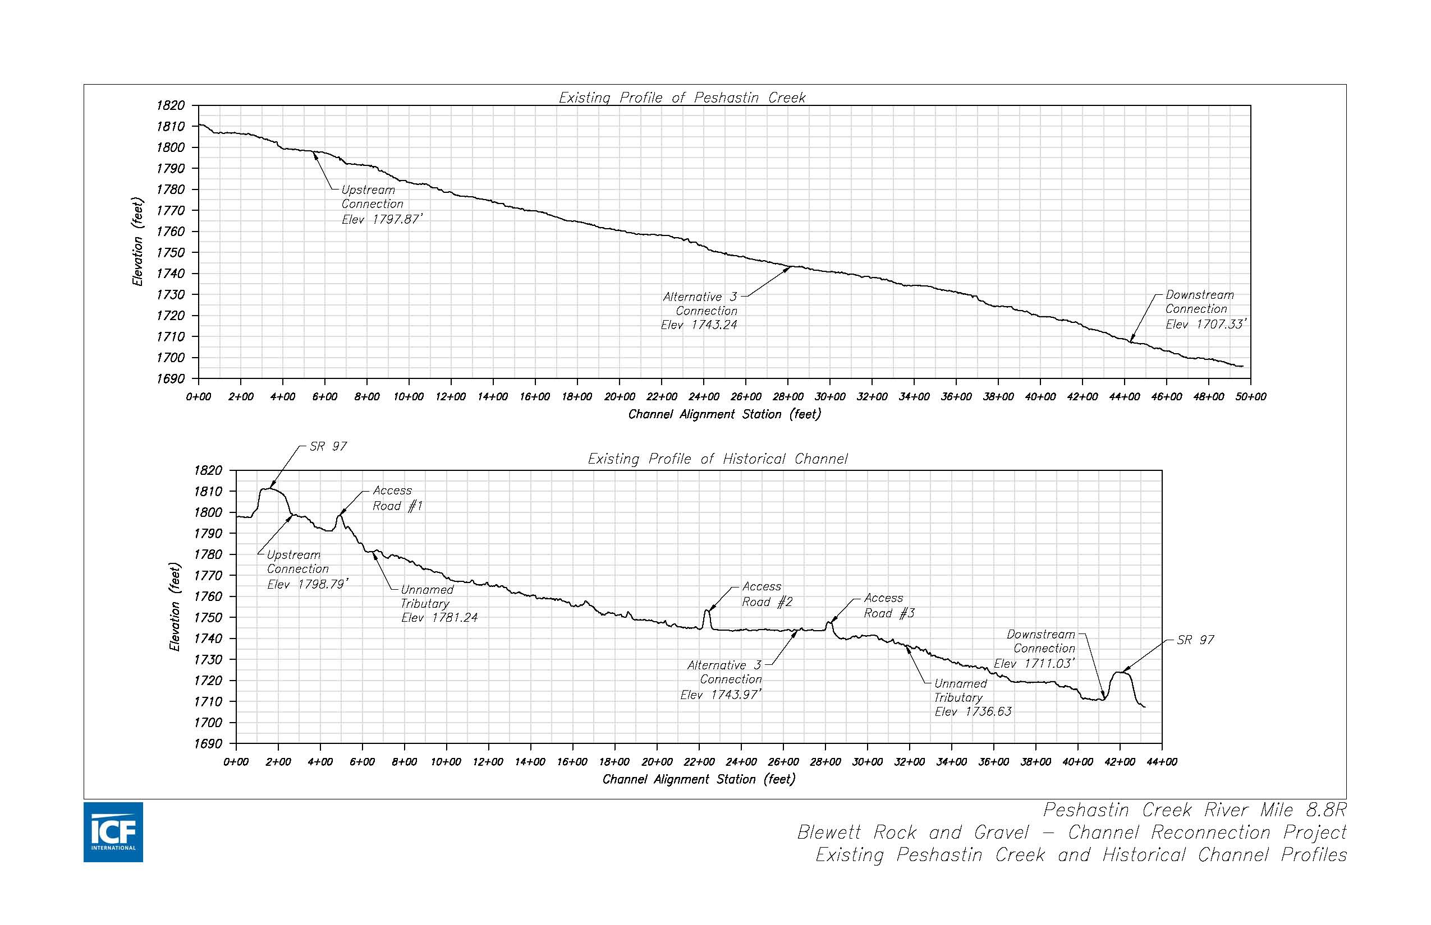

Slide 8
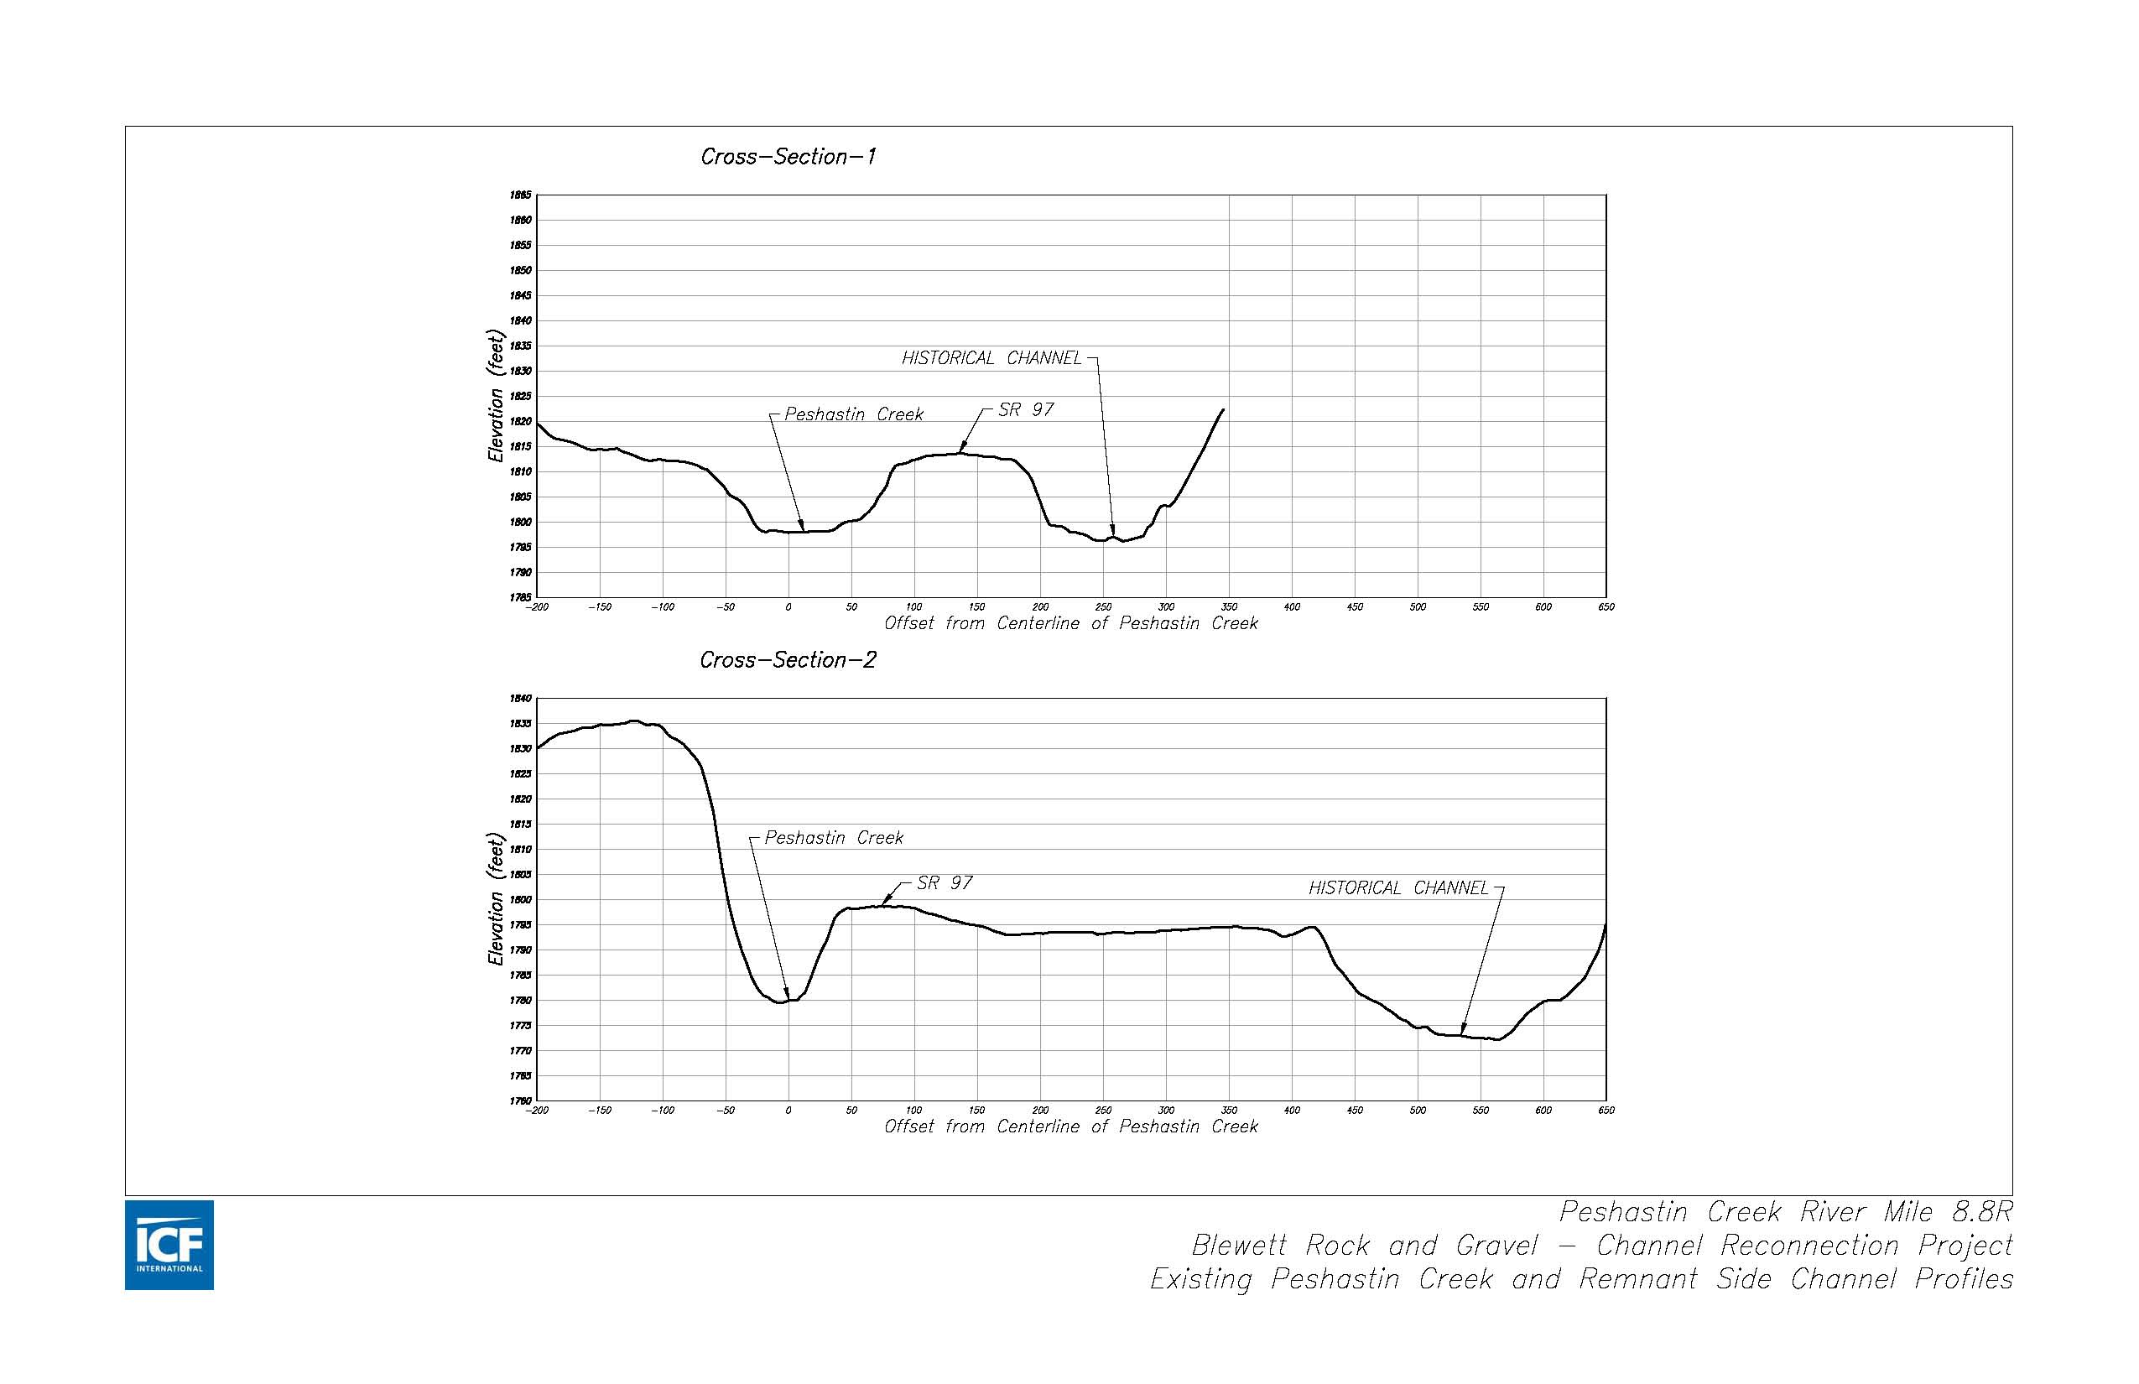

Slide 9
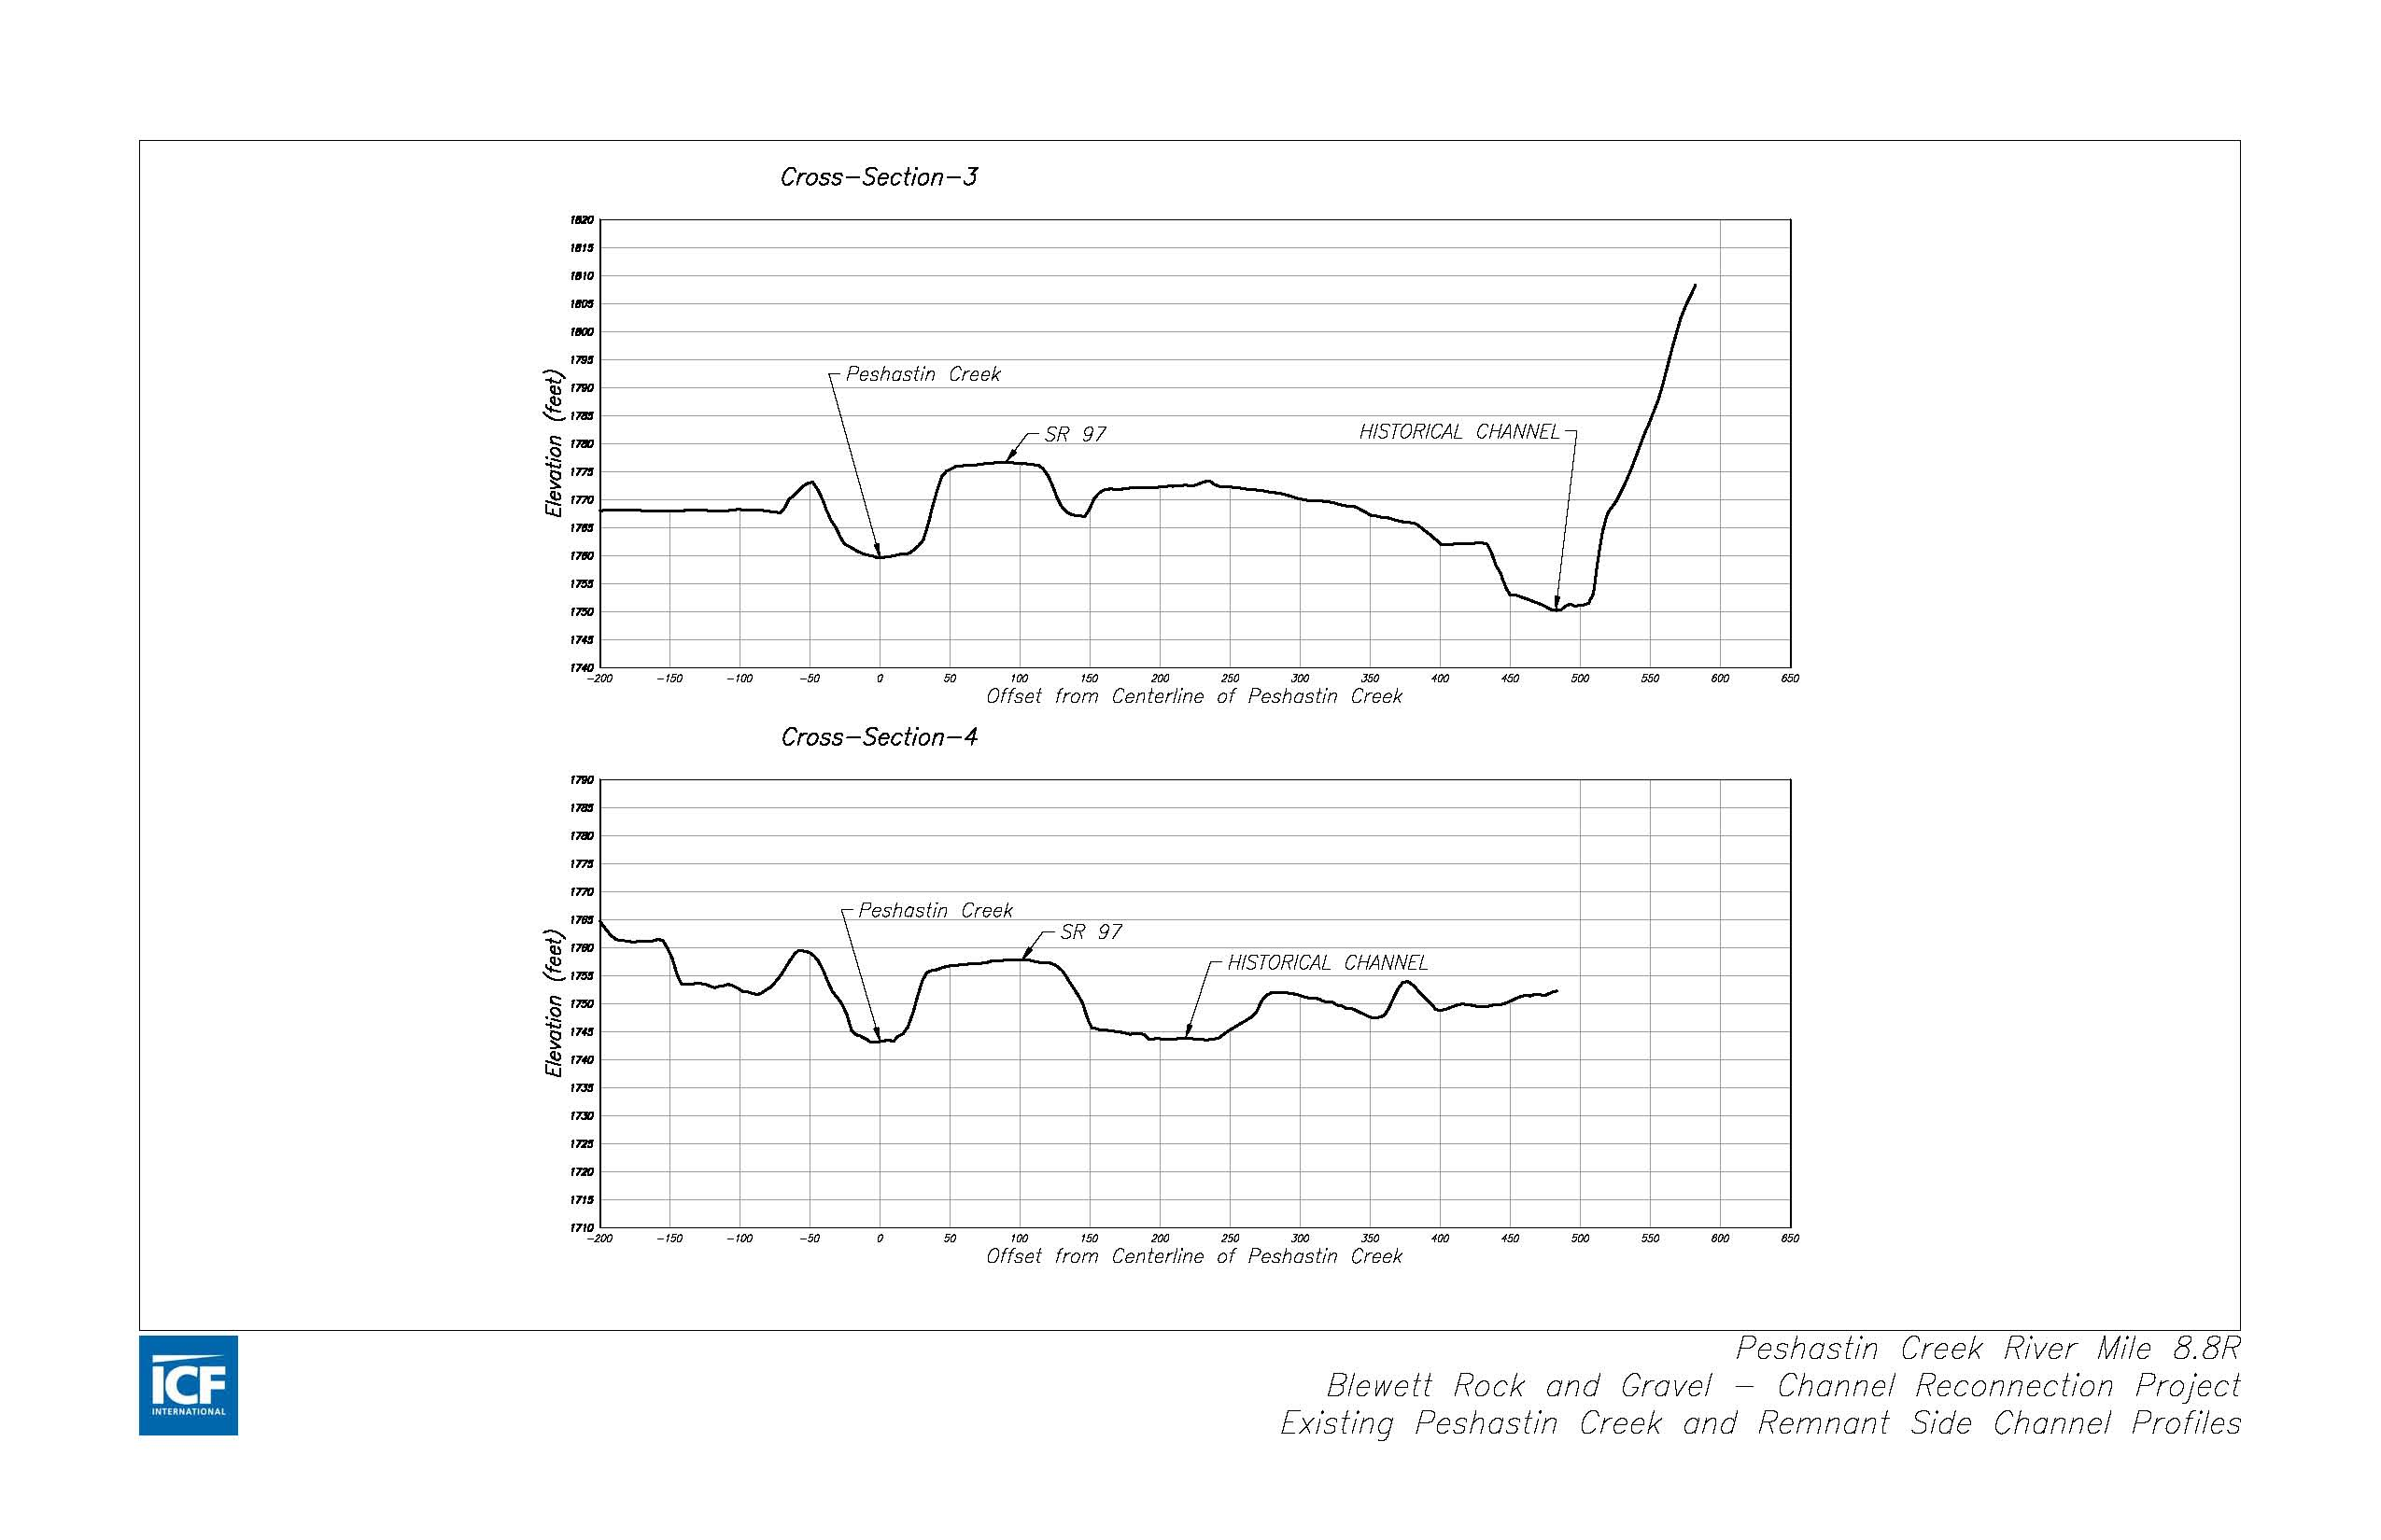

Slide 10
