Slide 1
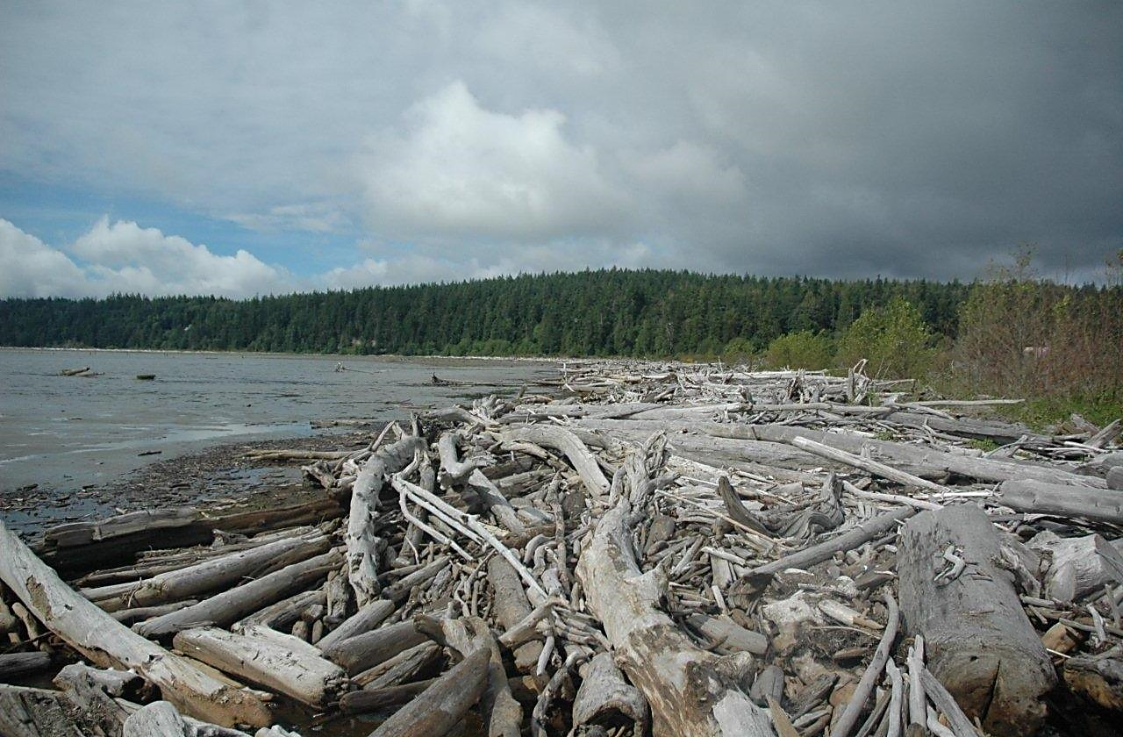
Livingston Bay Protection and Restoration Planning
RCO #20-1461
Estuary and Salmon Restoration Program
April 29, 2020
www.wclt.org | 360.222.3310

Slide 2
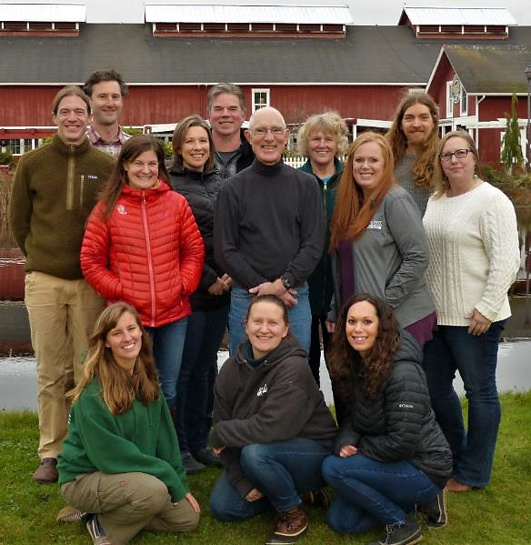
Project Partners
501(c)3 Non-profit organization
Founded in 1984
Nearly 10,000 Acres Protected
Willing landowners
Nationally accredited

Slide 3
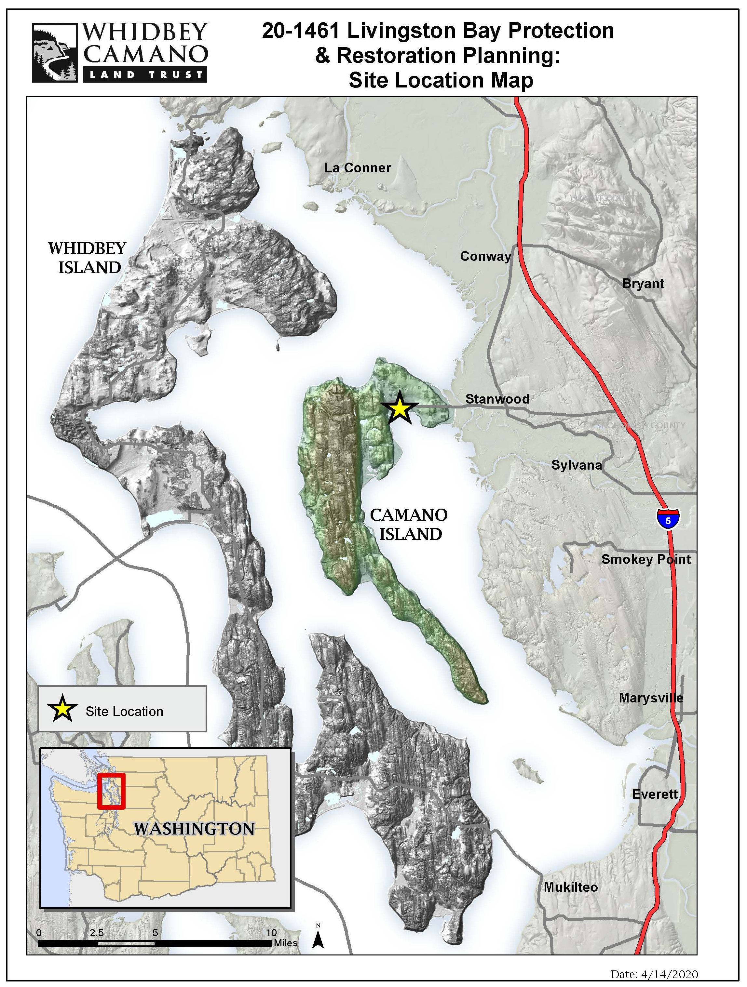
Project Location

Slide 4
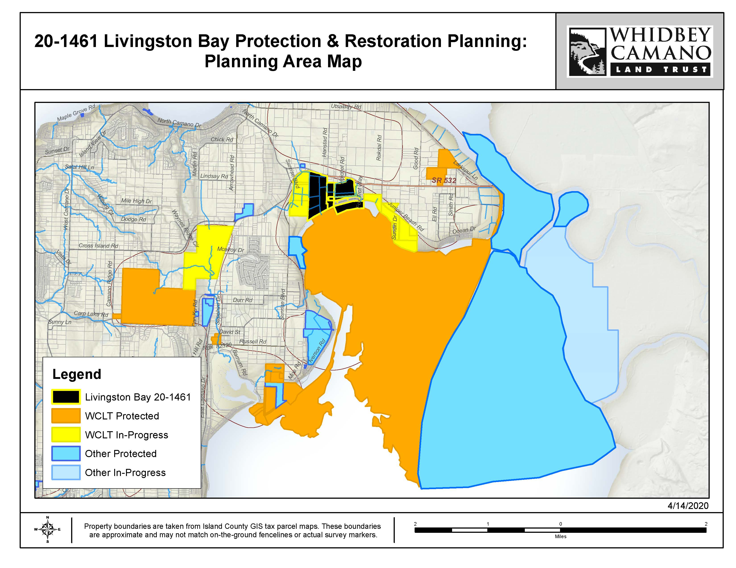
Project Planning Area

Slide 5
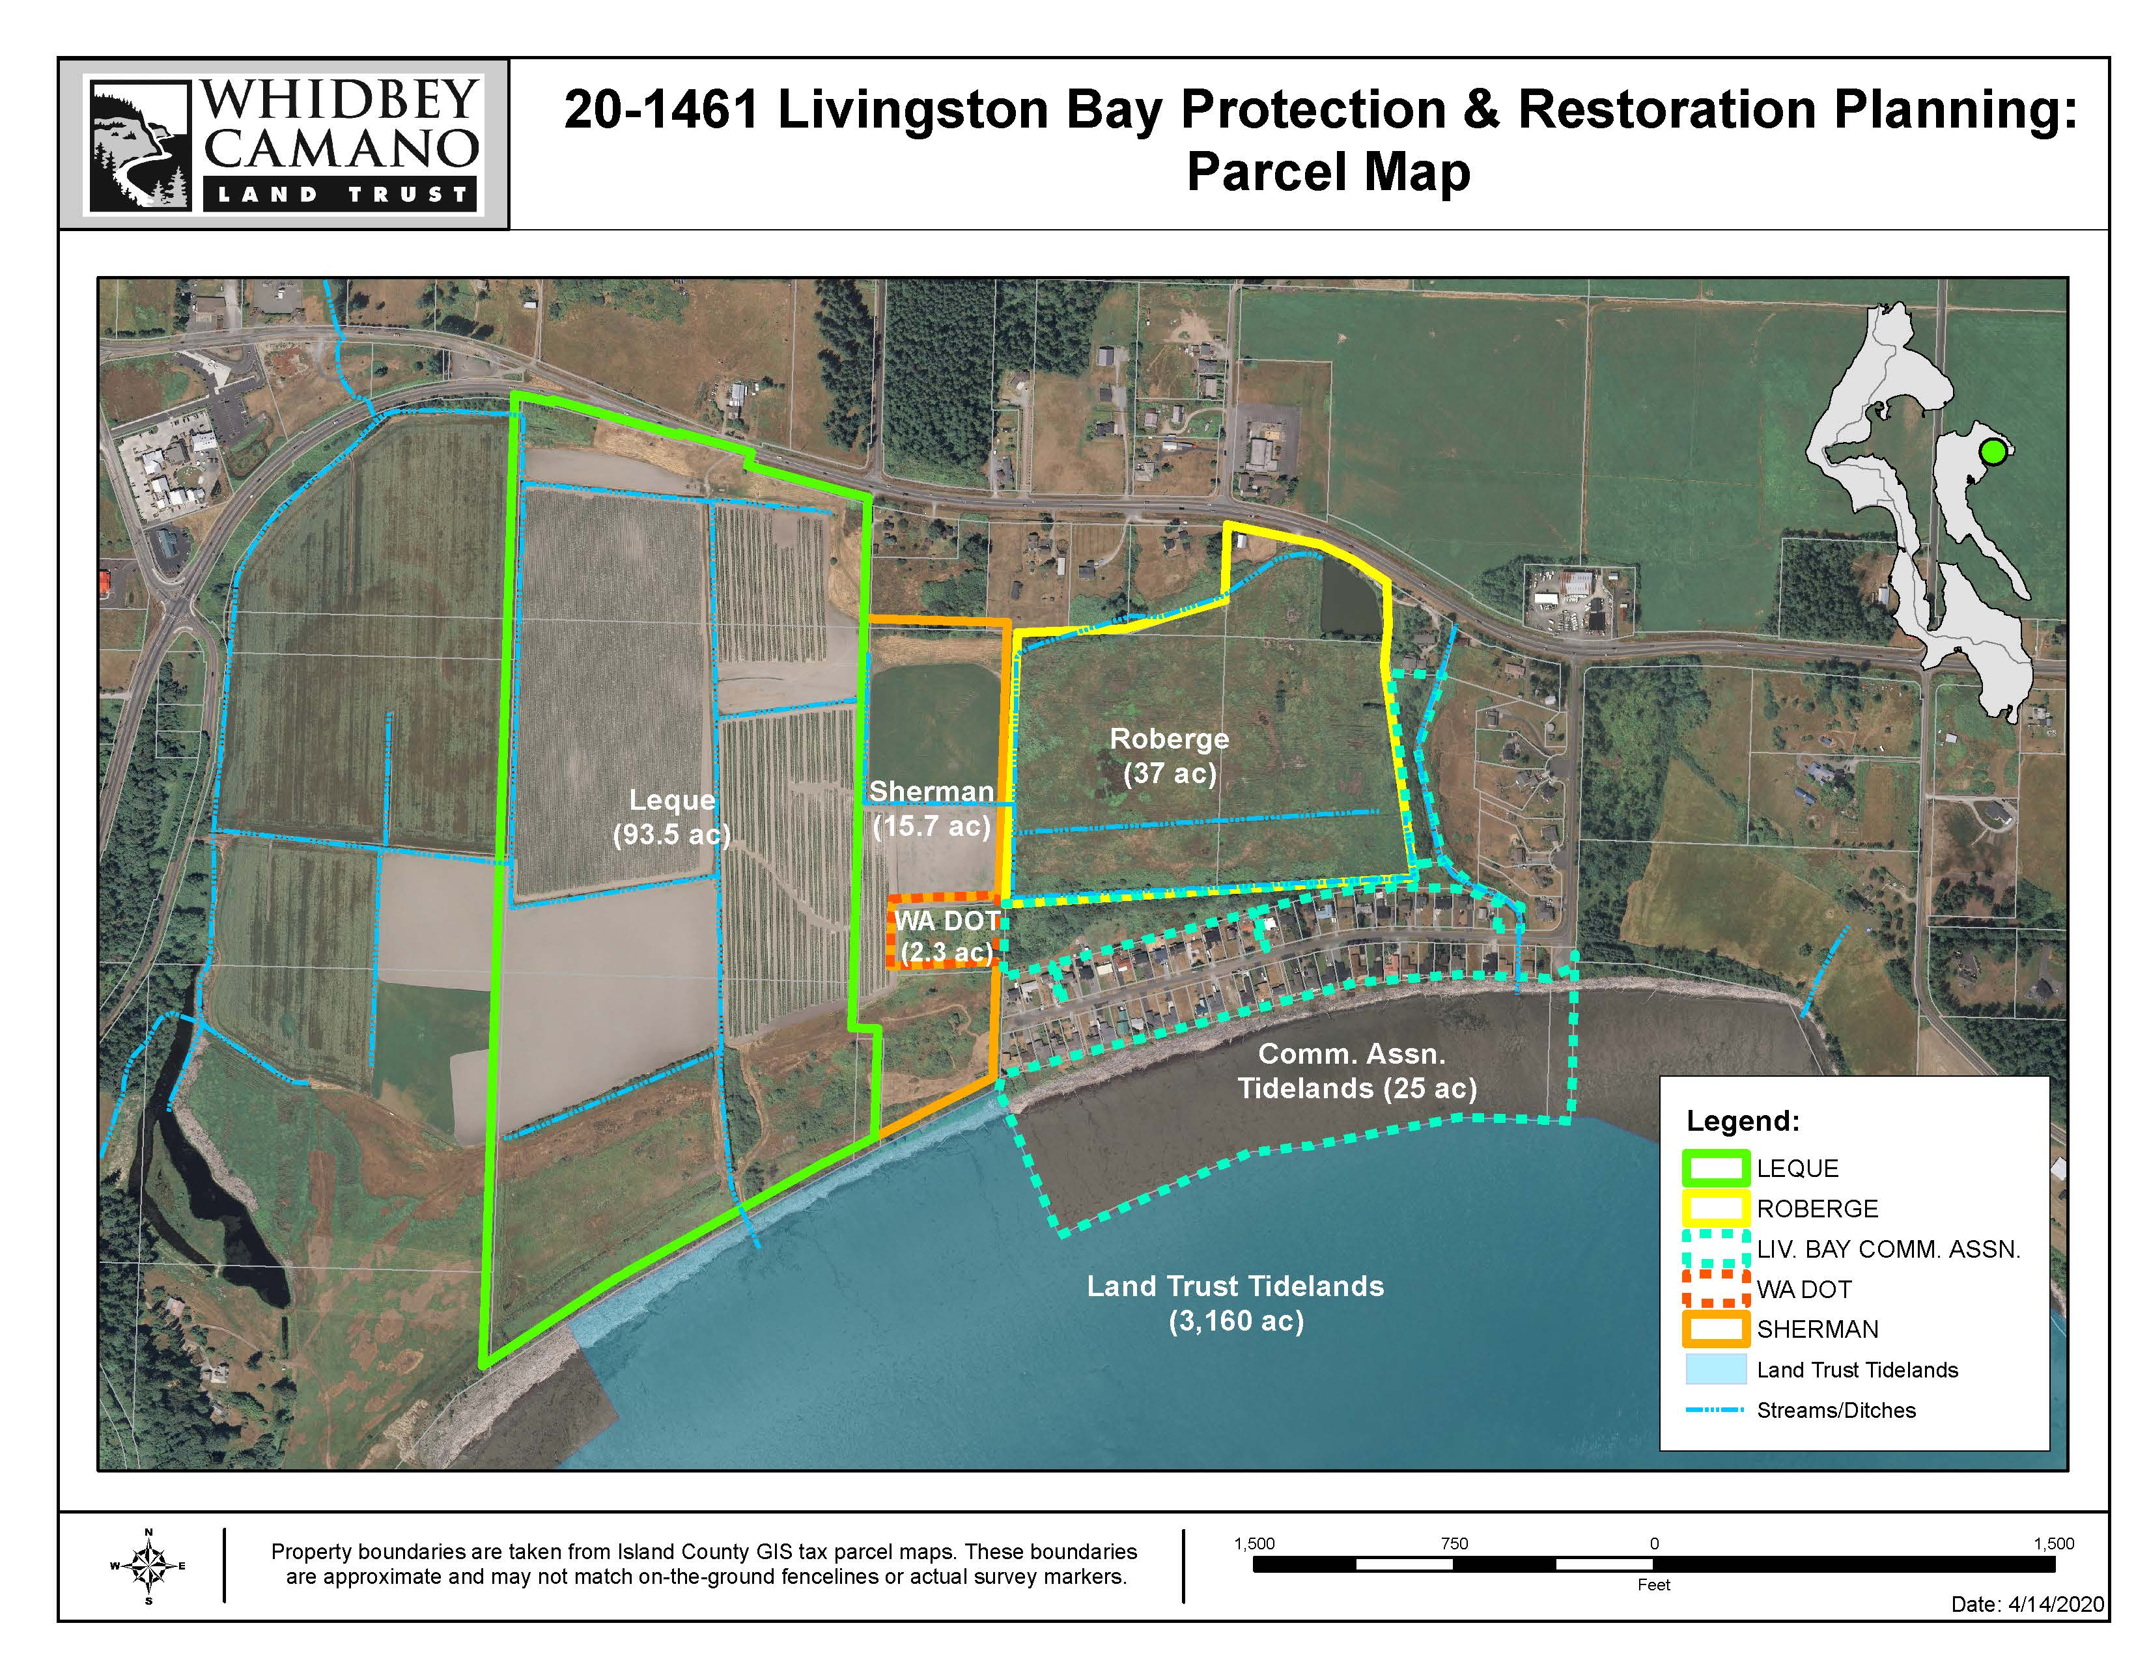
Project Parcels

Slide 6
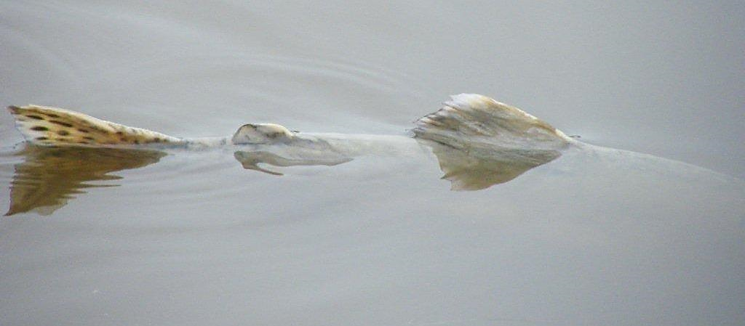
Project Goal
Permanently protect former estuarine and wetland habitat and plan for restoration of critical salmon and wildlife habitat in Livingston Bay
Photo: Matt Griffin

Slide 7
Ecological Importance
Livingston Bay Protection and Restoration Planning is a multi-benefit project that:
Conserves +/- 180 acres (25 acres of tidelands)
Protects more than 4,100 feet of shoreline
Restores +/- 155 acres of former estuarine and wetland habitat
Increases available transitional, migratory, and rearing habitat for multiple species of salmonids, including ESA listed Puget Sound Chinook salmon and Puget Sound steelhead.
Photo: Matt Griffin
Morgan Bond

Slide 8
Ecosystem Processes
The primary ecological processes:
Sediment supply and sediment transport
Tidal channels formation and maintenance
Shoreforms:
Beaches & Embayments
Barrier Embayment Strategy:
Permanent protection of barrier beaches sustained by sediment input from unarmored feeder bluffs
Planning for restoration of tidal flow process within a system degraded by anthropogenic habitat alterations.
Photo: Matt Griffin
Morgan Bond

Slide 9
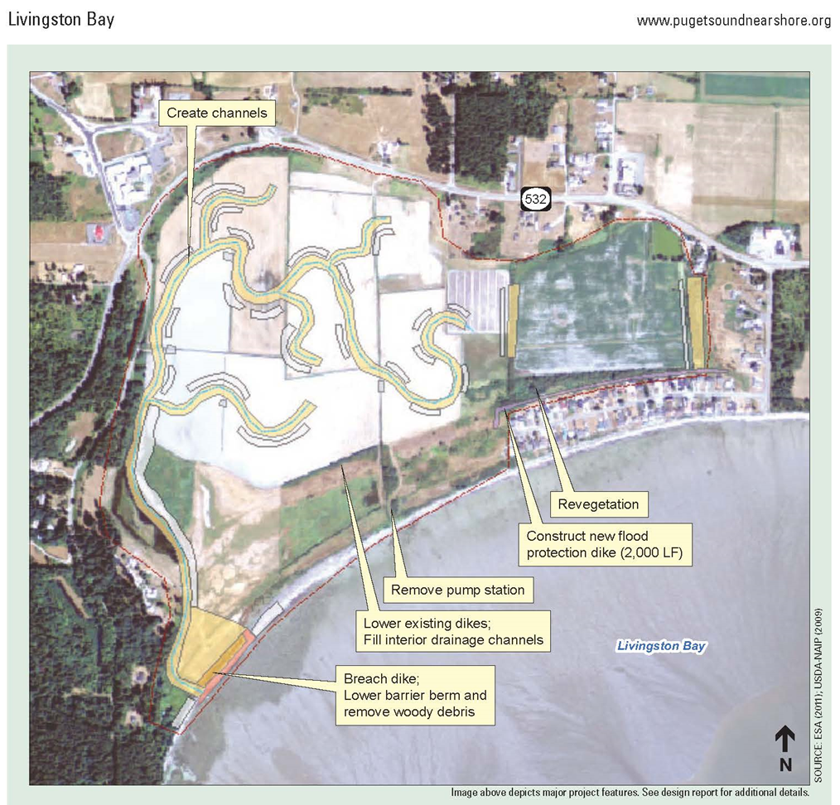
Regional Priorities
WRIA 6 Multi-Species Salmon Recovery Plan 2019 Update
Stillaguamish Watershed Chinook Salmon Recovery Plan
Puget Sound Salmon Recovery Plan – Watershed Profile of Whidbey and Camano Islands
PSNERP’s Strategic Restoration Conceptual Engineering - Design Report (project #1618)
Photo: Matt Griffin
Morgan Bond

Slide 10
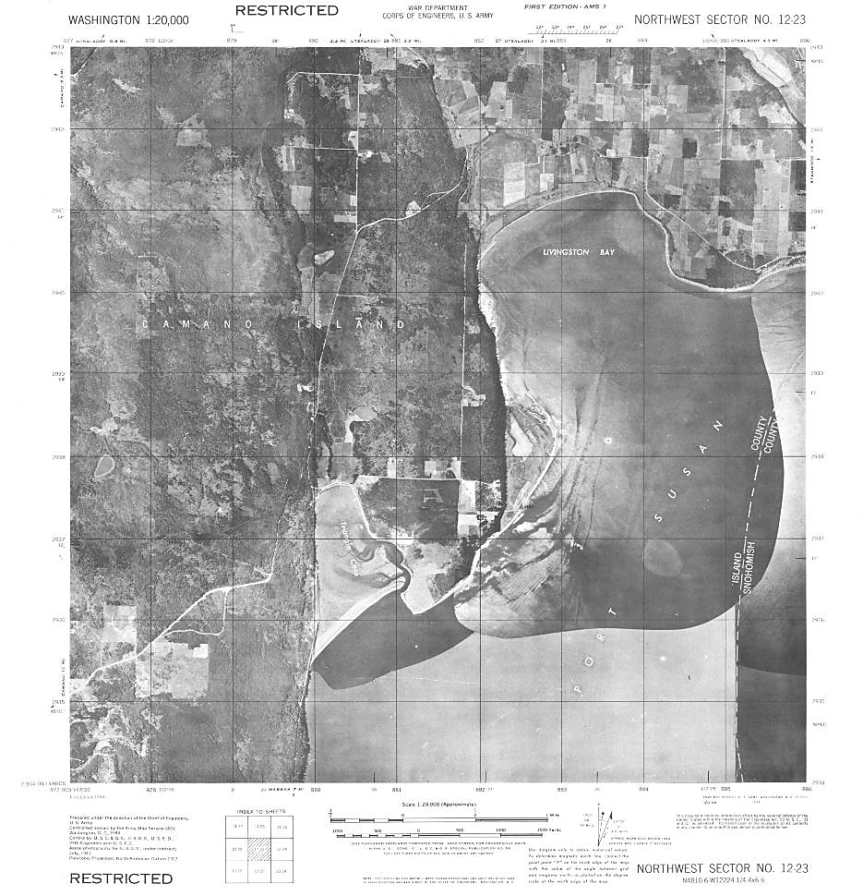
Project Site
Photo: Washington State Department of Ecology, https://fortress.wa.gov/ecy/coastalatlas/tools/ShorePhotos.aspx

Slide 11
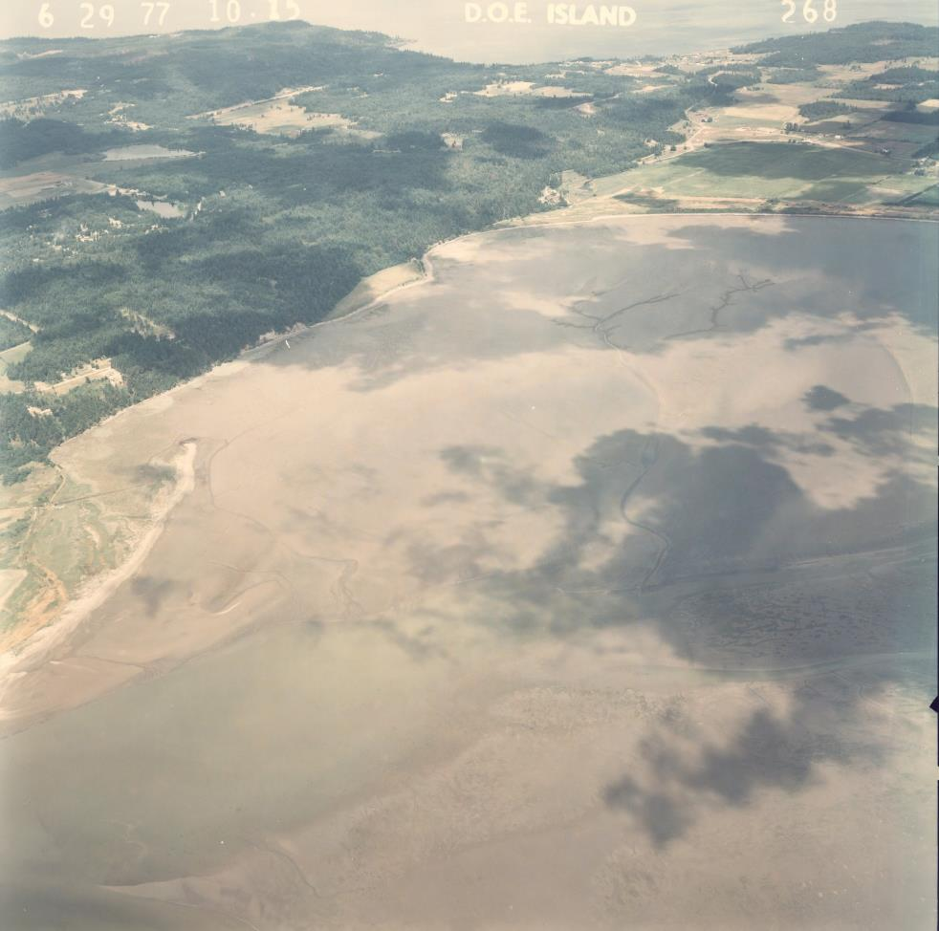
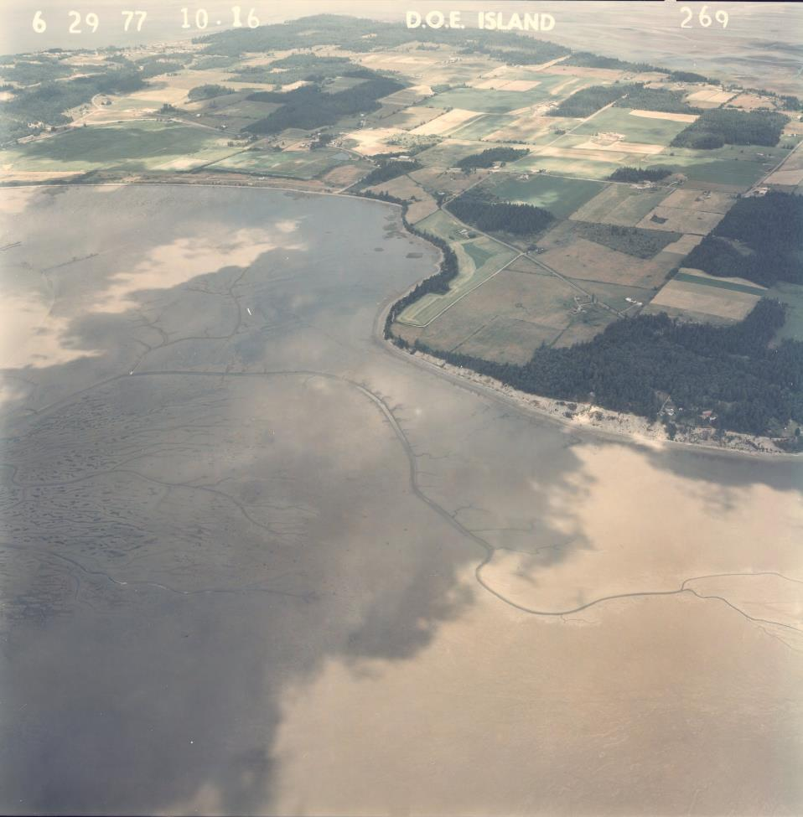
Project Site
Photo: Washington State Department of Ecology,
https://fortress.wa.gov/ecy/coastalatlas/tools/ShorePhotos.aspx
Photo: Washington State Department of Ecology,
https://fortress.wa.gov/ecy/coastalatlas/tools/ShorePhotos.aspx

Slide 12
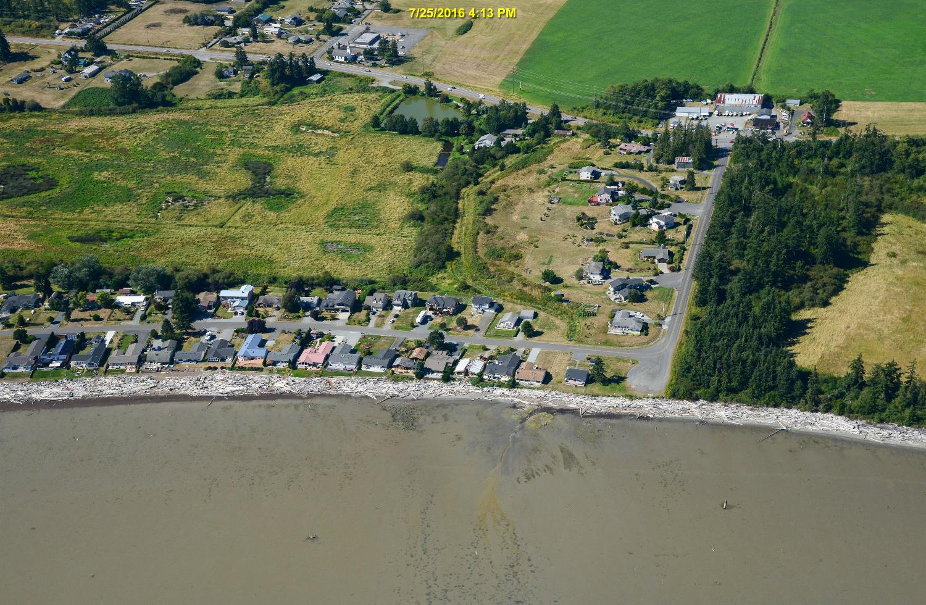
Project Site
Photo: Washington State Department of Ecology,
https://fortress.wa.gov/ecy/coastalatlas/tools/ShorePhotos.aspx

Slide 13
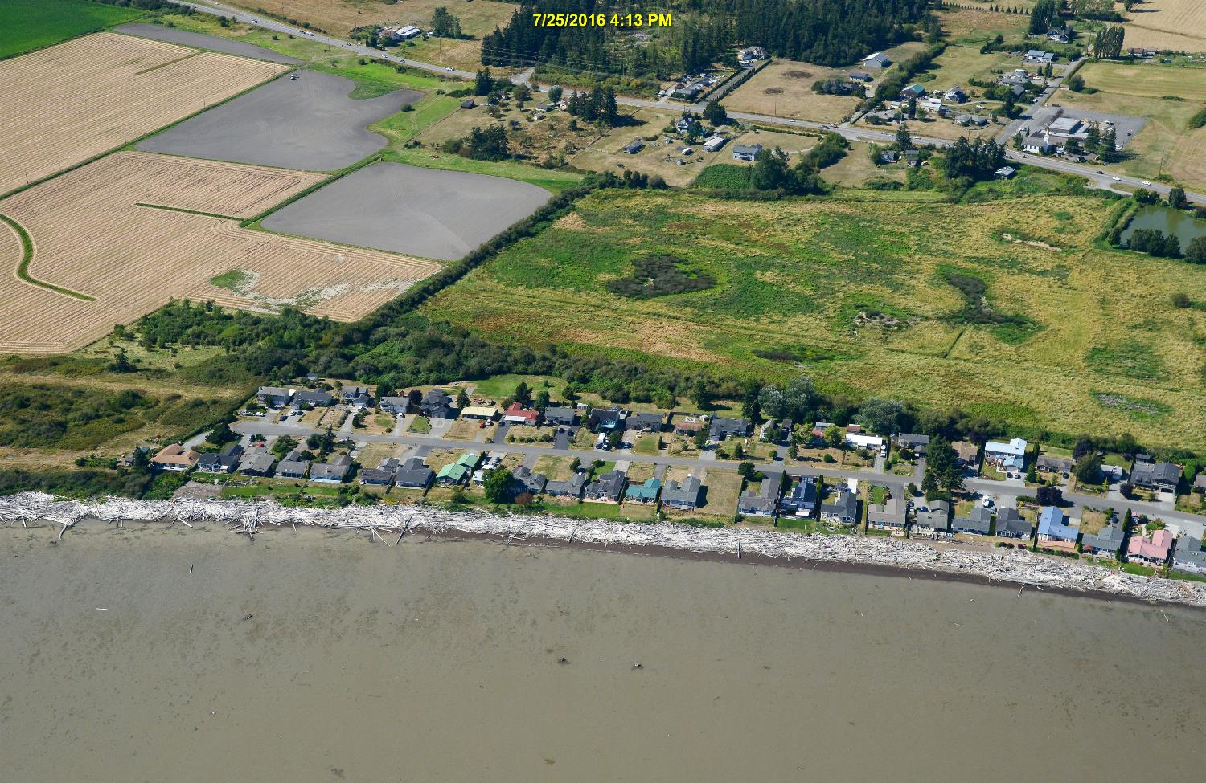
Project Site
Photo: Washington State Department of Ecology,
https://fortress.wa.gov/ecy/coastalatlas/tools/ShorePhotos.aspx

Slide 14
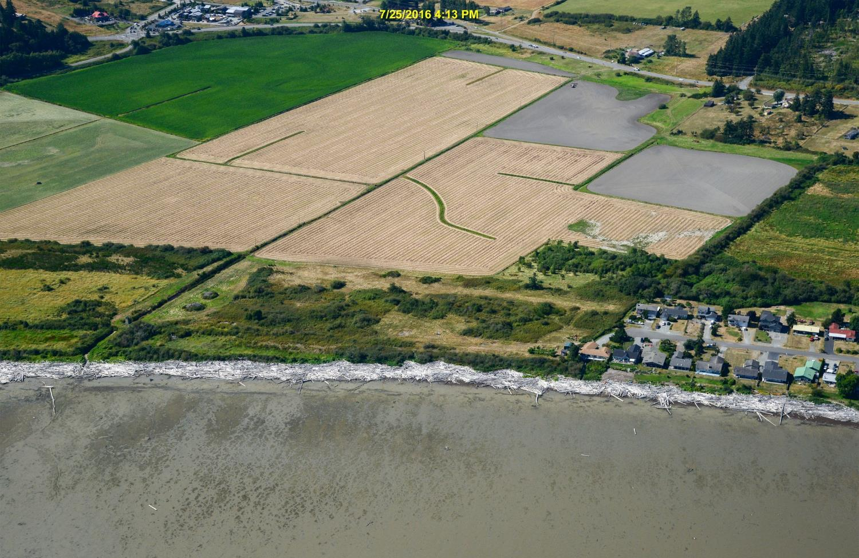
Project Site
Photo: Washington State Department of Ecology,
https://fortress.wa.gov/ecy/coastalatlas/tools/ShorePhotos.aspx

Slide 15
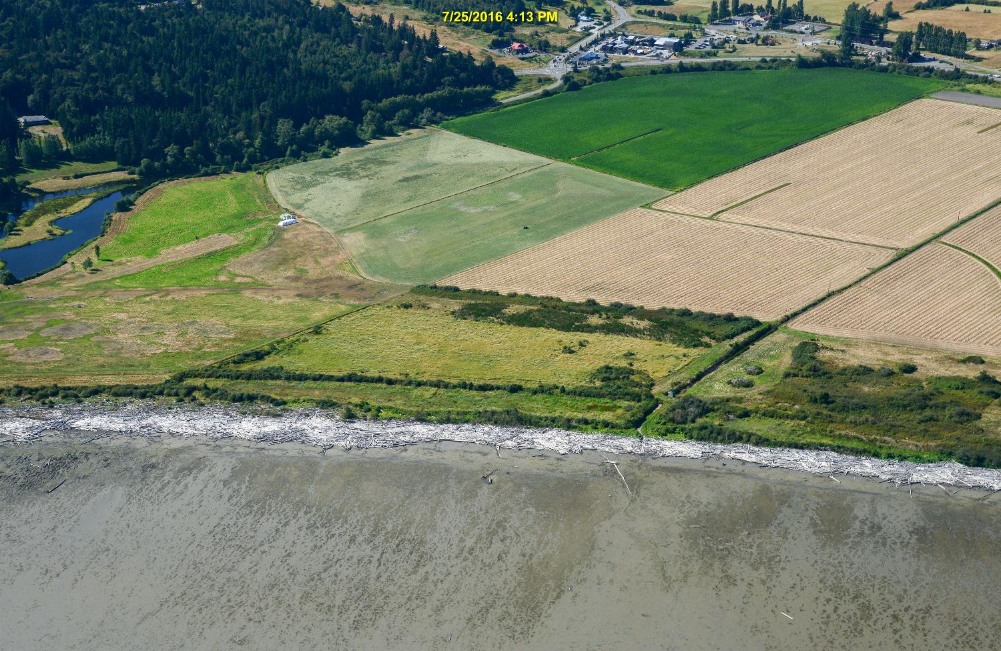
Project Site
Photo: Washington State Department of Ecology,
https://fortress.wa.gov/ecy/coastalatlas/tools/ShorePhotos.aspx

Slide 16
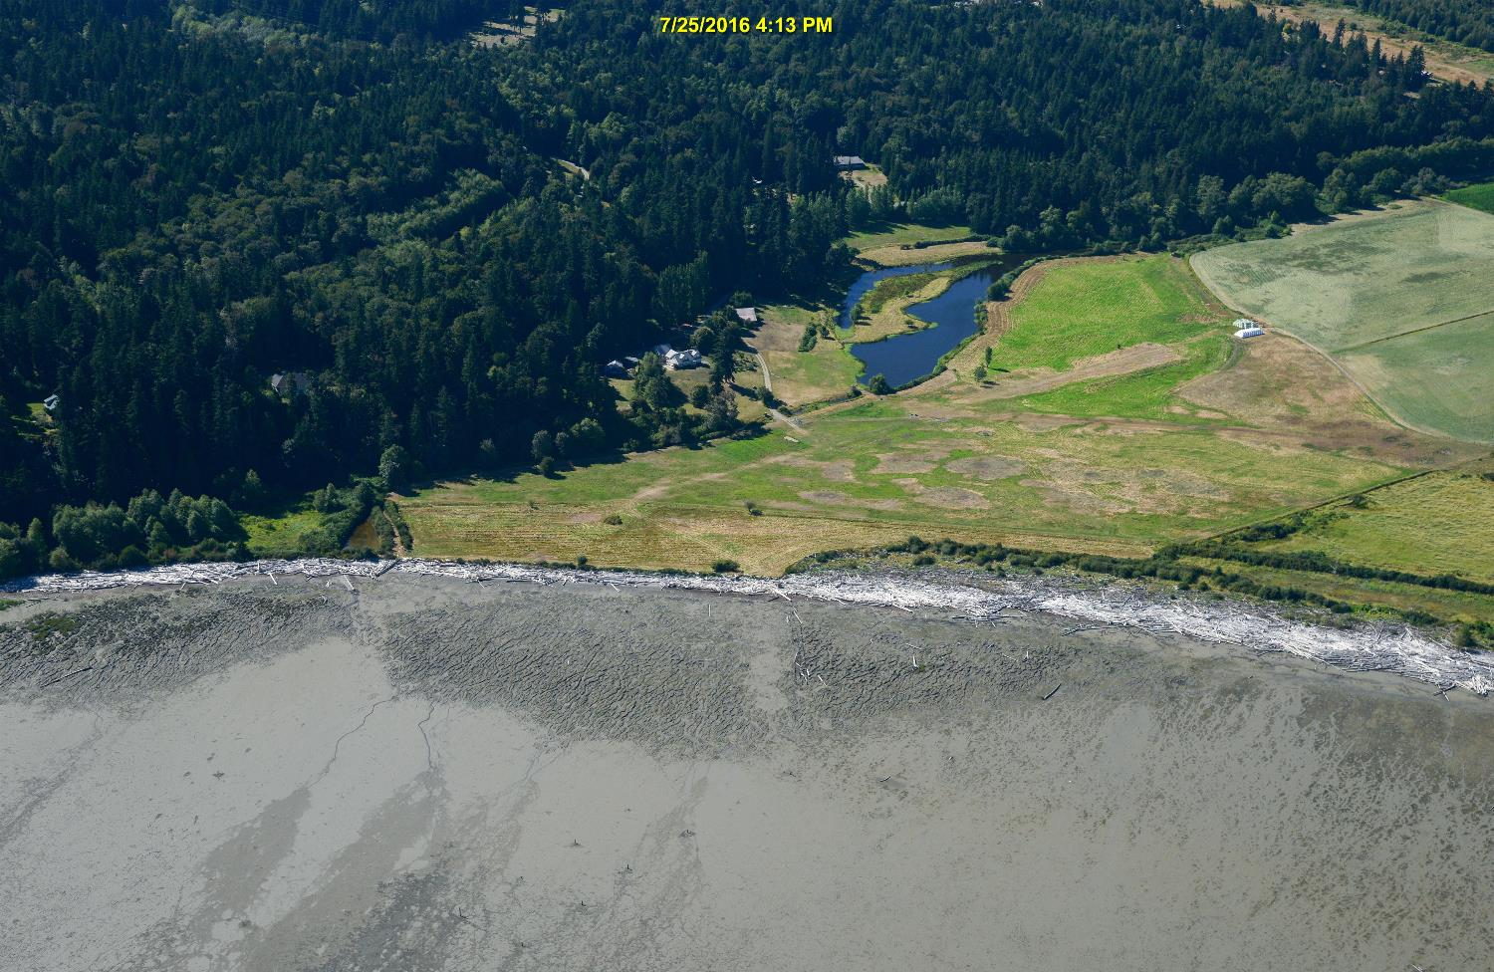
Project Site
Photo: Washington State Department of Ecology,
https://fortress.wa.gov/ecy/coastalatlas/tools/ShorePhotos.aspx

Slide 17
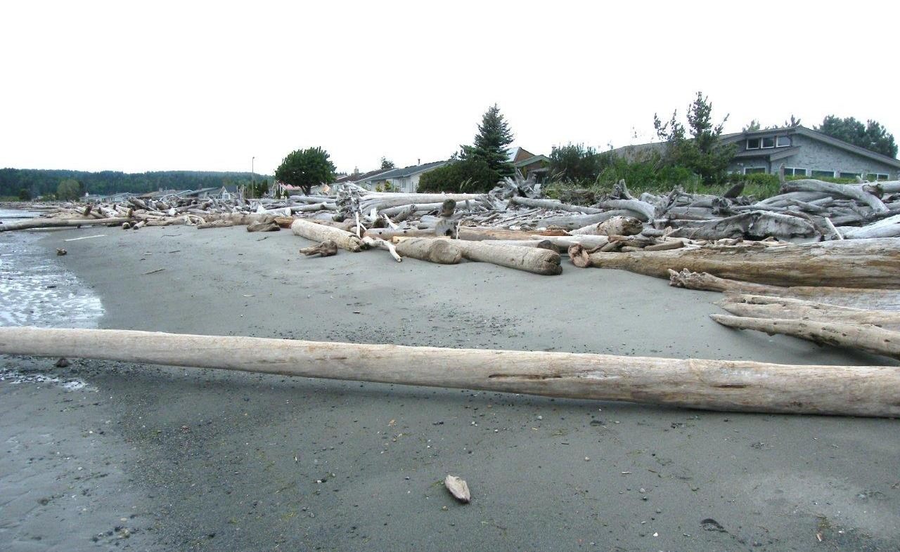
Project Site
Photo: Matt Griffin - LBCA shorefront-east end

Slide 18
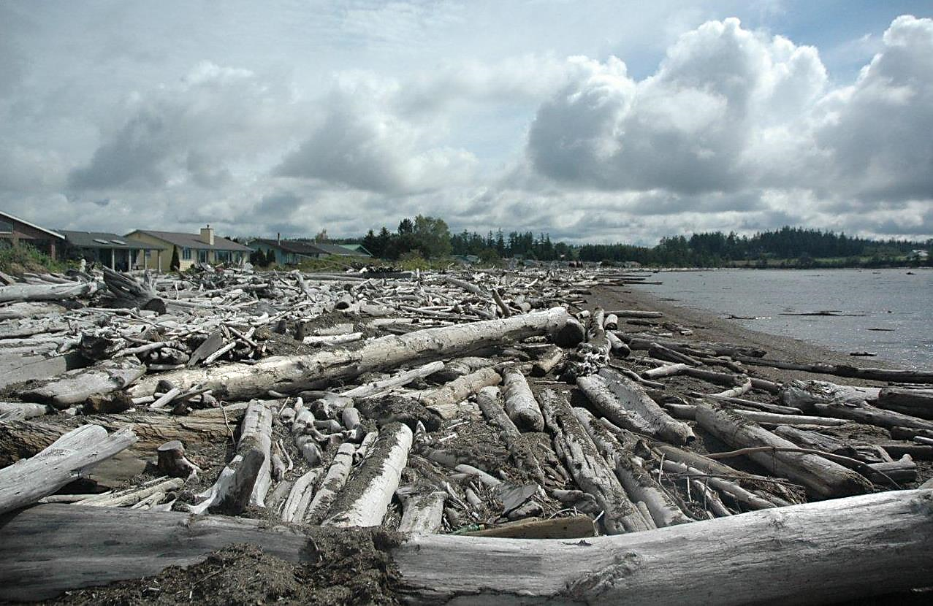
Project Site
Photo: Matt Griffin - LBCA shorefront-west end

Slide 19
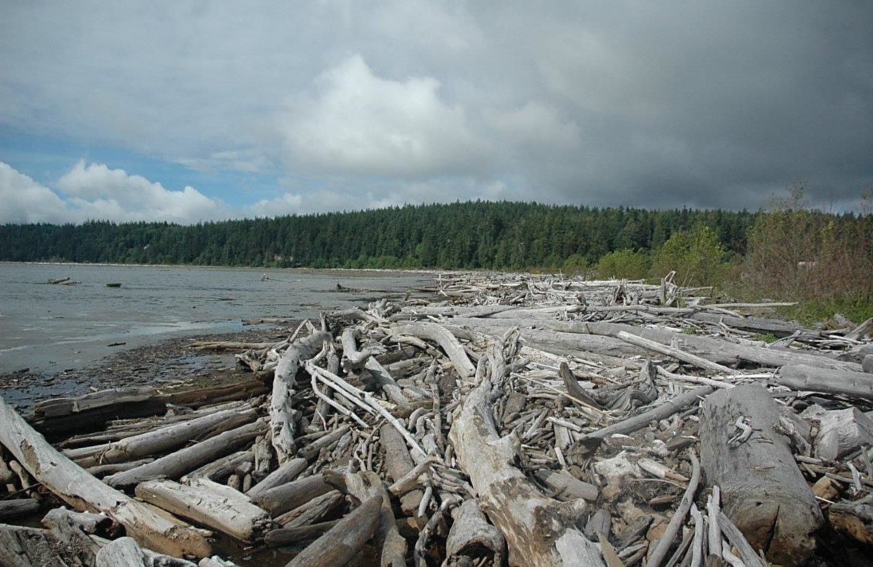
Project Site
Photo: Matt Griffin - Leque property and Nelson property shorefront, looking southwest

Slide 20
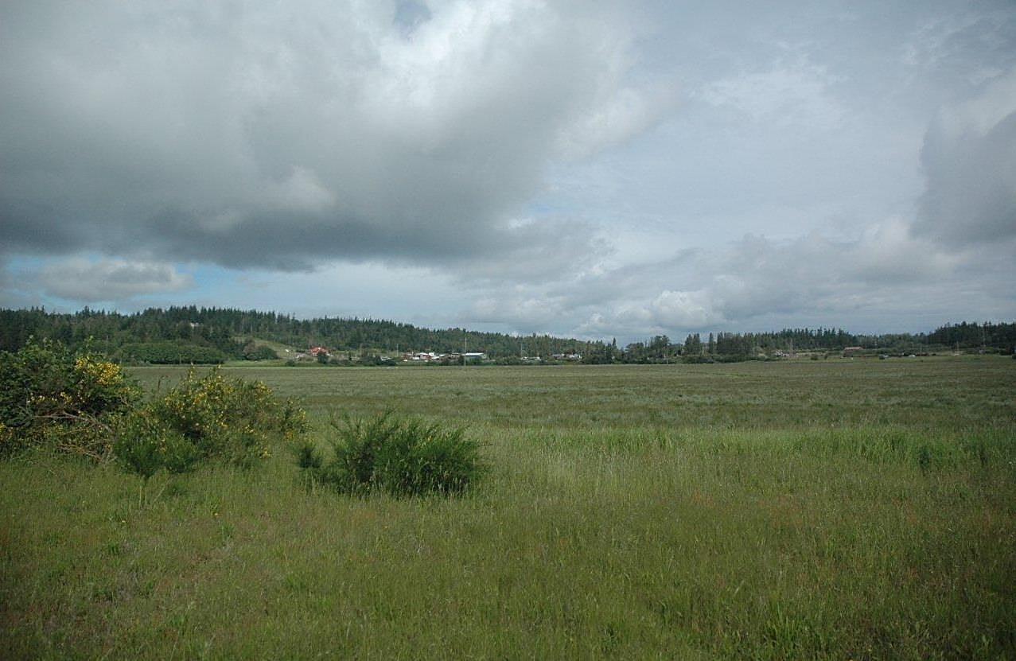
Project Site
Photo: Matt Griffin - Looking northwest from Leque property

Slide 21
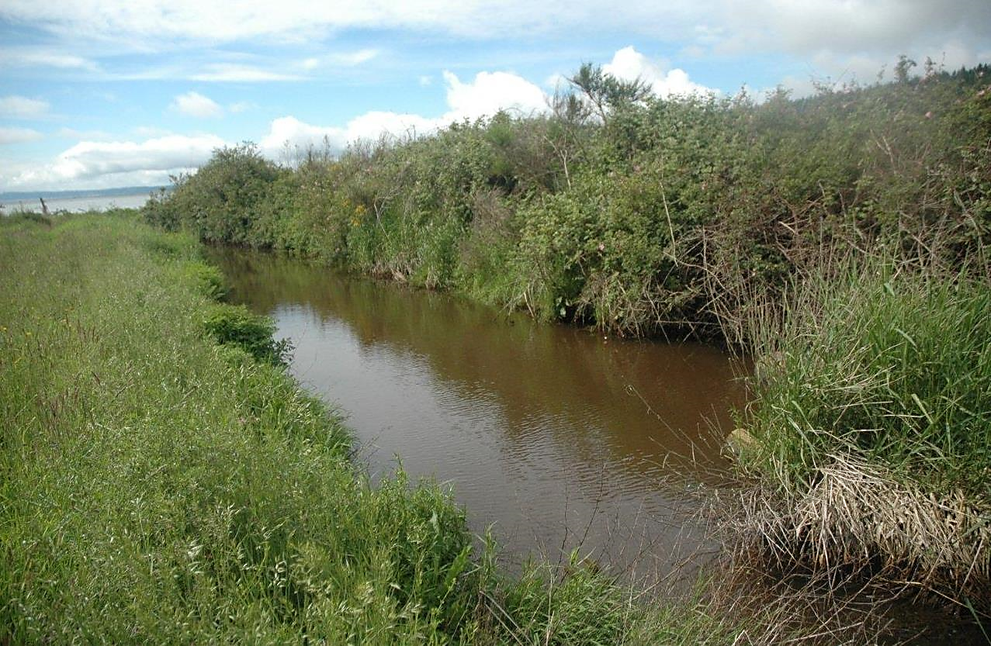
Project Site
Photo: Matt Griffin – Leque property drainage canal exiting into Livingston Bay

Slide 22
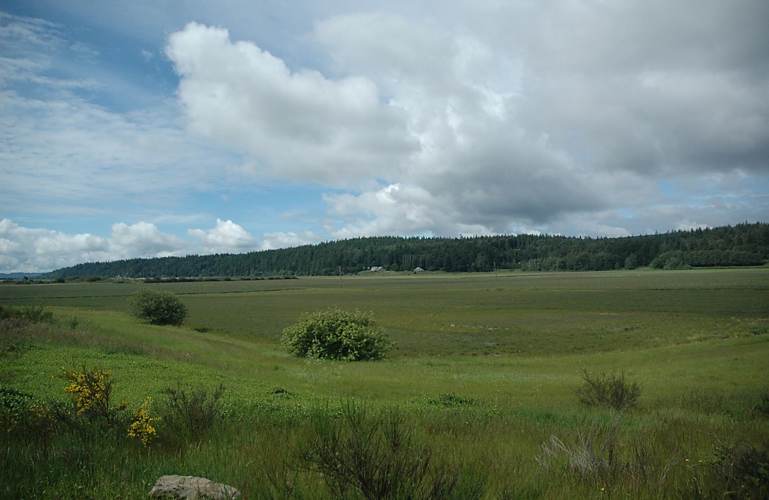
Project Site
Photo: Matt Griffin - Looking southwest at Leque property and Nelson property from SR532

Slide 23
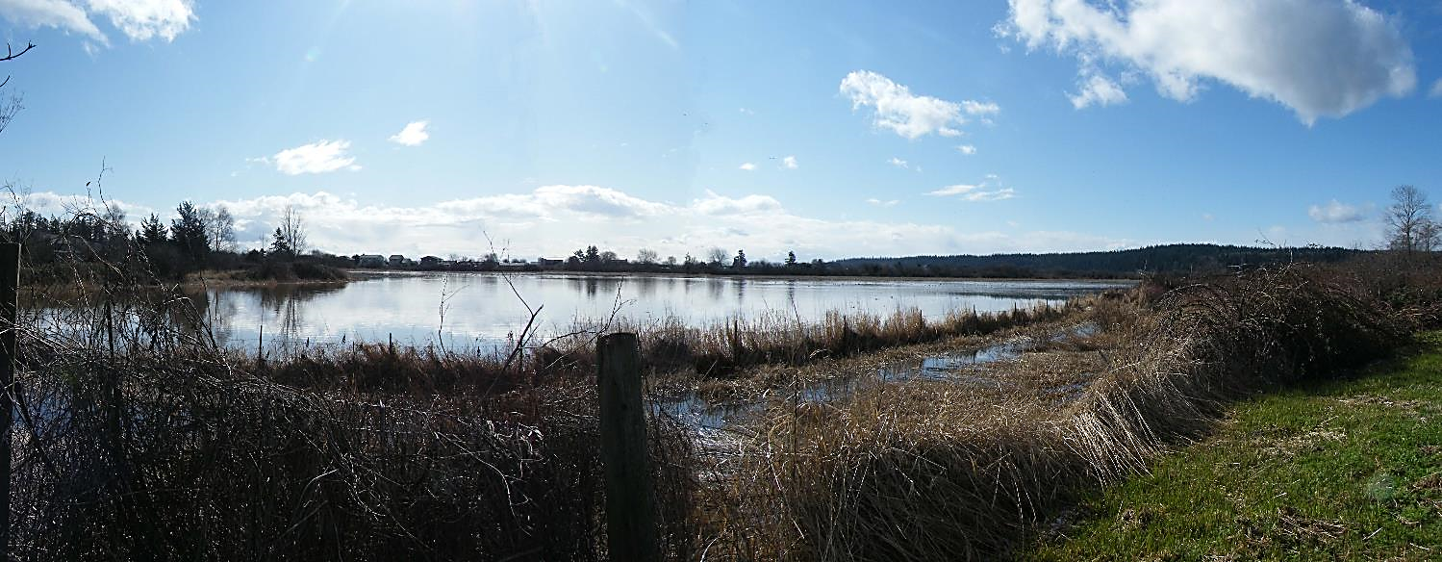
Project Site
Photo: Matt Griffin

Slide 24
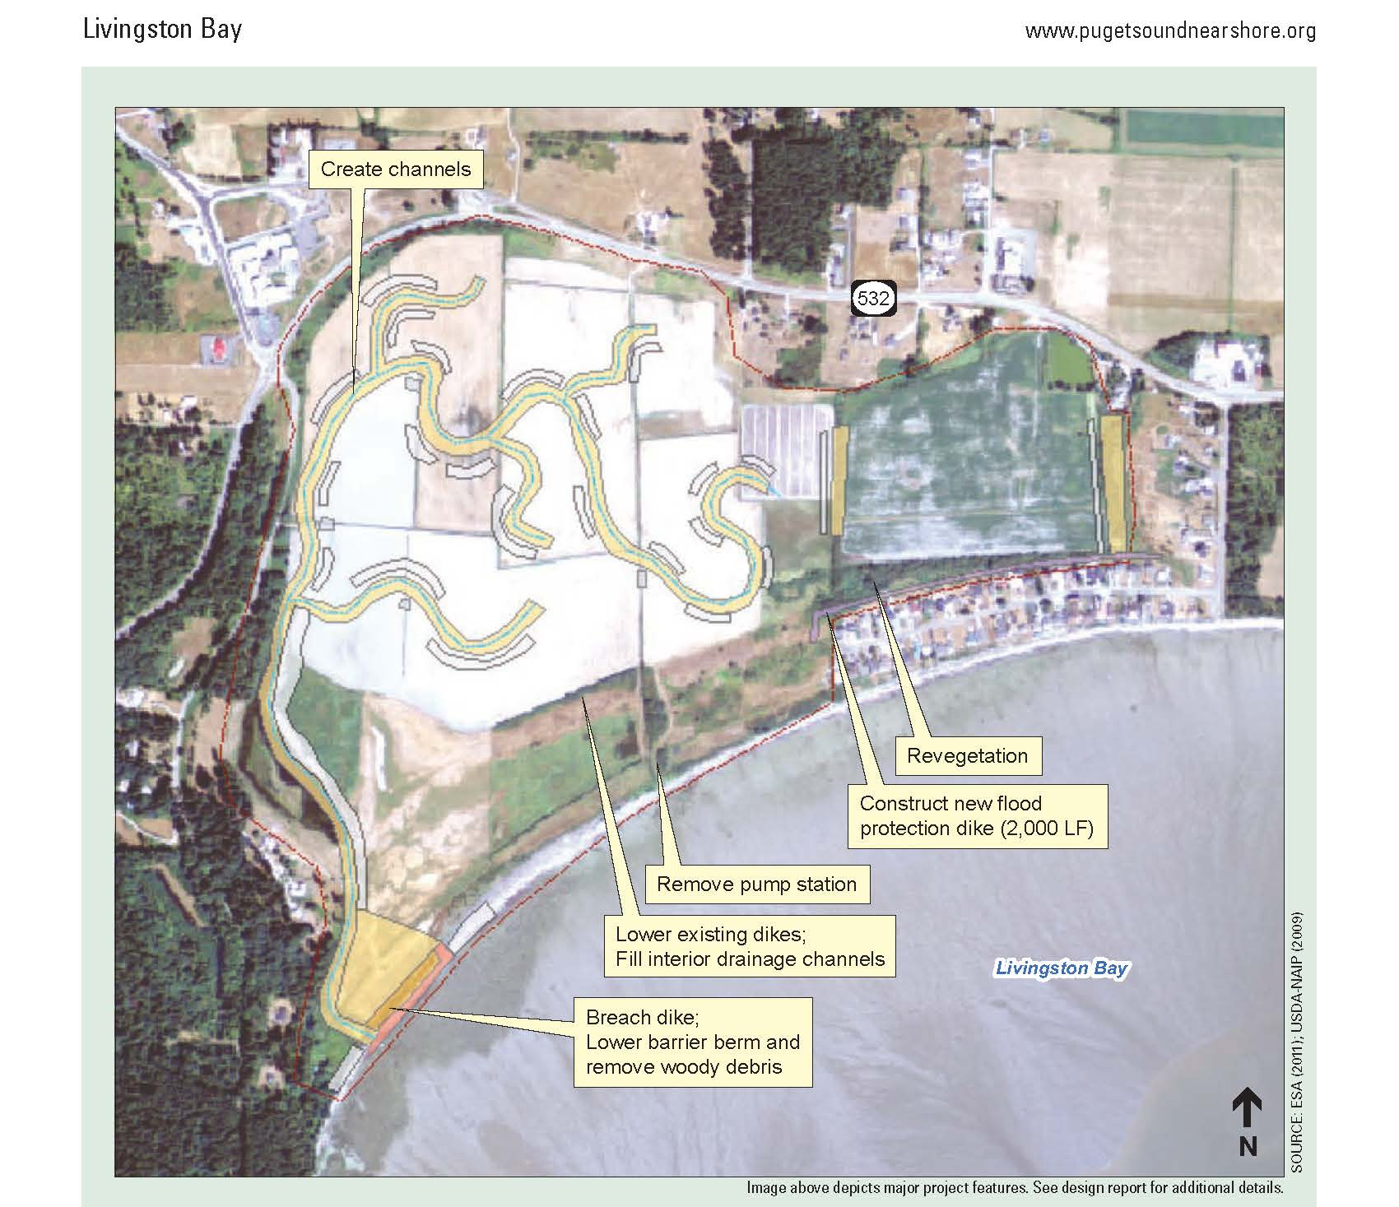
Restoration Planning

Slide 25
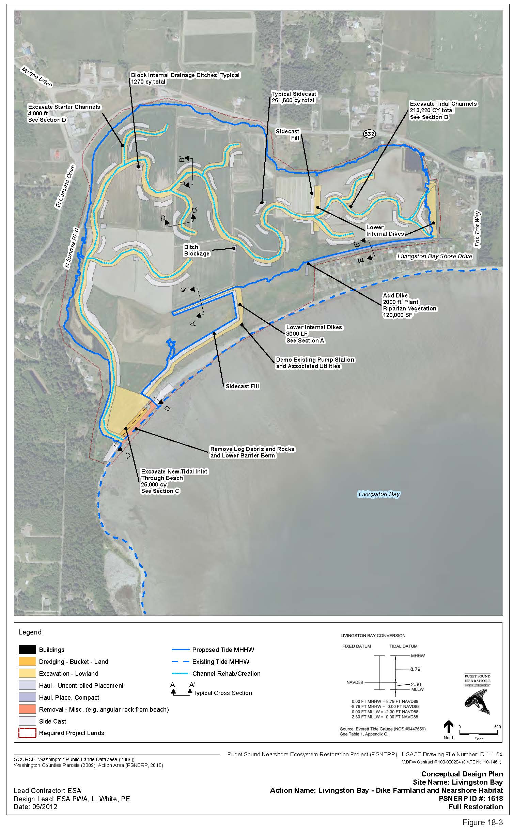
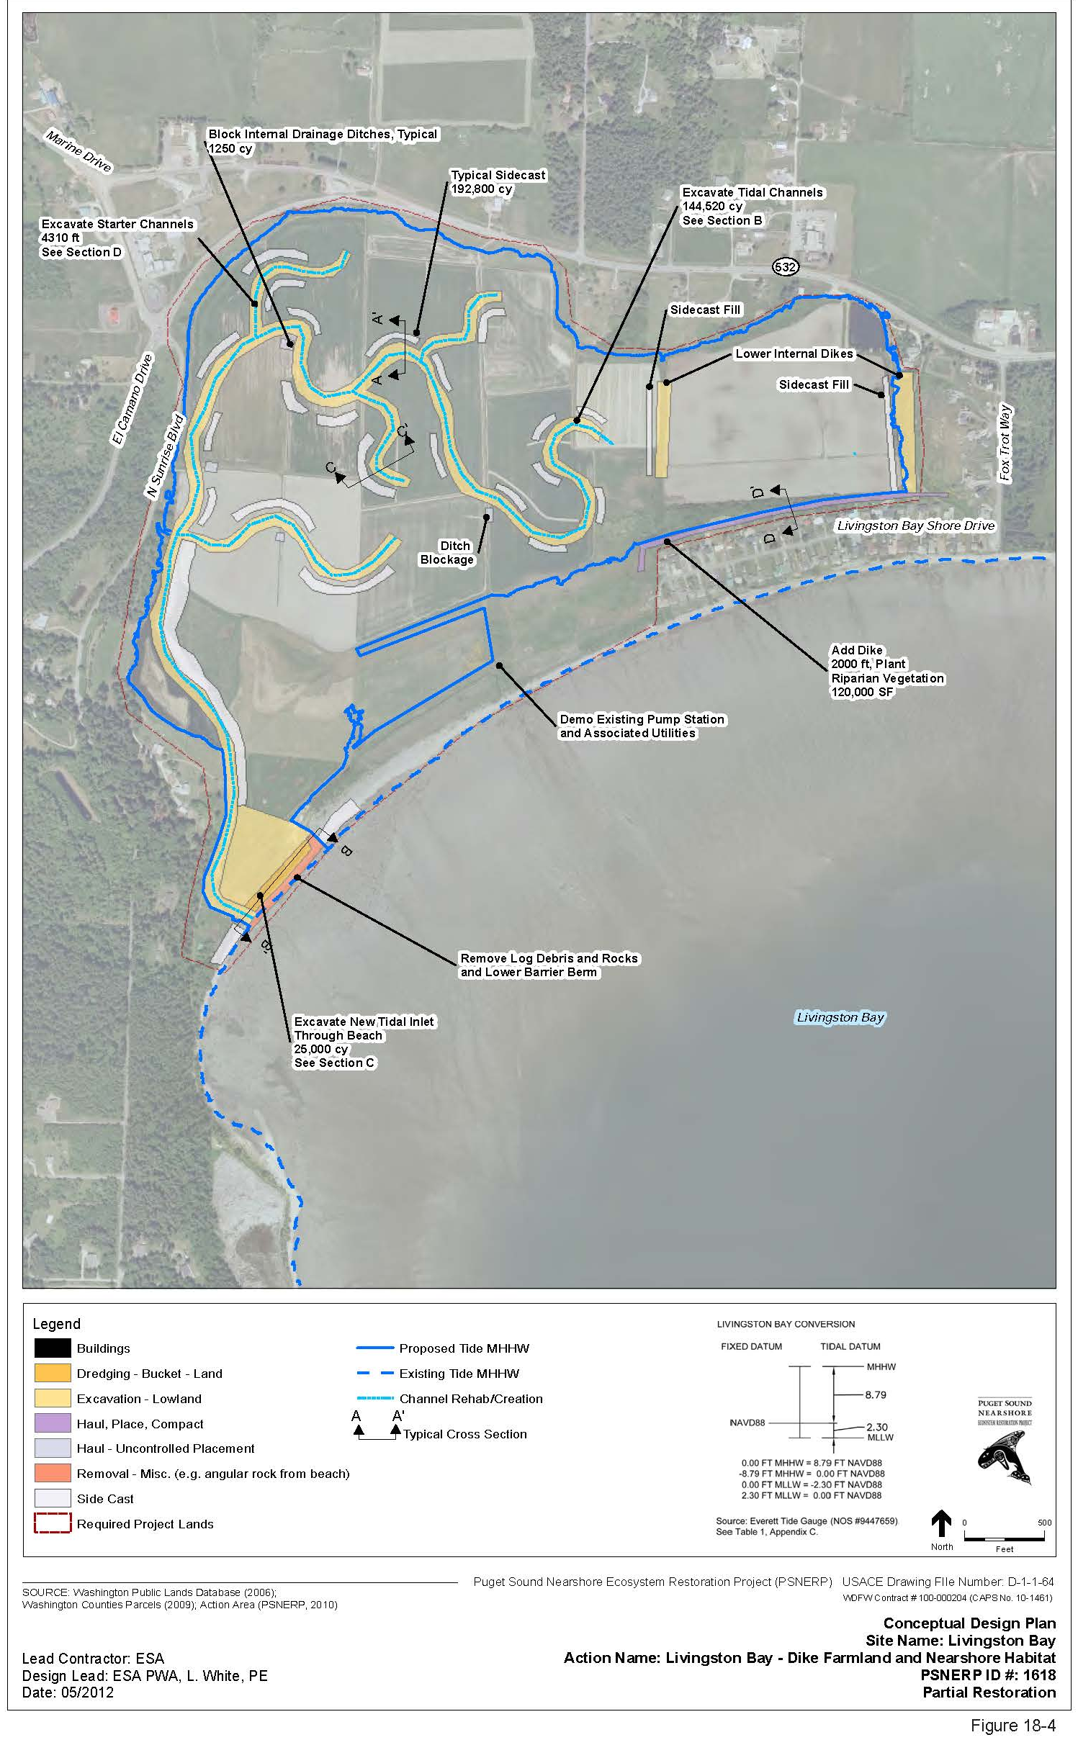
Restoration Planning

Slide 26
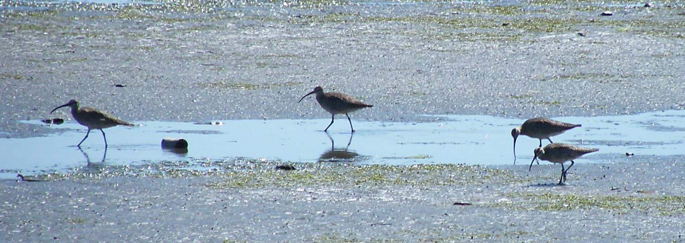
Project Budget
ESRP Grant Proposal = $1,500,000 (57%)
Matching Funds = $1,117,000 (43%) = Federal + State + Local Grants
Total Project Cost = $2,617,000 (100%)
Photo: Matt Griffin

Slide 27
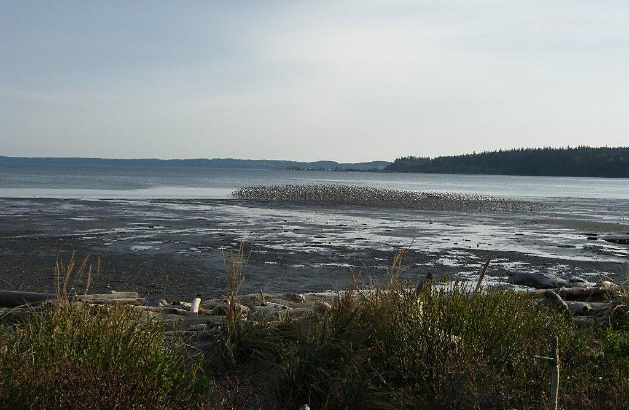
Thank You!
www.wclt.org | 360.222.3310

