Slide 1
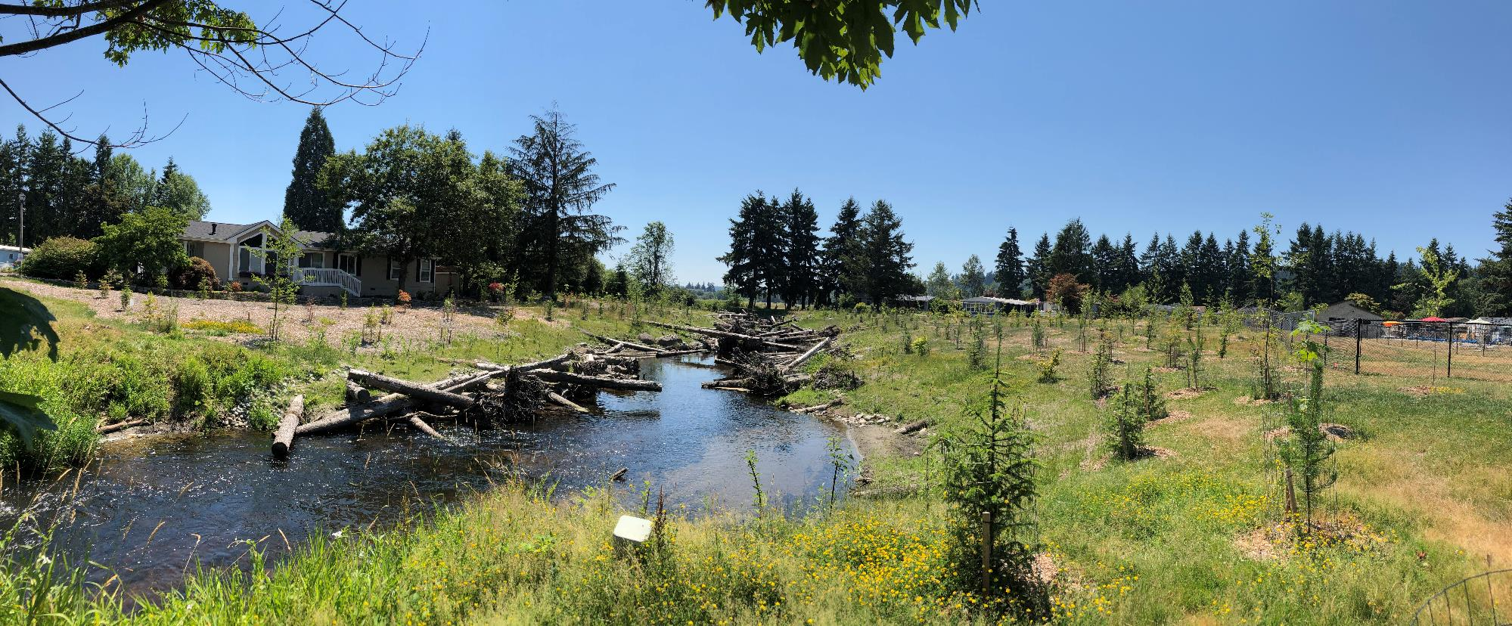
16-1215 Bear Creek Reach 6 – Ph II Construction
Adopt-A-Stream Foundation
Friendly Village Mobile Home Park
King County Housing Authority
July 2, 2021
Elizabeth Butler

Slide 2
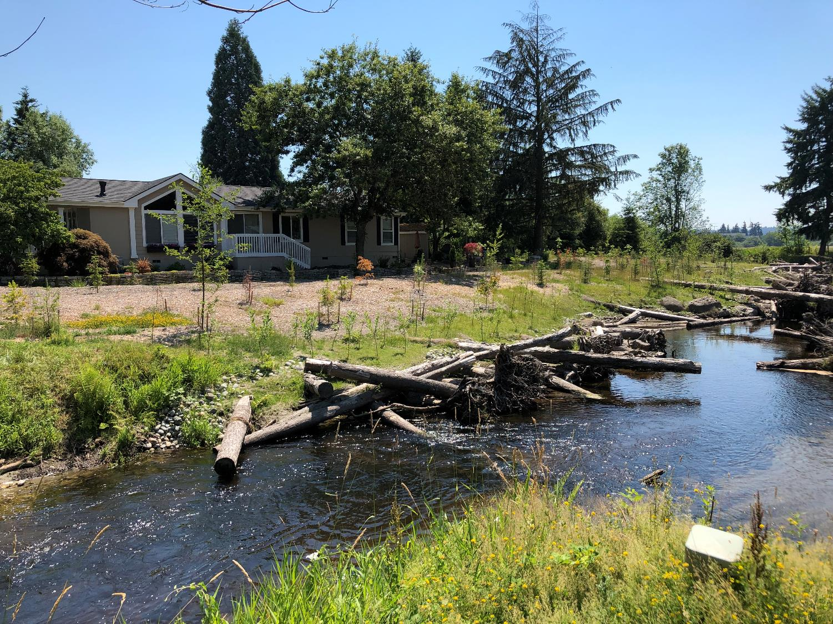

Slide 3
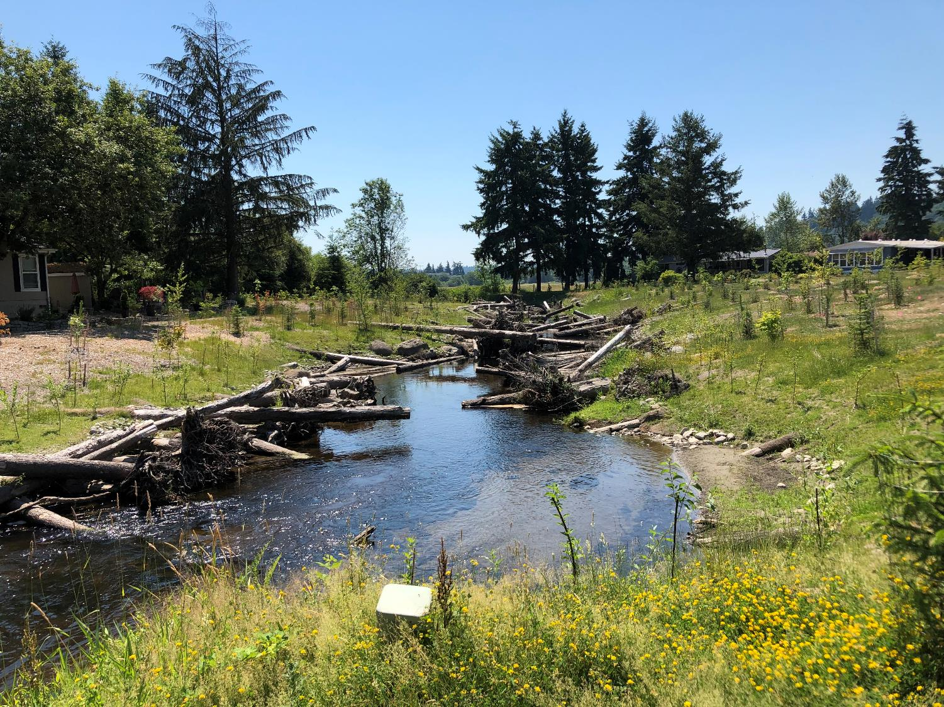

Slide 4
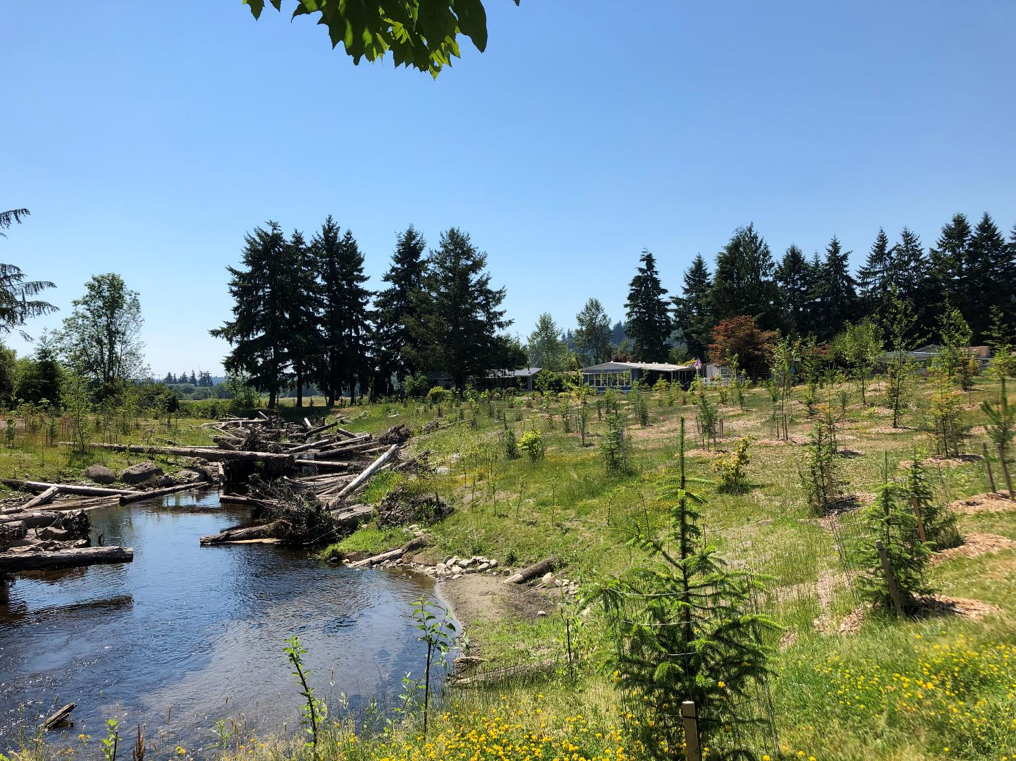

Slide 5
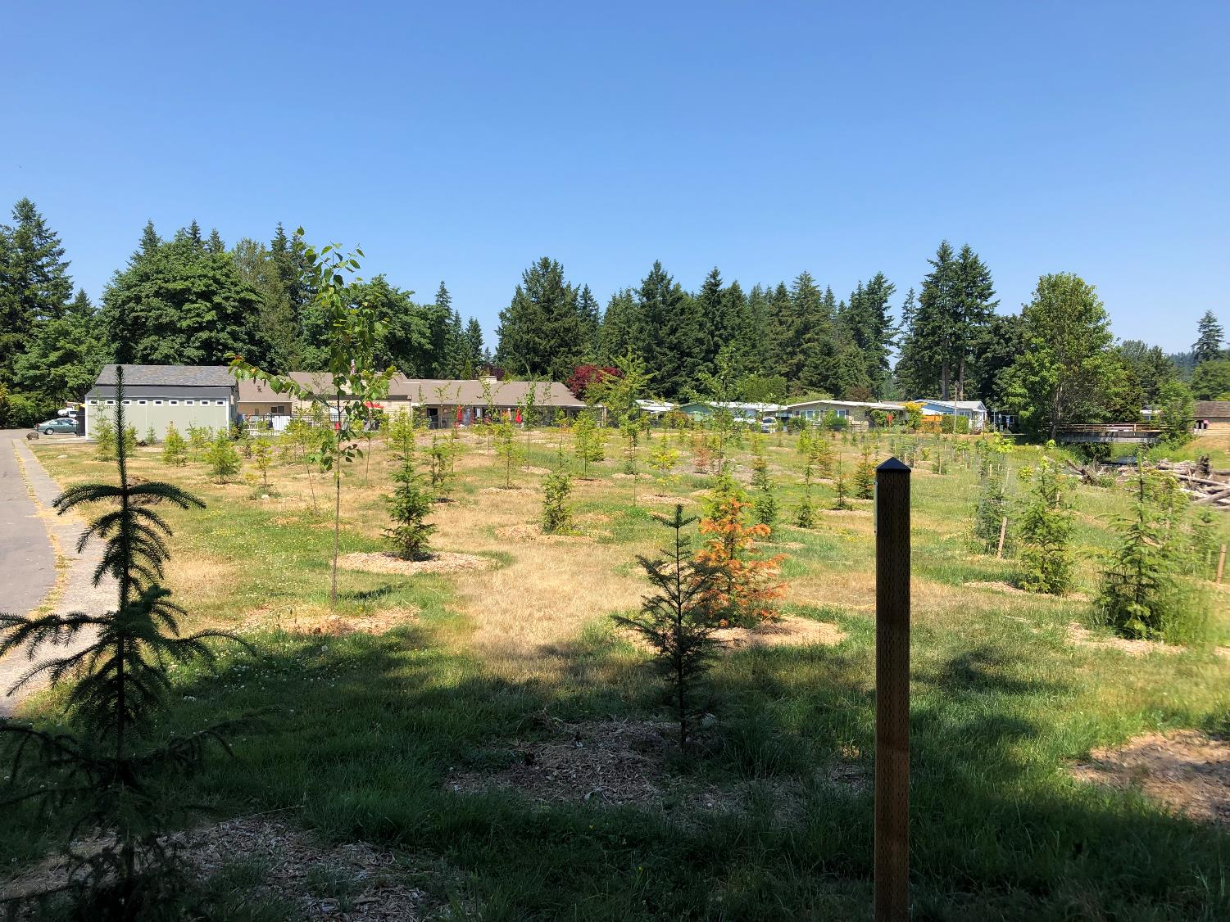

Slide 6
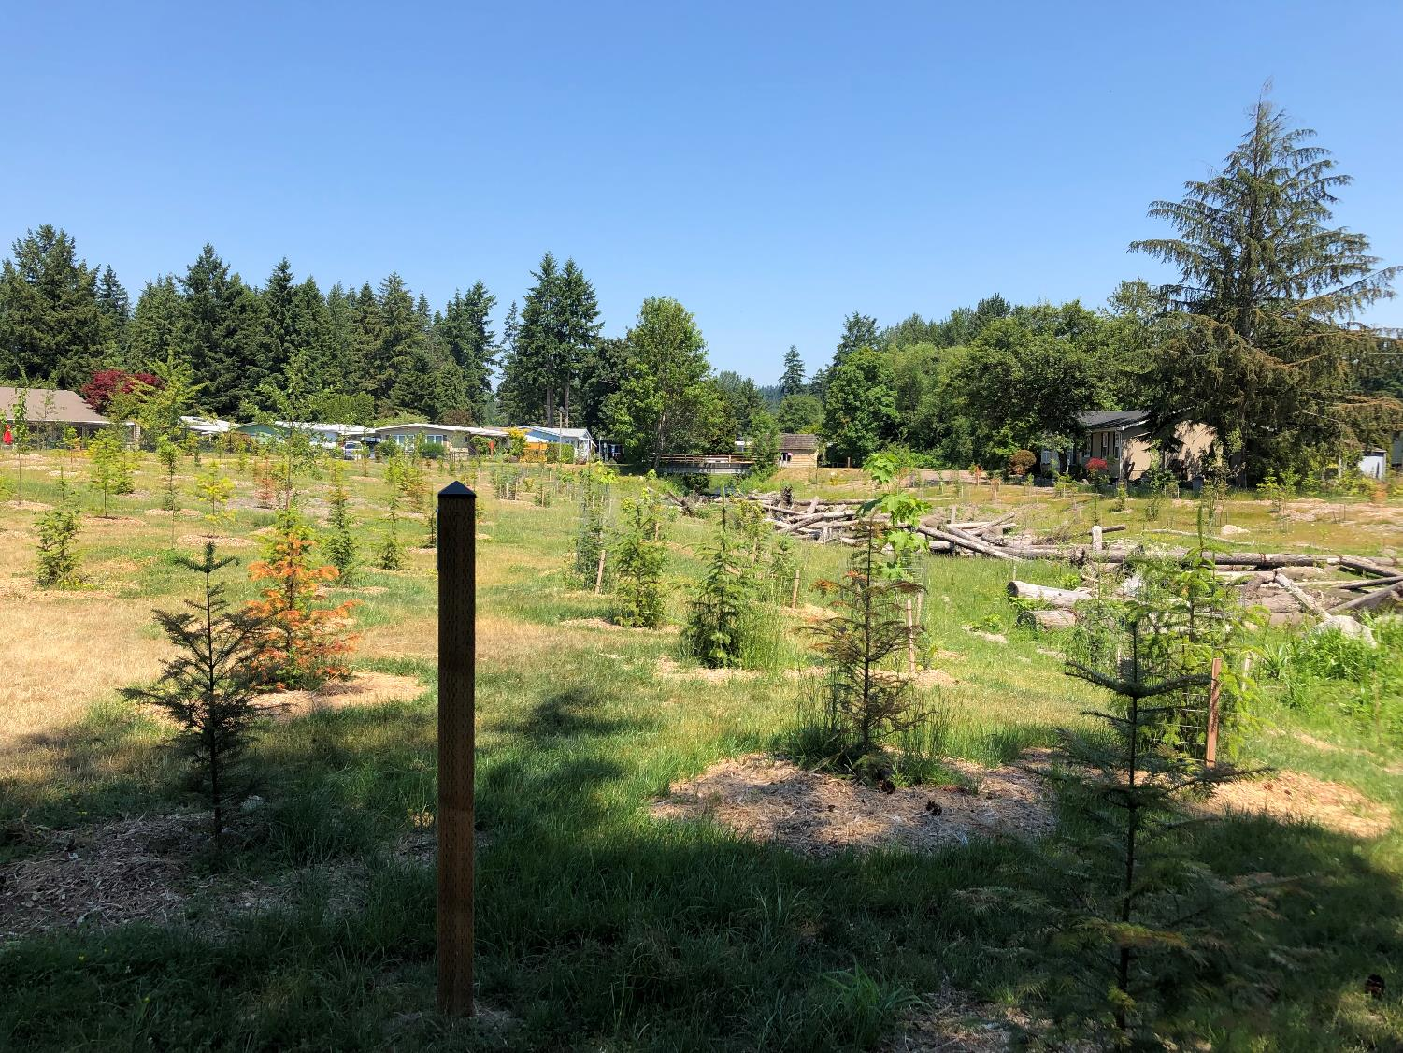

Slide 7
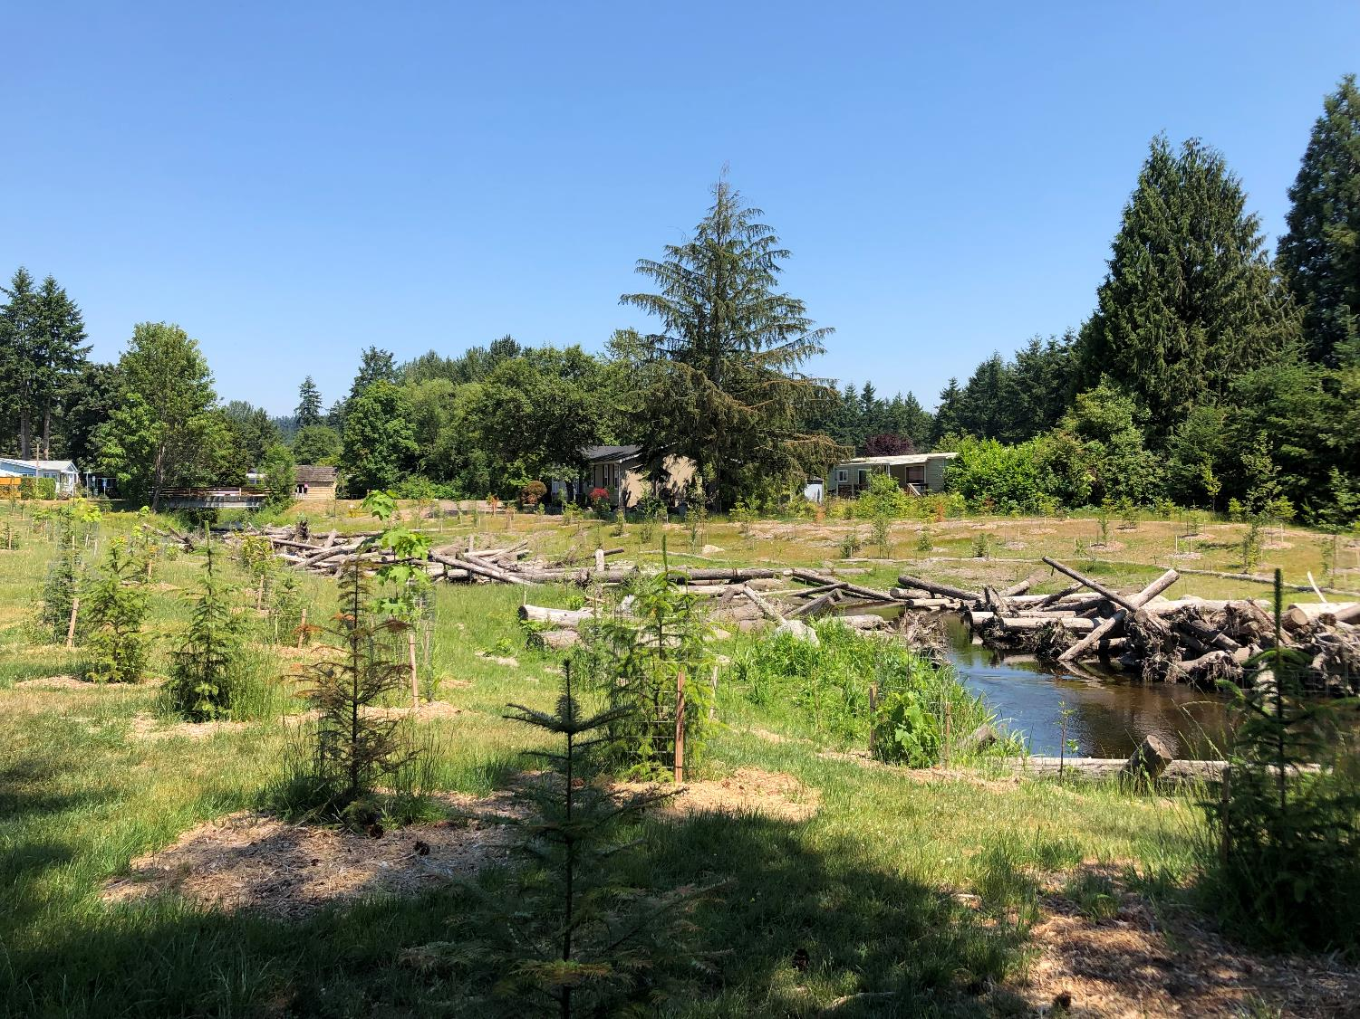

Slide 8
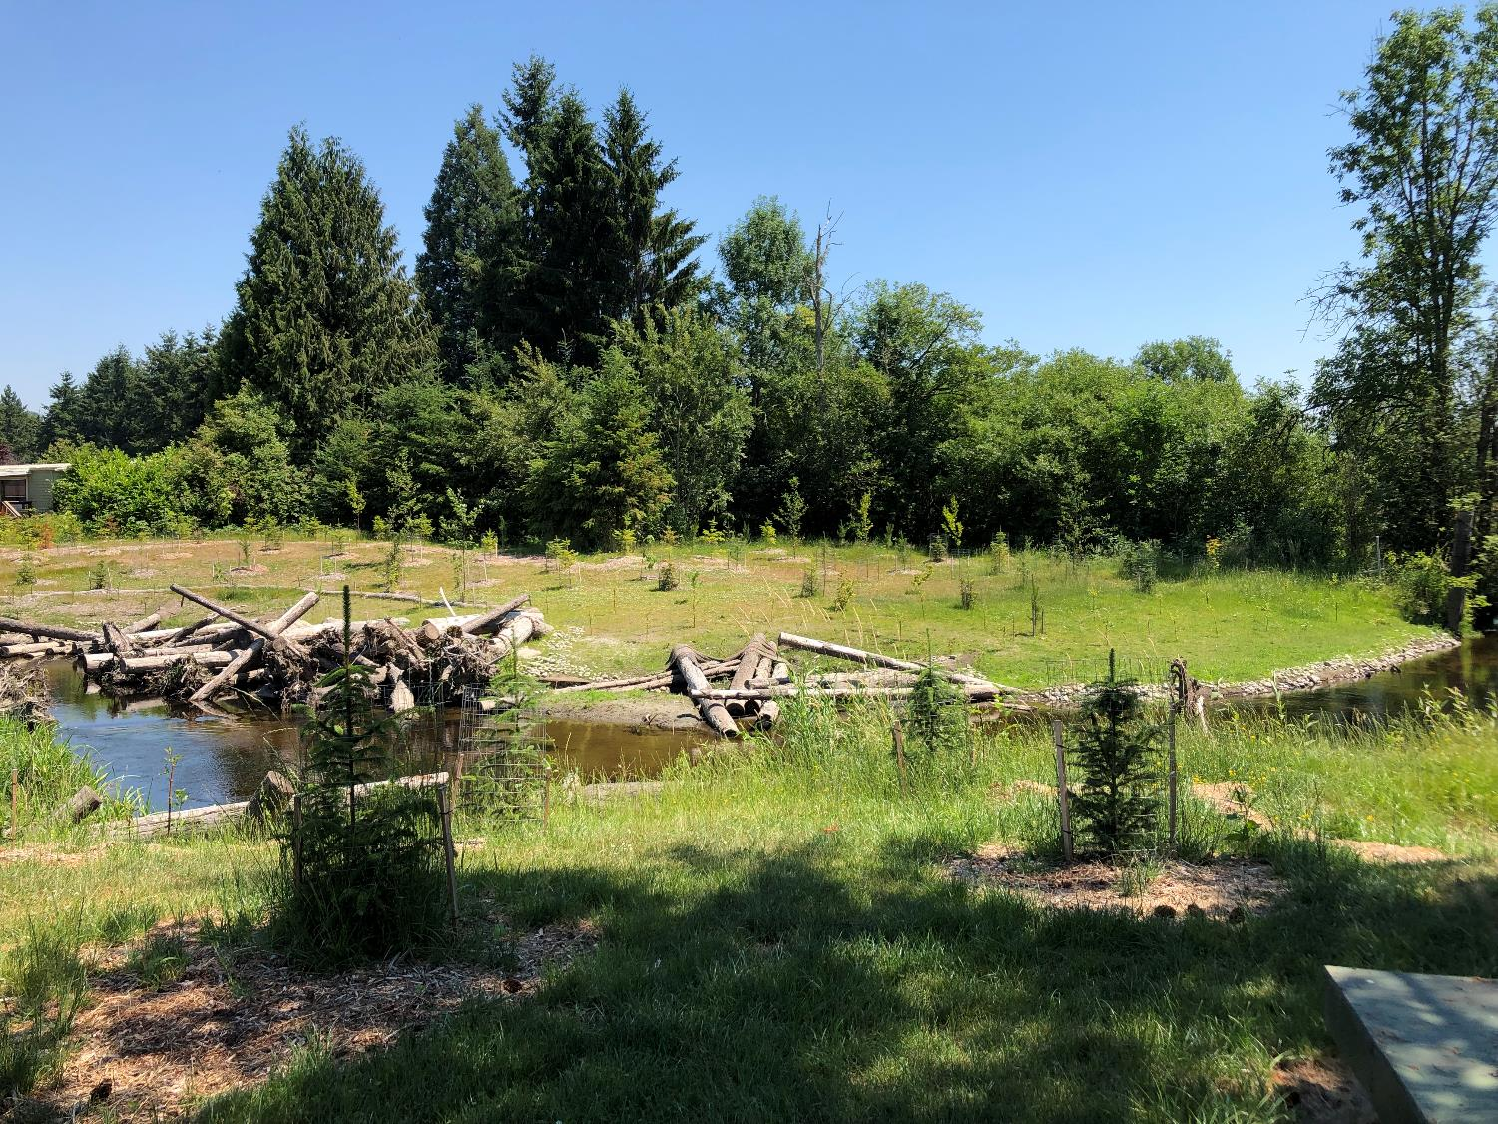

Slide 9
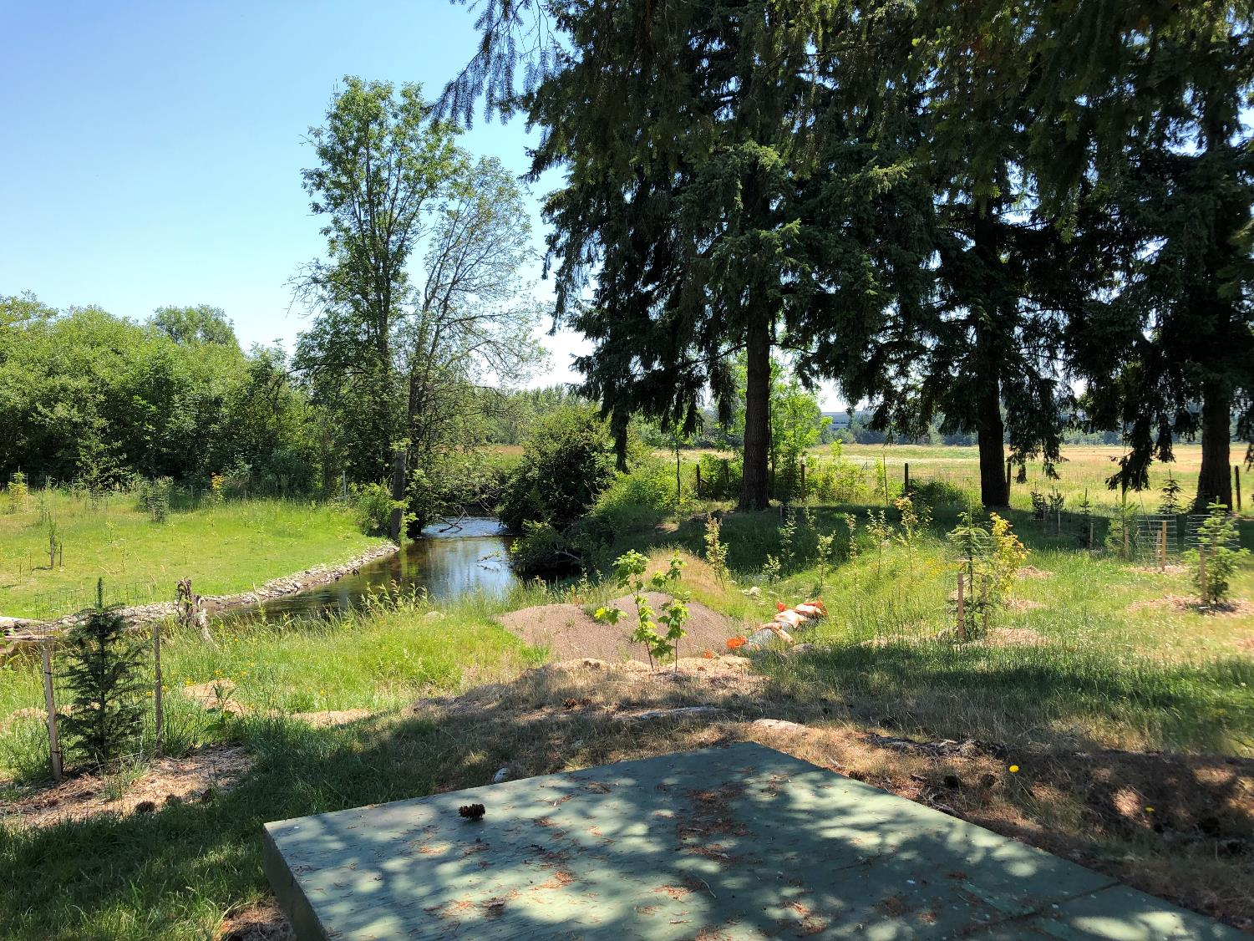

Slide 10
