Slide 1
11-1553 Willow Creek Daylighting
by Marc Duboiski
Early Application Site Visit
June 8, 2011

Slide 2
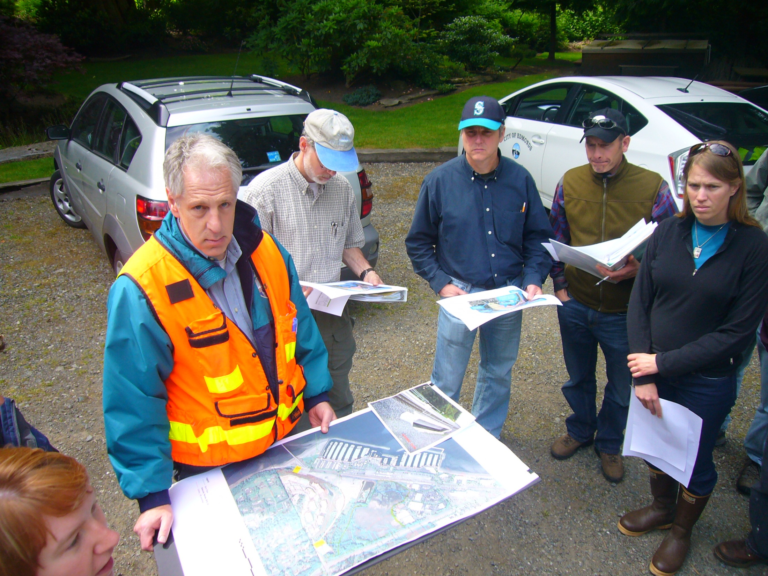

Slide 3
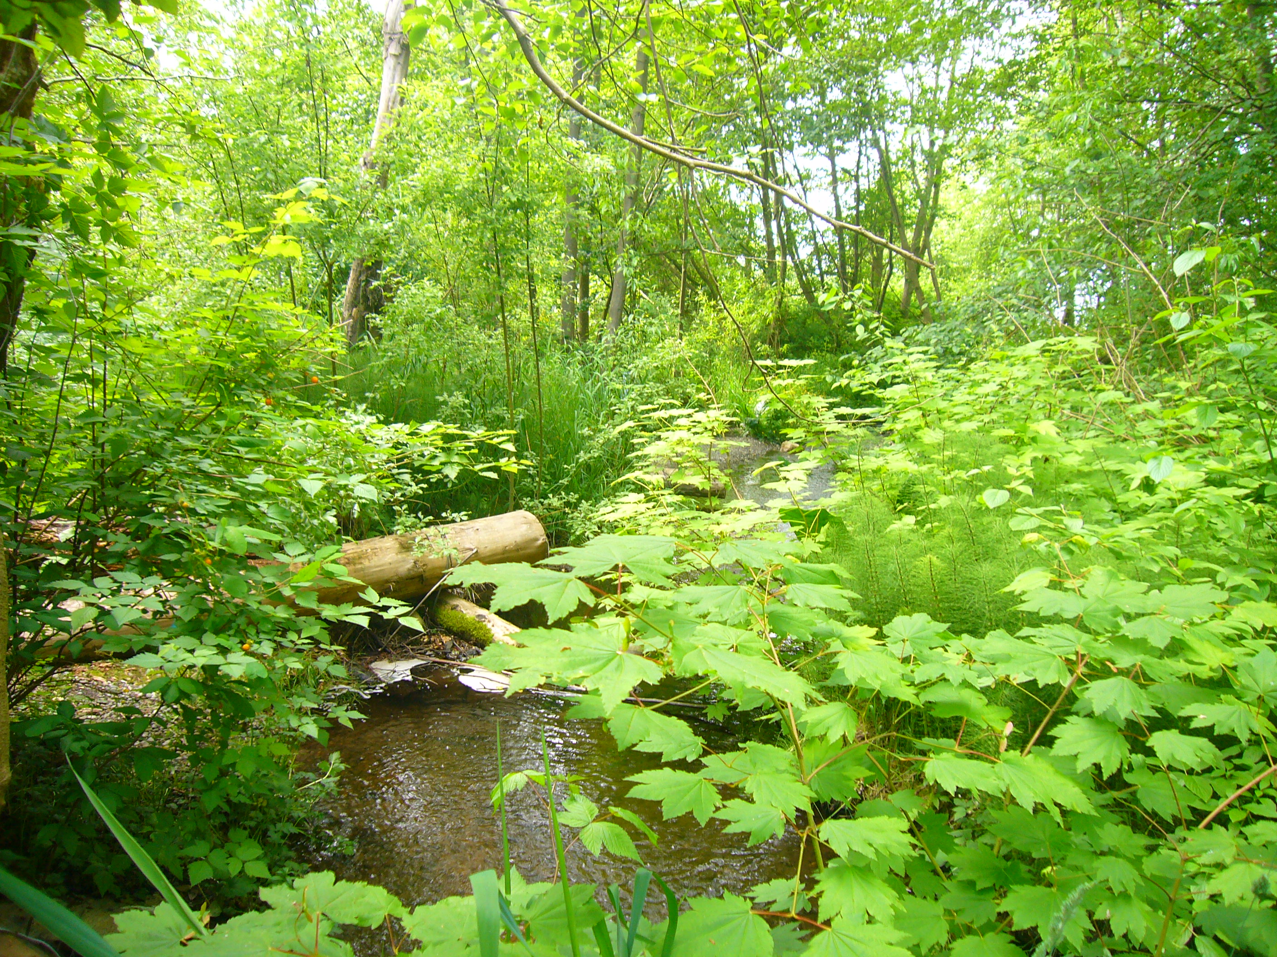

Slide 4
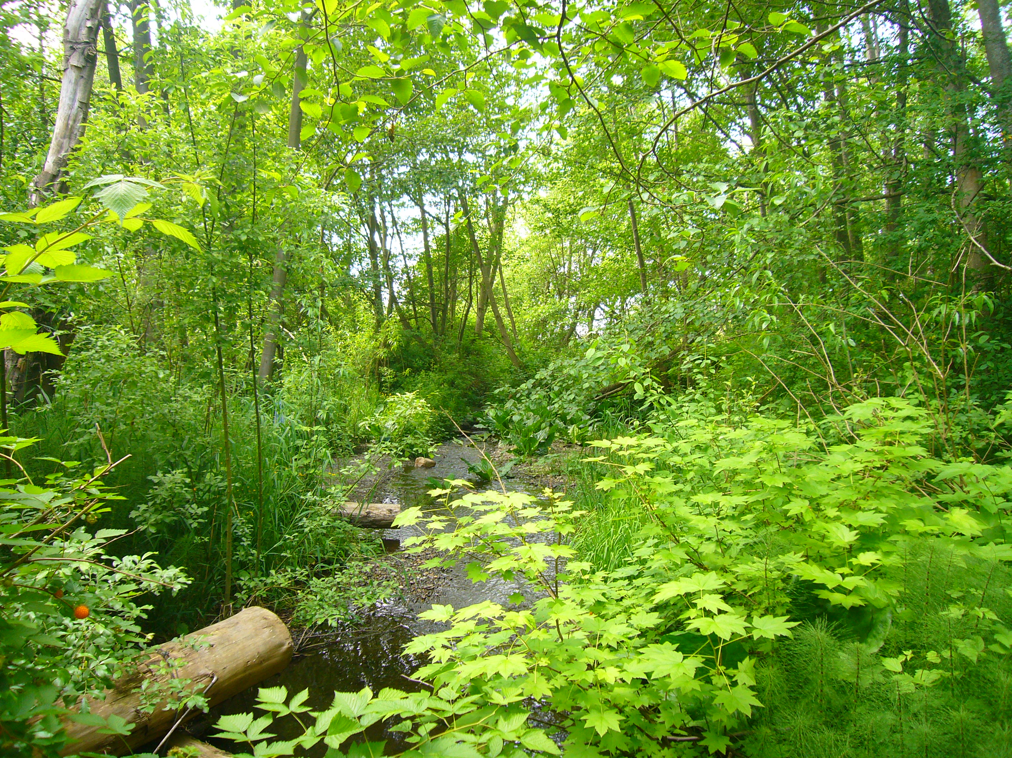

Slide 5
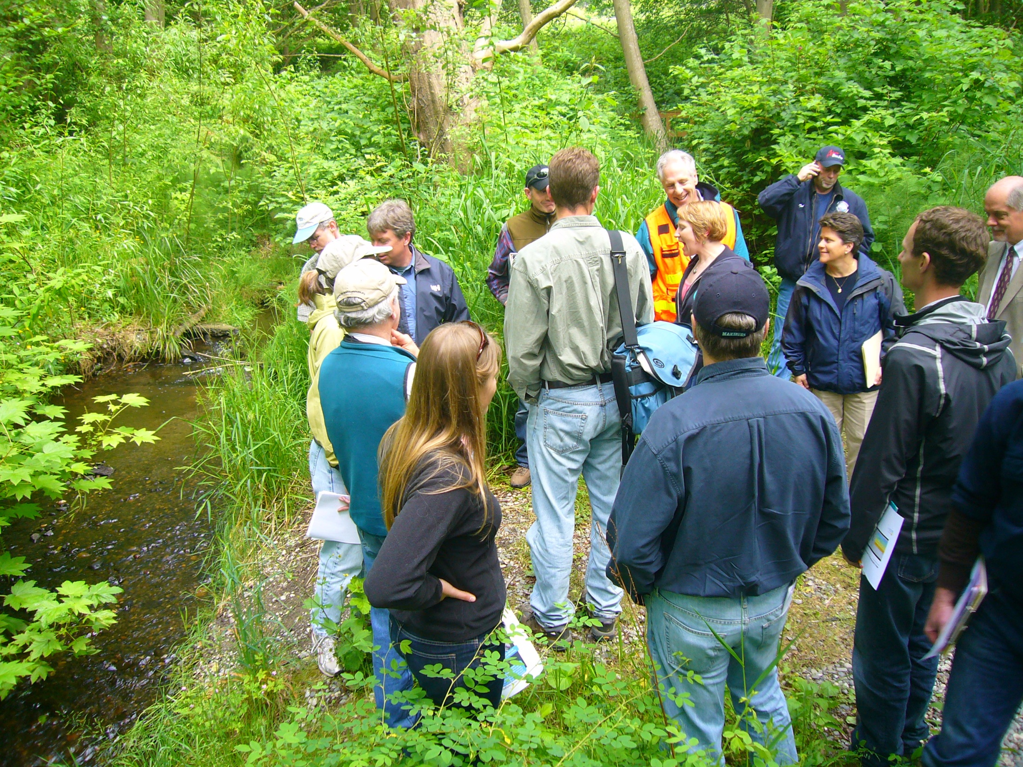

Slide 6
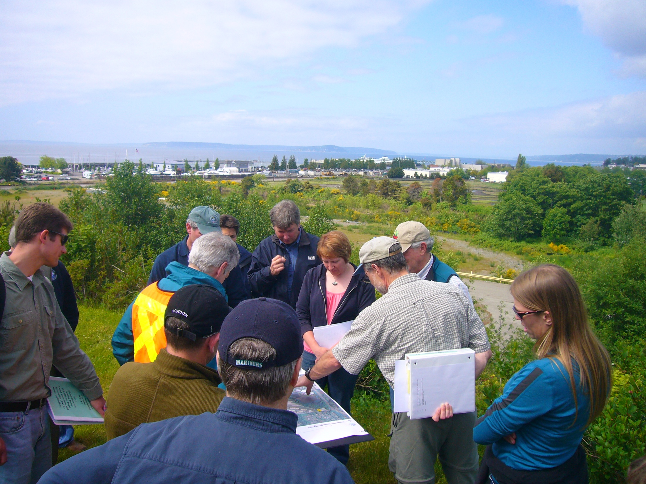

Slide 7
