Slide 1
Paradise Valley Conservation Area Acquisition
#99-1705
Snohomish County Parks Dept
Compliance Inspection Photos
Josh Lambert
8/15 & 9/14/2017

Slide 2
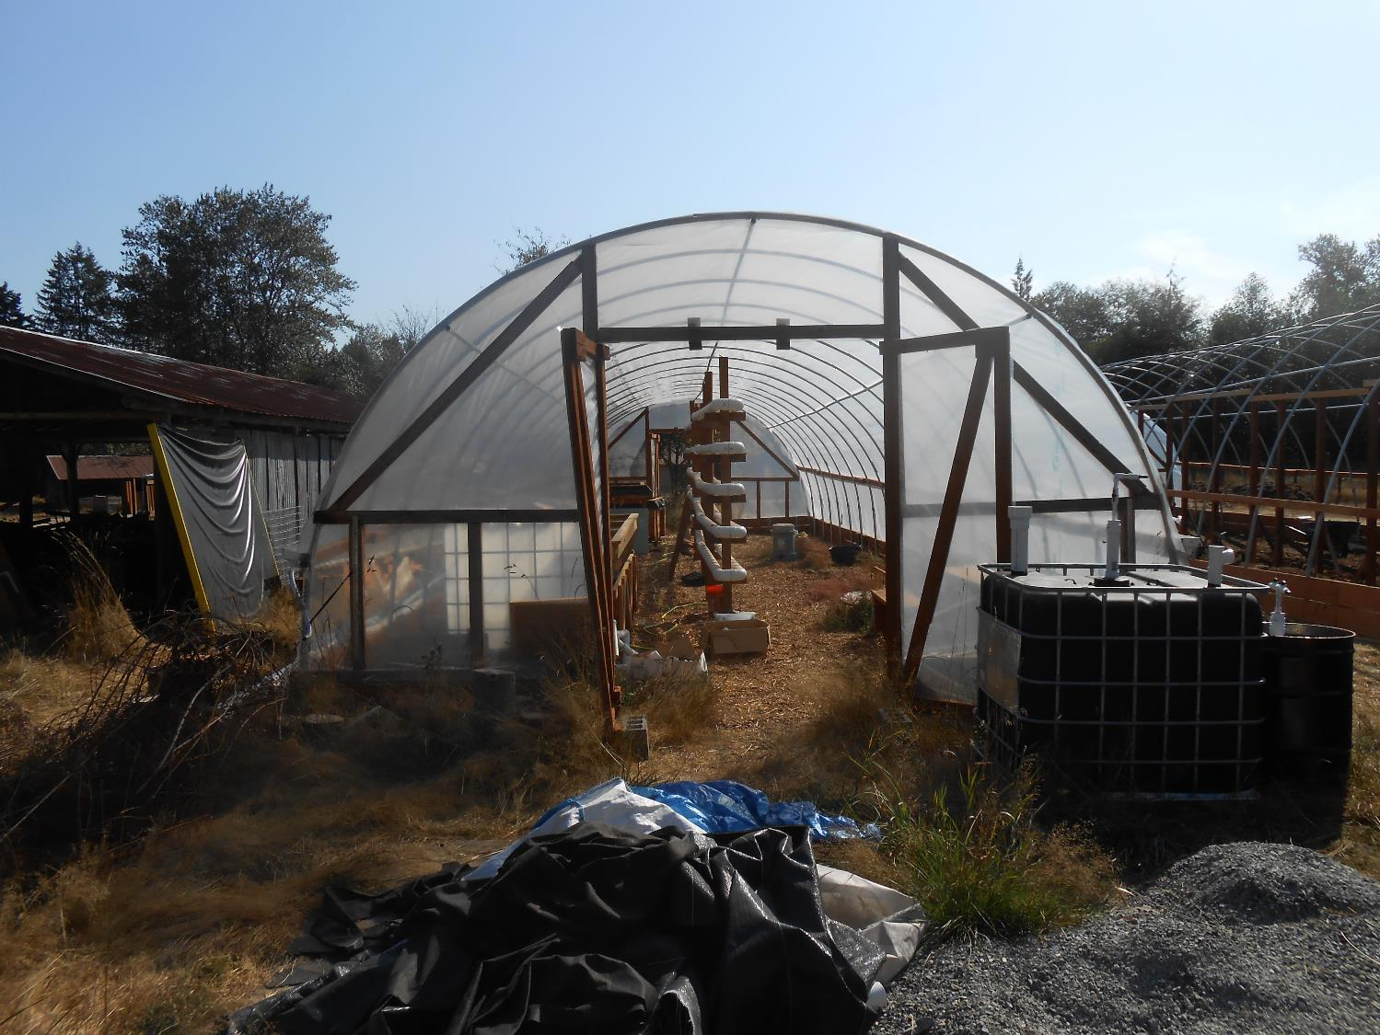
9/14/2015
Hydroponic hoop house

Slide 3
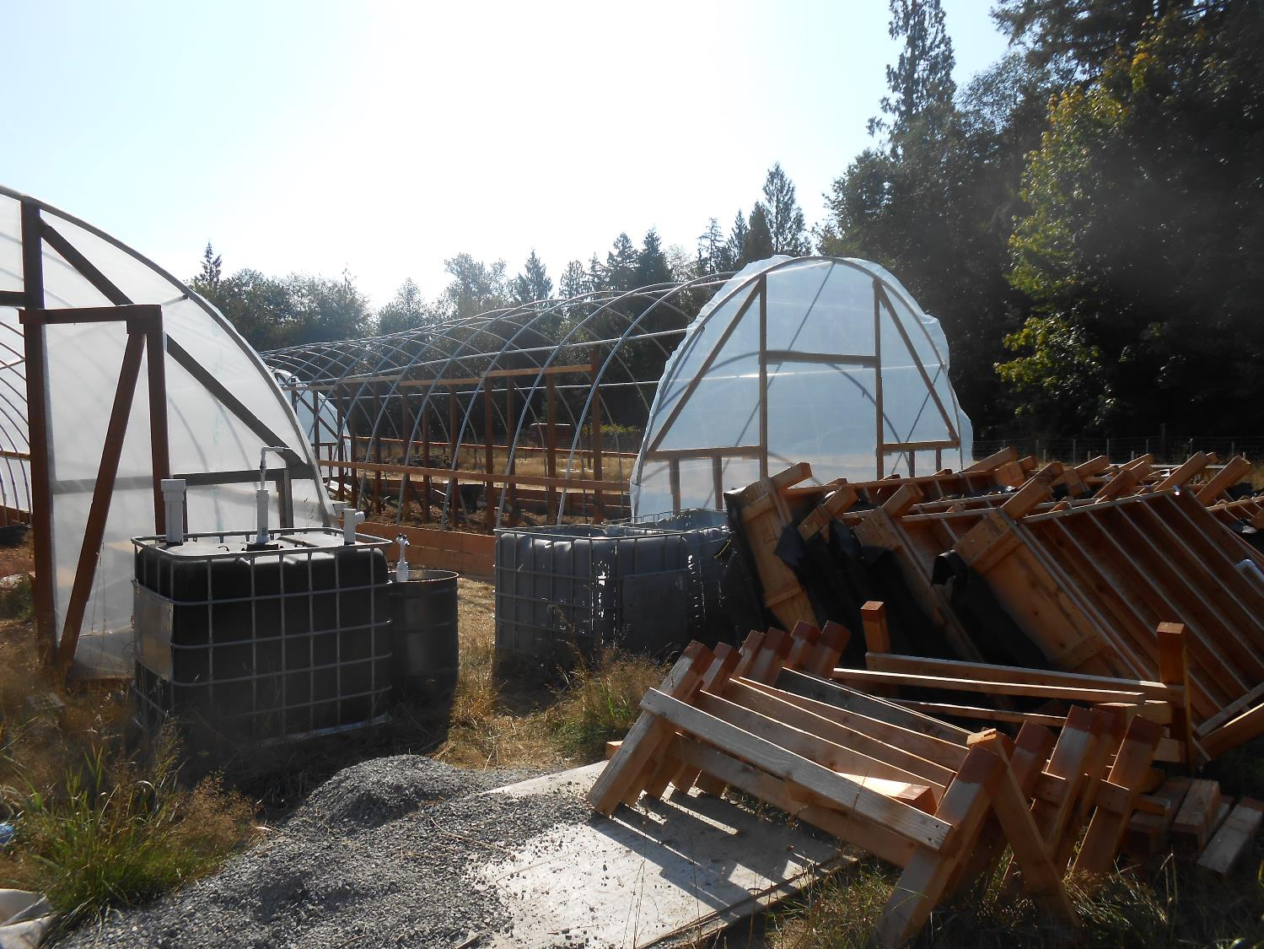
9/14/2015

Slide 4
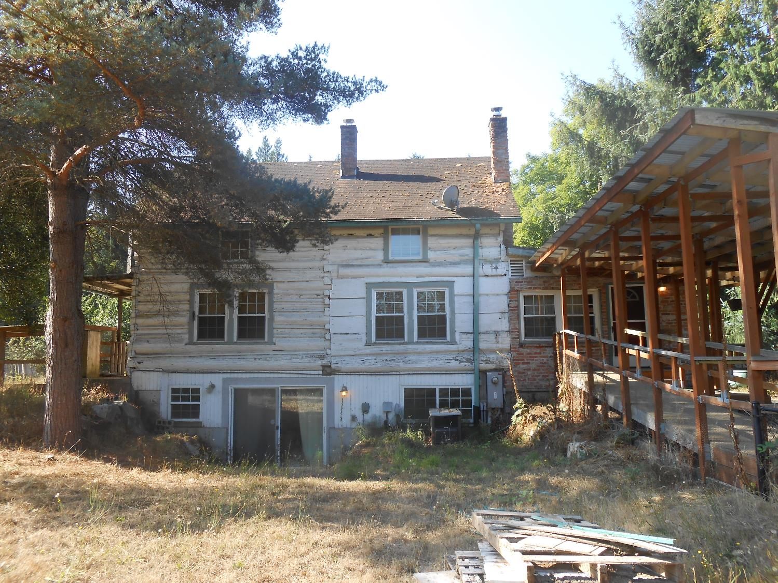
9/14/2015
Original farmstead home – not registered

Slide 5
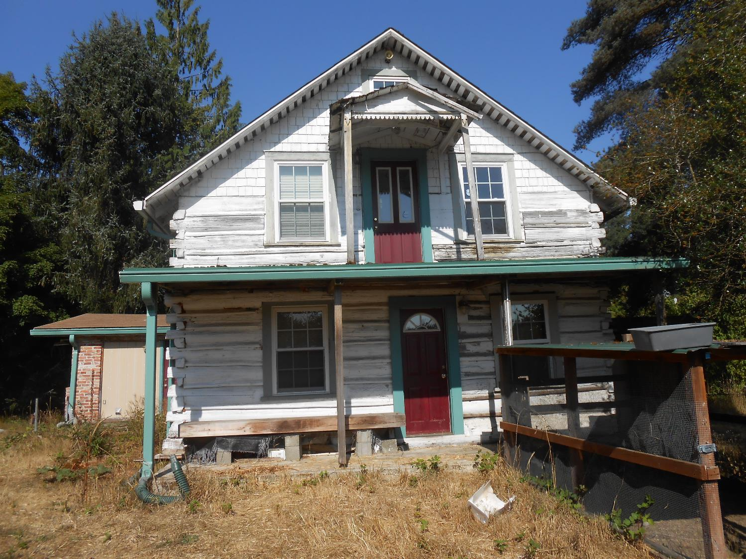
9/14/2015

Slide 6
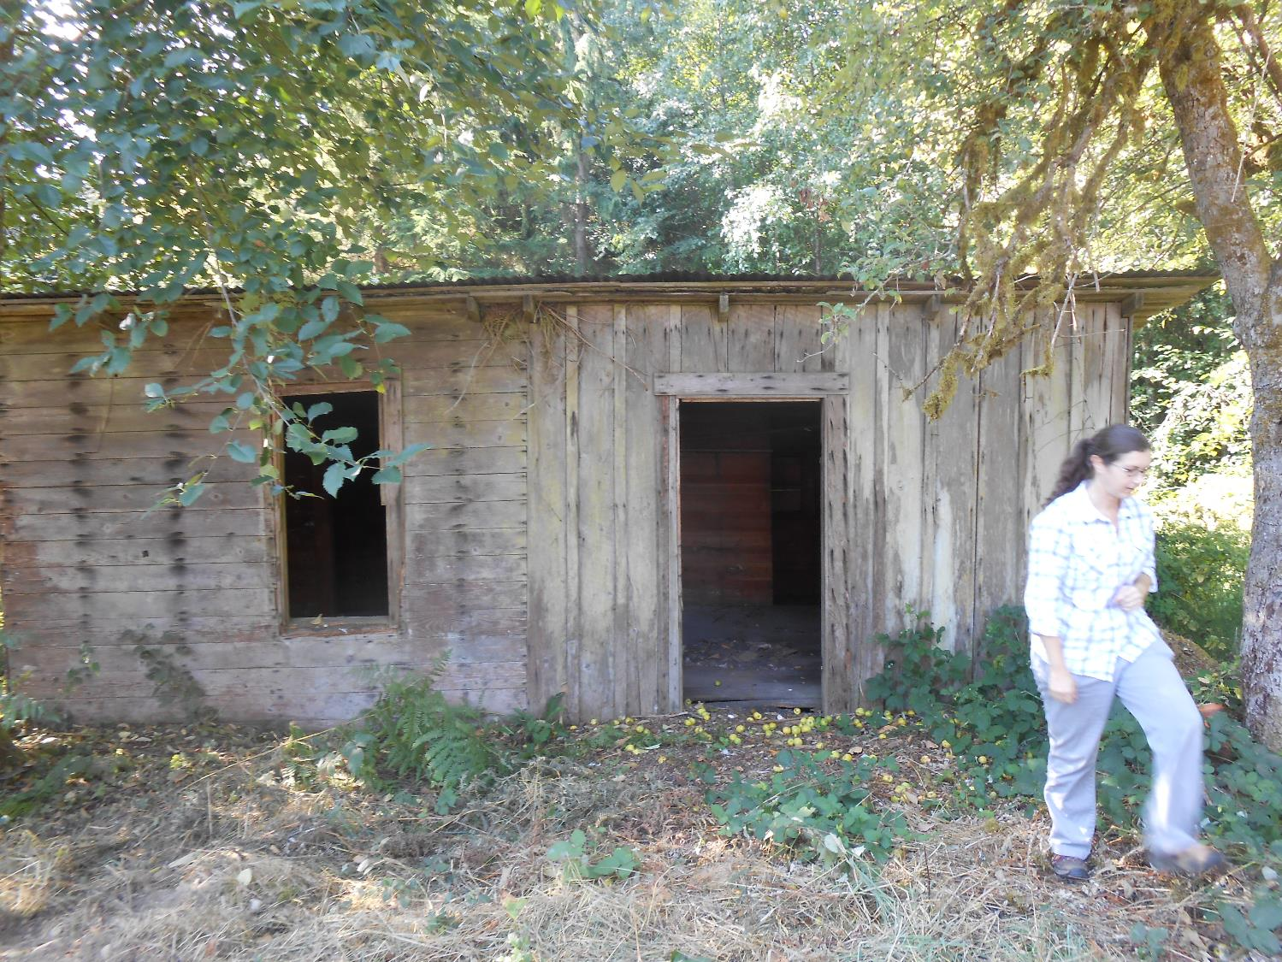
9/14/2015
Old farm outbuilding - Potential site of Historical Museum

Slide 7
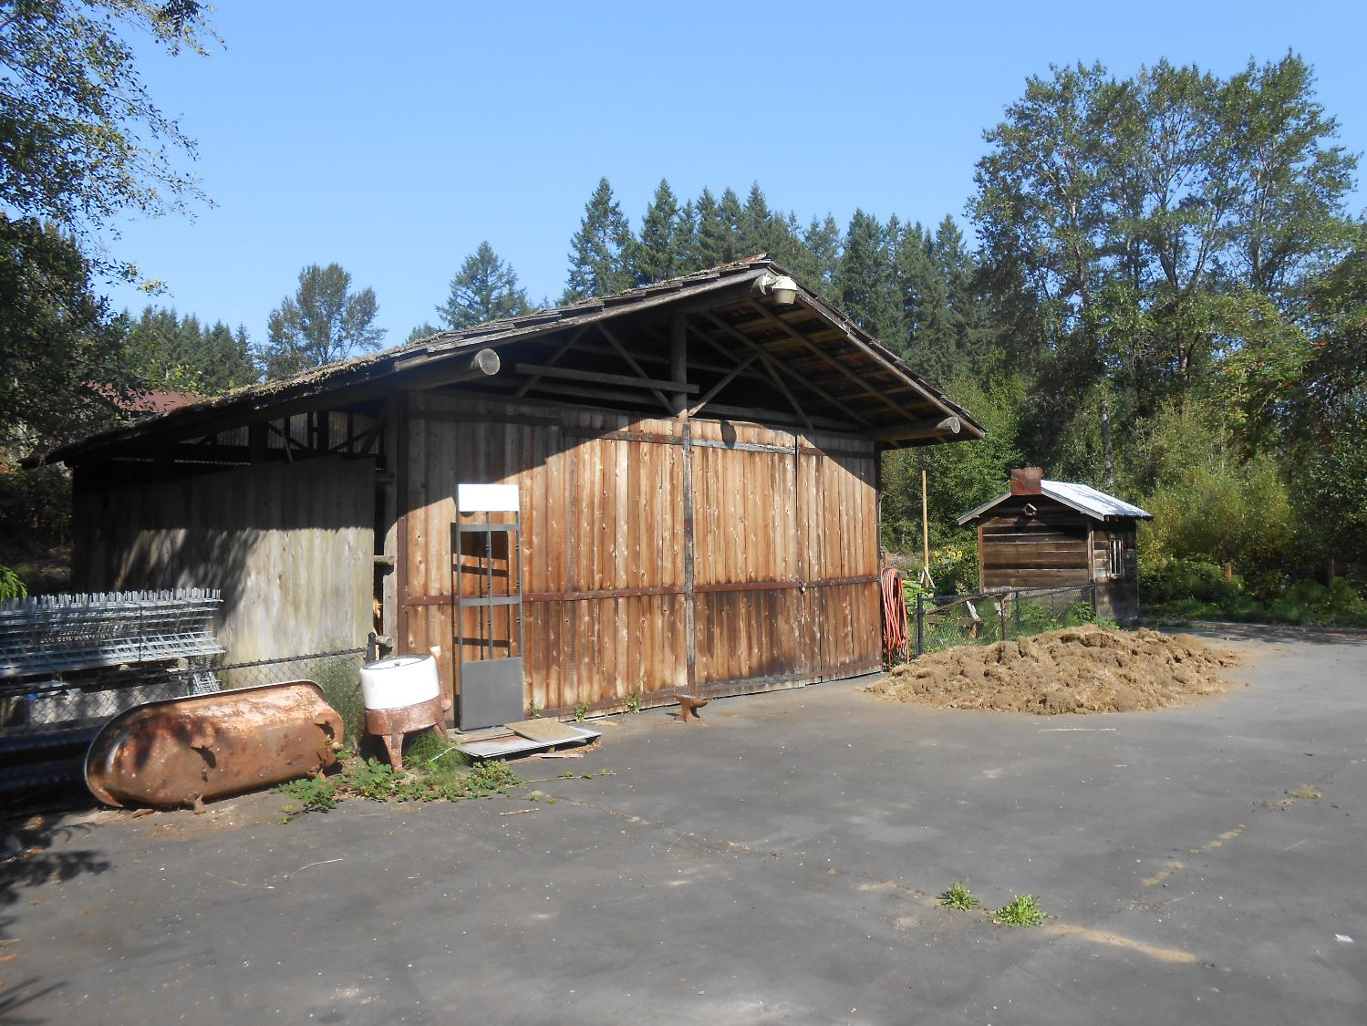
9/14/2015
Hay barn – listed on historical registery

Slide 8
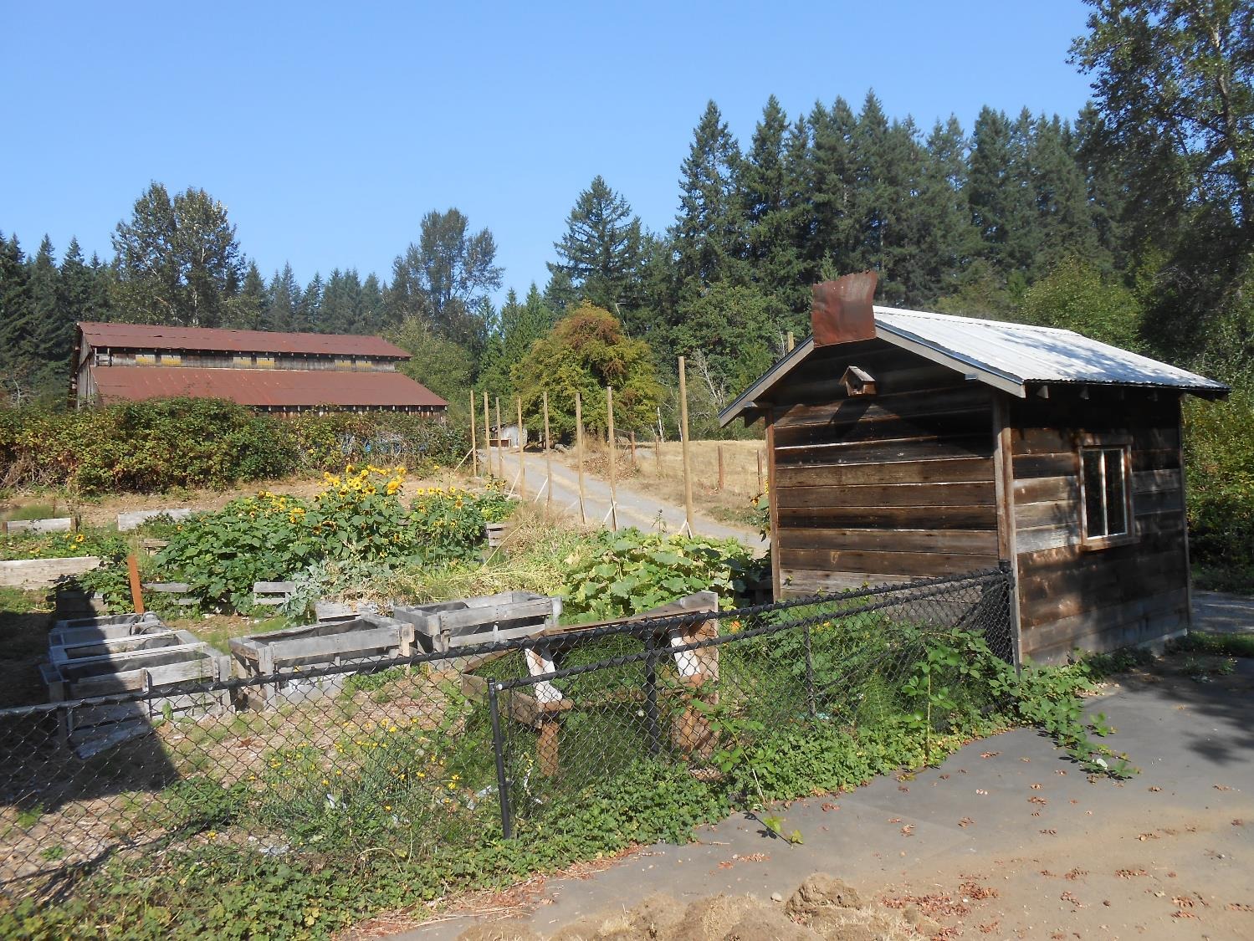
9/14/2015

Slide 9
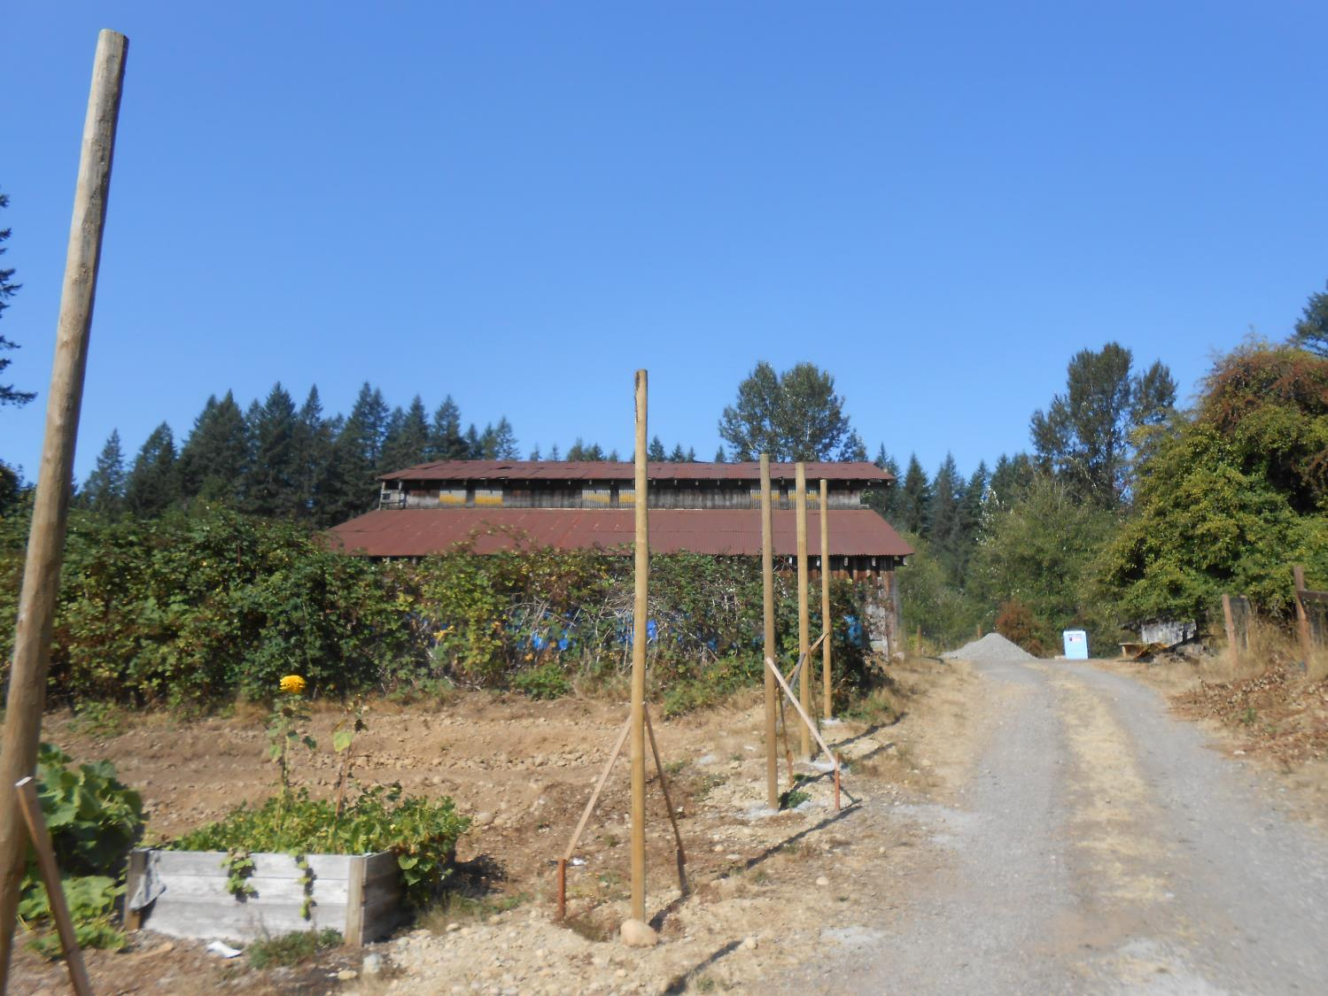
9/14/2015

Slide 10
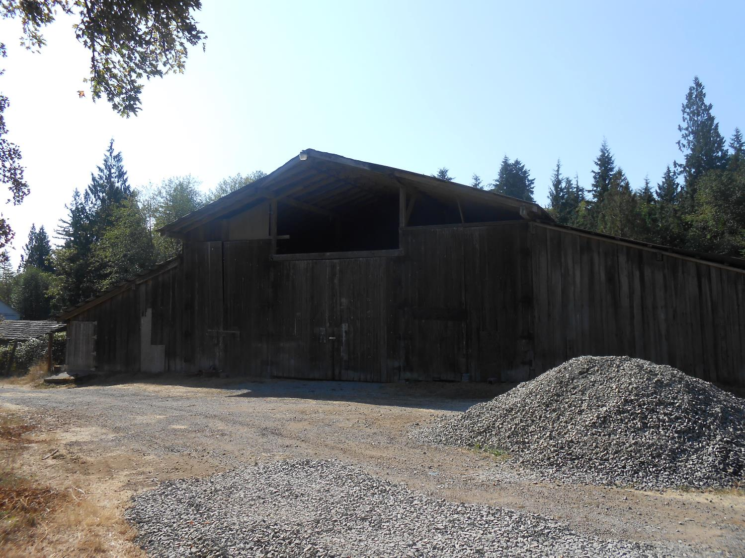
9/14/2015

Slide 11
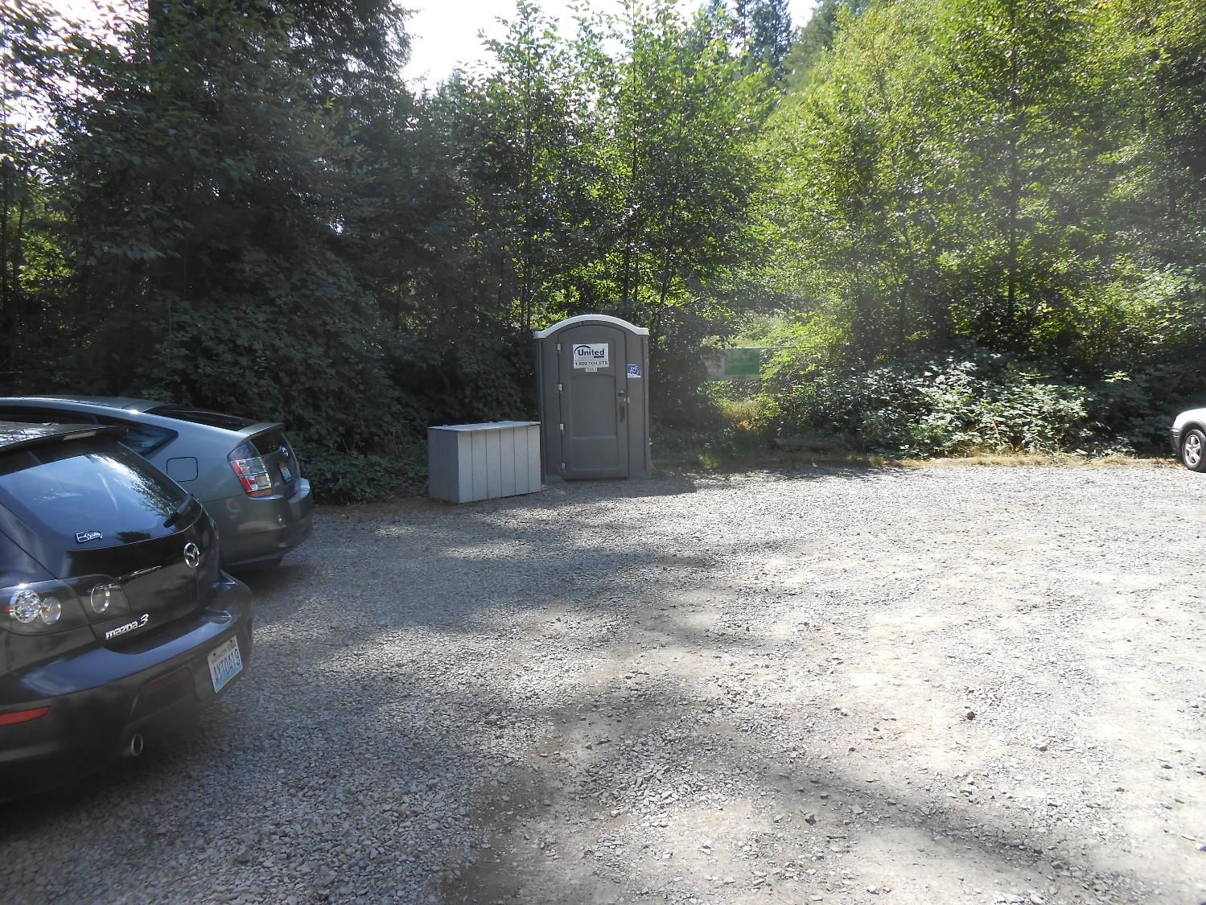
8/15/2015
Existing parking lot (RCO #05-1159) - fence to the right of porta-potty will be the entrance to the new parking expansion area under construction

Slide 12
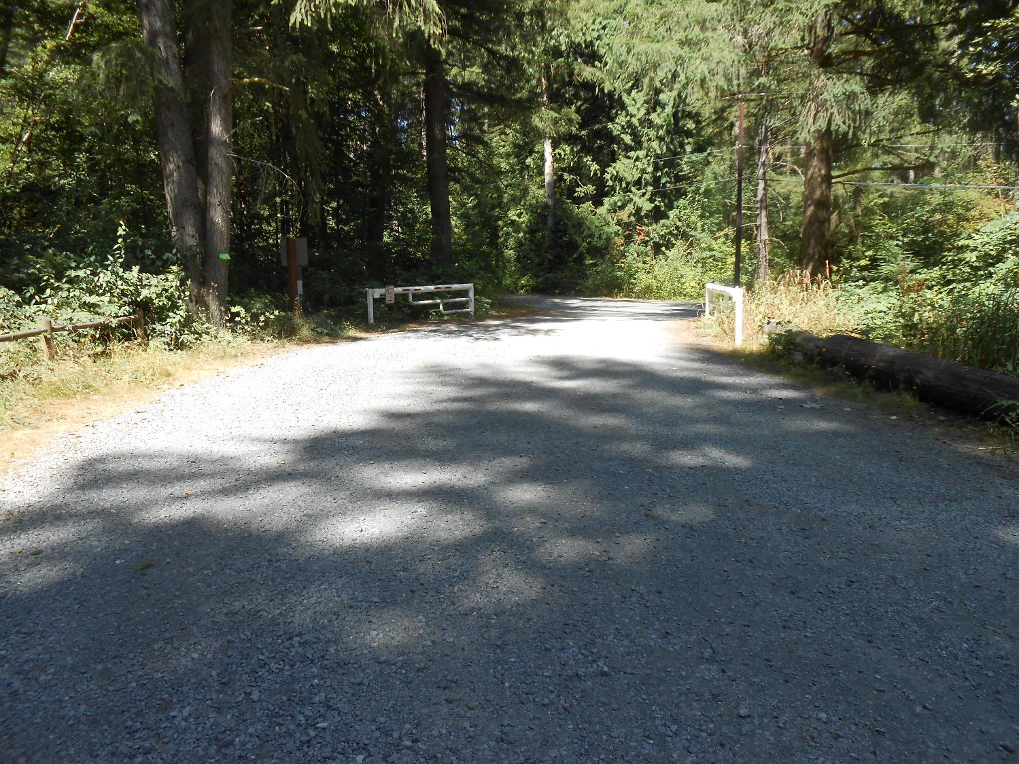
8/15/2015
Existing parking lot (RCO #05-1159)

Slide 13
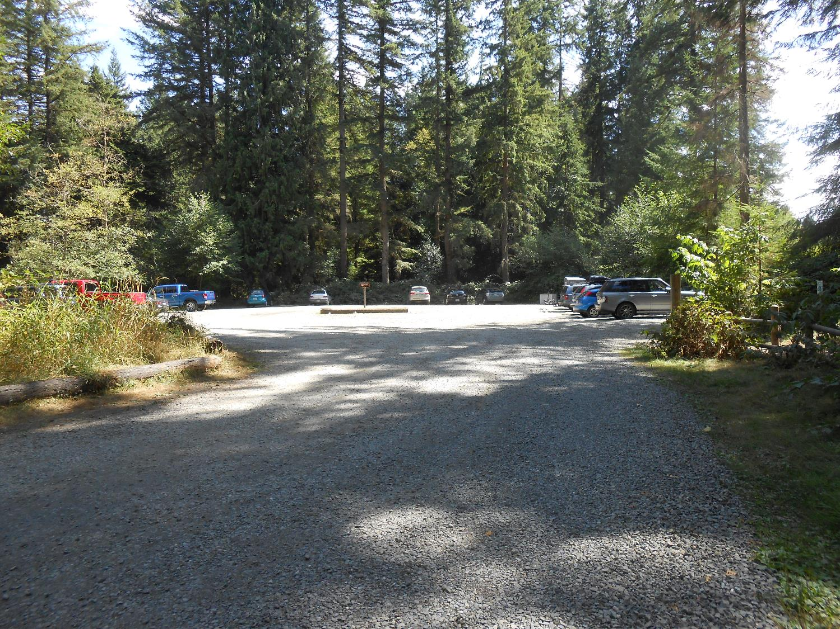
8/15/2015
Existing parking lot (RCO #05-1159)

Slide 14
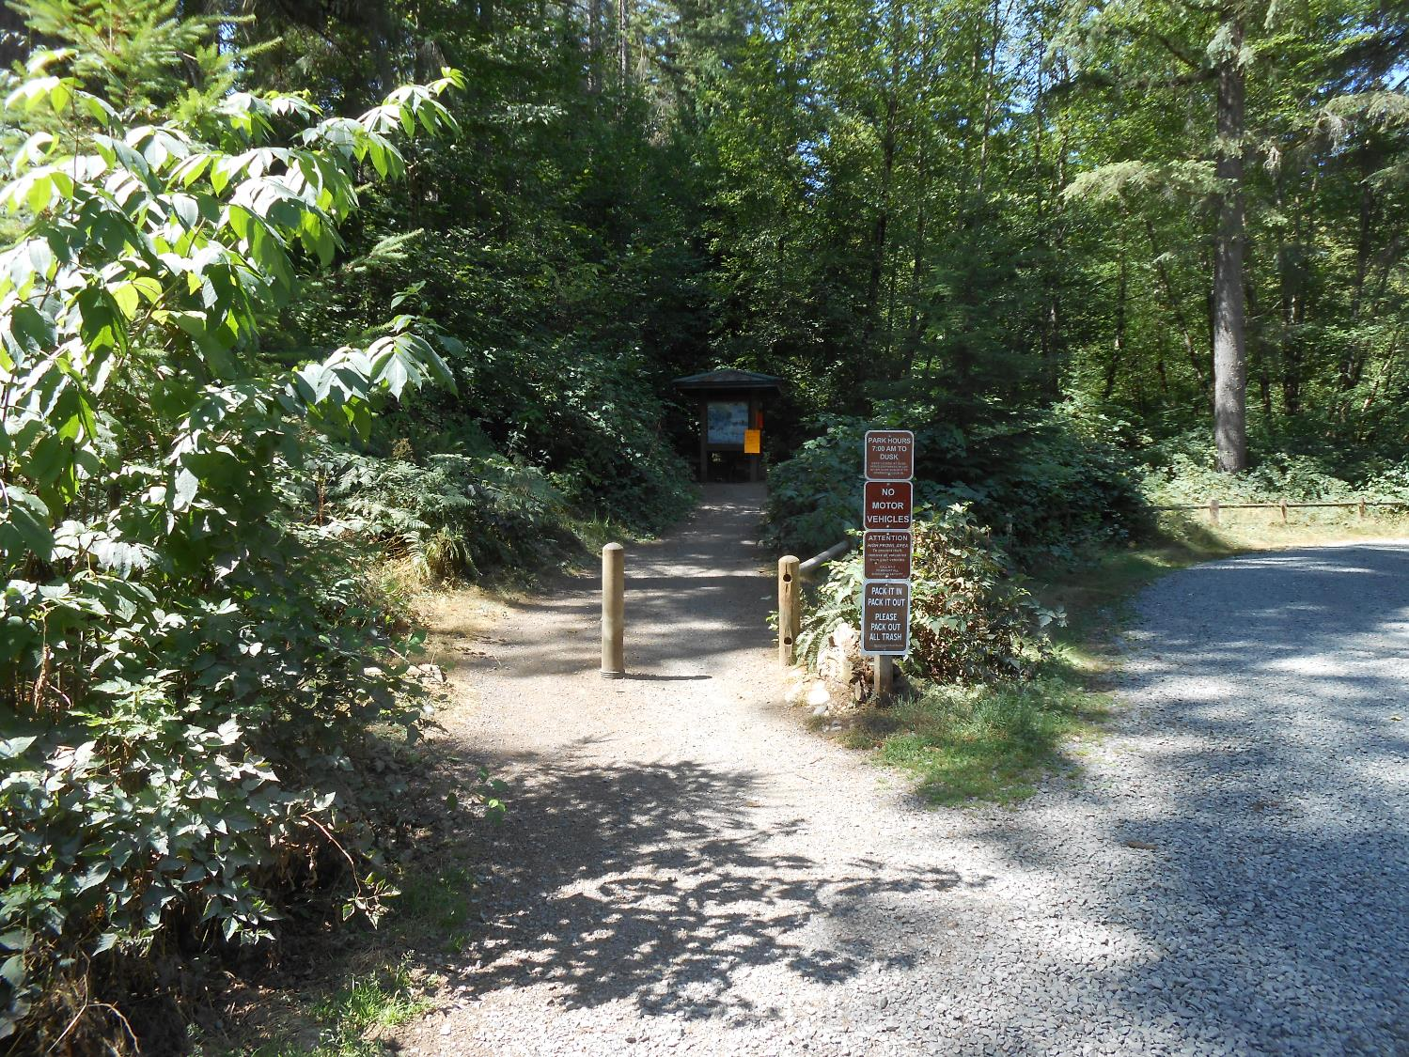
8/15/2015

Slide 15
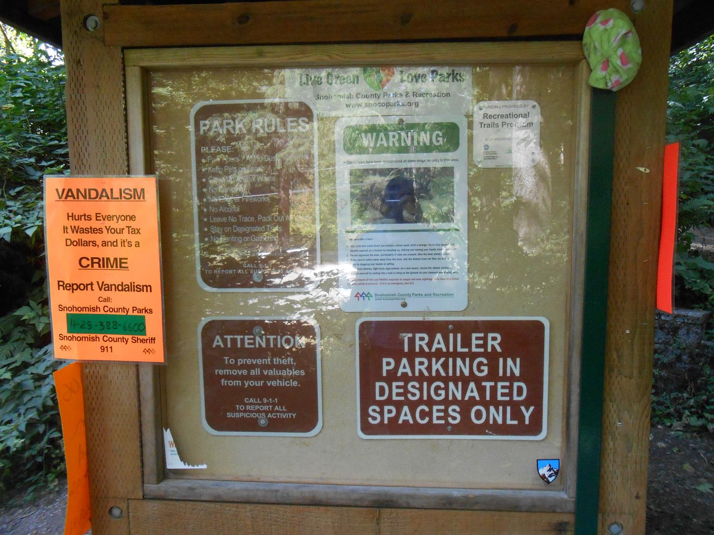
8/15/2015

Slide 16
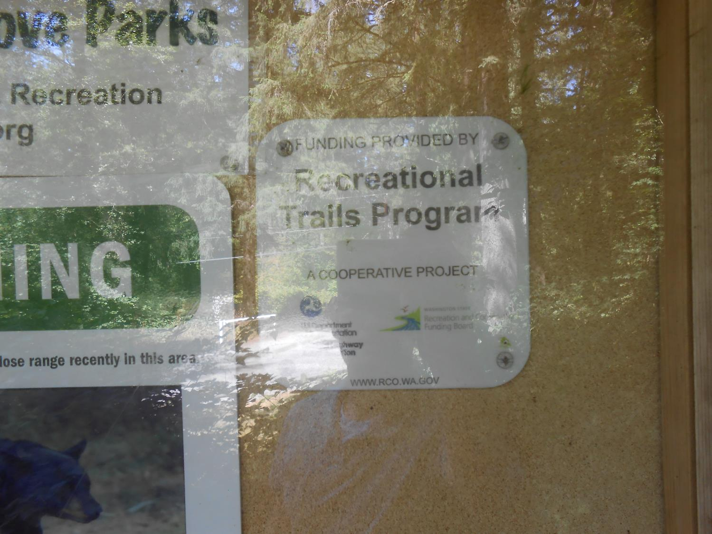
8/15/2015

Slide 17
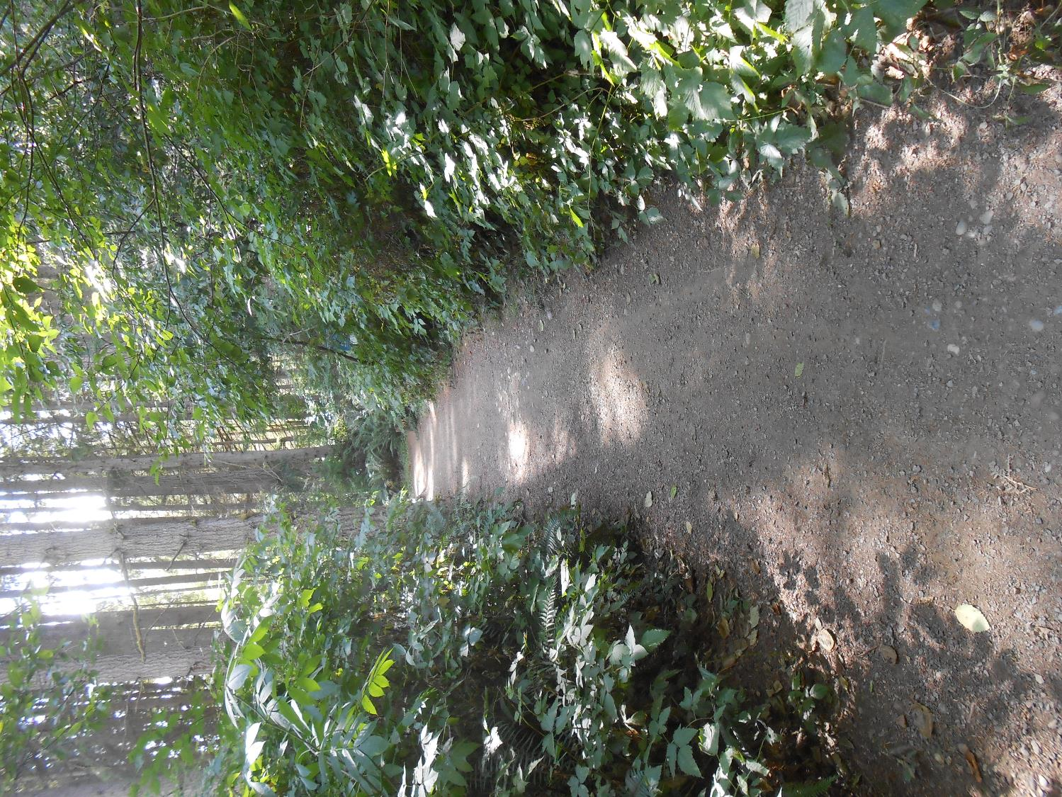
8/15/2015

Slide 18
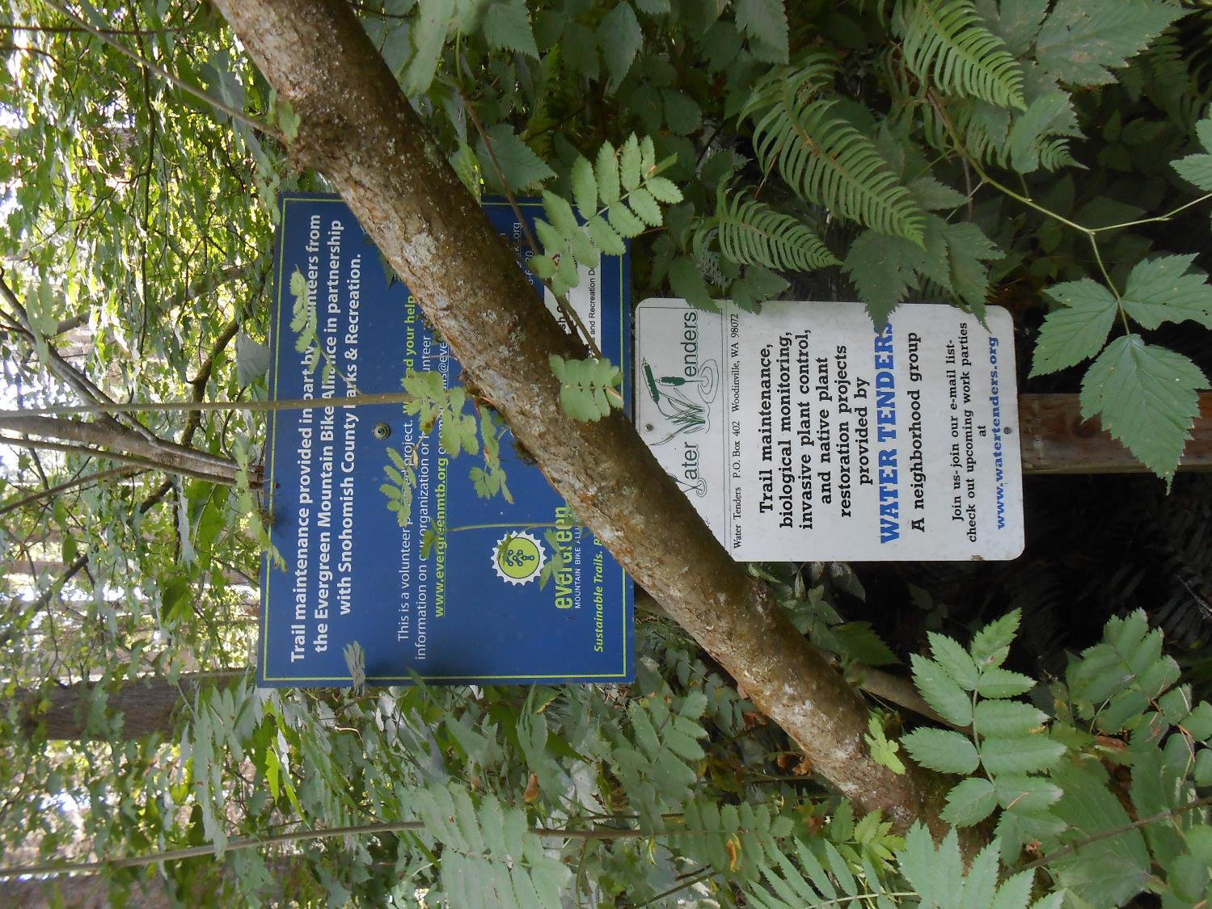
8/15/2015

Slide 19
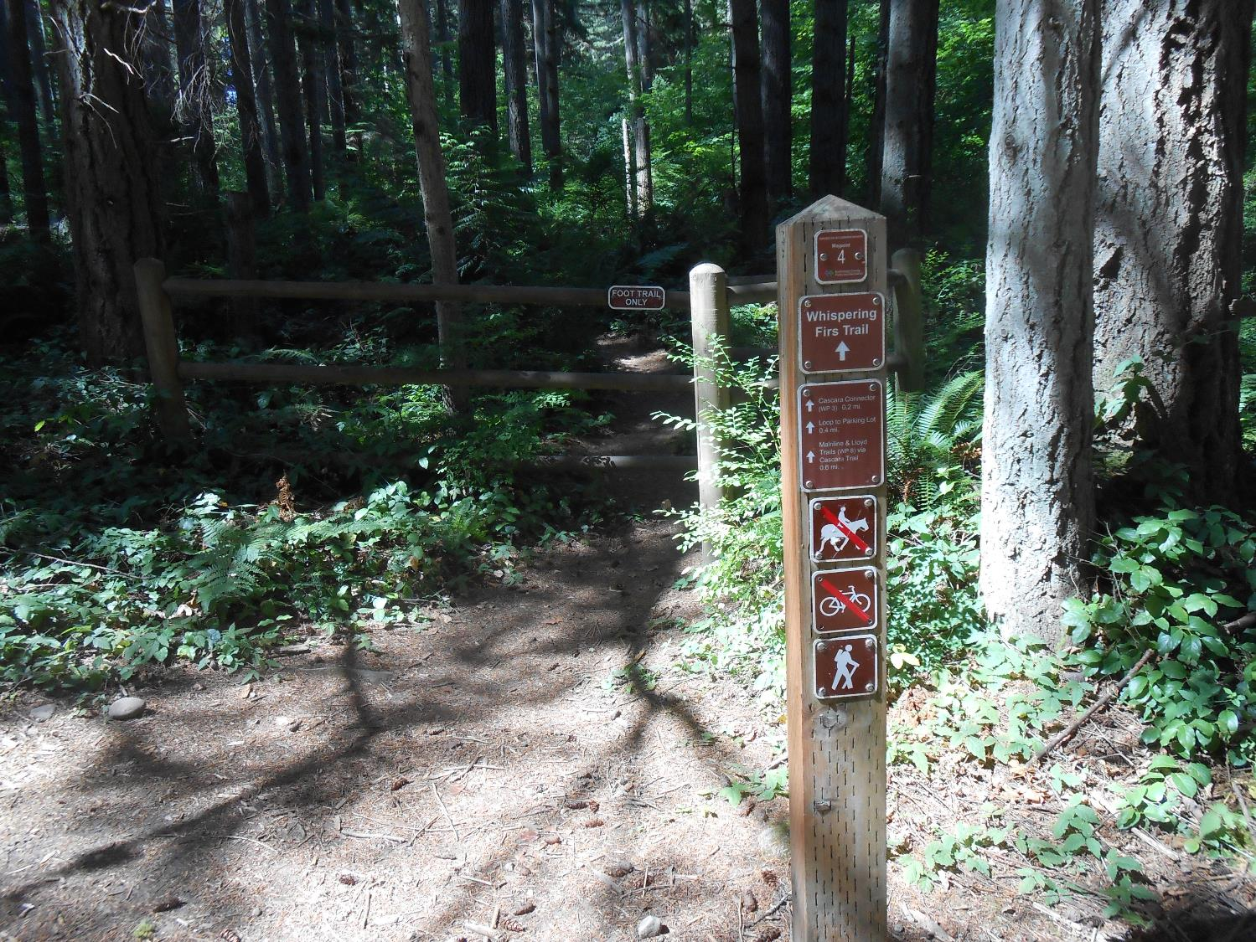
8/15/2015

Slide 20
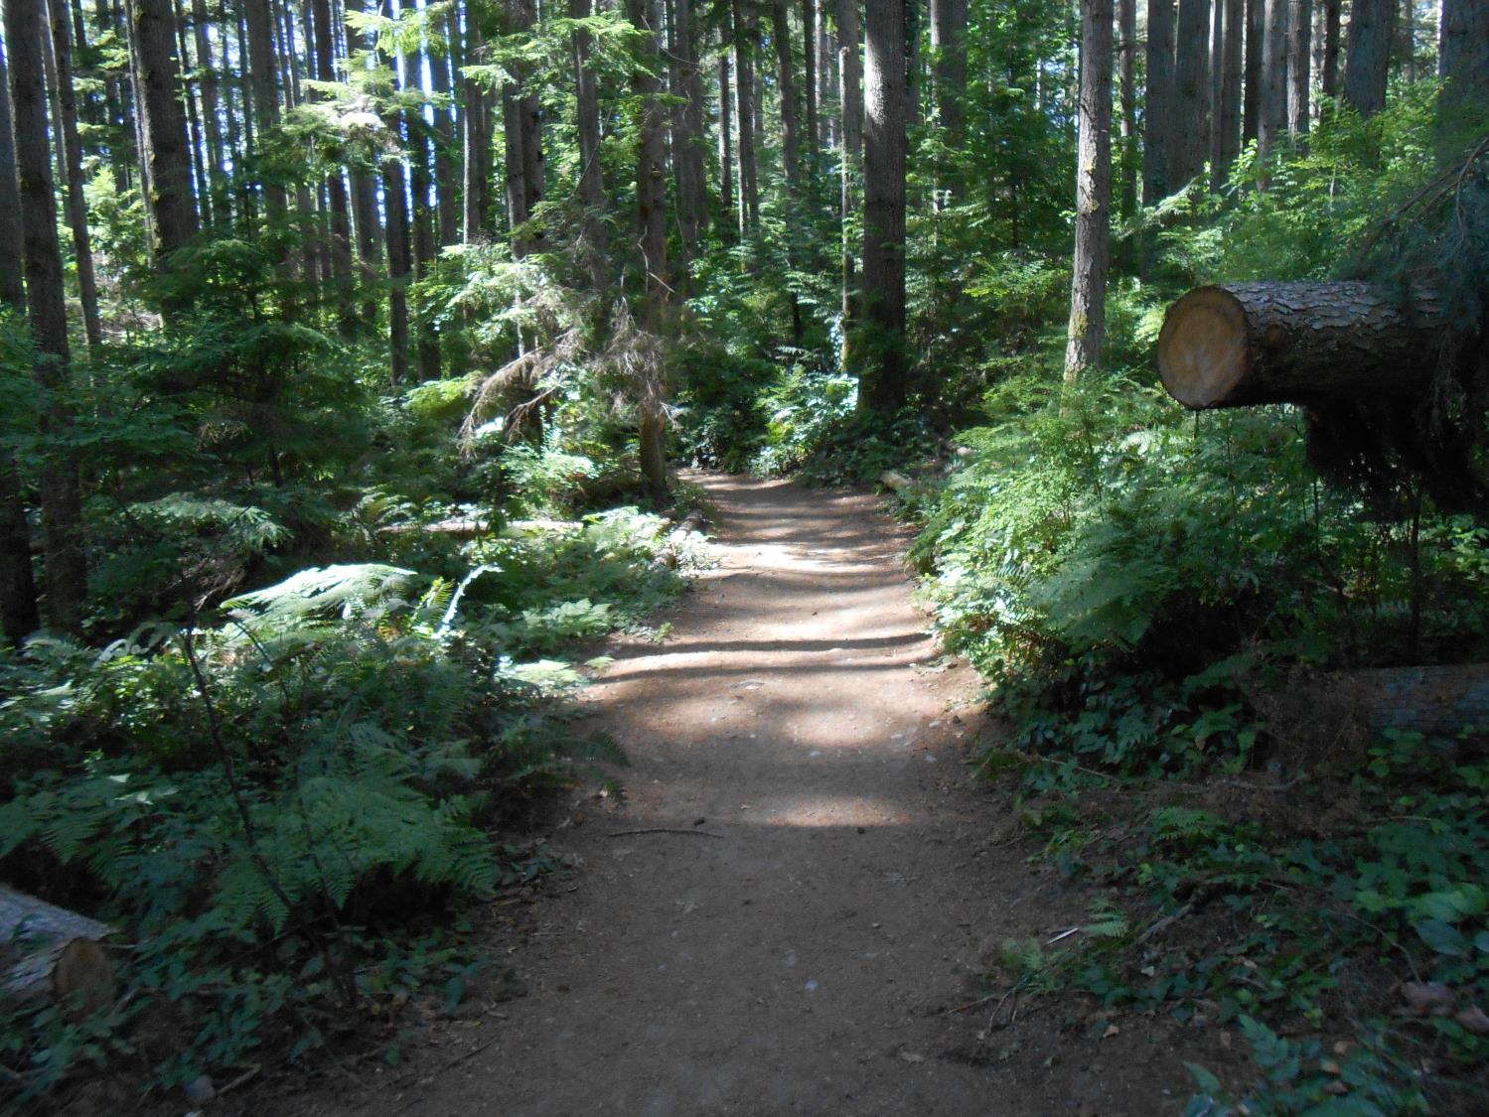
8/15/2015

Slide 21
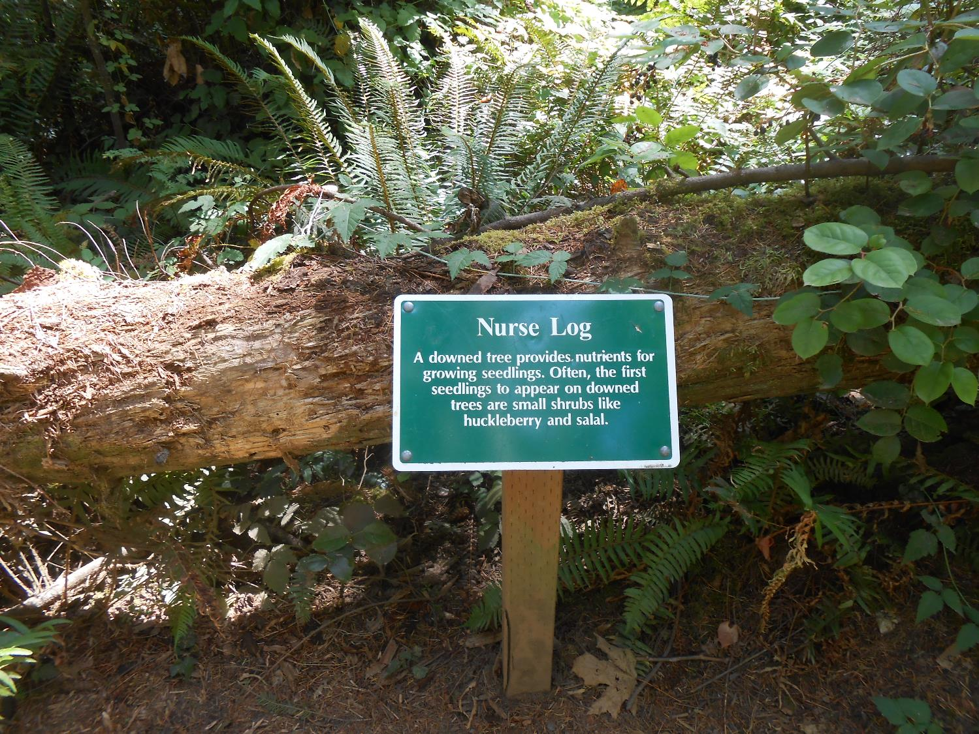
8/15/2015

Slide 22
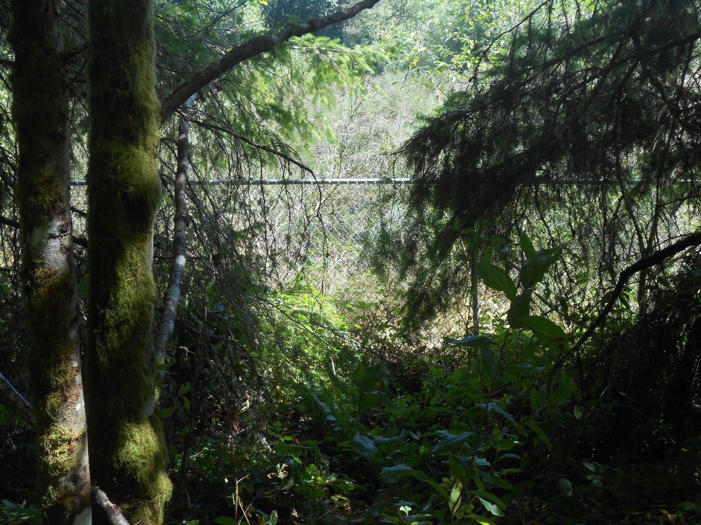
8/15/2015

Slide 23
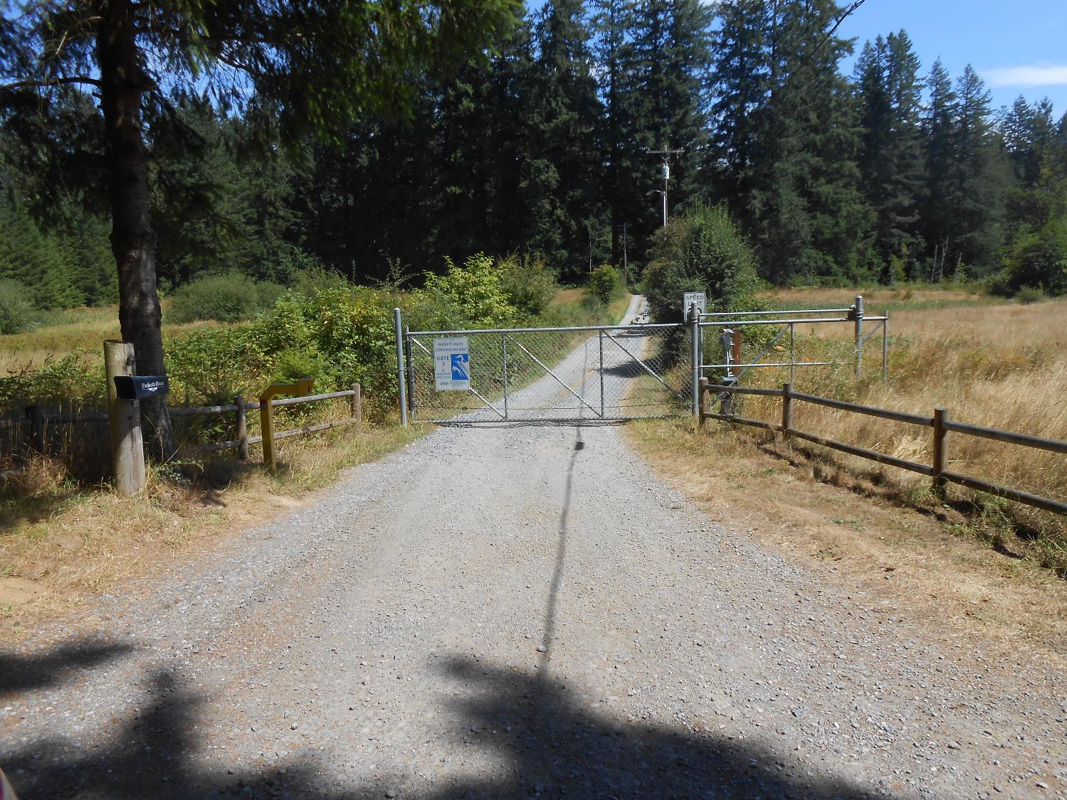
8/15/2015

Slide 24
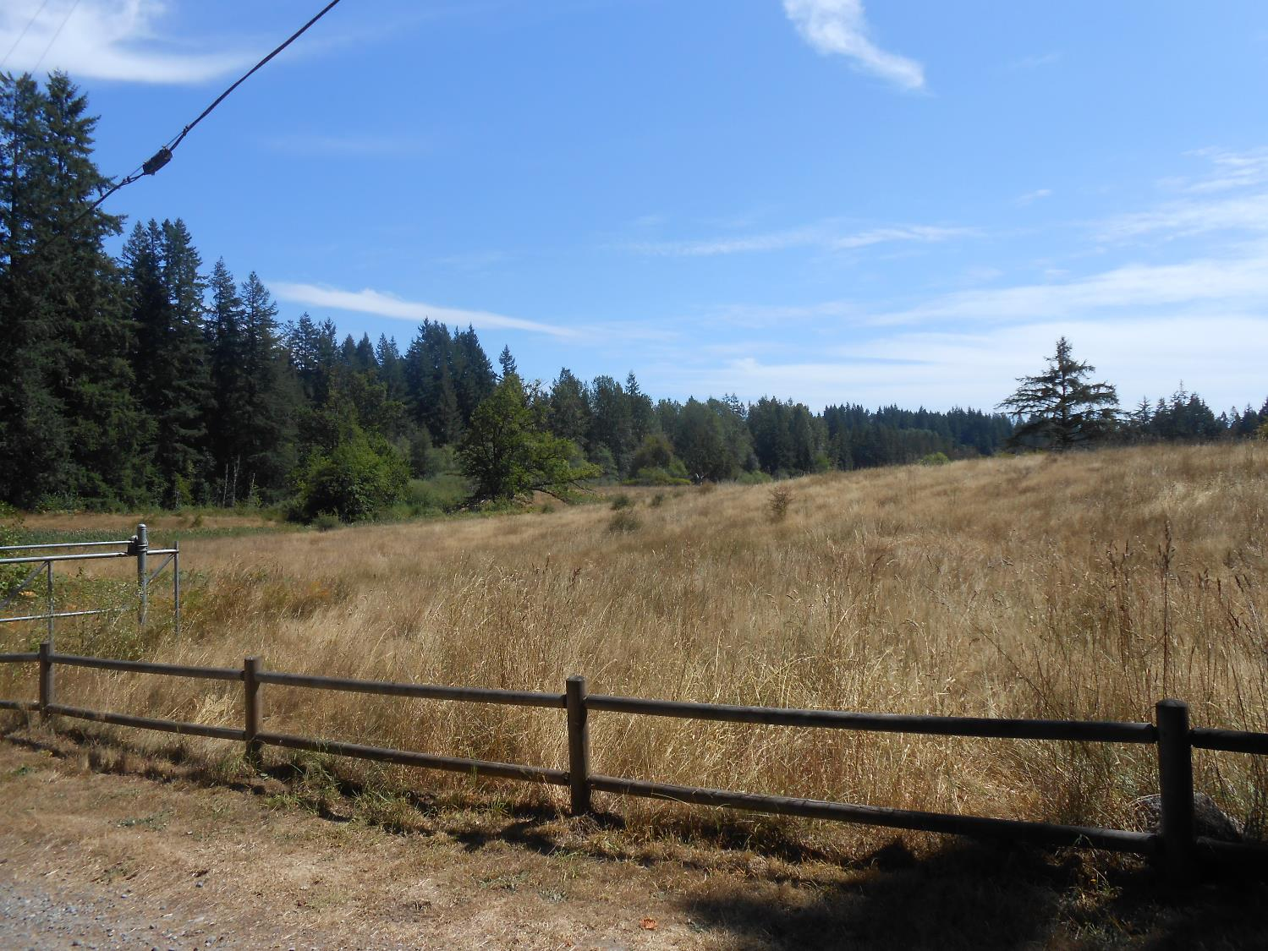
8/15/2015

Slide 25
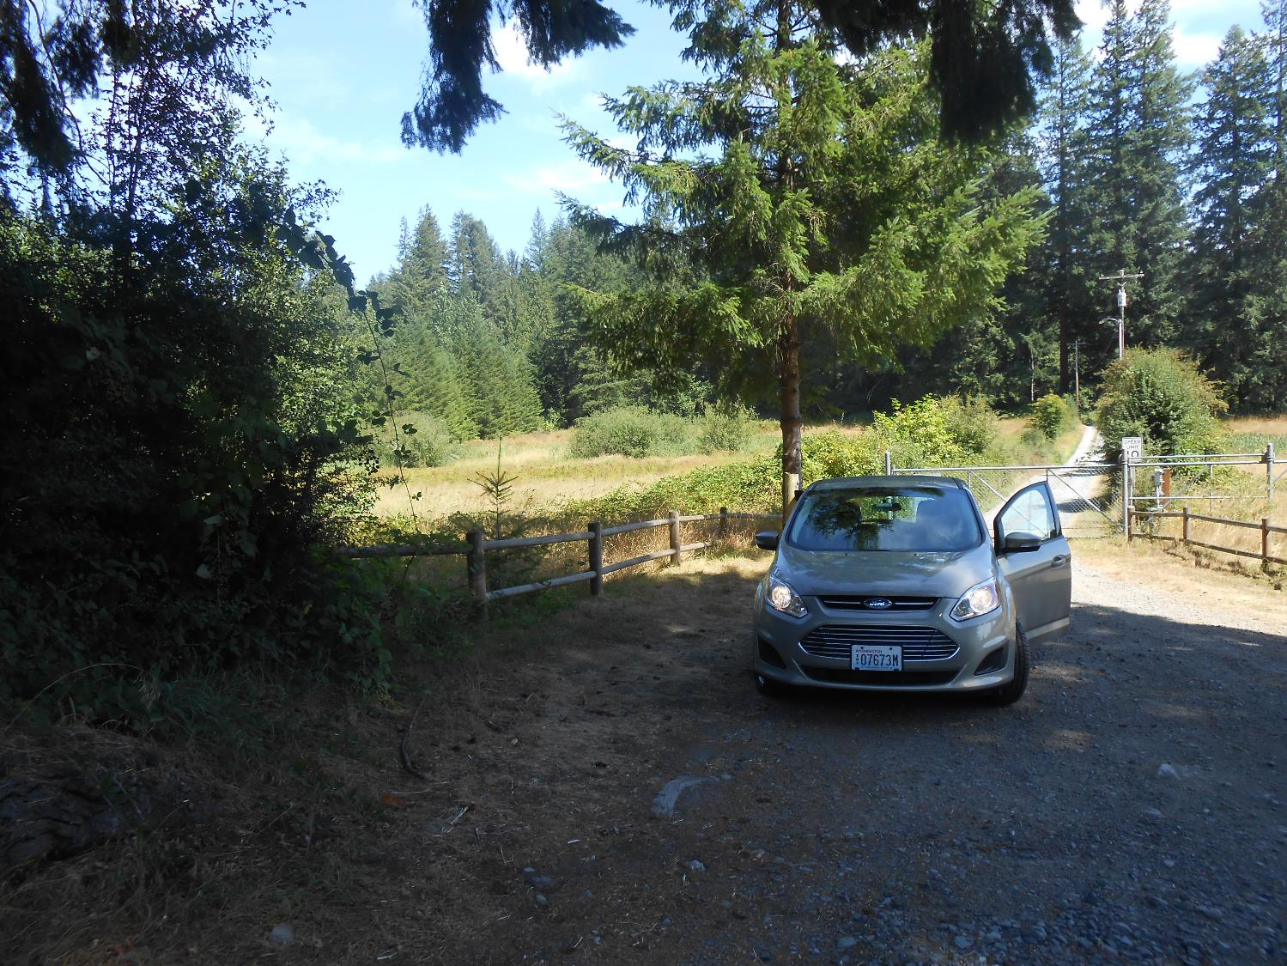
8/15/2015

Slide 26
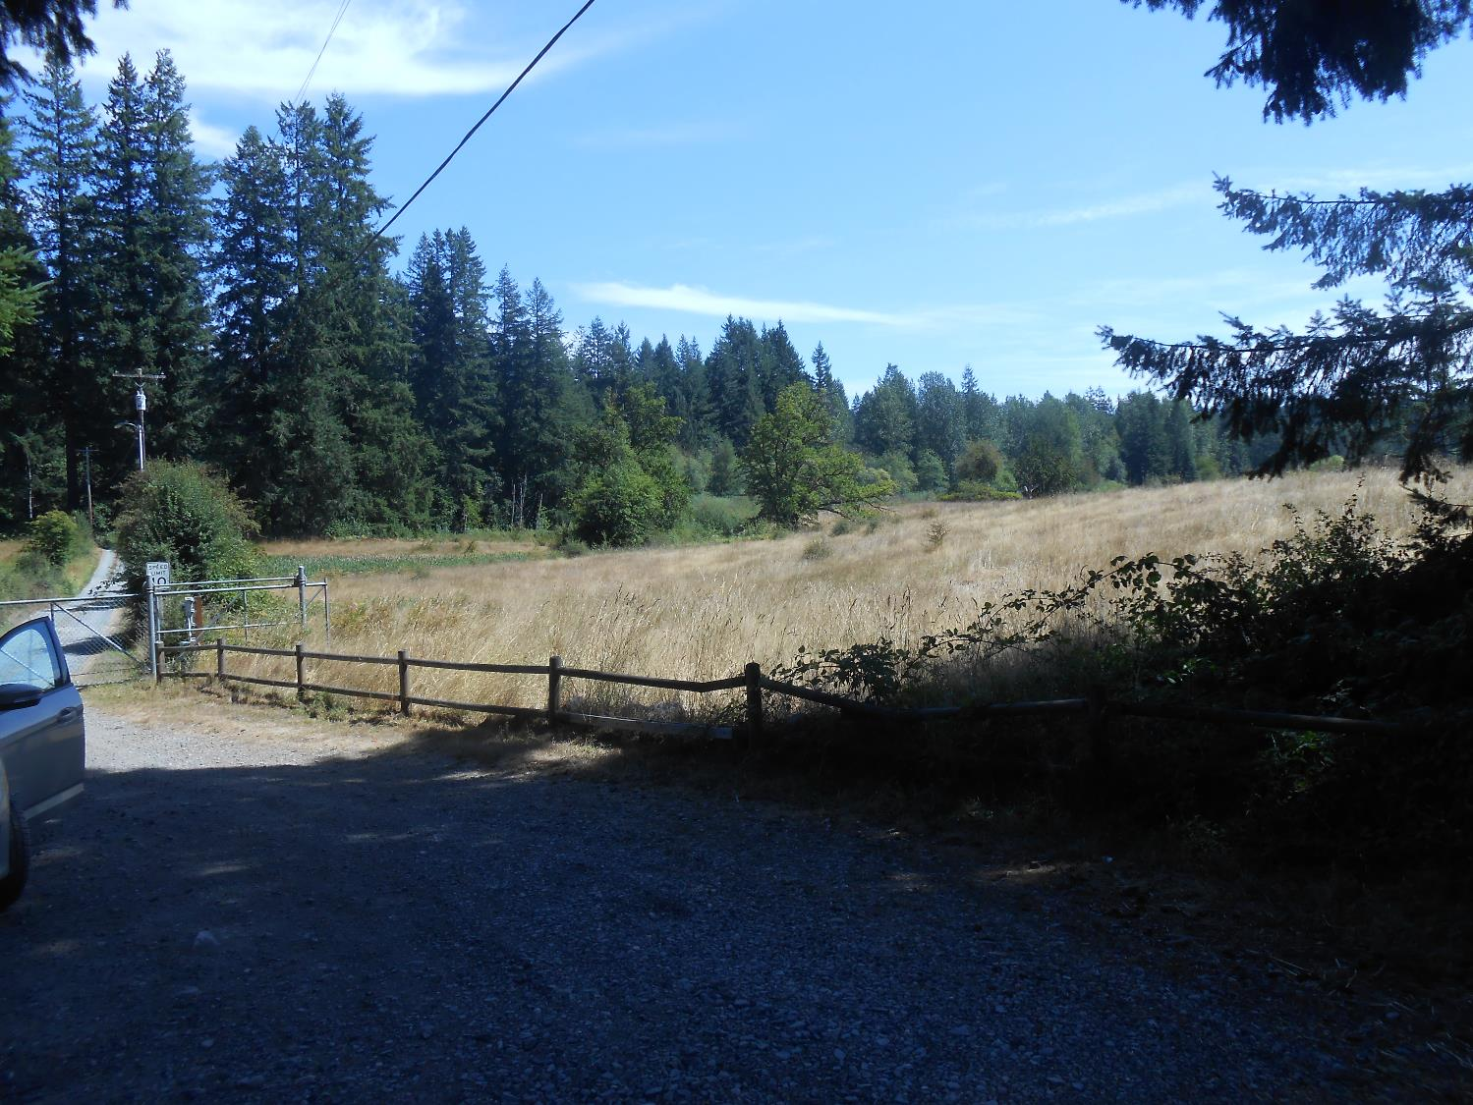
8/15/2015

Slide 27
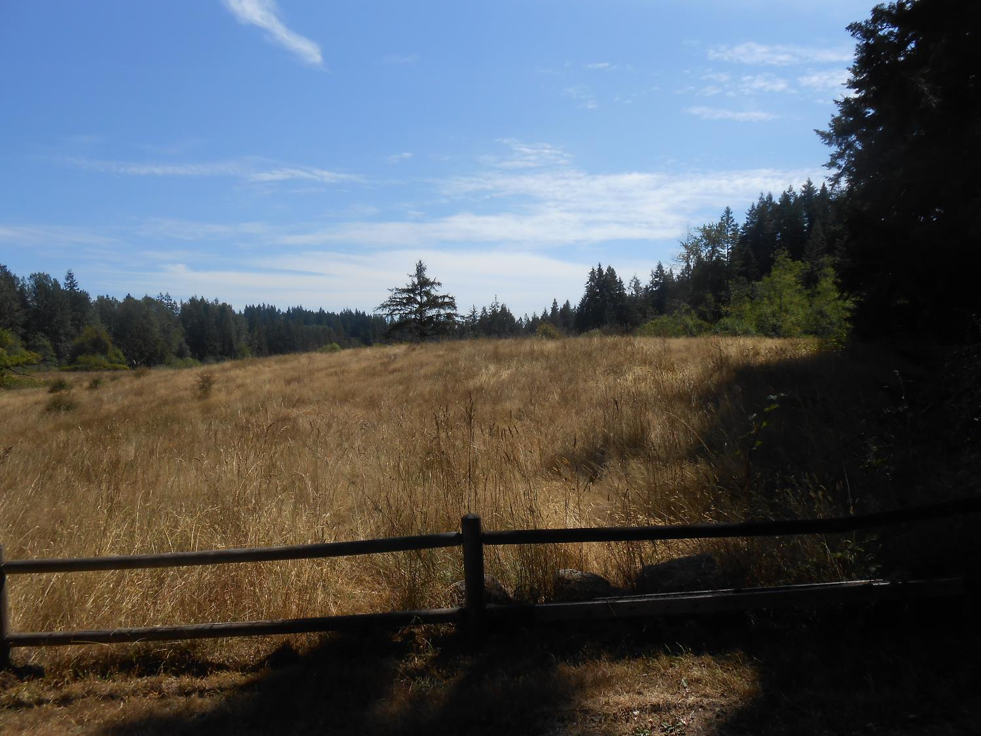
8/15/2015

Slide 28
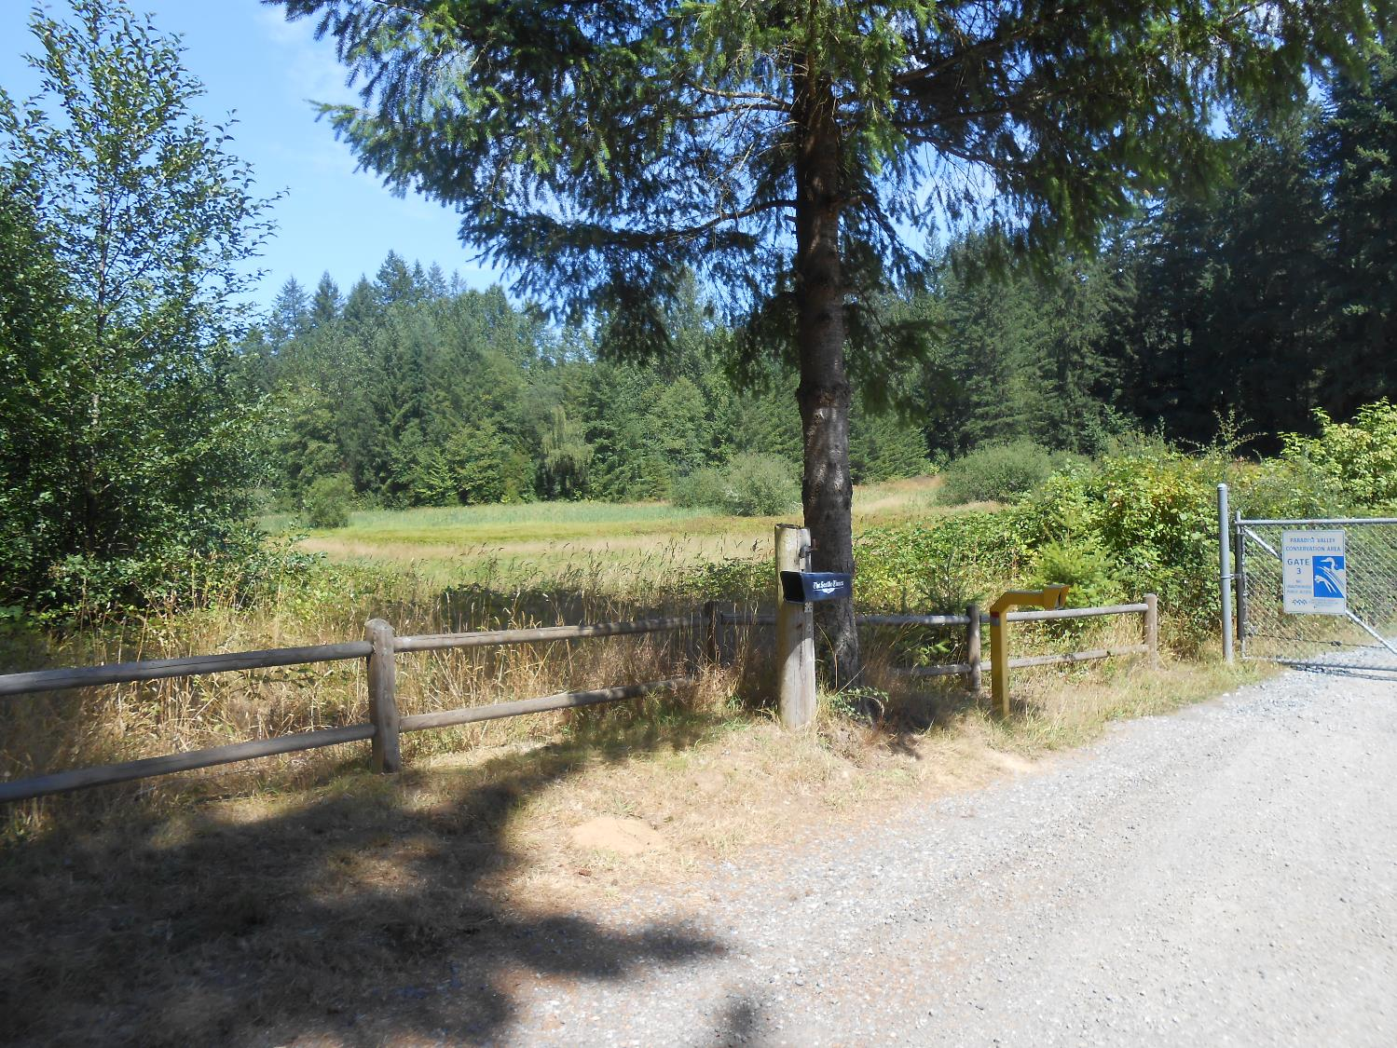
8/15/2015

Slide 29
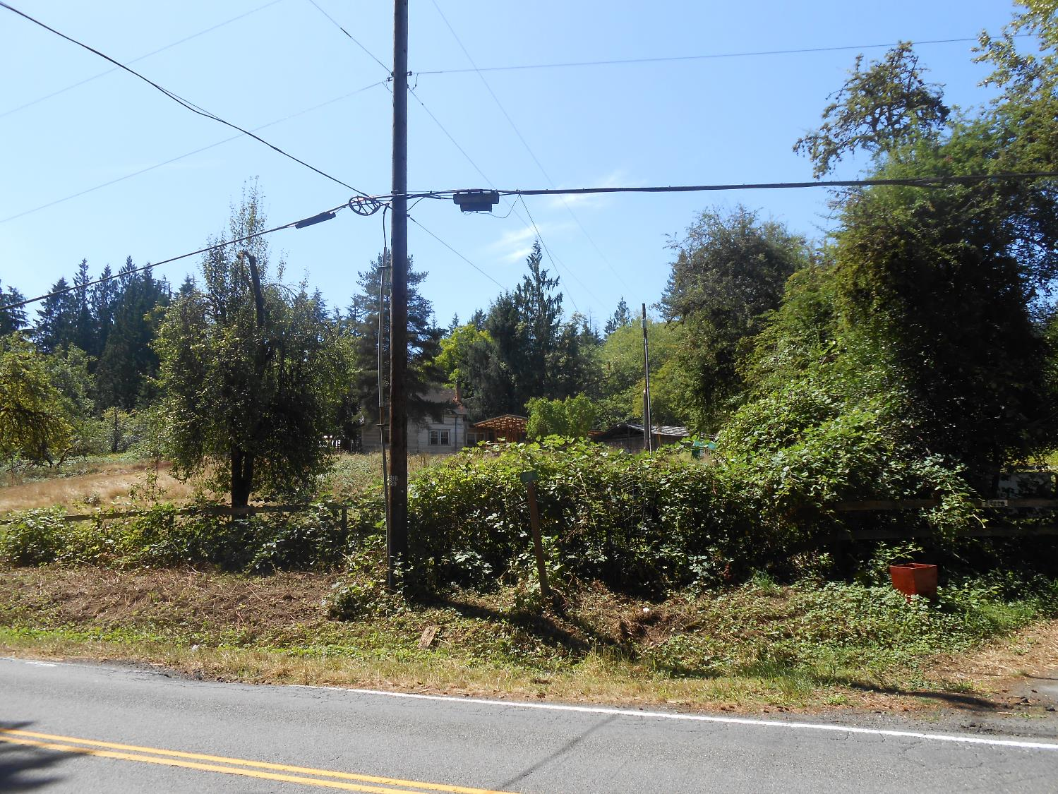
8/15/2015

Slide 30
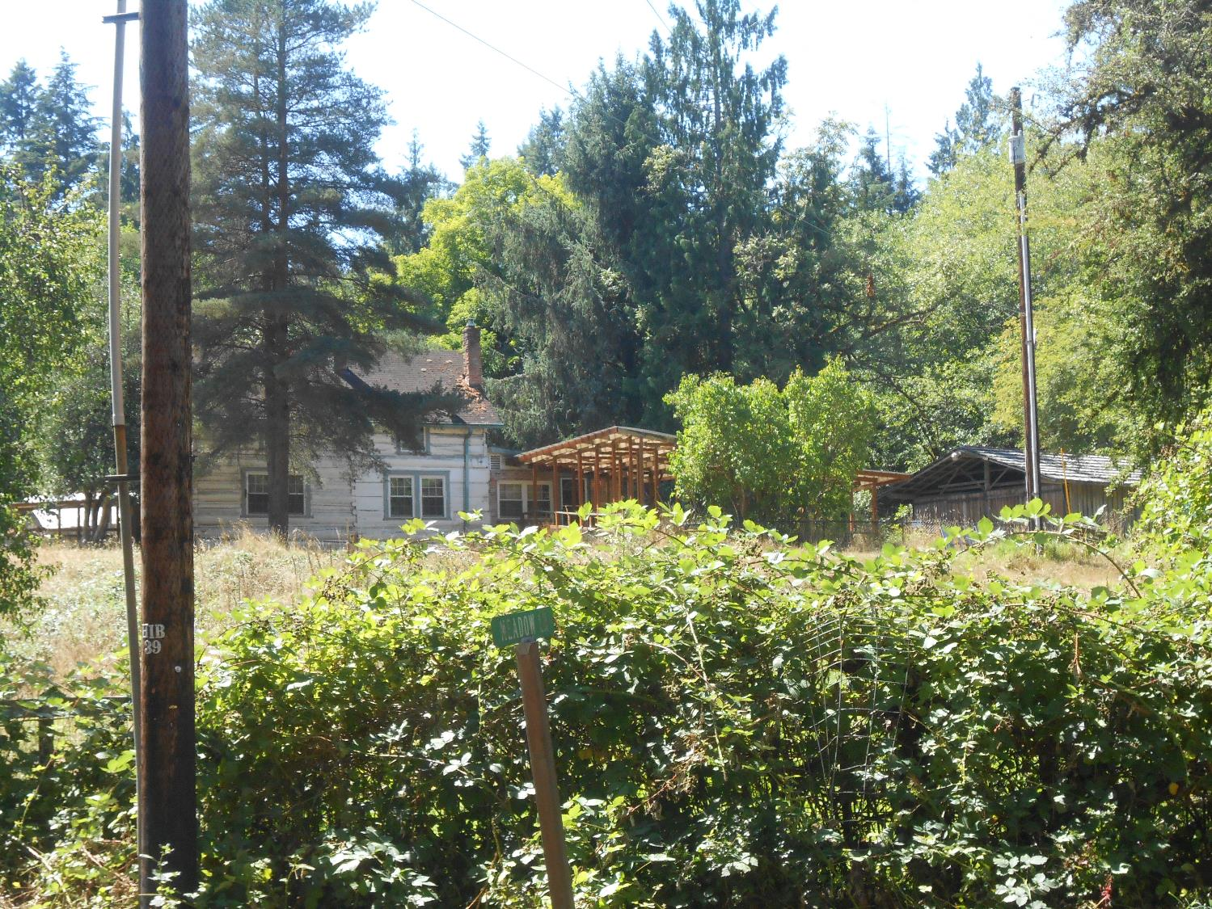
8/15/2015

Slide 31
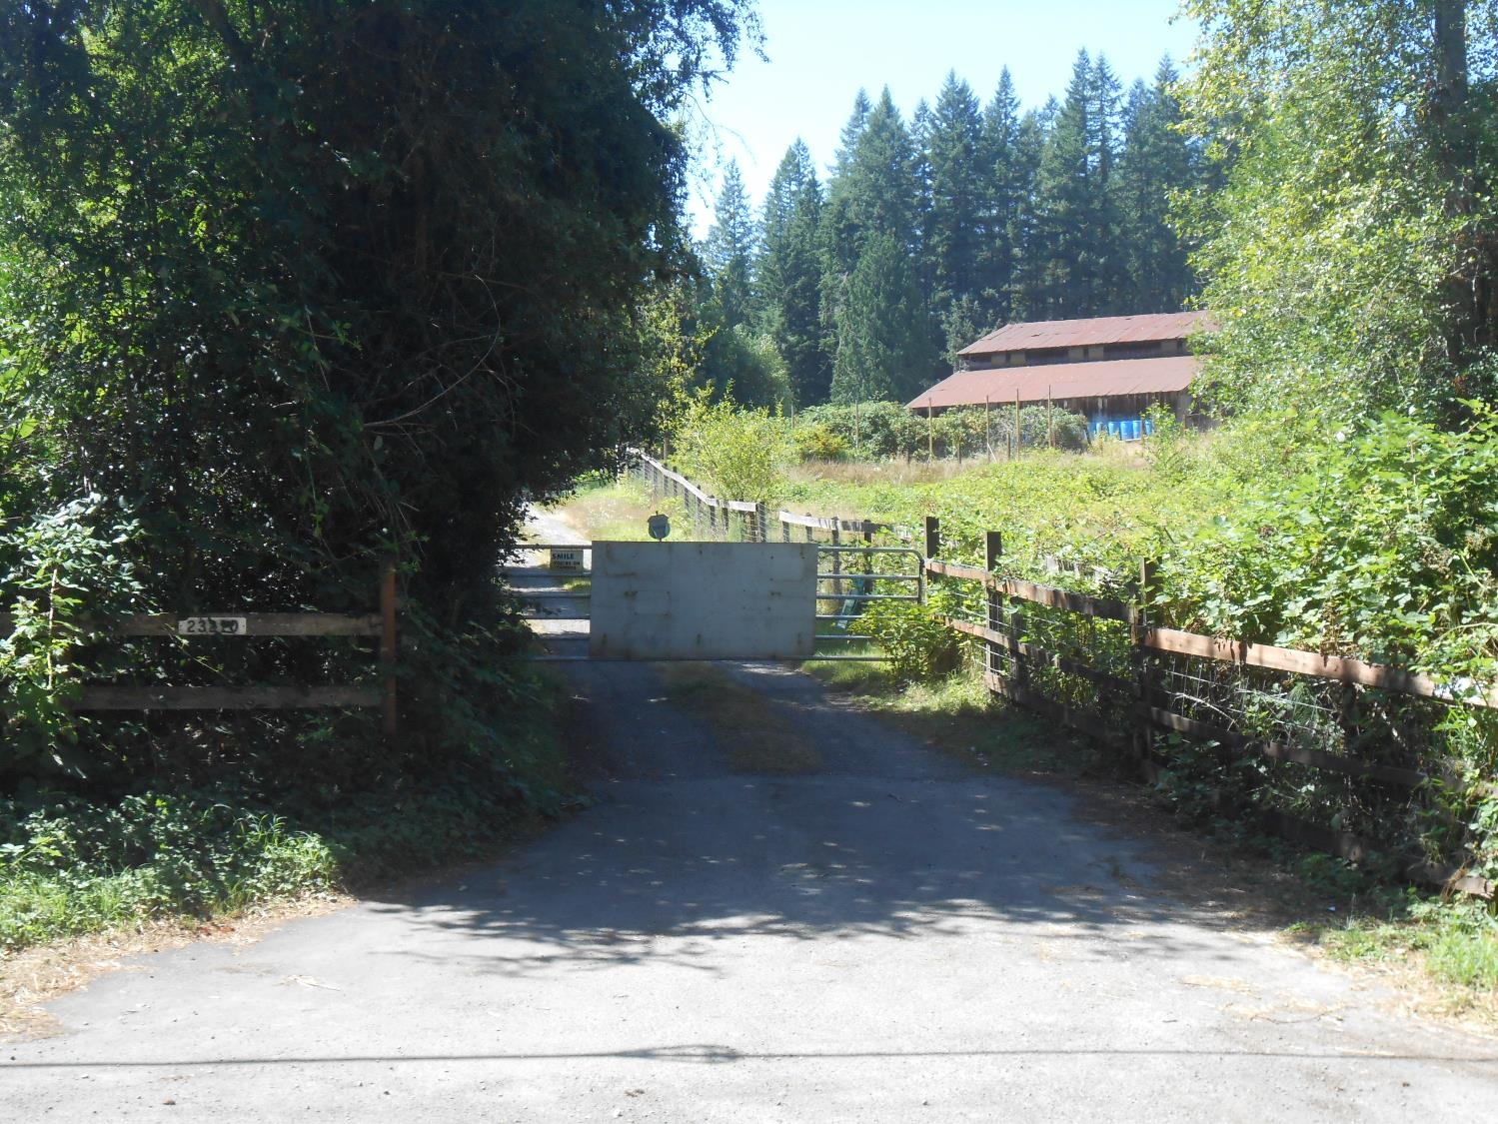
8/15/2015

Slide 32
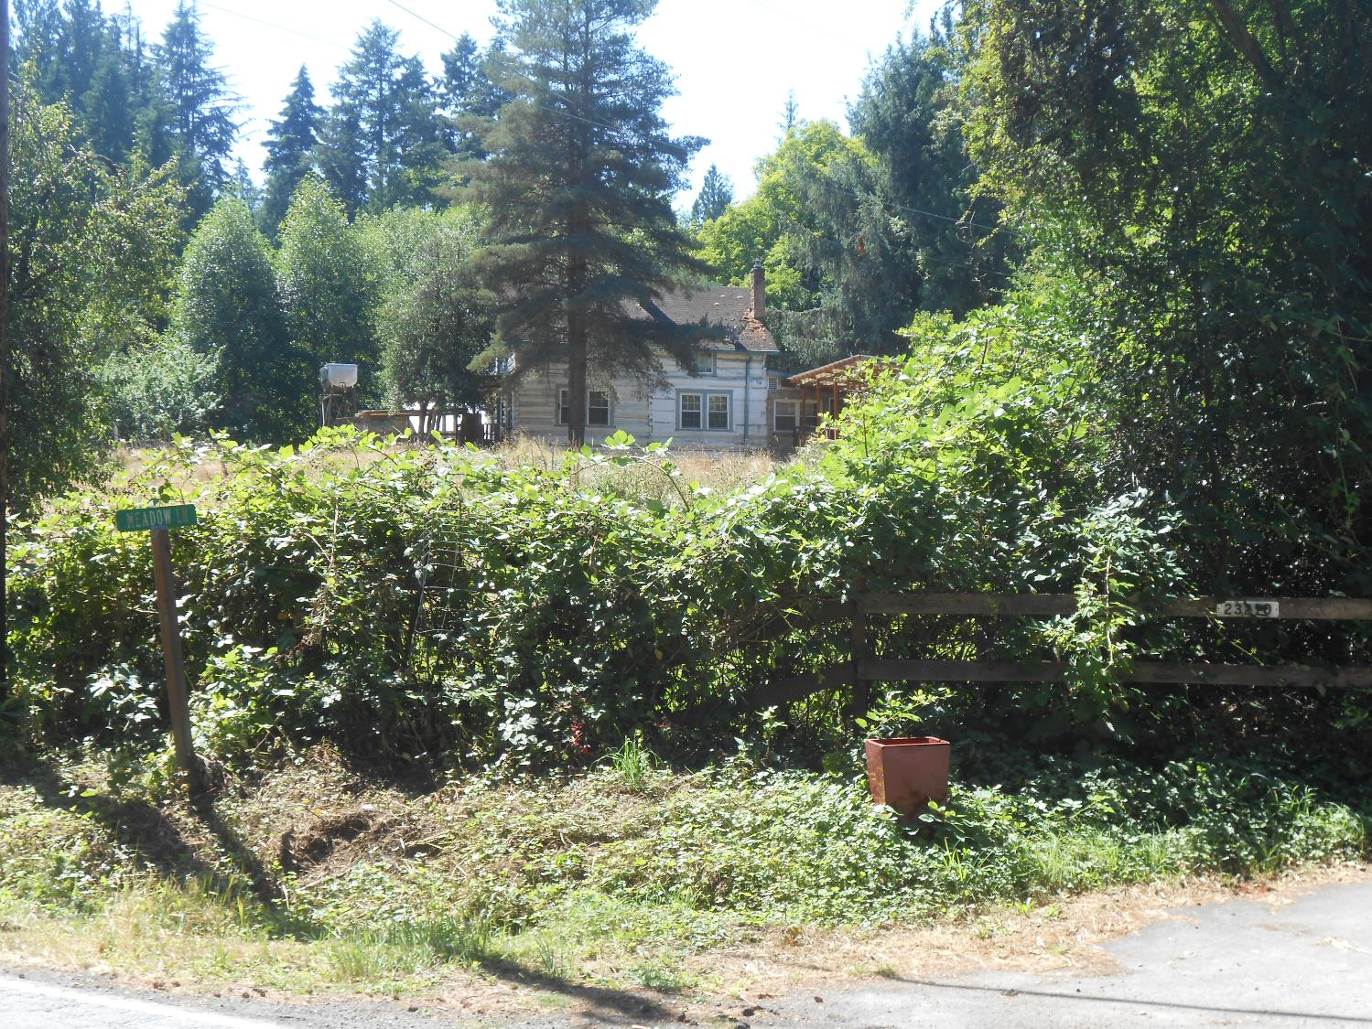
8/15/2015

Slide 33
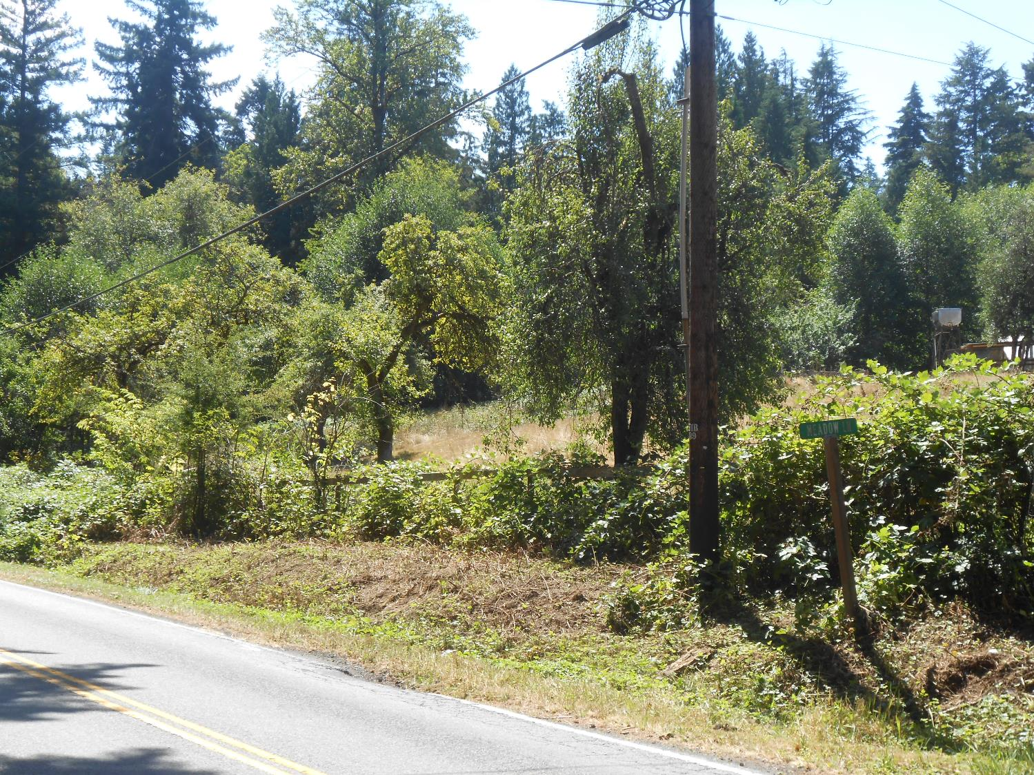
8/15/2015

