Slide 1
Ala Spit Flood Photos – 96-010, 05-1491, 08-1864, 12-1260 & 14-1108
by Island County Staff
March 10-11, 2016

Slide 2
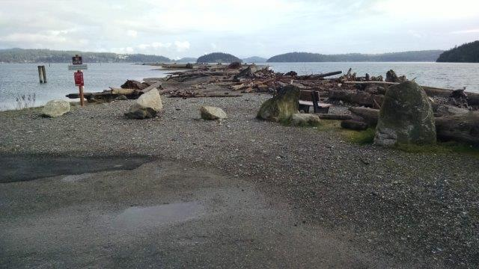

Slide 3
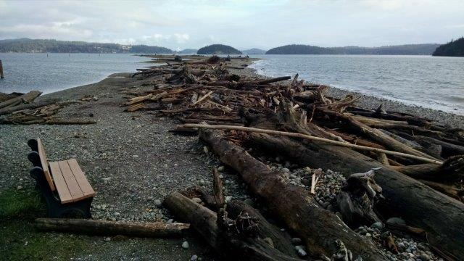

Slide 4
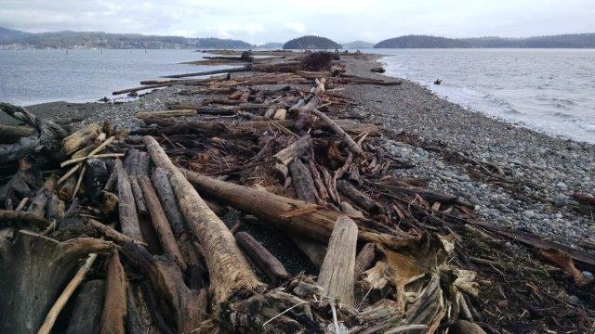

Slide 5
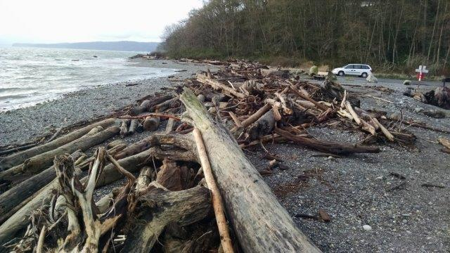

Slide 6
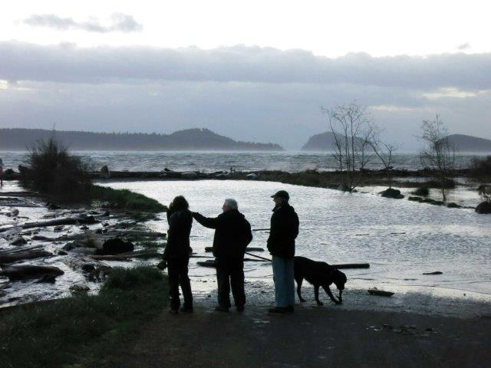

Slide 7
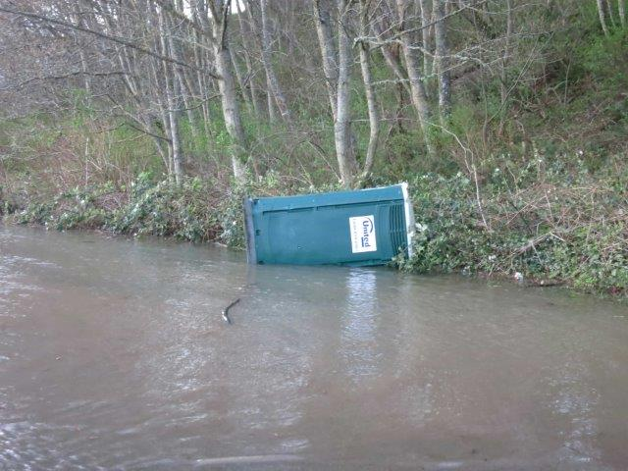

Slide 8
