Slide 1
08-1962 North Road Culvert Replacement
by Marc Duboiski
Final Inspection
April 5, 2011

Slide 2
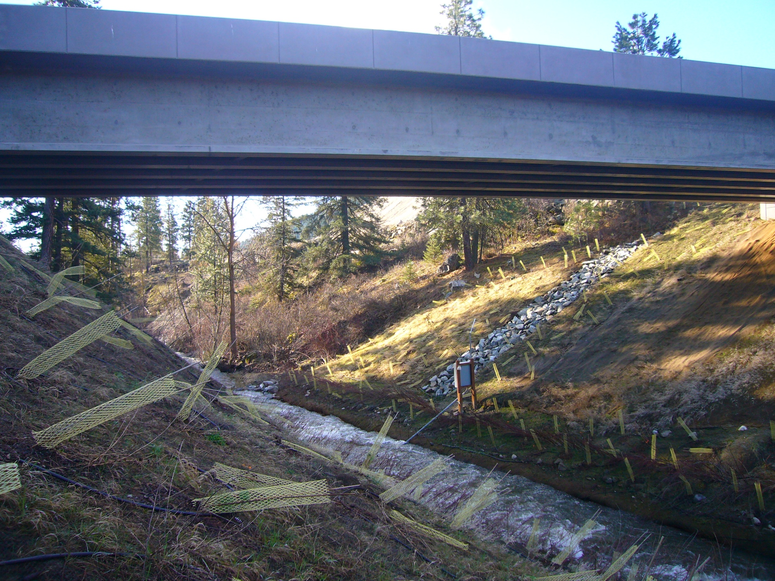

Slide 3
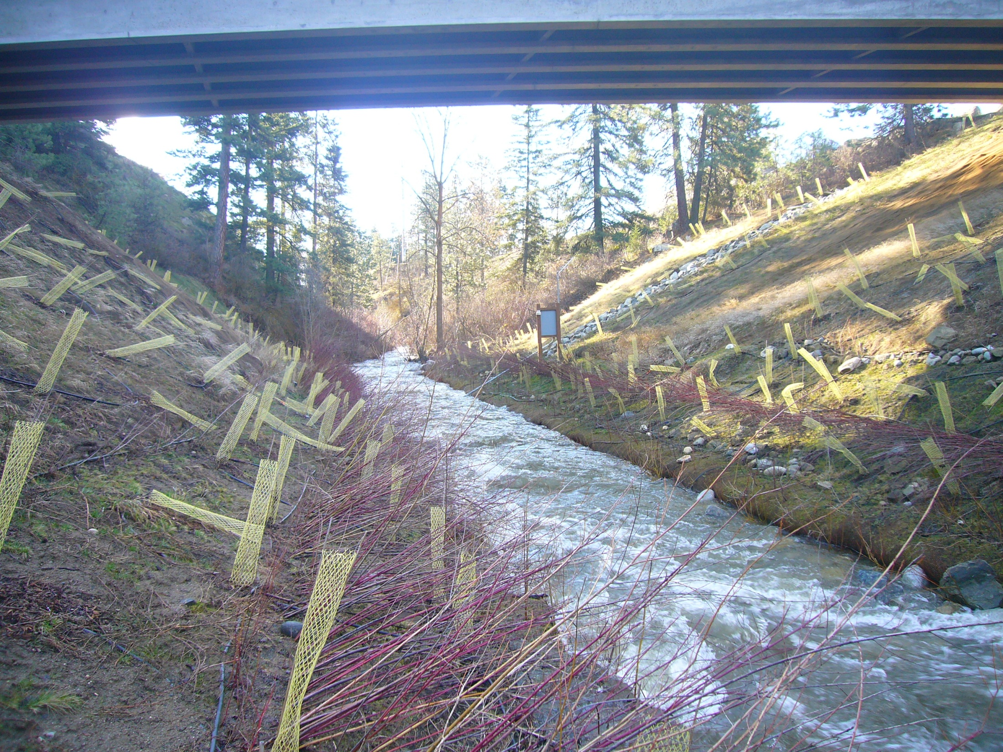

Slide 4
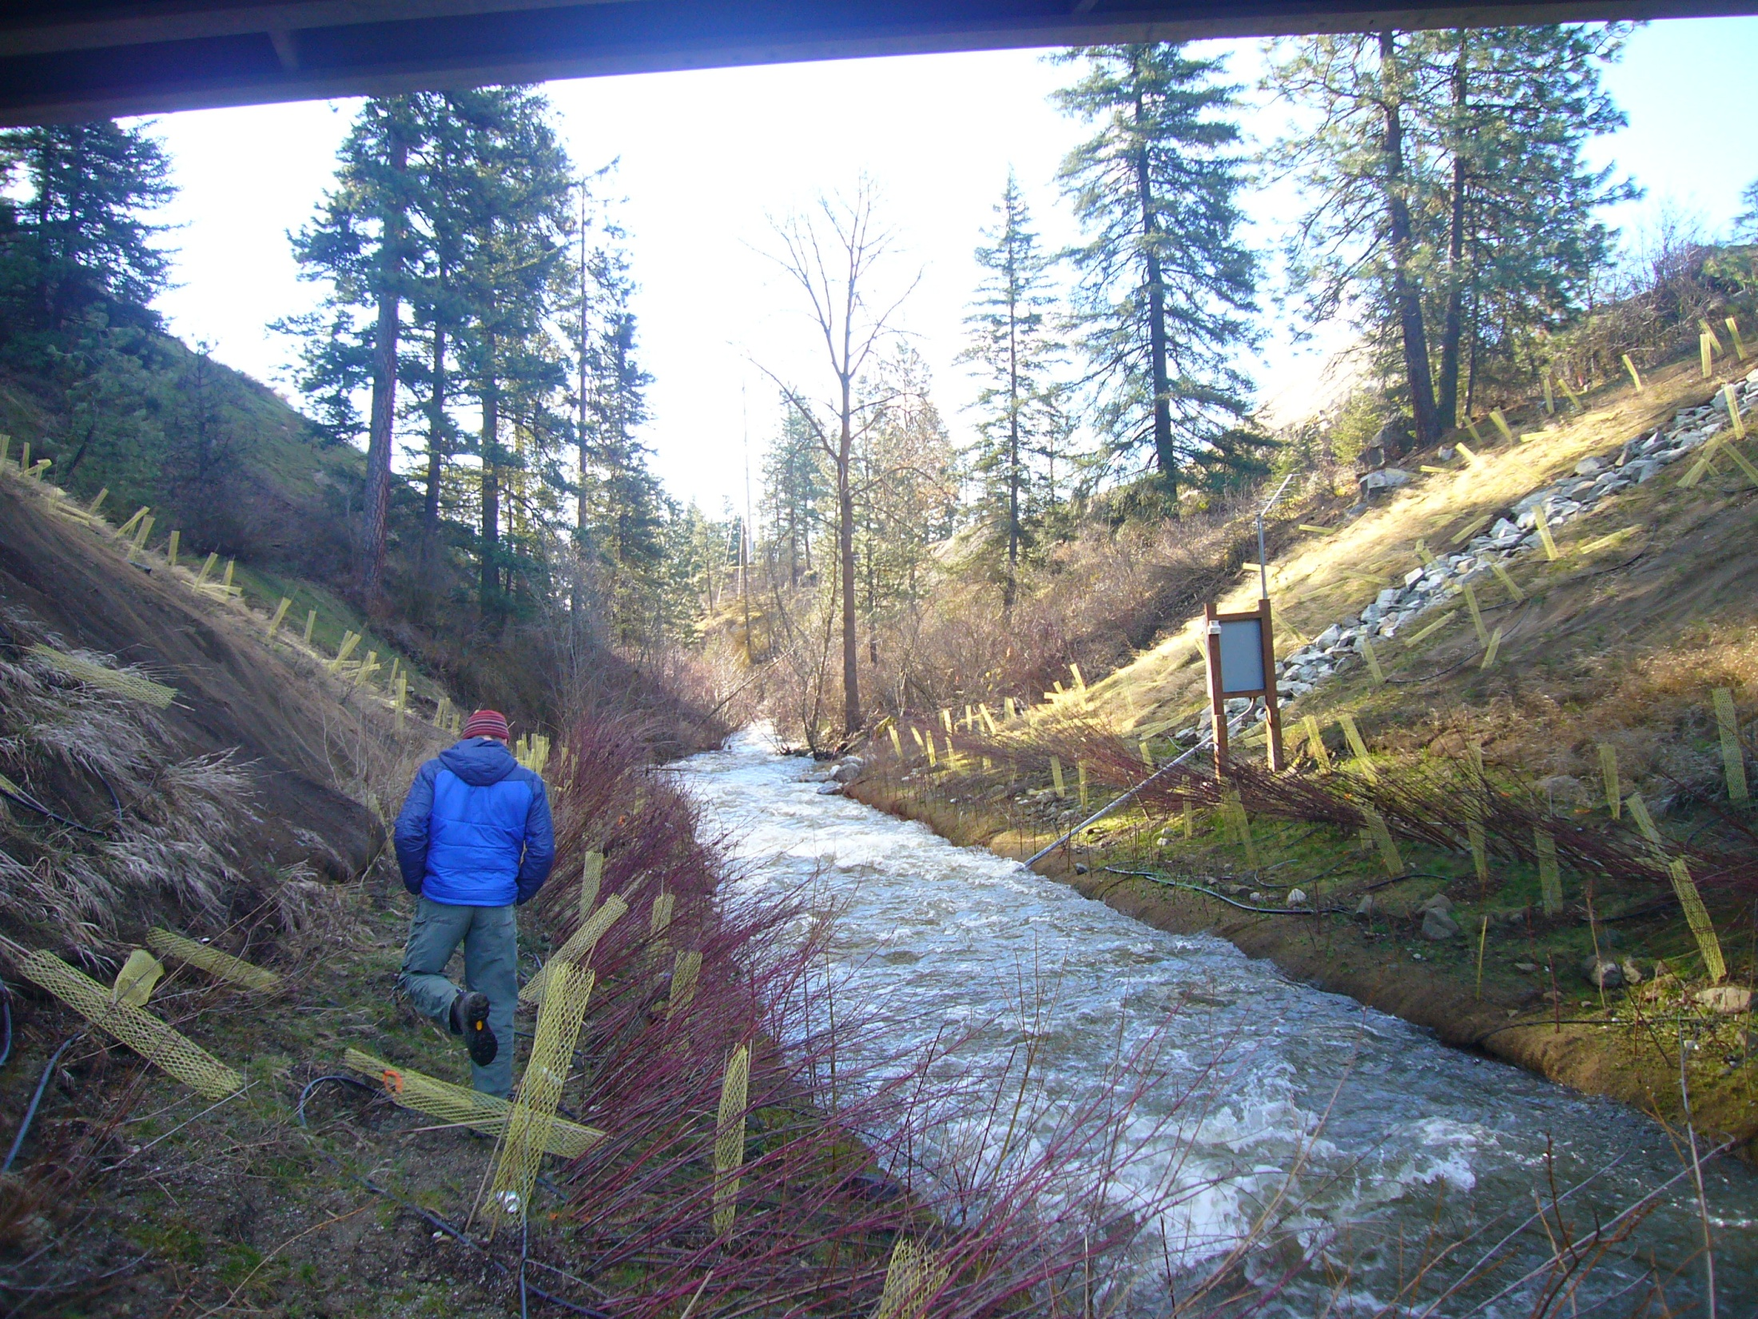

Slide 5
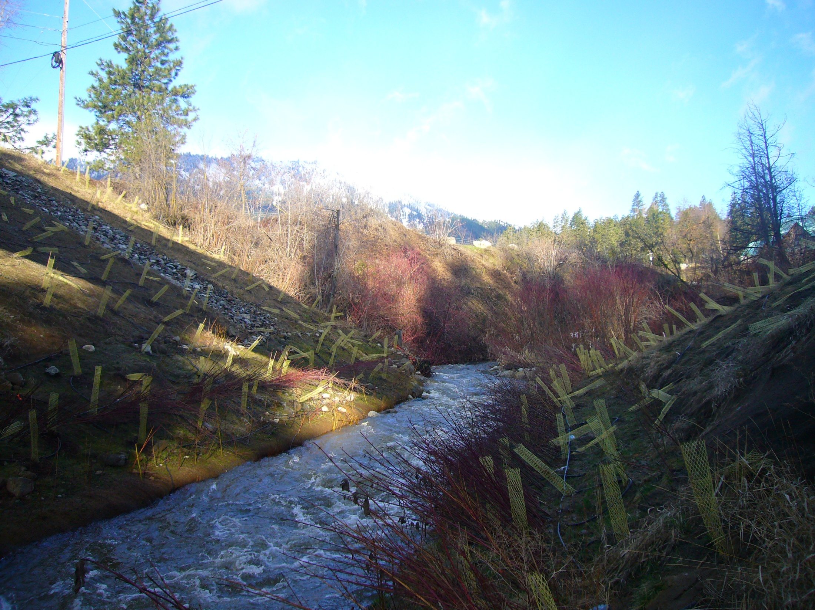

Slide 6
