Slide 1
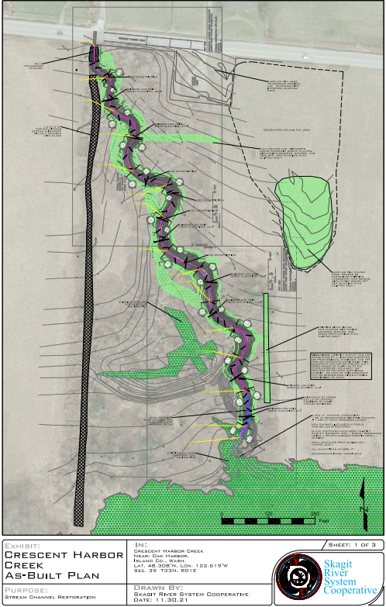
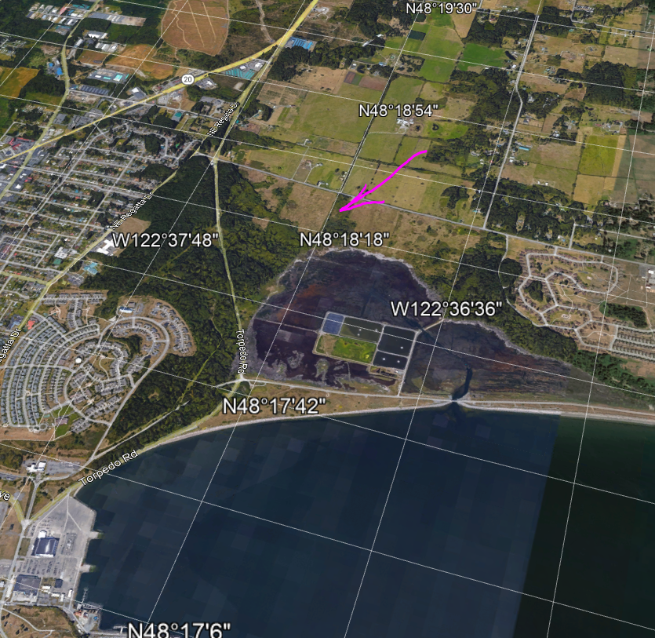
18-1366 Crescent Harbor Creek Restoration

Slide 2
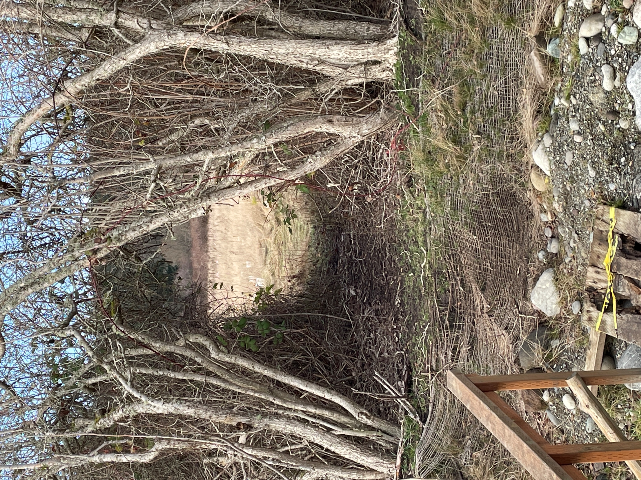
Photos for Close out field Inspection 1/23/2023
Roughened channel, raised streambed
Riparian planting adjacent and west of stream

Slide 3
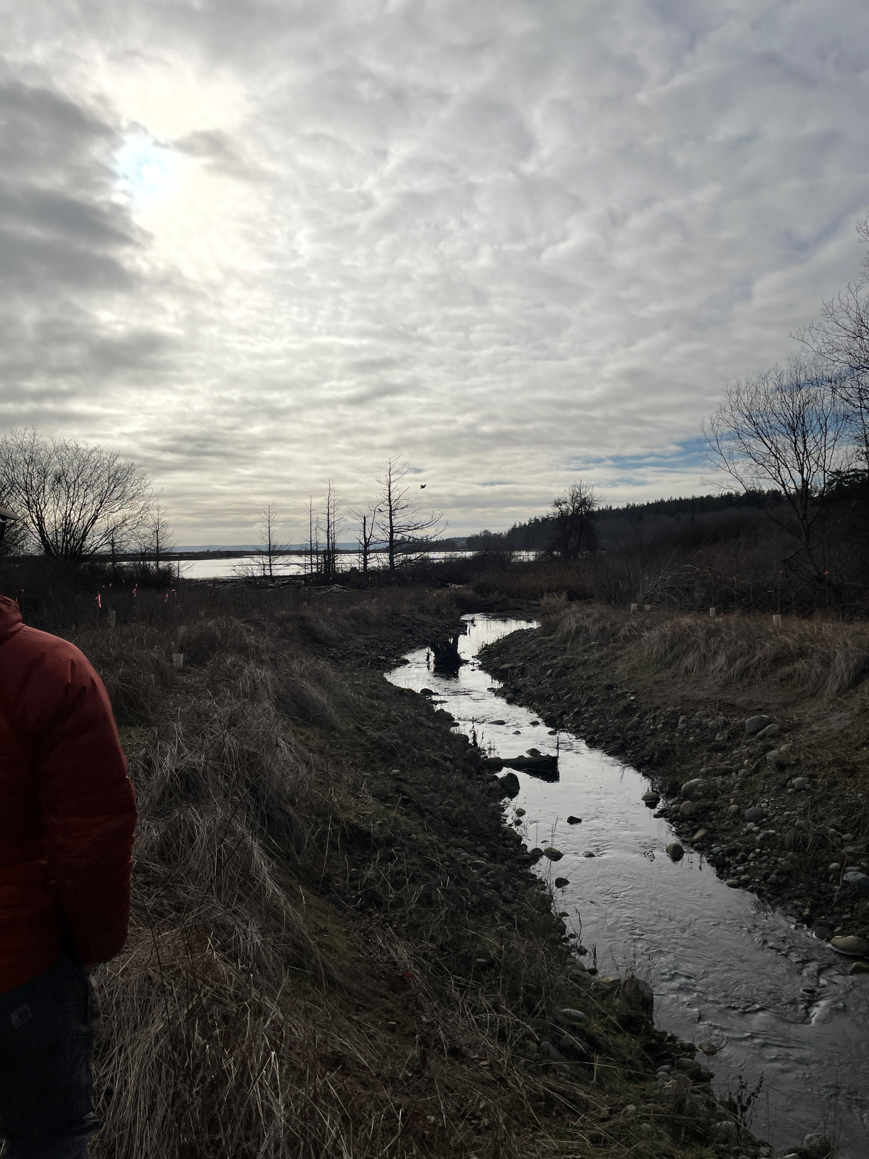
Instream structures and meander

Slide 4
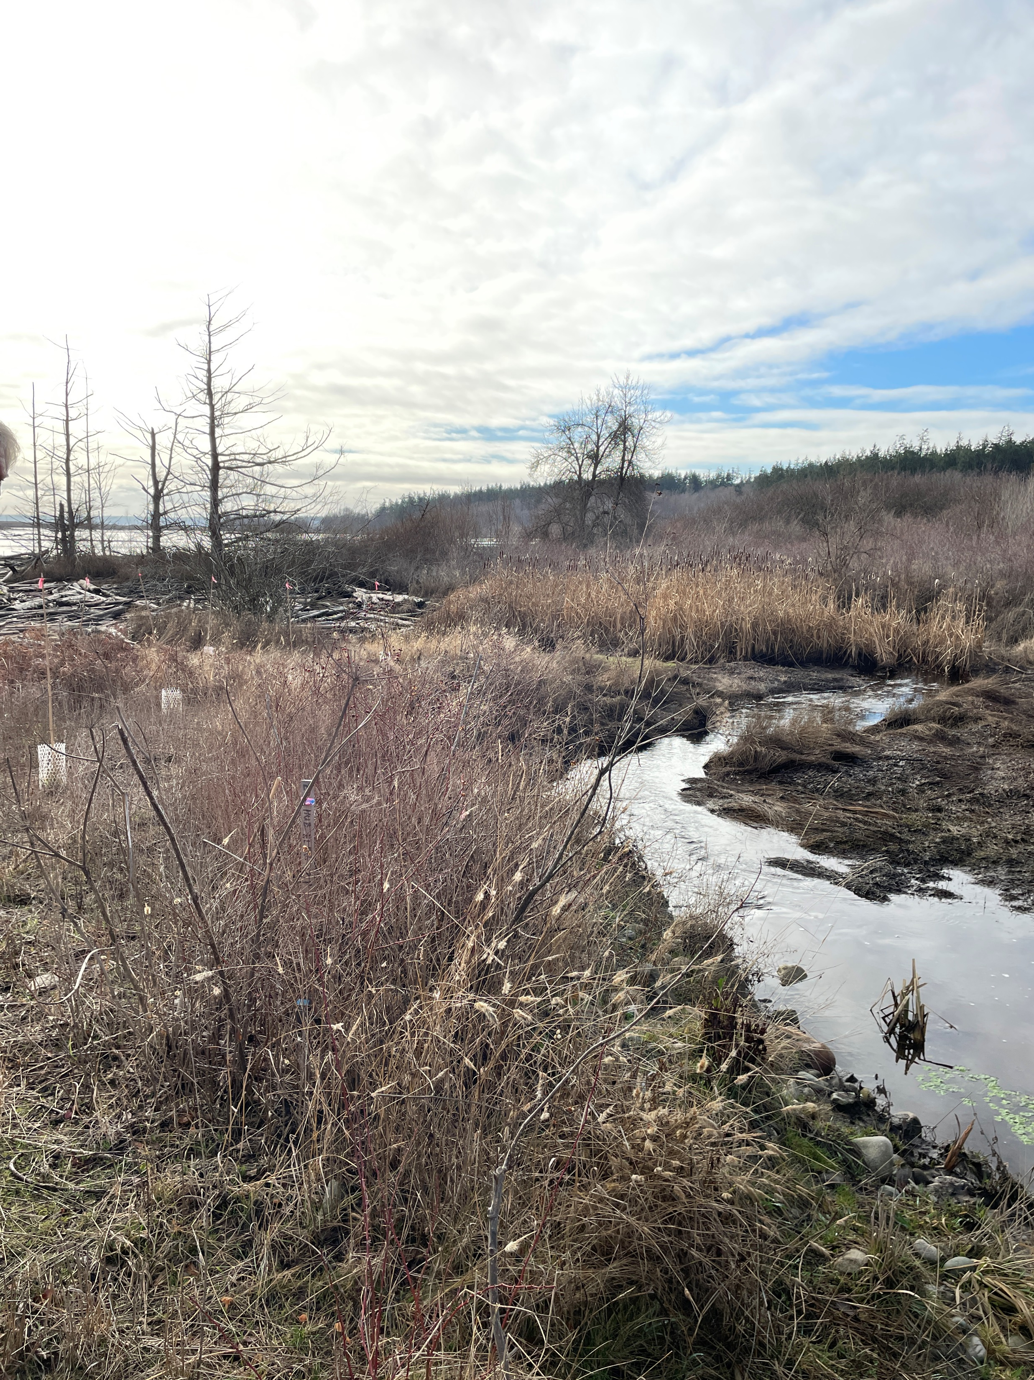
Instream structures, pools, meander and connection to estuary

Slide 5
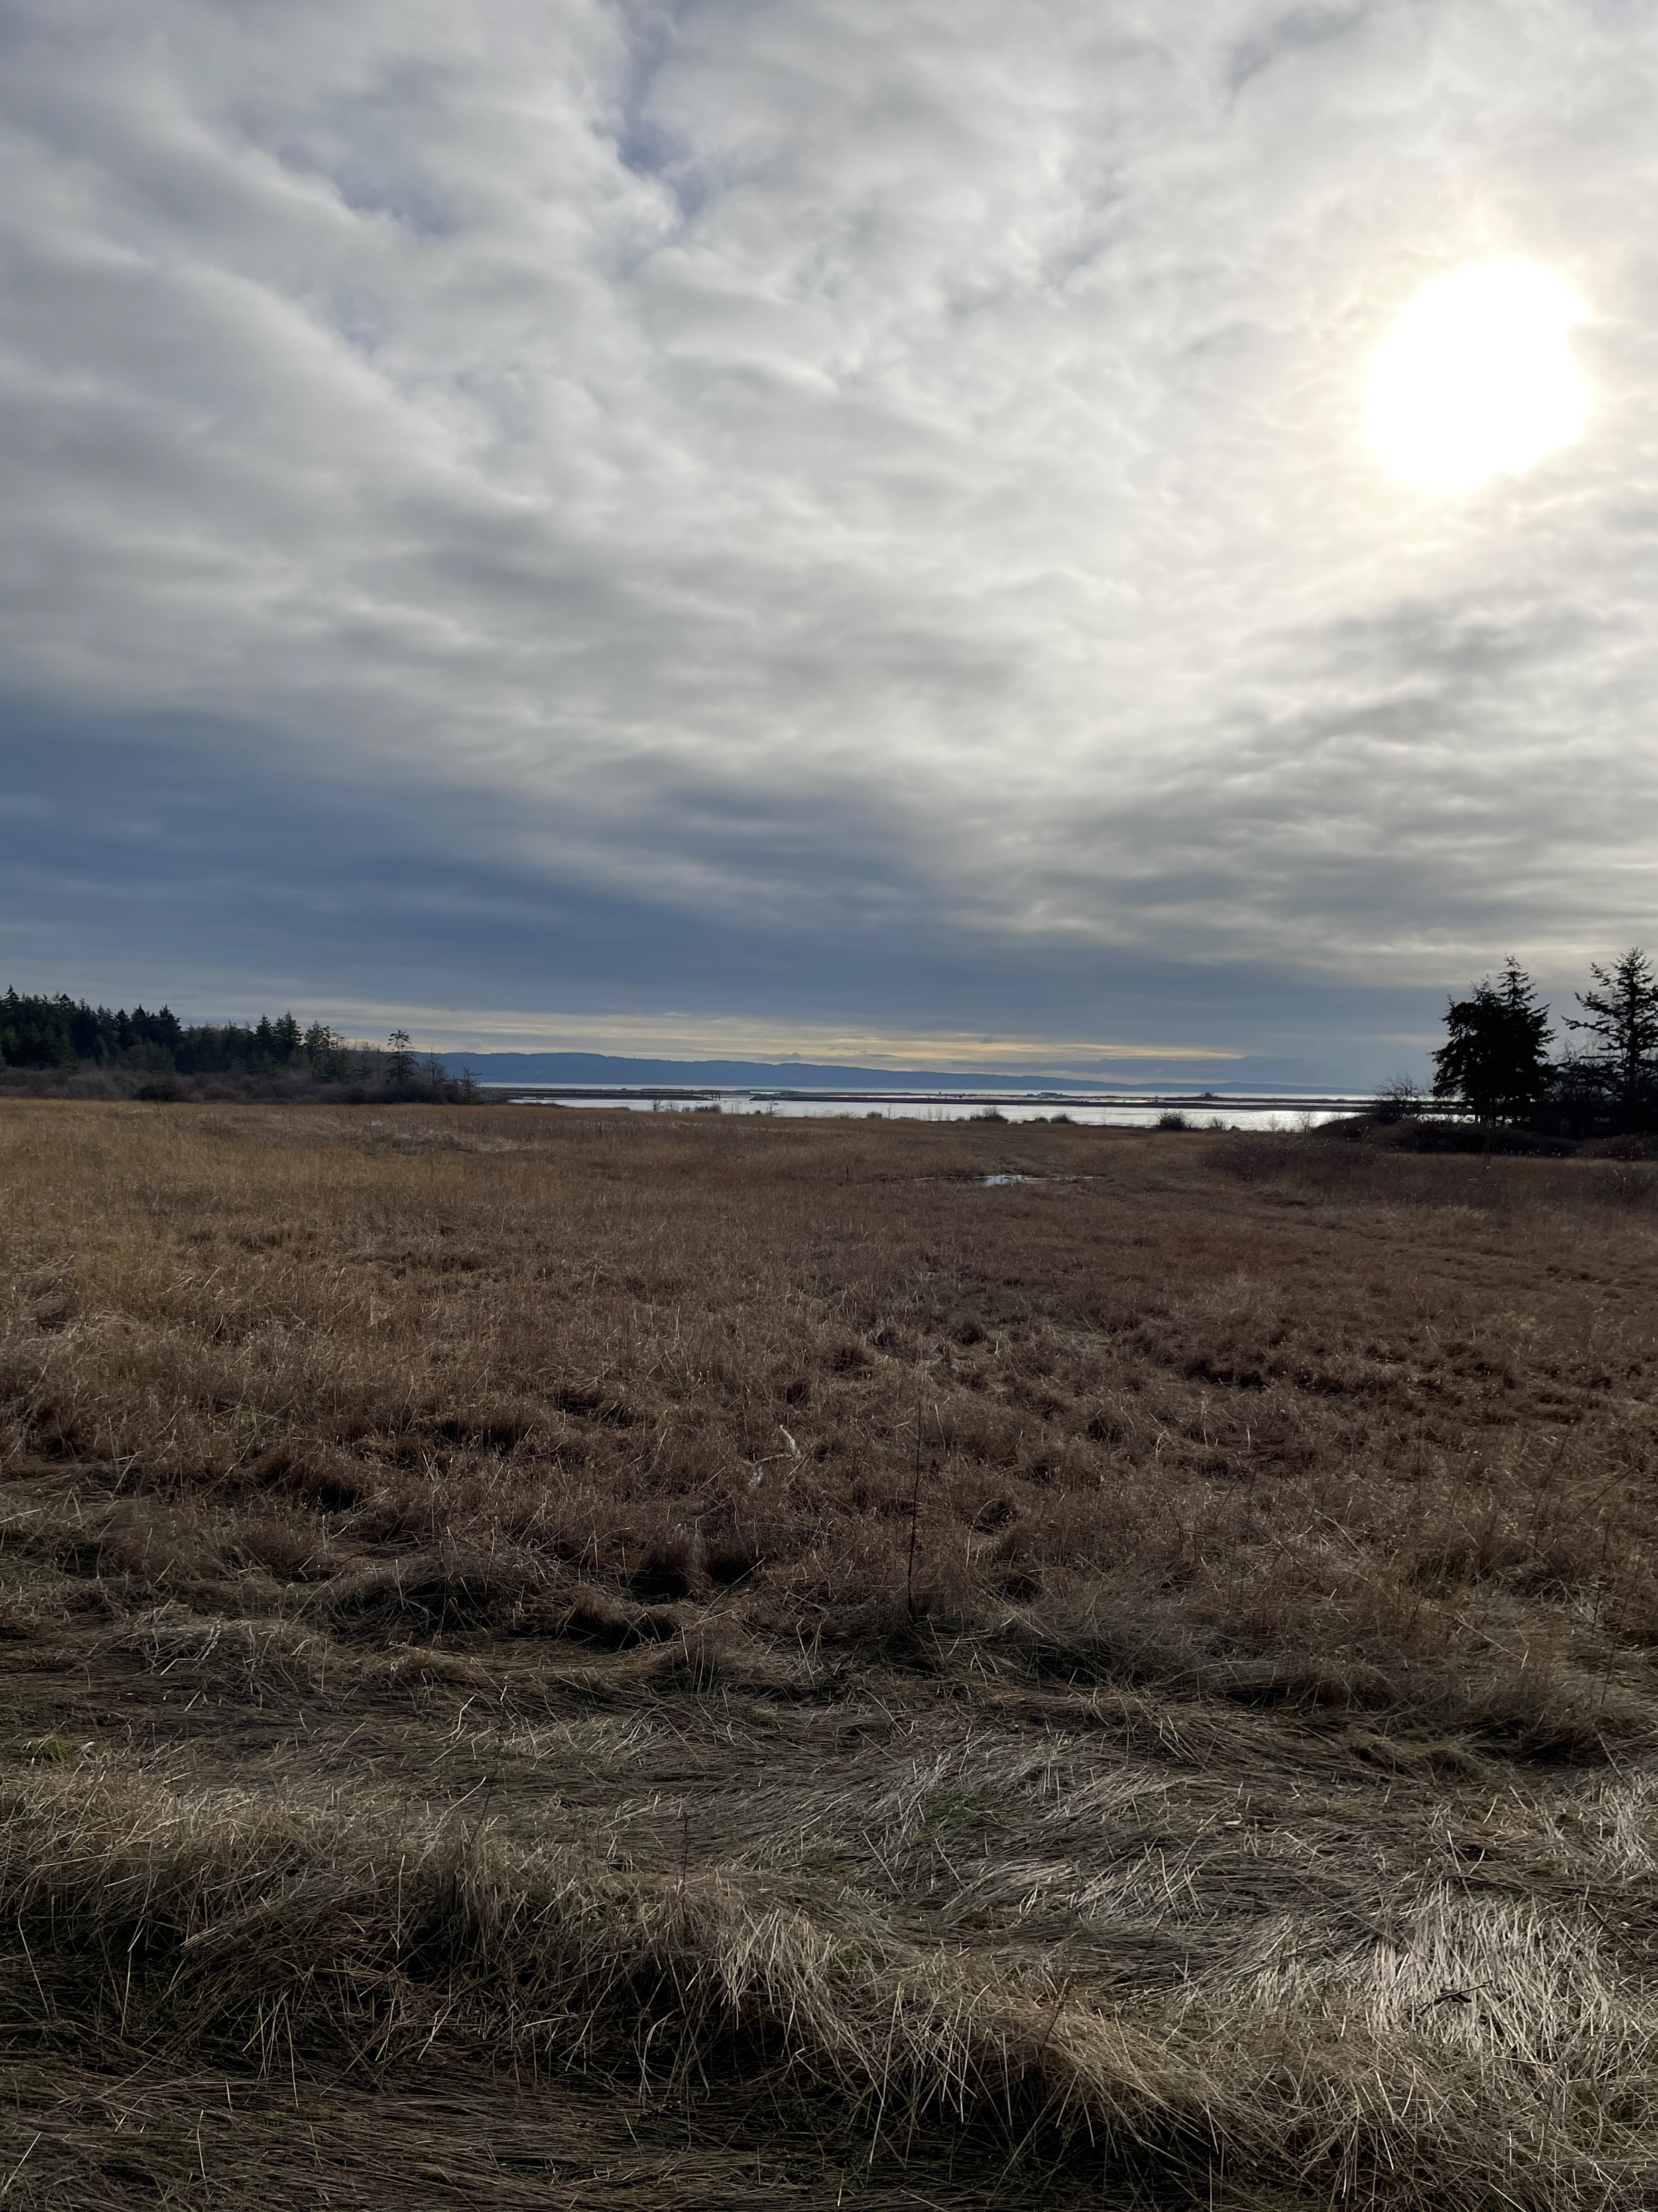
Looking to the right of the stairs, as facing the water

