Slide 1
15-1058 Lower Bear Creek Natural Area Additions
Little Bit Riding Center: Bear Creek + Riparian Acquisition
Avondale Rd NE
NE 106th St
Bear Creek
Tom Beavers (King County)
Elizabeth Butler (RCO)
February 22, 2019

Slide 2
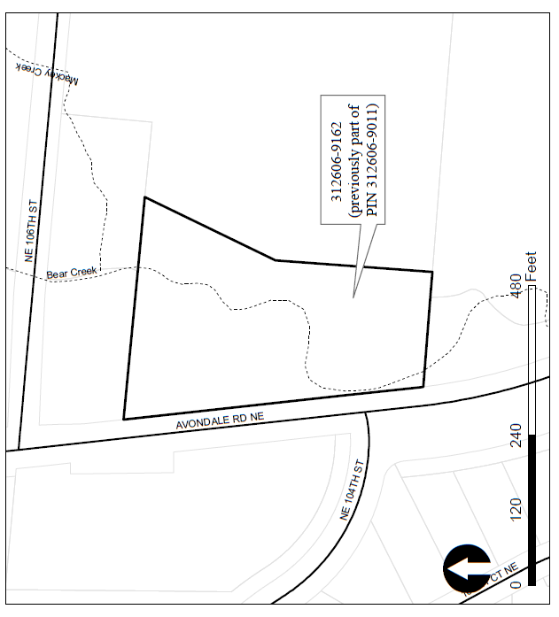
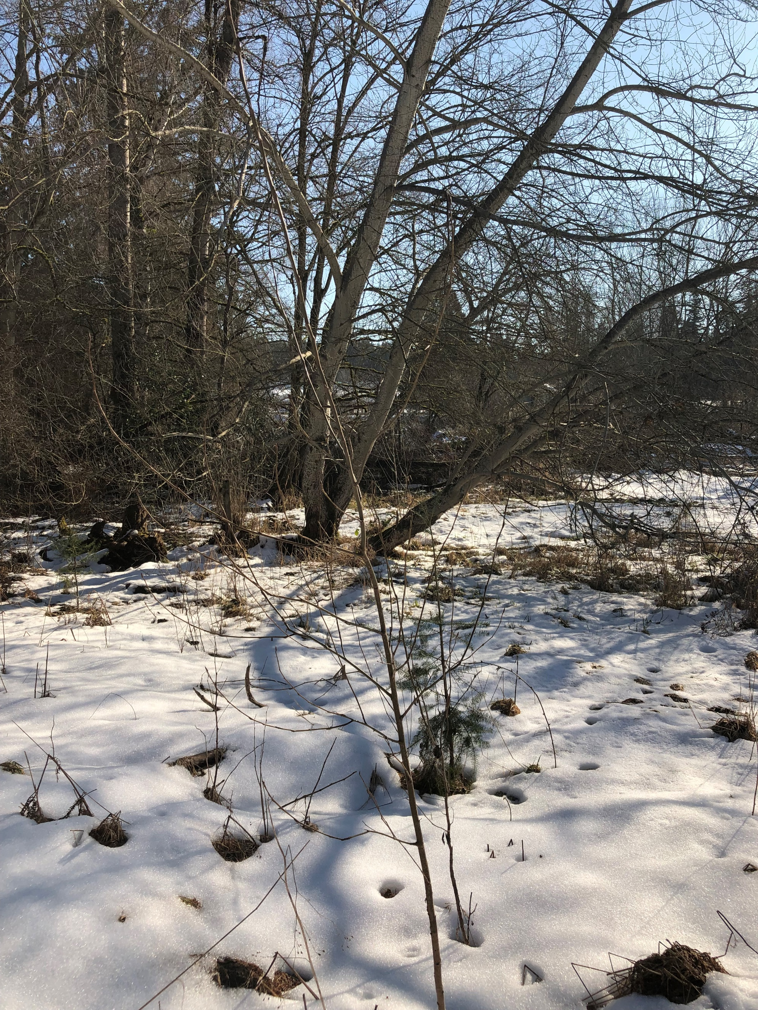

Slide 3
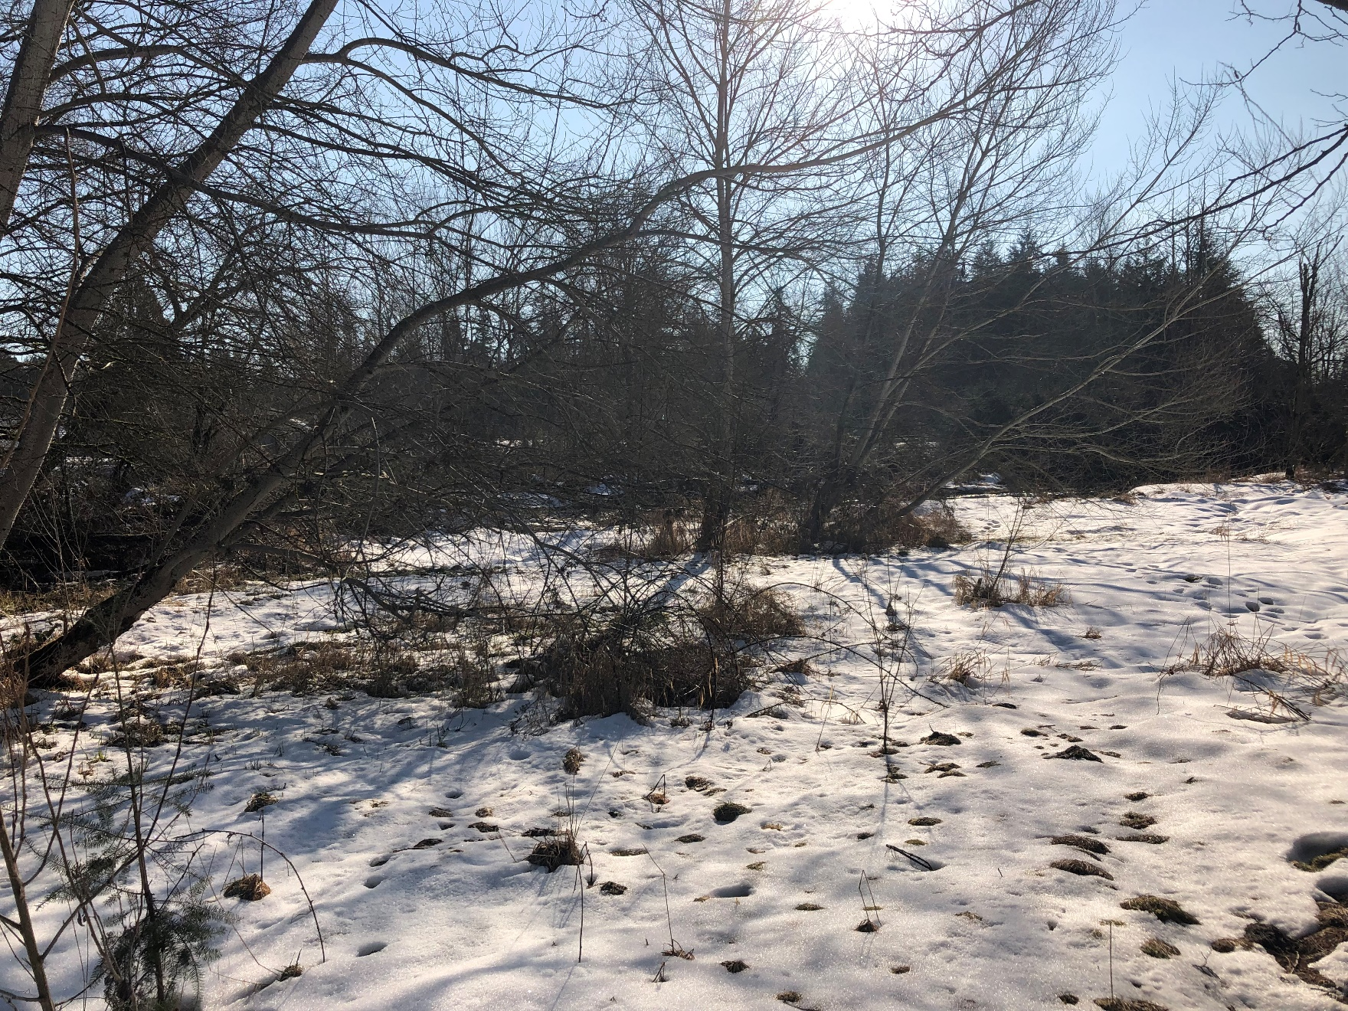

Slide 4
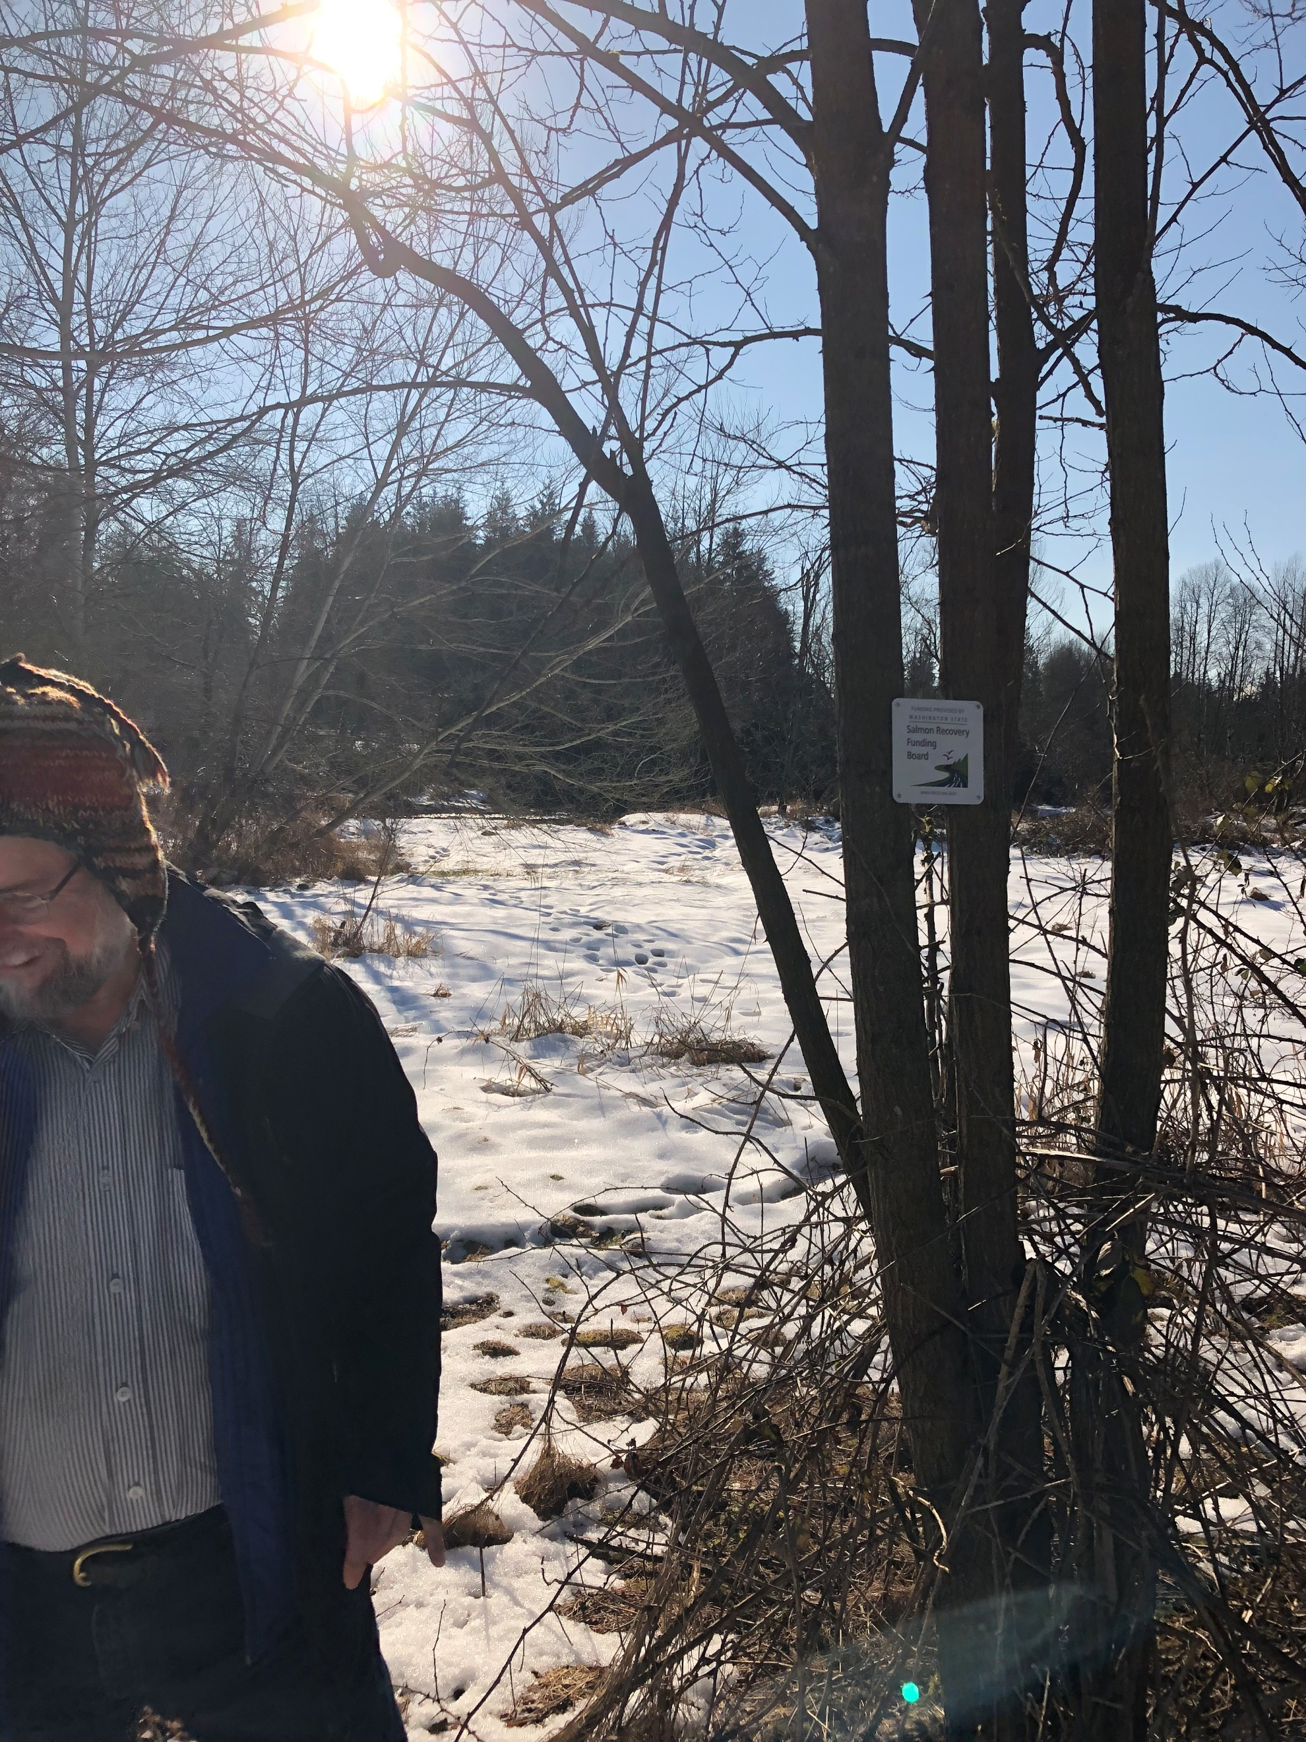

Slide 5
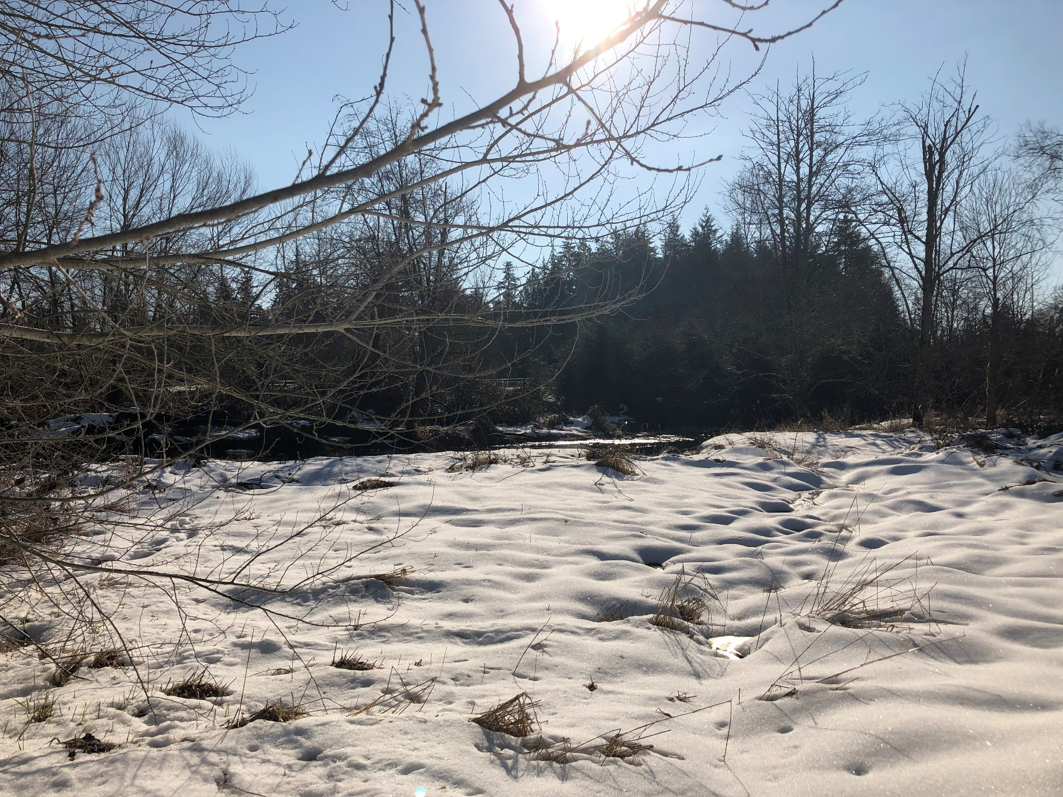

Slide 6
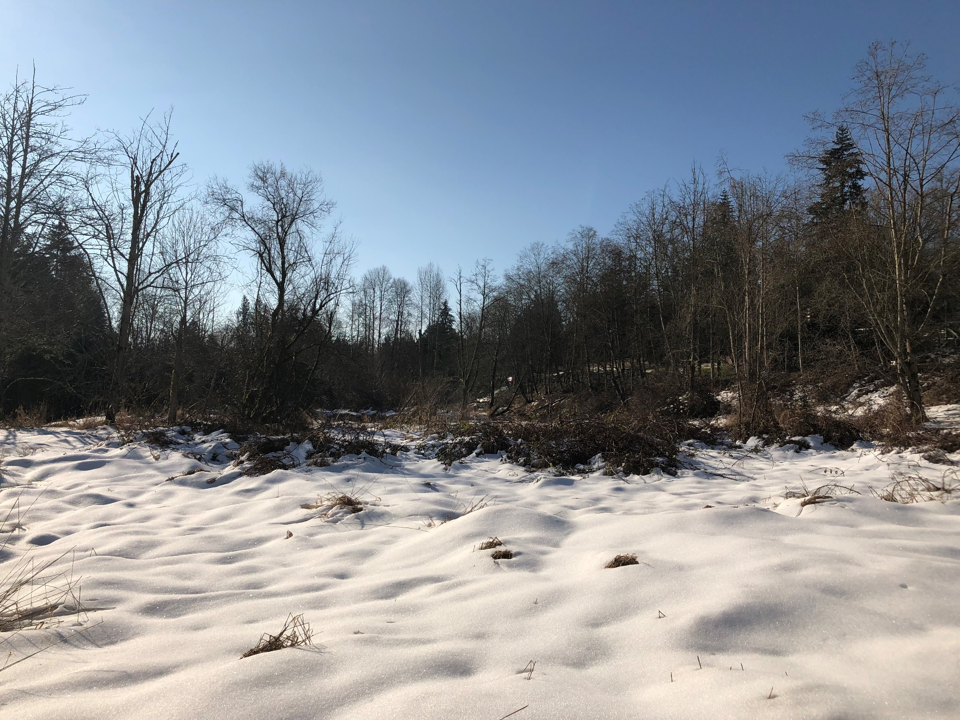
Avondale Road NE

Slide 7
Bear Creek

Slide 8
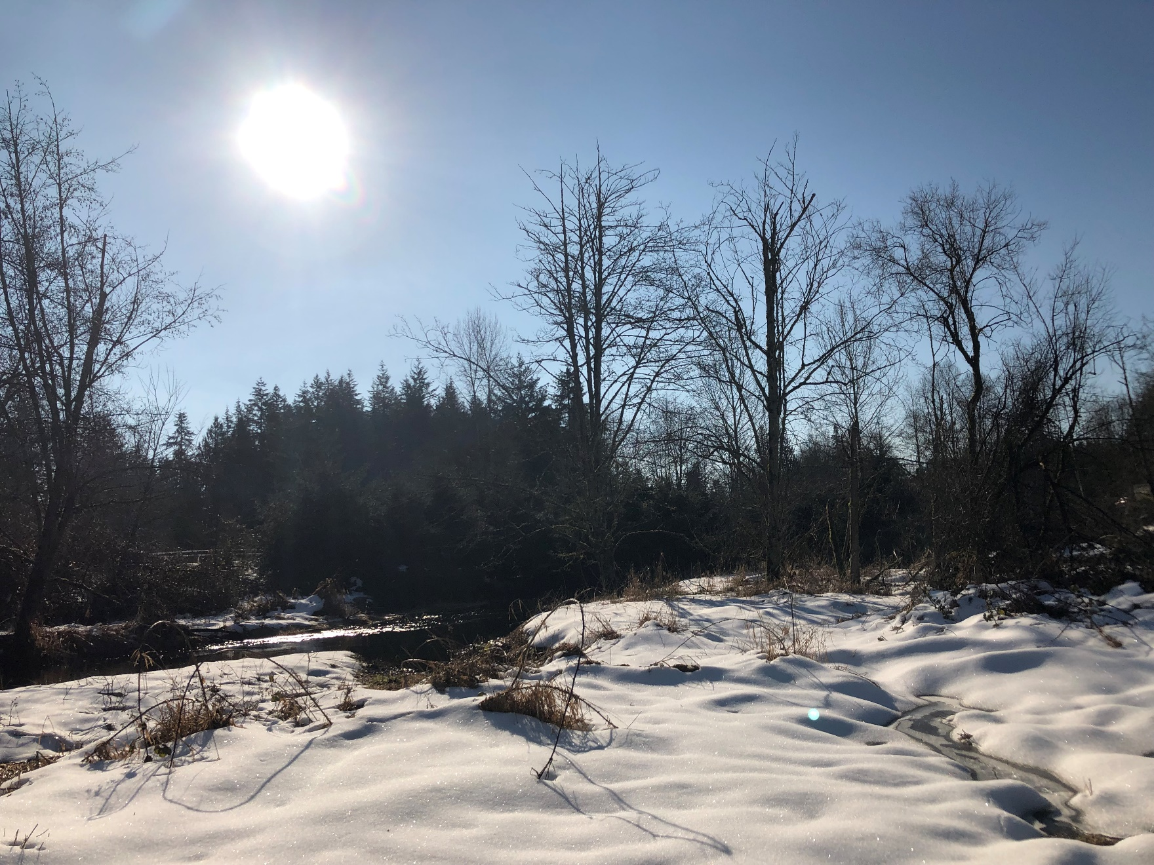

Slide 9
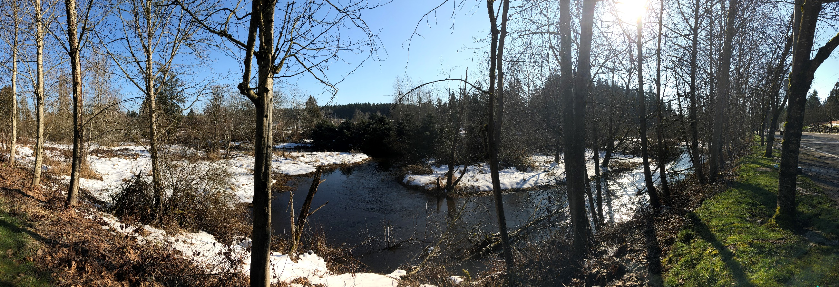
View from Avondale Road NE looking east.

Slide 11
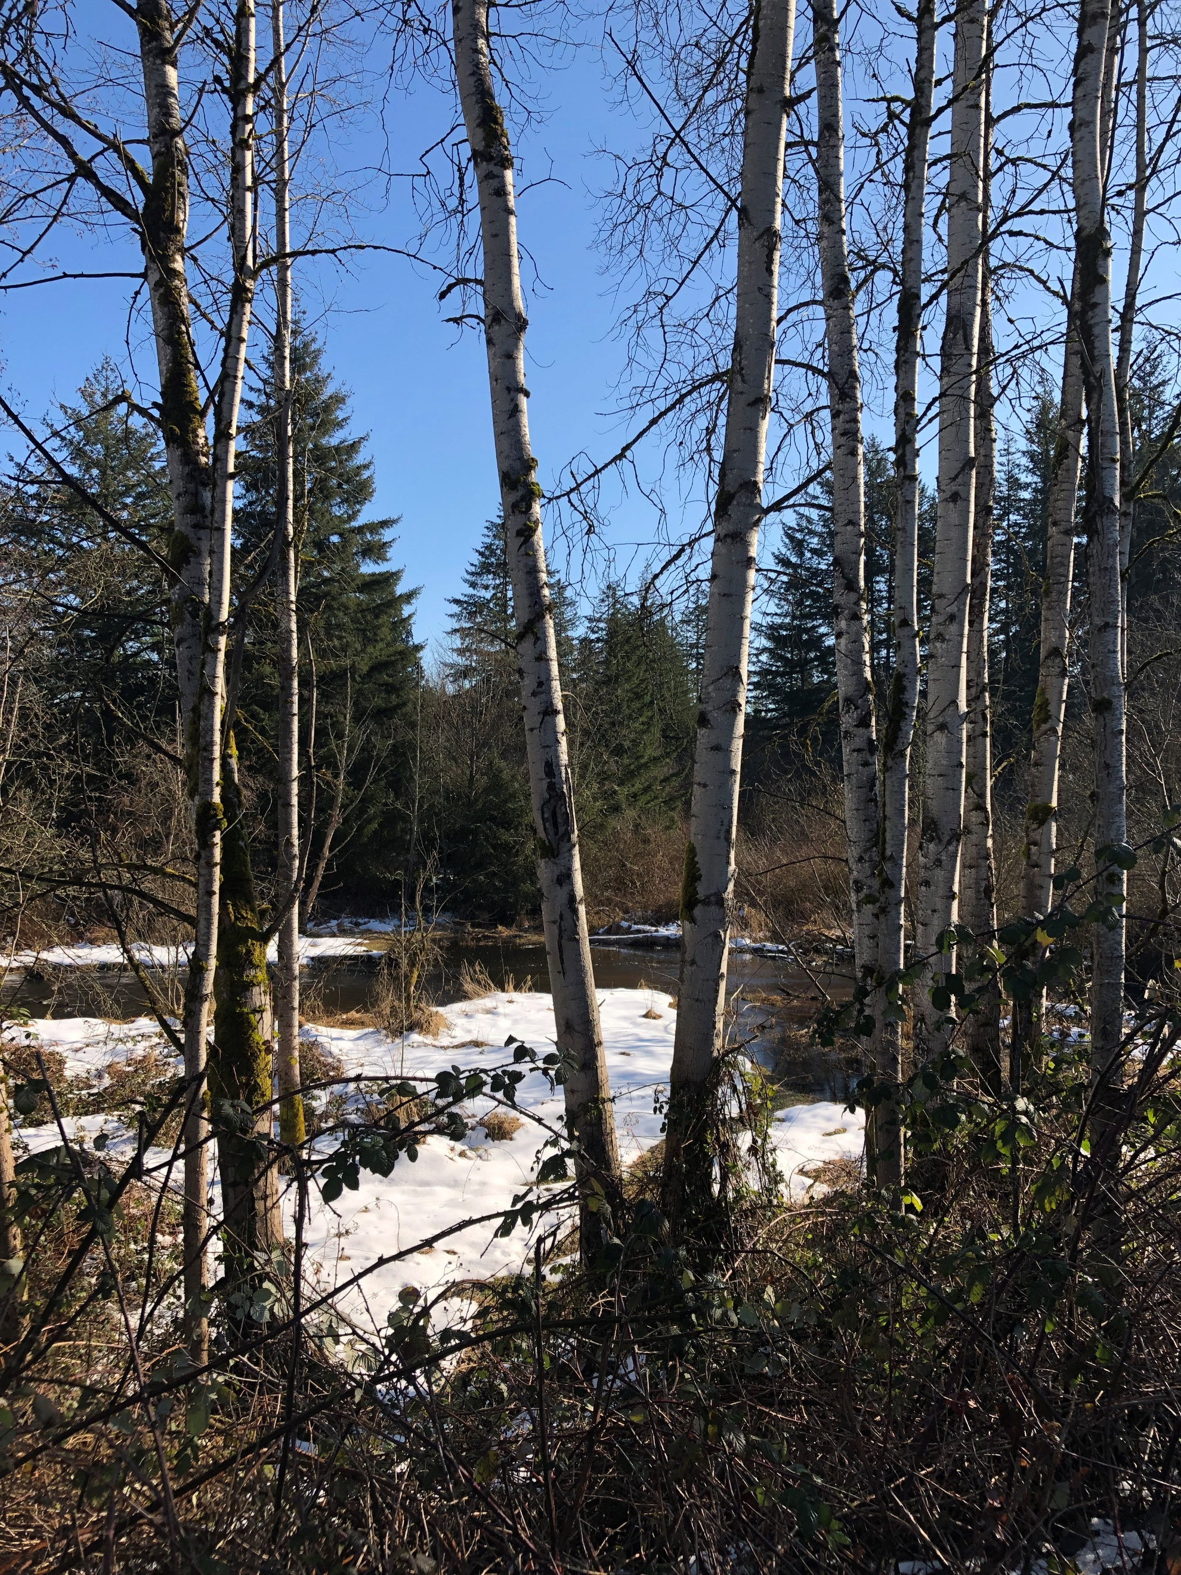
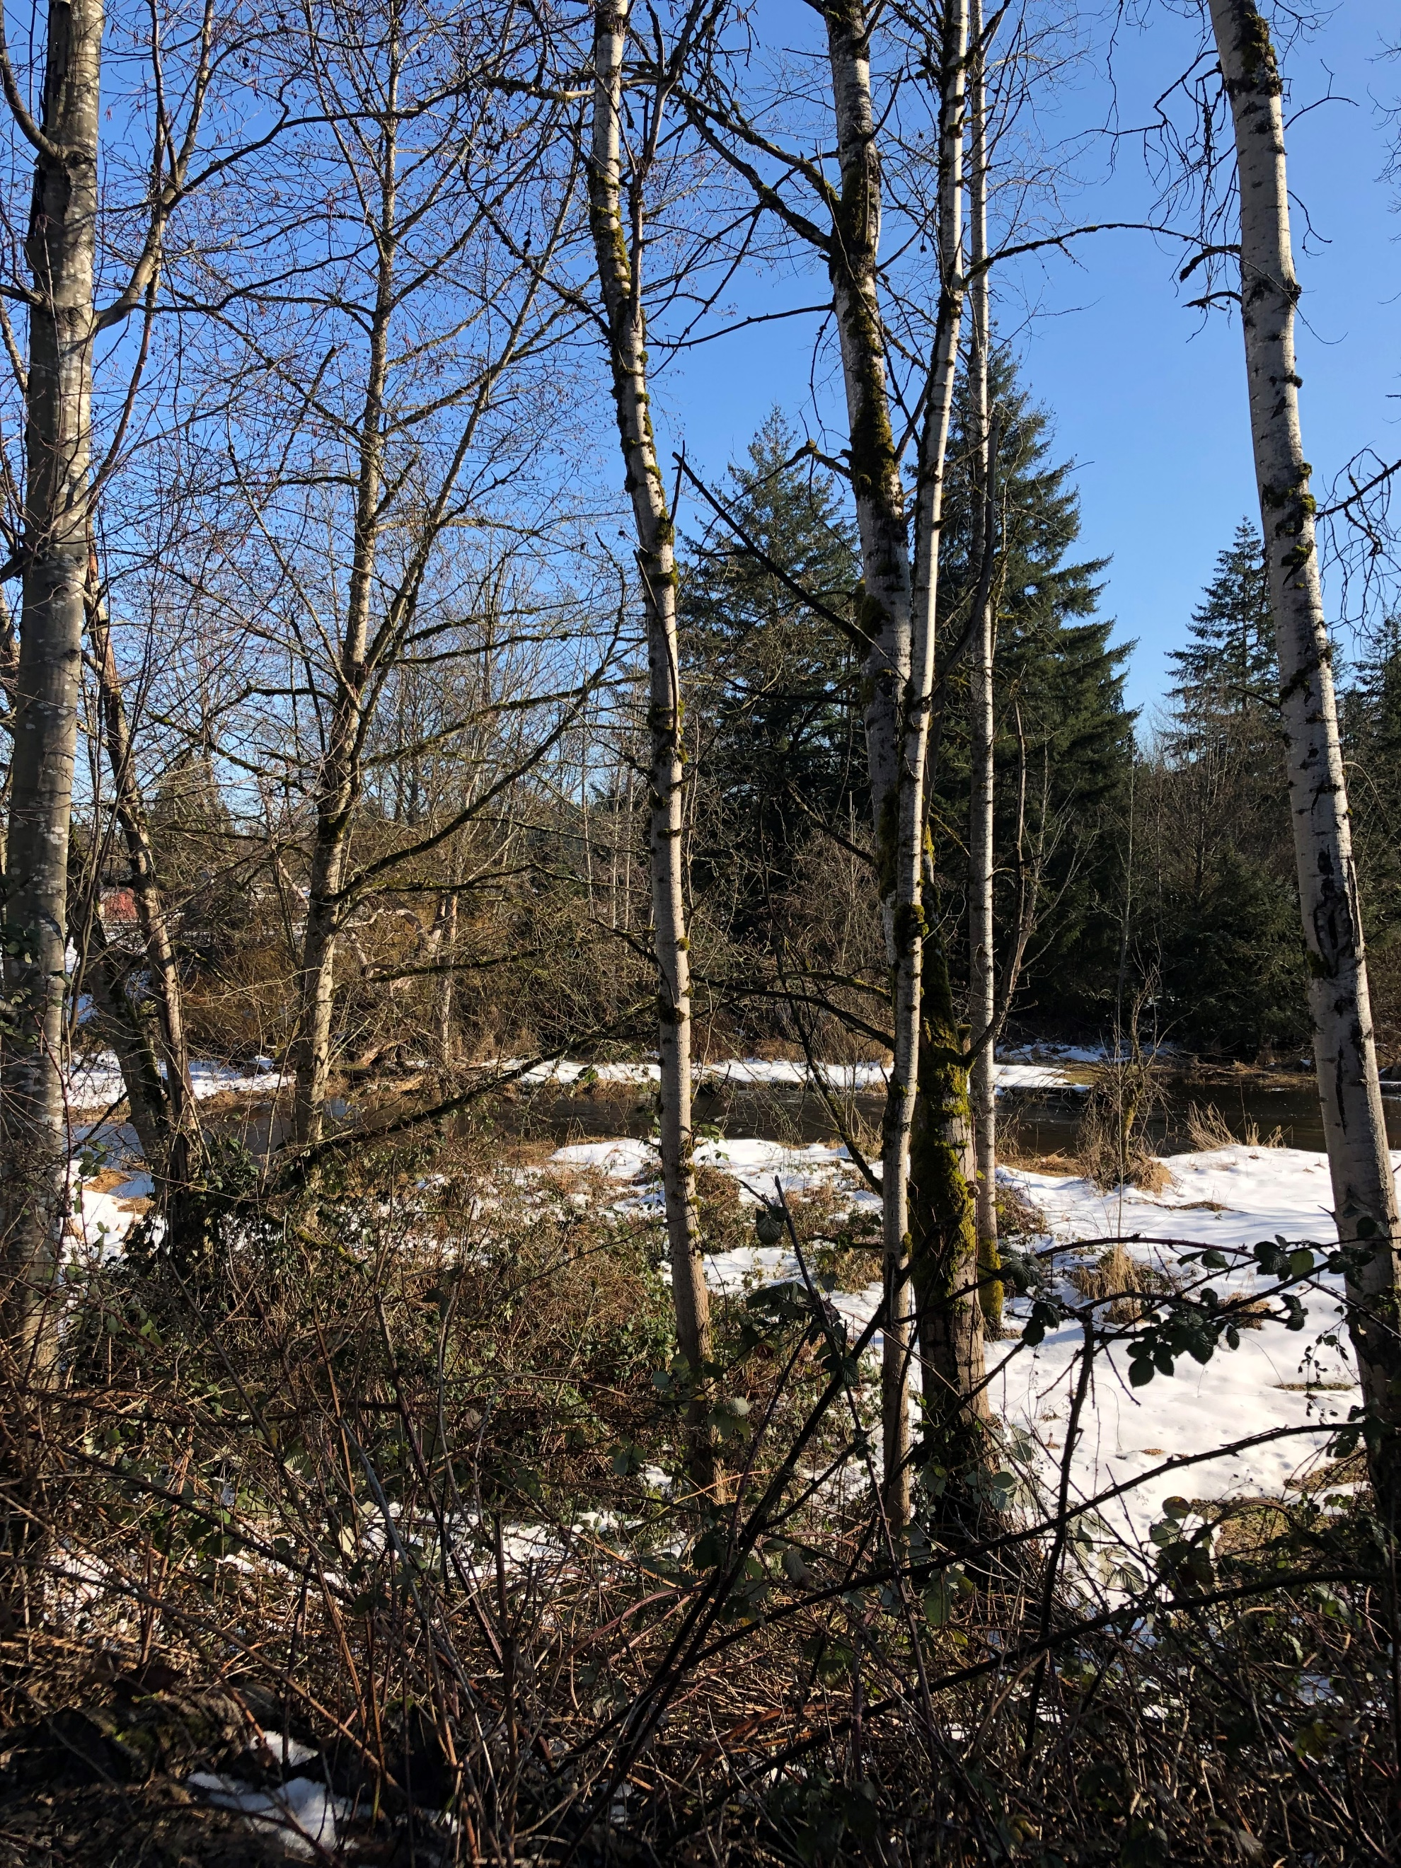

Slide 12
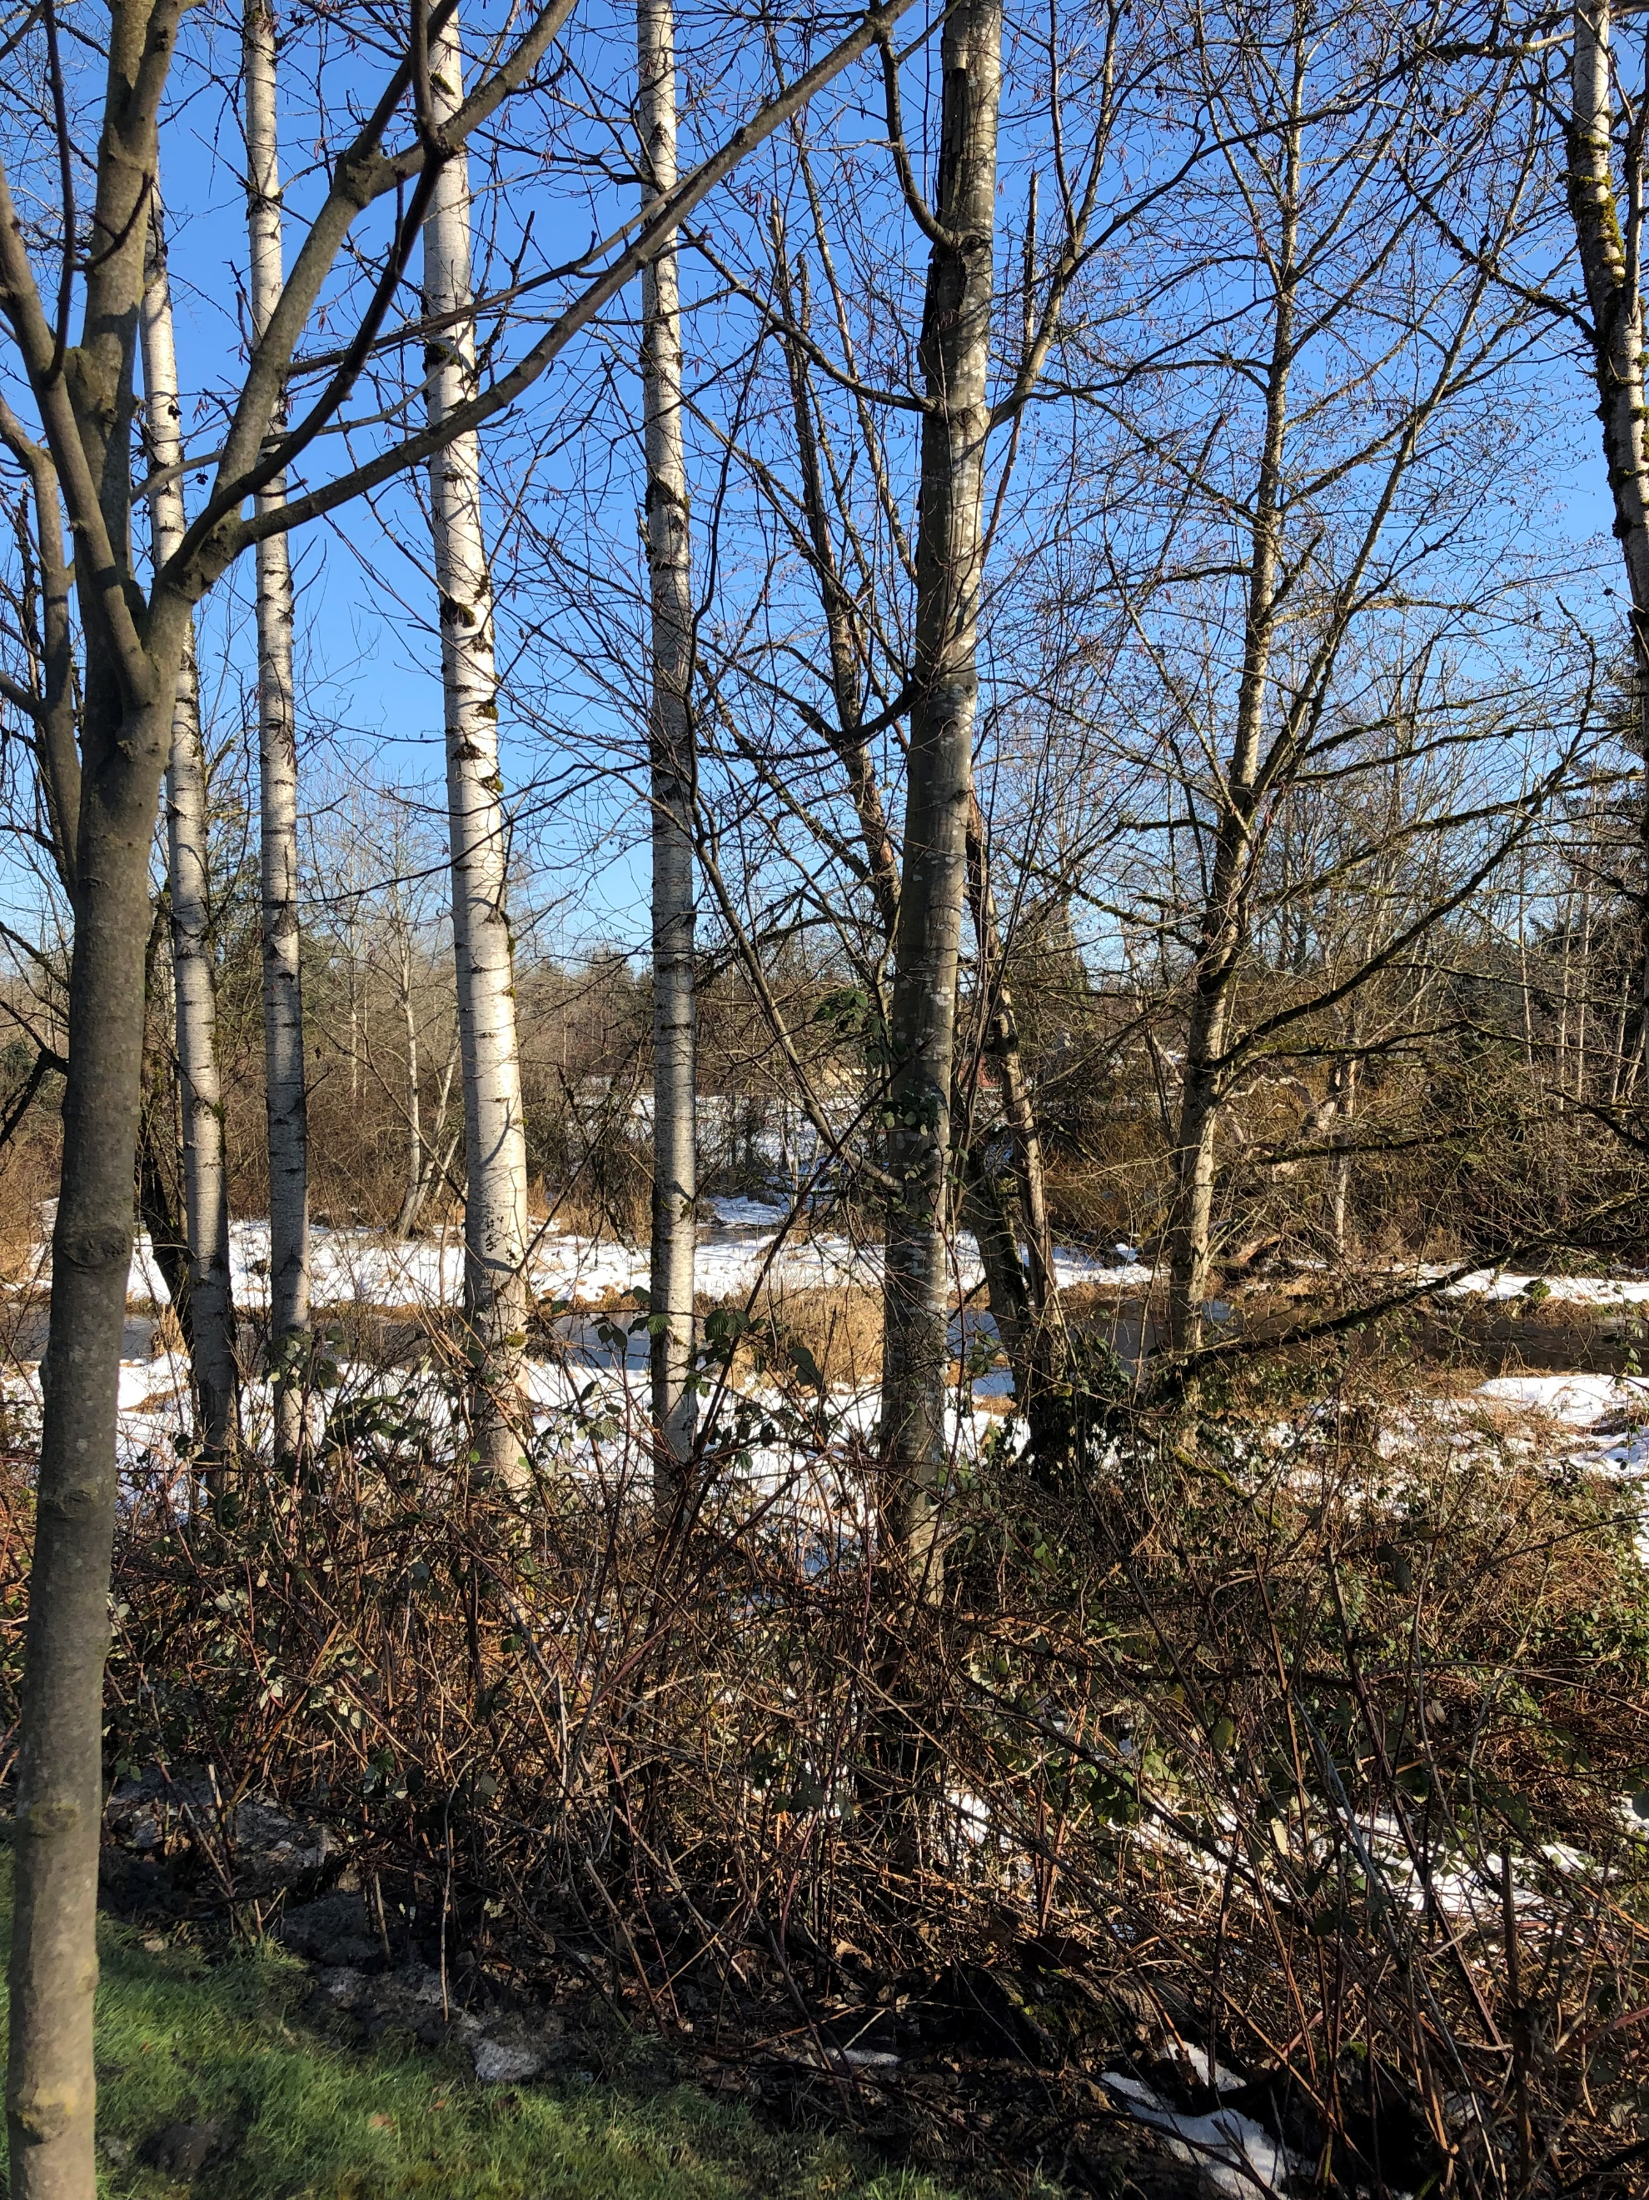

Slide 13
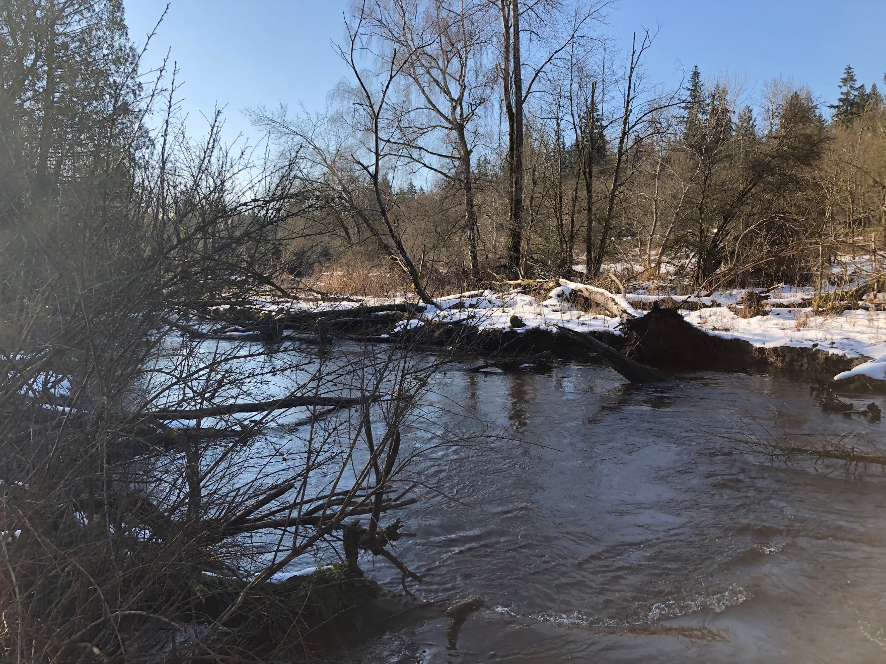
View looking downstream
from the NE 106th Street
crossing to the north.

Slide 14
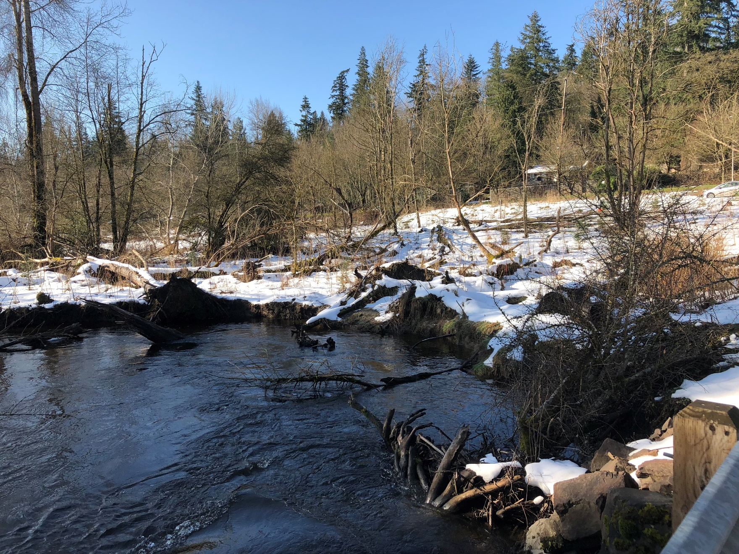

Slide 15
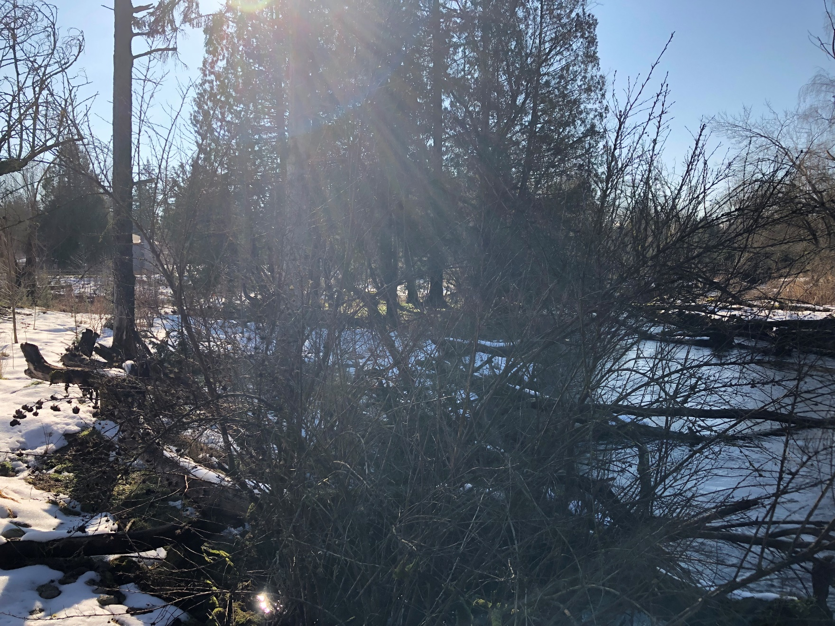

Slide 16
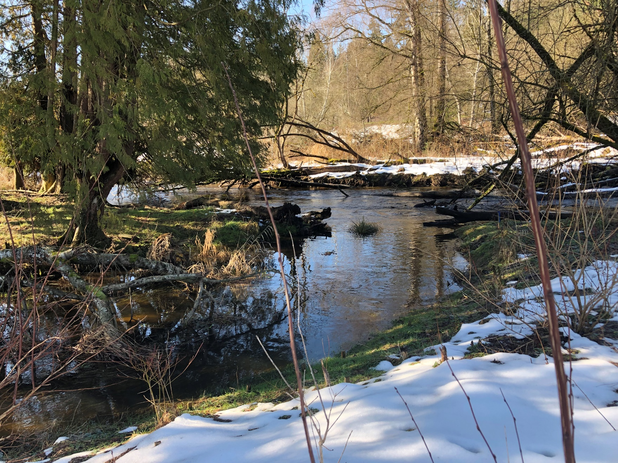
View of upstream property,
north of NE 106th St which had a
For Sale sign posted (with an
expensive residence fronting
on Avondale Rd).

Slide 17
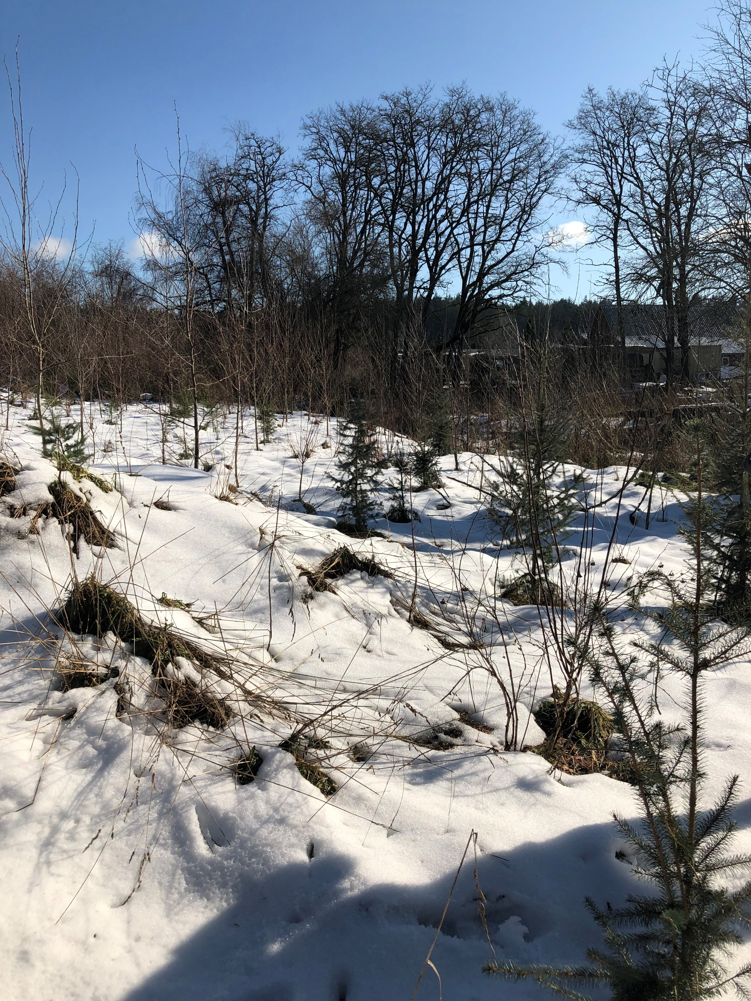
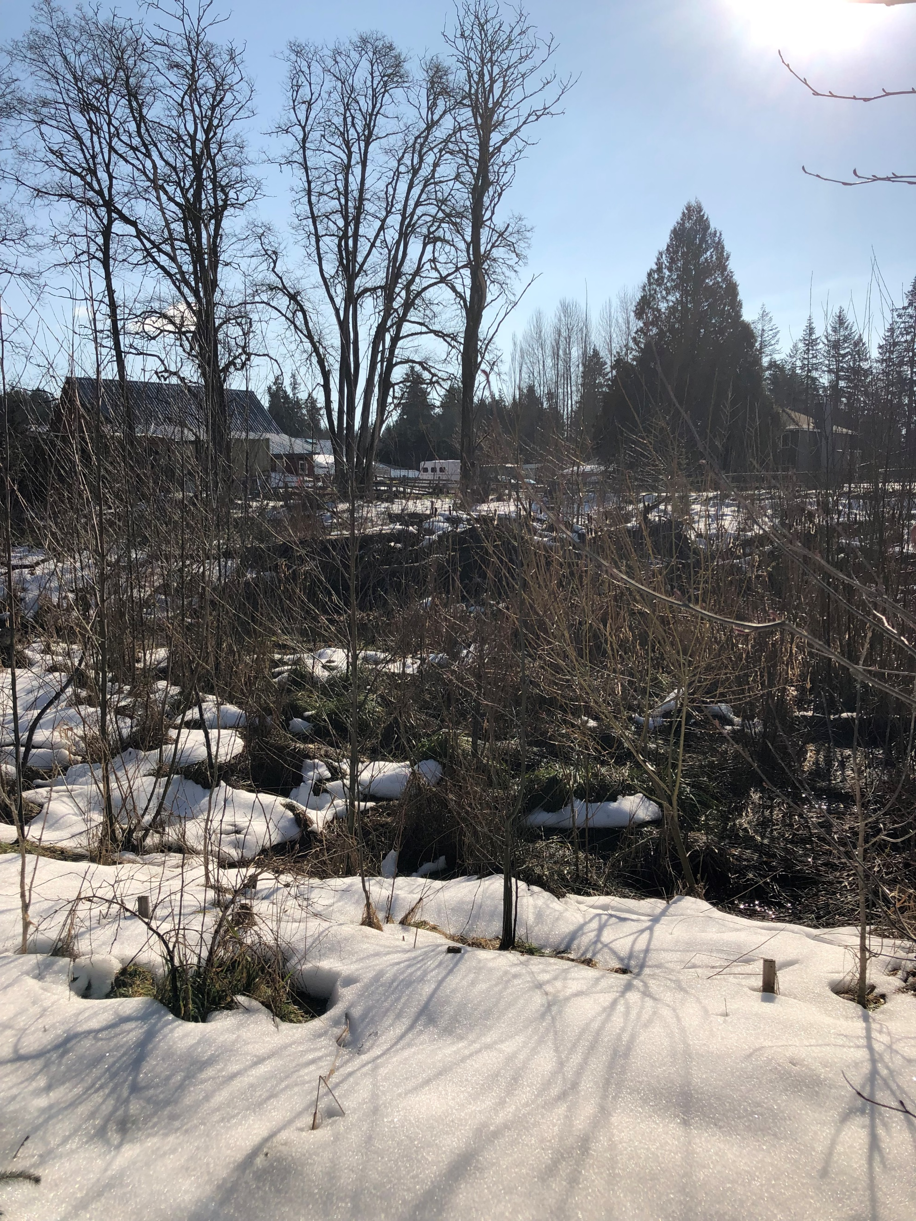
View of adjacent
property
(immediately
upstream)
where King County
completed riparian
restoration plantings

Slide 18
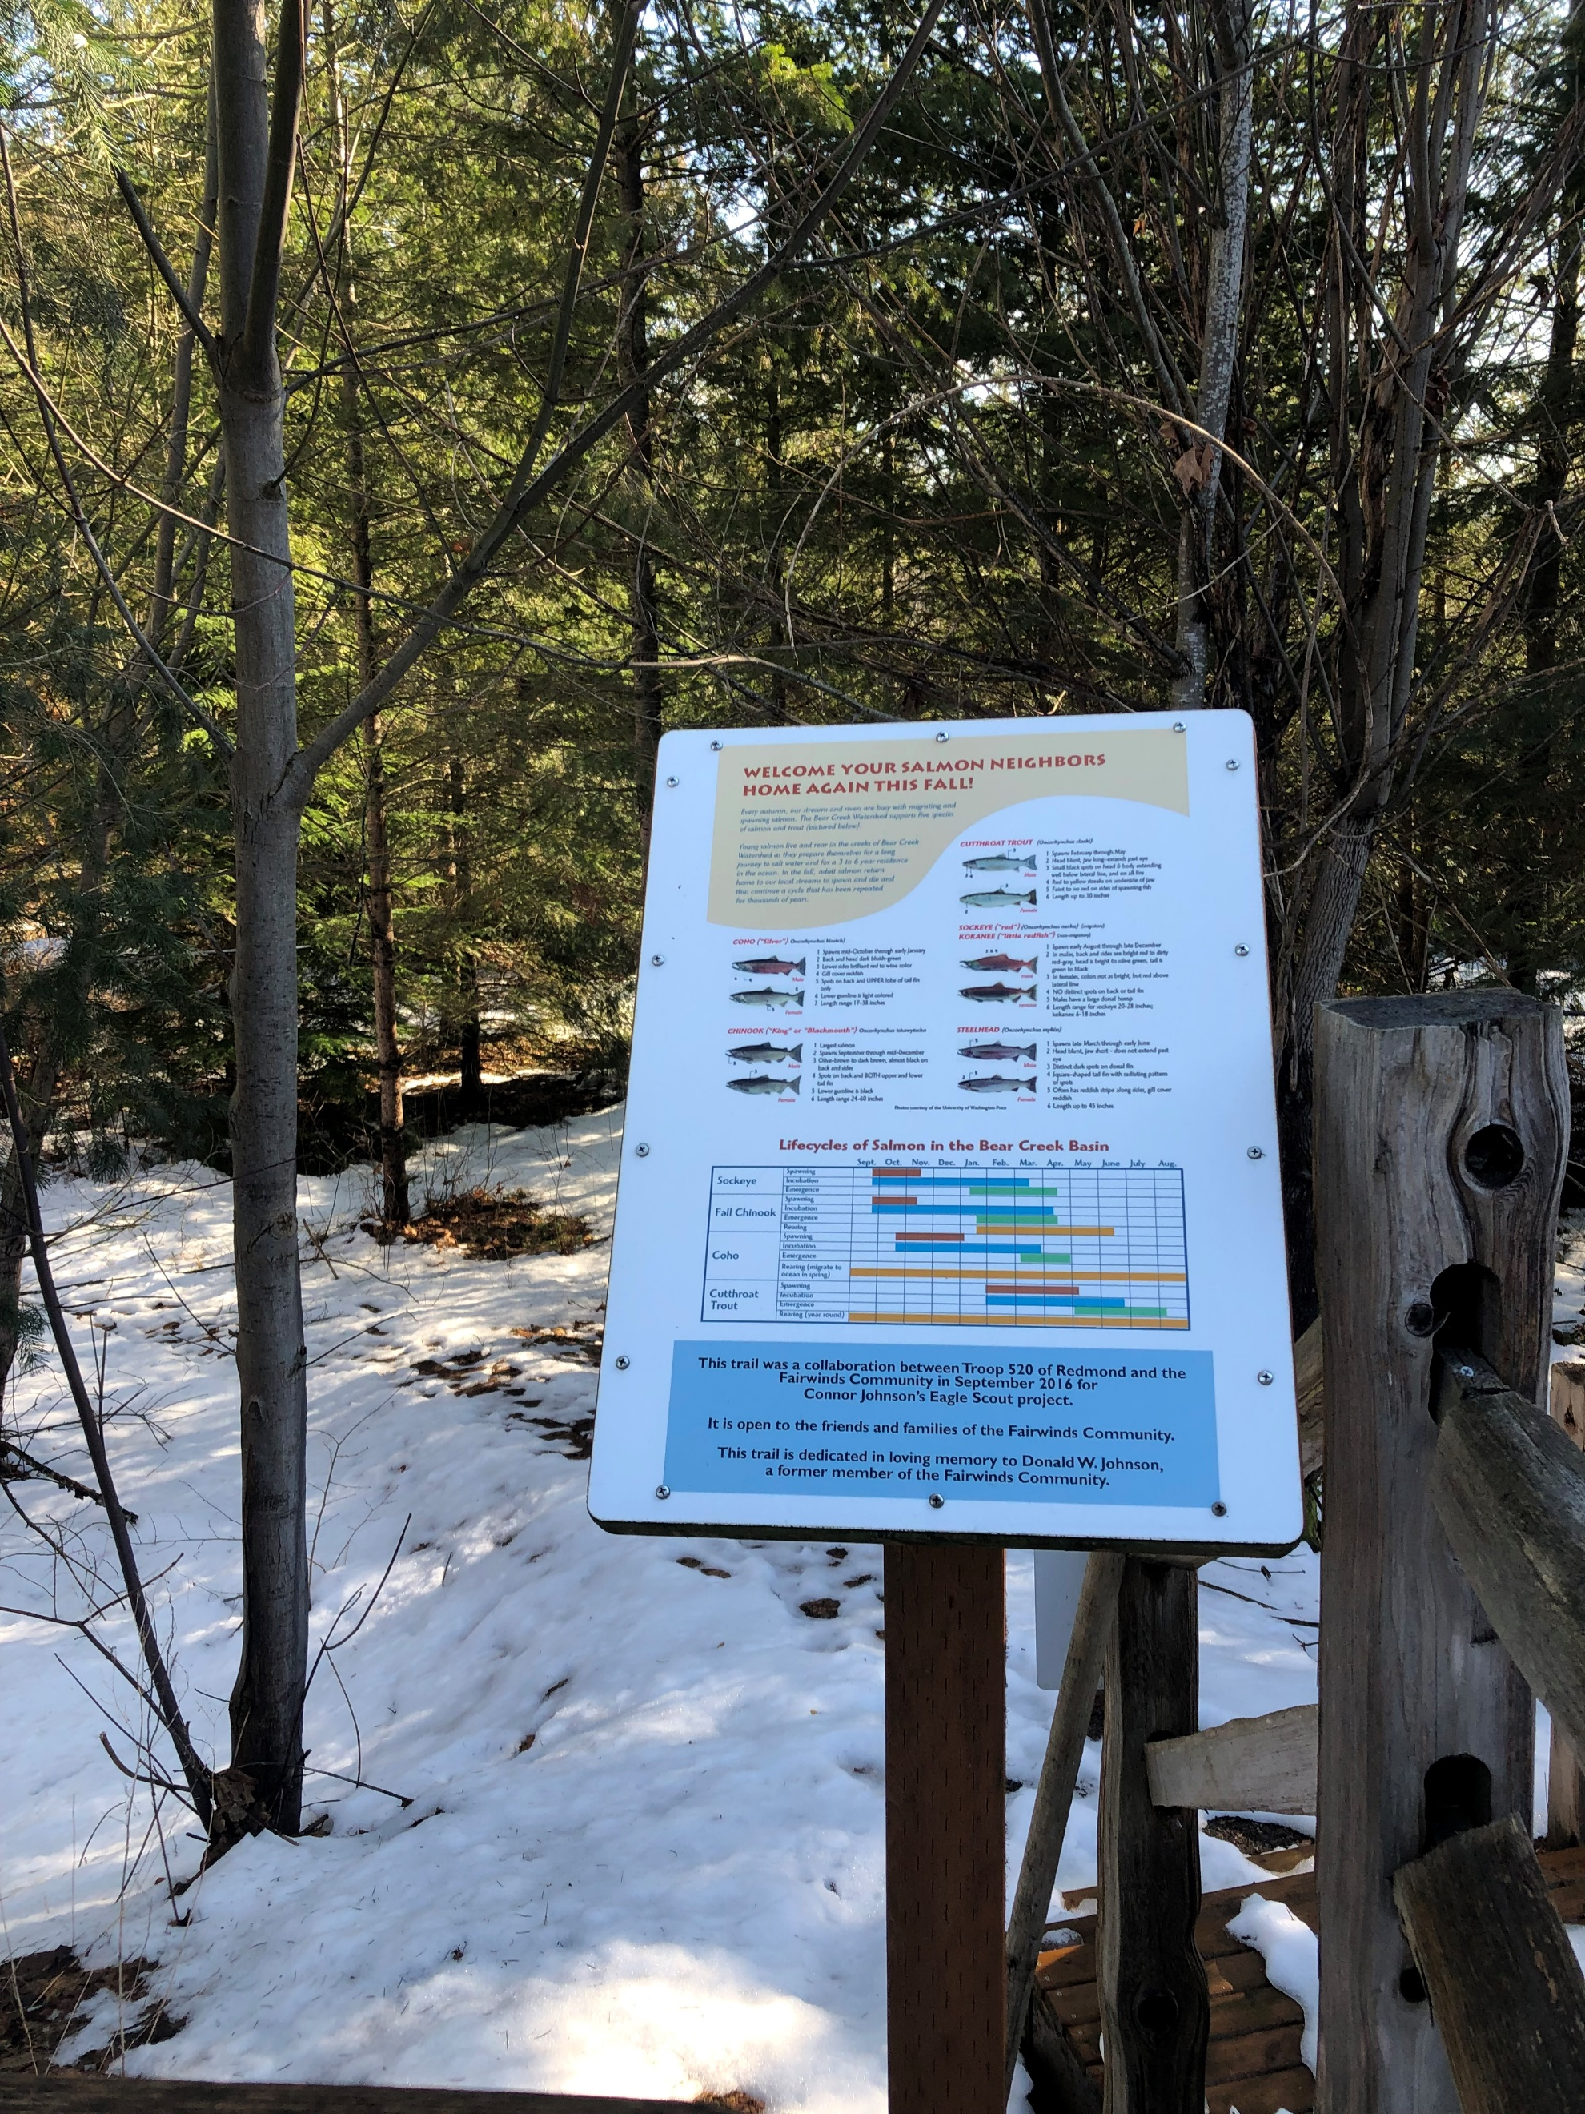
The following pictures are of another King County floodplain
restoration project just downstream which represents what
they hope to be able to accomplish on the property acquired
from the Little Bit Riding Center.

Slide 20
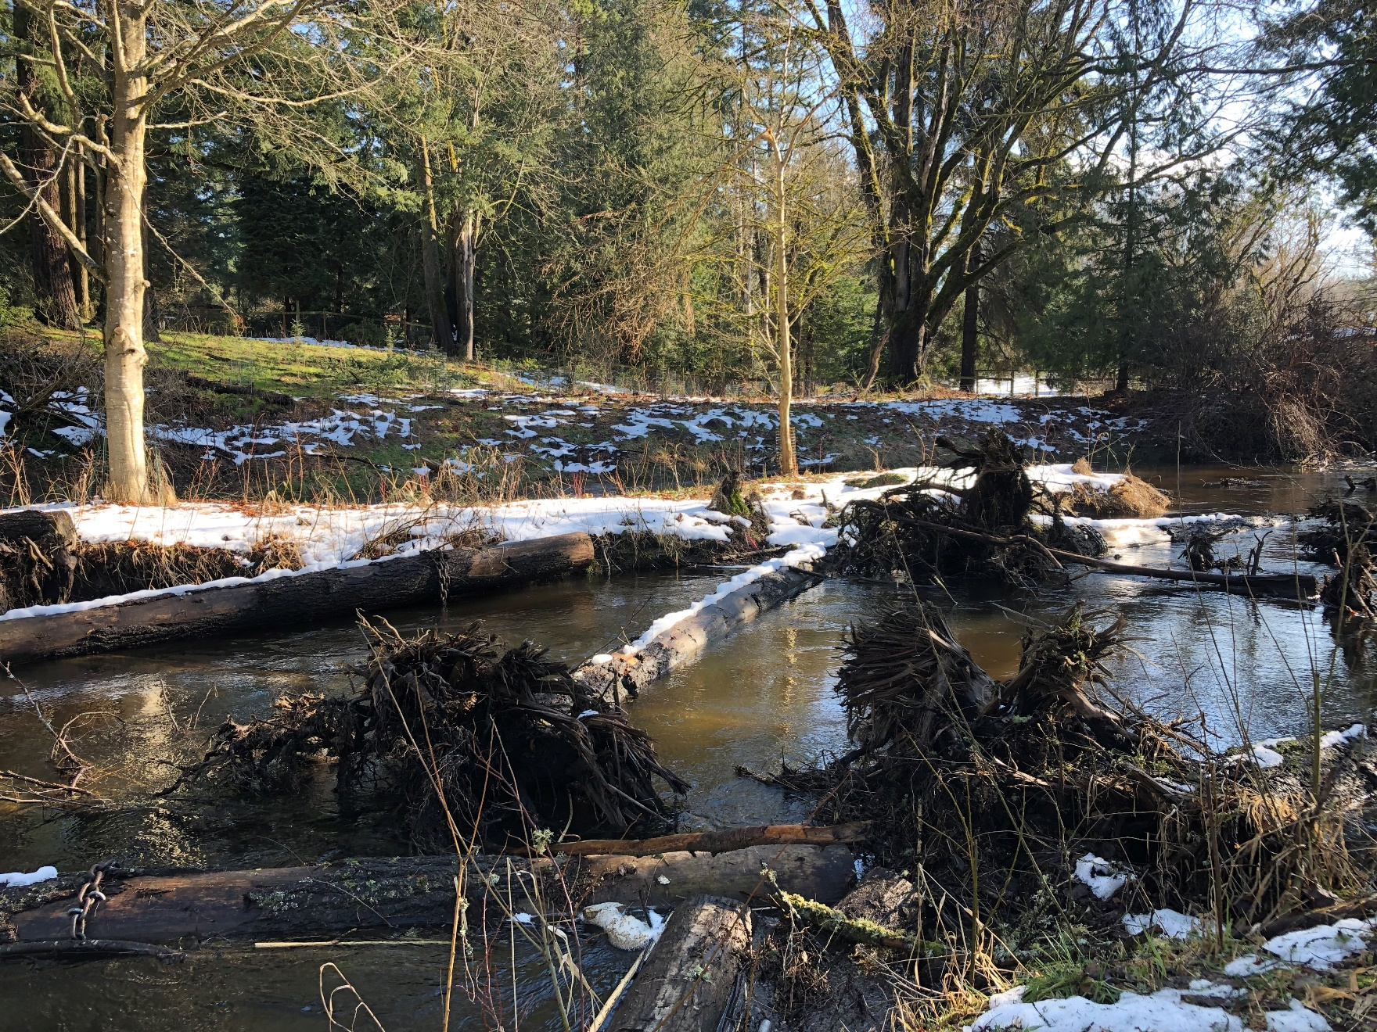

Slide 21
