Slide 1
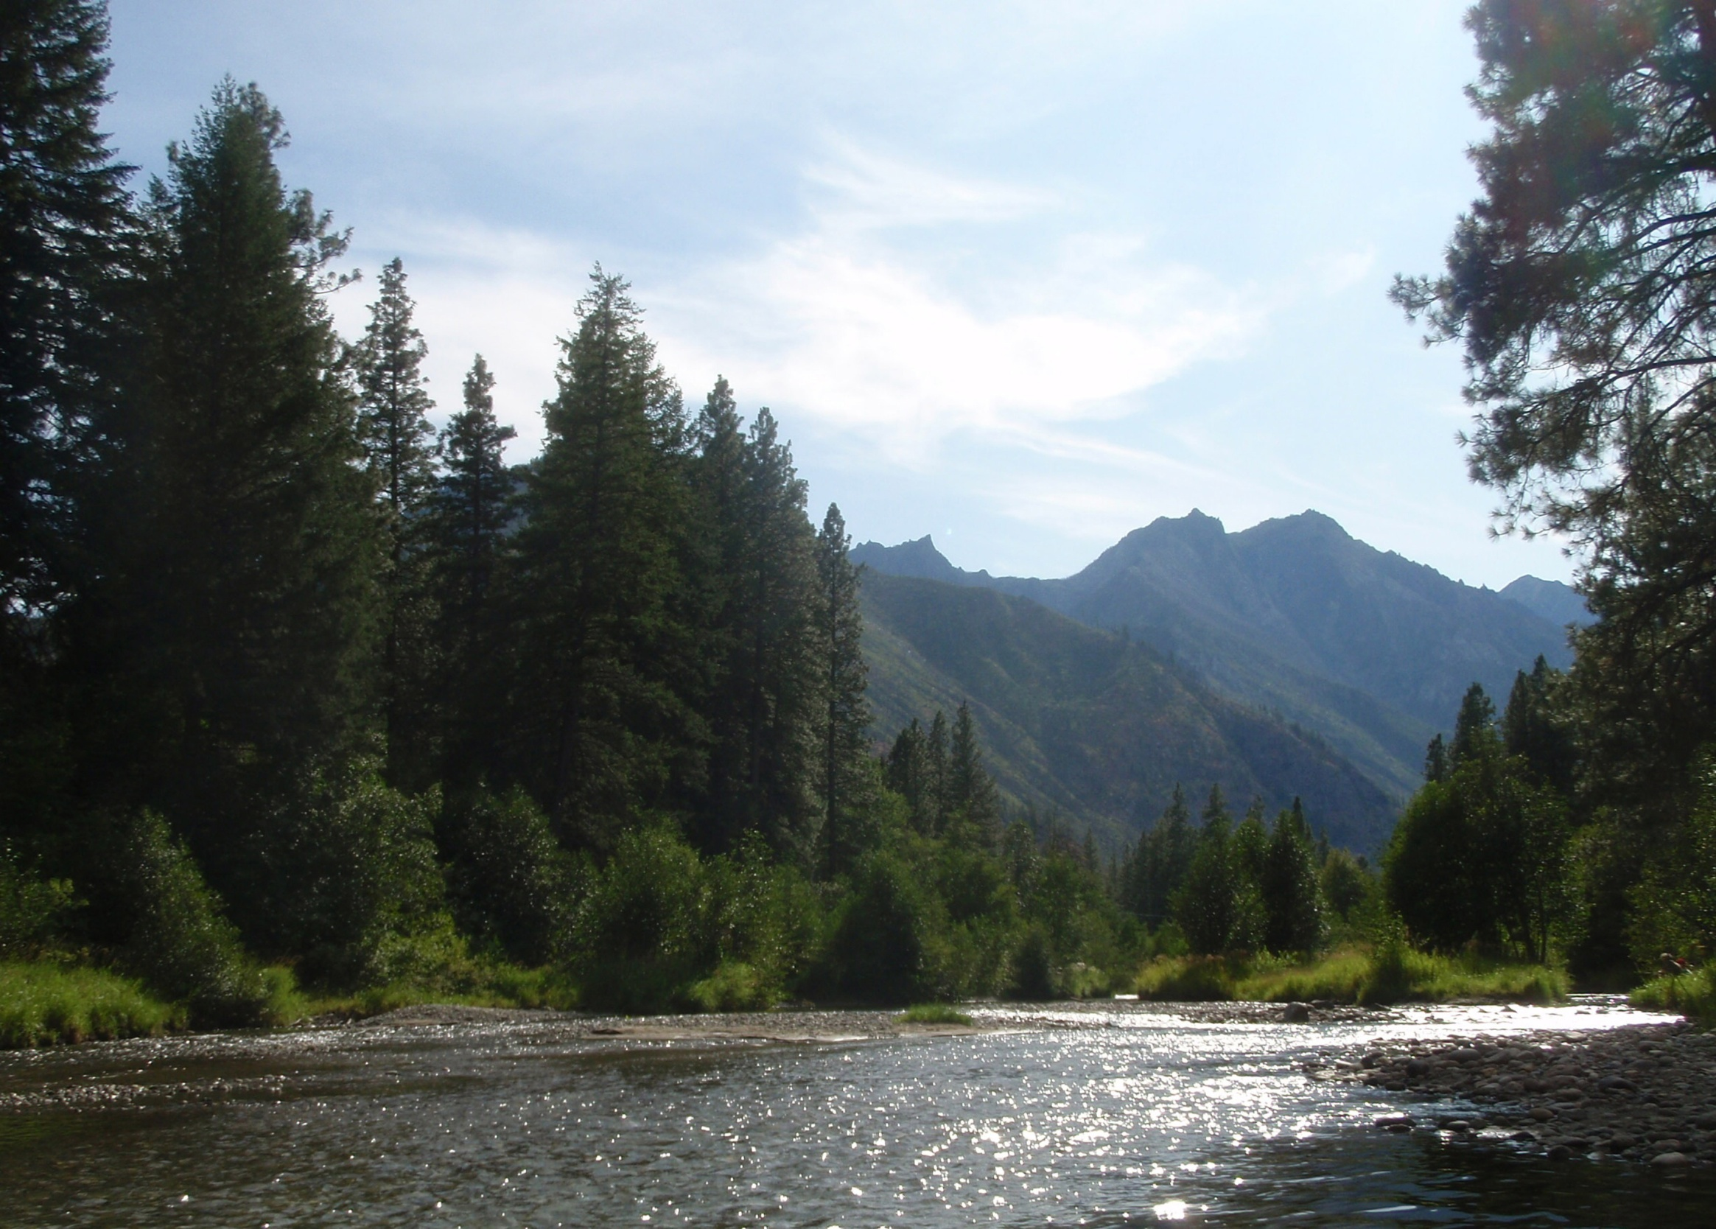
Wenatchee/Icicle Confluence
Category 2 watershed, minor spawning area for spring chinook, major spawning area for steelhead, core area for bull trout

Slide 2
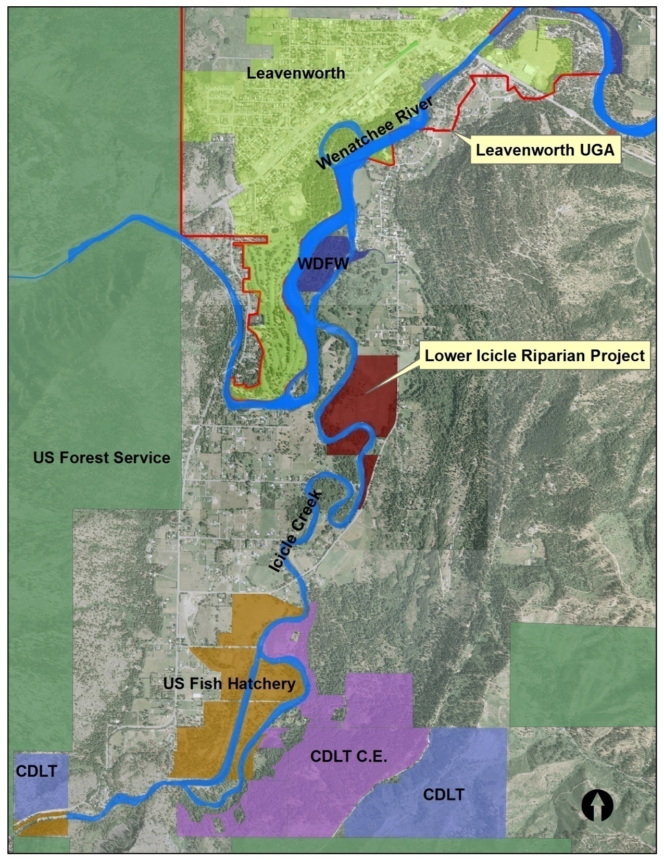
3 riverfront acres donated to CDLT
CONFLUENCE PROJECT AREA
CE on 268A, 4265 ft. riverbank donated to CDLT
Notes:
Like many other groups, the Land Trust has identified the lower Icicle Creek as a conservation priority. It is unique in having a functional riparian/stream system adjacent to the Leavenworth Urban Growth Boundary. The Land Trust has already secured four major properties in the Icicle Creek area for conservation, recreation and/or education purposes. The Fromm Conservation is particularly special in the way it balances riparian protection and salmon recovery with a viable farm operation.

Slide 3
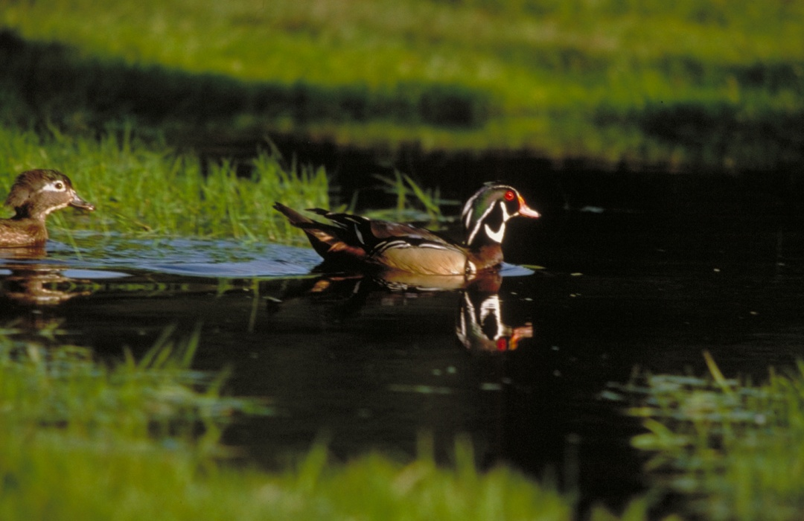
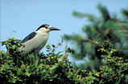
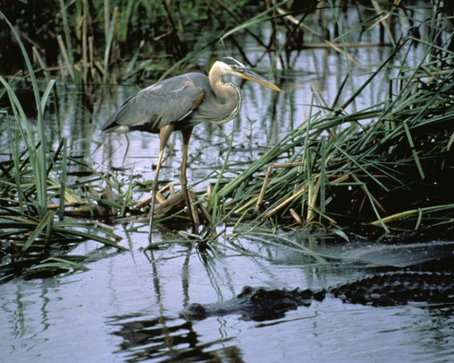
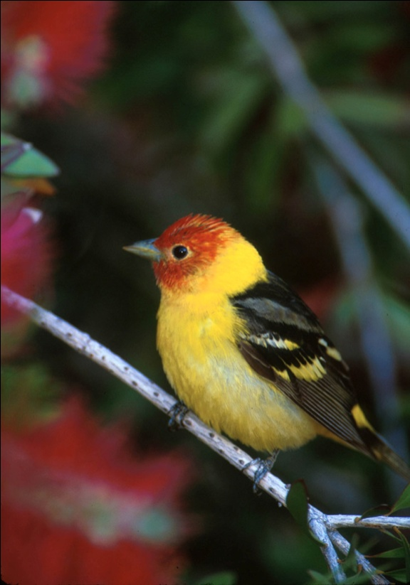
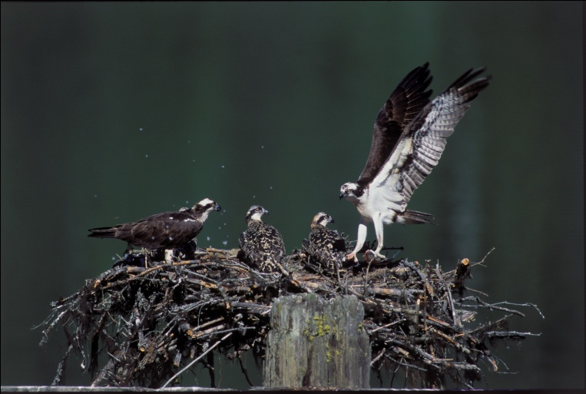
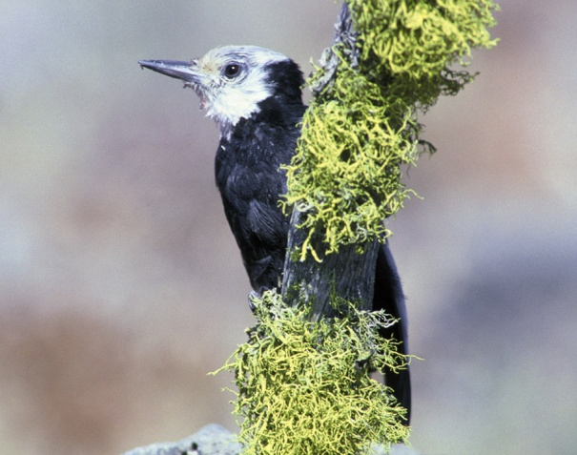
LOWER ICICLE WILDLIFE
Notes:
Lower Icicle is home to a great diversity of wildlife. There is a bald eagle nest on the Fromm Conservation Easement (a State-designated “Sensitive Species”) as well as actively-used habitat by harlequin ducks and peregrine falcons on the property (both protected as “Species of Concern” by the State.)

Slide 4
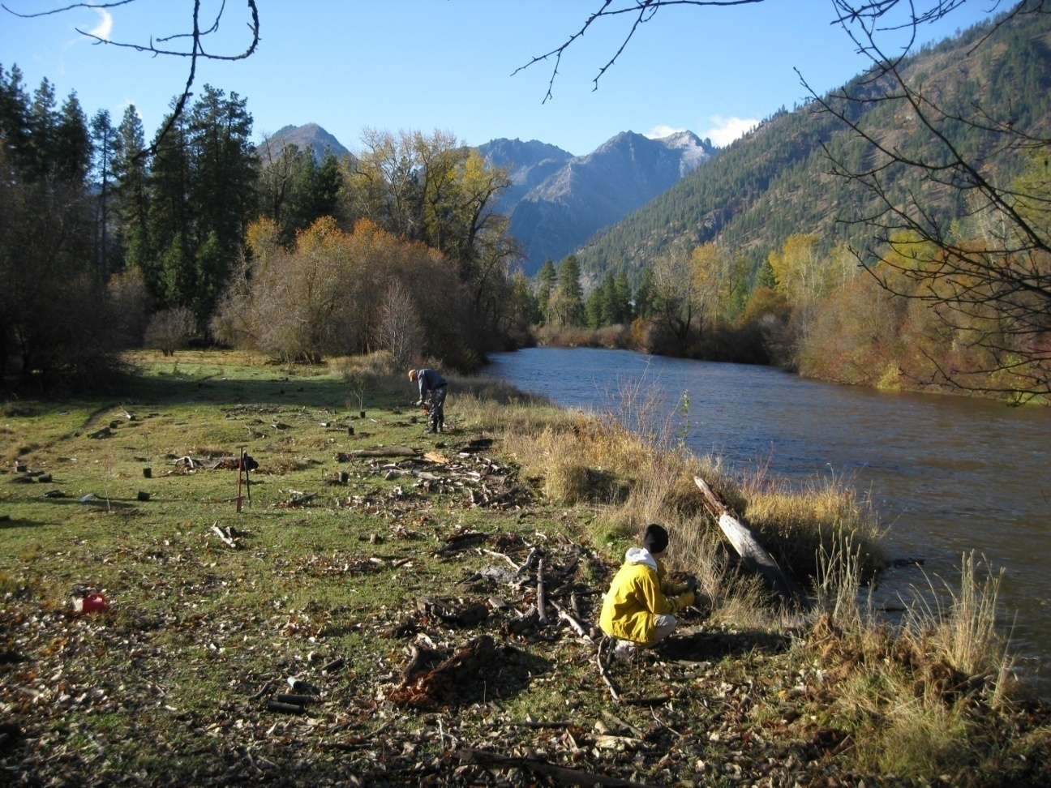
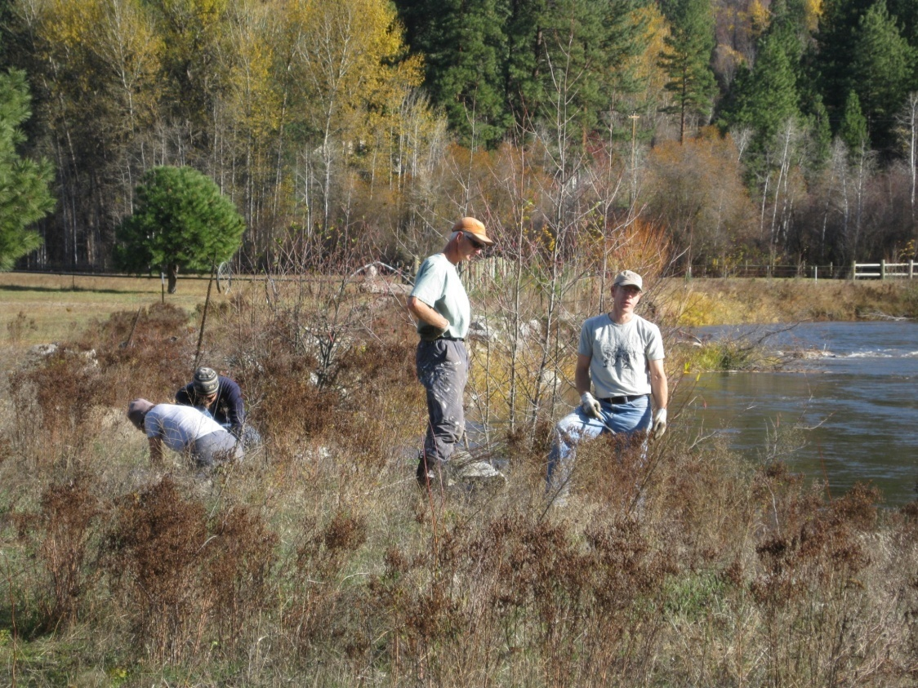
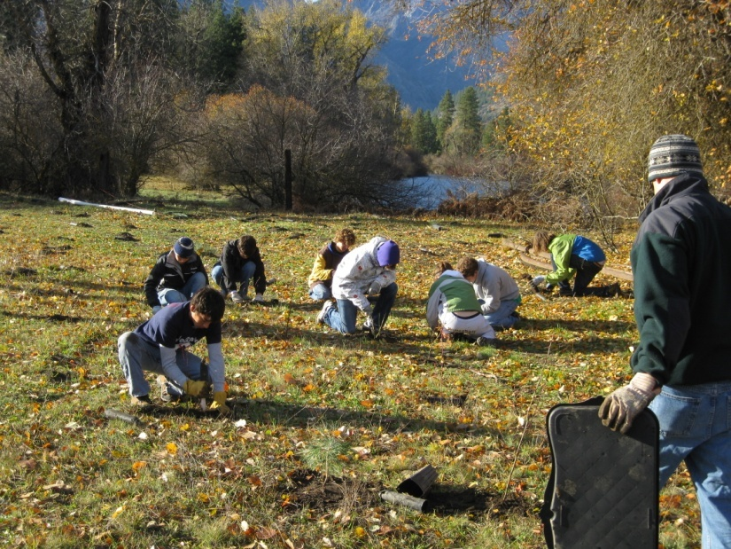
LOWER ICICLE RESTORATION
Notes:
In partnership with several groups, the Land Trust secured funding to plant native woody vegetation along the Lower Icicle Creek. This project has been very successful in engaging youth in the Leavenworth Community as well as re-establishing riparian areas.

