Slide 1
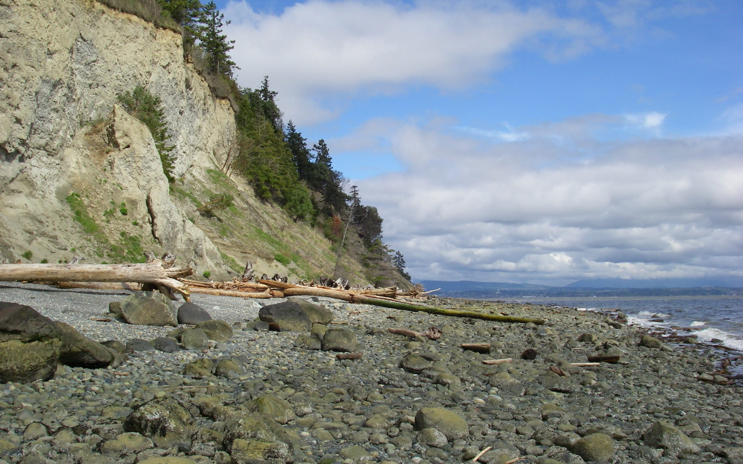
Barnum Point Acquisition
WWRP Technical Review – Water Access Project #16-1834

Slide 2
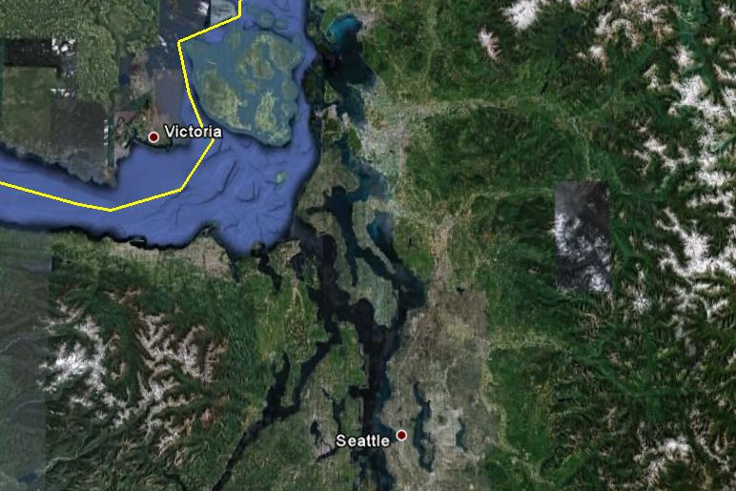
Intro: Regional Location
Barnum Point
2

Slide 3
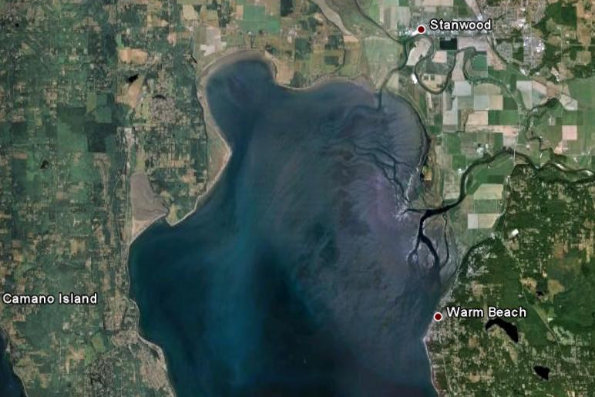
Intro: Site Location
Livingston Bay
Stillaguamish River
(Hatt Slough)
Iverson Spit
Triangle Cove
Barnum Point
Port Susan Bay
3

Slide 4
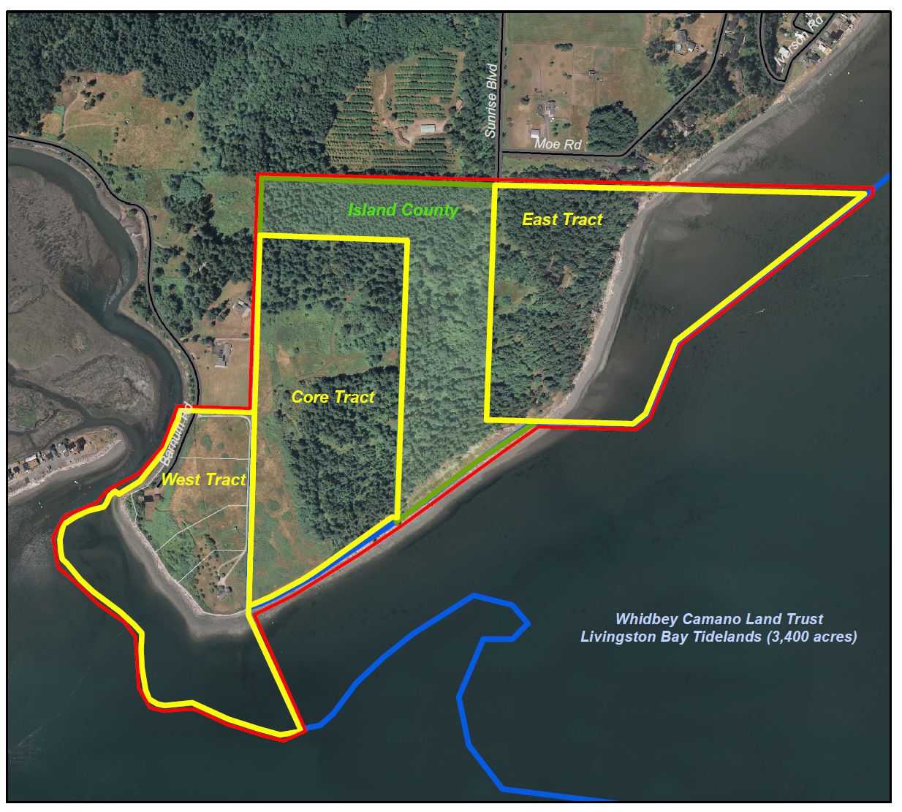
Intro: Project Scope

Slide 5
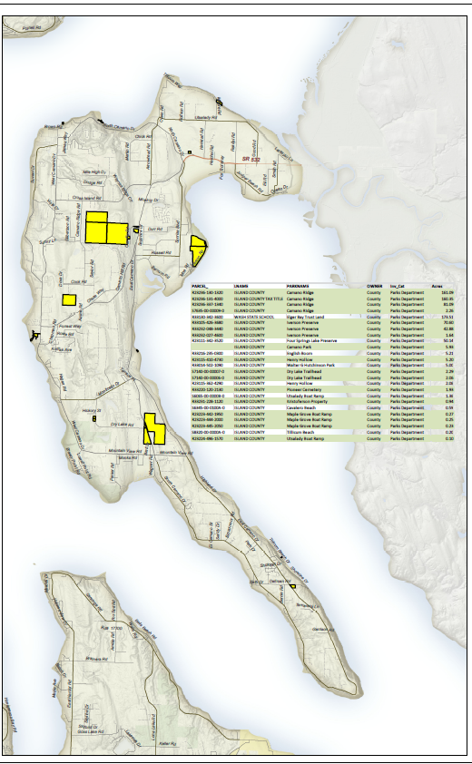
1. Public Need
83% of Camano Island
beaches are privately owned.
5
© Benjamin Drummond

Slide 6
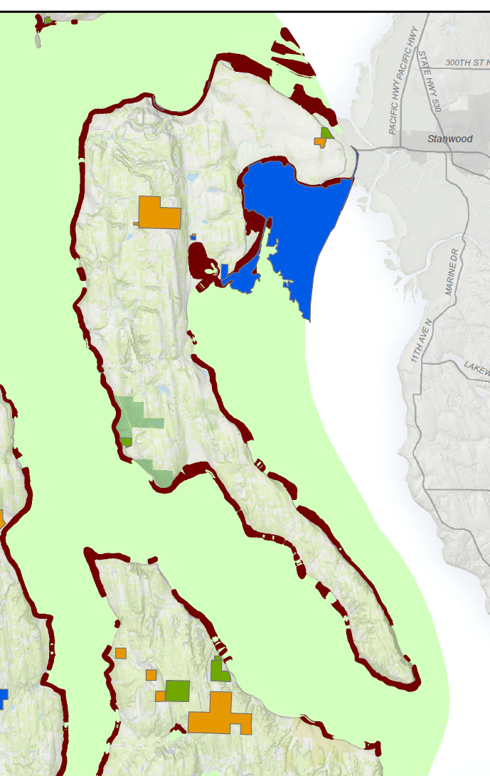
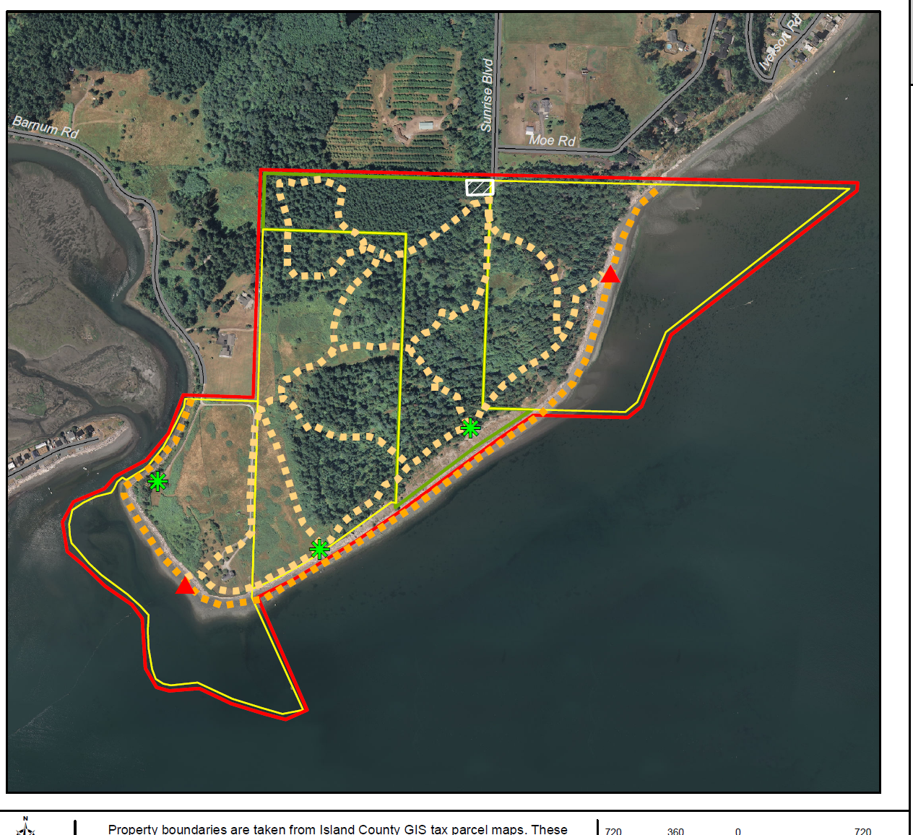
1. Public Need
“The most critical needs are for trails and water access, to go for a walk in nature or play on the beach.” (ICCP p. 47)
“Consider Barnum Point for potential to address for beach access, kayak camp, trails/trailhead, and habitat conservation needs.” (ICCP p. 81)
6

Slide 7
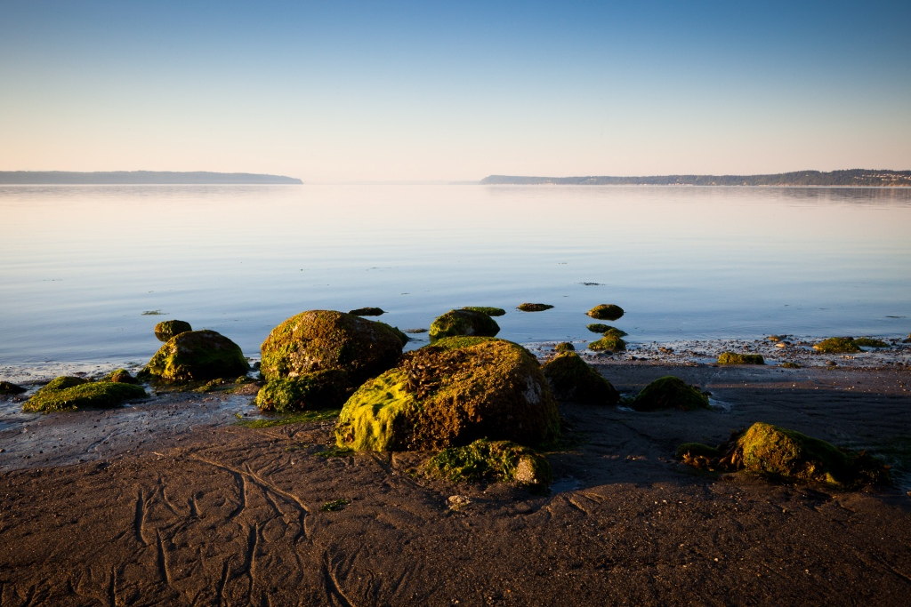
2. SCORP Priorities
New recreational opportunities for all ages, abilities, and incomes.
7

Slide 8
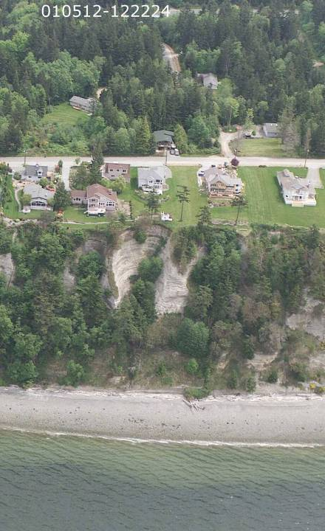
3. Immediacy of Threat
Development
High value view property in rapidly growing county
Landowner willing to sell for development
Growth – Island County
Projected 23,000 new residents (+32%) between 2000-2020
Ecological Processes
Loss of feeder bluff function
Loss of marine riparian forest
Western shore of Camano Island
Photo: Washington Department of Ecology

Slide 9
5. Sustainability & Environmental Stewardship

Slide 10
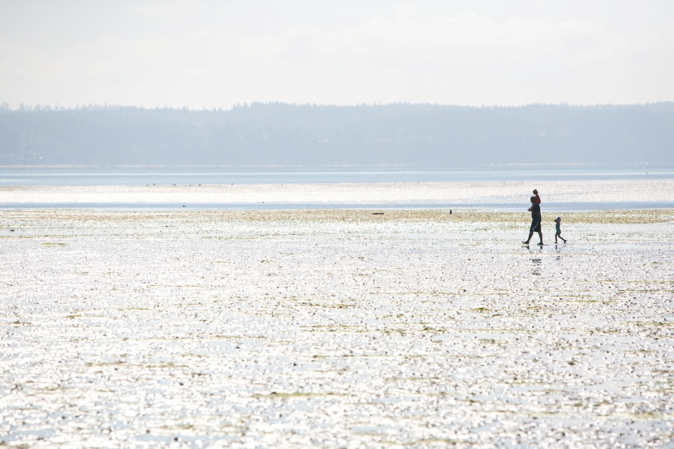
5. Sustainability & Environmental Stewardship
Long-term Stewardship and Maintenance Needs:
Trail maintenance
Invasive species removal
- Ivy, holly, blackberry, scotch broom
Assistance:
Funds donated by Land Trust
Key Partner: Friends of Camano Island Parks (FOCIP)
Active volunteer stewardship group
Trail and Invasives control
10
© Benjamin Drummond

Slide 11
5. Sustainability & Environmental Stewardship
Marine riparian forest
© Melinda Milner/TNC
11

Slide 12
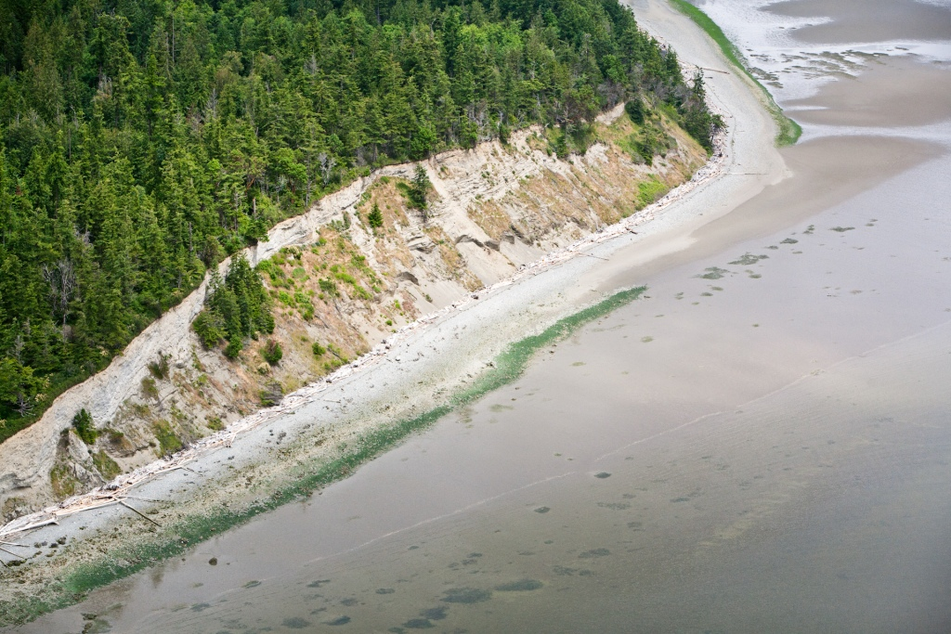
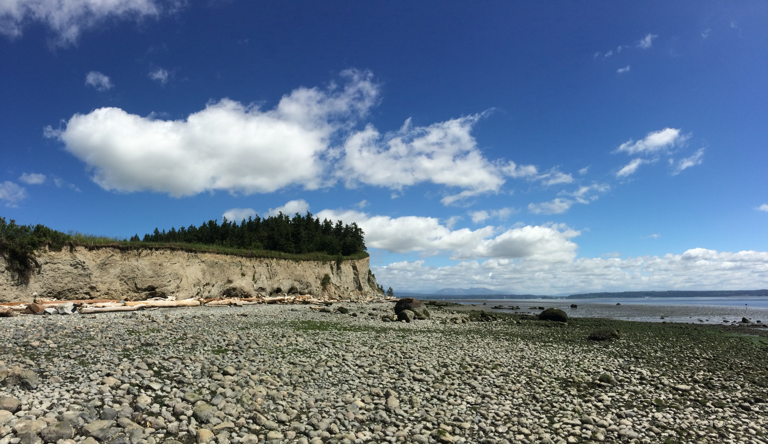
5. Sustainability & Environmental Stewardship
Exceptional feeder bluffs
12

Slide 13
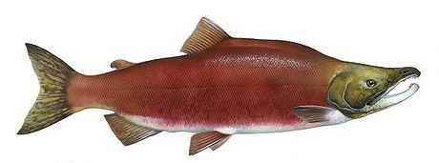
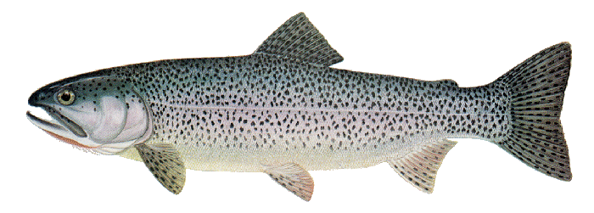
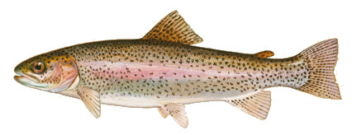
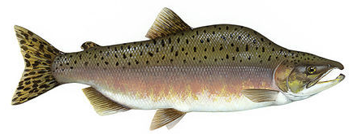
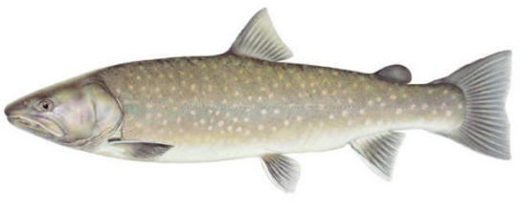
5. Sustainability & Environmental Stewardship
Benefits all 8 salmonids that spawn in the Greater Skagit and Stillaguamish Delta
sockeye
Chinook
chum
steelhead
coho
coastal cutthroat trout
bull trout
pink

Slide 14
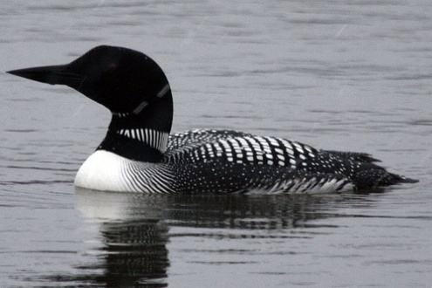
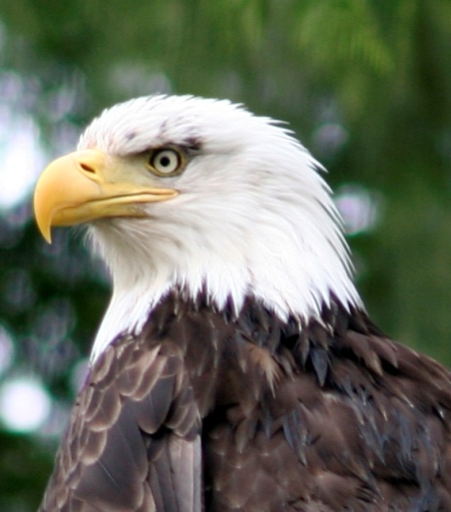
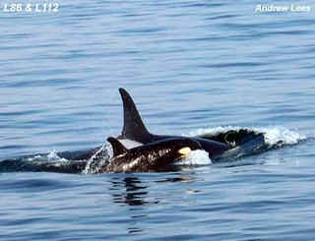
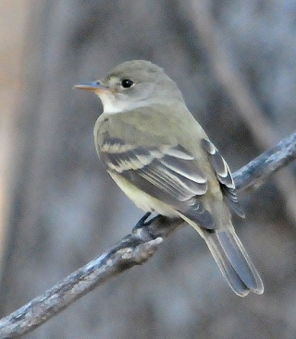
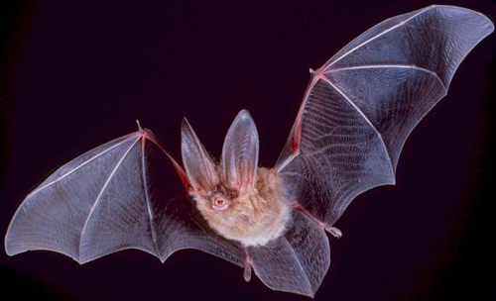
5. Sustainability & Environmental Stewardship
Federal and State listed species and species of concern
common loon
peregrine falcon
pileated woodpecker
bald eagle
western grebe
Southern Resident killer whale
Townsend’s big-eared bat
willow flycatcher
marbled murrelet
Not pictured: Steller sea lion, Pacific herring, merlin, Yuma myotis, Vaux’s swift

Slide 15
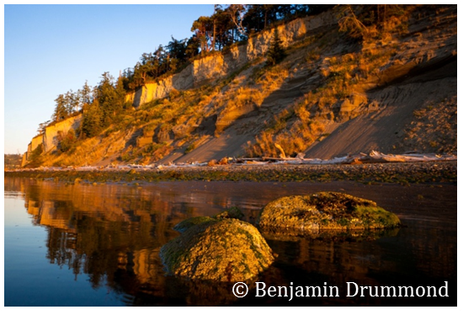
6. Site Suitability
Specifically identified in County Parks Plan
Compatible surrounding land uses
Passive use for Sensitive Resources
Uniquely meets County needs for trails and beach access
Site management plan to be developed
15

Slide 16
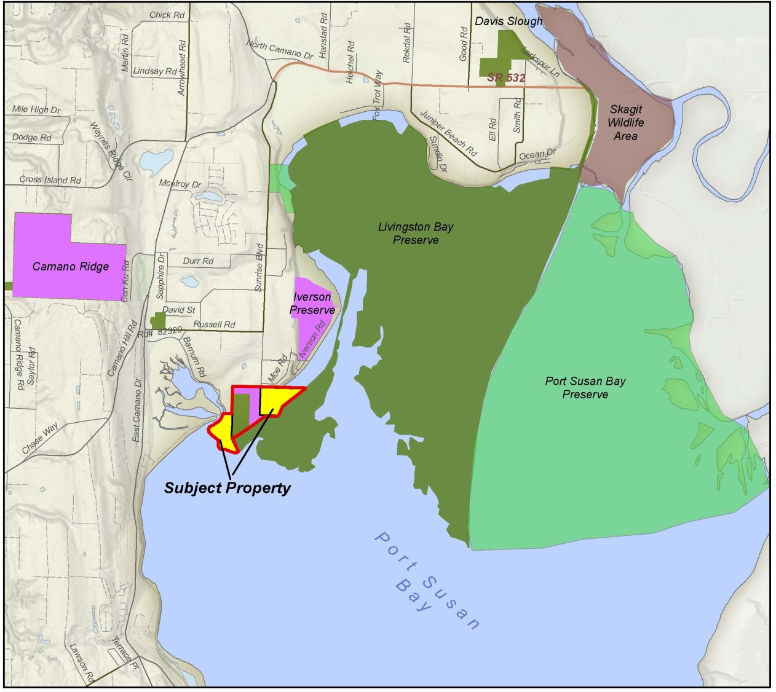
7. Expansion

Slide 17
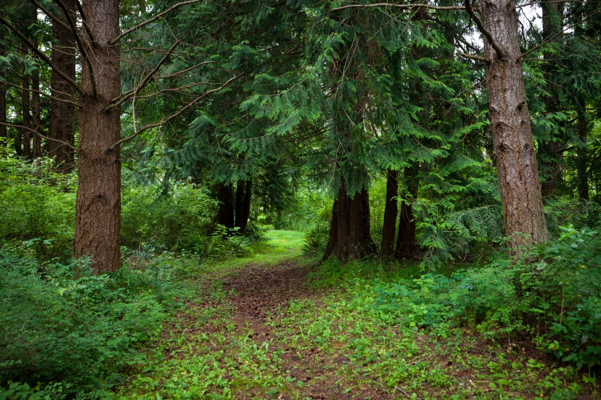
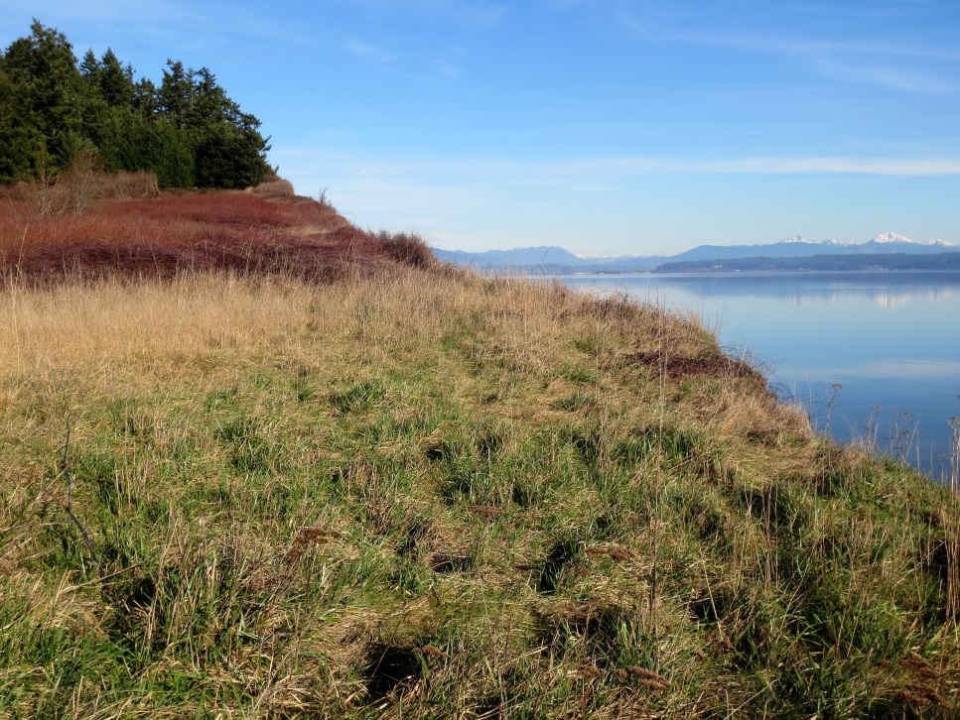
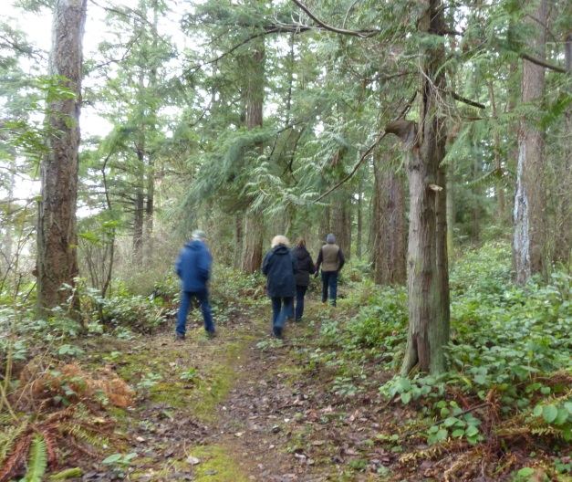
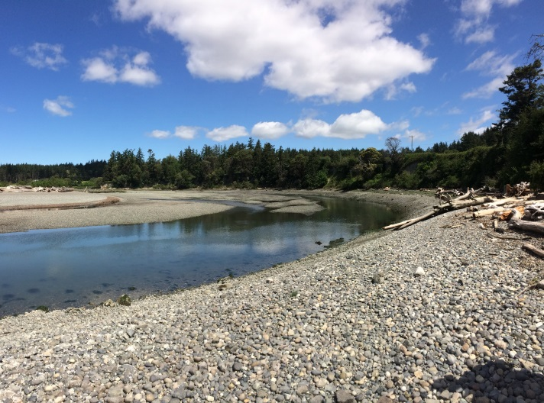
8. Diversity of Recreational Uses
Existing Trails
Spectacular Views
1 mile of Beach Access
17

Slide 18
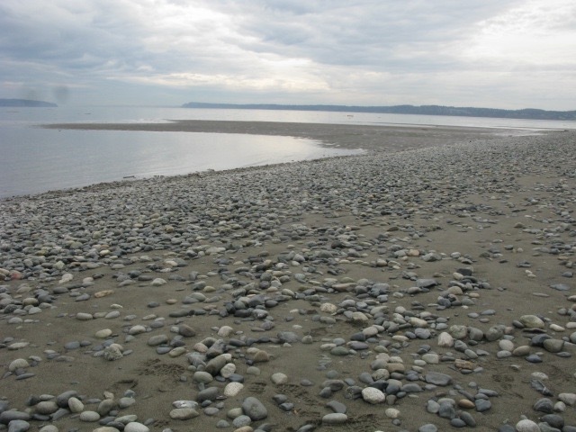
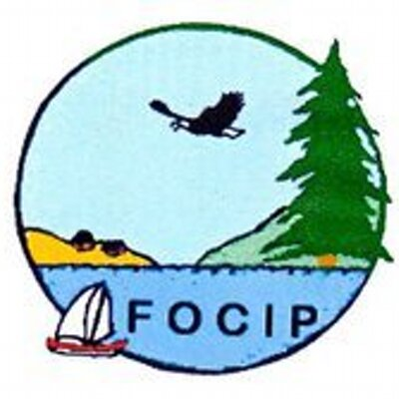
9. Project Support
- Project partners and supporters:
18

Slide 19
10. Cost Efficiencies
(ALEA/
WA/
NCWC/
SRFB)
(LWCF/
LP/
ALEA/
CFF)
(ALEA/
WA/
NCWC)

Slide 20
10. Cost Efficiencies:
Sources: Water Access $1,500,000 (24% of total)
ALEA $1,000,000 (16% of total)
Local Parks $ 850,000 (13% of total)
LWCF $ 500,000 ( 8% of total) SRFB $ 550,000 ( 9% of total)
NCWC $1,000,000 (16% of total)
Conservation Futures $ 150,000 ( 2% of total)
Private Donations $ 750,000 (12% of total)
TOTAL $6,300,000
Fund Use: Land Acquisition $5,750,000
Direct costs $ 150,000
Administration $ 50,000
TOTAL $5,950,000
20

Slide 21
Questions?
21
© Benjamin Drummond

Slide 22
Questions?
22

